Slide 1


Partners in Gas Detection

Slide 2

Company Background
RKI founded in 1994
Partner company: Riken Keiki
  Leader In Gas Detection & Sensor Technology for over 75 years
California Corporation
Average employee gas detection experience is 10 years
Premier Safety/Argus has been RKI’s #1 Distributor 22 of RKI’s 23 year existence.

Slide 3




Company Culture
Customer Service
Technical Service
Fast Delivery
Quality

Slide 4
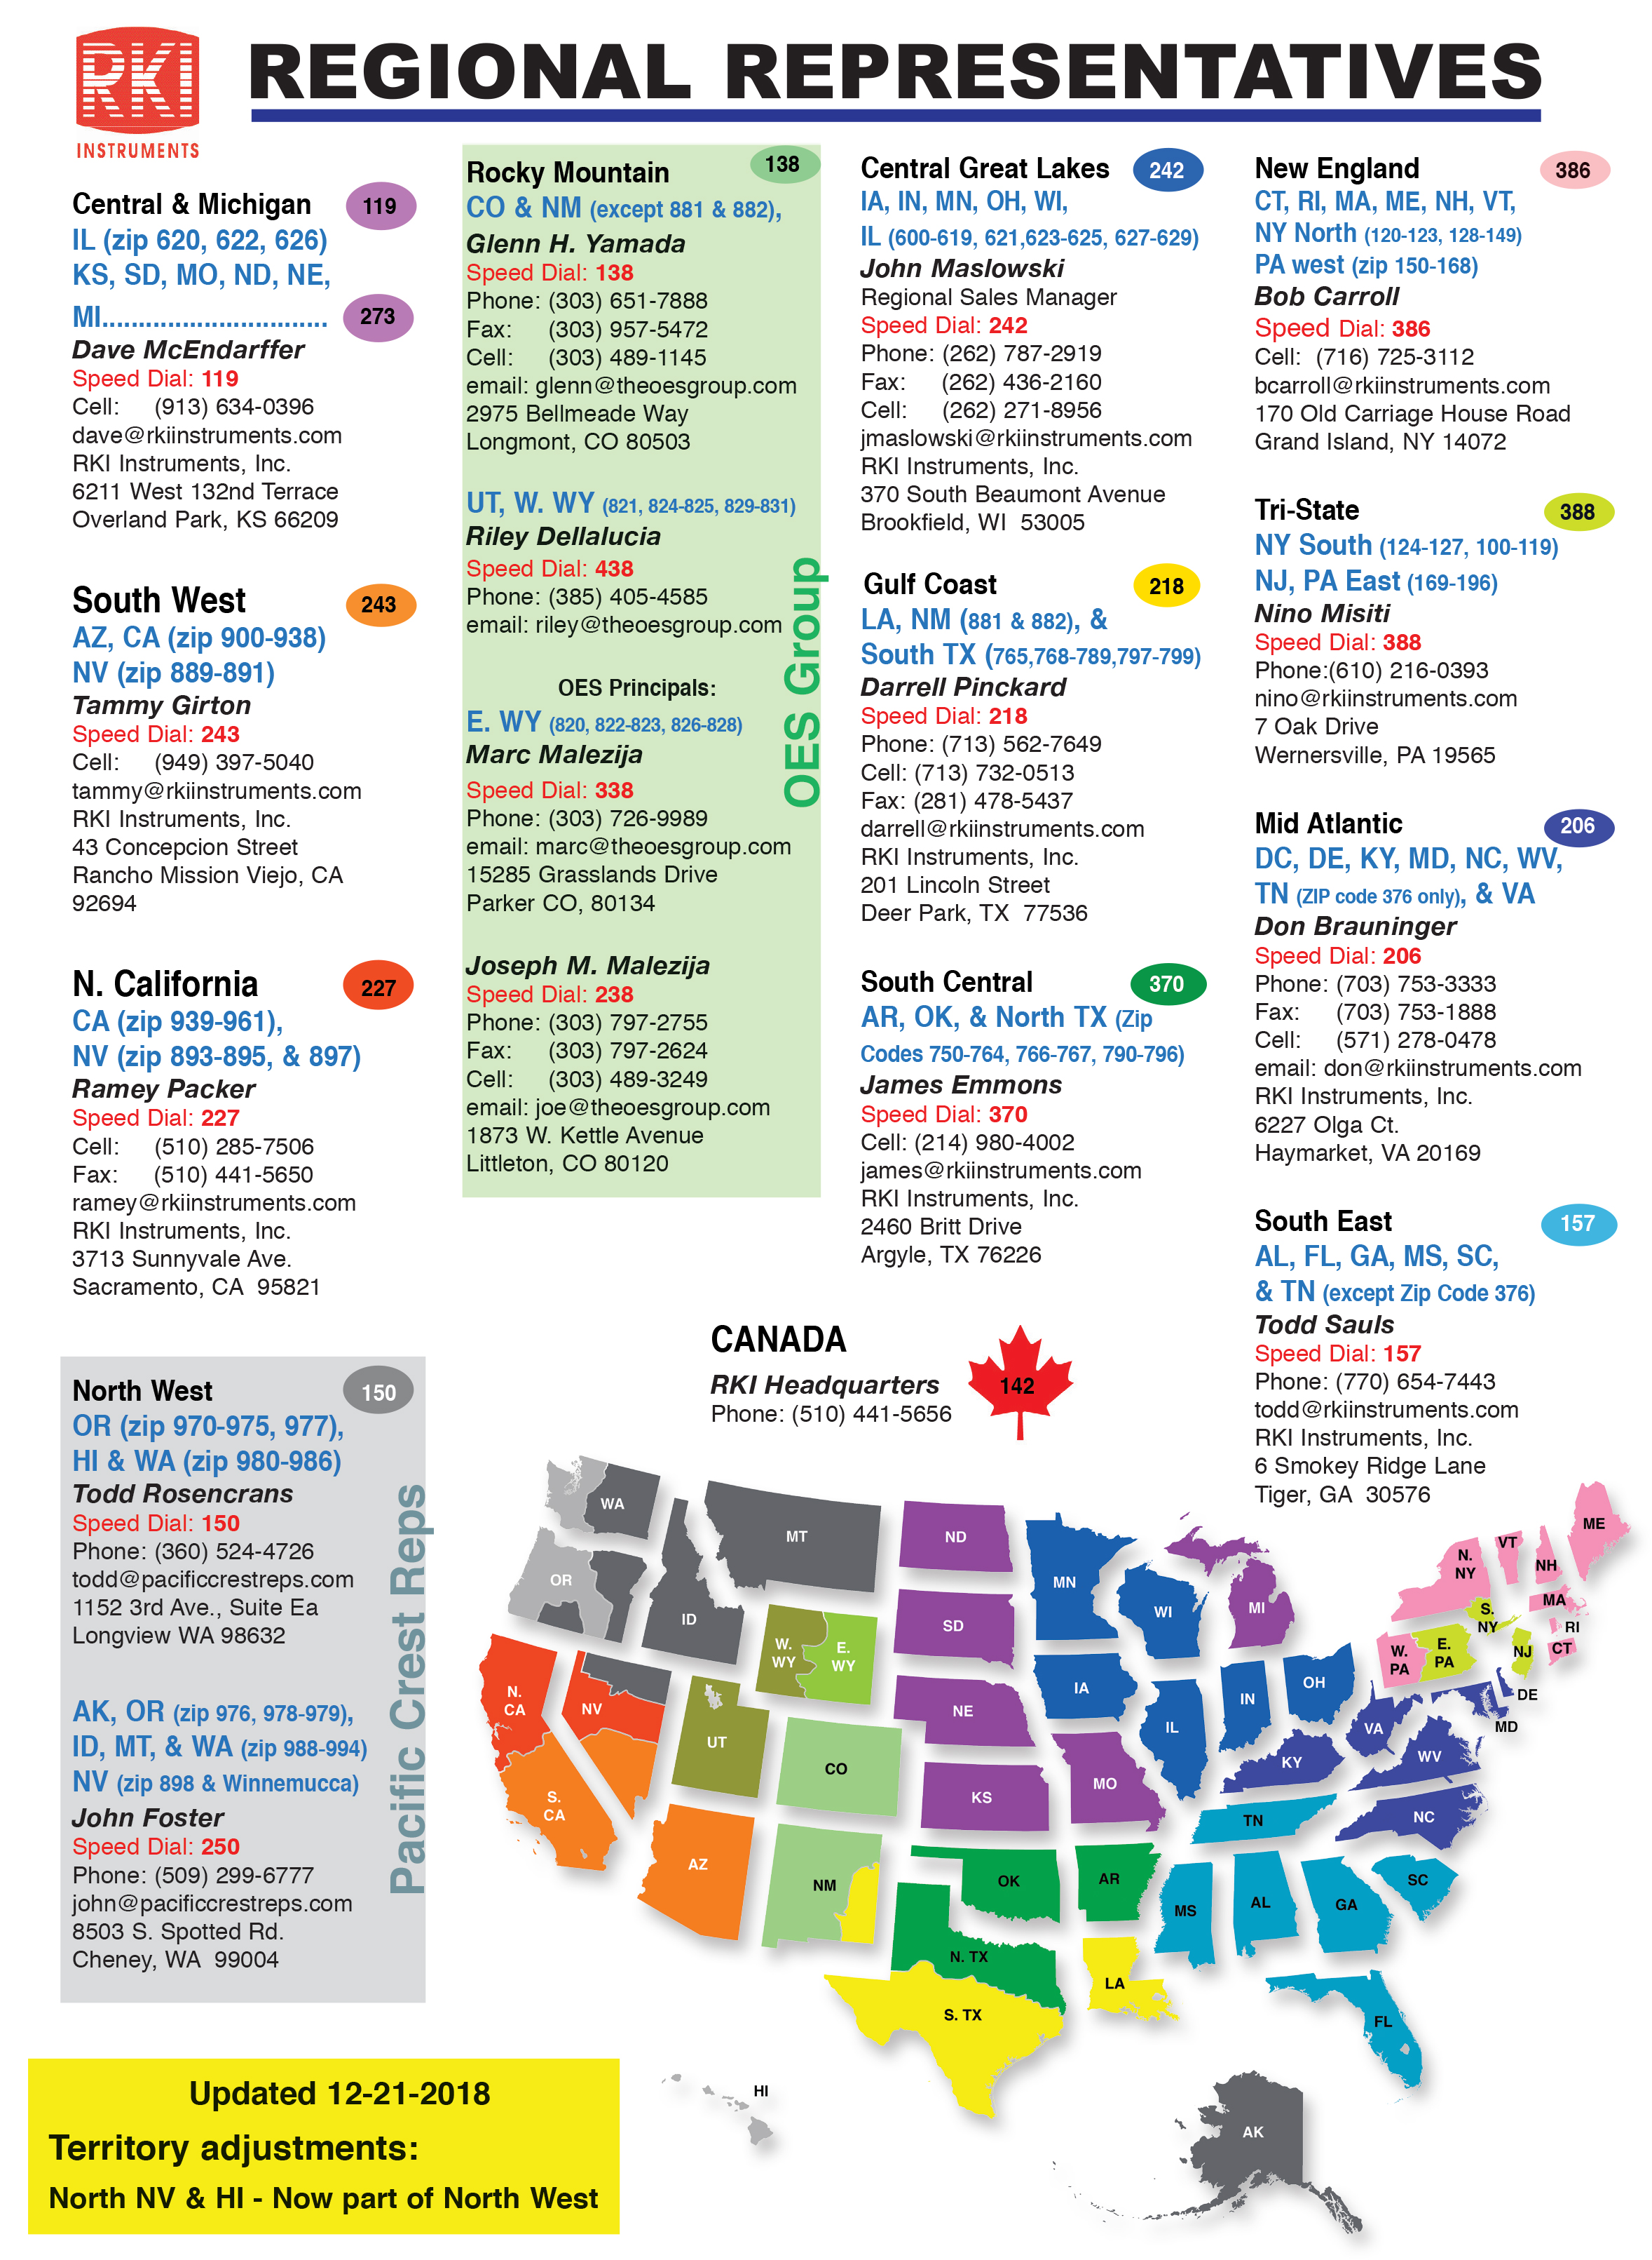

Slide 5


Slide 6
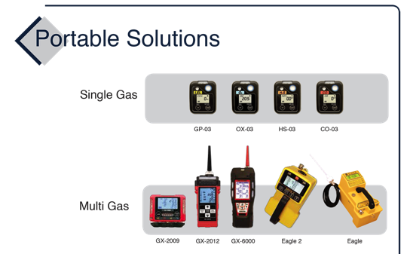
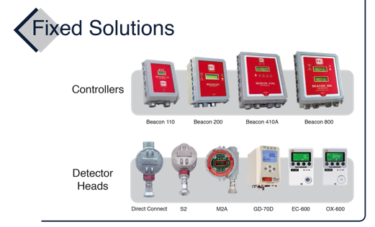

Slide 7
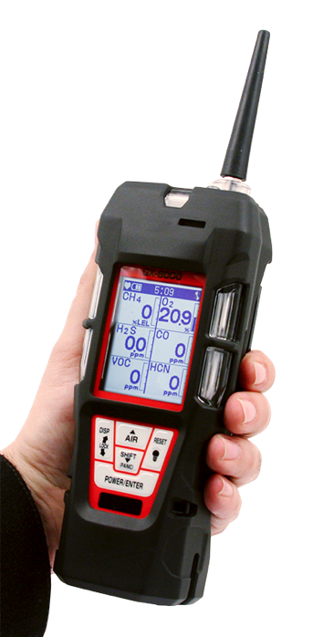
Maximum Flexibility
Model GX-6000
6 gas, sample draw with smart PID, IR & super toxics

Slide 8

Monitor up to 6 Gases
H2S, CO, O2, LEL
2 smart sensor slots
  PID for VOC’s (10.0, 10.6 & 11.7 eV)
  IR for CH4, HC, & CO2
  EC for NH3, Cl2, HCN, NO2, & SO2
LCD display
Auto flip display
Peak bar graphs
Adjustable auto backlight
Customize order of gases
Single gas view with large font & auto sequence
5 operating modes
Normal
Leak check
Inert
Bar hole
Snap Log
Alarms
2 adjustable gas alarms per channel
Man Down alarm
4 alarm LED’s
Audible and vibration alarms
Trouble alarms for low flow, sensor connection, low battery, circuit error, & calibration
PID library of more than 600 VOC’s
50 ppm / 6,000 ppm ranges
Easily choose a target VOC
  User defined VOC list of 30
  Recently used VOC list last 8
LEL Protection mode
Shields LEL sensor from damaging VOC exposure
Internal Sample Pump
50’ sampling range

Slide 9
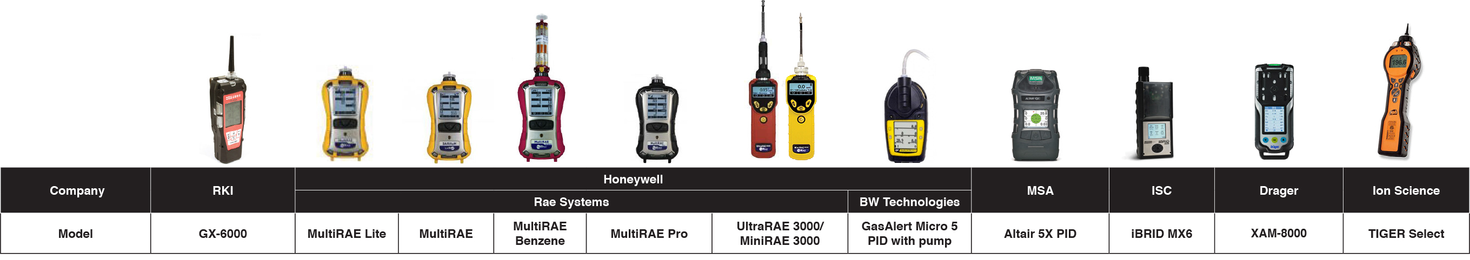
Current Players

Slide 10
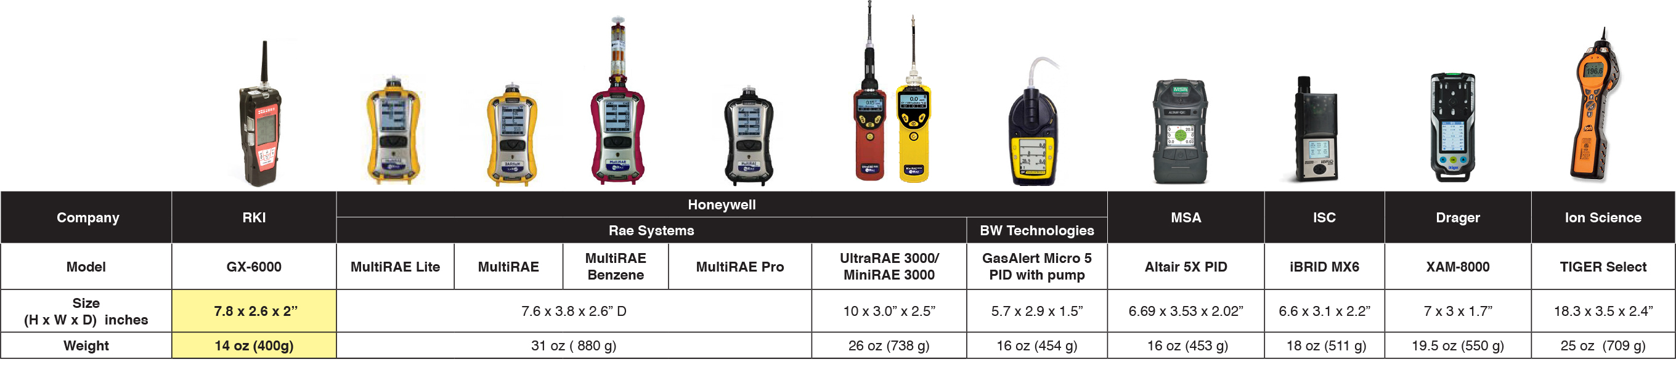
Smallest & Lightest

Slide 11
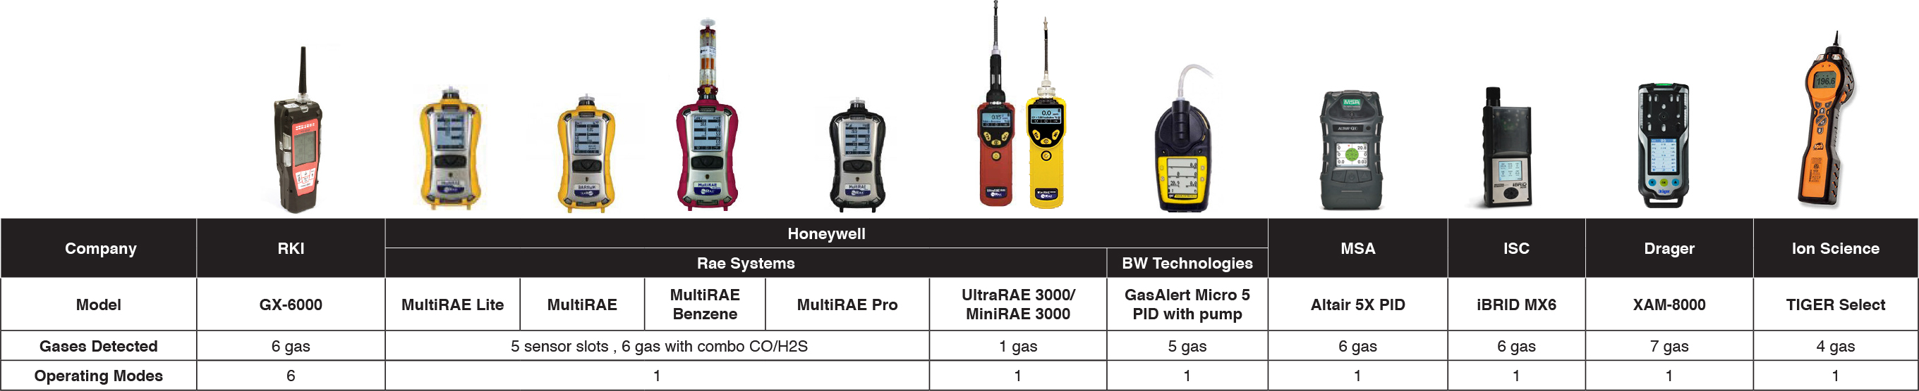
6 Operating Modes
Normal
Benzene Specific
Leak Check
Inert
Bar Hole Measuring
Snap Logging

Slide 12
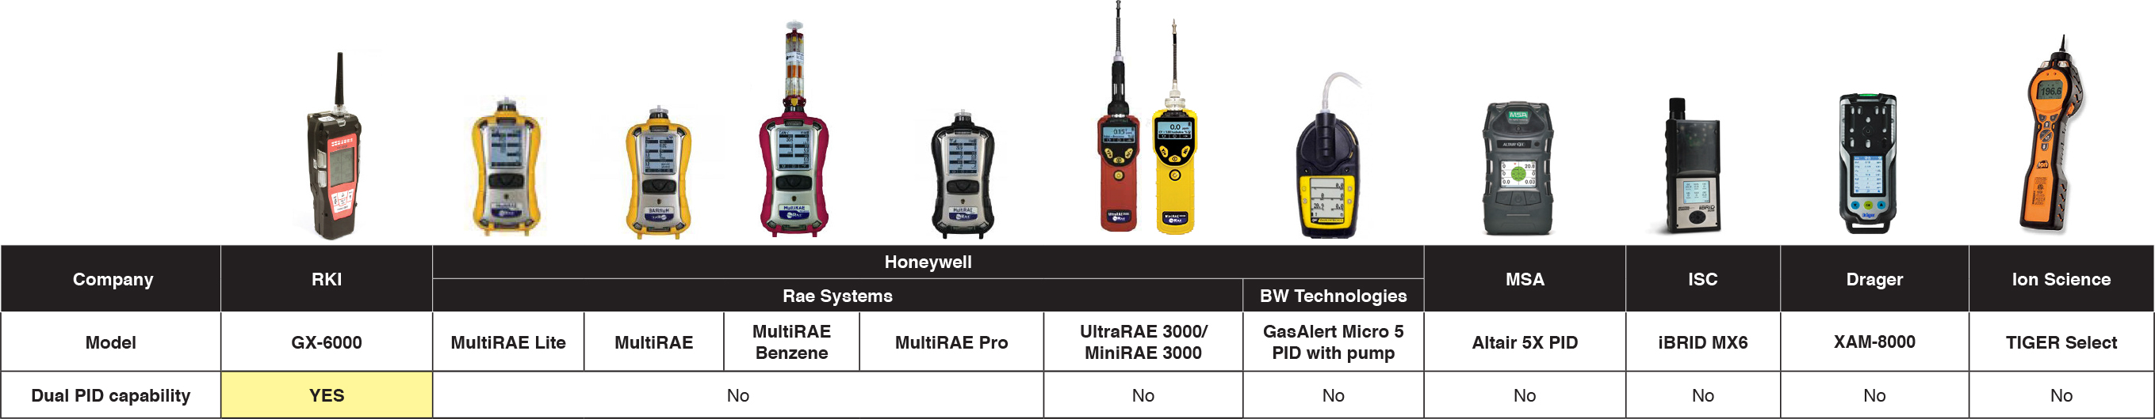
Dual PID!

Slide 13
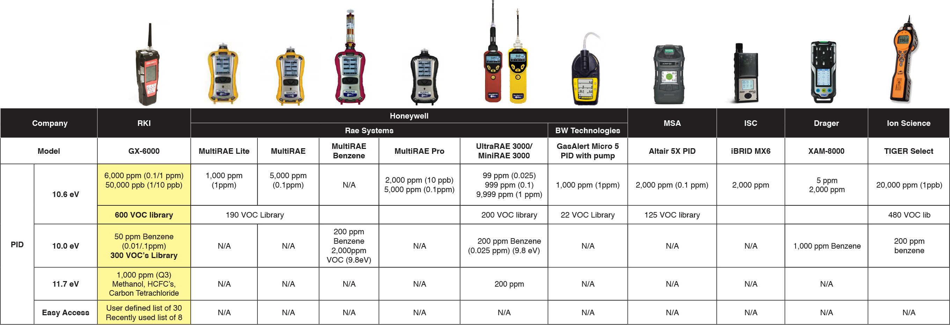
4 PID Lamp Options

Slide 14
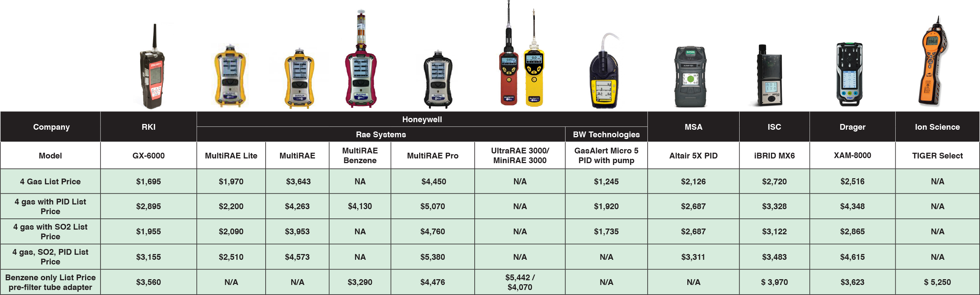
Pricing

Slide 15

Realities of Confined Space

Slide 16
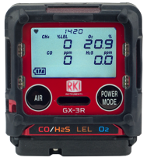
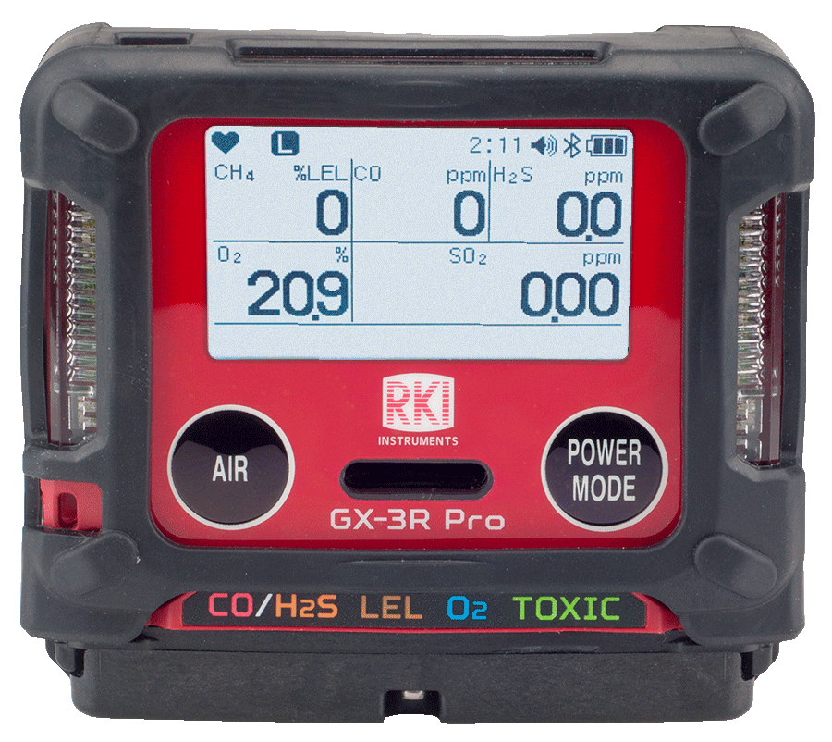

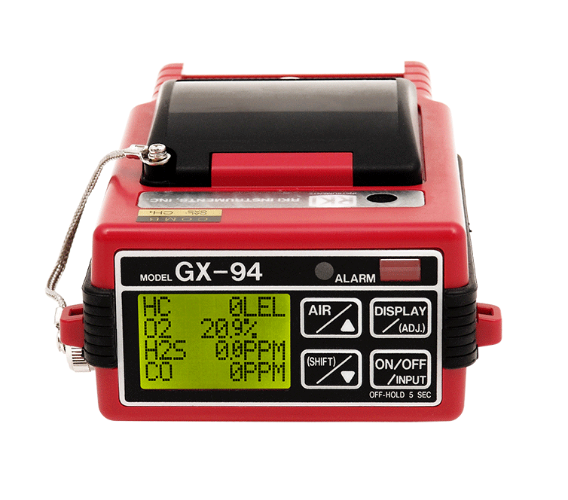
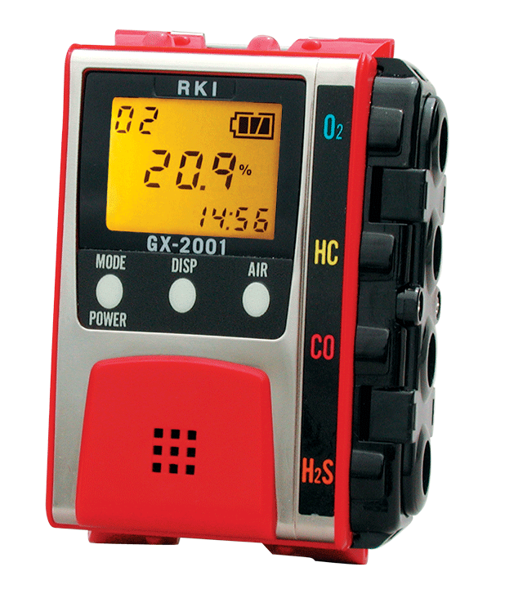
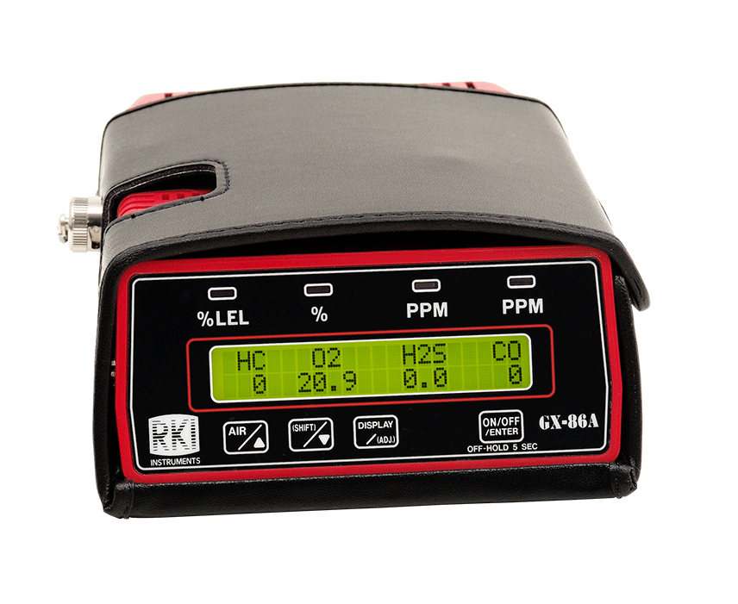
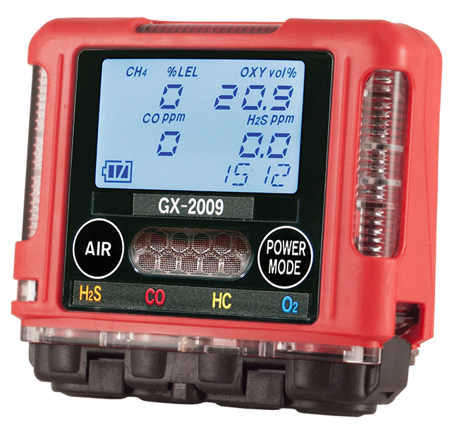
Next Generation of Gas Detection
GX-3R
GX-3R Pro
GX-82 (1982)
GX-86 (1986)
GX-94 (1994)
GX-2001 (2001)
GX-2009 (2009)

Slide 17
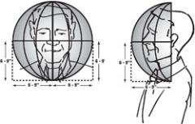


Considerations
Small & Light
Breathing Zone
OSHA (USA) recommends gas detection instruments be worn in the Breathing Zone.
A small and light instrument is important for workers to feasibly wear in the breathing zone.
Durability
Resistance to impact, dust, water, chemicals (solvent, silicone…etc), high-low temperature and “Long sensor life” are all important.

Slide 18


Considerations
Multi Functional
Ability to add a 5th Gas or man-down alarm.
Communication & Connectivity
Wireless communication is needed by some customers.

Slide 19
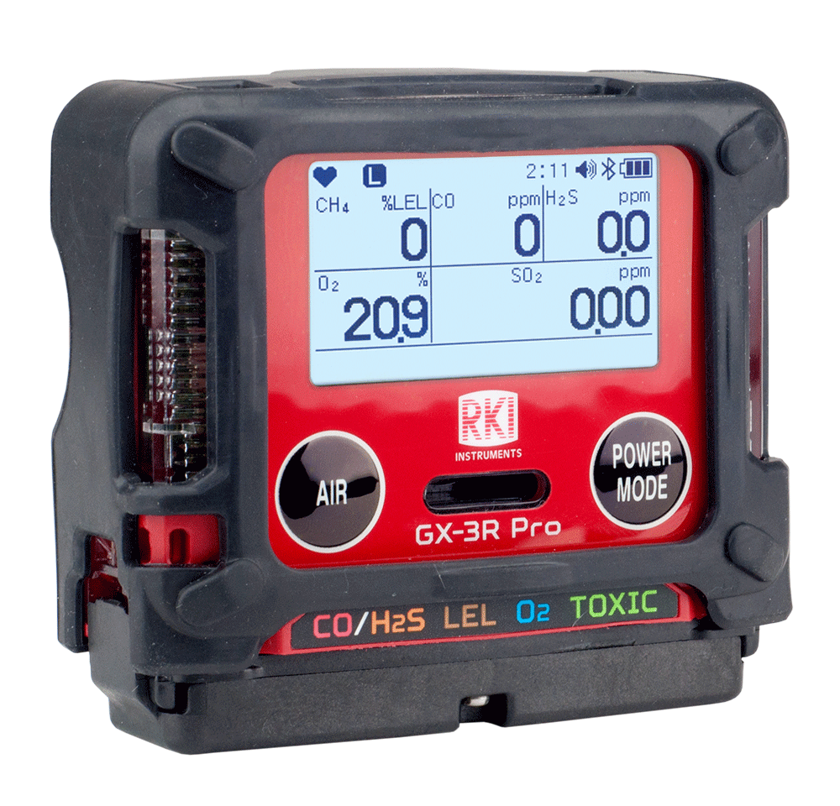
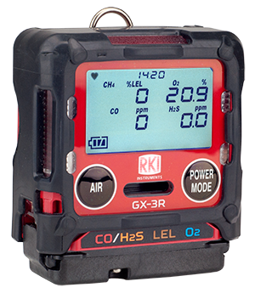
2 Versions - Depending on Need
Basic 4 Gas version
Advanced version
GX-3R
GX-3R Pro
Worlds smallest and lightest
Economical
4 gas Plus
  Wireless communication with phone app
  Other toxic gas options
  Man-down alarm
  Alkaline/Rechargeable

Slide 20
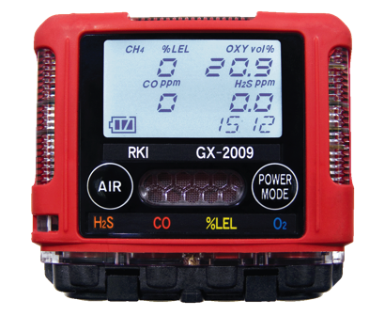
Advancements
Size & Weight
Smallest and Lightest Currently Available
3” x 2.7” x 1”
4.6 ounces
GX-2009

Slide 21
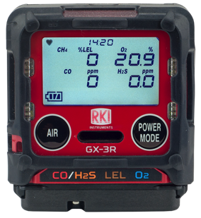
Advancements
Size & Weight
The NEW Smallest and Lightest Currently Available
2.4” x 2.7” x 1”
3.9 ounces
GX-3R

Slide 22
Advancements
Size & Weight
Advanced version same size as GX-2009
3” x 2.7” x 1”
4.6 ounces
GX-3R Pro

Slide 23

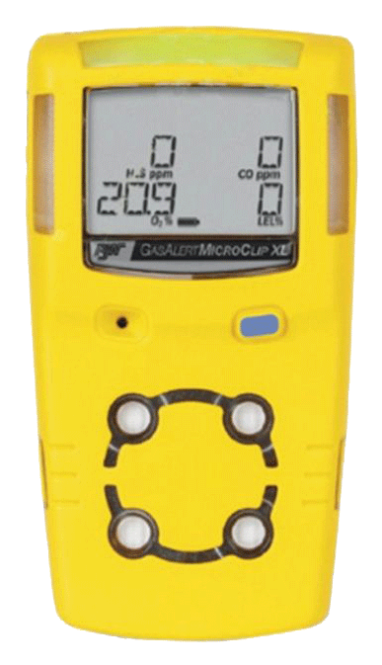
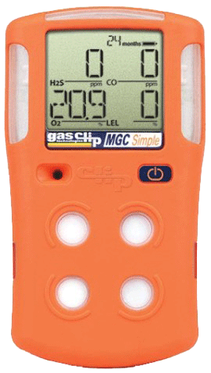



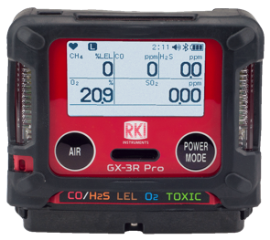
Comparison
Size & Weight
2.7” x 2.4” x 1”
3.9 ounces
2.7” x 3” x 1”
4.6 ounces
4.4” x 2.4” x 1.2
6.7 ounces
4.1” x 2.3” x 1.4”
7.05 ounces
4.7” x 2.7” x 1.2”
7.67 ounces
5” x 1.9” x 1.2”
7.8 ounces
4.4” x 3.0” x 1.4”
8.07 ounces

Slide 24
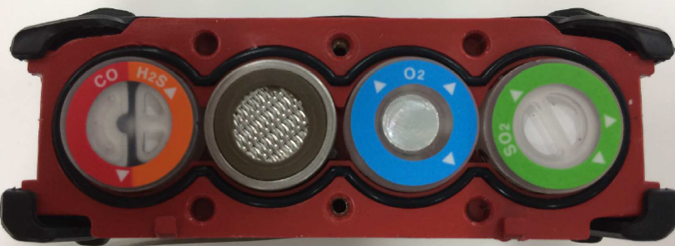
Advancements
Dual Sensor
4 Sensors slots for 5 gas channels
GX-3R Pro
CO/H2S
3 Sensors slots for 4 gas channels
GX-3R

Slide 25

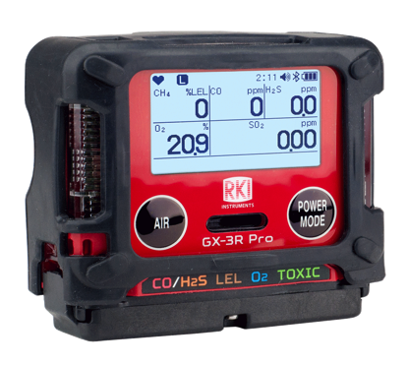
Advancements
Warranty
2 years sensors and instrument
GX-2009
GX-3R
3 years sensors and instrument
GX-3R Pro

Slide 26
Advancements
Durability
1 meter drop test
GX-2009
GX-3R
7 meter drop test
GX-3R Pro

Slide 27
Advancements
Familiar User Interface
2 button design
GX-2009
2 button design with similar operational menus
(bump testing & calibration simplified)
GX-3R
GX-3R Pro

Slide 28
Advancements
Operating Temperature Range
-4° to 122° F
GX-2009
GX-3R
-40° to 140° F
GX-3R Pro

Slide 29
Advancements
Continuous Operation Battery Life
20 hours, rechargeable
GX-2009
GX-3R
24 hours, rechargeable
Alkaline battery option
GX-3R Pro

Slide 30

Advancements
Water & Dust Resistant Ratings
IP 67
Dust, dirt, and sand resistant
Submersible in water 1 meter for up to 30 minutes
GX-2009
IP 68:
Dust, dirt, and sand resistant
Submersible in water > 1 meter for more than 30 minutes
GX-3R
GX-3R Pro

Slide 31
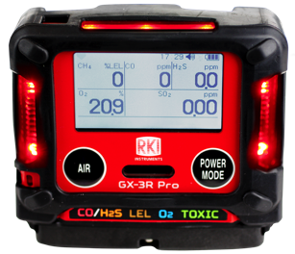
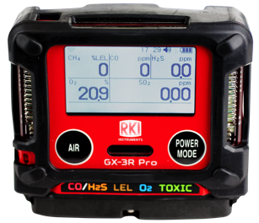
Advancements
Non Compliant Indicator
Non compliance indicator: LEDs flash once every 30 seconds
GX-3R
Non compliance: Operating instrument while bump test or calibration are past due
GX-3R Pro

Slide 32
Advancements
Wireless Communication
GX-2009
Not available
GX-3R
Bluetooth (BLE) with phone app
GX-3R Pro

Slide 33
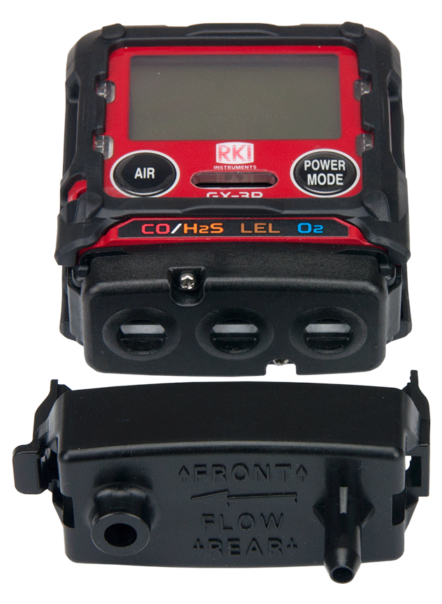

Cal Cup
Ships as standard
Sold Separately
GX-2009
GX-3R
Ships as standard
GX-3R Pro

Slide 34

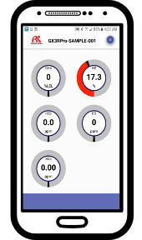




BLE Applications
Alarm Notification
Email Event Logs & Calibration History

Slide 35
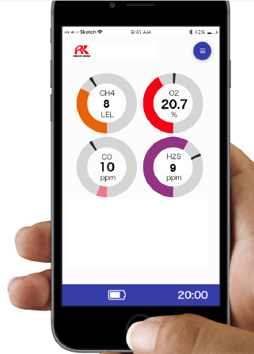
Phone App
Direct readings from instrument
Digital values
Graphical display
Alarm indications
Email or text alarm event notifications

Slide 36
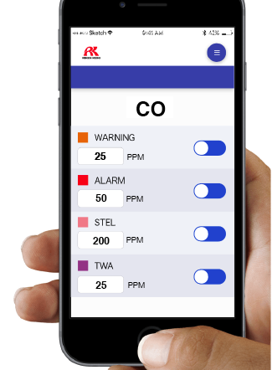
Phone App
Change instruments settings
  Alarm Settings
  Bump test settings
  User & Station ID’s

Slide 37
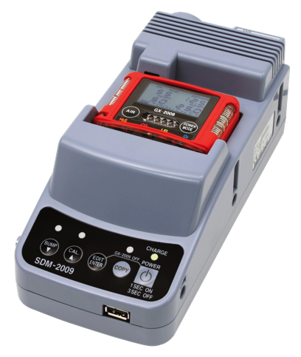

Calibration Stations

Slide 38
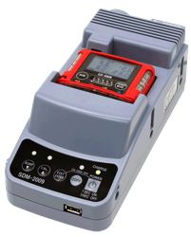

Advancements
Calibration Stations
Bump Time: 10 seconds
Gas Consumption: 450 ml / min
Output: USB drive / USB Cable to PC
SDM-2009
Bump Time: 10 seconds
Gas Consumption: 250 ml / min
  (Lowest gas usage per bump test available)
Output: Internal memory / LAN cable / USB Cable to PC
Accepts both GX-3R or GX-3R Pro
SDM-3R

Slide 39

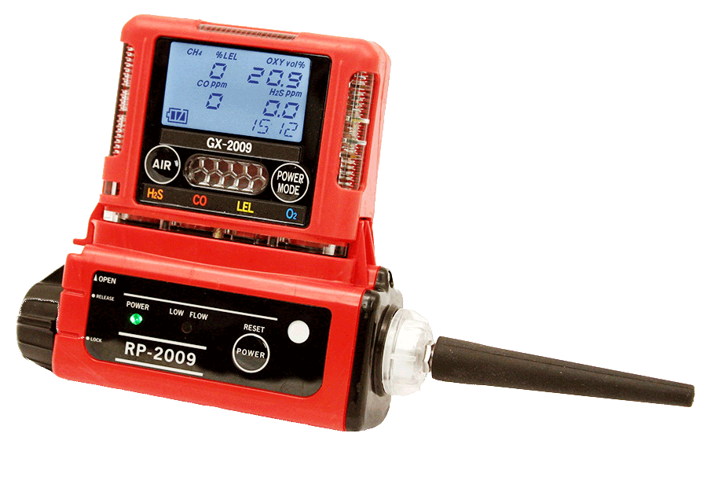
Pump Unit

Slide 40
Advancements
Pump Unit
Flow rate: 450ml / min
Distance to draw: ~10m
Operation time: 8h
Operation mode: Normal mode only
RP-2009
Flow rate: 500ml / min
Distance to draw: ~30m
Operation time: 10h
Operation mode: Normal mode / Eco Mode
RP-3R

Slide 41


Slide 42

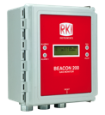
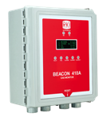
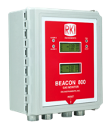
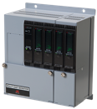
Controllers
Relays per channel
Alarm levels per channel
Common relays
Direct connect sensors
Channels
Beacon 110 | 1 | 2 | 3 | N/A | Yes
Beacon200 | 2 | 2 | 2 | 3 | Yes
Beacon 410A | 4 | 3 | 3 | 5 | Yes
Beacon 800 | 8 | 2 | 2 | 3 | No
RM-5000 | Up to 12 | 2 | 2 | 3 | Yes
Beacon 110
Beacon 200
1 – 8 Channel fixed systems controllers
Digital Readout
Weather proof NEMA 4X enclosure
Audible alarm
Alarm reset button
Optional strobe & battery backup
Beacon 410A
Beacon 800
RM-5000

Slide 43


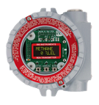
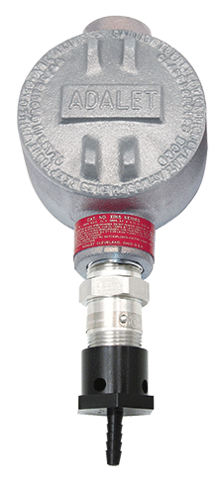

Common System Components
Beacon 410A
M2A Transmitter
Remote Mount Sensor
With Cal Cup
S2
RKI’s diffusion style remote mount detectors allow for easy calibrations in difficult access areas
Alarm Relays Activate Ventilation / Exhaust System

Slide 44
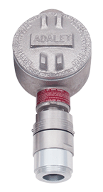

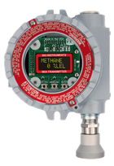

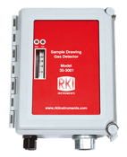

Sensors & Transmitters
Direct Connect
S2 Transmitter
M2A Transmitter
Cost Effective
Water repellent sensor coating
Explosion Proof
Transmitters 4-20mA output
Explosion Proof
Stainless steel option
Operates with or without controller
OLED display
2 programmable alarm relays
Non intrusive calibration
4-20mA and Modbus outputs
GD-70D
Smart Sample Draw
Wide range of plug & play sensors
Large LCD Display
35-3001 Sample Draw
LEL, O2, H2S, CO CO2, & H2 available
Multigas versions
Internal sample pump with 100’ range
SD-1 Series
Explosion proof, IP-65/67
Monitor ppm or % LEL ranges
Available for H2, IPA, CAN, and ETO

Slide 45
H2 Specific Sensors & Transmitters
Proprietary sensor technology for either % LEL or PPM H2 ranges
Highly specific to H2
Eliminates false alarms from IPA and other gases
Superior resistance to catalyst poisons
Available in Direct Connect Sensor, S2, or M2A transmitters
Direct Connect / S2
M2A Transmitter
Ideal for Semiconductor, Power Plants, Battery Rooms, H2 Fueling Stations, and Gas Plants

Slide 46
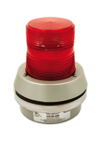

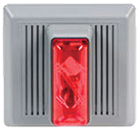



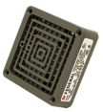
Horns & Strobes
Non Hazardous Location
Lights or Strobes with Horns
4 wire ( Strobe and Horn wired separately)
Lights or strobes with horns
2 wire
Lights, Strobes, or Horns
Rotating Alarm 120V
Green, Amber, Red or Blue
Horn with Strobe
115 VAC / 24 VDC , 4 wire
Amber, Blue or Red
Flashing Alarm Light with Horn
115 VAC / 24 VDC
Red, Blue or Amber
Strobe NEMA 3R / 4X Red Housing
Amber, Red or Blue
Horn with Strobe
NEMA 3R, 4 Wire, 24 VDC
Amber or Red
Strobe with Horn
115 VAC / 24 VDC, NEMA 4X / 3R
Amber, Blue or Red
24 VDC Vibrating Horn

Slide 47

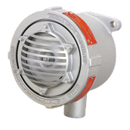
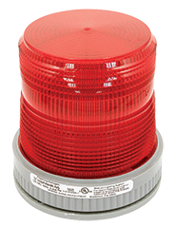

Horns & Strobes
Hazardous Location
Class I Div 1 Strobes or Horns
Class I Div 2 Strobes or Horns
Horn with Strobe
115 VAC / 24 VDC , 4 wire
Amber, Blue or Red
Horn 115 VAC
Strobe Light
115 VAC / 24 VDC
Red or Amber
Horn 115 VAC

Slide 48

Fixed System Applications
Refineries
Chemical & Petrochemical Plants
Water & Wastewater
Fuel Storage
Breweries
Wineries
Oil and Gas

Slide 49

Fixed System Uses
Room air monitoring for employee protection
Fence line or perimeter monitoring
Process control
Gas cabinet exhaust monitoring
Industrial point gas monitoring

Slide 50
Key Markets for Gas Monitors
Who to call and where to go.

Slide 51

Who To Call
Looking for the person in charge of the following:
  PPE (personal protective equipment)
  HSE or EHS (Health, Safety, & Environment or Environmental, Health, & Safety)
  Industrial Hygiene
  Safety
  Instrumentation shop

Slide 52
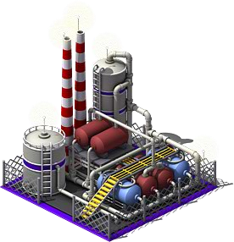


Where to Call
Oil & Gas Production (downstream operations)
  Gases encountered:
    Combustibles
    O2 deficiency
    H2S, CO
    SO2, HCN, NH3
  RKI Products
    GX-2009 advantages:
      Smallest & lightest available. Ideal for workers wearing monitors for entire shifts
      Proven reliability
      Available
    GX-6000 advantages:
      6 Gas channels
      5 operating modes
      Benzene specific PID
      Smart sensors

Slide 53


Where to Call
Energy – Power Utilities
  Gases Encountered
    Combustibles
    O2 deficiency
    H2S, CO
  RKI Products
    GX-2009 advantages:
      Smallest & lightest available. Ideal for workers wearing monitors for entire shifts
      Proven reliability
      Available
    GX-2012 advantages:
      Internal sample pump
      3 operating modes: Normal, leak check, and bar hole sampling
      Uses the same sensors as GX-2009

Slide 54

Where to Call
Construction
  OSHA CFR 1926 –
    Confined Spaces in Construction
  Gases Encountered
    Combustibles
    O2 deficiency
    H2S, CO
  RKI Products
    GX-2009 advantages:
      Very popular with Trench Construction companies
      Smallest & lightest available. Ideal for workers wearing monitors for entire shifts
    GX-6000 advantages:
      Internal sample pump for pre-entry sampling
      PID sensors for VOC monitoring
      6 operating modes: Normal, leak check, and bar hole sampling
      Uses the same sensors as GX-2009

Slide 55

Where to Call
Water & Waste Water
  Gases Encountered
    Combustibles
    O2 deficiency
    H2S, CO
    Ammonia, Chlorine, Ozone, Sulfur Dioxide, & VOC’s
  RKI Products
    GX-2009 advantages:
      Smallest & lightest available. Ideal for workers wearing monitors for entire shifts
      Proven reliability
      Available
    GX-6000 advantages:
      6 Gas channels
      5 operating modes
      Benzene specific PID
      2 Smart sensor slots to monitor NH3, Cl2, SO2, & VOC’s

Slide 56

Where to Call
Manufacturing
  Gases Encountered
    Combustibles
    O2 deficiency
    H2S, CO
    Process gases like Carbon Dioxide, Ammonia
  RKI Products
    GX-2009 advantages:
      Smallest & lightest available. Ideal for workers wearing monitors for entire shifts
      Proven reliability
      Available
    GX-6000 advantages:
      6 Gas channels
      5 operating modes
    Fixed System Products
      Continuously monitor process gases

Slide 57


Where to Call
First Responders
  Gases Encountered
    Combustibles
    O2 deficiency
    H2S, CO
    Hydrogen Cyanide
  RKI Products
    CO-03:
      Clipped to gear bags, nuisance calls, Verify SCBA removal
    GX-2009 advantages:
      Smallest & lightest available. Ideal for workers wearing monitors for entire shifts
      Proven reliability
      Available
    GX-6000 advantages:
      6 Gas channels
      5 operating modes

Slide 58

Questions?

