Slide 1
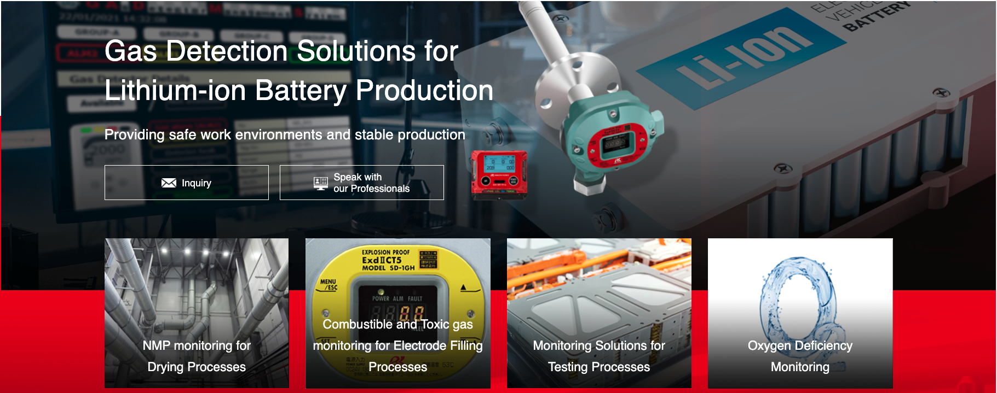
Lithium-ion Battery Market
Introduction
World Leader in Gas Detection &
Sensor Technology

Slide 2
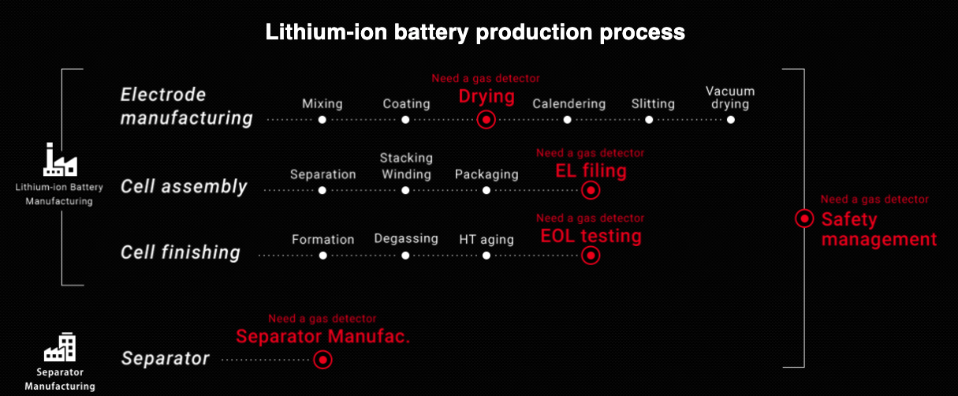

Slide 3
Lithium Battery Production Process
Electrode manufacturing
Mixing
Coating
Drying
Calendering
Slitting
Vacuum drying
Gas detector
required!!
Cell assembly
Separation
Stacking Winding
Packaging
EL filing
Gas detector
required!!
Large number of instruments are used in these processes.
“Competitive”
Cell finishing
Degassing
HT aging
EOL testing
Formation
Gas detector
required!!
Separator
Related activity
Separator
Manufac.
Separator manufacturing process
requires “Gas detector” as well.

Slide 4
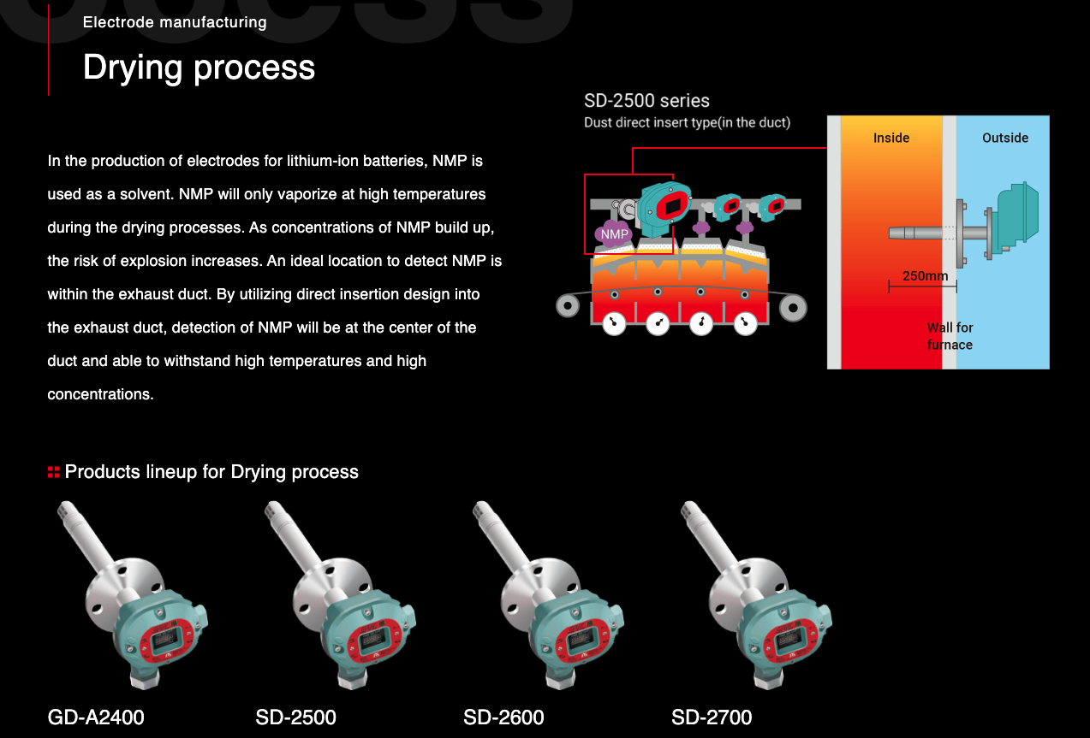

Slide 5
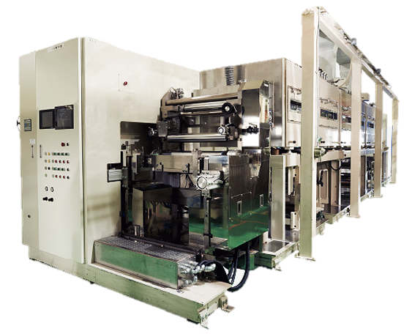
Coating & Drying Process
NMP is present all the time at the coating and drying process.
Necessity of gas detection
To confirm the concentration is not decreasing
To confirm it will not exceed the explosion limit.
For 32GWh factory …
・around 8 lines
・around 18 sets of gas detectors per line

Slide 6
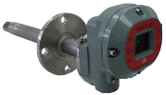
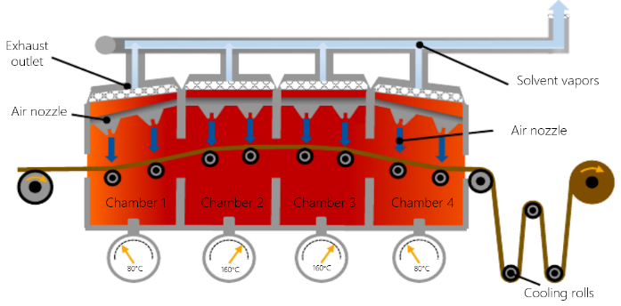
Coating and drying process mainly uses NMP.
It generates explosive NMP in this drying process
SD-2500 series
Directly samples within the Duct
NMP
NMP
NMP
NMP
NMP volatilizes only at high temperatures.
Therefore, it is necessary to insert a detector directly into the exhaust duct and detect it at high temperature.

Slide 7
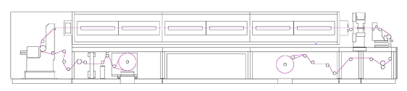
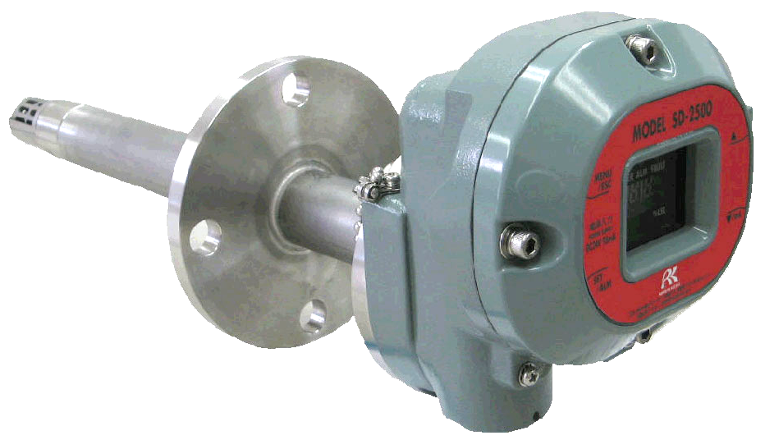
Coater- Dryer
Responsible for the manufacturing process of electrode plates (positive and negative electrode materials), which is a key battery manufacturing process.
Suggest instrument:
1) SD-2500

Slide 8
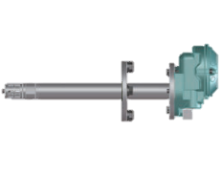
Product advantage
Directly detecting inside the DUCT
Accurate detection is possible because there is no risk of condensation (liquefaction)
Model: SD-2500
Advantages
1. No risk of liquefaction
⇒avoid solvent adsorption on piping and sensors.
2. Duct insert diffusion method
⇒ no dead time.
3. No suction pump required
⇒ low running cost
Layout drawing

Slide 9
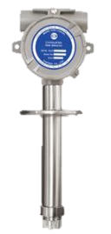
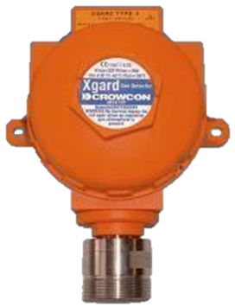
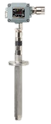
In-furnace direct feed type recommended
RIKEN KEIKI
- SD-2500 : 0- +160℃
- SD-2600 : 0- +200℃
GASTRON
- GTD-2000: -20- +60℃
CROWCON
Xgard : -40- +150℃
New COSMOS ELECTRIC
- KD-12HT : 0- +160℃
UL/ATEX approval
ATEX approval
ATEX approval
Non ATEX approval
Riken Keiki Advantages
1) Has UL/ATEX
2) Has wide temperature range
3) Has long insert part
RIKEN KEIKI is an explosion-proof product that can be used in the highest temperature environment and has the longest insert！！

Slide 10
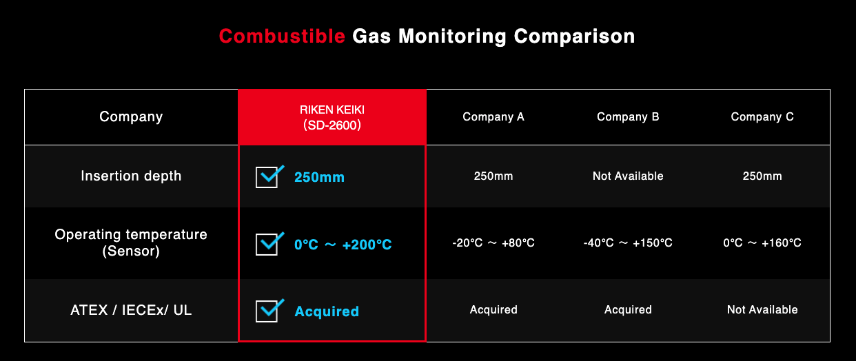
Competitive Advantages

Slide 11
Lithium Battery Production Process
Electrode manufacturing
Mixing
Coating
Drying
Calendering
Slitting
Vacuum drying
Gas detector
required!!
Cell assembly
Separation
Stacking Winding
Packaging
EL Filling
Gas detector
required!!
Large number of instruments are used in these processes.
“Competitive”
Cell finishing
Degassing
HT aging
EOL Testing
Formation
Gas detector
required!!
Separator
Related activity
Separator
Manufac.
Separator manufacturing process
requires “Gas detector” as well.

Slide 12
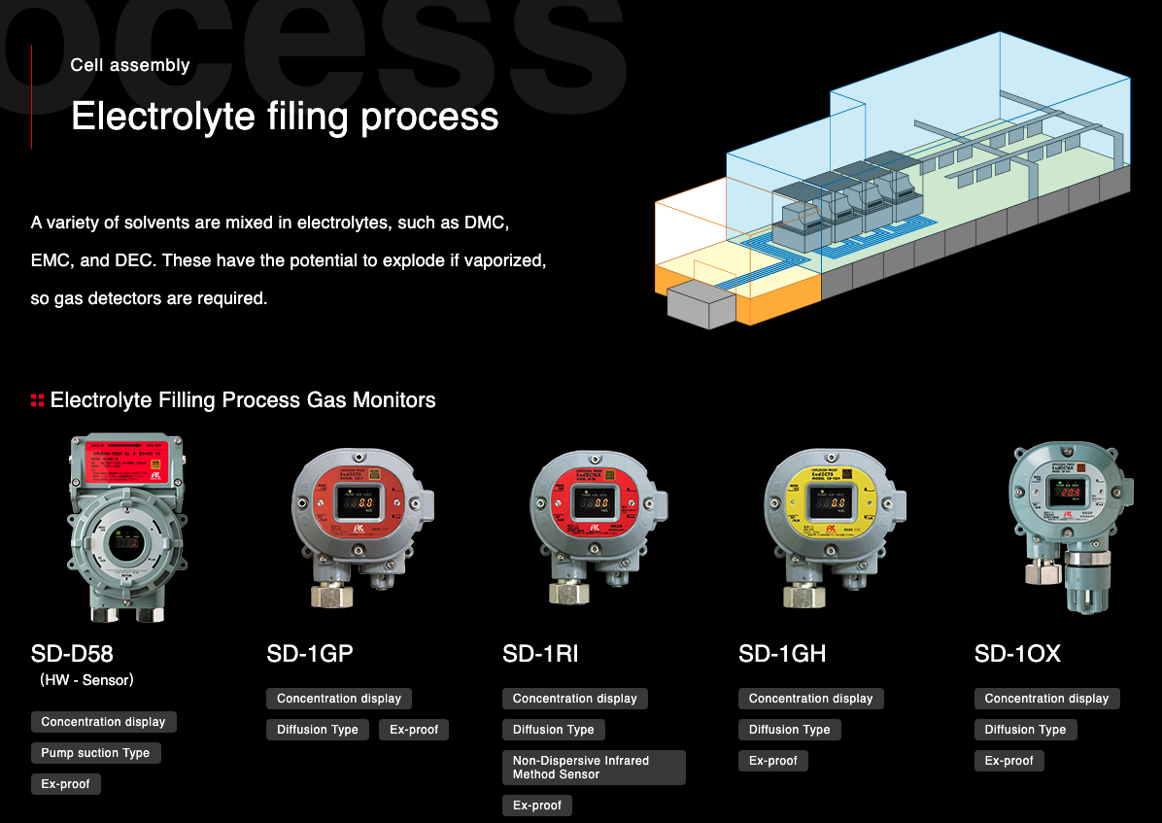
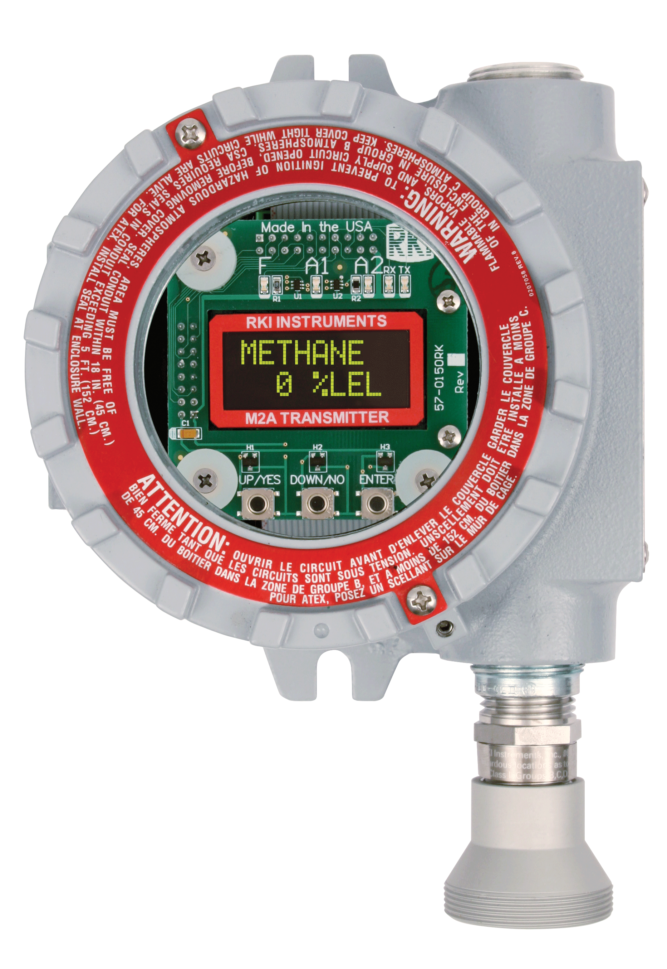
M2A

Slide 13
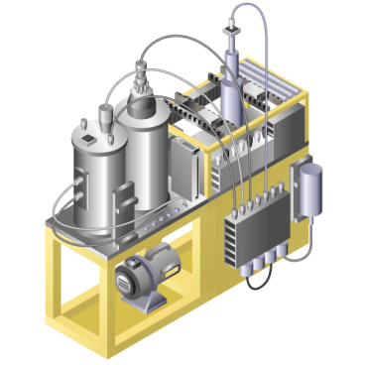
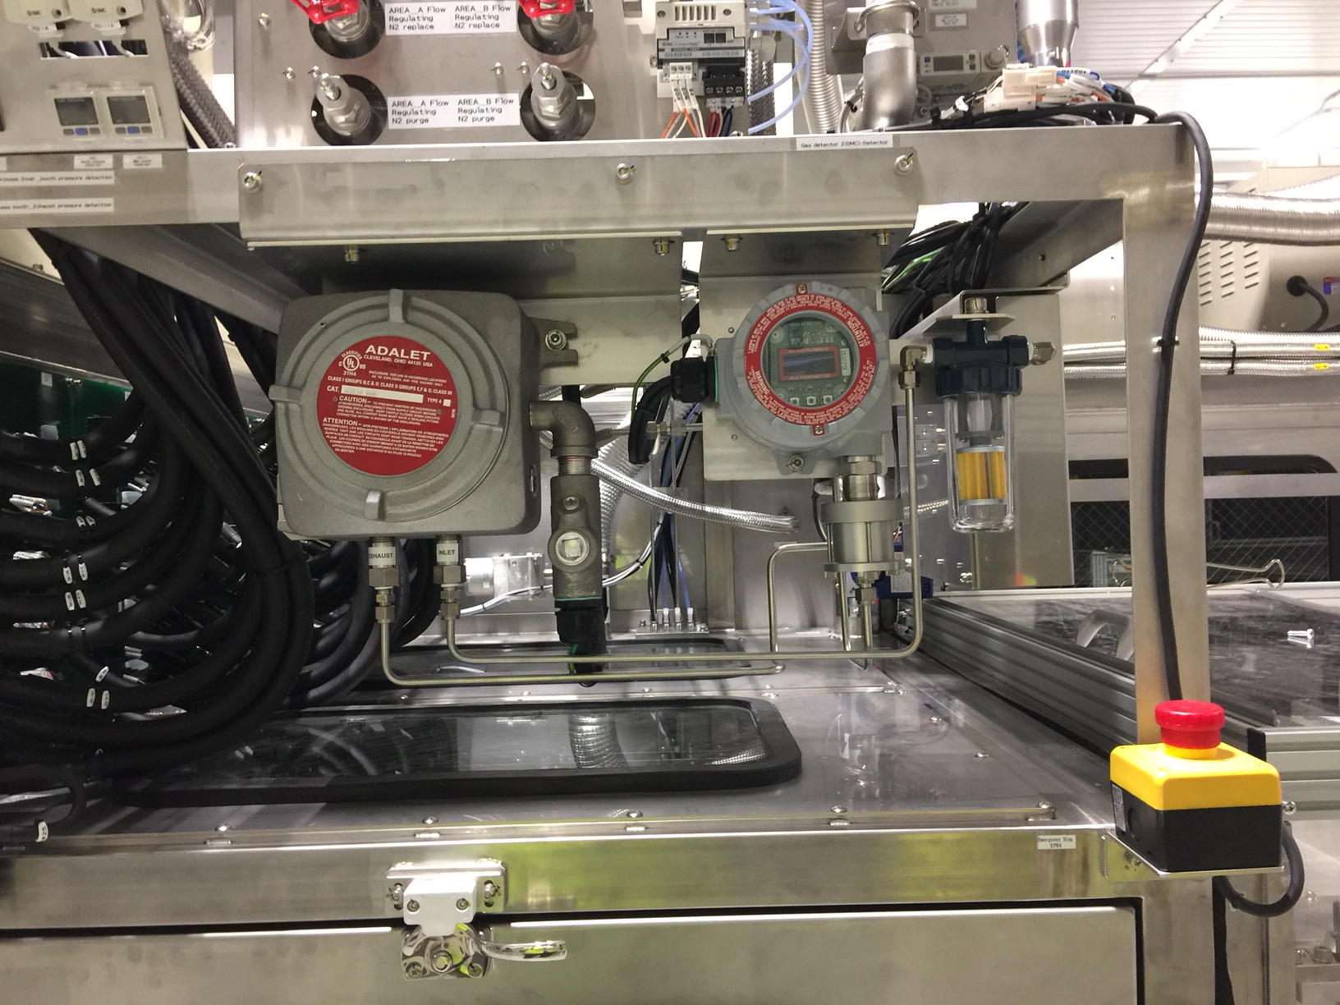
The electrolyte contains DMC (dimethyl carbonate) and when it is vaporized, it becomes an explosive atmosphere. Also, to prevent oxygen deficiency during inspections, oxygen meter is installed.
M2A – DMC
Model 1017F
For 1 unit of electrolyte injection system …
DMC detector：1unit＋OX-5001：1unit＋O2 detector：1unit is used
For a 32GWh factory …
・around 24 lines
・around 20 sets of gas detector per line

Slide 14
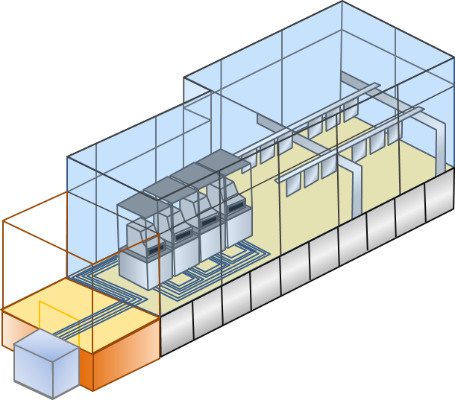


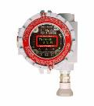

When DMC(dimethyl carbonate) contained in the
electrolyte is vaporized, it becomes an explosive gas.
We have prepared detectors that can handle each gas type.
Use : Explosion prevention /
Leakage detection（DMC）
Model : SD-D58 (DMC) /
SD-１RI (diffusion type) /
M2A
Use : Oxygen deficiency prevention
Model : SD-1 OX（diffusion type）
【Electrolyte injection device (image)】

Slide 15
Lithium Battery Production Process
Electrode manufacturing
Mixing
Coating
Drying
Calendering
Slitting
Vacuum drying
Gas detector
required!!
Cell assembly
Separation
Stacking Winding
Packaging
EL filing
Gas detector
required!!
Large number of instruments are used in these processes.
“Competitive”
Cell finishing
Degassing
HT aging
EOL testing
Formation
Gas detector
required!!
Separator
Related activity
Separator
Manufac.
Separator manufacturing process
requires “Gas detector” as well.

Slide 16
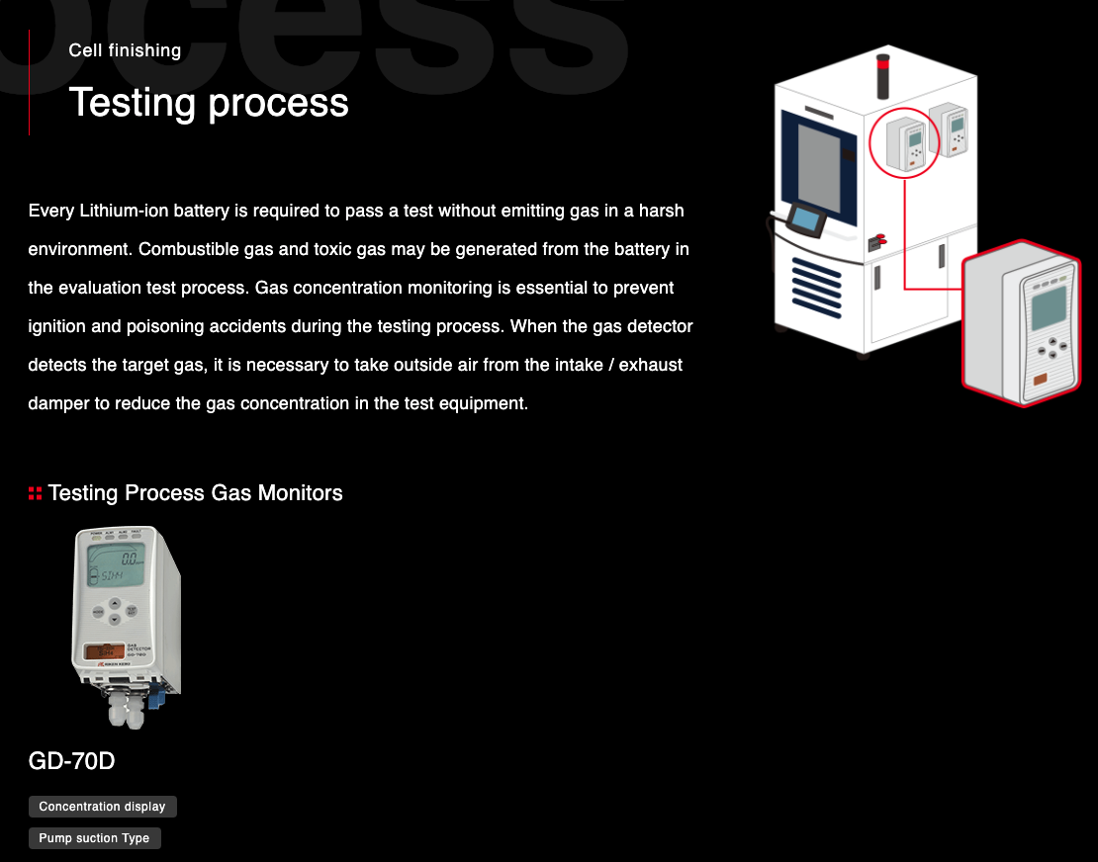

Slide 17
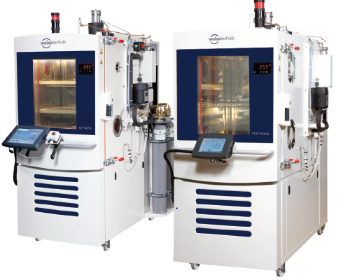

■Test process
Depending on the Type of battery (encapsulated
electrolyte), H2(hydrogen), CO(carbon monoxide),
H2S(hydrogen sulfide) occurs !!
Use：Explosion prevention /
Poisoning prevention
(H2/CO/H2S/HF etc)
Model：GD-70D
Gas: CO, H2, H2S, HF, CH4, O2
Typically 1 or 2 gas monitors per test equipment.
“Test equipment (image)”
Notes:
Since the environment inside the test equipment is extremely harsh, it is necessary to perform pretreatment by sampling (air-cooled dehumidification, activated carbon adsorption, etc.).

Slide 18
Lithium Battery Production Process
Electrode manufacturing
Mixing
Coating
Drying
Calendering
Slitting
Vacuum drying
Gas detector
required!!
Cell assembly
Separation
Stacking Winding
Packaging
EL filing
Gas detector
required!!
Large number of instruments are used in these processes.
“Competitive”
Cell finishing
Degassing
HT aging
EOL testing
Formation
Gas detector
required!!
Separator
Related activity
Separator
Manufac.
Separator manufacturing process
requires “Gas detector” as well.

Slide 19
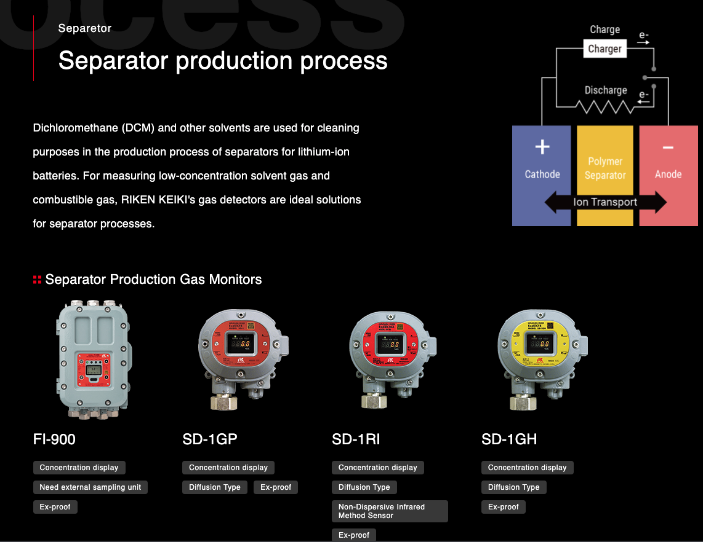

Slide 20
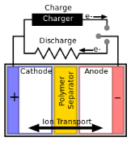
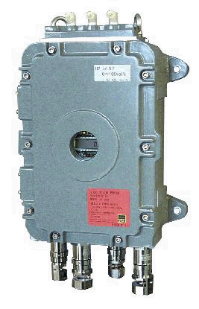
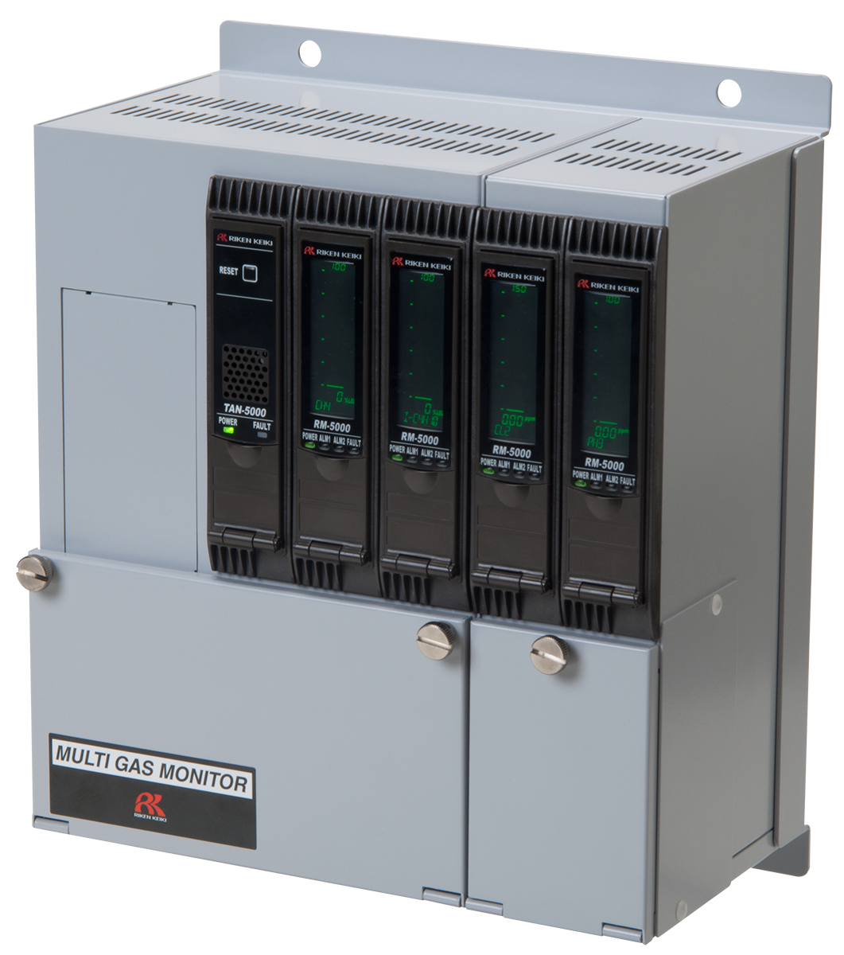
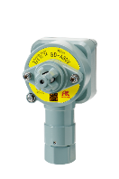
Separator
We have installation experience in Japan with ASAHI KASEI (Celgard, LLC) the No.1 separator company. Have an individual instrument that no other competitor has which was accepted by the separator company.
-> Dichloromethane is inspected while separator is manufactured.
Use：Explosion prevention /
Poisoning prevention
Model：FI-800 + RS-330
SD-1GH + Beacon Controller
GH-5001 + GD-A80V
Gas: Dichloromethane, Propane
FI-800
RM-5000
GD-A80V

Slide 21
Major Accident Cases
Created by quoting and processing from the workplace safety site
(Ministry of Health, Labor and Welfare：http://anzeninfo.mhlw.go.jp/anzen/sai/saigai_index.html)

Slide 22
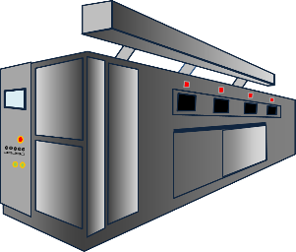
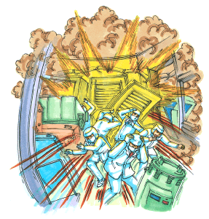
Explosion of drying equipment while heat drying chemicals
Drying equipment cause of damage
  During the drying operation, the odor of ethanol as a solution was strongly felt and the exhaust device was confirmed. An explosion occurred after the switch was turned on because the exhaust system was not operating.
Injured : 6 people
- Thorough training of workers needed
- Establishment of safety management
system
+
- Installation of detector to detect
leakage of flammable gas

Slide 23
Product Information

Slide 24
Coating & Drying Processes
Flame-proof Furnace Safety Monitor
Model：SD-2500／SD-2600／GD-2400
Features
Detection of high boiling point solvents
Detection of N-methyl-2-pyrrolidone(NMP) vaporized in the drying furnace
Catch the exact concentration in the center of the exhaust duct by direct insertion in the furnace

Slide 25
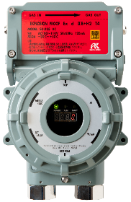
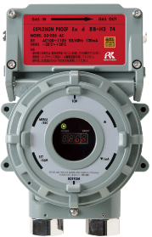
Electrolyte Filling Process
Flame-proof Suction Type Gas Detector
Model：SD-D58 | GD-D58 | M2A
Features
Suitable for use as an explosion proof product even in hydrogen atmospheres
Equipped with automatic flow rate abnormality
Integrated assemblies of replacement parts to simplify maintenance
SD-D58
(With concentration
indicator)
GD-D58
(Without concentration
indicator)
M2A
(With gas display)

Slide 26
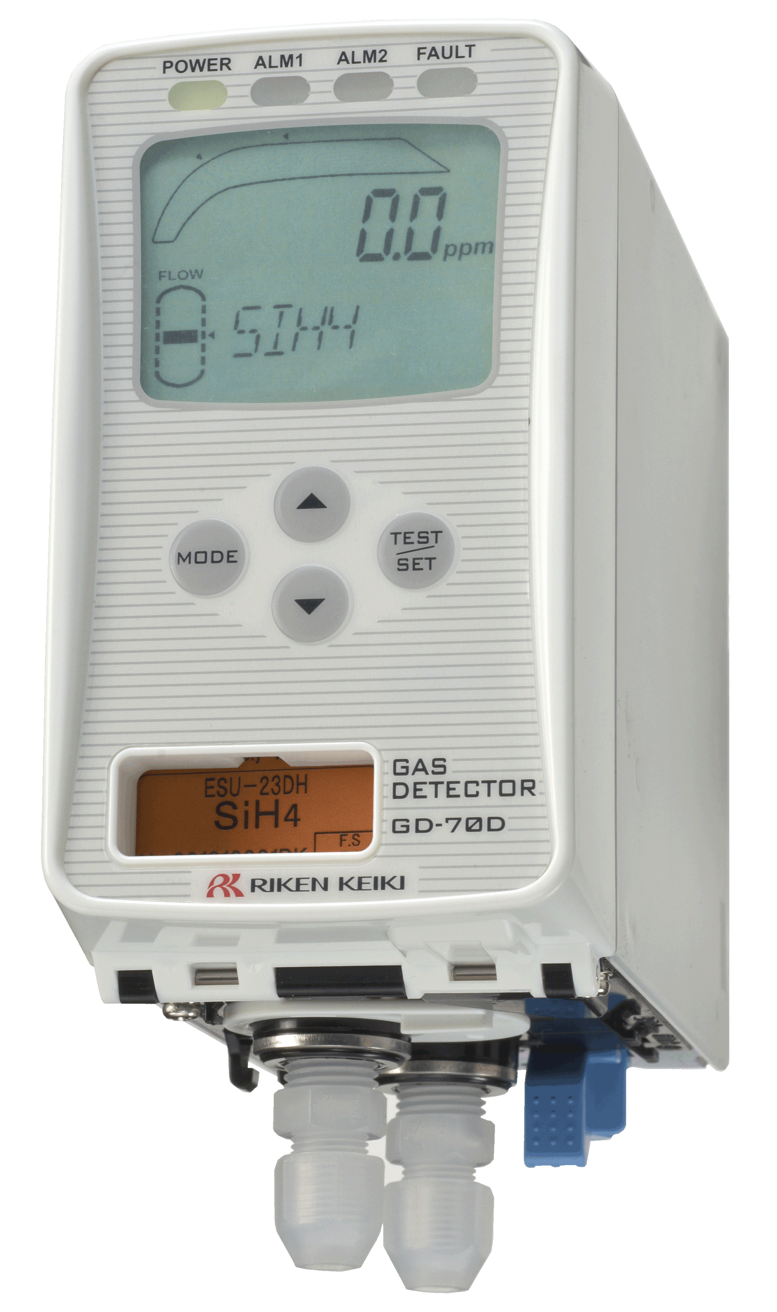
Testing Process
Smart Transmitter / Gas Detector
Model：GD-70D
Features
A universal design that does not depend on the sensor technology. The main unit is shared.
Reduced power consumption - up to 20% of conventional (Potentiostatic Electrolysis Method)
Compliant with GADMS and other systems
No internal tubing (Main unit) / No Coil (Pump unit)
Front access, no tools required for easy replacement of sensor & pump

Slide 27


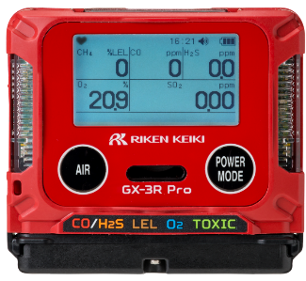
Personal Safety | Confined Space | VOC Detection
Portable Gas Monitors
Model：GX-3R | GX-3R Pro | GX-6000
GX-3R
- Smallest confined space monitor
GX-3R Pro
- Smallest 5 gas monitor
- Bluetooth alarm notifications
GX-6000
- 6 gas sample draw with
smart sensors
- 4 PID sensor options
- 5 operating modes

Slide 28





SUCCESSES

Slide 29
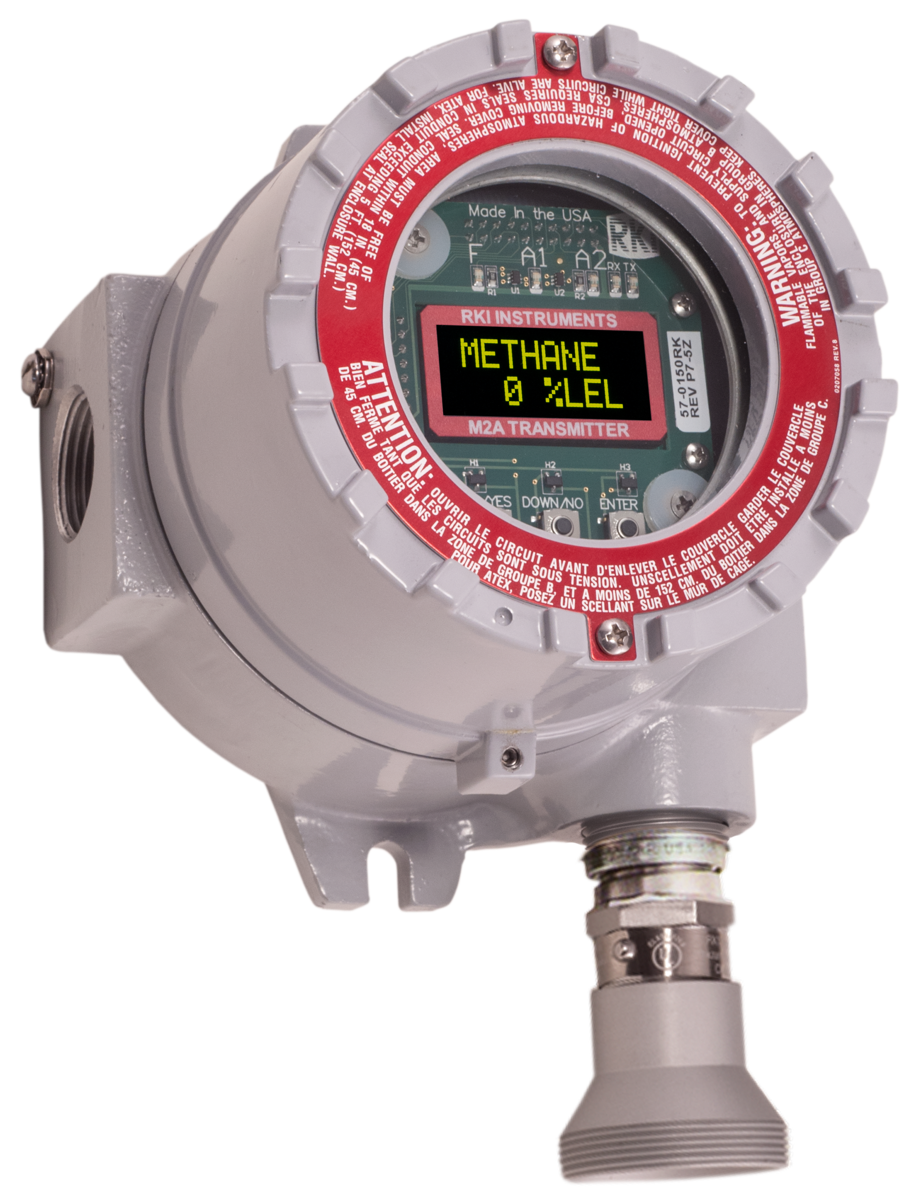
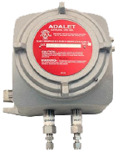
Panasonic Energy of North America

Slide 30
Li-Ion Manufacturing Shipments
Equipment | Model | Gases | Ranges | Units
Liquid injection device | M2A（IR Type） | DMC | 0-100％LEL | 200
Liquid injection device | OX-5001-1017 | O2 | 0-25VOL% | 200
GNC Device | M2A（IR Type） | DMC | 0-100％LEL | 200
GNC Device | OX-5001-1017 | O2 | 0-25VOL% | 200
Encapsulation device | GP-6001-1017 | Xylene, Hexane | 0-100％LEL | 10
Coater machine | GP-5001-A2400 | NMP | 0-100％LEL | 126

Slide 31
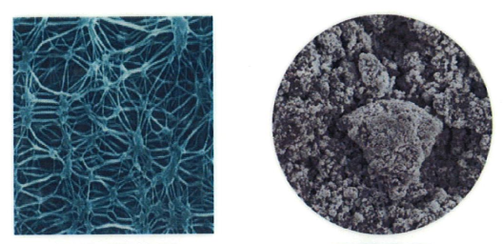

Gas sensor deterioration factors
In principle, the gas sensor detects gas by a chemical quantitative reaction.
Contact with substances that are chemically harmful to the sensor
Due to changes in the properties of sensor constituent materials due to long-term use
Its sensitivity is gradual, but it deteriorates.
Sensitivity confirmation by regular inspection and regular replacement as preventive maintenance are required
Deterioration factors of constant potential electrolytic sensor
■ Working electrode [Reduction of surface area]
⇒ Impurity mixed (surface oxidation / dissolution)
⇒Long-term contact with reaction gas (surface oxidation)
■ Gas permeable membrane [Reduction of transmittance]
⇒ Adhesion of fine particles, oil misto, etc. (clogging)
⇒ Organic solvent vapor contact (decreased water repellency)
⇒ Pressure load (decreased water repellency)
■ Electrolyte [Reduction of liquid volume]
⇒ Dry air contact (electrode exposure)
Gas permeable membrane
Deterioration factors of constant potential modulus sensor
■ Working electrode [Reduction of surface area]
⇒ Impurity mixed (surface oxidation / dissolution)
⇒Long-term contact with reaction gas (surface oxidation)
■ Gas permeable membrane [Reduction of transmittance]
⇒ Adhesion of fine particles, oil misto, etc. (clogging)
⇒ Organic solvent vapor contact (decreased water repellency)
⇒ Pressure load (decreased water repellency)
■ Electrolyte [Reduction of liquid volume]
⇒ Dry air contact (electrode exposure)

Slide 32
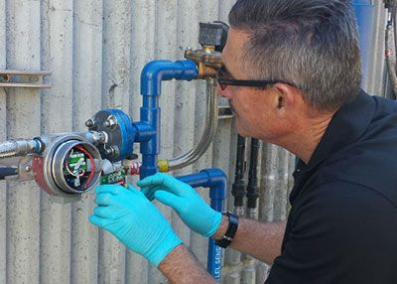

Need for maintenance
---------- Specificity of gas detector equipment ----------
■ The usage environment is complicated and diverse →
There is a "difference" in the operating status (due to the environment)
■ Normally, it is in a standby state (it never operates) →
There is almost no opportunity to check the operation
■ The detection target is gas →
There is no operation inspection method other than gas introduction
To operate correctly in case of emergency
Maintenance of functions and performance is extremely important
Maintaining durability in continuous operation.
Regular inspection and maintenance

Slide 33
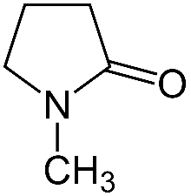
N-Methyl-2-pyrrolidinone(NMP) Physical properties
Chemical formula : C5H9NO
Molecular weight : 99.13
Lower explosion limit : 0.9 vol%
Flash point : 95 ℃
-> Exceeding this may produce air and
explosive gas mixtures
Boiling point : 204 ℃
Vapor pressure : 66 Pa(25 ℃) -> 7 %LEL
3200Pa(=3.2kPa)->350 %LEL(3.15 vol%)
Classification : Corresponds to third petroleum
Structure formula

Slide 34

Dimethyl carbonate(DMC) Physical properties
Chemical formula : C3H6O3
Molecular weight : 90.08
Lower explosion limit : 4.2 vol%
Flash point : 18 ℃
-> Exceeding this may produce air and
explosive gas mixtures
Boiling point : 90.2 ℃
Vapor pressure : 7.4 kPa(25 ℃) -> 173 %LEL(7.3 vol%)
Classification : Corresponds to first petroleum
Structure formula

