Slide 1


GX-3R
User Training

Slide 2
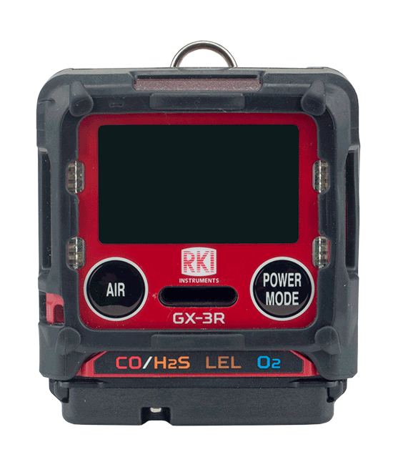
Turn on
Turn on the GX-3R by pressing and holding the POWER MODE button until you hear one beep

Slide 3
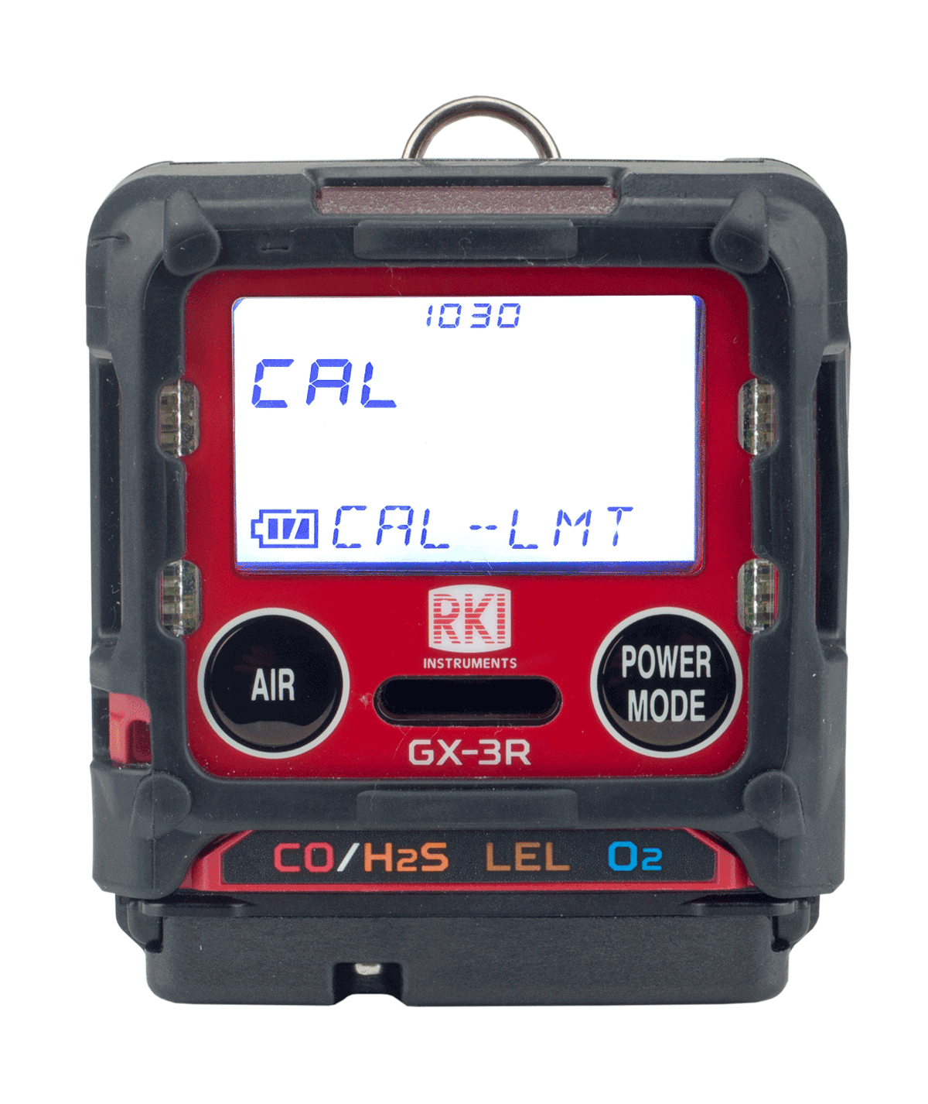
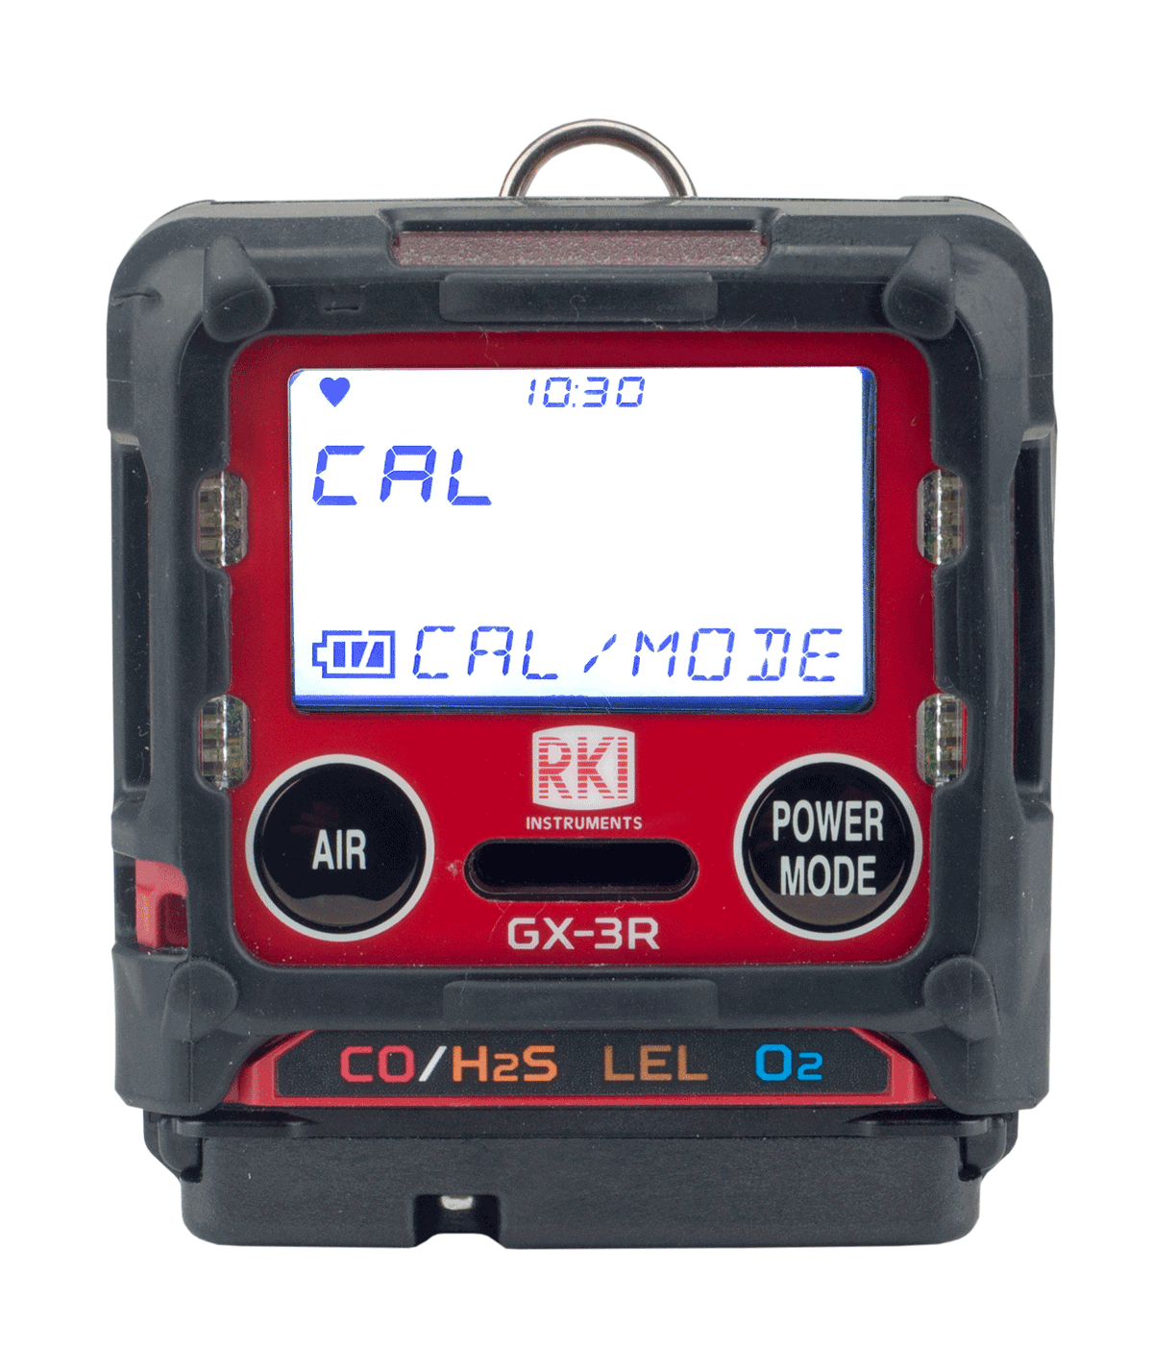
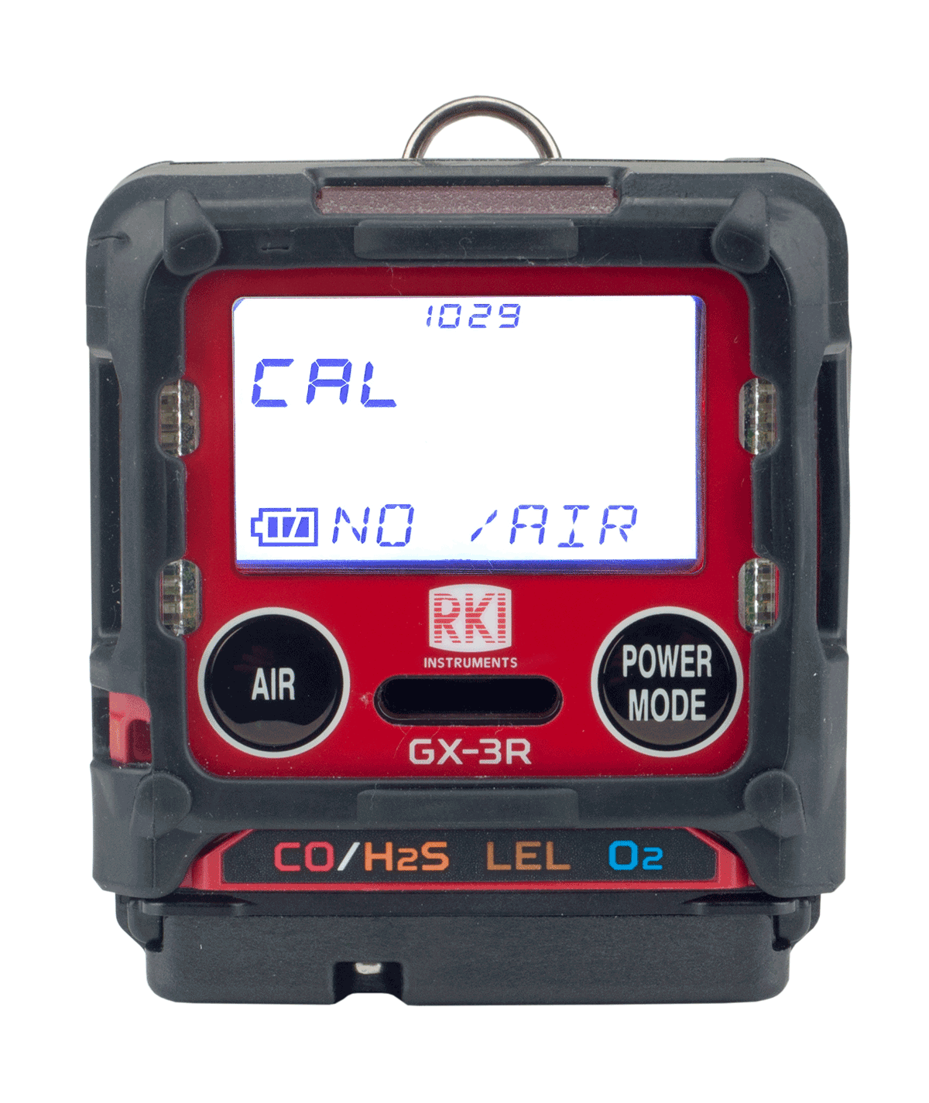
Cal Reminder
Acknowledge and use
If your instrument is past its 30 day calibration limit, you will see a CAL-LMT reminder at start-up
Perform a calibration
Press the POWER/MODE button to perform calibration.
Press AIR button to continue without performing a calibration

Slide 4
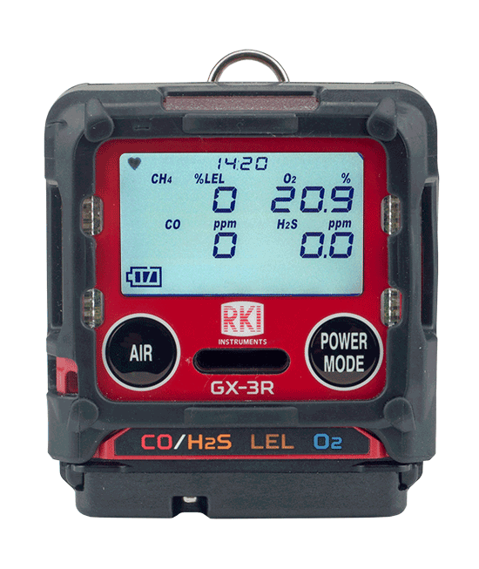
Normal Mode
After warm-up, the normal screen will appear.

Slide 5
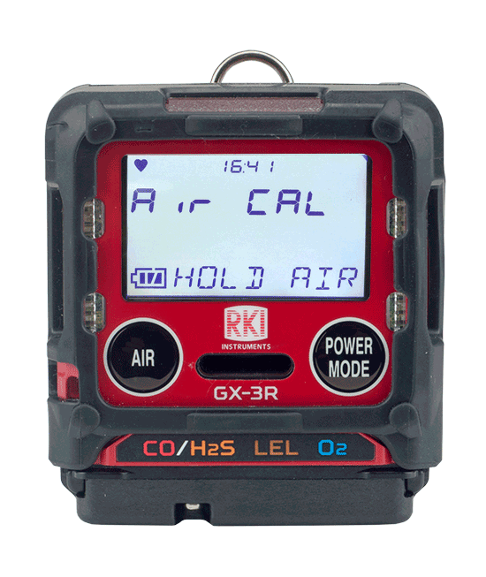
Fresh Air
To perform a fresh air adjustment, make sure you’re in a fresh air environment.

Slide 6
Fresh Air
Press and hold the AIR button

Slide 7
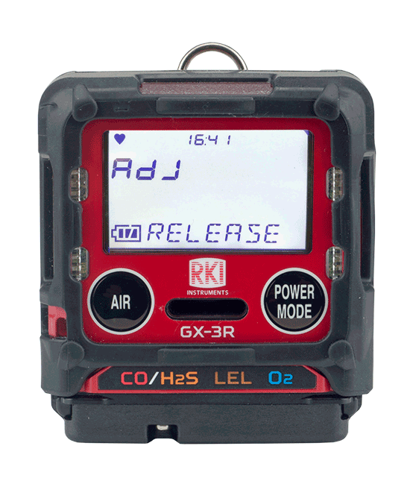
Fresh Air
When prompted, release the AIR button
The GX-3R will beep once and return to normal mode after the fresh air adjust is complete

Slide 8
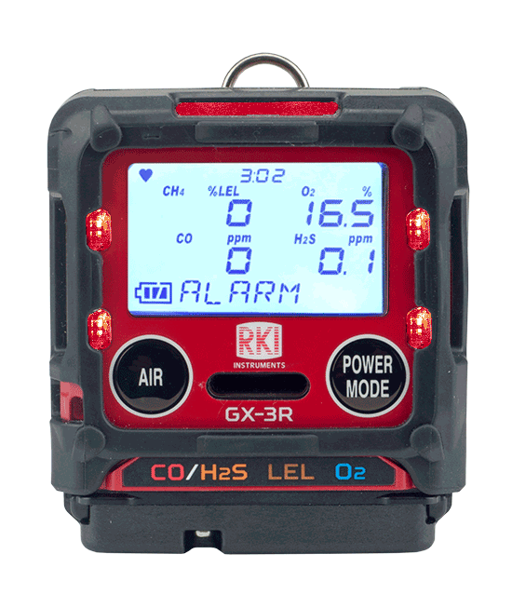
Alarm
In the event of an alarm, the GX-3R’s visual, audible and vibration alarms will alert you.
The readout will identify which sensor is in alarm.
The visual, audible, and vibration alarms will stop.
To reset the instrument, go to a safe location. Once the readings return to fresh air values, then press the POWER/MODE button.

Slide 9
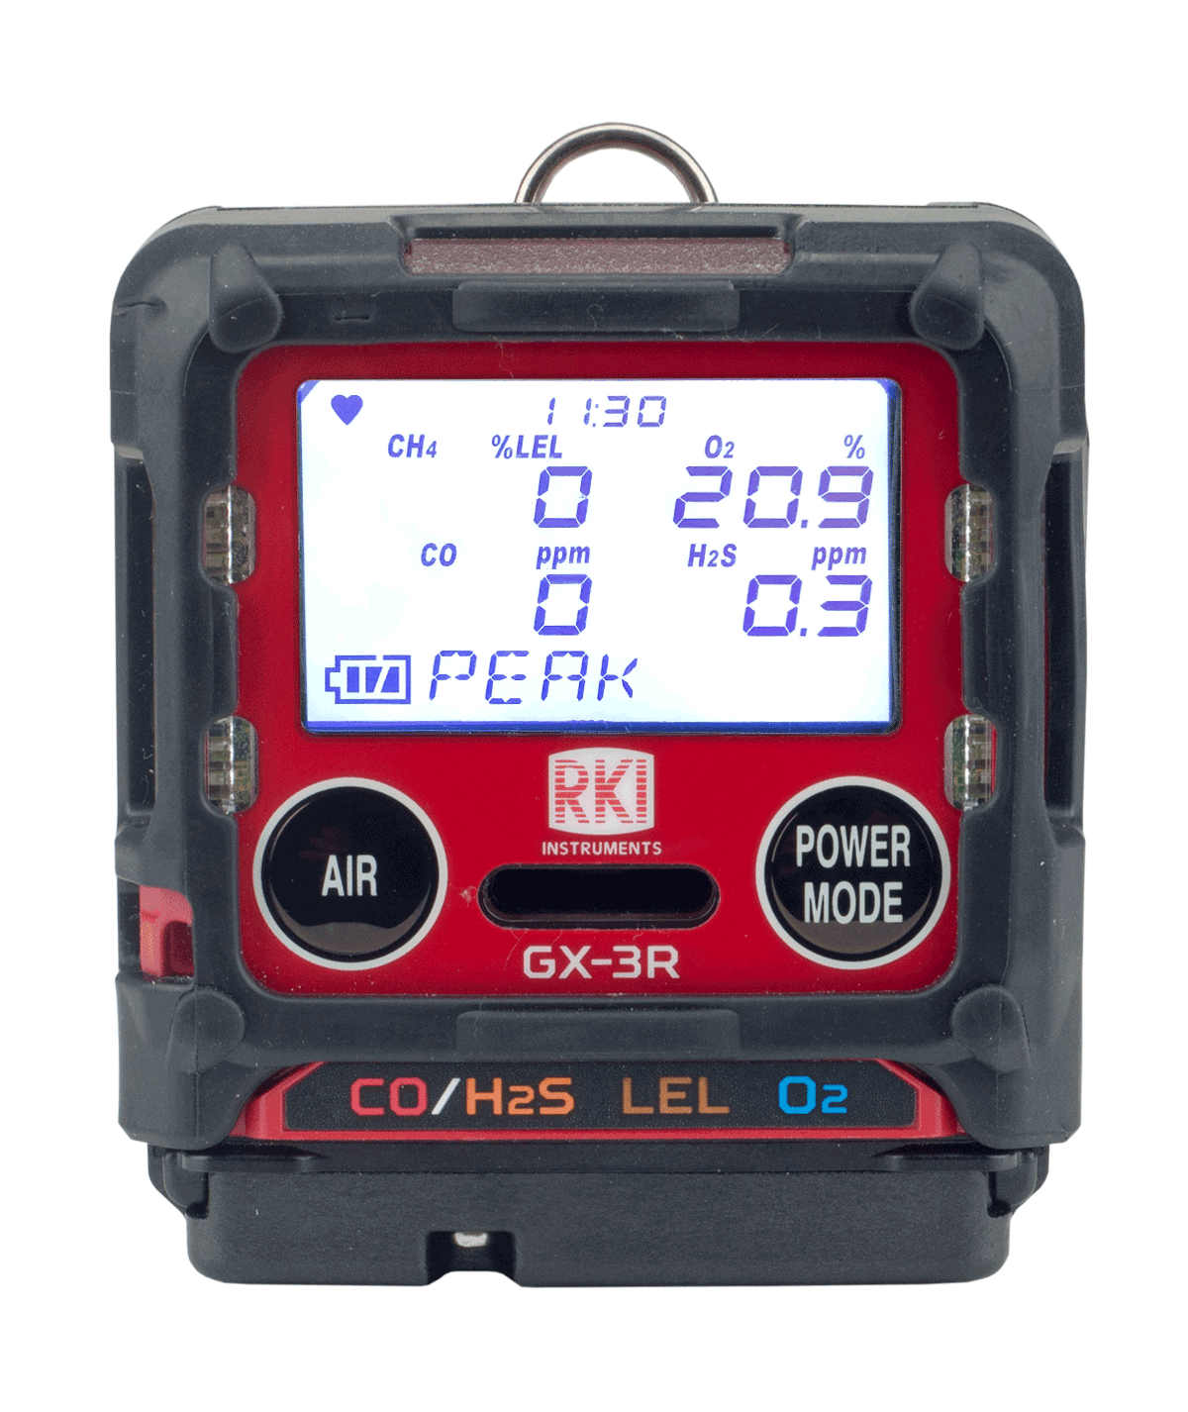
Display Mode
To enter display mode, press and release the Power Mode button

Slide 10
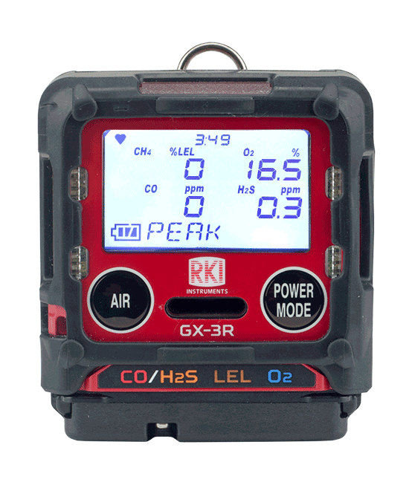
Display mode vs. Normal Operation
PEAK
STEL
TWA
HC GAS LIST
USER ID
STN ID
CAL DATA
BUMP DATA
TEMPERATURE
ALARM-PT
You will know you are in display mode if you see a display mode menu title on the bottom of your screen
To return to normal operation, scroll all the way through the display menu using the AIR button, or wait 20 seconds and the GX-3R will automatically return to normal mode

Slide 11
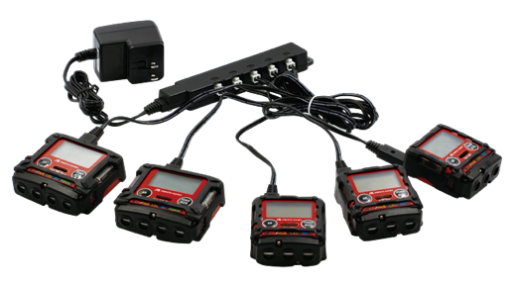
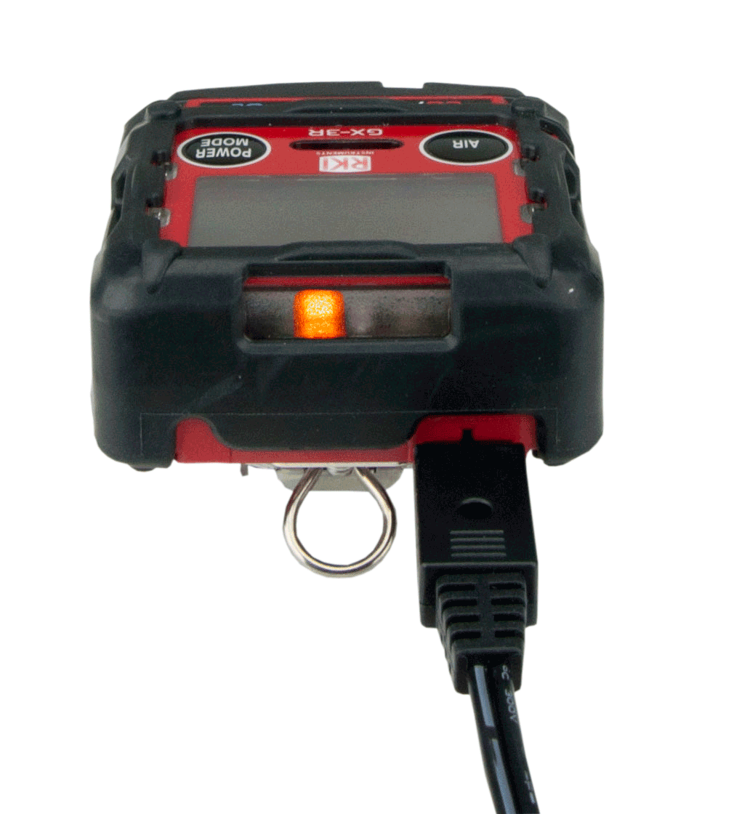
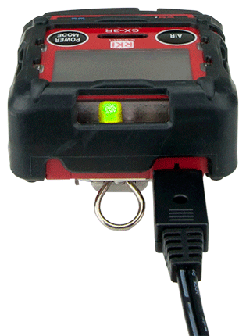
Charging the instrument
Plug the charger into the instrument. A full charge takes 3 hours, and will power the instrument up to 25 hours.
Once the GX-3R is charged, the light will go from orange to green
A 30 minute charge will provide 8 hours of operation time.
Multi-unit AC Adapter is available
(#49-0134)

Slide 12
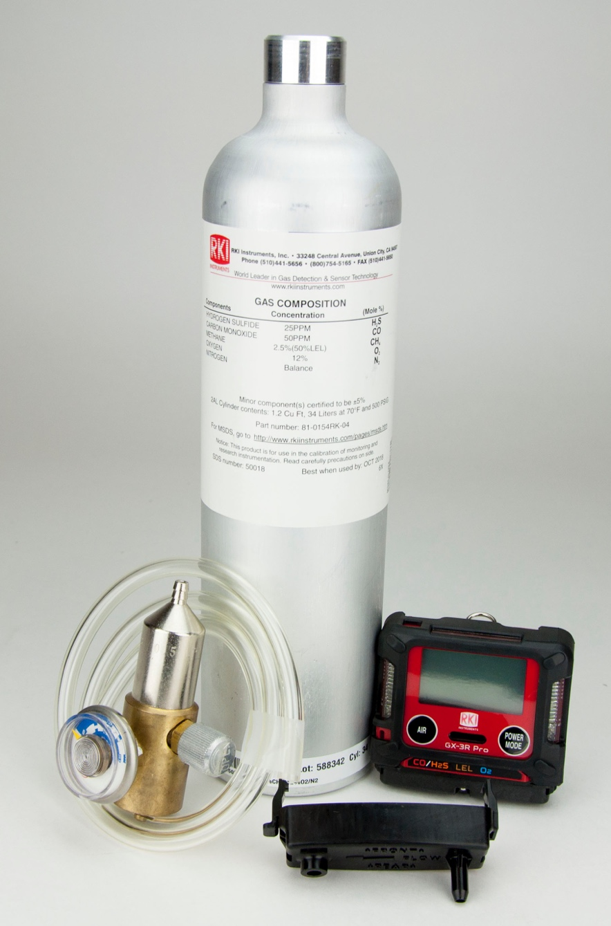

Calibration

Slide 13
Calibration
Acknowledge and use
Perform a calibration
If your instrument is past its 90 day (factory set default) calibration limit, you will see a CAL-LMT reminder at start-up
Press the AIR button to continue without performing a calibration
Press the POWER/MODE button to perform calibration.

Slide 14
Calibration
To perform a fresh air calibration
⎯ Make sure you are in a gas free environment
⎯ Press and hold the “AIR” button
⎯ When prompted, release the button
Note: If you are unable to perform a Fresh Air adjustment, it may be that “DEM ZERO” in Maintenance Mode has been turned off.
In this case, you will have to enter User Mode and select
GAS CAL → AIR CAL to perform one.

Slide 15
Calibration
To perform a calibration without being prompted by the calibration reminder (CAL RMDR) turn the instrument off and restart it in User Mode
To enter User Mode:
Turn the GX-3R off
Press and hold the “AIR” button
Then press and hold the “POWER/MODE” button
Release after one beep

Slide 16
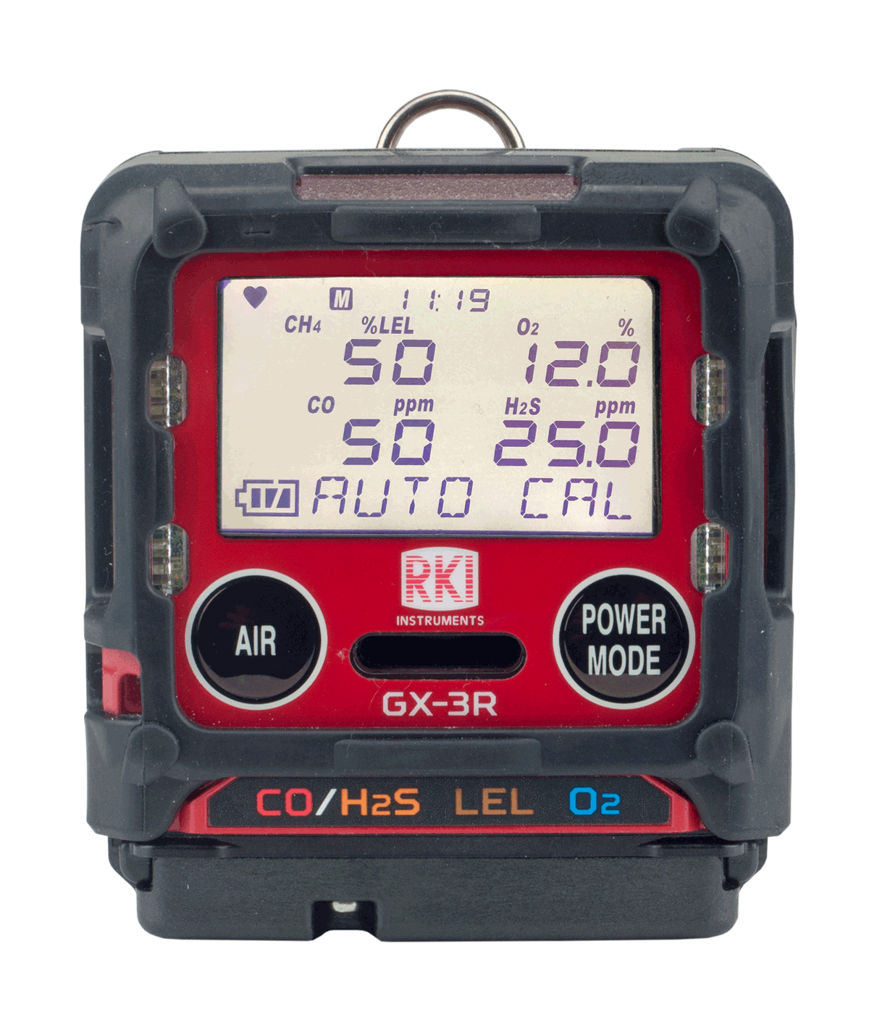
Calibration
In the User Mode menu
  Use the “AIR” button to scroll options
  Use the “POWER/MODE” button to select
Select “GAS CAL”
  Note your sub-menu options are “AIR CAL” and “AUTO CAL”
  (NOTE: This is where you can do a “fresh air” calibration if you did not on start-up)
  Select “AUTO CAL”
  Calibration values will be displayed
  (LEL – 50%, O2 – 12%, CO – 50ppm, H2S – 25ppm)
  (factory set default values)

Slide 17
Calibration
If the calibration values displayed do NOT match the gas cylinder values:
Enter the AUTO CAL menu (User Mode→ Gas Cal→ Auto Cal)
Scroll with “AIR” and select “CAL-P” with “POWER/MODE”
You should see the active channel marked with 3 dashes (- - -)
Use “AIR” to select which gas you want to change the value of
Press “POWER/MODE” to select
Use ”AIR” to adjust to the value matching your cylinder
(HINT: if you need to reverse the direction of your numbers, press AIR and POWER/MODE together quickly)
Press the “POWER/MODE” button to save
Press “AIR” to move to the next gas. Repeat as necessary
Select “ESCAPE” to return to the Auto Cal menu

Slide 18
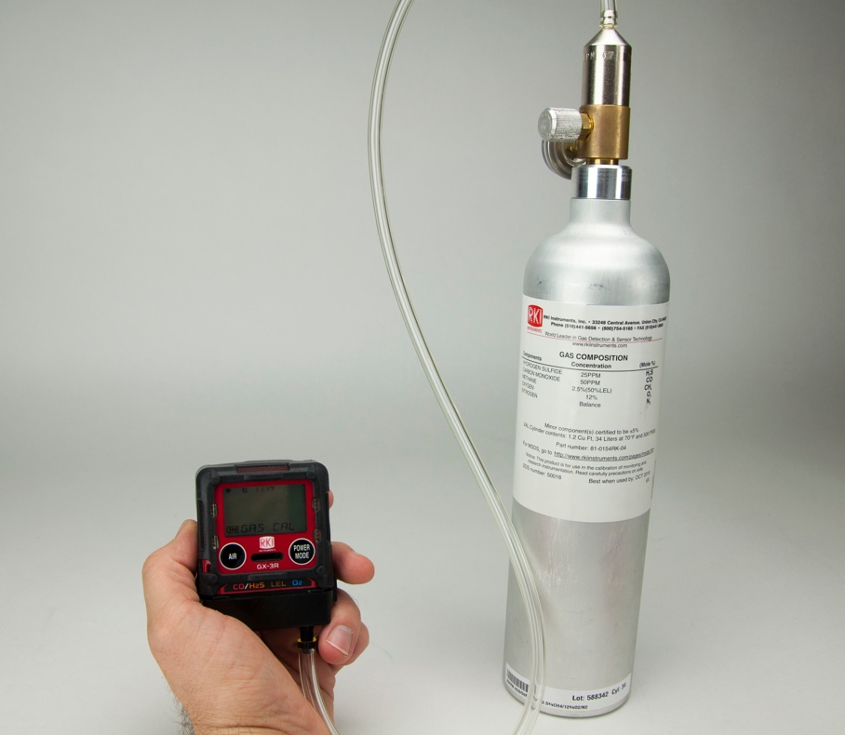
Calibration
Applying gas to the GX-3R
  Attach a fixed flow regulator to the calibration gas cylinder
  Attach the calibration adapter to the instrument and connect it to the 0.25 LPM regulator with tubing
  With “AUTO CAL” highlighted, press ”POWER/MODE”
  Turn on the regulator

Slide 19
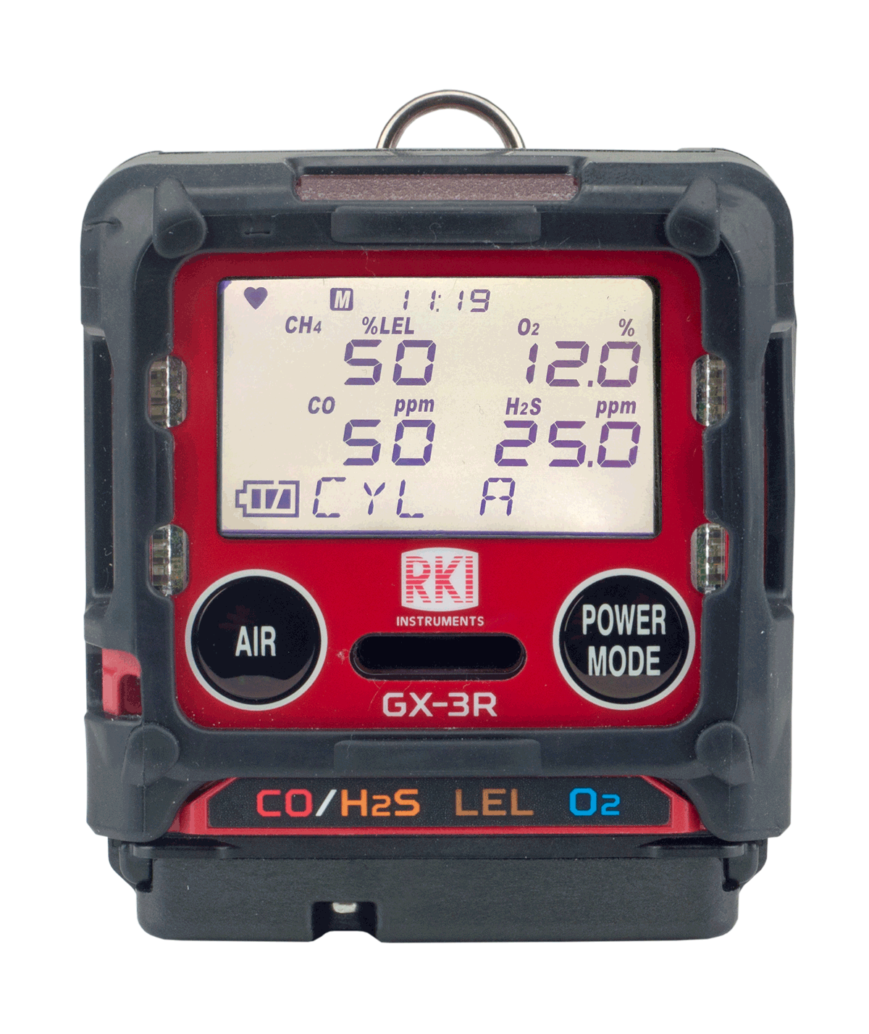
Calibration
  “AUTO CAL/CYL A” should be alternating on the display
  Press “POWER/MODE”
  Apply gas until readings stabilize or for 2 minutes maximum
  Press “POWER/MODE” Turn the gas regulator off

Slide 20
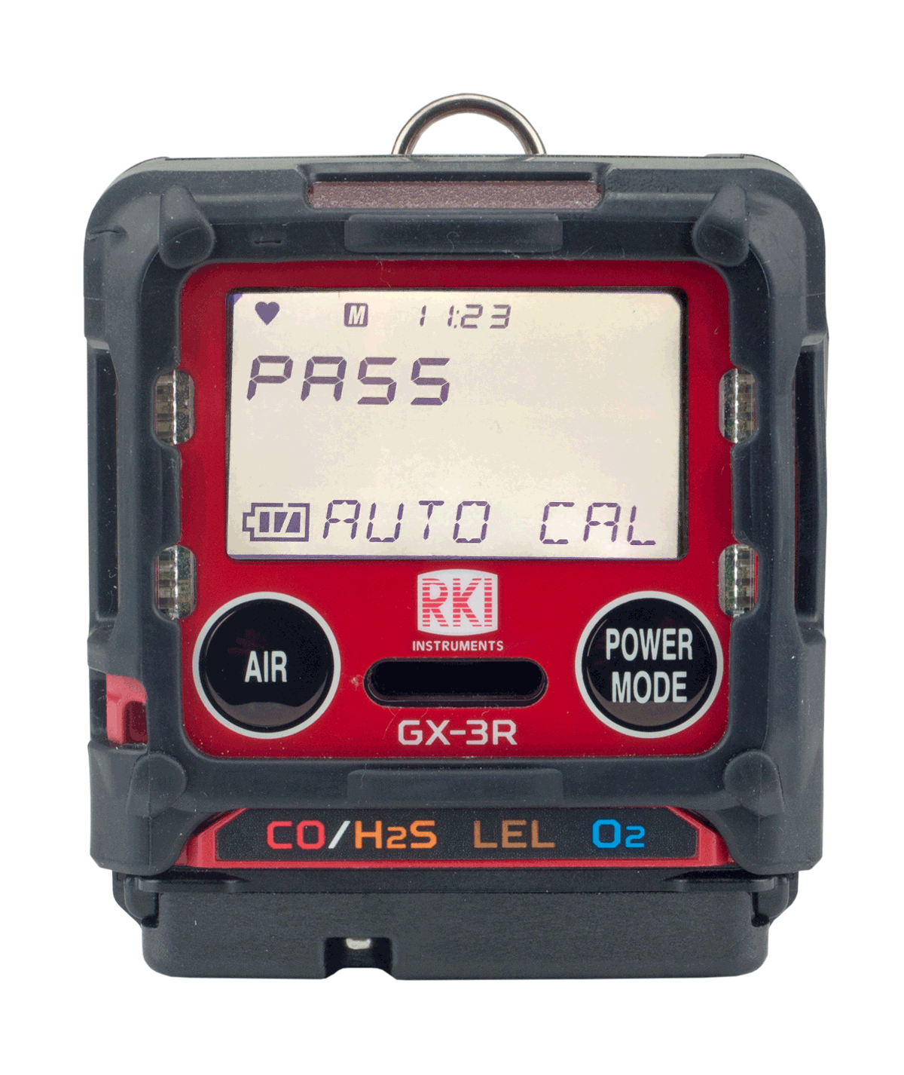
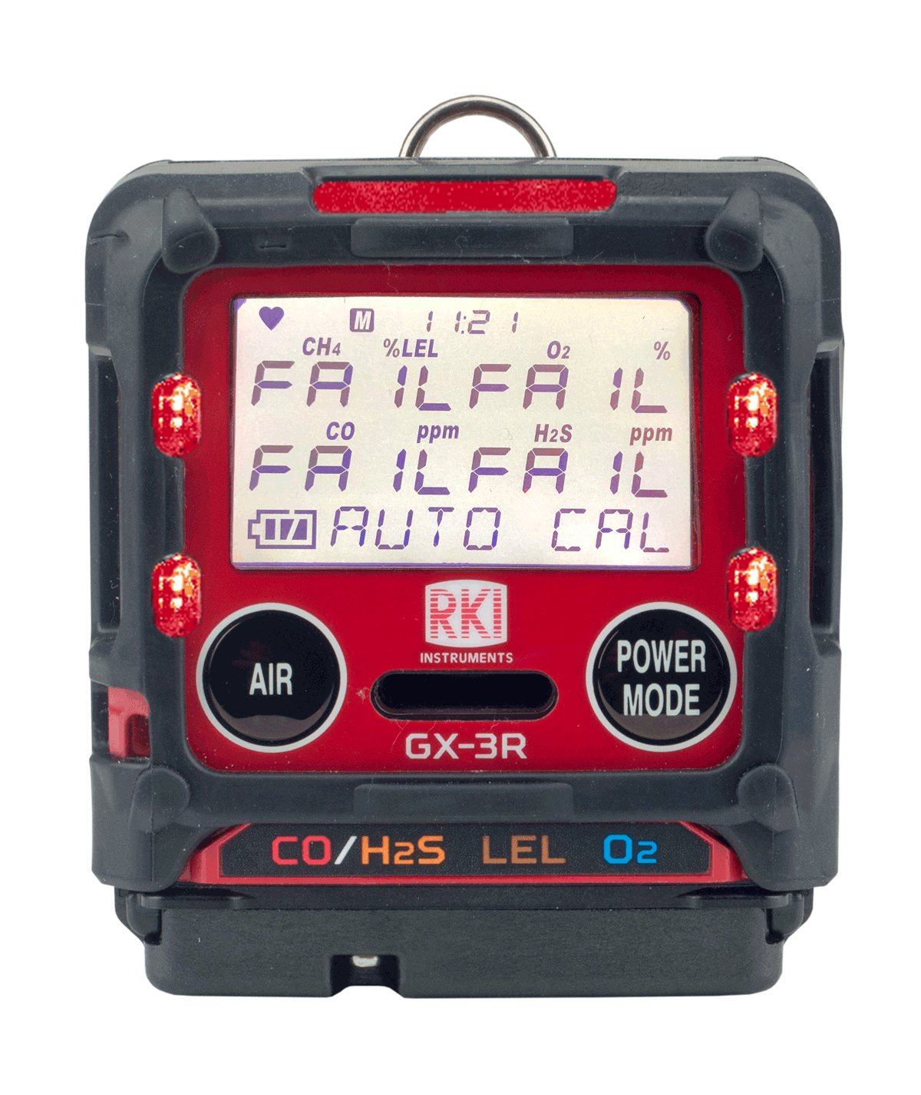
Calibration
  If the calibration is successful, the unit will read “PASS”
  If the calibration is unsuccessful, the unit will read “FAIL”
Note that the fail message gives status for each sensor

Slide 21
Calibration
AUTO CAL pass
  Remove the calibration adapter
  The unit will read “PASS,” then go through its start up sequence and enter measurement mode, ready for use
AUTO CAL fail
  The unit will read “FAIL” and return to the AUTO CAL menu in User Mode
  NOTE: In the “CAL EXPD” User Mode menu item, you can set the instrument to “CANT USE” to prevent the end user from continuing without calibration

Slide 22
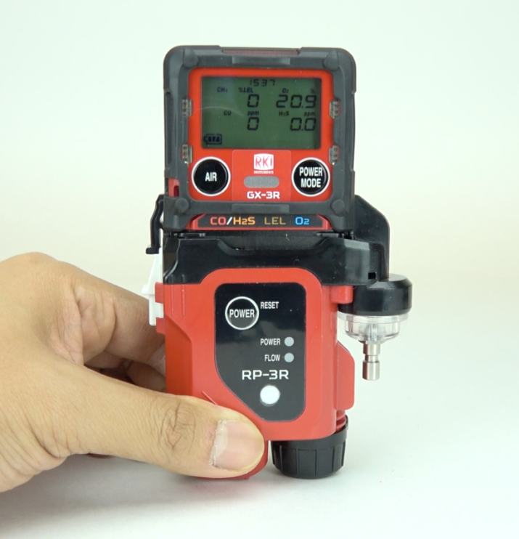
RP-3R Attachable Pump

Slide 23
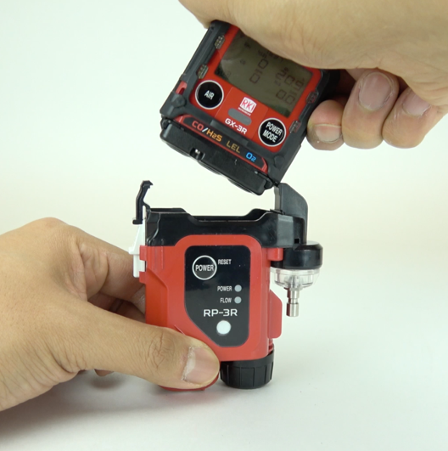

RP-3R Pump
Place the GX-3R right bottom first (as illustrated above) and then seat the left side until the clip latches.

Slide 24
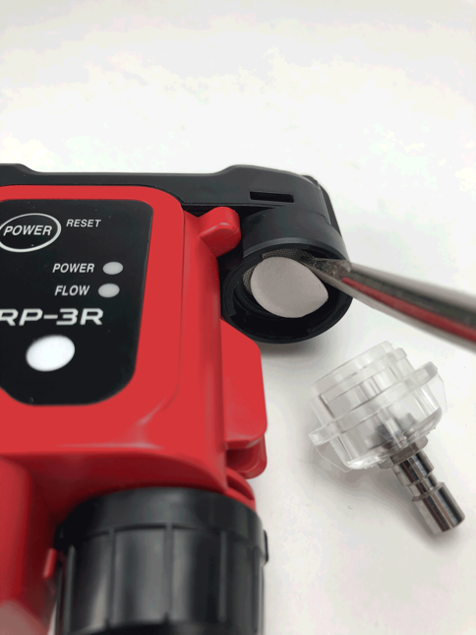
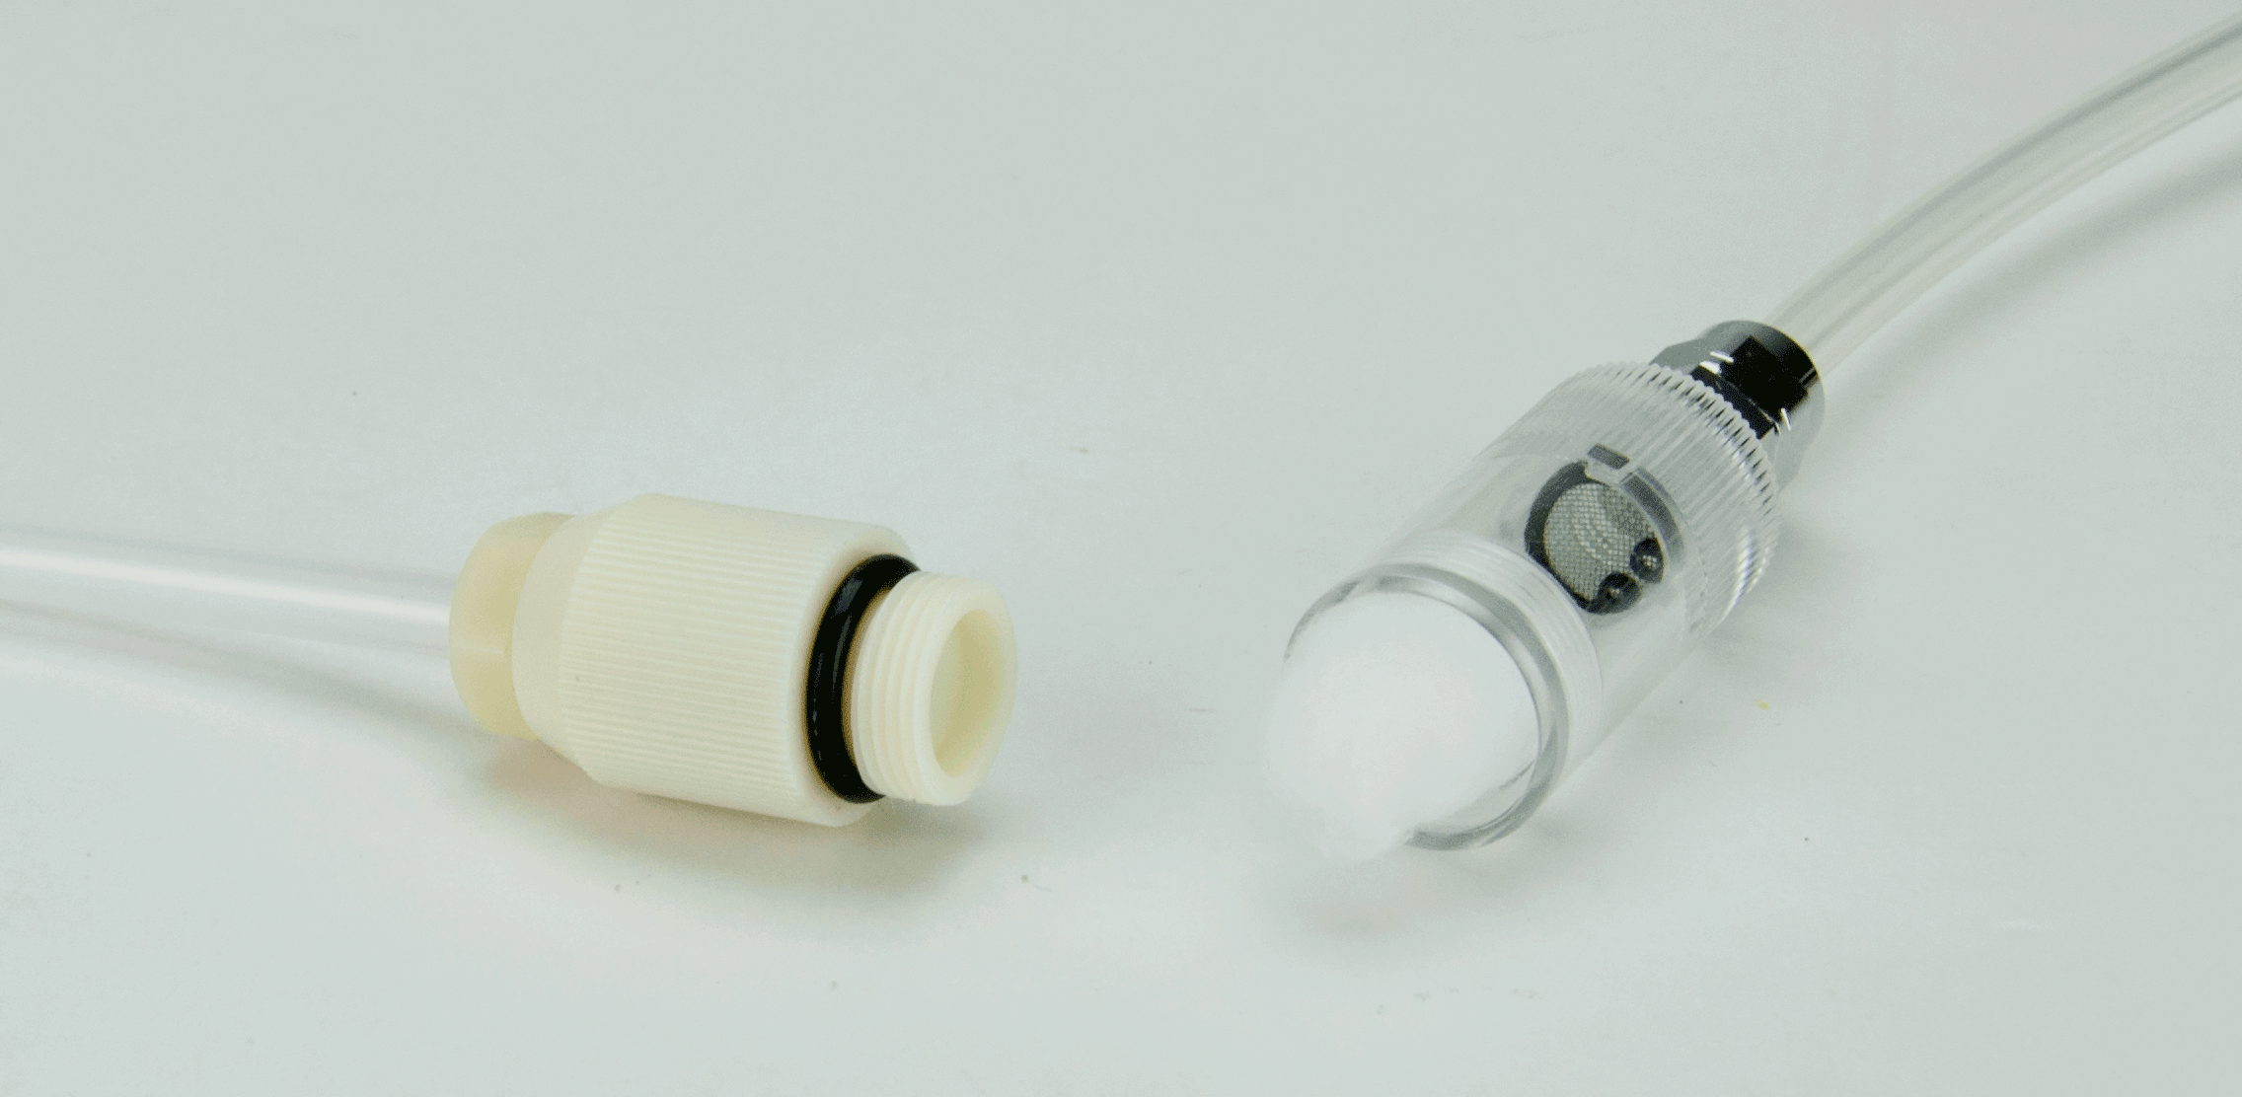
RP-3R Pump
The inlet filter housing contains a hydrophobic filter
The attachable probe has a dust filter to ensure the quality of your samples

Slide 25
Turn off
Turn off the GX-3R by pressing and holding the POWER MODE button

Slide 26
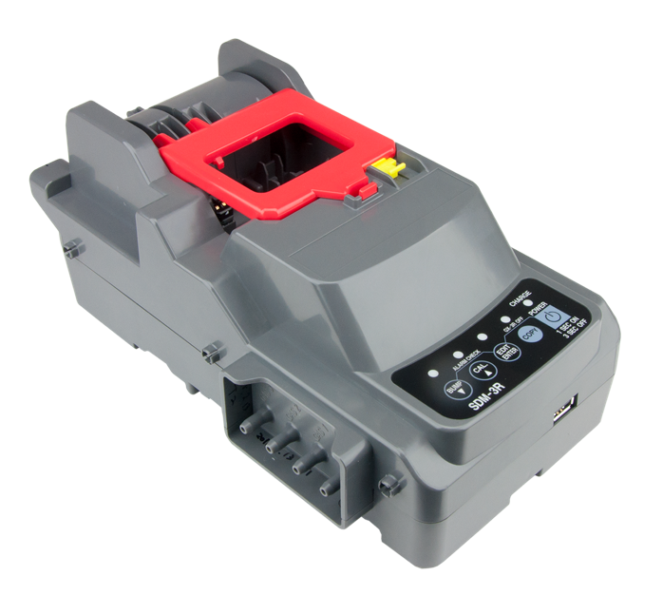
SDM-3R Calibration Station

Slide 27
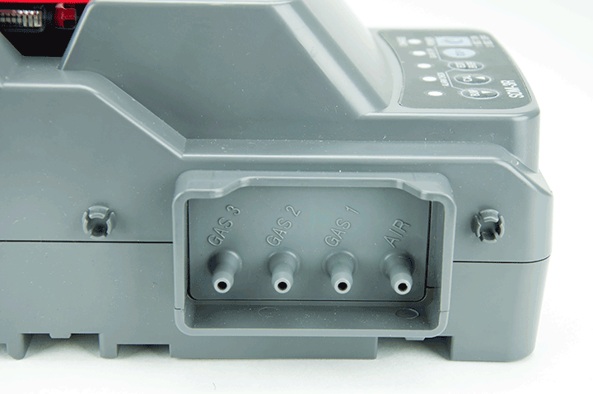
SDM-3R: Gas Ports
Gas 3
Not used
Gas 2:
Not used
Gas 1:
4 gas mix
Air port:
Dust Filter

Slide 28
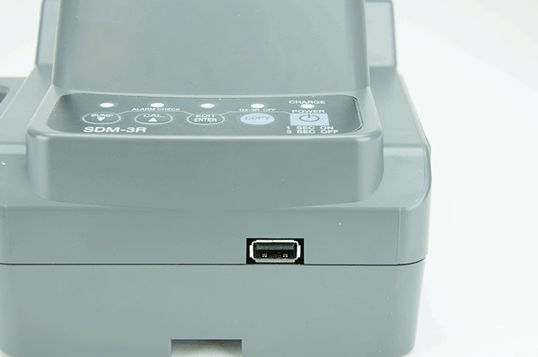
SDM-3R: USB port
USB port

Slide 29
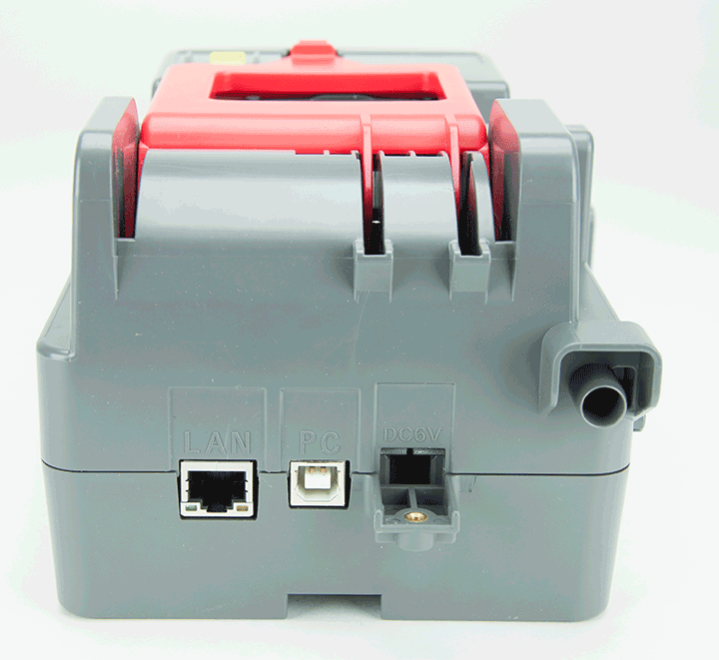
SDM-3R: Rear ports
Ethernet
PC Connection
AC power

Slide 30
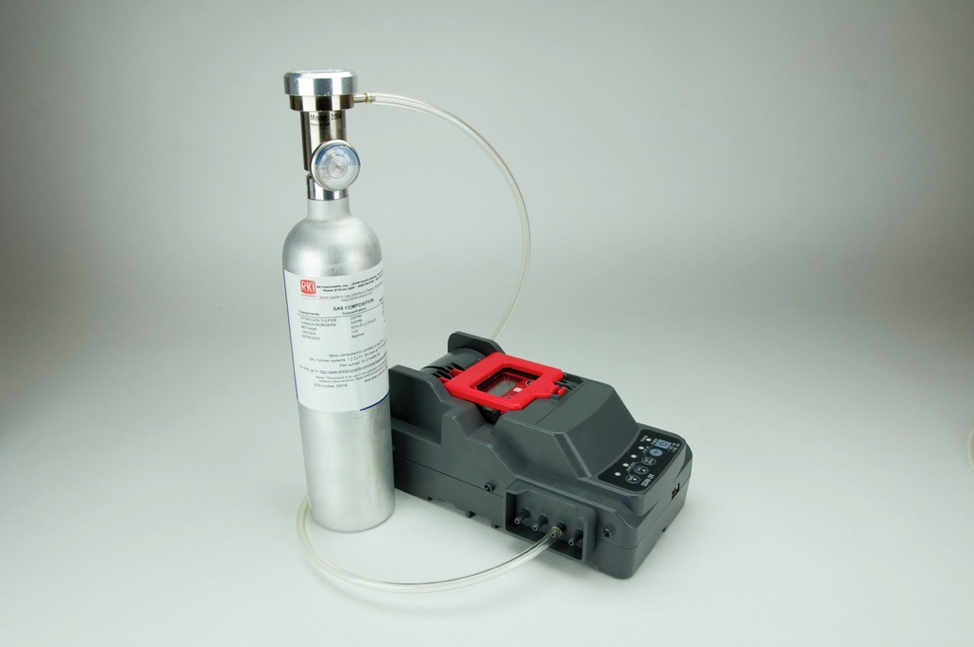
Connect Cylinder to SDM-3R
Connect a 4 gas mix cylinder into “Gas 1 “ port.
Make sure to use a demand flow regulator

Slide 31
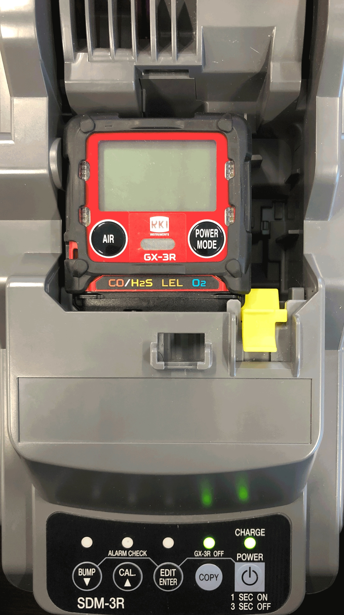
SDM-3R: GX-3R Placement
Plug in power adaptor and turn on the SDM-3R
Make sure the GX-3R is powered off before installing into the SDM-3R
When placing the GX-3R into the docking station, remember to have the yellow tab engaged upwards

Slide 32
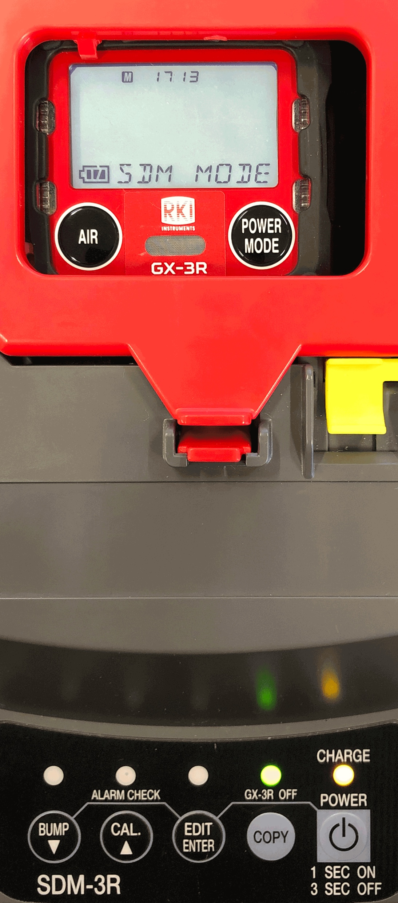
Turn on
Close the red door completely, the GX-3R will turn on automatically
When the GX-3R is connected to the SDM-3R, the GX-3R’s date and time are automatically updated to the SDM-3R’s current time and date
If an automatic test is set up to occur, it will start as soon as the GX-3R is connected to the SDM-3R

Slide 33
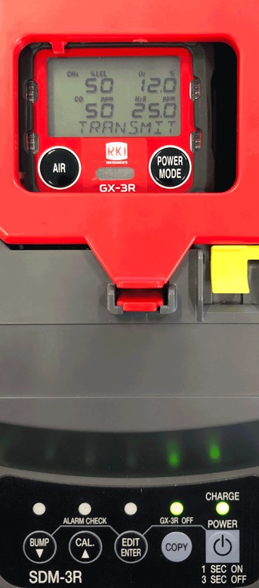
Bump Test
Press the BUMP button to start bump test
Note: Verify that the appropriate calibration gas cylinder is connected to the gas 1 fitting on the left side of the SDM-3R

Slide 34
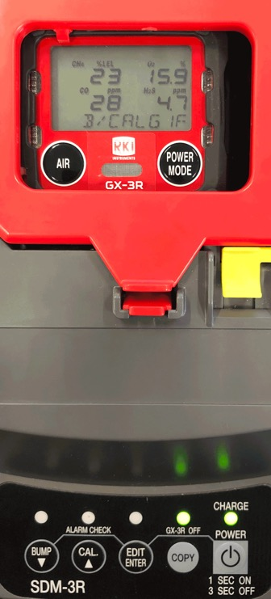
Bump Test
During the bump test, the GX-3R’s screen will display the current gas readings

Slide 35
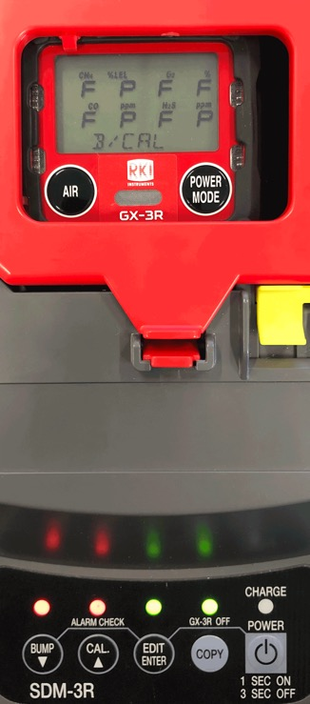
Bump Test
Once a bump test is complete, the LCD screen will alternate between the gas concentration and pass/fail status (shown as P or F on screen) for each sensor.
The “BUMP” LED light on the SDM-3R will be green when a bump test passes.
The GX-3R will shut off automatically after successful bump test.

Slide 36
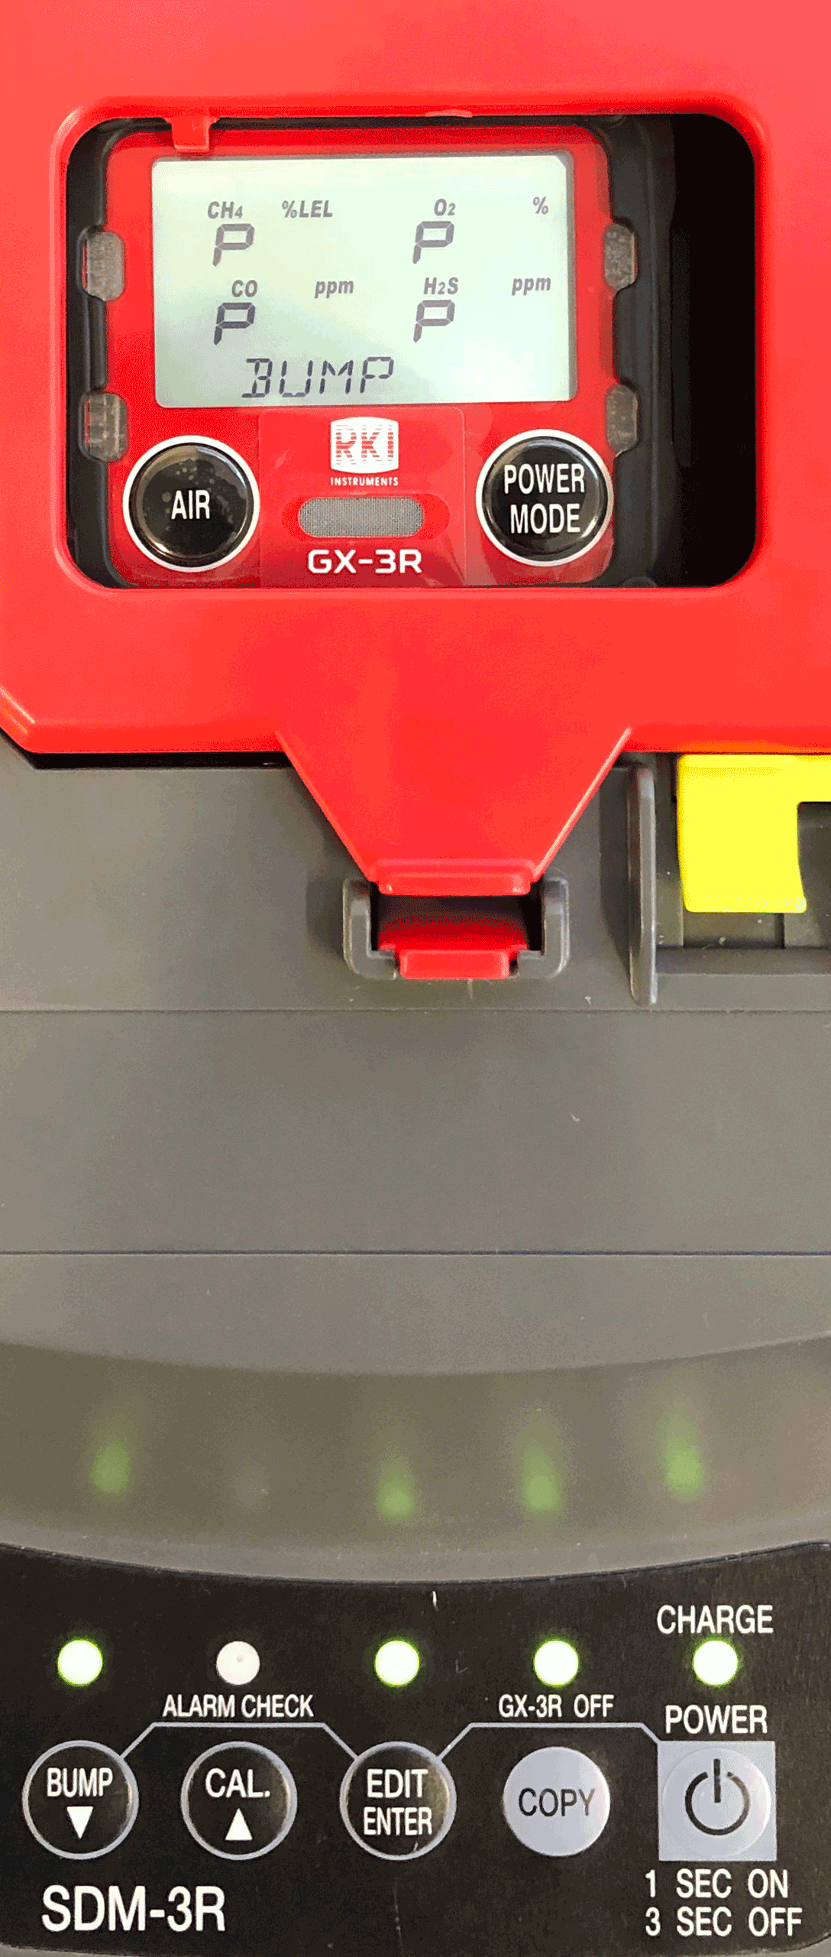
Bump Test
If the bump test fails, ”BUMP” LED light is red. The SDM-3R will then automatically perform a calibration
The LCD screen will alternate between the gas concentration and pass/fail status (shown as P or F on screen) for each sensor for both bump test and calibration
If calibration is successful, the GX-3R will automatically power off

Slide 37

Calibration
Press the CAL button until you hear the pump to start calibration
Make sure calibration gas concentrations match values shown on display

Slide 38
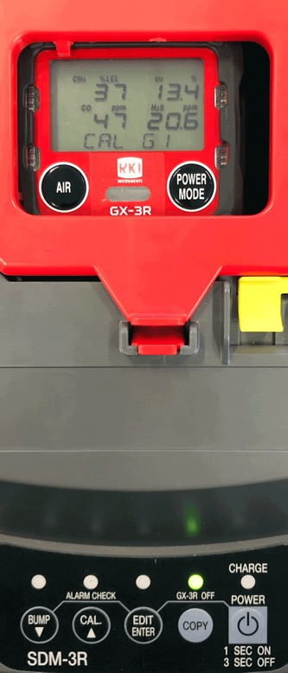
Calibration
During calibration, the display shows current gas readings.
Calibration will take approximately 90 seconds.

Slide 39
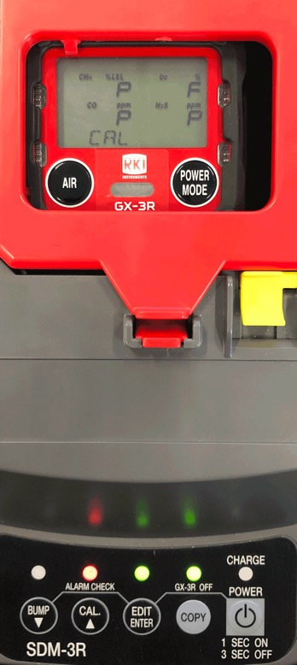
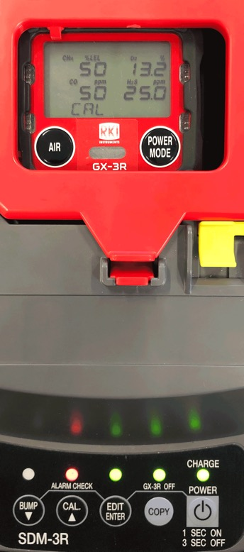
Calibration
Once calibration is complete, the LCD screen will alternate between the gas concentration and the letter “P” for pass or an “F” for fail for each sensor
The “CAL” LED light on the SDM-3R will be green when calibration is passed
“CAL” LED light is red if there if a failure. The GX-3R will power off after a successful calibration

Slide 40
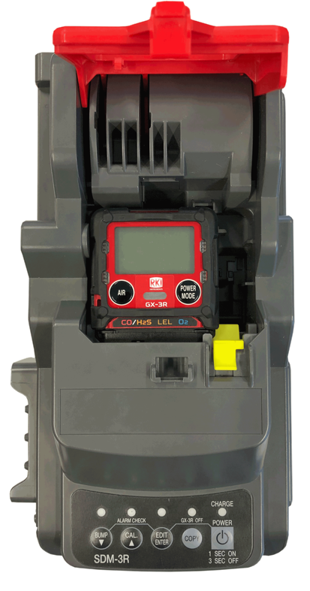
Removing from SDM-3R
Release the tab on the red door
Remove the GX-3R

Slide 41
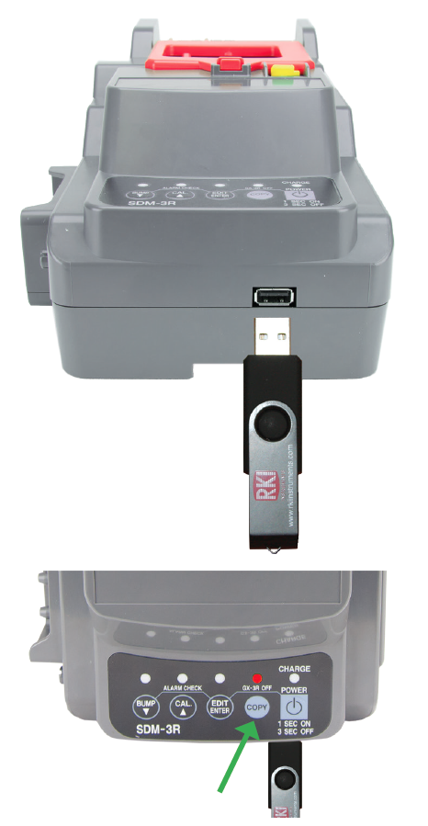
Data Transfer
Insert a USB flash drive with unit powered on.
To download the calibration and bump test data, press and hold COPY until the COPY LED is solid red, then release.
To download stored data from the gas monitor, keep pressing the COPY button until LED is flashing orange.
The USB flash drive can be removed when the COPY LED flashes green

Slide 42
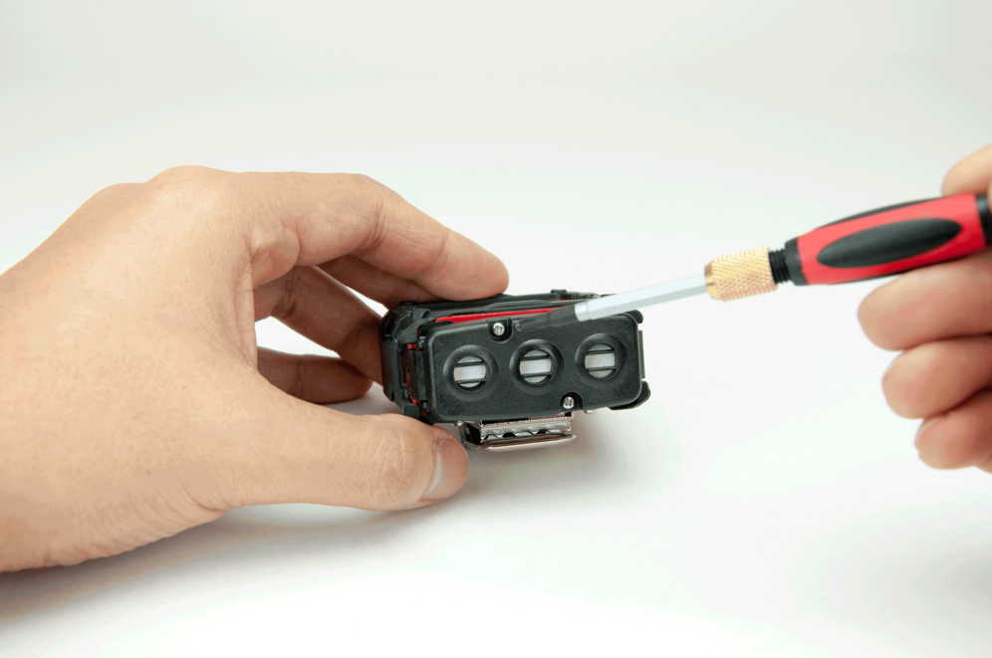
Sensor/Filter replacement
Unscrew the captive screws on the GX-3R.

Slide 43
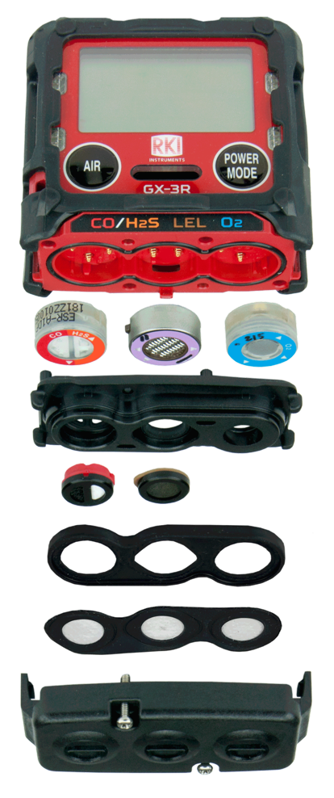
Sensor/Filter replacement
H2S/CO:
ESR-A1DP
O2 Sensor:
ESR-X13P
Scrubber Disk Filter for H2S/CO:
33-7130 (5 pk)
LEL Sensor:
NCR-6309
Scrubber Disk Filter for LEL:
33-7131 (5 pk)
Sensor Dust Filter:
33-0181-10 (10 pk)

Slide 44

Questions?

Slide 45


