Slide 1


Guardhat + RKI
Prepared for RKI Sales Kickoff
December 2021
CONFIDENTIAL AND PROPRIETARY. ANY USE OF THIS MATERIAL WITHOUT SPECIFIC PERMISSION OF GUARDHAT IS STRICTLY PROHIBITED
Notes:
IIoT to IIoP

Slide 3
Agenda
Guardhat – an introduction
Offering & pricing
Demo
Positioning & competitive environment
Bonus: RKI input from the field + battle card build out

Slide 4

The mission
Guardhat exists to align safety and success for industrial workforces, so companies can advance by putting their workers first.​
We build people-centric technologies that connect and protect frontline workers​, so companies can drive growth and expand their impact and legacy.​
No company can do this alone. Creating at best ecosystem of partners is core to our mission. RKI knows gas detection. Together, we can help create a more secure, more confident and more productive workforce.​

Slide 5


The issues
Our workforce is largely invisible to us
Their work conditions are too frequently unknown and dangerous
Communications are unreliable and inefficient
Data on worker safety goes uncaptured and unused

Slide 6
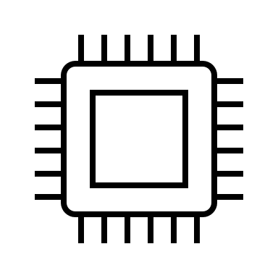


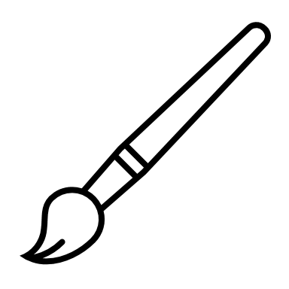



Infrastructure
Operating System, Hardware, iCloud
Apps & Services
Native
3rd Party
Devices
Computer
iPad
iPhone
Watch
TV
Apple® Ecosystem
A better way to connect

Slide 7
Industrial roadblocks
Connectivity is a luxury with less than
45%
of producers reporting they can accurately track operational connections and data flow
Less than
1%
of unstructured IIoT data is analyzed or used
Extreme environments require
rugged
technology
VC investment in industrial technology is just catching up, increasing
9x
in the last 10 years
Metrics are selected on the availability of data, prioritizing machines
over people
62%
of US workers have concerns about employer’s use of
tracking data
Accenture, Dealroom, HBR, LNS
7
Notes:
Saikat
Connectivity is a luxury – LNS data (2020) - https://www.ptc.com/-/media/Files/PDFs/IoT/LNS-Plant-Data-Connectivity-WP.pdf
Privacy – Accenture data (2019) https://newsroom.accenture.com/news/more-responsible-use-of-workforce-data-required-to-strengthen-employee-trust-and-unlock-growth-according-to-accenture-report.htm
VC investment – https://blog.dealroom.co/industrial-innovation-the-next-big-opportunity-in-tech/
Unstructured data – HBR - https://news-blogs.cisco.com/datacenter/internet-of-things-iot-data-continues-to-explode-exponentially-who-is-using-that-data-and-how

Slide 8

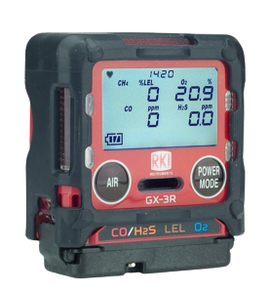
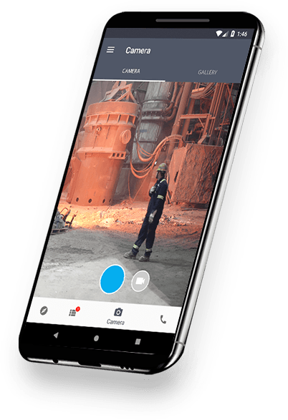
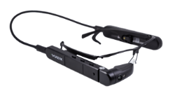
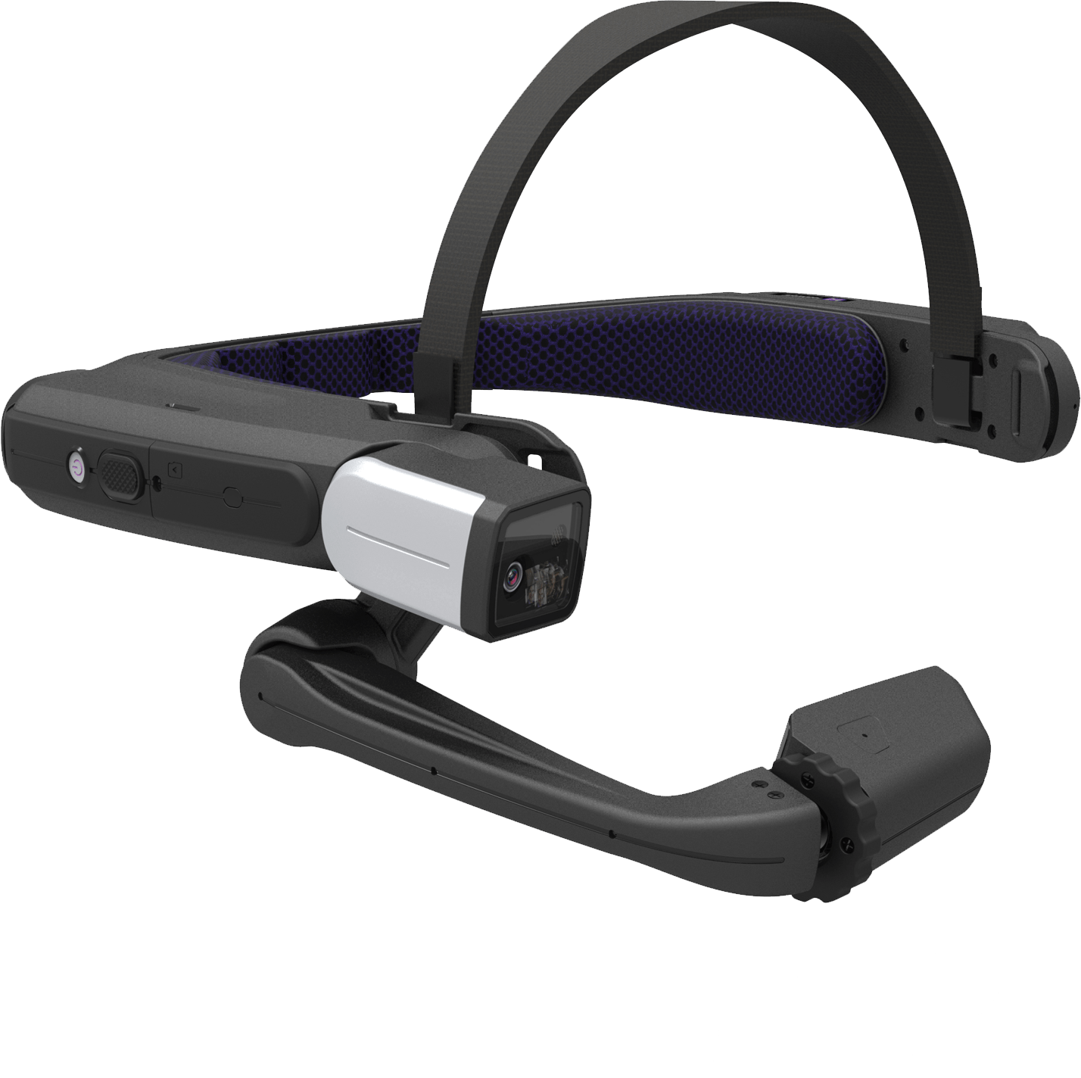
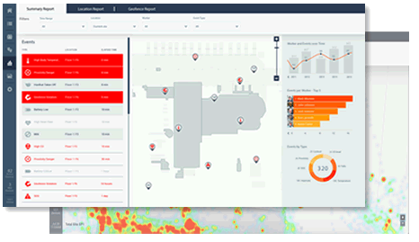
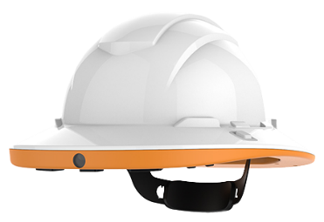
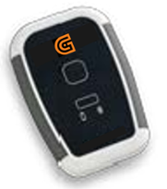
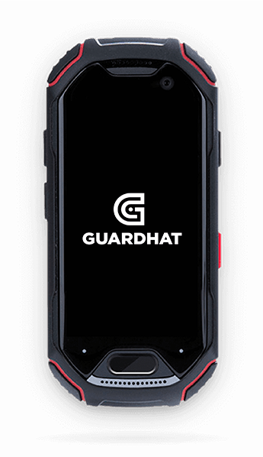
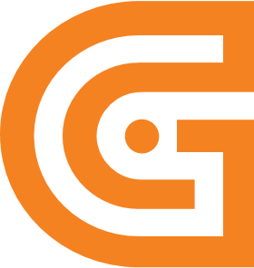


Guardhat Platform
Software platform, Hardware infrastructure, Integrations
Solutions
Lone Worker (LW)
Worker Condition Monitoring (WCM)
Control Access Zoning (CAZ)
Collision Avoidance (CA)
Time & Attendance (TMAT)
Remote Expert (REX)
Devices
Connected hardhat
Smart tags
Smart glasses
Smart, bio-tracking bands
Phone
Dosimeters
Gas detectors
All intrinsically safe
With more to come…
A better way to connect

Slide 9
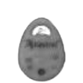
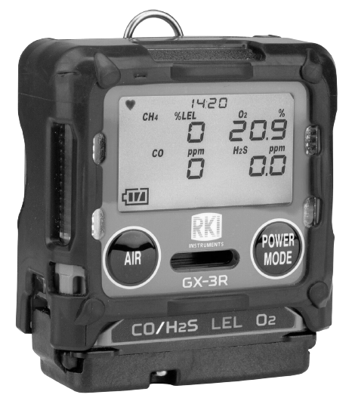
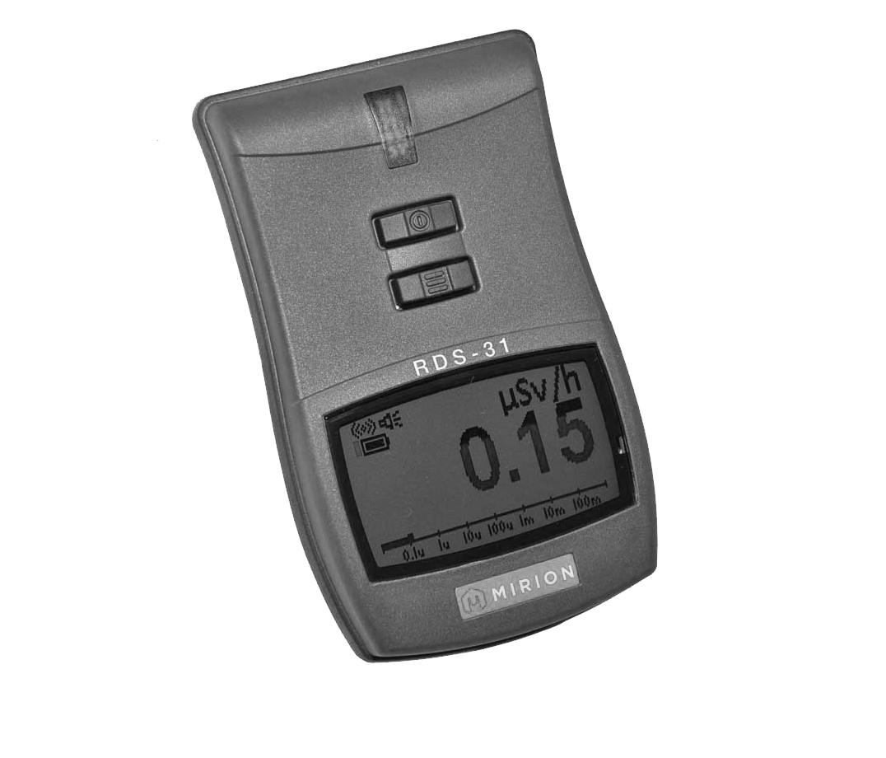










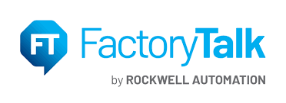













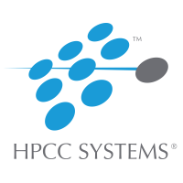

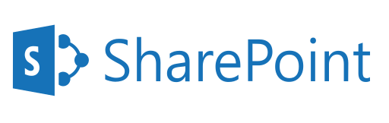








An expanding ecosystem
Gas Sensors
Biometric / Physiology
Dosimeters
Smart Glasses ;
Devices
Operational Technology (OT)
Breathalyzers
Face Recognition
Temperature Scans
Temperature
APIs | SDKs | 200+ standard protocols
Pressure/Humidity
Location
Noise
Fall Detection
Legacy Enterprise Systems
New & Emerging Technology
9

Slide 10
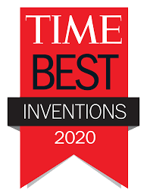




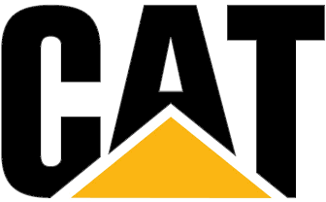

Why Guardhat
Built by practitioners
Deep experience across steel, mining, reﬁning & energy
Co-designed with the UAW for privacy
12 patents & trademarks, +3 pending
Interoperable from the outset
Integration-ready with enterprise and operations platforms; pre-built integrations available
Rich support for devices and protocols
Flexible deployment options – edge, on premises, cloud or hybrid
Built from the ground-up for analytics and AI
Recognized as the best
Backed by 3M, Bedrock, Caterpillar, General Catalyst, Sallyport+
Bought by Ortec, Total, Westinghouse, West Fraser +
Awarded Best Invention of 2020 by TIME magazine, 2020 Global Connected Safety Company of the year by Frost & Sullivan, and 2021 Product of the Year by OH&S magazine
Notes:
Saikat

Slide 11
Impact of Guardhat
Human & asset safety
Productivity
Cost savings & capital generation
Information to seed innovation

Slide 12
Offering & Pricing
Notes:
https://guardhat.sharepoint.com/:p:/s/ProductManagement/Ed4y0_18rLREnpVY_Yn9w6ABbb0runno0jpJDmR3x_CoMg?e=nIeJau

Slide 13
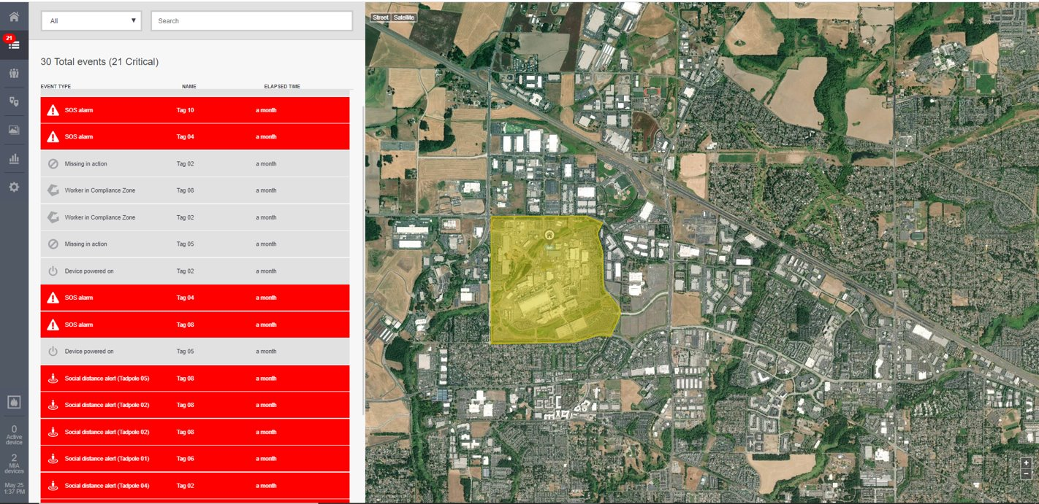
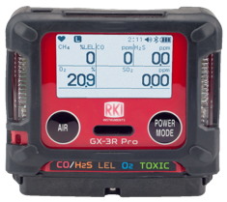
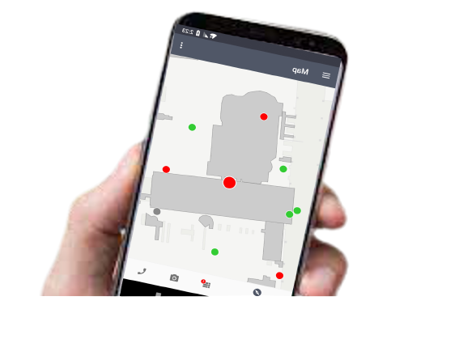
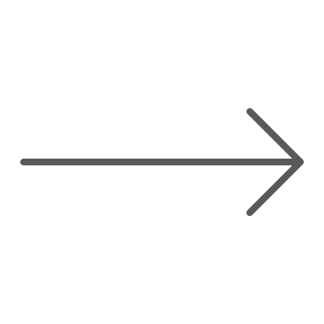

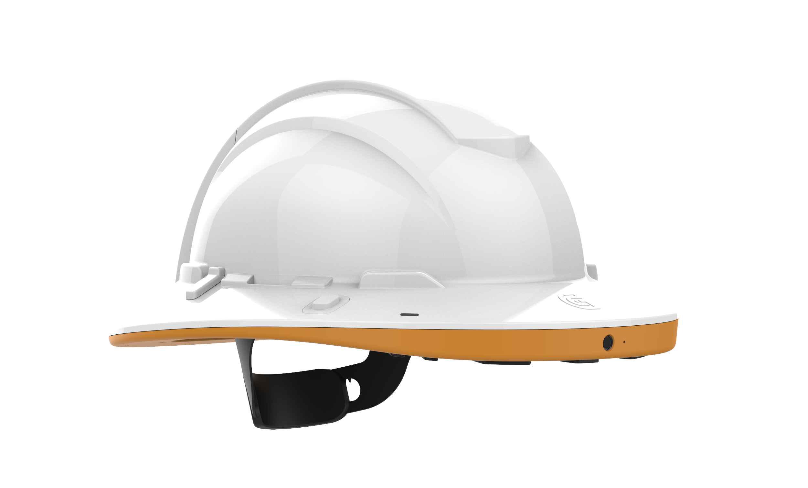
The offering
A connected gas detection solution integrated with a scalable connected worker platform
    Enables maintenance records, user compliance tracking, and alarm data management
    Easy to deploy, SaaS model
    Position against MSA, ISC, Honeywell and Blackline
Safety Compliance Solution
Guardhat Platform &
App on
worker’s phone
RKI GX-3R Pro
Productivity Solution
Guardhat Platform & Communicator smart hardhat or App
RKI GX-3R Pro
Today – Demo and kickoff with RKI sales
Q1 2022 – Guardhat Platform 2.0 with new UX & Lone Worker Use Case
2 weeks – Share/create sales enablement materials
45 days – Guardhat App Beta available for gas detection
Q2 2022
iOS App

Slide 14

Features & pricing
Features | Annual subscription packages per worker
 | Safety Compliance LIST PRICE - $360 | Productivity LIST PRICE - $1,080
Live web-based monitoring: Shows current gas readings, alarms, geographic location, instrument compliance, and history for all subscribed users
Communication (Safety Monitoring Center): Accessible by computer, tablet, or phone​ Email, SMS, and text to speech​ Ability to notify near-by users of gas alarms​
Analytics: Ability to analyze bump, calibration, and alarm history for compliance and maintenance per user or instrument.​
Geofencing: Warning of restricted areas, including on-demand incident geofencing​
Heatmapping: Historical graphical heat map data of gas readings​
Flexible deployment: Option to provide Cloud-base server or customer-hosted server solution​
Unlimited Push-to-Talk​
Audio & Video Communication​
Media Library (upload pictures or videos to cloud)​
Walk path reporting: bread crumb tracking of user​

Slide 15



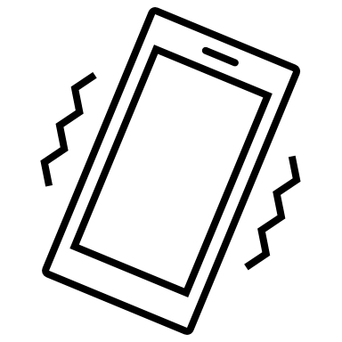


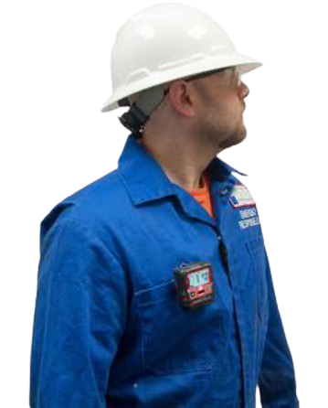
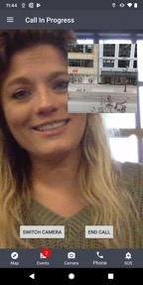
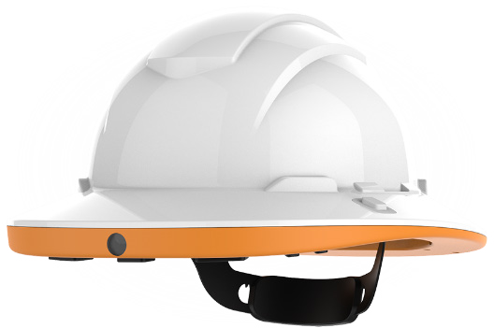

4
Notifications
How it works
3
Guardhat Platform
2
Email, SMS, WhatsApp, Phone Calls
Cellular/Wifi
Internet / Intranet
Frontline worker wearing GX-3R Pro & Guardhat device
Client’s Safety Operating Center - Guardhat SCC
1
4
BLE
Guardhat App on
worker’s phone
Unified gas sensor analytics
Guardhat Communicator smart hardhat
BLE

Slide 16
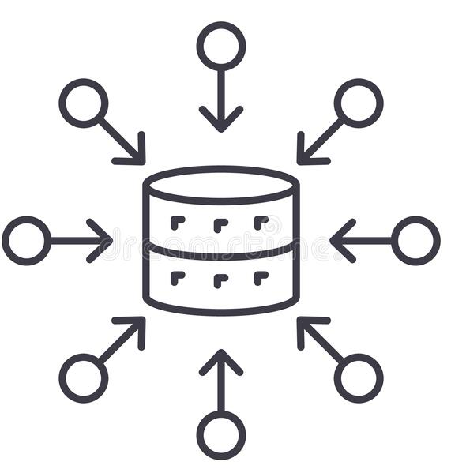



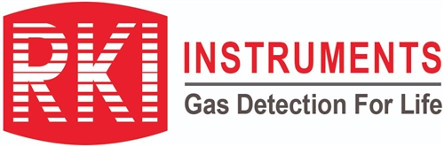
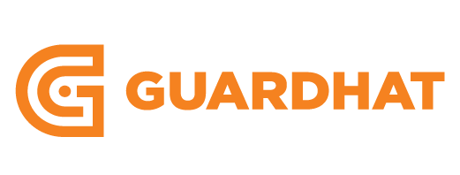
How it works
1. DETECT
2. AGGREGATE
3. ANALYZE
4. COMMUNICATE
Detect presence of gas
Send via BLE to Guardhat app or wearable
Contextualize sensor data with location, alarms, and pertinent worker info.
Sensor analytics
Calibration compliance
Send bump test reminders
Send an alert via multiple paths – Email, SMS and WhatsApp, etc.
Notify via centralized server, e.g. Safety Monitoring Center

Slide 17
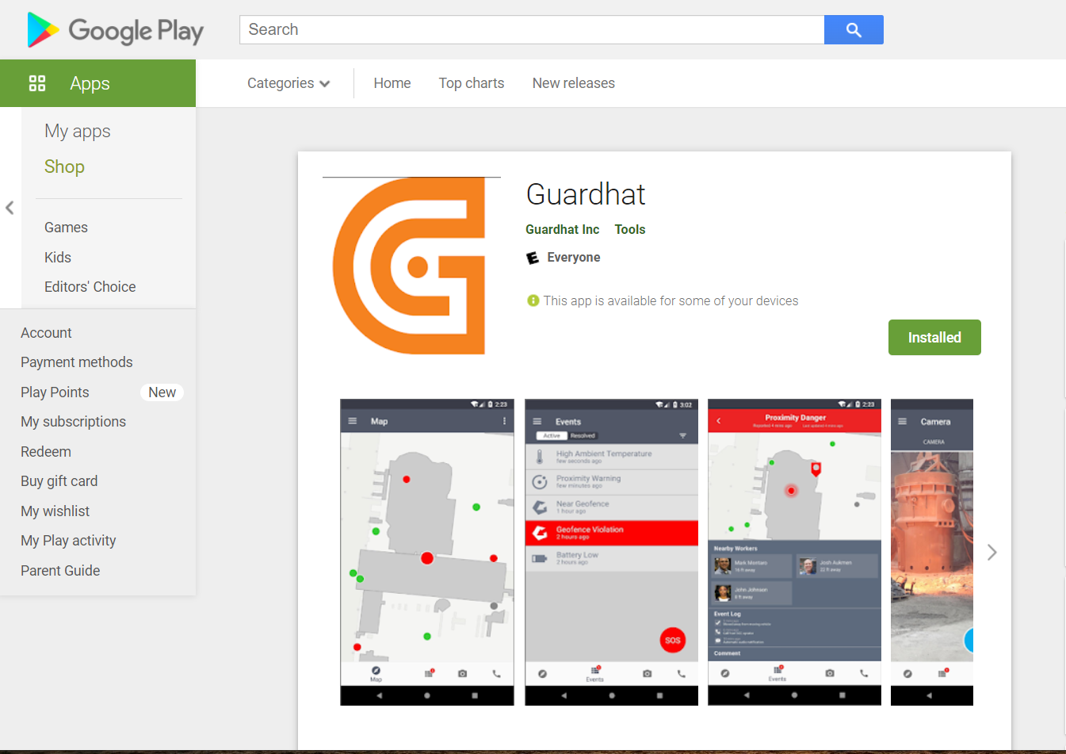

App comparison
RKI Link App
Guardhat App
RK Link App is a companion* app
Device <-> RK Link App <-> Email notification
Configure alarms & parameters of GX-3R Pro
Displays all readings in app
Ability to configure email alerts and create groups
No backend platform to show all connected gas detectors
Can only pair with 1 GX-3R Pro device
Acts as gateway to transmit data to Guardhat Platform
Ability to have audio & video communication
Built-in fall detection
Built-in SOS button
Access to media gallery
Configuration of alerts on backend platform
Ability to connect multiple wearables
Receive event-based alerts
Push-to talk (coming in Q1 2022)
*Please work with the Guardhat product team if any feature of RKI Link App needs to be built in the Guardhat App

Slide 18
DEMO
Safety Compliance Solution

Slide 19
Positioning & Competition

Slide 20
RKI + Guardhat solutions serve the needs of over a quarter of the Connected Worker market
Connected Worker Market Forecast By Use Case 2020-2026
4,237
TOTAL CAGR
Logistics
14.4%
12.7%
14.3%
14.6%
12.4%
13.6%
15.3%
3,714
Vital Signs Monitoring
3,258
Motion Monitoring &
Ergonomics
2,870
2,535
Remote Assistance
2,215
Environmental
Hazard Monitoring
Lone Worker
Monitoring
Operational Insights &
Work Instructions
2021
2022
2023
2024
2025
2026
Verdantix

Slide 21



RKI + Guardhat capabilities vs. the competition
Feature
Gas analytics
Location Awareness
Communication & Connectivity
Mass Notification
Access Control
Incident Management
Worker Safety Features
Interoperability
Key gas analytics features will be available in Q1 2022
Solution is significantly richer and more capable in terms of connectivity, communications, configurable real-time management and reporting
Only interoperable smart gas detection solution
Notes:
Competitive UI
https://guardhat.sharepoint.com/:p:/s/ProductManagement/Edv7Q5ihifJBvYIoLrAJzCMBPrx0EZTwR2gp-l3gIidGPw?e=c2QZ9z

Slide 22
The details + building the solution out
Feature
Gas analytics | Real-time readings w/ geolocation Bump test, calibration reporting & reminders* Compliance dashboard* Automatic, recurrent compliance reports* Fleet management* | Real-time readings w/ geolocation Bump test, calibration reporting & reminders Compliance dashboard Automatic, recurrent compliance reports Fleet management | Real-time readings w/ geolocation Bump test, calibration reporting & reminders Compliance dashboard Automatic, recurrent compliance reports Fleet management | Real-time readings w/ geolocation Bump test, calibration reporting & reminders Compliance dashboard Automatic, recurrent compliance reports Plume modeling Fleet management | Real-time readings w/ geolocation Bump test, calibration reporting & reminders Compliance dashboard Automatic, recurrent compliance reports Fleet management
Location Awareness | Submeter, full 3D GPS, UWB, Bluetooth, Satellite* | 3-meters, 2D GPS, Satellite (LIMITED) | 3-meters, 2D GPS, Bluetooth | 3-meters, 2D GPS | 3-meters, 2D GPS
Communication & Connectivity | Audio, Video, PTT, Channel & talk groups, Text-to-speech WIFI, LTE, IoT protocols*, BLE | Audio, PTT, Channel & talk groups (new feature, up to ~20) LTE, BLE | None LTE, BLE | None BLE | None BLE
Mass Notification | Mustering Mass evacuation Notification engine* | Mustering Mass evacuation Notification engine | Mustering Mass evacuation Notification engine | Notification engine | None
Access Control | Geofencing Offline geofencing Configurable geofencing | Geofencing Configurable geofencing (LIMITED) | Geofencing (LIMITED) Configurable geofencing (LIMITED) | Geofencing (LIMITED) | None
Incident Management | Automated workflow Customizable SOP* | Customizable SOP | None | None | None
Worker Safety Features | Fall detection Worker down/SOS Mobile hazard detection | Fall detection Worker down/SOS | None | None | None
Unique extras | Guardhat Platform capabilities Interoperability with 3rd party wearables and sensors | AI-powered gas clustering & leak detection | Performance scoring, benchmarking against other customers' data | Calibration & bump test forecasting High-risk area IDing Incident playback + data sharing with first responders | None
* Features on the Guardhat 2022 roadmap
Notes:
Lone Worker Remote Expert Collision Avoidance Worker Condition Monitoring (using biometrics sensor)
https://guardhat.sharepoint.com/:p:/s/ProductManagement/Edv7Q5ihifJBvYIoLrAJzCMBPrx0EZTwR2gp-l3gIidGPw?e=c2QZ9z

Slide 23

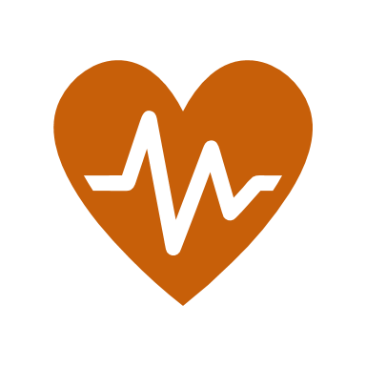


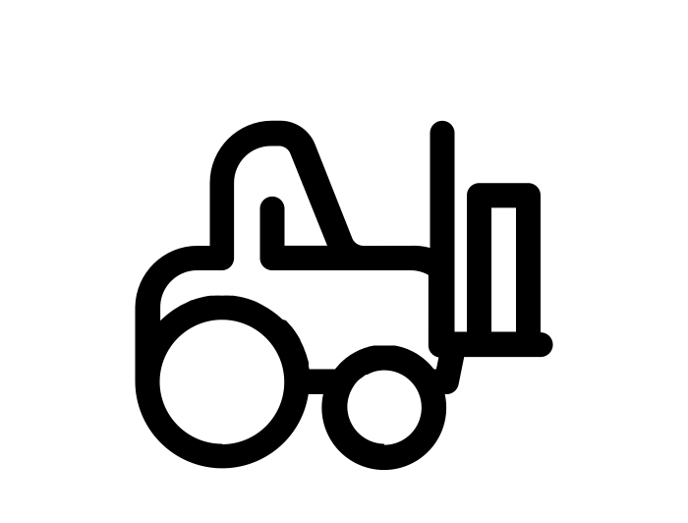



Guardhat Platform solutions
Lone Worker
Worker Condition Monitoring
Control Access Zoning
Collision Detection & Avoidance
Remote Expert
Time & Motion Studies
Know where your workers are in real-time
Stay in touch, via audio, visual, text-to-speech and check-in communications
Receive automated check-ins, fall detection, worker-down alerts
Access rich, configurable incident management
First industrial-grade solution for worker condition monitoring
Event-based alerts help prevent injury or even death from exposure to heat, gas, radiation, noise, over-exertion, or worker-specific health issues
Engineered, automated and configurable controls for zone access for dynamic industrial environments
Real-time and offline functionality keeps workers safe without standup meeting or physical cordoning
Allows for mobile zones around or under moving equipment
Protect people and equipment in real-time, across outdoor facilities, plants, distribution centers
Historical trend reports provide insights for facility, path, and workflow optimization and how to keep fleets and teams at peak operation
Connect your frontline team with experts from anywhere
Livestream and recorded content shared via optional head mounted or smart glasses displays
Understand work processes and trends to a new level of granularity to reduce bottle necks, direct needed training, improve security, and optimize supervisor to worker ratios
23
Notes:
Saikat

Slide 24
In the Field

Slide 25
Battle Card - template
Company snapshot
HQ: Founded: Employees: Revenue/Funding: Major Clients: Regions: Verticals:
Questions to ask
How to win
When to walk away
:
Product
Product 1: Name + One-liner description Comparable RKI+ Guardhat offering Product 2: Name + One-liner description Comparable RKI+ Guardhat offering
Competitor claims | How to address
Pricing
Licensing bundles: Option 1 Option 2 Services: Option 1 Option 2
Competitor weaknesses | How to address
Notes:
https://guardhat.atlassian.net/l/c/kr8YnSTh

Slide 26
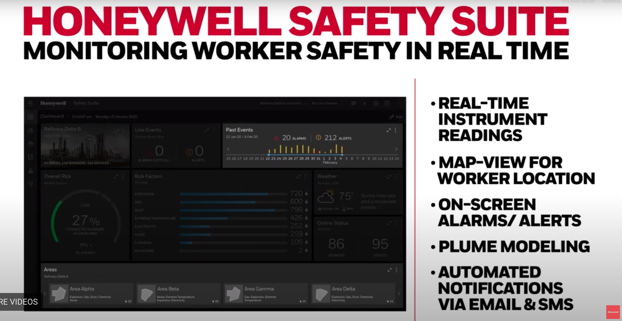
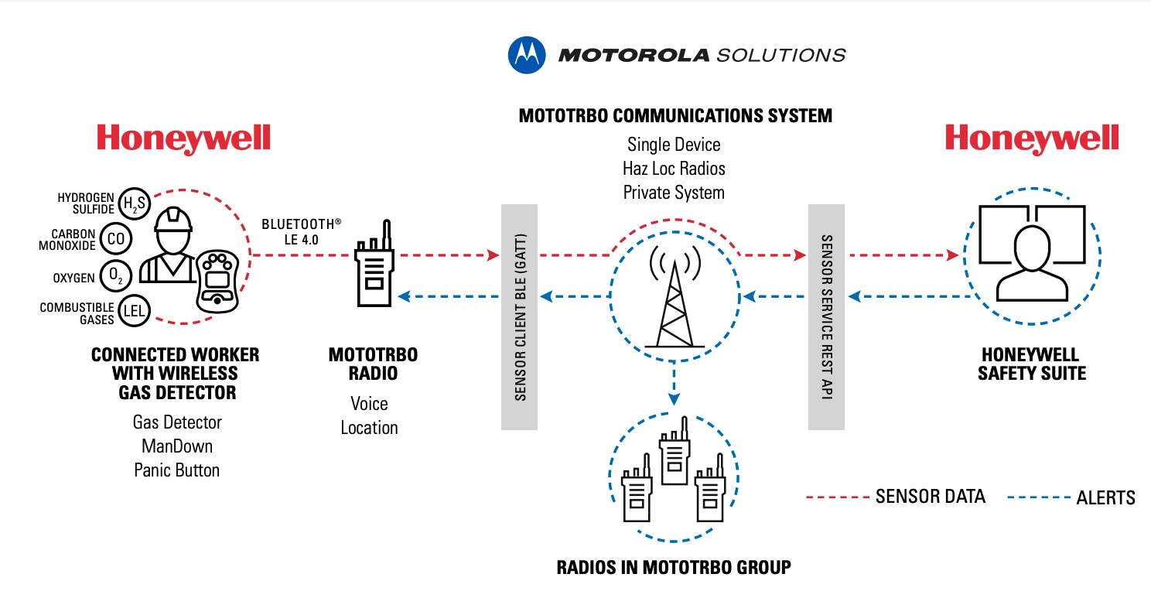
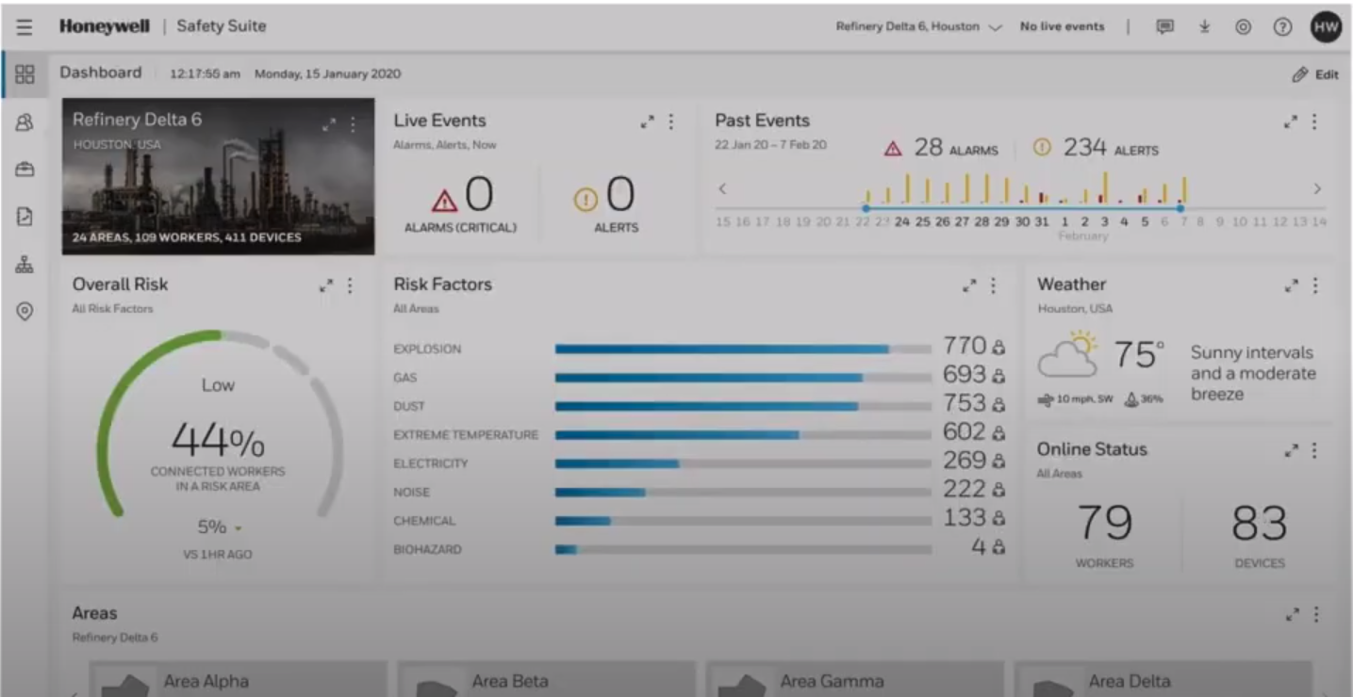
Competition - Honeywell

Slide 27
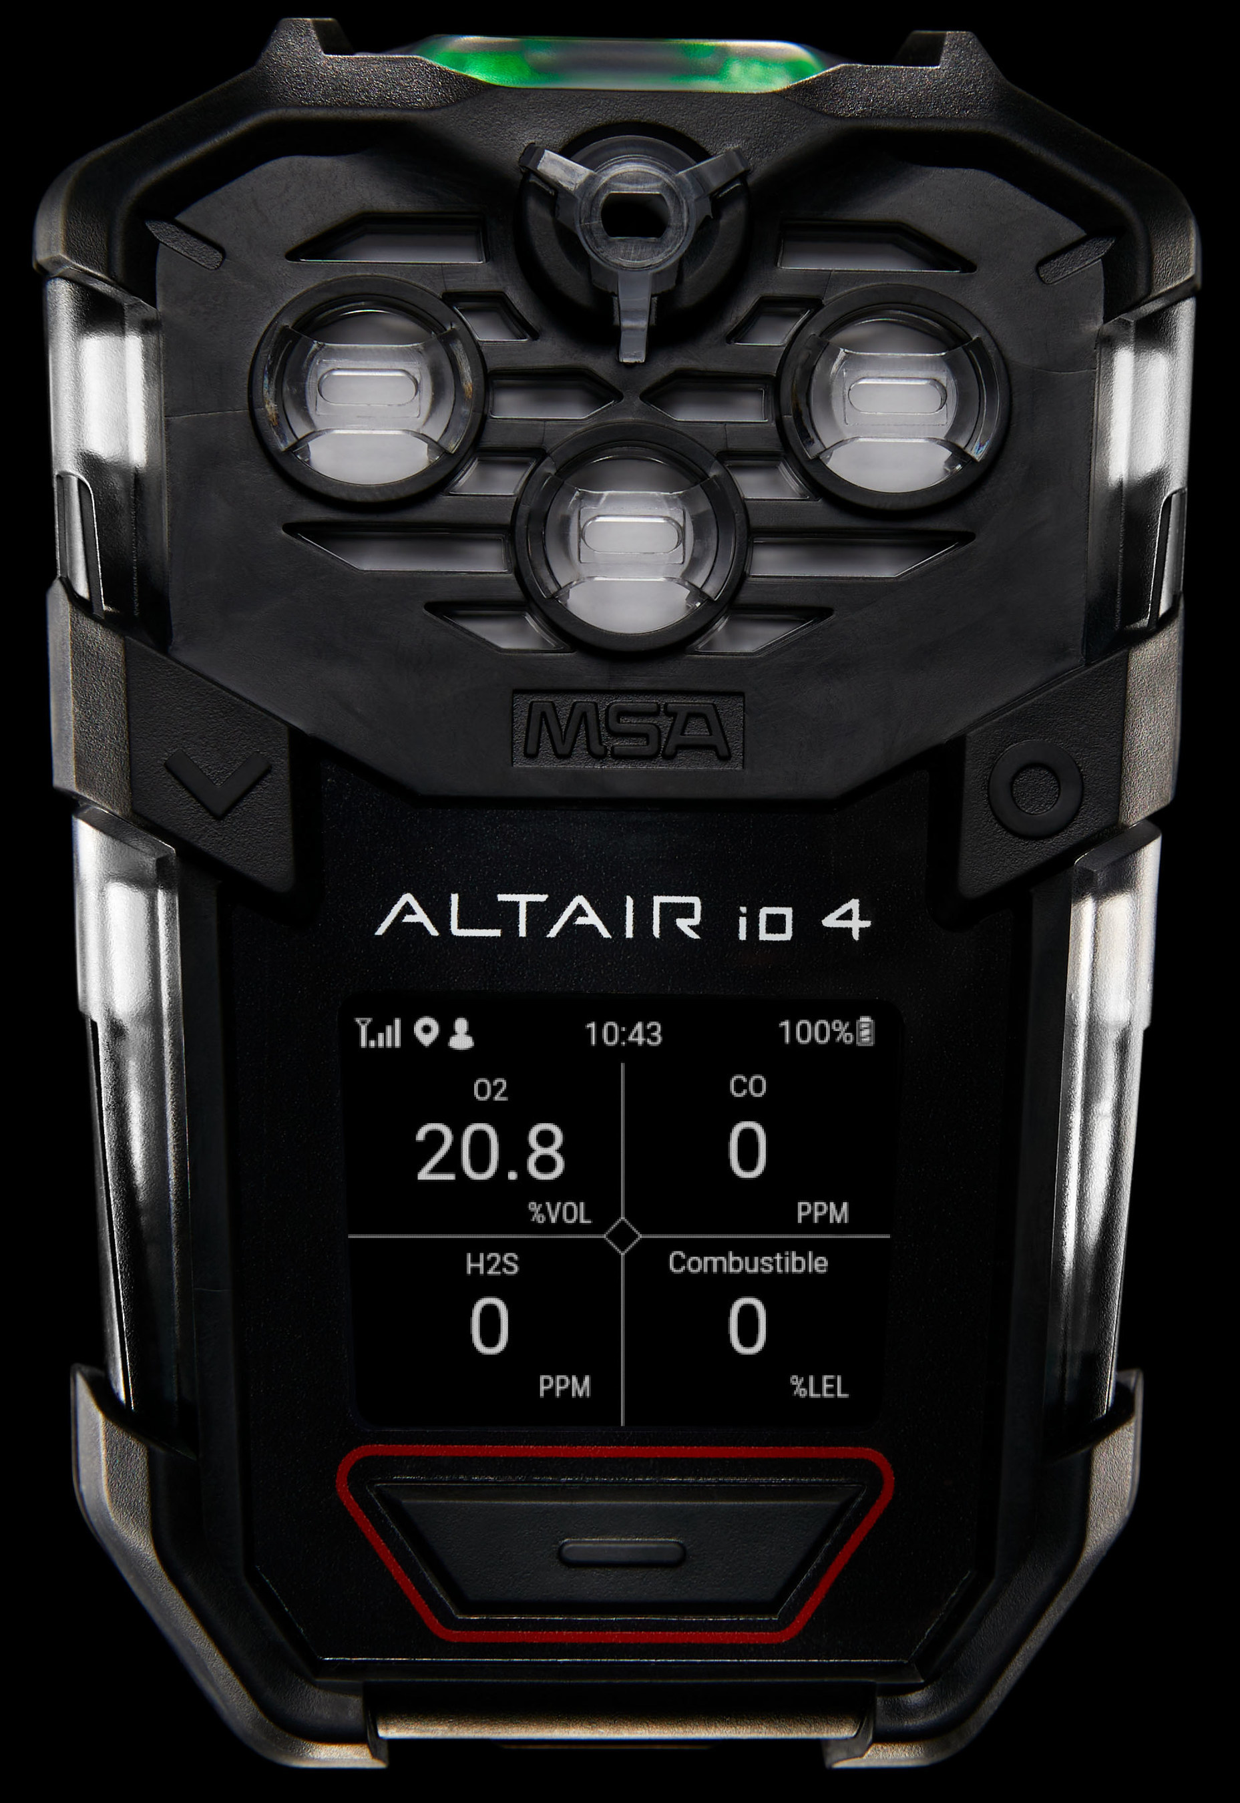
Competition - MSA
MSA+ Subscription Service and ALTAIR io™ 4
Out-of-the box global cellular connectivity and GPS location to transmit real-time data, like critical gas detection readings and location information, directly to the MSA Grid software platform;
Access to MSA's Grid software services that enable fleet management, as well as real-time remote monitoring and incident reporting;
A new, electronic MSA id™ device tag that replaces paper-based sign-out processes;
MSA's industry-leading XCell® Sensors; and
Compatibility with a new ALTAIR io Dock calibration test stand, enabling automatic bump testing, calibration and data logging.
ALTAIR io4 in the first half of 2022

Slide 28
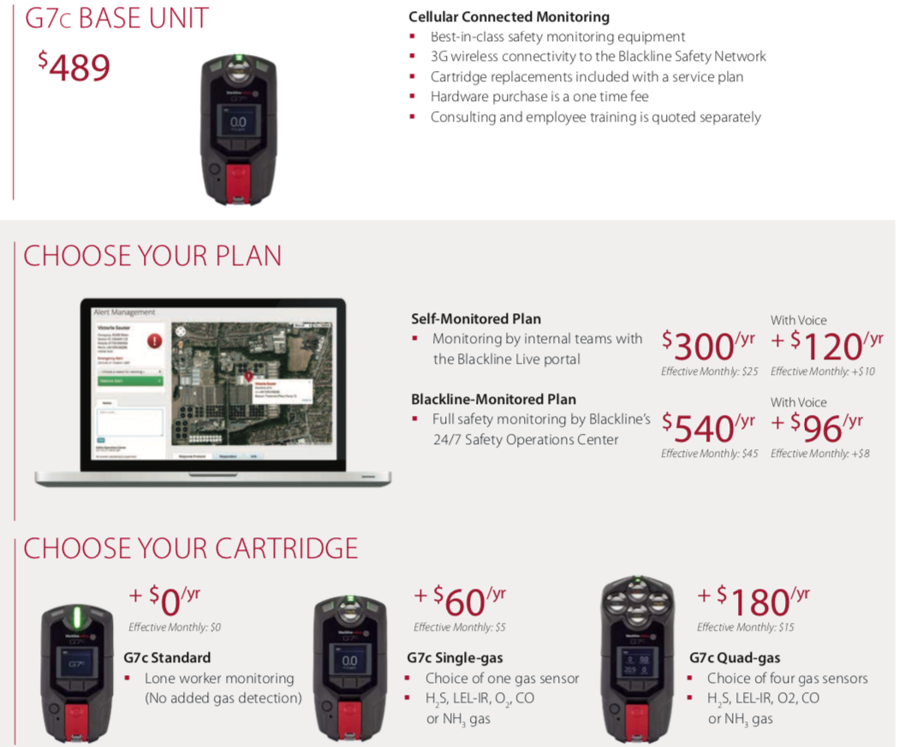
Competition – Blackline Safety

Slide 29
Disclaimer
The material in this document is proprietary and confidential. The material has been prepared by Guardhat Inc. (“Guardhat”), solely for your information and it may not be reproduced, re-transmitted or further distributed to any other person or entity, or published outside the intended recipient’s immediate organization—in whole or in part—for any other purpose, without express written consent from Guardhat.
Any product roadmap necessarily incorporates plans that may change, and hence any references to the roadmap and associated timeline projections should be treated as the point-in-time snapshot of a living artifact that is updated on a quarterly–basis.

