Slide 1
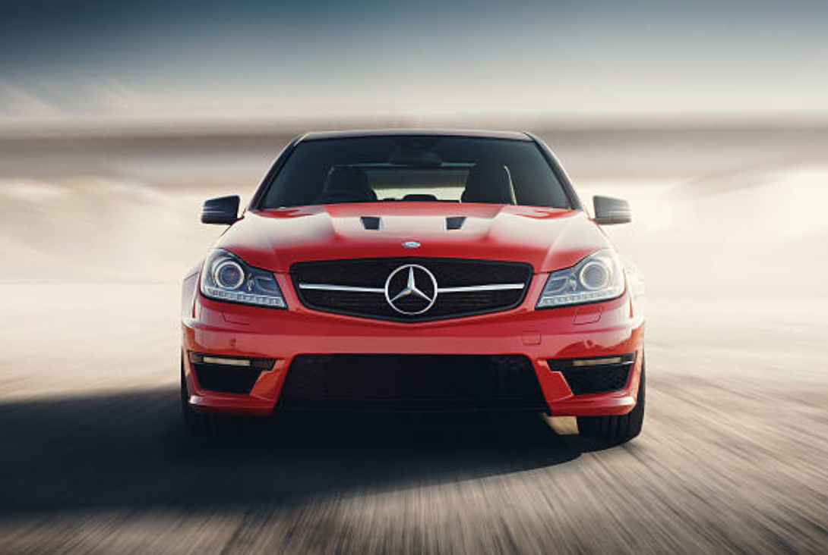
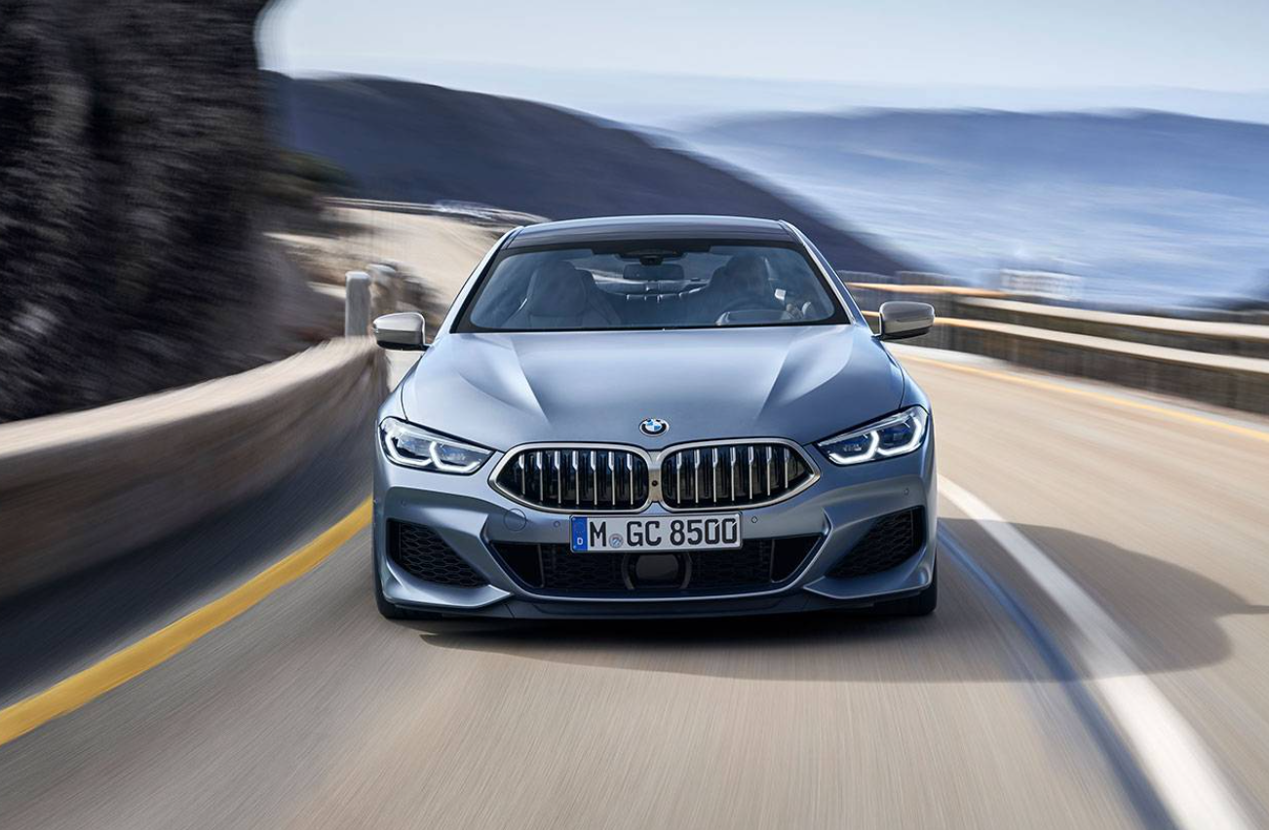
When to sell the Beacon 3200 and Otis master controller
Notes:
Mercedes and BMW cars are both great vehicles

Slide 2
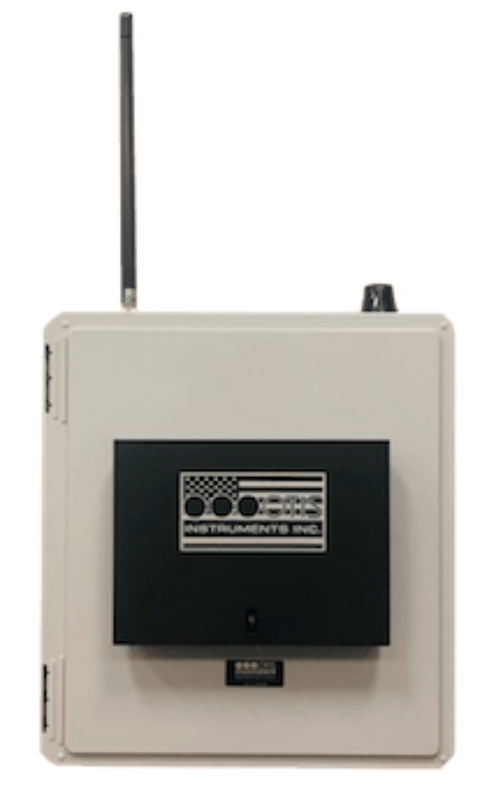
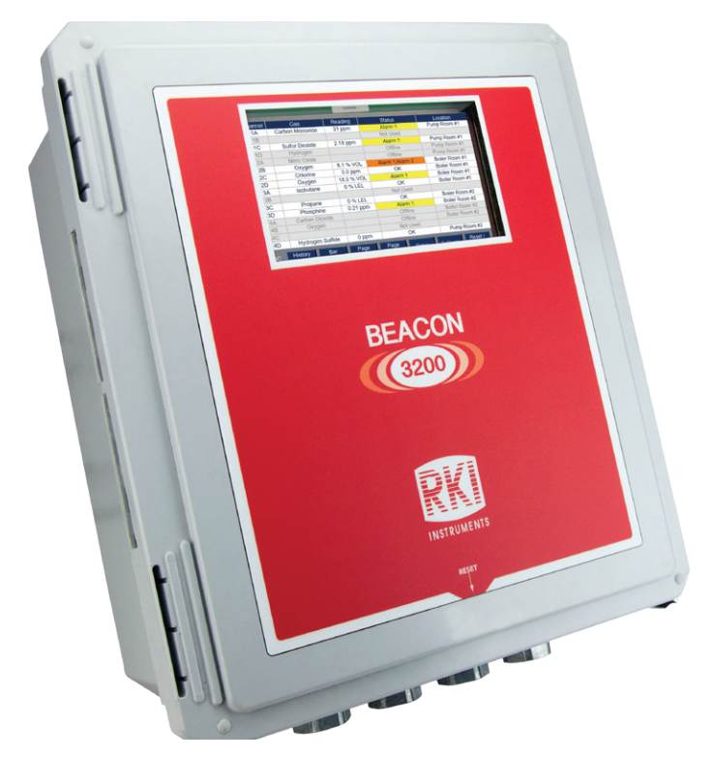
Beacon 3200 and Otis Master controller

Slide 3
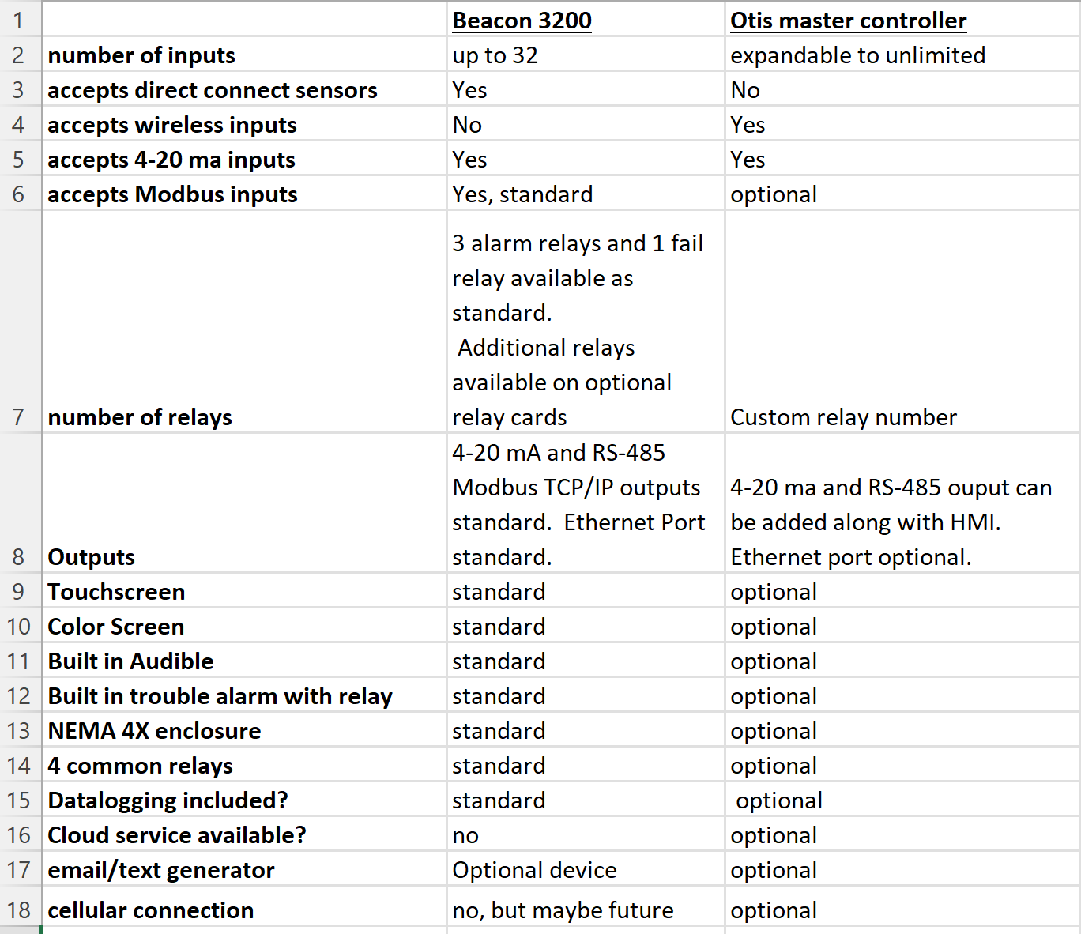
Notes:
The 3200 has 8 slots. They can be input cards or relay cards. 1 input card has 4 inputs. 1 relay module has 8 relays

Slide 4
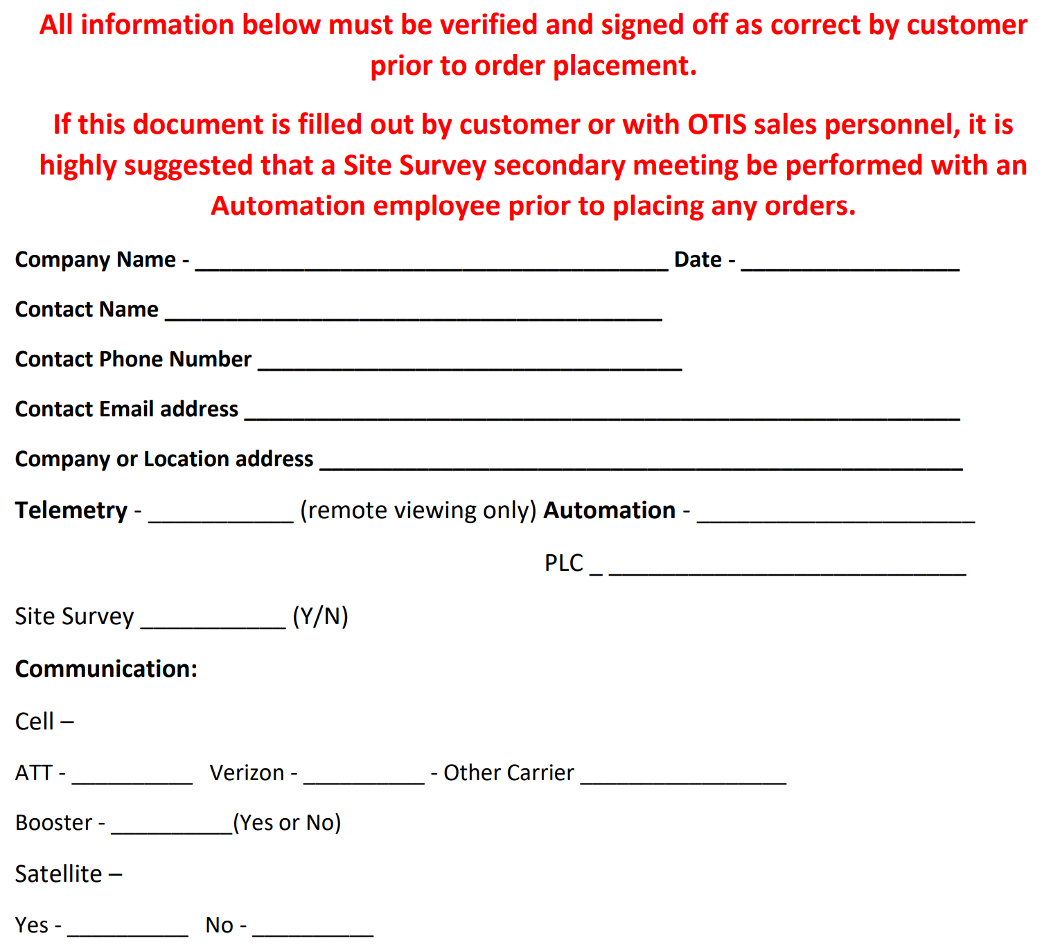
Otis Master Controller Questionnaire

Slide 5
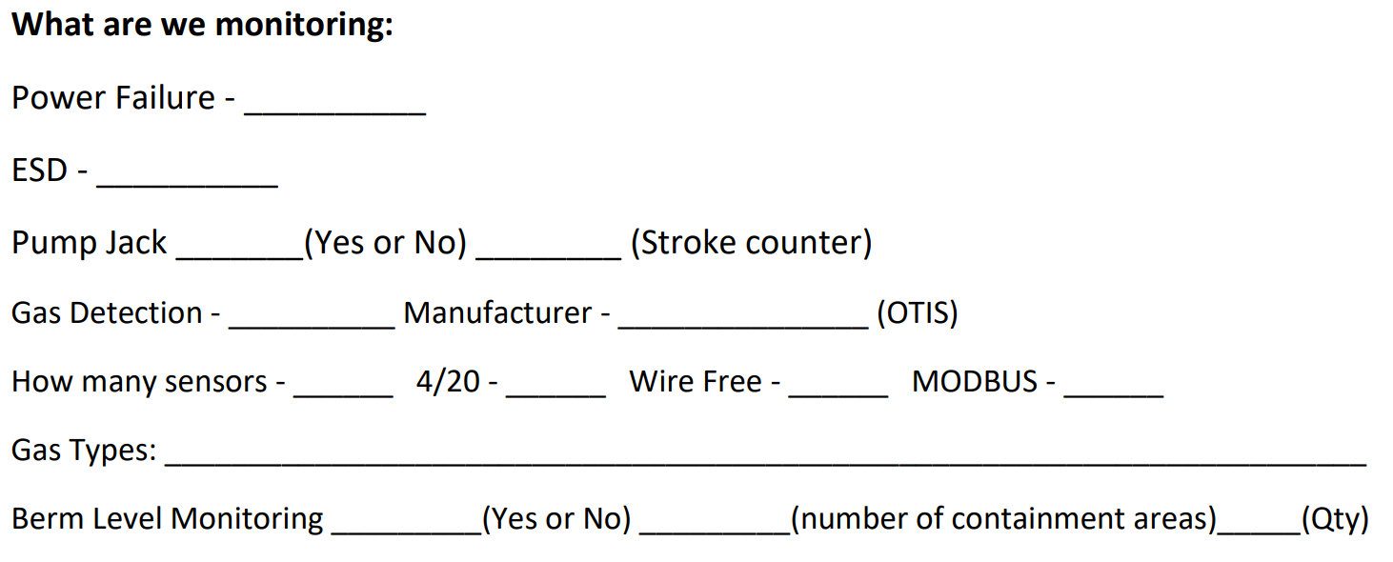
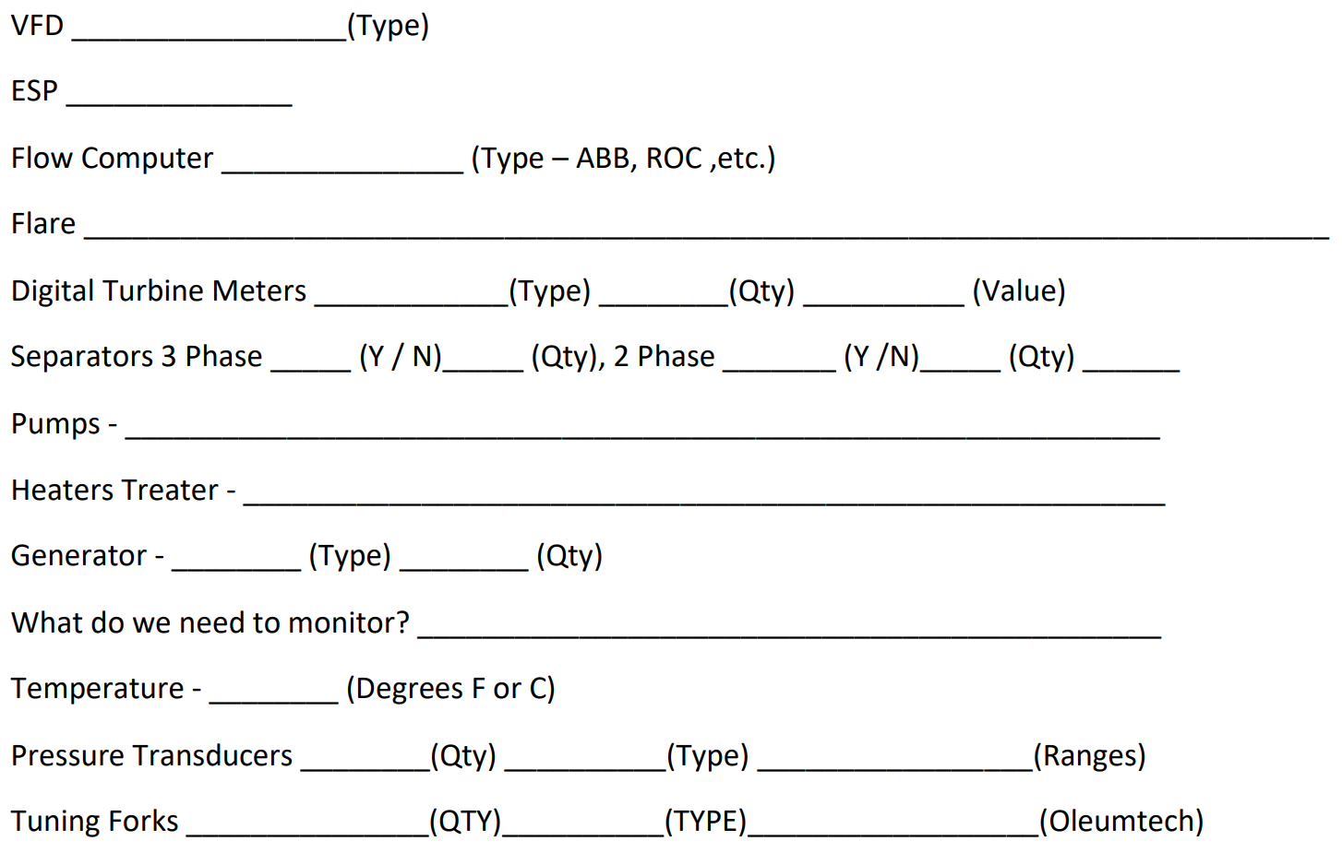

Slide 6
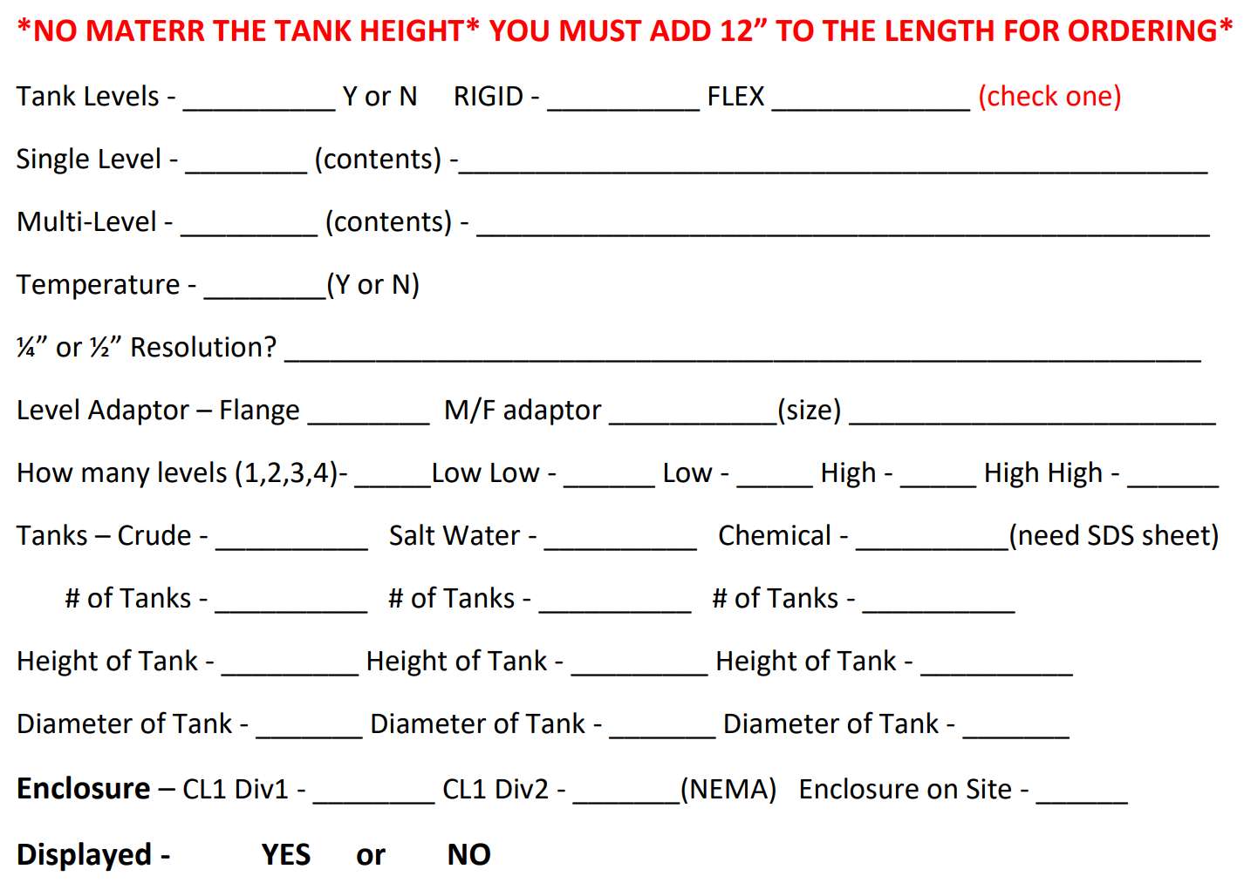

Slide 7
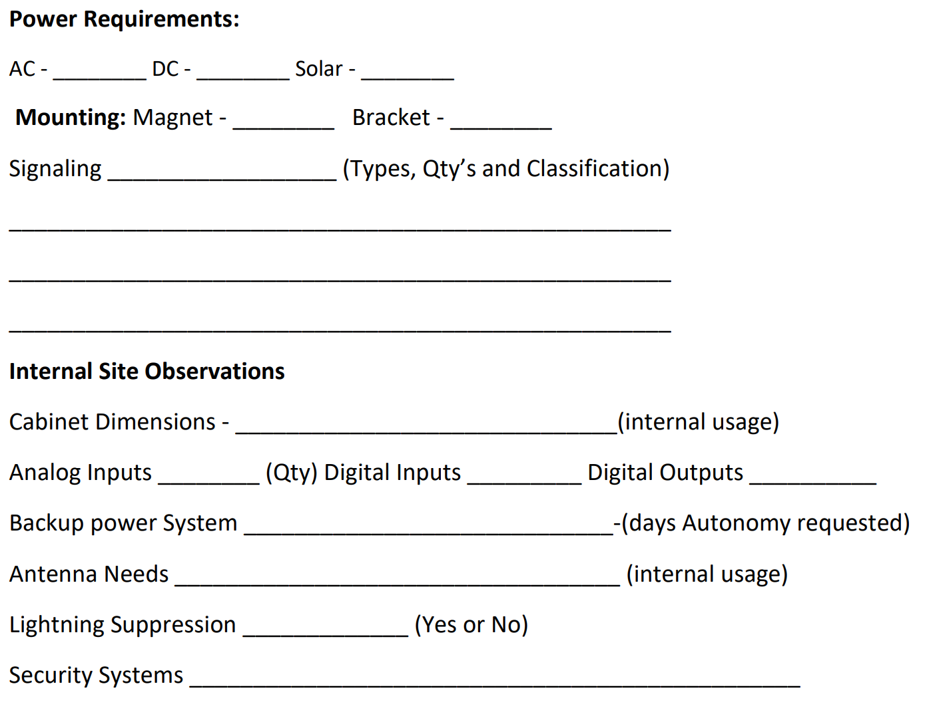

Slide 8
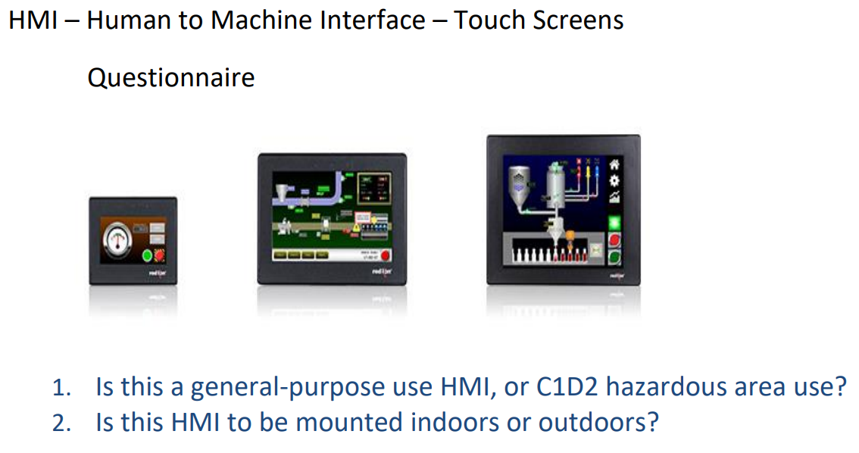
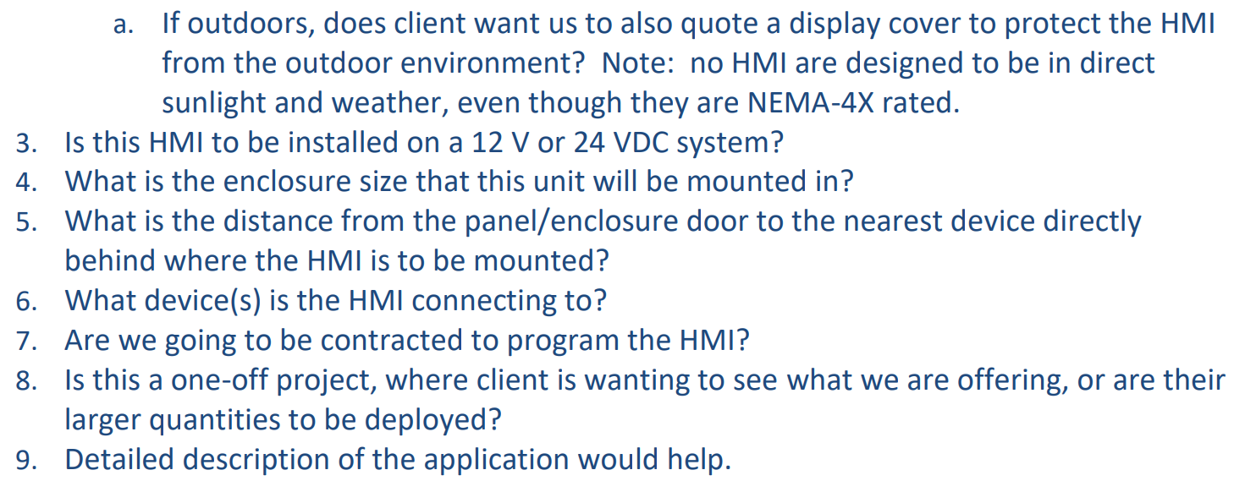

Slide 9
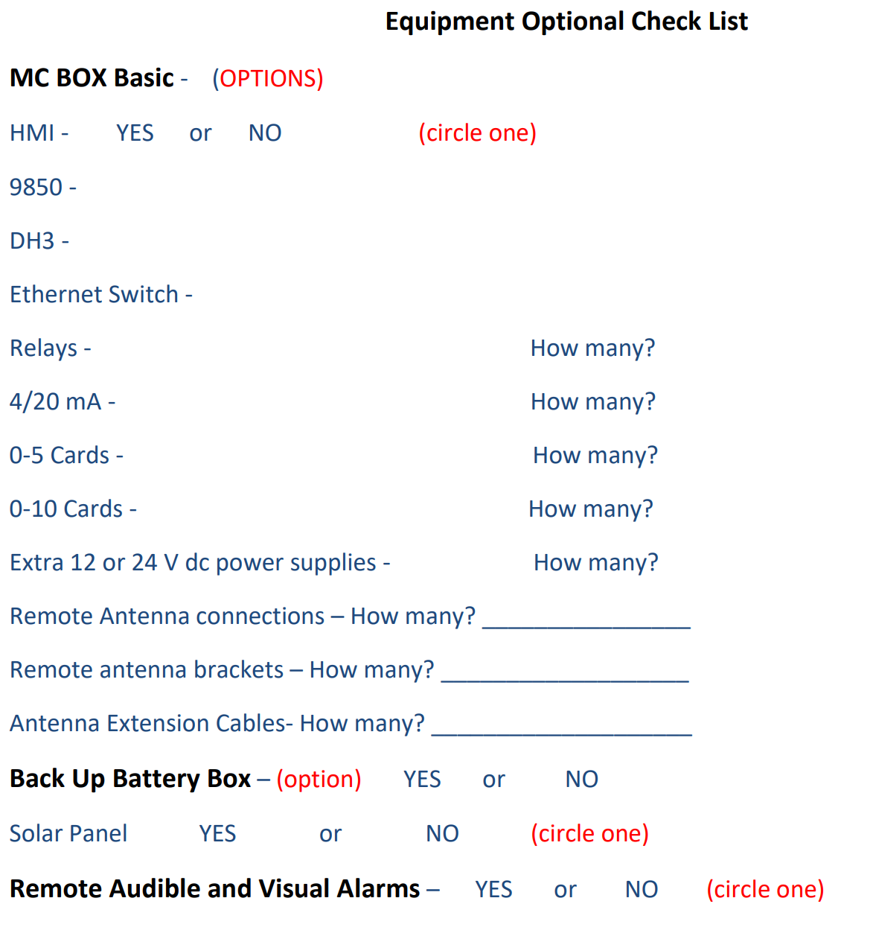

Slide 10
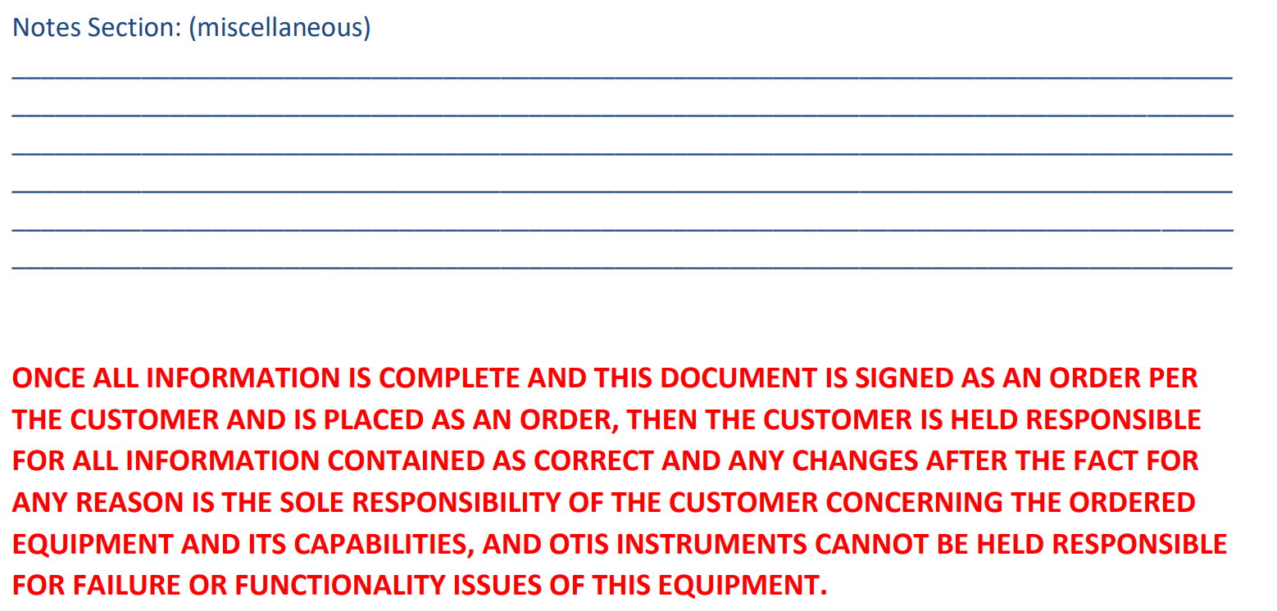

Slide 11
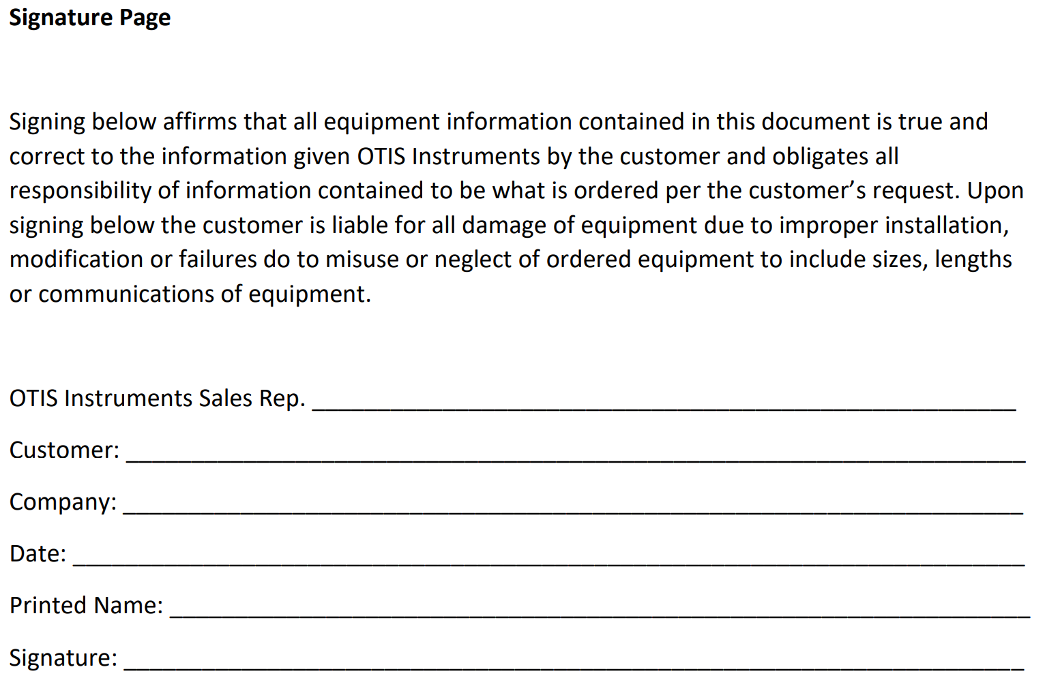

Slide 12
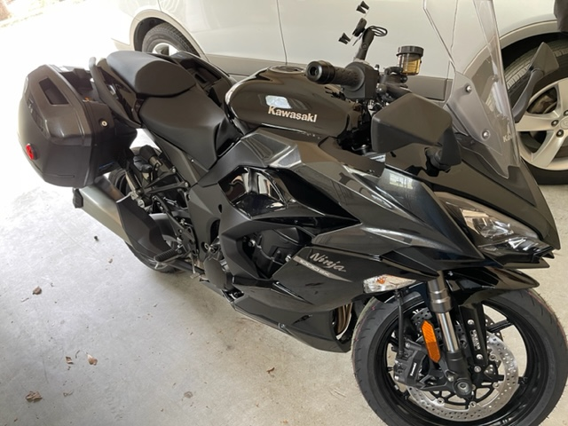
What I chose to ride
Notes:
In 2022, let’s all go fast to meet our goals together. Let’s accelerate hard in the first quarter and finish the race strong.

