Slide 1

If you don’t aim for something, you will never hit anything.
Notes:
This is Amy Dodson

Slide 2
Aim for something
Before the beginning of 2022, I strongly encourage you to set professional goals for yourself. Include some new fixed system services’ goals.
I suggest creating a document and reviewing it every Monday.
I do this every year. Some of mine for 2022 are..
close at least one install and one start-up with every salesperson
Learn more Riken Keiki fixed system products
Better communication with all sales folks
  FileMaker Pro
Notes:
Set goal at Safeware to be part of the million dollar club--2020

Slide 3
Typical sales process for fixed gas detection installation
Distributor contacted RKI with a fixed system install opportunity.
RKI RSM arranged for a TEAMS meeting with end user, distributor, RKI National Fixed Systems Manager, and herself.
  Topics discussed (answers are highlighted)
    Application? Battery manufacturer. Charging areas.
    What type of battery? Lead Acid
    Is there an existing system? No
    What gases need to be detected? Hydrogen
    What range of detection is needed? 0-100% LEL
    How many points of detection are needed? 8
      Layout of facility--provided
      Vapor density .07—lighter than air
      Air movement in space static
      What are the sources of potential gas? Battery stations where charging occurs.
    Does any of the equipment need to be explosion proof? no
      If yes, explain what part of the solution, what class, and what division is required?
    What is the temperature that the sensor will be exposed to? 65-75 degrees Fahrenheit
    What are the humidity levels that the sensor will be exposed to? 30-50%
    Does any of the equipment have to be mounted outside? No
      If yes, explain.
    Is the preferred sampling method pump or diffusion? diffusion
    Is wired or wireless preferred? wired
    Do the transmitters need a display? Yes
    Do the transmitters need relays? Yes

Slide 4
    Do the transmitters need to report to one of our central controllers? Yes
      Yes
        What needs to happen when there is an alarm detected? Panel needs to alarm and there must be a blue strobe light on each transmitter that activates.
        What auxiliary equipment must be activated? Blue strobe light
        Does our controller need to communicate with any other control device (fire panel, SCADA, PLC, etc.) No
          Yes
            What signal input does your control device require?
      No
        Does the transmitter need to be stand alone or report back to your control device?
          Your control device
          What signal input does your control device require?
          What power can your control device supply to run the transmitters?
RKI RSM set up an on-site walk through with the distributor.
  RKI National Fixed System Manager would connect via Facetime for walk through

Slide 5
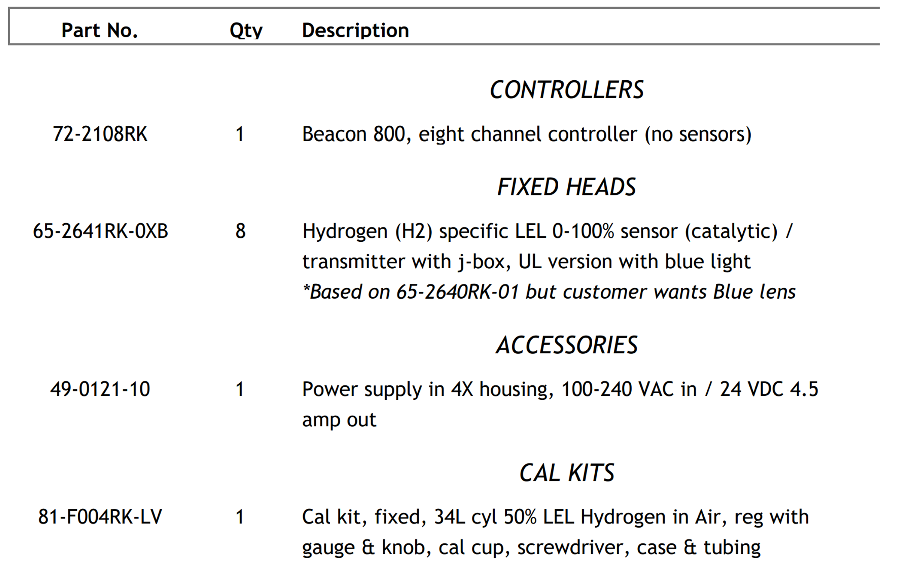
On-site walk through completed and the best solution was discovered.
  Below is the product list

Slide 6
RKI National Fixed Systems Manager determined Scope and price for full installation. Below is the Scope.
Labor to install, commission, calibrate, and test complete gas detection system. RKI will also provide training after the installation.
The system consists of 1 Beacon 800 controller, 1 24 VDC power supply, and 8 M2A Hydrogen Specific 0-100% LEL with blue 24 VDC lights.
RKI will mount and run all conduit and wiring that is required.
This price is estimated for three people for 4 days on-site. RKI will use ABC Company’s calibration equipment. RKI will absorb all their expenses (hotel, travel, food, etc.) for this price.
All conduit will be ½ or ¾ inch EMT.
The equipment does not have to be explosion proof. The installation does not have to be explosion proof.

Slide 7
RKI’s electrician will supply ladders that are required for installation. No lifts will be required.
RKI will run 110 VAC from the power panel to the Beacon 800. ABC Company will provide a 20 amp isolated breaker in the power panel.
110 VAC will be no further than 60 feet from the Beacon 800.
Each M2A will have 5 wire, stranded, 18 gauge conductors, with a shield, connected to the Beacon 800. Each M2A will have a blue light. (3 wires to power and communicate, 2 wires for the 24 VDC blue light)
#1 M2A will be no further than 105 feet from the Beacon 800
#2 M2A will be no further than 125 feet from the Beacon 800
#3 M2A will be no further than 175 feet from the Beacon 800
#4 M2A will be no further than 205 feet from the Beacon 800
#5 M2A will be no further than 115 feet from the Beacon 800
#6 M2A will be no further than 135 feet from the Beacon 800
#7 M2A will be no further than 185 feet from the Beacon 800
#8 M2A will be no further than 215 feet from the Beacon 800
will be performed in Houston Texas.

Slide 8
Each blue strobe will be activated by the Beacon 800’s individual channel relays.
Facility has drop ceiling with ceiling tiles. Ceiling is 12 feet high.
Facility has sheetrock walls.
Installation and calibration will be performed in Houston Texas
If any information given to RKI by ABC Company was incorrect, ABC Company may be charged for the additional parts and $95.00 per hour/per person labor rate to correct the problem.
RKI can work on site 7:00 AM to 5:00 PM Monday through Friday.
ABC Company is responsible for providing a safe work environment.
RKI will be required to attend a 2 hour safety orientation class.
If there are any additional requirements dictated by ABC Company at the time of service, or if there is any additional equipment required to make the system operational, ABC Company may be charged for the additional parts and $95.00 per hour/per person labor rate.
ABC Company will supply clear access to work areas.
RKI will program the Beacon 800 and the M2A per Schneider Electric requirements.

Slide 9
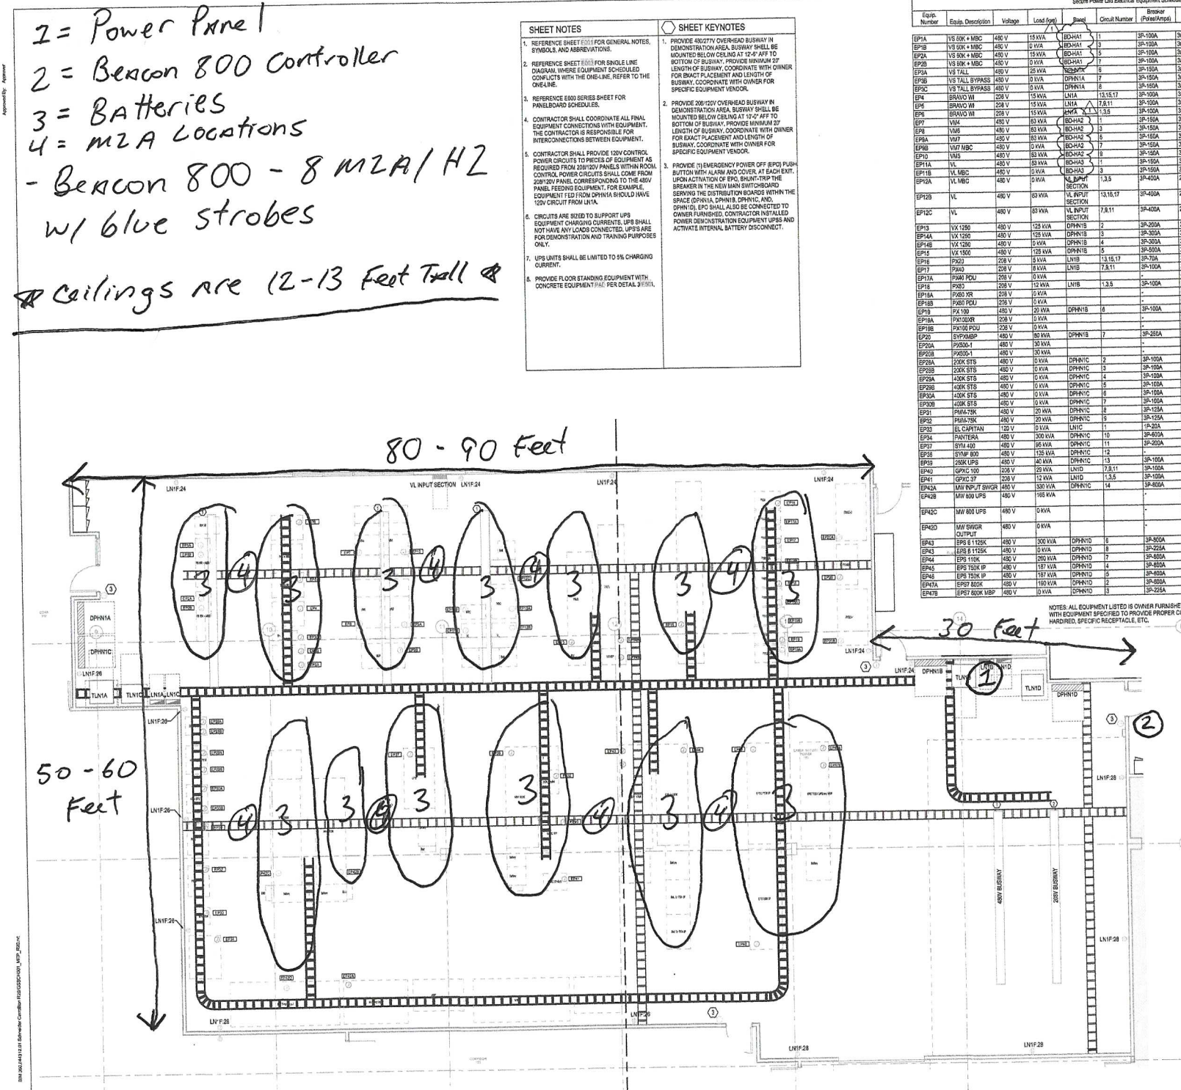
Below is the layout.

Slide 10
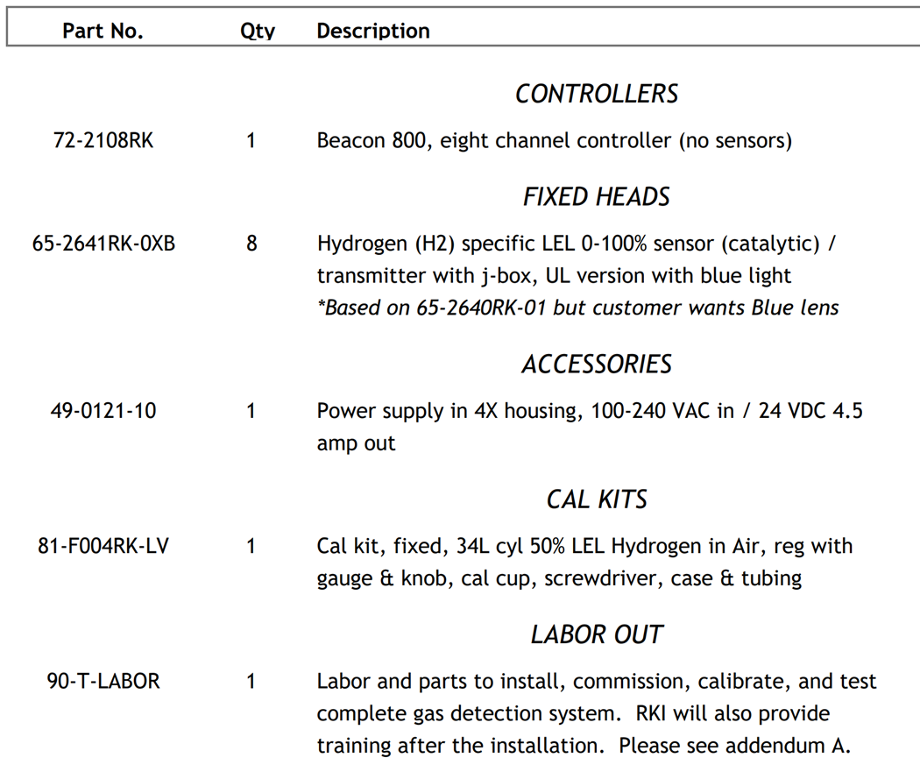
Complete solution is presented to the distributor

Slide 11
The distributor quotes the customer.
Customer issues PO# to distributor
Distributor issues PO# to RKI

Slide 12
How do we keep up with all of this?
Our CRM—FileMaker Pro
Notes:
Connect to CRM and show AM/NS—Christoph Borchers.
MFAS is another good example

