Slide 1
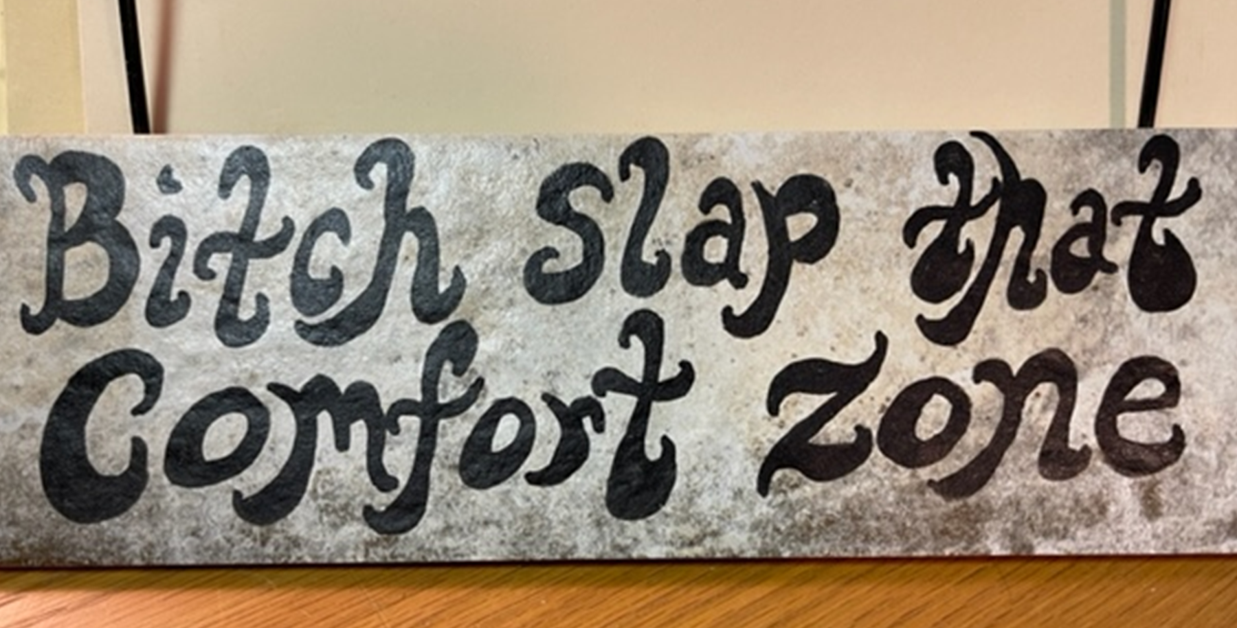
Notes:
Clint on airplane

Slide 2
2021 New Fixed system services
Start-up
  RKI or select partner confirms wire termination, programs system per customer’s requirements, calibrates, tests relay function, and trains end user.
Installation
  Our technical fixed gas detection representatives are ready to help you design the safest and most cost-effective fixed gas detection system possible. RKI’s qualified fixed system specialists can set up a virtual meeting or visit your facility to identify your exact hazards, determine site-specific requirements, and offer the optimal fixed system solution. Professional engineering staff works hand in hand with our customers to design systems that meet all client requirements and ensure compliance with local and federal regulations.
  RKI’s certified technicians and select partners can install the equipment in its entirety. Turn-key means you never have to touch a screwdriver. RKI and select partners can do it all – explosion proof, non-explosion proof, hang conduit, pull wiring, use advanced relay logic, programming, connect ancillary equipment, low voltage, high voltage, calibrations, etc.

Slide 3
ASK THE QUESTIONS
How do you plan on installing and integrating your new gas detection system?
How do you plan on programming, calibrating, testing relay functions, and provide training to your employees?
Notes:
I went through a sales seminar less than 2 years ago and they stated that the #1 problem with sales professionals is that they do not ask the right questions. One presenter said that over 70% of sales folks never asked for the order---what!

Slide 4
Common Responses
We have our own electrician?
  Are they high voltage and low voltage certified?
  Have they installed control systems?
  Do they know our products?
We will do our own start-up?
  Liability
  Warranty
  Manufactures requirements
Notes:
Have one story---Glock

Slide 5
Why RKI?
We make the products, who would be better to install them?
You receive an RKI calibration certificate for every sensor after installation?
  Three other documents from RKI stating that the install was done properly.
Experience
Right the first time.
What other manufacturers offers turn key?
Notes:
Would you buy a new Gulfstream Jet and then ask Boing to test the plane and train you on how to fly it?

Slide 6
2021 Successes—just a few
Sulzer—57K
AM/NS—67K ordered. 300K pending
Birchwood foods—49K.
Cemex—15K
Glanbia County—25K
Pinnacle– 37K
Total fixed systems invoiced this year that includes new services
$247, 281.80
Notes:
Glanbia County—Jeremy Wise. Digester and commission.

Slide 7
Booked but not invoiced
Total booked but not invoiced fixed systems that includes new services is $115, 939.75

Slide 8
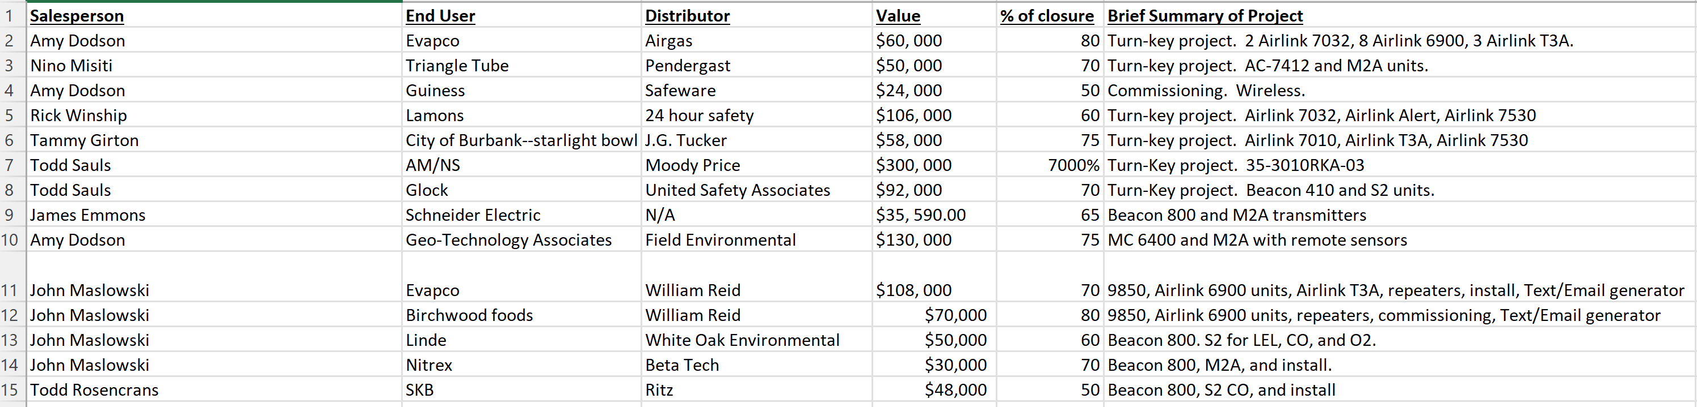
Open projects
Total = $1, 091, 590.00
Notes:
I have to submit every Friday to management team. Does not include Start-up only projects

Slide 9
Popular Riken products
Best solutions, products, support, and deliveries.
  Riken Keiki
    GD-70D
    600 series
    SD-1GH
  RKI Apps and Engineering Team
  I am in this with you for the long haul.
Notes:
SD-1GH: Riken’s M2A style fixed head which can use a MOS sensor. For ppm applications in clean environments, this can be an excellent solution. Must only be used where the only gas present besides fresh air is the target gas.
OX-600: Very popular due to its ease of installation for a stand alone solution and reasonable cost. This is a quick and easy solution to many Oxygen monitoring situations.
EC-600 for CO and the RI-600 for CO2: As for the oxygen version, these are also a simple solution and easy to install for a stand alone solution, (although in the case of CO2 there are much lower cost alternatives available)
GD-70D: Best toxic gas sensors in the industry and reasonably priced. For any toxic gas situation we should consider the GD-70D over any other option if it fits the application.
Go to Rieken’s website and look at their products.
Apps Team—best in business. Give example of customer asking why buy us over Honeywell---general question, call and get answer.

Slide 10
Future Riken products
SD-3
GD-81D
GD-84D
Notes:
SD-3: This will be available for toxic gases in a diffusion mode, with an XP/Intrinsically safe head. It will use the new “F” toxic sensors. (Available later in second half of 2022?). Auto range from PPM to % LEL. Has FM rating. Has 4-20ma output, Modbus option, and Hart.
GD-81D: Available later in 2022, this is the next generation of fixed sample draw head to eventually replace the GD-70D. It will use the new “F” sensors. Single sensor unit.
GD-84D: Also available later in 2022, this will be a sample draw head that can accept up to 4 toxic sensors. It will also use the new “F” sensors. Has 2 pumps in case 1 fails. POE Ethernet hub.

Slide 11
Future Fixed systems
Develop a strong partnership with the Riken Team, to develop practical fixed system products equipped with unique features that produce substantial benefits focused on the US Market, including
  Across-the-board Specifications
  Apropos Approvals
  Delivered on time
  With Affordable Pricing
  Using feedback from
      RKI RSMs
      Distributor Partners
      Key End-Users
Notes:
Brad Pierce---mission trips, family members dying, children problems. Call at 3:00 AM and we will be there for each other. We would take a bullet for each other. Who is that person to you? We want that professional relationship with the Riken Team.

Slide 12

Our future is bright!
Notes:
Picture is from this Thanksgiving when Amy and I rode in a hot air balloon over the Valley of the Kings.

