Slide 1
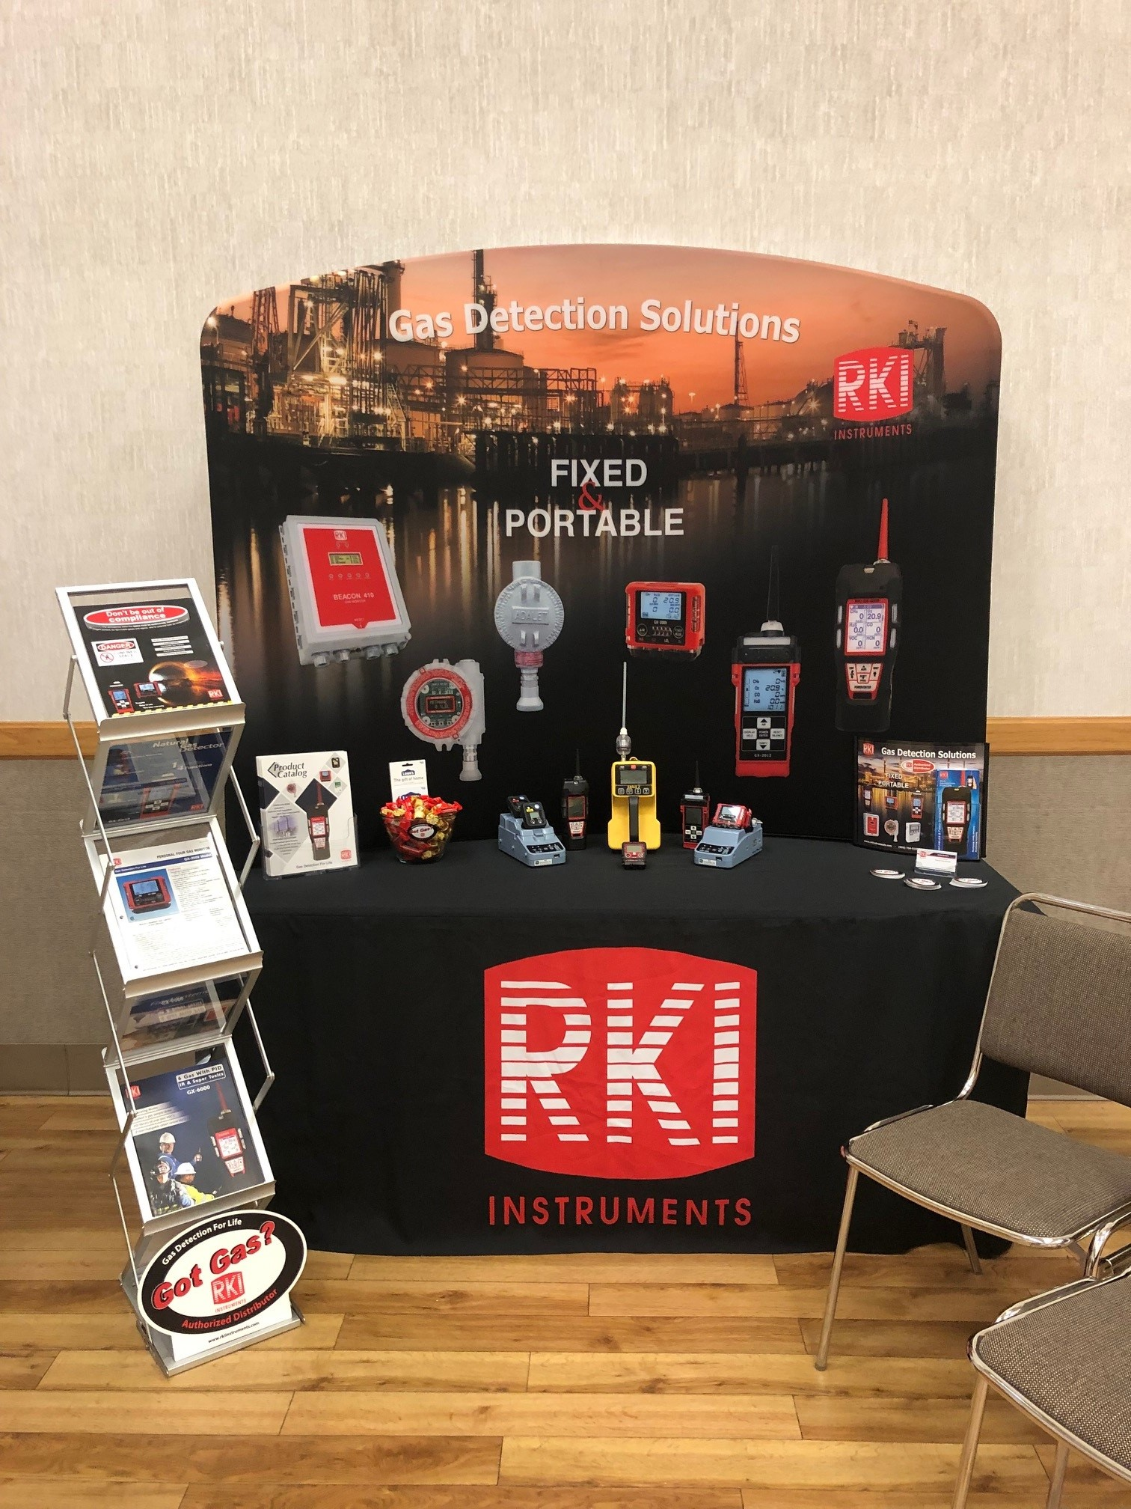
Rep’s Tradeshow Booths

Slide 2


Slide 3


Slide 4
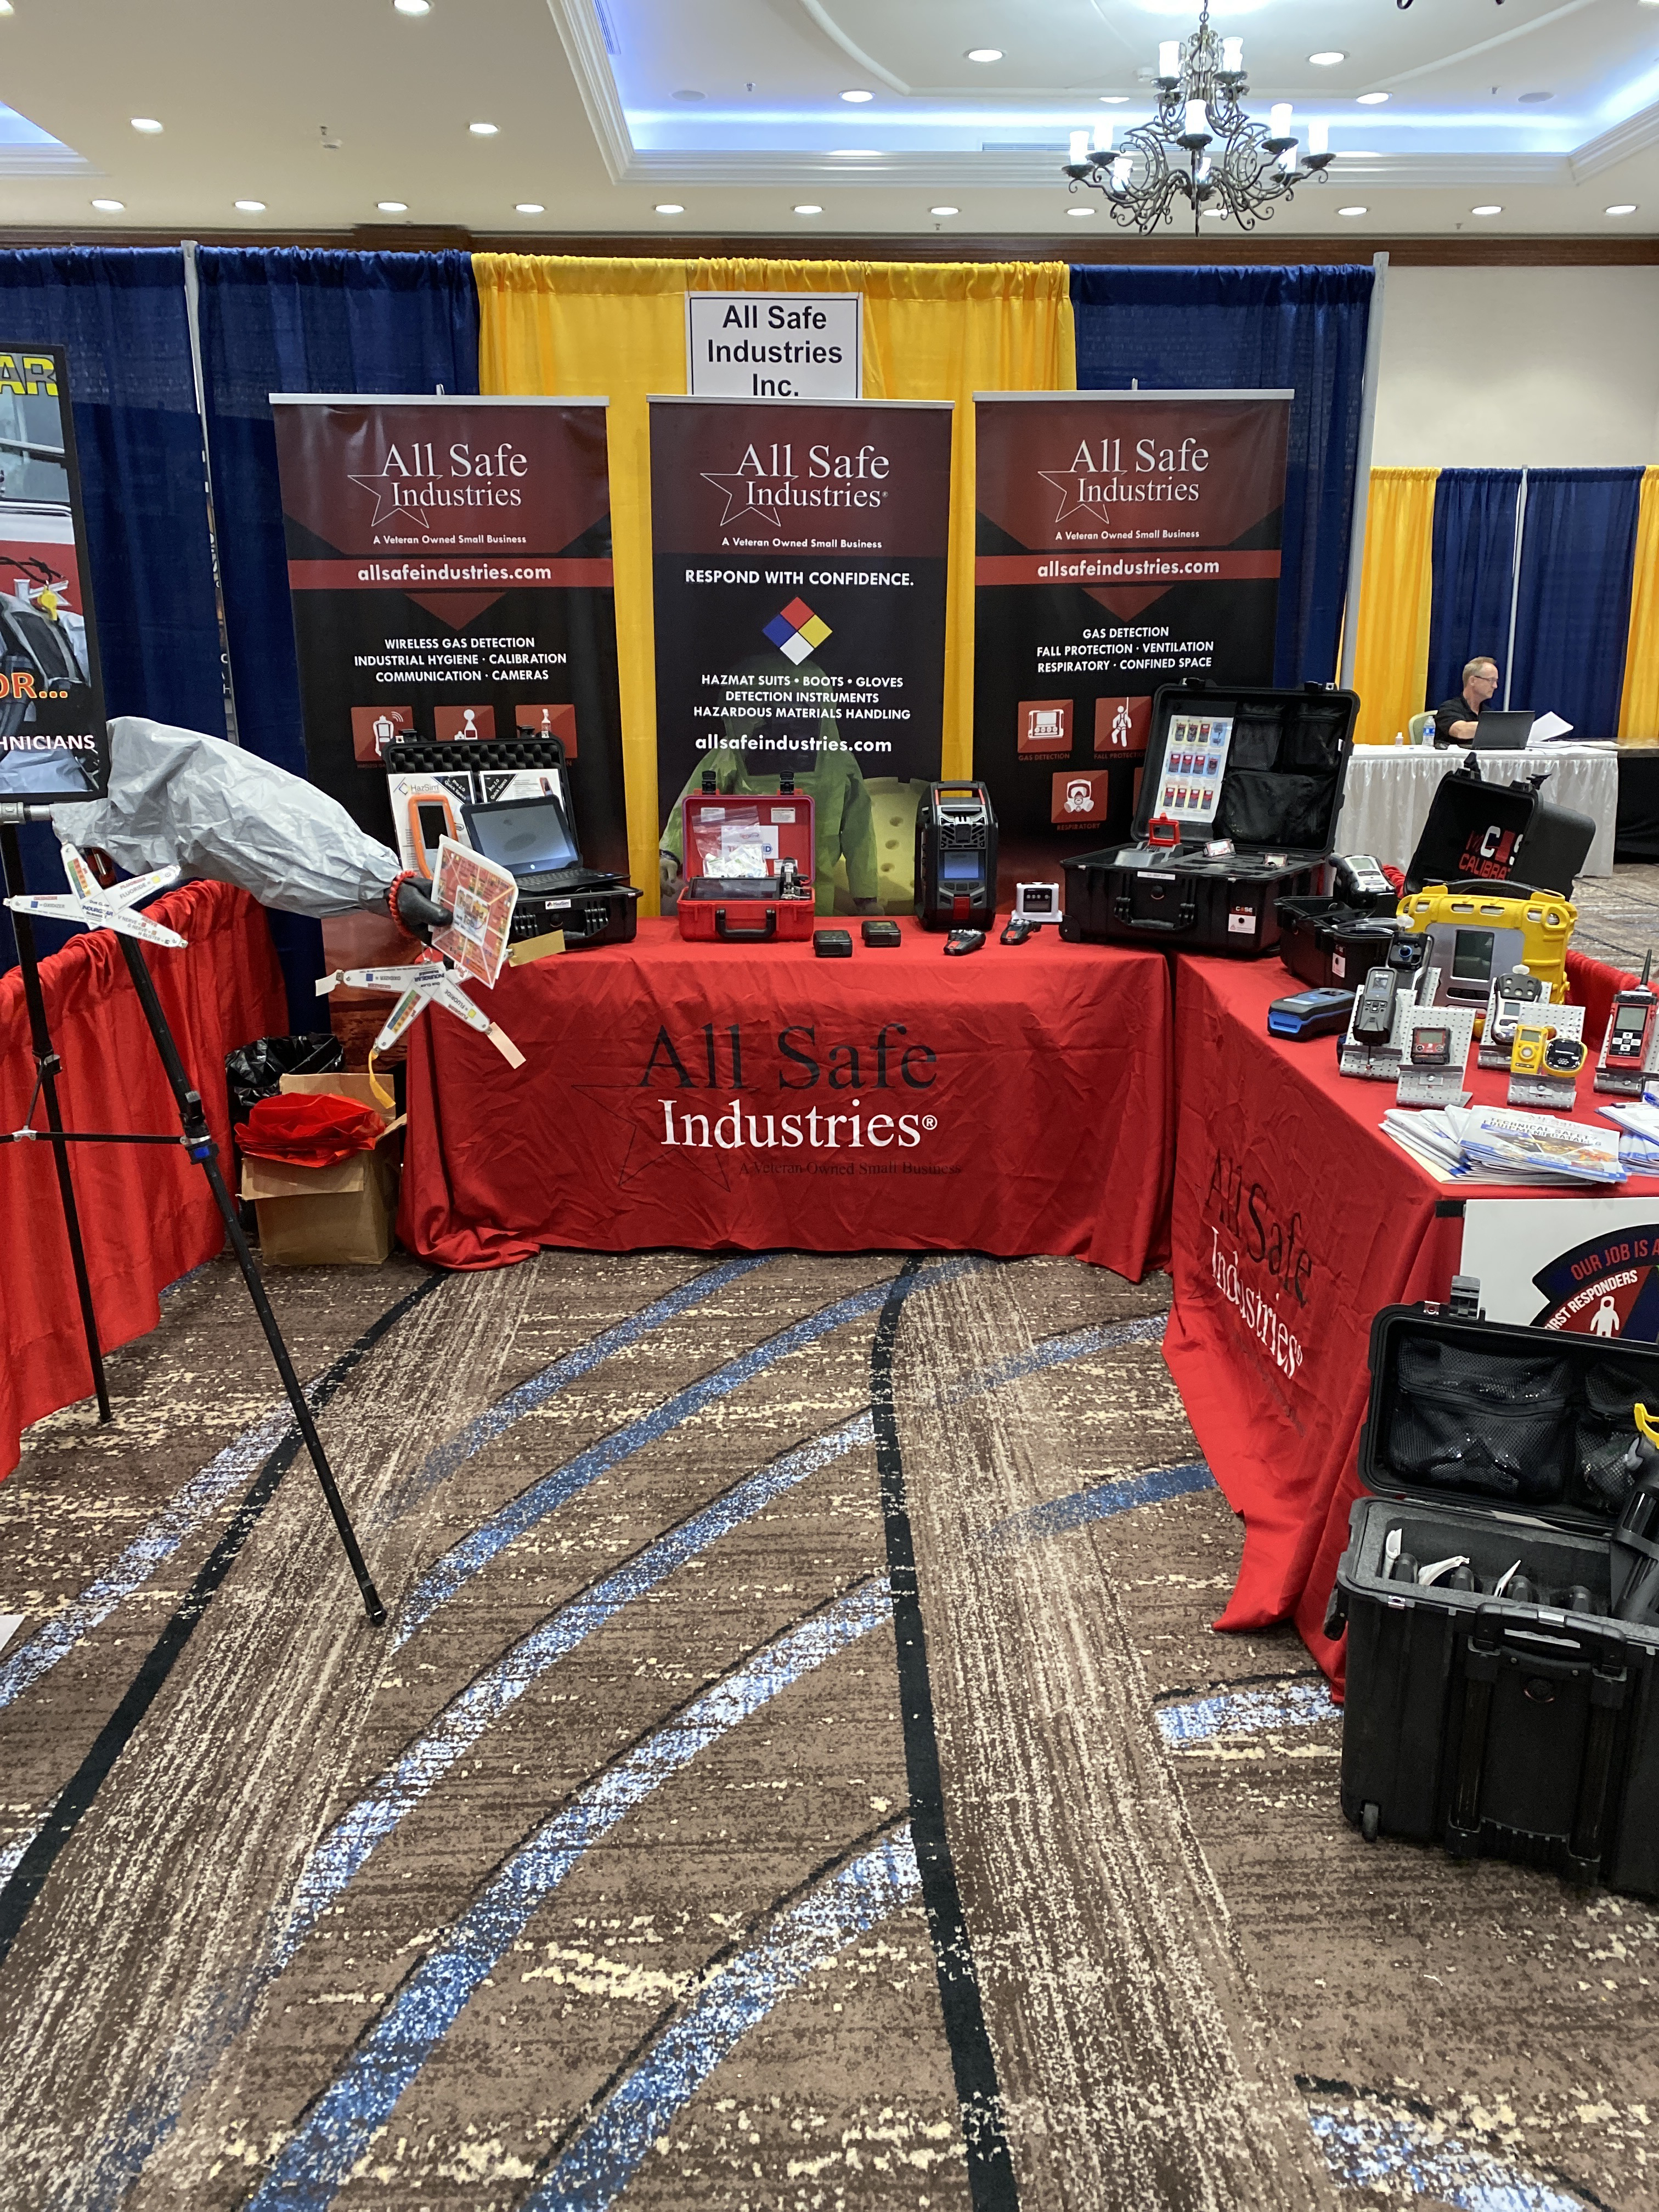

Slide 5


Slide 6
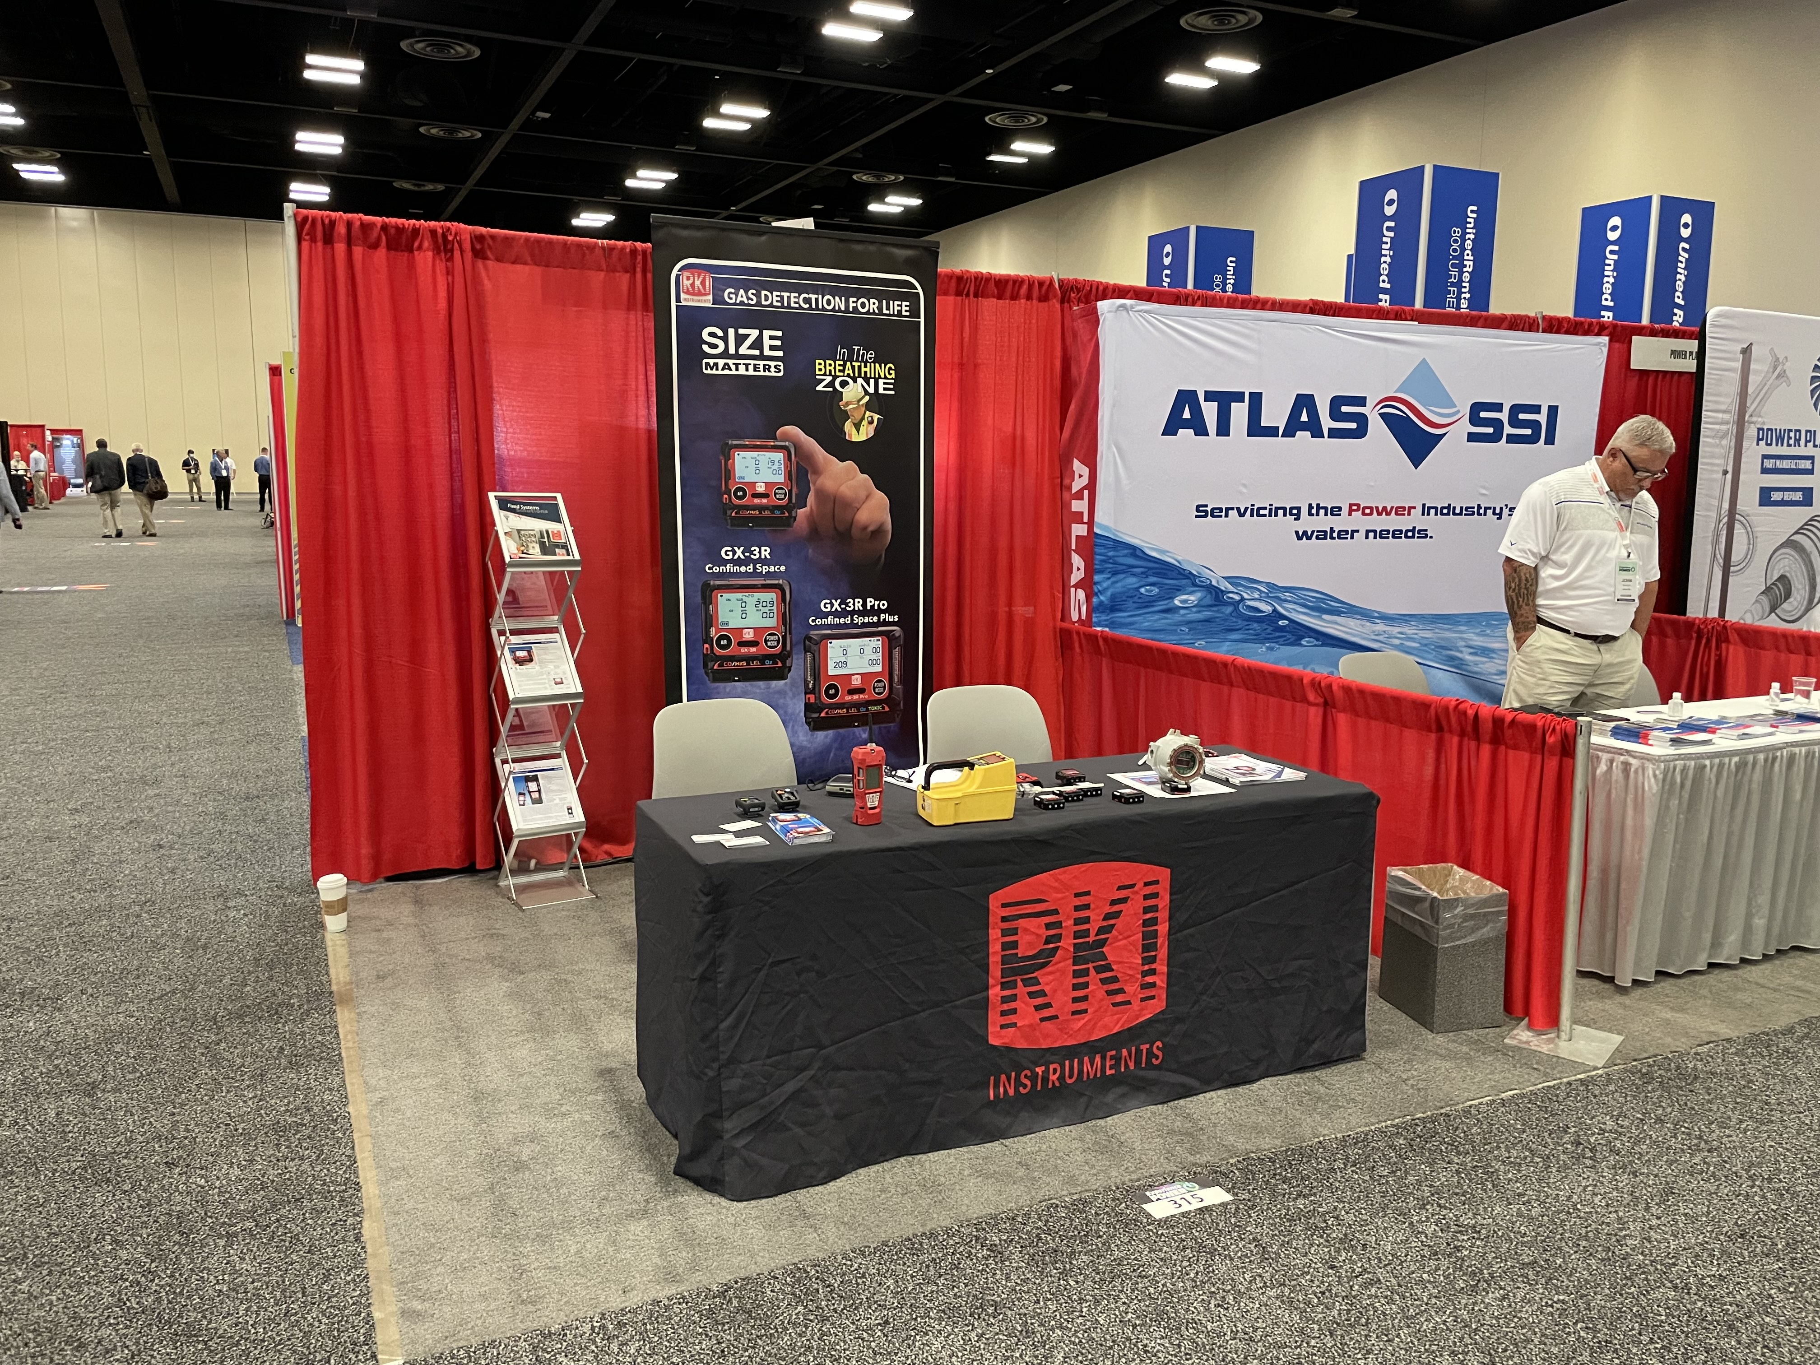

Slide 7


Slide 8
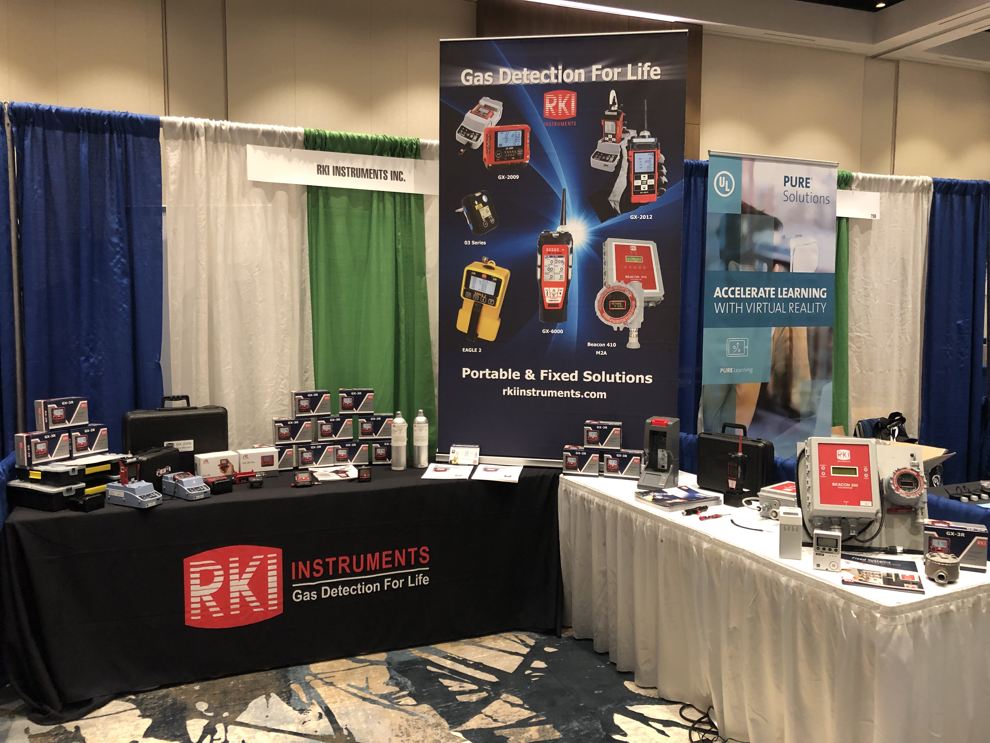

Slide 9


Slide 10


Slide 11
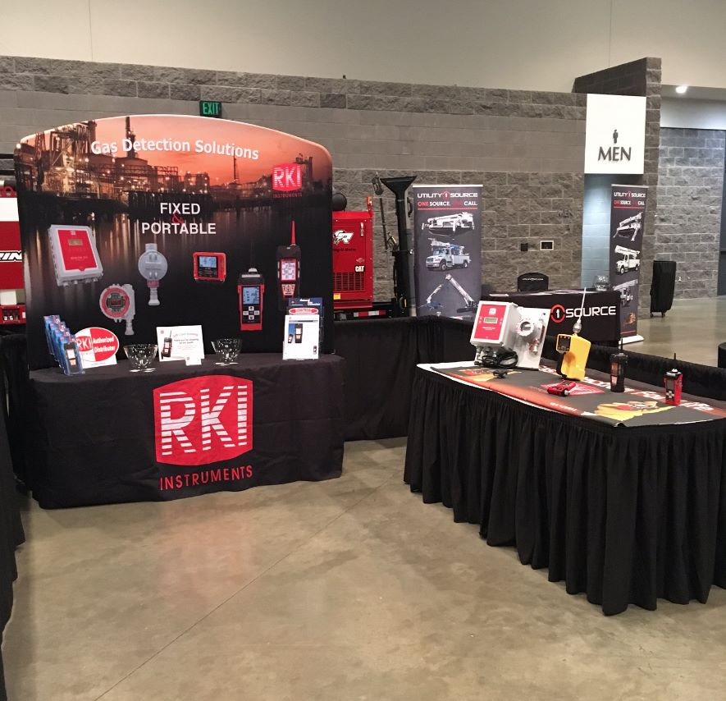

Slide 12
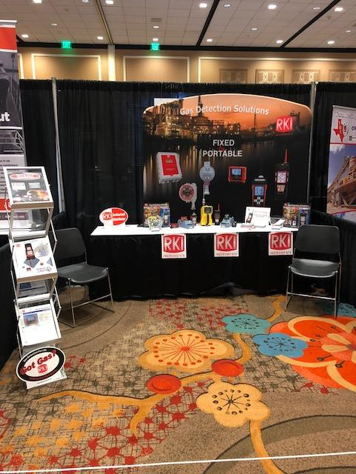

Slide 13
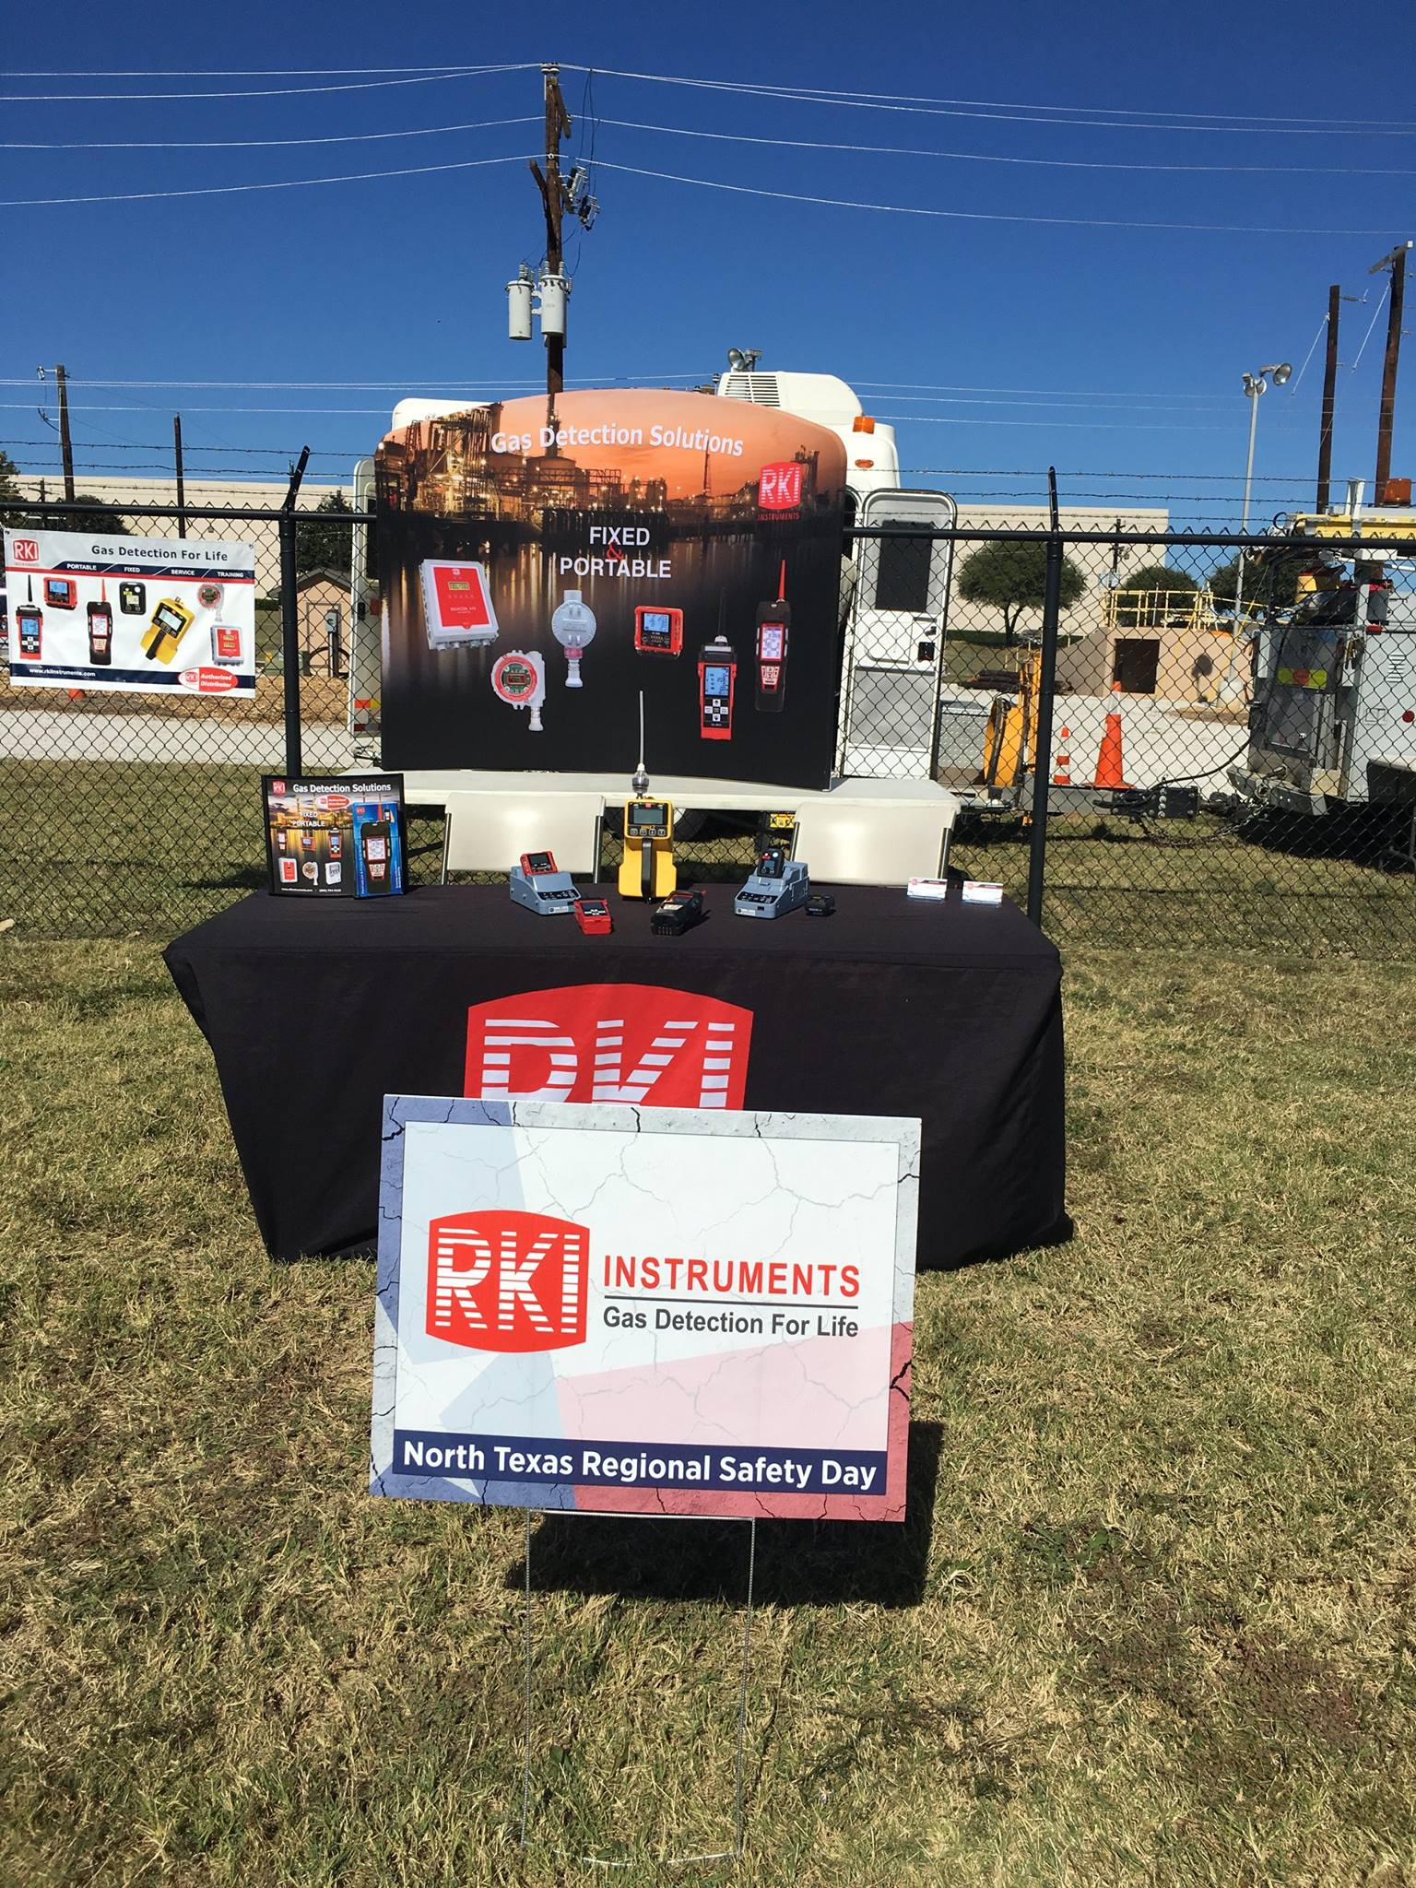

Slide 14
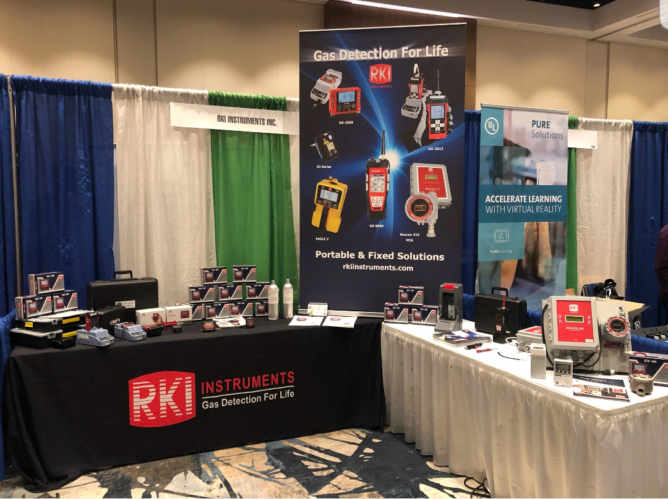

Slide 15
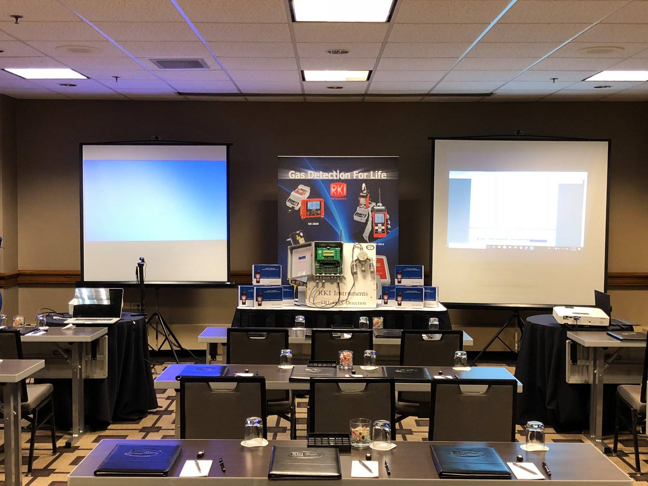

Slide 16
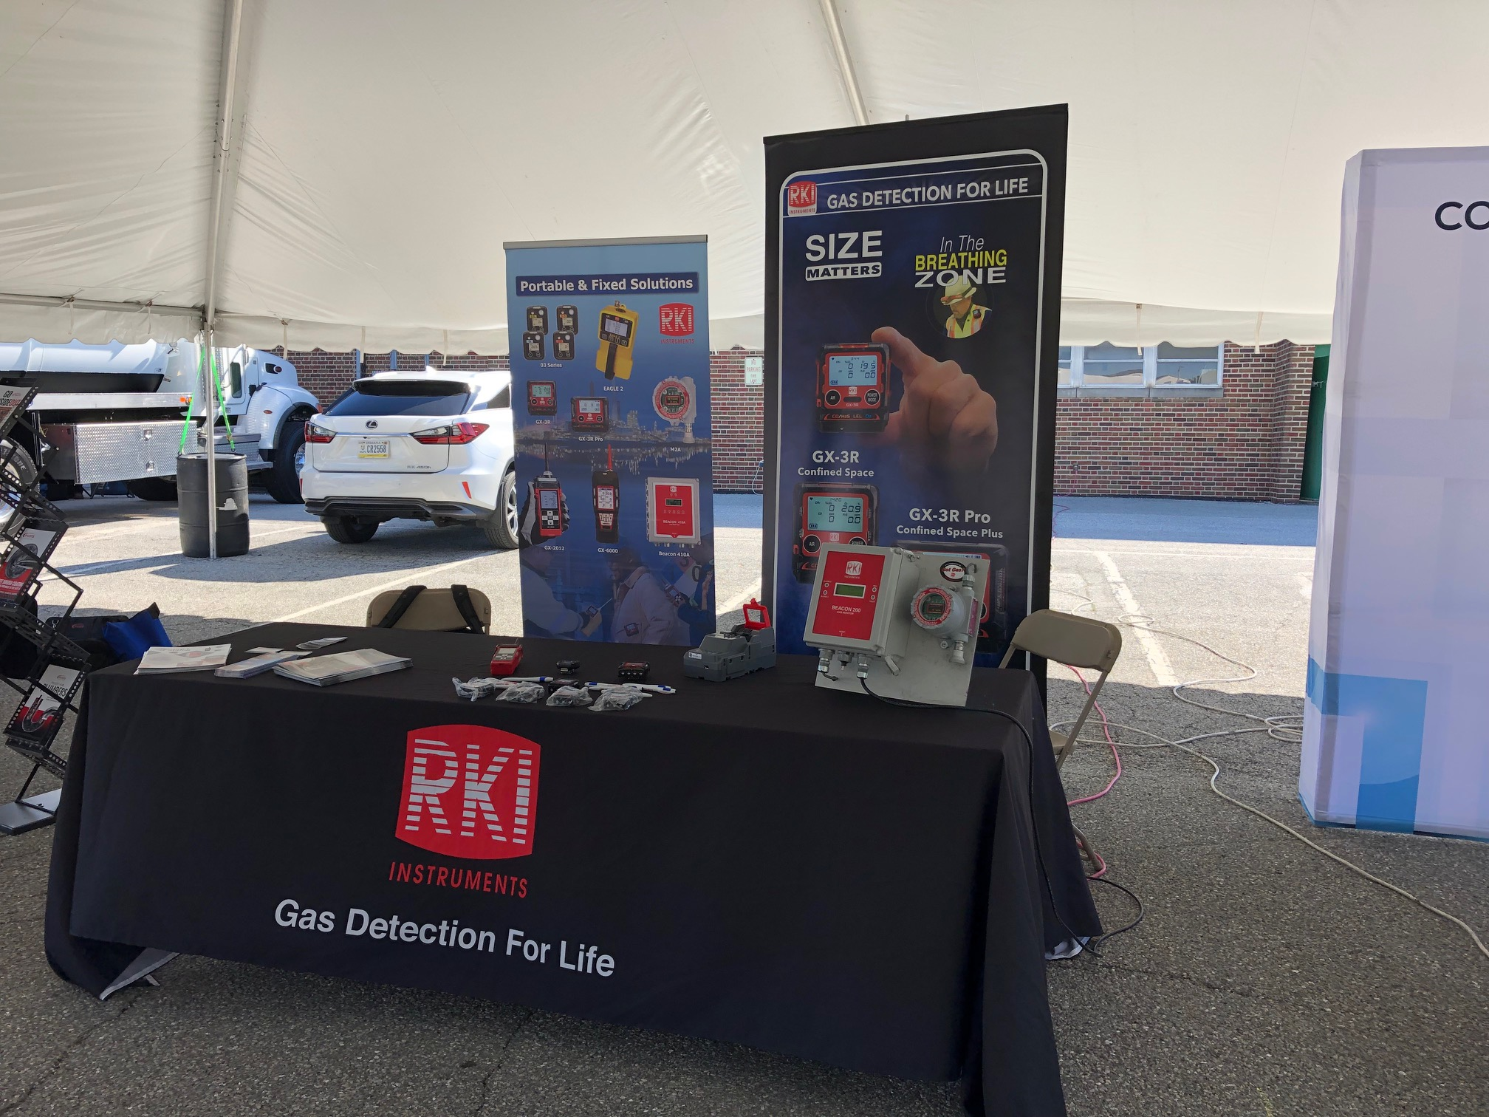

Slide 17


Slide 18


Slide 19
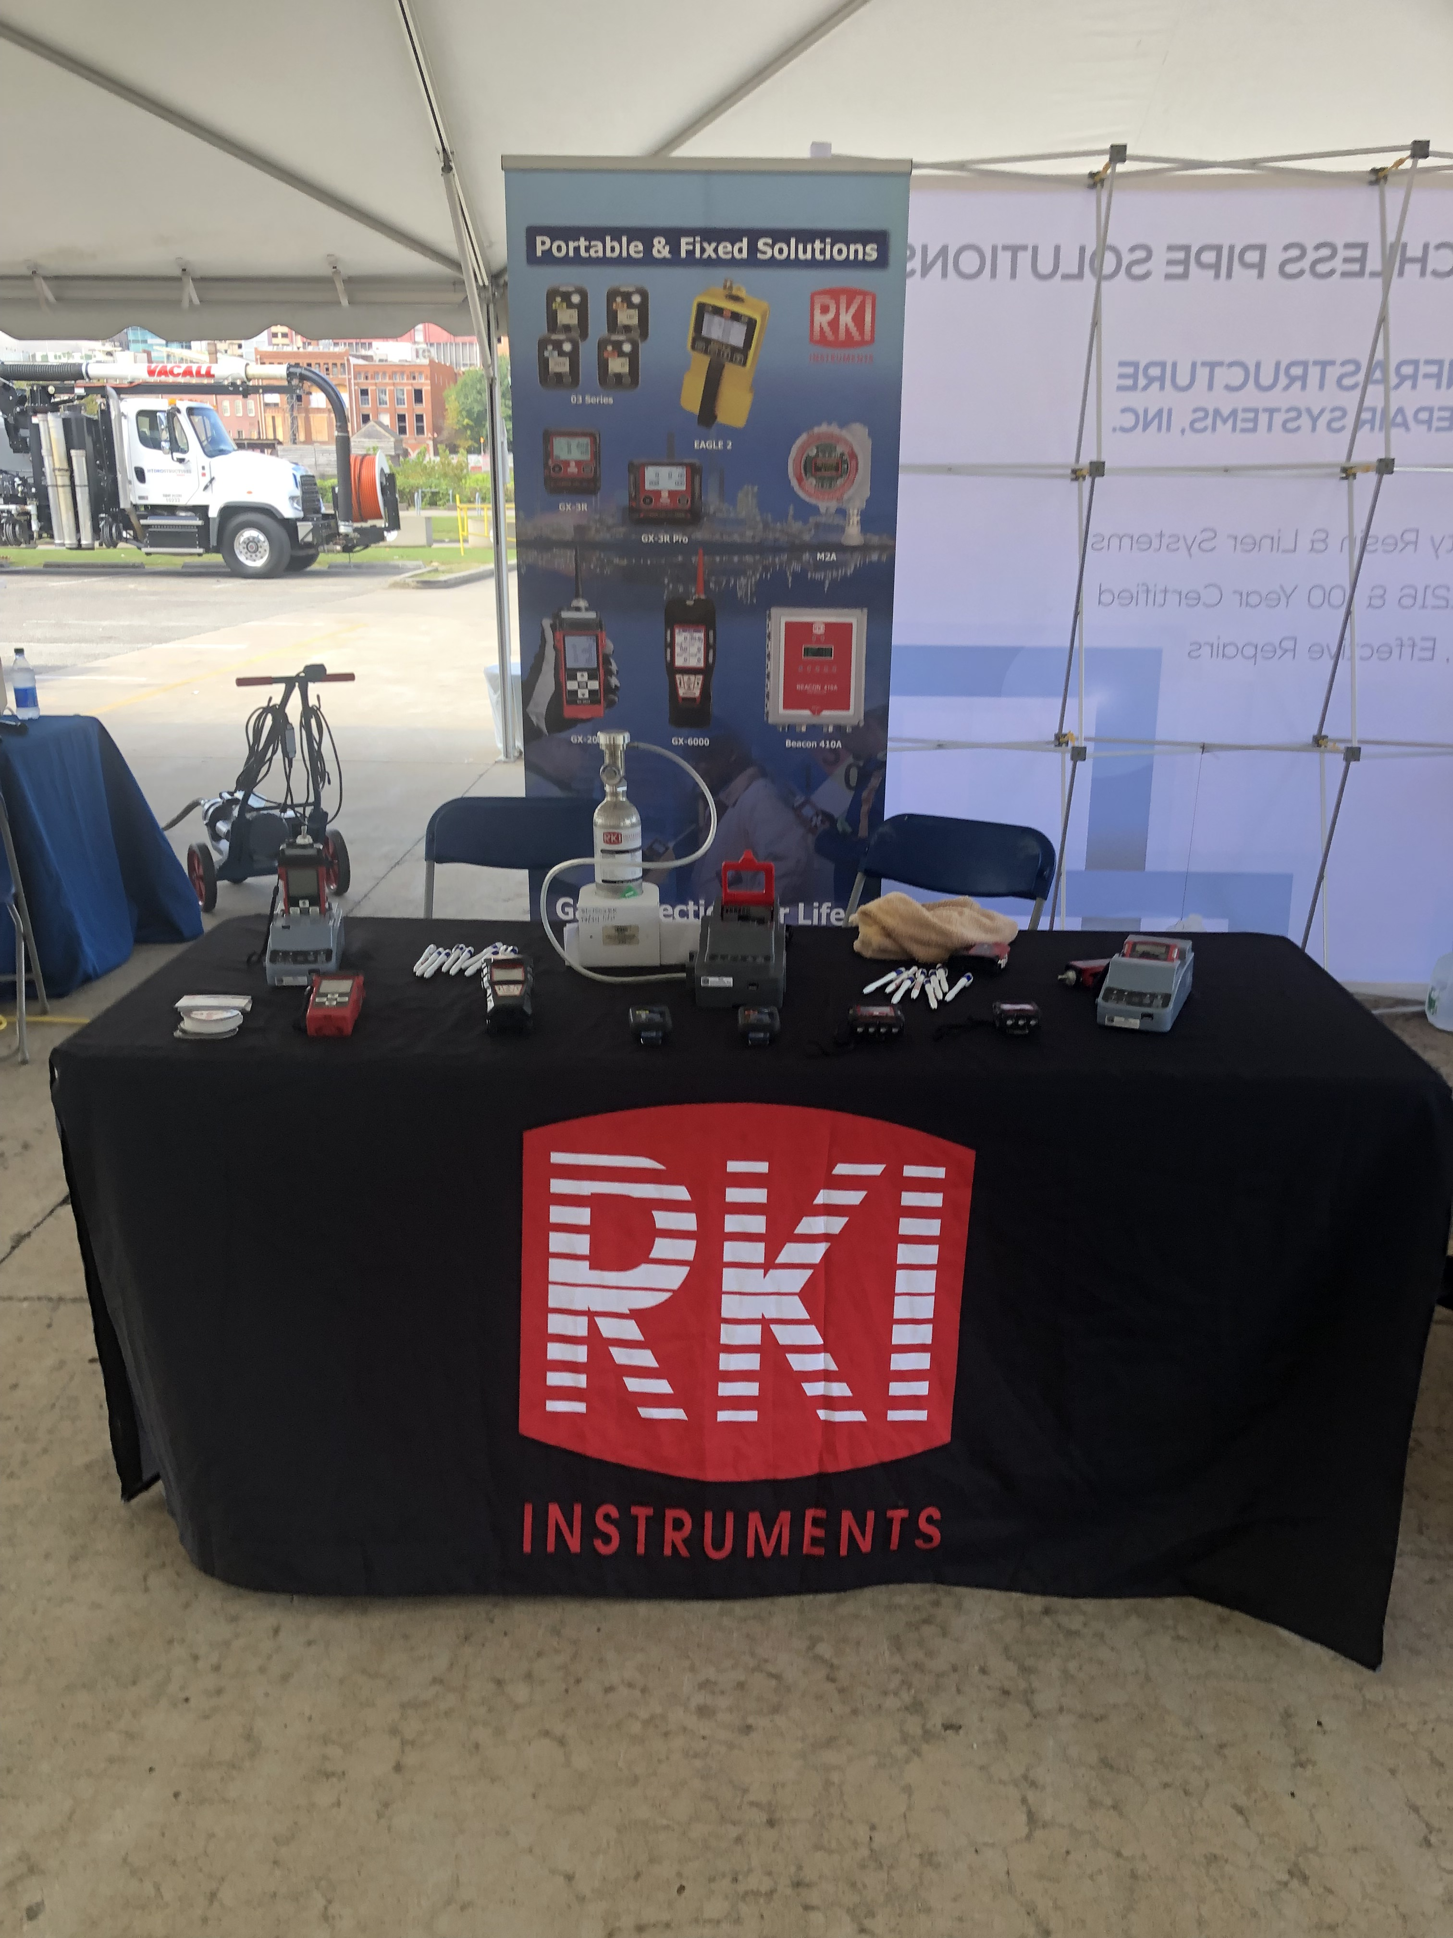

Slide 20
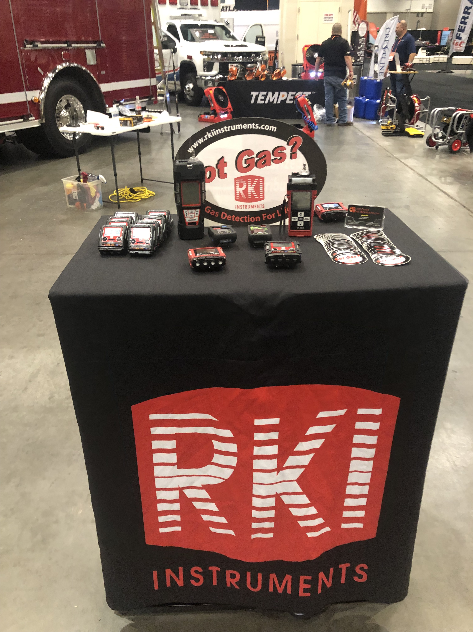

Slide 21
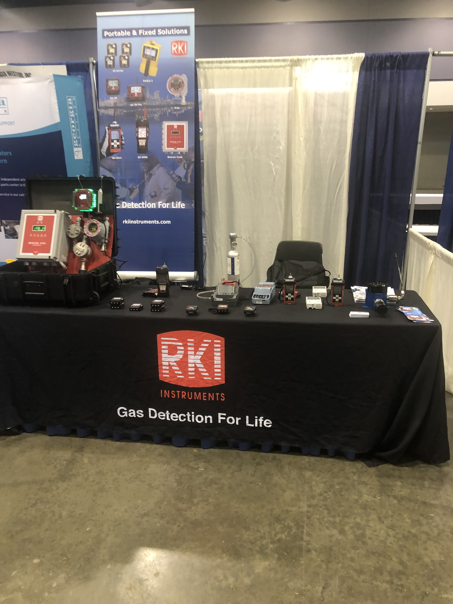

Slide 22
Updated Tradeshow
Booth Artwork

Slide 23
47”x90”
Pullup

Slide 24

48”x97”
Pullup

Slide 25
36”x93”
Pullup

Slide 26

36”x93”
Pullup

Slide 27


Slide 29
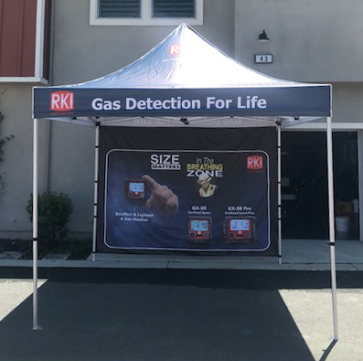
RKI Tent

