Slide 1
Key National Distributors
Airgas
Mallory
Ritz Safety
Northern Safety/Orr Safety
Moody Price
Alpha Process Sales
Southern Cross
Safeware
Code Red Safety
USA Bluebook
Trench Plate Rental
Pine Environmental
Total Safety
Martin Safety
Dival Safety
Geotech Environmental
Field Environmental
Vallen Safety

Slide 2
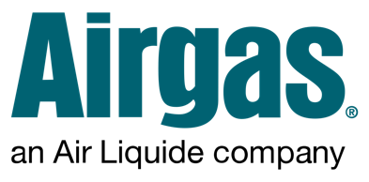
Jan-Nov 2020 $735,384
2021 Sales Jan-Nov $338,625
Airgas Safety
  Good progress from Atmos deal
  George Watlington-Gate Keeper
  Tony Emmolo’s new position
    Future bright
Airgas Specialty Gas
  Huge Opportunity
  Airgas Gas Equipment Group
    Not a good situation
  Take advantage of your area reps
  Relationships

Slide 3

2021 Projected $1,005,363
Sales 2020 $740,460.00
Definitely an important account.
Success in some areas and nothing with other branches.
Lots of competitive lines but they express a desire to do more with us.
New opportunities in Texas now and they are continually acquiring additional distributors.
Lots of room to grow.
Need to put on fixed product awareness webinar.
Mallory Contacts

Slide 4

Projected 2021 $396,264.00
Sales 2020 $314,923.00
  Mobile $78,682.00
  Oklahoma $64,459.00
  Jacksonville $36,733.00
  Houston $25,320.00
  Pompano $16,997.00
  San Antonio $16,291.00
  Tampa $16,058.00
  Dallas $13,346.00
  Oregon $9,084.00
  Las Vegas $7,632.00
https://www.ritzsafety.com/locations

Slide 5

Northern 2021 Projected $62,823.00
Sales2020 $28,576.00
Orr 2021 Projected $248,385.00
2020 $518,094.00
Corpus Christi branch just ordered GX-3R for stock. Good sign
They will be watching this branch as a model.
Over 100 outside reps combined throughout the US
NSI - ORR Outside Sales Roster Map

Slide 6

2021 Projected $180,295.00
Sales 2020 $46,261.00
This account was responsible for the two-wire development.
They have gone a bit quiet, but we believe they will pick-up strong for 2022.
Mainly cover Texas to Alabama.
One of the largest providers of instrumentation, filtration, steam/energy management and high-pressure products in the United States.
Over 100 employees.
Locations | Moody Price

Slide 7

2021 Projected $38275.00
Sales 2020 $4632.00
Gas services company over seventy-five years old trying to increase product sales.
Exclusive distributor for the gas utilities for Inficon Irwin Methane Leak Detector.
Sales team are all based inside. They are trying hard to build sales but are having trouble getting to the right person.
Nationwide coverage
Gas | Products | Southern Cross (southerncrossinc.com)

Slide 8

2021 Projected $866,296.00
Sales 2020 $772,919.00
They have representatives all over the country. We are strong in the southeast, Colorado and doing better in the northeast.
Omnia Partners Contract (Formerly US Communities Contract). Makes buying easier with no bid practice
We work with the folks that want to work with us.
They will continue to grow but we will never be there first out of the bag in areas that we are not already.
Great group of people and ownership.
Safeware Locations | Safeware (safewareinc.com)

Slide 9

2021 Projected $99,542.00
Sales 2020 $74,905.00
No communication with their team. Never return calls or emails.
Fell into a great fixed system a few months ago
Use us for Eagle II
Terminating their discount
CONTACT US | Code Red Safety

Slide 10

2021 Projected $35,600.00
Sales 2020 $0.00
Focused on the small to medium sized water/waste water market.
We just got in their catalog, so the numbers are low.
Very promising account. Due to Covid, we have not been able to get in front of their team.
Have a large team of outside reps base throughout the country
They are expanding their model into the food and beverage industry

Slide 11

2021 Projected $209,238.00
Sales 2020 $75,297.00
Holding company purchased Trench Plate Rental and National Trench Safety.
Combined sixty-three branches in the US, two in the UK
Todd has worked hard for this account and we have many more opportunities
National Trench Safety - St. Lois MO Trench & Traffic Safety Specialists (ntsafety.com)

Slide 12
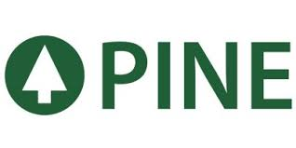
2021 Projected $387,017.00
Pine Env 2020 $355,757.00
Sandra to elaborate

Slide 13

2021 Projected $313,144.00
Combined 2020 $281,608.00
2021 Projected $161,449.00
Total Sales 2020 $209,927.00
2021 Projected $151,695.00
Total S&S 2020 $71,681.00
This account is huge
Predominantly Blackline Safety
We have some success’ in certain areas.
Future possibilities regarding cloud-based tracking.
Locations - Total Safety

Slide 14

2021 Projected $49,028.00
Sales 2020 $39,194.00
They bought Safety Wear out of Indiana. Zac Brough (previous owner) is safety category manager.
They are 100% of these numbers.
We could grow well with them, but we are not getting responses from their regional managers.
Future unknown
2021 Martin Safety Directory

Slide 15

2021 Projected $82,423.00
Sales 2020 $139,620.00
Dival has lost some reputation as a gas detection house
Gene Scherer is the gas detection champion but cannot get his team to do much with detection.
Unless they invest in more gas detection people, I don’t see much growth with this account.
Eleven locations
DiVal Safety Equipment, Inc. - Locations

Slide 16
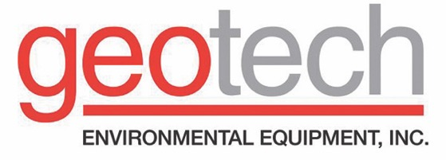
2021 Projected $95,270.00
Sales 2020 $60,308.00
Nine branches throughout the US.
Tammy has done some good things and Dave is getting attention at corporate in Denver
No RKI products on the website
Great potential, especially PID
Geotech Branch Locations (geotechenv.com)

Slide 17

2021 Projected $105,006.00
Sales 2020 $90,704.00.00
Most of the Sales out of PA and CA
Similar account to Pine and Geotech.
Thirteen locations
Locations (fieldenvironmental.com)

Slide 18

2021 Projected $48,833.00
Sales 2020 $44,870.00
Sales in TX, OH, NJ, NC, MI, AZ, AL
Recent meeting with their engineering fire and gas project team in Pasadena sounds very promising for fixed systems. They do these projects nation-wide and can turn-key.
Locations Finder | Shop Vallen

Slide 19

2021 Projected $62124.00
US Sales 2020 $57052.00
2021 Projected $44948.00
Canada 2020 $75896.00
We are opening the US operations up for a discount on an as needed basis.
If we can develop relationships with certain reps, we can work with them.
They have supply chain contracts with many large companies
500 Branches
Locations - Motion Branches & Shops - Motion (motionindustries.com)

