Slide 1

Gas Detection for Life

Slide 2
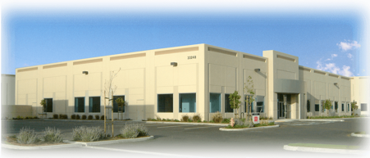
Who is RKI?
RKI founded in 1994
Partner company: Riken Keiki
  Leader In Gas Detection & Sensor Technology for over 80 years
California Corporation
Average employee’s gas detection experience is 10 years

Slide 3




Company Culture
Customer Service
Technical Service
Fast Delivery
Quality

Slide 4
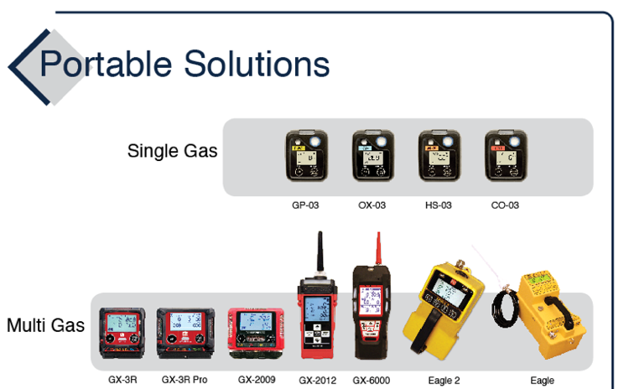
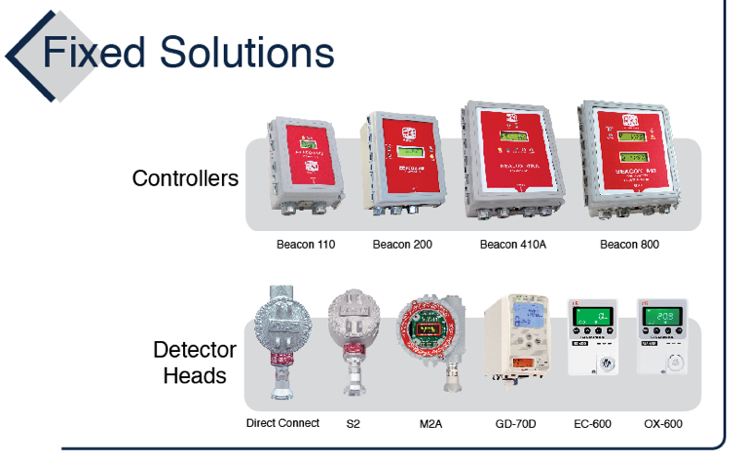
Product Family

Slide 5
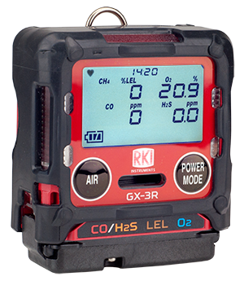
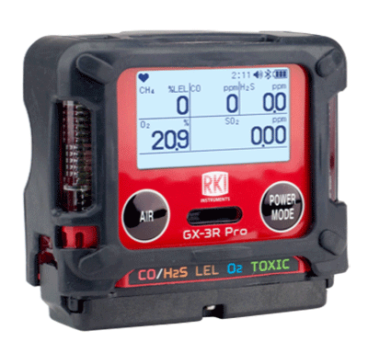
GX-3R & GX-3R Pro
2 Models—Depending on Need
4-gas compliance model
5-gas pro model
GX-3R
GX-3R Pro
Worlds smallest and lightest
4-gas monitor
Impact, water, & dust resistant
3-year Warranty
  4-gas plus extra slot for toxic or IR sensor
  Wireless communication with mobile app
  Man-down and panic alarms
  Alkaline & Rechargeable options

Slide 6

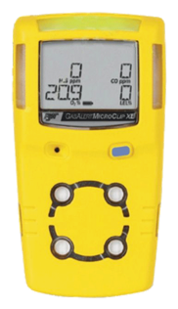
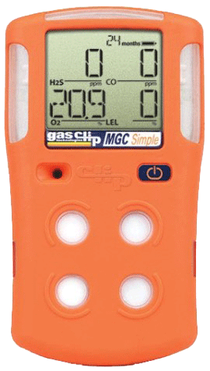

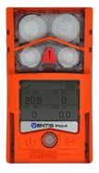
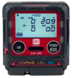
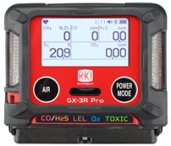
Competitor Comparison
Size & Weight
2.2” x 2.55” x 1”
3.7 ounces
2.9” x 2.66” x 1.06”
4.6 ounces
4.4” x 2.4” x 1.2
6.3 ounces
4.1” x 2.3” x 1.4”
6.4 ounces
4.7” x 2.7” x 1.2”
7.67 ounces
4.4” x 3.0” x 1.4”
7.9 ounces
5.12” x 1.9” x 1.8”
8 ounces
The GX-3R weighs about half of the average 4-gas detector!

Slide 7
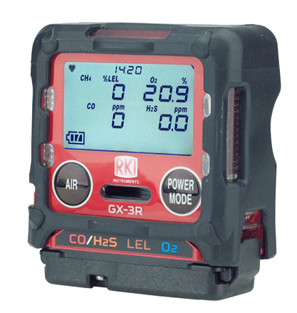


GX-3R
The world’s smallest and lightest 4-gas monitor
Size matters in the “Breathing Zone!”
Field replaceable sensors and parts
Non-compliance indicator
Concussion resistant – drop tested at > 20ft.
IP-68 and IP-66 rated
3-year warranty
3 adjustable alarm levels
Datalogging
Low cost of ownership
“The breathing zone is within a ten inch radius of the worker's nose and mouth. OSHA requires that worker exposure monitoring air samples be collected in the breathing zone. Air sampling filters may be attached to the collar or lapel.”

Slide 8
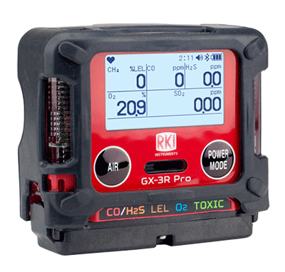
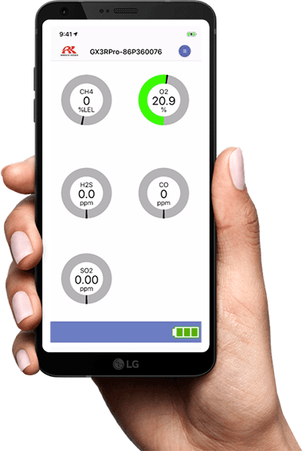

GX-3R Pro
All of the great features of the GX-3R, plus:
An extra sensor slot for IR or toxic sensors
Man down and panic alarms
Full-dot LCD display with auto-rotate and auto-backlight
Bluetooth (BLE) connectivity
RK Link mobile app
RK Link app:
Text or Email alarm notifications with GPS location
Direct readings from instrument
Alarm indications
Configure instrument settings
Instrument locator
Available on iOS and Android

Slide 9




No-Fee Lone Worker Solution
Text and / or Email alarm notifications with alarm data and GPS location of the worker.
Text and / or email up to 150 recipients
RK Link is a free download on iOS or Android.
No monthly service fees.
Stay connected with no fee!

Slide 10
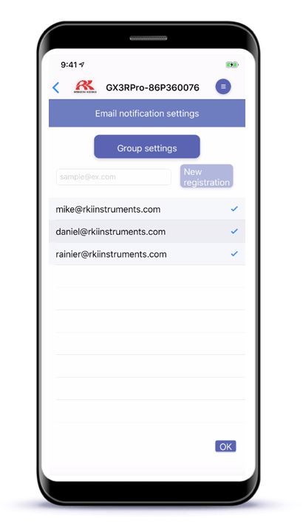
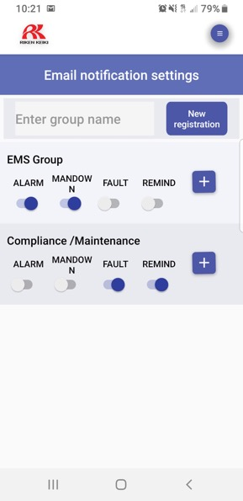


Alert Different Team Members
Based on Alarm Type
EMS Group
Compliance / Maintenance

Slide 11
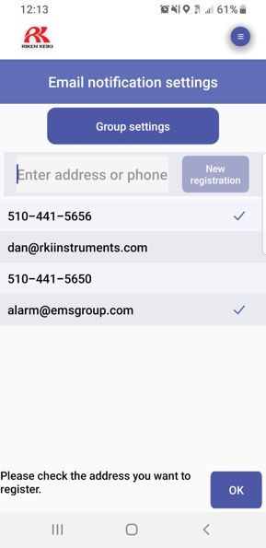


Send Alerts By SMS or E-mail

Slide 12
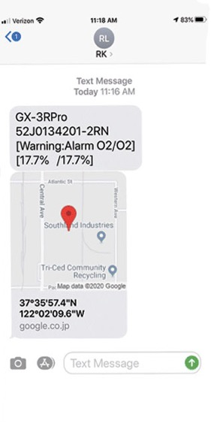
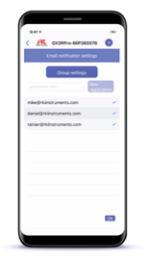
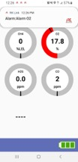
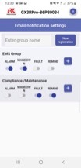

Alerts Include Alarm Data and GPS Location

Slide 13
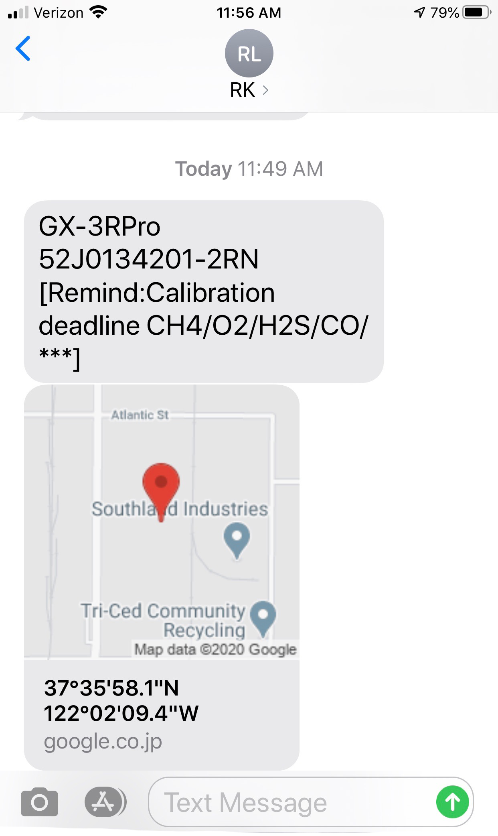
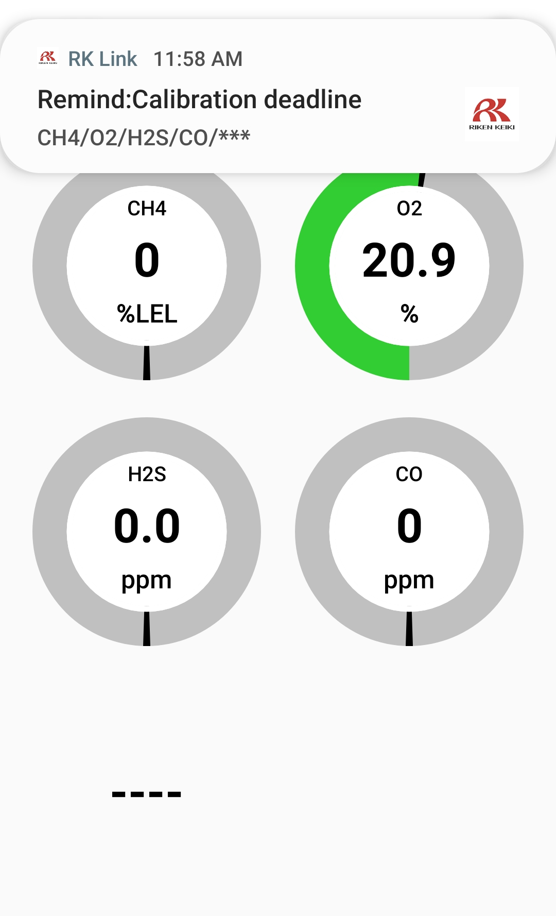
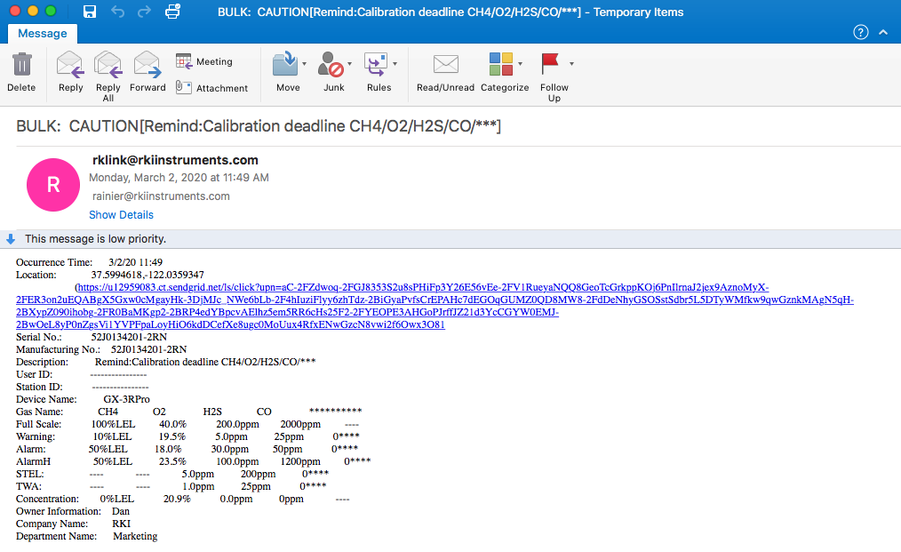
Automatically Send Compliance Notifications
Compliance / Maintenance

Slide 14
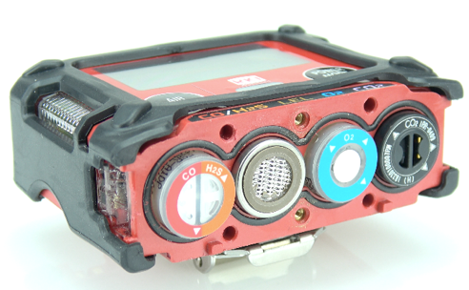

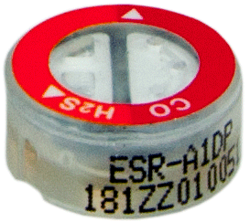
Sensors
The Heart of Every Instrument
We manufacture our own sensors
Our micro-sensors allow us to make the smallest gas detectors in the world
3-year warranty
New LEL sensor’s dual-filament design is silicon resistant
Lead-free EC tech gives O2 sensor 3-5 year lifespan
Dual sensor – 2 channels in one sensor slot
Dual filament
LEL sensor
F1
Dual Sensor
F2
+ Si removal filter
CO/H2S

Slide 15
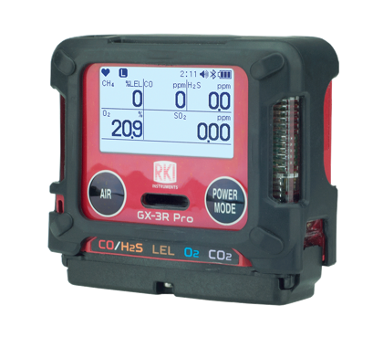

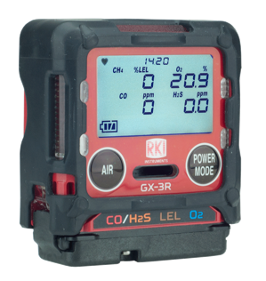
Sensor Options
GX-3R and GX-3R Pro
3-year warranty on all GX-3R and GX-3R Pro Sensors!
GX-3R and GX-3R Pro | GX-3R Pro Only | Coming in 2020 (GX-3R Pro only)
CO/H2S | CO2 ppm (IR) | HCN
LEL | CO2 % vol (IR) | NH3
O2 | SO2 | NO2
H2S |  | Cl2
CO
(-H2) CO

Slide 16
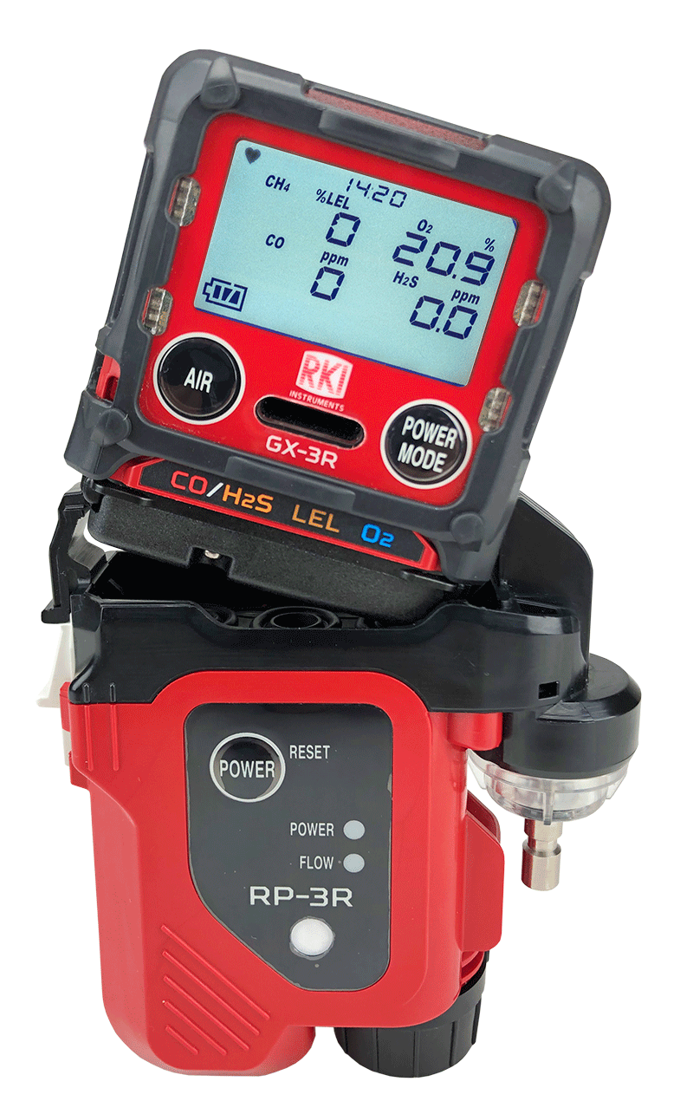
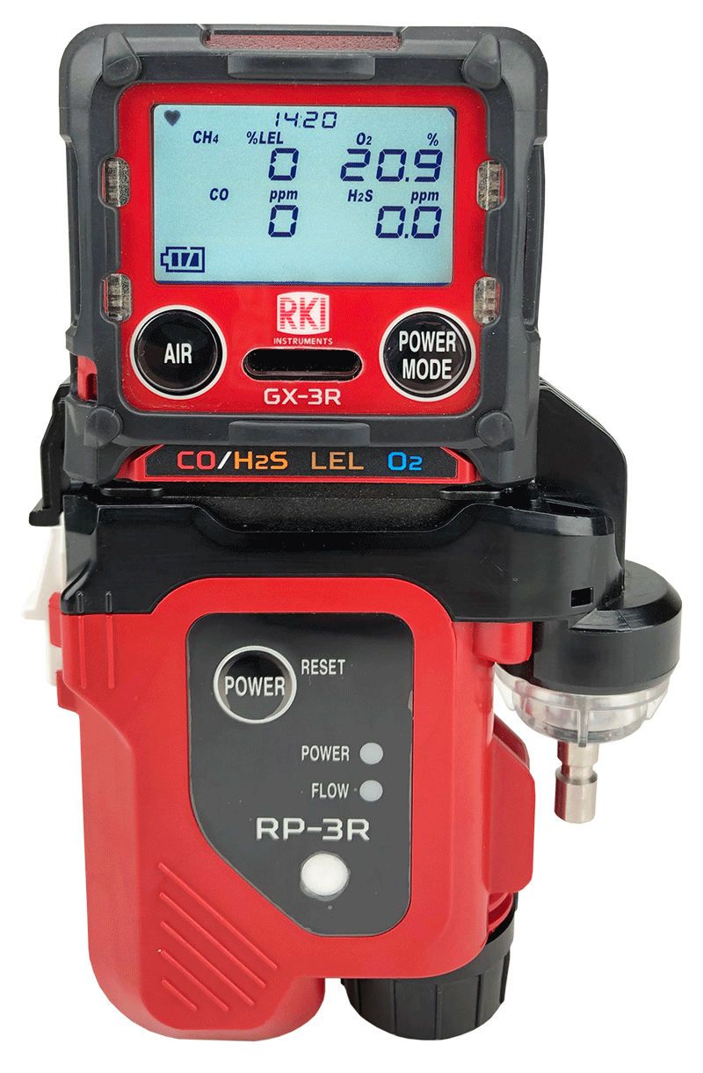

Attachable Pump and Cal Station
GX-3R & GX-3R Pro
RP-3R Sample Draw Pump:
Compatible with both GX-3R and GX-3R Pro
Flow rate: 500ml / min
Distance to draw: 50 feet
Operation time: 10h
Independent power supply
RP-3R
SDM-3R Calibration Station:
Accepts both GX-3R and GX-3R Pro
Bump Time: 10 seconds
Gas Consumption: 250 ml / min
Output: Internal memory / USB drive / LAN cable / USB Cable to PC
SDM-3R

Slide 17
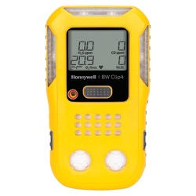
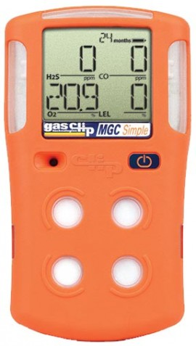
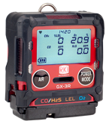

Stacking Up to the Competition
Feature | GX-3R | BW Clip4 | Multi Gas Clip Simple
Price | Lower list price | Higher list price | Same list price
Size and weight | Smaller and lighter | Larger and heavier | Larger and heavier
Sensor ranges | Better sensor ranges | Narrower sensor ranges | Narrower sensor ranges
Alarm points | 3 adjustable alarm points | 2 alarm points | 2 alarm points
Warranty | 3 year warranty | 2 year warranty | 2 year warranty
Attachable sample draw pump | Available sample draw pump | No sample draw option | No sample draw pump option
Cost of ownership | Lower cost of ownership | Disposable | Disposable

Slide 18

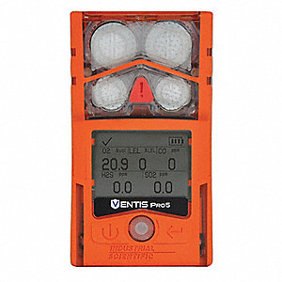
Stacking Up to the Competition
Feature | GX-3R | MSA Altair 4XR | ISC Ventis Pro 5
Price | Lower list price | Higher list price | Even Higher List Price
Size and weight | Smaller and lighter | Larger and heavier | Larger and heavier
Replacement sensors | Less expensive | More Expensive | More Expensive
Alarm points | 3 adjustable alarm points | 2 alarm points | 2 alarm points
Durability | IP-66 AND IP-68 rating | Only IP-68 | Only IP-68
Attachable sample draw | Available sample draw attachment | More expensive sample draw | More expensive sample draw
Cost of ownership | Lower cost of ownership | Higher cost of ownership | Higher cost of ownership

Slide 19
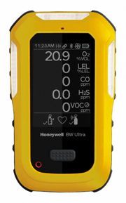
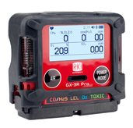
Stacking Up to the Competition
Feature | GX-3R Pro | BW Ultra (5-gas)
Price | Lower list price | Higher list price
Size and weight | Smaller and lighter | Larger and Heavier
Sensor ranges | Better sensor ranges | Narrower sensor ranges
Sensor costs | Lower sensor costs | Higher sensors costs
Battery life | Longer battery life | Shorter Battery Life
Alarm points | 3 alarm points | 2 alarm points
Warranty | 3 Years – Instrument and Sensors | Instrument – 3 years, Sensors – 2 or 3 years, Battery – 2 years

Slide 20
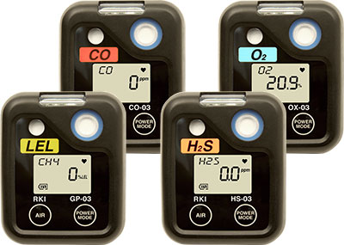
Single Gas Monitors
03 Series:
Hands-free gas monitoring
4 gases to choose from
2,000-3,000 battery life
Small, lightweight and durable
Datalogging
Overall warranty rate <5%
04 Series - coming 2020 with additional toxic gases!

Slide 21


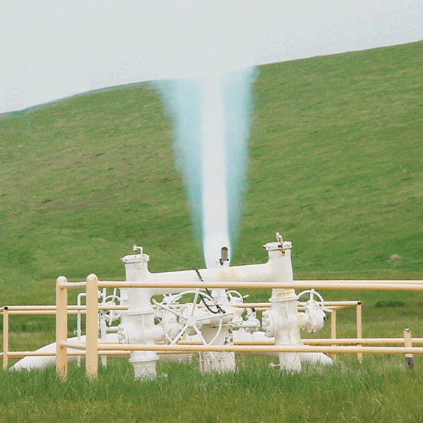
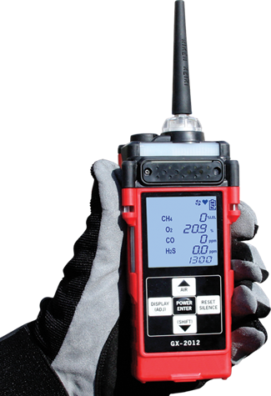
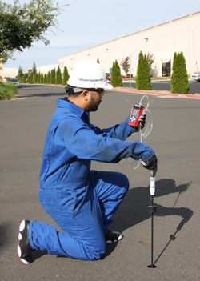
GX-2012
One Monitor – Four Functions
Leak Investigation
Confined Space Monitoring
Line Purge Testing
Bar Hole Sampling
Monitor LEL, O2, CO, H2S
Detects down to 100 ppm CH4
0-100% vol methane range
Internal sample pump
pulls samples up to 50’
Auto-ranging (from %LEL to %. vol)

Slide 22
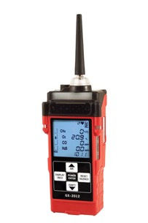

Stacking Up to the Competition
Feature | GX-2012 | BW GasAlertMax XT II
Battery options | Alkaline or rechargeable | Rechargeable only
Operating modes | Normal – Confined space Leak Check – ppm CH4 and CO surveying Line Purge – 100% vol CH4 Bar Hole – Timed underground CH4 sampling | One operating mode
Sensor slots | 5 sensor slots | 4 sensor slots
ppm/LEL/%vol auto-ranging | Auto-range readings from ppm → LEL → %vol* | LEL range only
Pump | 100’ max sample distance | 75’ max sample distance
*Requires optional TC sensor

Slide 23
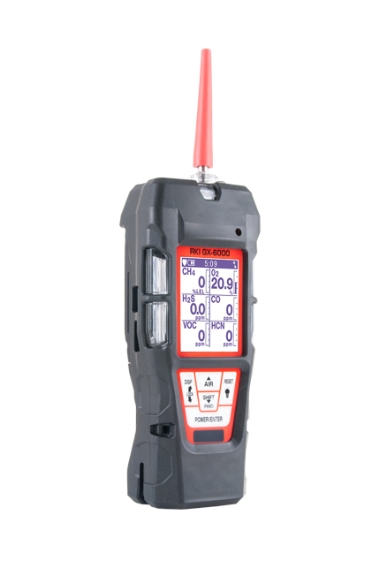

GX-6000
6-gas, sample draw with smart PID, IR & super toxics
VOC MONITORING
PID library of over 600 VOCs (10.6eV lamp)
Two ranges available:
    0-50,000 ppb or 0-6,000 ppm
Accepts 10.6eV/10.0eV/11.7eV PID lamps
Robust photo ionization detector (PID)
Can be combined with other sensors to maximize capacity
Benzene specific pre-filter tube available

Slide 24
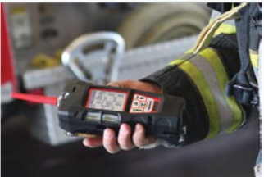
GX-6000
6-gas, sample draw with smart PID, IR & super toxics
FIRE INDUSTRY
Monitor low ppm levels of dangerous gases like NH3 or H2S commonly found in meth labs
Simultaneously monitor typical confined space hazards like LEL combustibles, O2 deficiency, CO & H2S
Find trace levels of flammables or HCN in arson investigation
Detect CO leaks or strange odors confidently
Man down alarm

Slide 25

GX-6000
6-gas, sample draw with smart PID, IR & super toxics
CONFINED SPACE ENTRY
Monitor LEL, O2, CO & H2S
Internal sample pump
Audible, visual and vibration alarms
Ideal for refinery applications
Man down alarm
Panic alarm
Optional sensors for toxic gases

Slide 26

GX-6000
6-gas, sample draw with smart PID, IR & super toxics
LEAK INVESTIGATION
Provides ppm detection of combustible gas
Leak check with changing blink/pulsing rate
    LEDs and alarm tones increase in frequency as gas concentration increases
Leak check mode displays both CO & combustible levels
Audible alarm silence
    Investigate leaks without alarming residents
Barhole mode for tracking leak migration

Slide 27
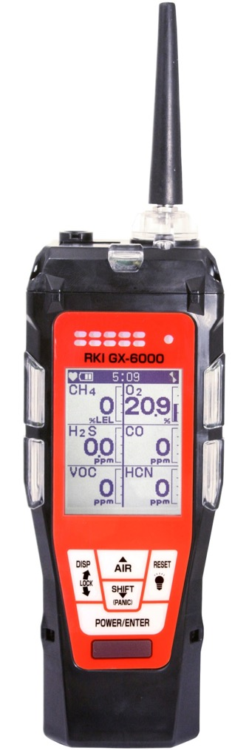
Features
Monitor up to 6 Gases
H2S, CO, O2, LEL
2 smart sensor slots
  PID for VOC’s (10.0, 10.6 & 11.7 eV)
  IR for CH4, HC, & CO2
  EC for NH3, Cl2, HCN, NO2, & SO2
  Dual PID capability
LCD display
Auto flip display
Peak bar graphs
Adjustable auto backlight
Customize order of gases
Single gas view with large font & auto sequence
5 operating modes
Normal
Leak check
Inert
Bar hole
Snap Log
Alarms
2 adjustable gas alarms per channel
Man Down alarm
4 alarm LED’s
Audible and vibration alarms
Trouble alarms for low flow, sensor connection, low battery, circuit error, & calibration
PID library of more than 600 VOC’s
0-6,000 ppm/ 0-50,000 ppb ranges
Easily choose a target VOC
  User defined VOC list of 30
  Recently used VOC list last 8
LEL Protection mode
Shields LEL sensor from damaging VOC exposure

Slide 28
Features
Smallest 6 gas sample draw
Lightweight & Ergonomic
High impact rubber boot
Ergonomic design fits comfortable in hand
Custom Unit Identification
User & Station ID selection Menu
Assign multiple users to select within one instrument
Internal Sample Pump
50’ sampling range
Weather & Dust Resistant
IP-67
Interchangeable battery options
Lithium-ion pack operates 14 hours
  Complete recharge in 3 hours
Alkaline pack operates 8 hours
9 Languages
English, Germany, Italian, French, Portuguese, Spanish, Japanese, Korean, Russian

Slide 29
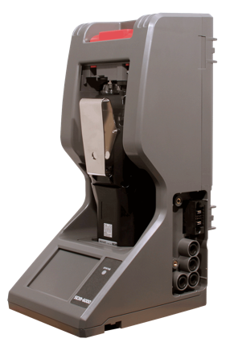
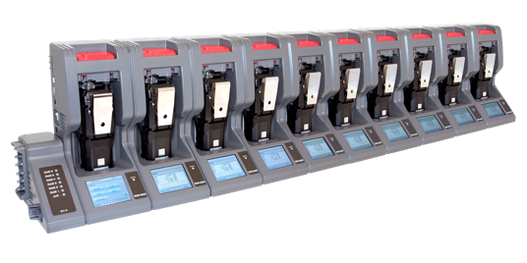
SDM-6000 Docking Station
  Stand alone station (no PC required)
  Charging
  Bump, Calibrate, and Alarm tests
  Touch screen menu display
  Save calibration, bump tests, alarm history and exposure data to an SD memory card or to a computer
  Automatically power on or off for scheduled maintenance
  Up to 3 ports for separate calibration gas cylinders
  Manage up to 10 instruments with one power source, calibration source, and computer
  Configure GX-6000 parameters
  SV-3 unit expands calibration ports up to 6 ports
  Easily connects to adjacent docks
  Automatically distributes power, calibration gas, and data once connected
  DIN Rail wall mount
  Local print out of calibration/bump and alarm test results

Slide 30
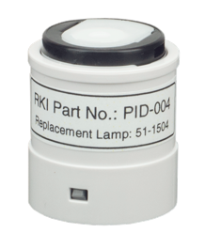
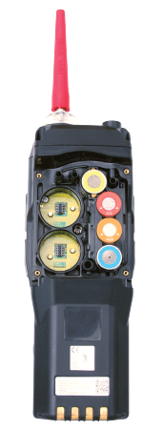
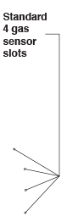

PID Options – GX-6000
4 PID’s to choose from:
PID /gas |  | Range | Accuracy
10.6 eV low | 600 VOC’s | 0-50,000 ppb | +/- 10% of reading, +/- 1 digit
10.6 eV high |  | 0-6,000 ppm
10.0 eV | Benzene specific | 0.1-50 ppm
 | 300 VOC’s | 0-100 ppm
11.7 eV | High- voltage lamp | 0-1,000 ppm
Standard 4-gas sensor slots
The GX-6000 is the only multi-gas monitor with simultaneous dual-PID capability
Long life 11.7 eV lamp
  Typical 9 to 12 month life!
  Monitor carbon tetrachloride, acrylonitrile, chloroform, methanol, refrigerants (R-143, R-132A), and more
Two PID / smart sensor slots

Slide 31


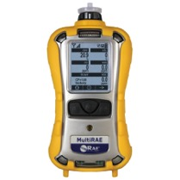

Stacking Up to the Competition
Feature | GX-6000 | BW ultra (PID) | RAE Systems MultiRAE
Size and weight | Smaller and lighter | Larger and heavier | Larger and heavier
# of PID options | 4 PID options | 1 PID option | 1 PID option
11.7 eV PID | 11.7 PID available | Not available | Not available
PID life | Longer PID life | Shorter PID life | Shorter PID life
Dual PID capable | Simultaneous dual PID | No | No
Benzene specific mode | Benzene specific mode | No | No
Leak check mode | Leak check mode | No | No
Bar hole mode | Bar hole mode | No | No
Sensor costs | Lower sensor costs | Higher sensor costs | Higher sensor costs
Battery life | Longer battery life | Shorter battery life | Shorter battery life
Cost of ownership | Lower cost of ownership | Higher cost of ownership | Higher cost of ownership

Slide 32
Stacking Up to the Competition
Feature | GX-6000 | Altair 4XR (PID) | Ventis Pro 5 (PID)
Size and weight | Smaller and lighter | Larger and heavier | Larger and heavier
# of PID options | 4 PID options | 1 PID option | 1 PID option
11.7 eV PID | 11.7 PID available | Not available | Not available
PID life | Longer PID life | Shorter PID life | Shorter PID life
Dual PID capable | Simultaneous dual PID | No | No
Benzene specific mode | Benzene specific mode | No | No
Leak check mode | Leak check mode | No | No
Bar hole mode | Bar hole mode | No | No
Sensor costs | Lower sensor costs | Higher sensor costs | Higher sensor costs
Battery life | Longer battery life | Shorter battery life | Shorter battery life
Cost of ownership | Lower cost of ownership | Higher cost of ownership | Higher cost of ownership

Slide 33


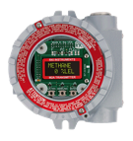



Common Fixed System Components
Beacon 410A Controller
M2A Transmitter
Remote Mount Sensor
with Cal Cup
S2 Transmitter
Direct Connect Sensor
RKI’s diffusion style remote mount detectors allow for easy calibrations in difficult access areas
Alarm Relays Activate Ventilation / Exhaust System

Slide 34







Fixed Sensors and Transmitters
Direct Connect
S2 Transmitter
M2A Transmitter
Cost Effective
Water repellent sensor coating
Explosion Proof
Transmitters 4-20mA output
Explosion Proof
Stainless steel option
Operates with or without controller
OLED display
2 programmable alarm relays
Non intrusive calibration
4-20mA and Modbus outputs
GD-70D
35-3001 Sample Draw
Smart Sample Draw
Wide range of plug & play sensors
Large LCD Display
SD-1 Series
LEL, O2, H2S, CO CO2, & H2 available
Multigas versions
Internal sample pump with 100’ range
Explosion proof, IP-65/67
Monitor ppm or % LEL ranges
Available for H2, IPA, CAN, and ETO

Slide 35




Products and Market
Oil & Gas Production (downstream operations)
  Gases encountered:
    Combustibles
    O2 deficiency
    H2S, CO
    SO2, HCN, NH3
    Benzene (C6H6)
  RKI Products
    GX-3R & GX-3R Pro advantages:
      Smallest & lightest available
      Ideal for workers wearing monitors in the breathing zone for entire shifts
      Bluetooth connectivity and toxic sensors for GX-3R Pro
    GX-6000 advantages:
      6 Gas channels
      5 operating modes
      Benzene specific PID
      Smart sensors with toxic and PID options

Slide 36



Products and Market
Energy – Power Utilities
  Gases Encountered
    Combustibles
    O2 deficiency
    H2S, CO
    H2
  RKI Products
    GX-3R & GX-3R Pro advantages:
      Smallest & lightest available
      Bluetooth capability and toxic sensors for GX-3R Pro
    GX-2012 advantages:
      3 operating modes: Normal, leak check, and bar hole sampling
      Internal sample pump
      Ideal for pre-entry sampling of manholes
    Eagle 2 advantages:
      Special transformer testing configuration

Slide 37

Products and Market
Construction
  OSHA CFR 1926 –
    Confined Spaces in Construction
  Gases Encountered
    Combustibles
    O2 deficiency
    H2S, CO
  RKI Products
    GX-3R & GX-3R Pro advantages:
      Smallest & lightest available
      Ideal for workers wearing monitors in the breathing zone for entire shifts
      Man-down and panic alarms for GX-3R Pro
    GX-6000 advantages:
      Internal sample pump for pre-entry sampling
      PID sensors for VOC monitoring
      6 operating modes:
      Normal, leak check, and bar-hole sampling

Slide 38


Products and Market
Water & Waste Water
  Gases Encountered
    Combustibles
    O2 deficiency
    H2S, CO
    Ammonia, Chlorine, Ozone, Sulfur Dioxide, & VOC’s
  RKI Products
    GX-3R & GX-3R Pro advantages:
      Smallest & lightest available
      Ideal for workers wearing monitors in the breathing zone for entire shifts
      Bluetooth connectivity and toxic sensors for GX-3R Pro
    GX-6000 advantages:
      2 Smart sensor slots to monitor NH3, Cl2, SO2, & VOC’s
      6 Gas channels
    Fixed System Products
      High range H2S solutions for extreme environments

Slide 39


Products and Market
Landfill / Waste
  Gases Encountered
    EPA Method 21
    CH4
    CO2
    Ammonia, Chlorine, Sulfur Dioxide, & NMOC’s & VOC’s
  RKI Products
    GX-6000 advantages:
      2 Smart sensor slots to monitor NH3, Cl2, SO2, & VOC’s
      6 Gas channels
      6 operating modes:
      Normal, leak check, and bar-hole sampling
    Eagle 2 advantages:
      6 Gas channels
      PPM, % LEL, or % Vol. auto-ranging combustible detection
      Infrared (IR) CO2, % LEL CH4, % Vol. CH4, % LEL HC, % Vol. HC
      Powerful long-life pump up to 125’ range

Slide 40



Products and Market
Fire/First Responders
  Gases Encountered
    Combustibles
    O2 deficiency
    H2S, CO
    HCN, NH3, & VOC’s
  RKI Products
    CO-03:
      Clipped to gear bags, nuisance calls, Verify SCBA removal
    GX-3R & GX-3R Pro advantages:
      Stealth mode for law enforcement applications
      Man-down and panic alarms for GX-3R Pro
    GX-6000 advantages:
      Monitor low ppm levels of dangerous toxics like NH3 or H2S commonly found in meth labs
      Find trace levels of flammables or HCN
      in arson investigation
      Avoid HCN exposure in overhaul

Slide 41


Products and Market
Food & Beverage
  Gases Encountered
    CO2
    Combustibles, O2 deficiency
    H2S, CO
    HCN, NH3, PH3
  RKI Products
    GX-3R & GX-3R Pro advantages:
      Smallest & lightest available
      Infrared CO2 sensors available for GX-3R Pro
    GX-6000 advantages:
      Monitor dangerous toxics like NH3, H2S, HCN or PH3
    Fixed System Products
      Continuously monitor for oxygen deficiency,
      NH3 refrigeration leaks, CO2 levels in beverage
      dispensing locations

Slide 42

Products and Market
Manufacturing
  Gases Encountered
    Combustibles
    O2 deficiency
    H2S, CO
    Process gases like Carbon Dioxide, Ammonia
  RKI Products
    GX-3R & GX-3R Pro advantages:
      Smallest & lightest available
      Ideal for workers wearing monitors in the breathing zone for entire shifts
      Bluetooth connectivity and toxic sensors for GX-3R Pro
    GX-6000 advantages:
      6 Gas channels
      5 operating modes
    Fixed System Products
      Continuously monitor process gases

Slide 43

Products and Market
Chemical Manufacturing
  Gases Encountered
    Combustibles
    O2 deficiency
    H2S, CO
    Cl2, H2, HCl, NO2, SO2, VOC’s
  RKI Products
    GX-3R & GX-3R Pro advantages:
      Smallest & lightest available
      Ideal for workers wearing monitors in the breathing zone for entire shifts
      Bluetooth connectivity and toxic sensors for GX-3R Pro
    GX-6000 advantages:
      6 Gas channels
      5 operating modes
      2 Smart sensor slots to monitor NO2, Cl2, SO2, & VOC’s
    Fixed System Products
      Continuously monitor process gases

Slide 44
Common Gas Hazards by Industry
Industry | Hazards/Gases | Portable Products
Oil & Gas | LEL, O2, H2S, CO, SO2, HCN, NH3, Benzene (C6H6) | GX-3R & GX-3R Pro, GX-2012, GX-6000, Eagle 2
Energy/Utilities | LEL, O2, H2S, CO, SO2, H2 | GX-3R & GX-3R Pro, GX-2012, Eagle 2
Construction | LEL, O2, H2S, CO, NO2 | GX-3R & GX-3R Pro, GX-2009 MSHA (for NO2), GX-6000
Water/Wastewater | LEL, O2, H2S, CO, NH3, Cl, O3, SO2, VOC’s | GX-3R & GX-3R Pro, GX-6000
Landfill/Waste | CH4, CO2, NH3, CL2, NMOC’s, VOC’s | GX-6000, Eagle 2
Fire/First Responders | LEL, O2, H2S, CO, HCN, NH3, VOC’s | CO-03, GX-3R & GX-3R Pro, GX-6000
Food and Beverage Production | LEL, O2, H2S, CO, HCN, NH3, CO2, PH3 | GX-3R & GX-3R Pro, GX-6000
Manufacturing | LEL, O2, H2S, CO, Process gases like CO2, NH3 | GX-3R & GX-3R Pro, GX-6000
Chemical | LEL, O2, H2S, CO, Cl2, H2, HCl, NO2, SO2, VOC’s | GX-3R & GX-3R Pro, GX-6000, Eagle 2

Slide 45




















Slide 46
Distributor Partnership Program
Stocking distributor: provide immediate delivery
  Increased sales
Service Center: provide immediate local instrument service, calibration and repair parts.
  Increased profits
Regional RKI Representatives provide ongoing product training and sales support.
  Increased confidence
RKI business culture is unlike any other gas detection manufacture in the industry. We provide the highest quality product, immediate and exceptional customer service and technical support (USA).
  Increased reliability
RKI believes in working with partner distributors to develop their markets by provide you with orders (not sales leads) from area end-users.
  Increased team loyalty and trust.

Slide 47

RKI Regional Reps
NORTH WEST
John Foster
Cell: (509) 299-6777
Todd Rosencrans
Cell: (509) 299-6777
Jeremie Wise
Cell: (208) 659-2564
Justin. Wise
Cell: (208) 640-1564
Henry Dukart
Cell: (720) 301-1160
CENTRAL & MICHIGAN
Dave McEndarffer
Cell: (913) 634-0396
CENTRAL GREAT LAKES
John Maslowski
Cell: (262) 271-8956
NEW ENGLAND
Bob Carroll
Cell: (716) 725-3112
TRI-STATE
Nino Misiti
Cell: (610) 216-0393
N. CALIFORNIA
Ramey Packer
Cell: (510) 285-7506
MID ATLANTIC
Don Brauninger
Cell: (571) 278-0478
SOUTH WEST
Tammy Girton
Cell: (949) 397-5040
SOUTH EAST
Todd Sauls
Cell: (770) 654-7443
GULF COAST
Darrell Pinckard
Cell: (713) 732-0513
SOUTH CENTRAL
James Emmons
Cell: (214) 980-4002

Slide 48

Quantity Discounts
RKI is committed to supporting all of our Distributor Partners’ stocking needs with quantity based discounts. When you place an order for any Premier Portables that has one “ship to” location, the following discounts will automatically be applied based on the quantity ordered.

Slide 49

Growth Rebate Partnership Program
In an effort to reward our distributor partners who are growing RKI's business, RKI offers a Growth Rebate Partnership Program. This program is designed to reward your organization with cash for sales growth achieved.
Growth Rebate Program
Growth Targets will be set based on previous year's sales, averaged on a quarterly basis
• 10% growth earns a 3% payment on the growth achieved
• 20% growth earns a 5% payment on the growth achieved
Eligibility for Growth Rebate requires exceeding the Year to Date Growth Target and will be evaluated at the end of each quarter
Quarterly growth rebate payments will be made within 30 days after each quarter
Growth Rebate Program Requirements
Must be a fully authorized RKI Distributor for a minimum of 12 months to participate
Distributor's credit account with RKI must be in good standing
Must have a minimum of $50,000 in sales within the prior year

Slide 50

Questions?

Slide 51


