Slide 1

Natural Gas Markets

Slide 2
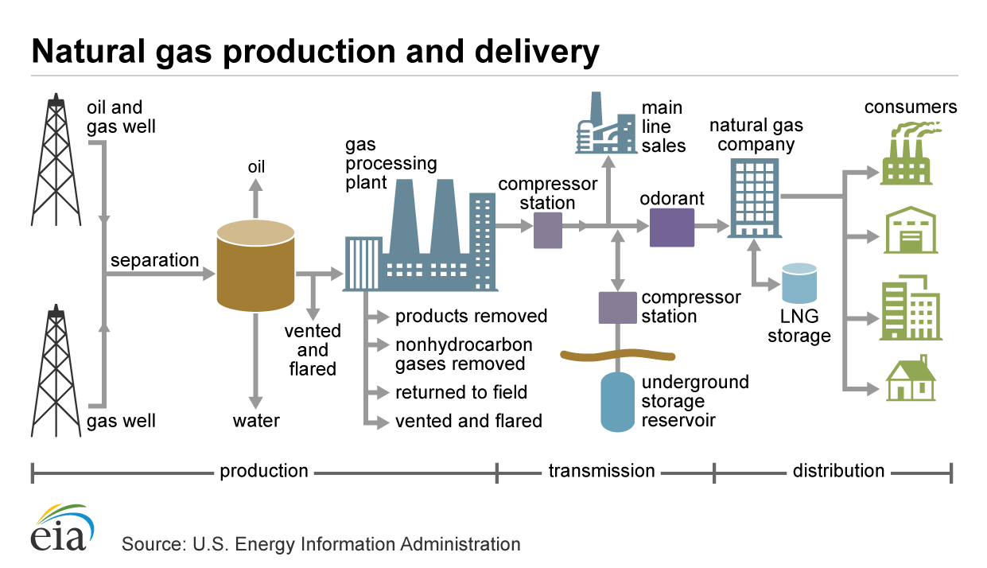
Overview
How natural gas gets from the ground to my water heater

Slide 3

Exploration
Locations for likely exploration

Slide 4

Pipelines
2.1 million miles of transmission pipeline
.9 million miles of distribution pipeline
Over 3 million miles of gas pipeline
It all needs to be tested and maintained

Slide 5
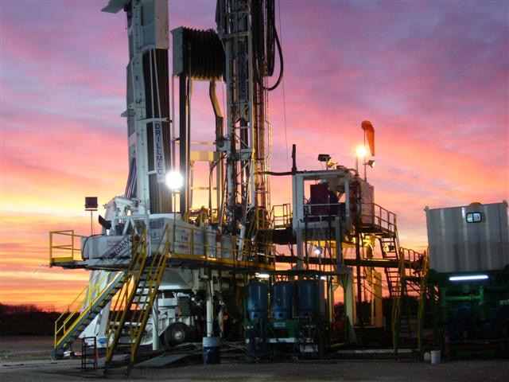
Production
Wells are drilled

Slide 6
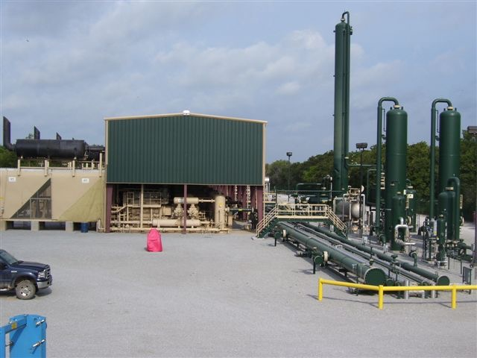
Compressor Station
Gases compressed for transporting

Slide 7
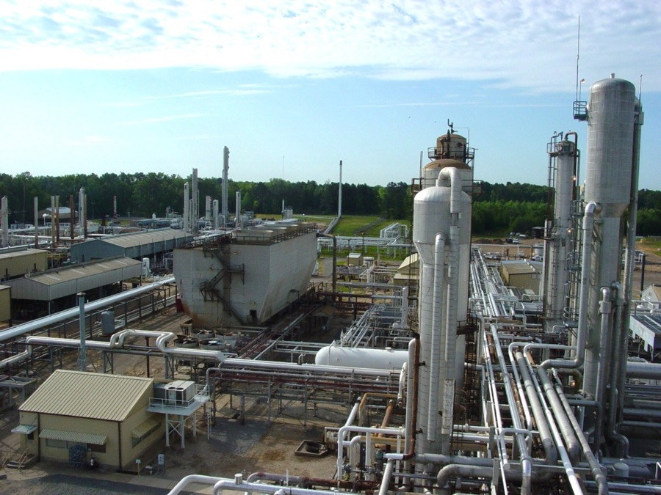
Gas Plant
Gases scrubbed and processed

Slide 8
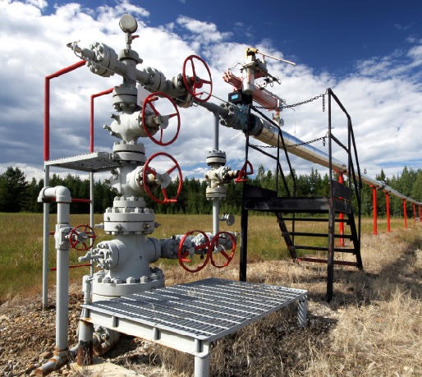
Transmission
Gases transferred to process centers

Slide 9
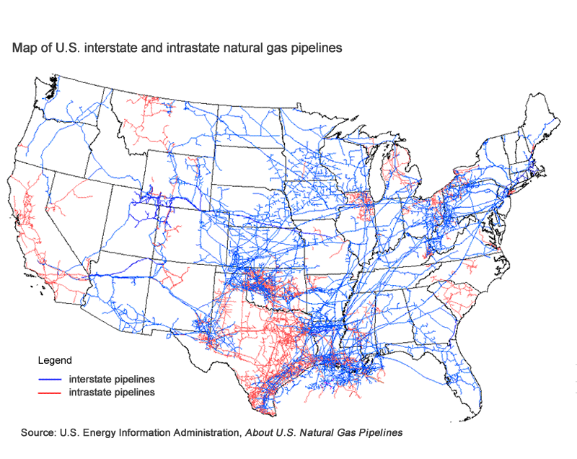
Transmission Pipeline

Slide 10
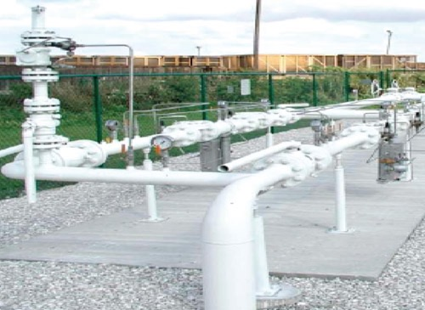
City Gate/ Storage
Wholesale becomes retail

Slide 11
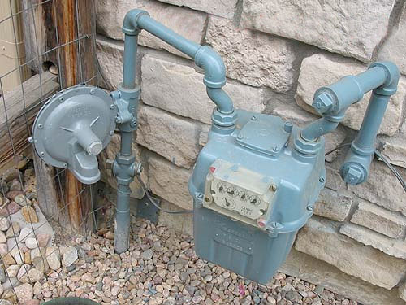
Distribution to homes and businesses

Slide 12







Each Step Needs Gas Detection
  Drilling and Production
  Fixed H2S and LEL on rig and perimeter
  Personal monitoring
  Compressor Stations
  Fixed LEL
  Personal Safety
  Leak survey
  Gas Plants/ Processing
  Fixed H2S , LEL, SO2
  Personal Safety
  Transmission Maintenance
  Leaks, Purge, Bar hole, Sampling
  Personal Safety
  Transmission Construction
  Safety, Permitting, Purge
  City Gate/ Storage
  Personal Safety
  Leaks, Purge
  Distribution
  Leaks, Purge, Bar hole
  Personal Safety

Slide 13
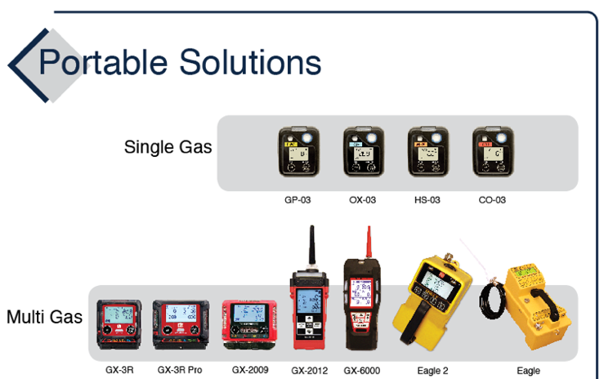
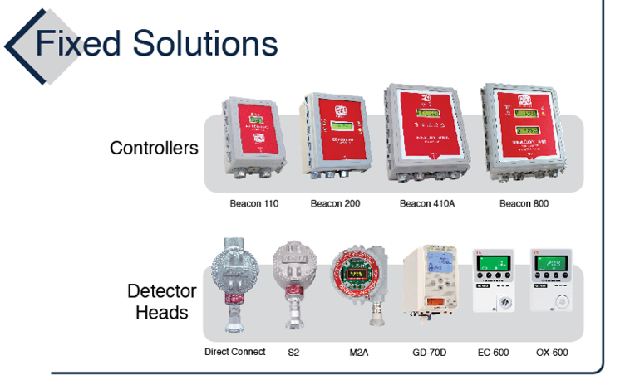
How does RKI fit in?

Slide 14
Two Types of Operators:
Construction and Maintenance (C&M)
  Build Inspect
  Repair
  Maintain
Measurement
  Test, check and repair instrumentation that measures flow, pressure, volume, purity etc

Slide 15
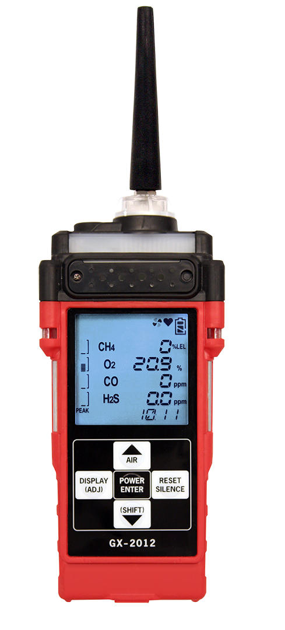
GX-2012
4 Operating Modes
  Leak check
  Bar hole
  % volume - Purge
  Safety

Slide 16
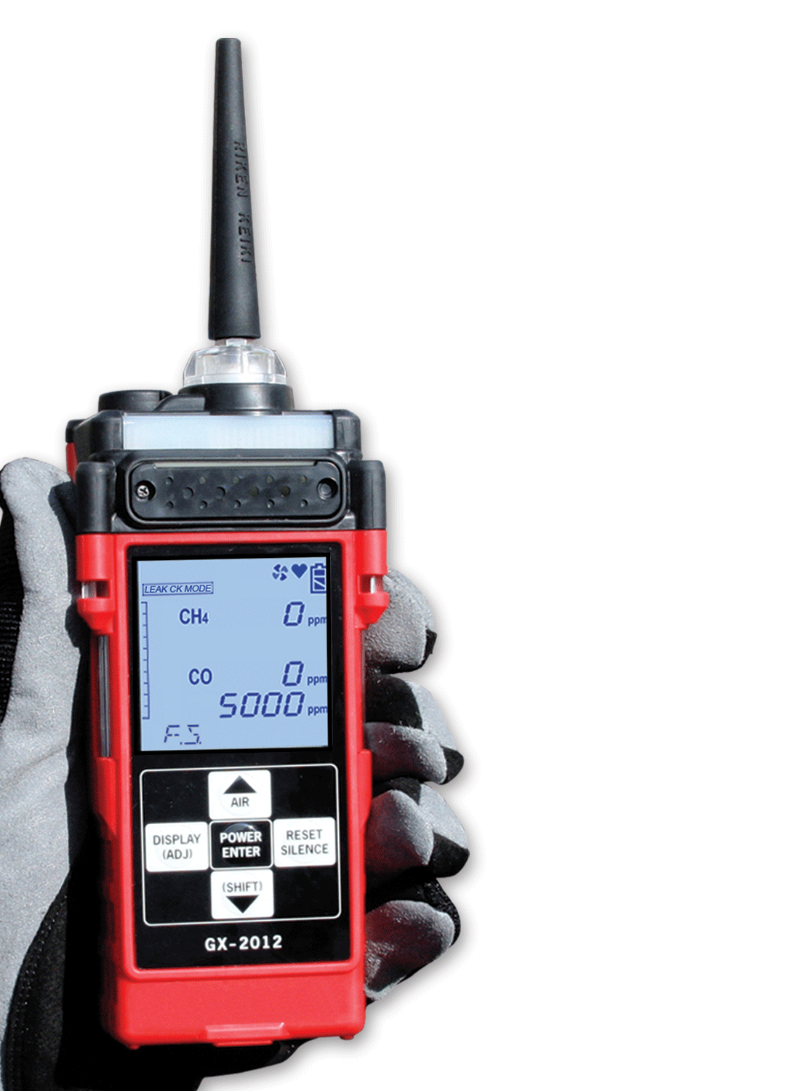
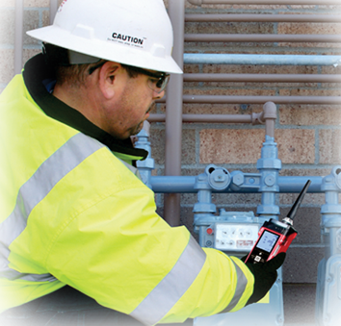
GX-2012
Leak Check Mode
PPM leak detector, detects down to 100 ppm CH4
Adjustable display ranges: 500/1000/2000/5000 ppm
Visual / audible pulses change with gas concentration
CO display in leak check mode, ideal for residential investigations

Slide 17

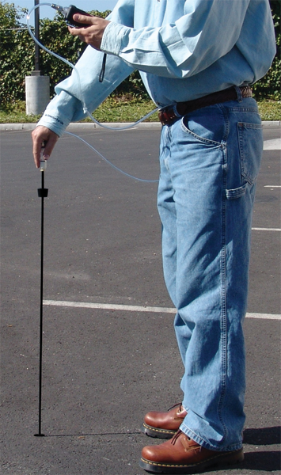
GX-2012
Bar Hole Mode
Bar hole datalogging
Samples on demand
Take samples when you’re ready
Fixed time sampling periods
Displays peak reading after sampling
Locate leaks quicker, more accurately

Slide 18
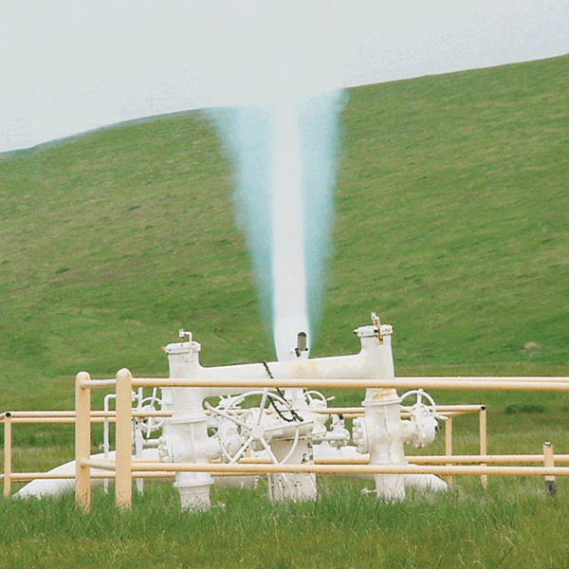
GX-2012
Line Purge Testing
TC Sensor
0 to 100% volume Methane range, Purge
Autoranging
Automatically ranges from % LEL to % Vol
Displays appropriate unit of measure

Slide 19

GX-2012
Confined Spaces
Monitor LEL, O2, CO, H2S
Internal Sample Pump
Pull samples up to 40’
Maintain steady sample flow to sensors
Vibration, audible, and visual alarms
3 ways to communicate with workers

Slide 20
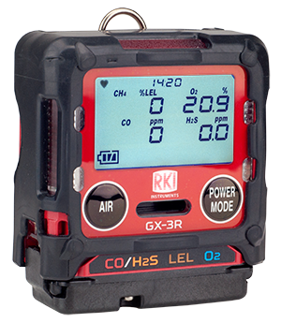
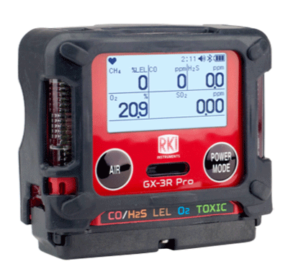
GX-3R & GX-3R Pro
2 Models—Depending on Need
4-gas compliance model
5-gas pro model
GX-3R
GX-3R Pro
Worlds smallest and lightest
4-gas monitor
Impact, water, & dust resistant
3-year Warranty
  4-gas plus extra slot for toxic or IR sensor
  Wireless communication with mobile app
  Man-down and panic alarms
  Alkaline & Rechargeable options

Slide 21
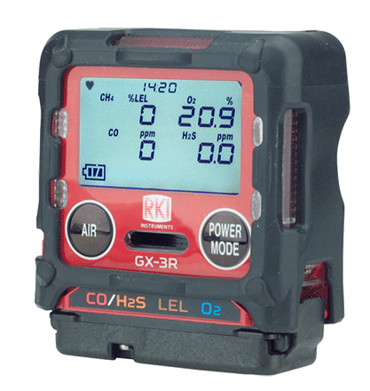


GX-3R
The world’s smallest and lightest 4-gas monitor
Size matters in the “Breathing Zone!
Field replaceable sensors and parts
Non-compliance indicator
Concussion resistant – drop tested at > 20ft.
IP-68 and IP-66 rated
3-year warranty
3 adjustable alarm levels
Datalogging
Low cost of ownership
“The breathing zone is within a ten inch radius of the worker's nose and mouth. OSHA requires that worker exposure monitoring air samples be collected in the breathing zone. Air sampling filters may be attached to the collar or lapel.”

Slide 22
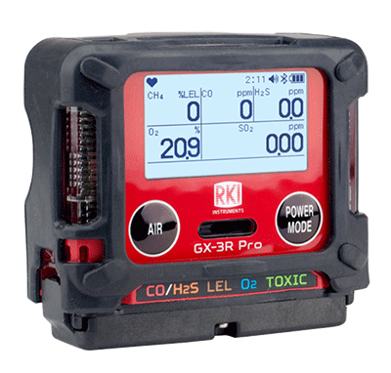
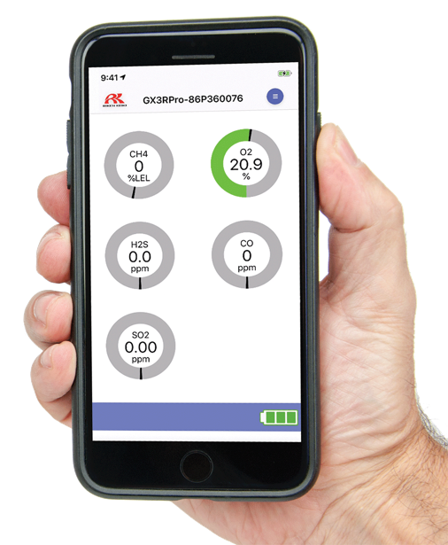

GX-3R Pro
All of the great features of the GX-3R, plus:
An extra sensor slot for IR or toxic sensors
Man down and panic alarms
Full-dot LCD display with auto-rotate and auto-backlight
Bluetooth (BLE) connectivity
RK Link mobile app
RK Link Mobile App
Text or Email alarm notifications with GPS location
Direct readings from instrument
Alarm indications
Configure instrument settings
Instrument locator
Available on iOS and Android

Slide 23
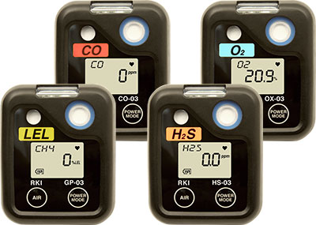
Single Gas Monitors
03 Series
Hands-free gas monitoring
4 gases to choose from
2,000-3,000 battery life
Small, lightweight and durable
Datalogging
Overall warranty rate <5%
04 Series - coming 2020 with additional toxic gases!

Slide 24
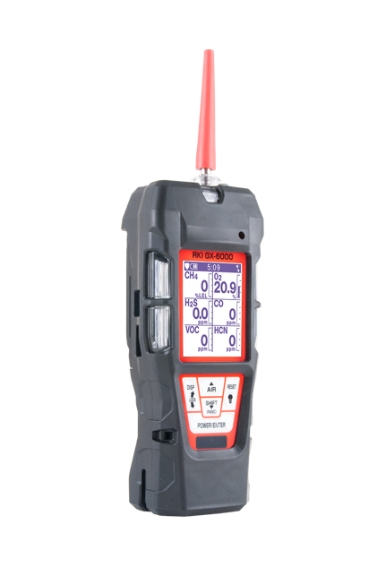
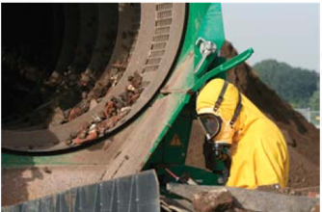
GX-6000
6-gas, sample draw with smart PID, IR & super toxics
VOC MONITORING
PID library of over 600 VOCs (10.6eV lamp)
Two ranges available:
    0-50,000 ppb or 0-6,000 ppm
Accepts 10.6eV/10.0eV/11.7eV PID lamps
Robust photo ionization detector (PID)
Can be combined with other sensors to maximize capacity
Benzene specific pre-filter tube available

Slide 25
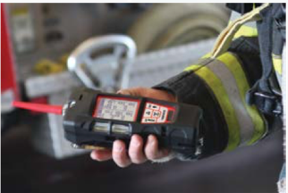
GX-6000
6-gas, sample draw with smart PID, IR & super toxics
FIRE INDUSTRY
Monitor low ppm levels of dangerous gases like NH3 or H2S commonly found in meth labs
Simultaneously monitor typical confined space hazards like LEL combustibles, O2 deficiency, CO & H2S
Find trace levels of flammables or HCN in arson investigation
Detect CO leaks or strange odors confidently
Man down alarm

Slide 26
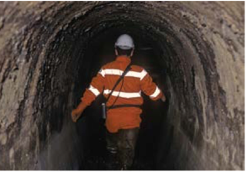
GX-6000
6-gas, sample draw with smart PID, IR & super toxics
CONFINED SPACE ENTRY
Monitor LEL, O2, CO & H2S
Internal sample pump
Audible, visual and vibration alarms
Ideal for refinery applications
Man down alarm
Panic alarm
Optional sensors for toxic gases

Slide 27
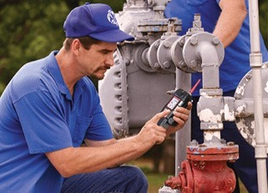
GX-6000
6-gas, sample draw with smart PID, IR & super toxics
LEAK INVESTIGATION
Provides ppm detection of combustible gas
Leak check with changing blink/pulsing rate
    LEDs and alarm tones increase in frequency as gas concentration increases
Leak check mode displays both CO & combustible levels
Audible alarm silence
    Investigate leaks without alarming residents
Barhole mode for tracking leak migration

Slide 28
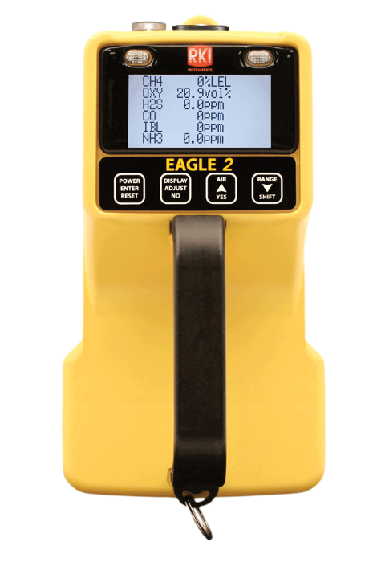
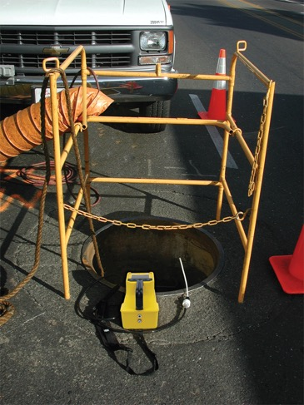
EAGLE 2
6-gas, sample draw with smart PID, IR & super toxics
CONFINED SPACE ENTRY
Monitor LEL, O2, CO, and H2S
Internal sample pump
  Pull samples up to 125’
  Maintain steady sample flow to sensors
Audible and visual alarms
  2 Ways to communicate with workers
Ideal for refinery applications

Slide 29
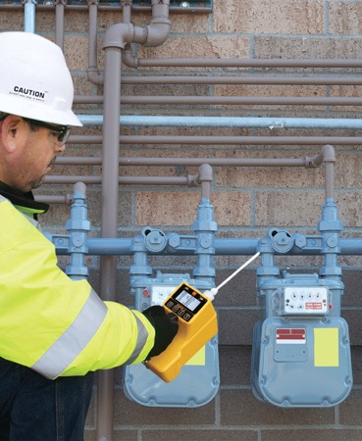
EAGLE 2
6-gas, sample draw with smart PID, IR & super toxics
LEAK INVESTIGATION
Provides ppm detection of combustible gas
Bar hole mode for tracking leak migration
Leak check with changing blink / pulsing rate
  LED’s and alarm tones increase in frequency as gas concentration increases
Audible alarm silence
Perform leak investigations without alarming residents

Slide 30
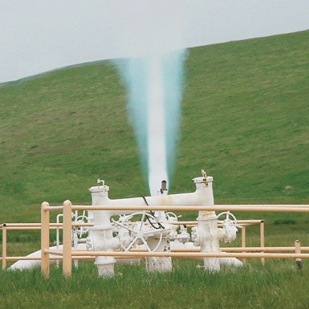
EAGLE 2
6-gas, sample draw with smart PID, IR & super toxics
LINE PURGE TESTING
Thermal conductivity sensor
  0 to 100% volume Methane / Hydrogen range
Autoranging IR
  Automatically changes from % LEL to % Vol.
  Displays appropriate unit of measure

Slide 31
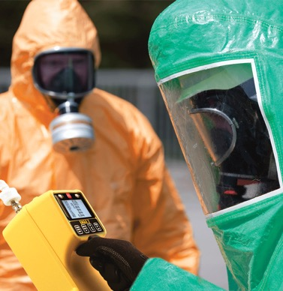
EAGLE 2
6-gas, sample draw with smart PID, IR & super toxics
VOC MONITORING
Robust photo ionization detector (PID)
Two ranges available,
  0-50 ppm or 0-2,000 ppm
Can be combined with other sensors to maximize capability
Method 21 compliant

Slide 32
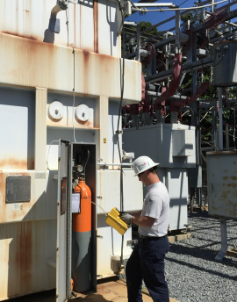
EAGLE 2
6-gas, sample draw with smart PID, IR & super toxics
TRANSFORMER TESTING
Robust photo ionization detector (PID)
Two ranges available,
  0-50 ppm or 0-2,000 ppm
Can be combined with other sensors to maximize capability
Method 21 compliant

Slide 33
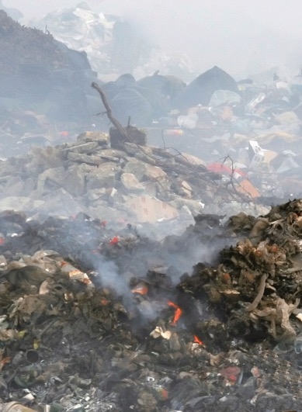
EAGLE 2
6-gas, sample draw with smart PID, IR & super toxics
LANDFILL MONITORIN
LEL / PPM and 0-100% volume Methane
0-60% Carbon Dioxide range
Can be combined with other sensors (O2/H2S/CO) to maximize capability

Slide 34


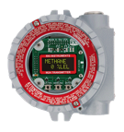
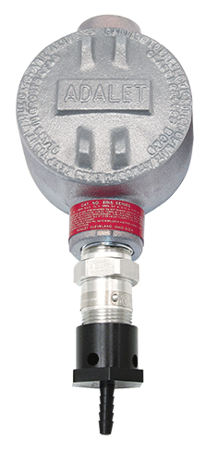
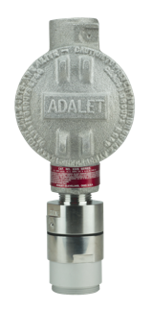

Common Fixed System Components
Beacon 410A Controller
M2A Transmitter
Remote Mount Sensor
with Cal Cup
S2 Transmitter
Direct Connect Sensor
RKI’s diffusion style remote mount detectors allow for easy calibrations in difficult access areas
Alarm Relays Activate Ventilation / Exhaust System

Slide 35

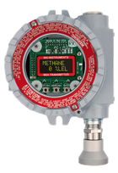
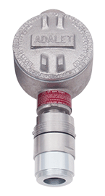
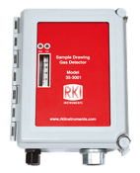

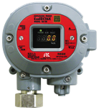

Fixed Sensors and Transmitters
Direct Connect
S2 Transmitter
M2A Transmitter
Cost Effective
Water repellent sensor coating
Explosion Proof
Transmitters 4-20mA output
Explosion Proof
Stainless steel option
Operates with or without controller
OLED display
2 programmable alarm relays
Non intrusive calibration
4-20mA and Modbus outputs
GD-70D
35-3001 Sample Draw
Smart Sample Draw
Wide range of plug & play sensors
Large LCD Display
SD-1 Series
LEL, O2, H2S, CO CO2, & H2 available
Multigas versions
Internal sample pump with 100’ range
Explosion proof, IP-65/67
Monitor ppm or % LEL ranges
Available for H2, IPA, CAN, and ETO

Slide 36

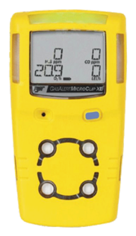
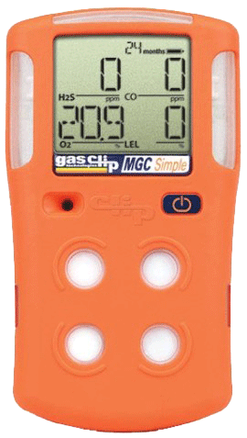

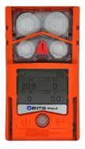
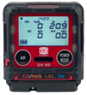
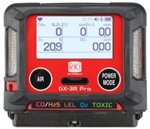
Stacking Up to the Competition
Size & Weight
2.2” x 2.55” x 1”
3.7 ounces
2.9” x 2.66” x 1.06”
4.6 ounces
4.4” x 2.4” x 1.2
6.3 ounces
4.1” x 2.3” x 1.4”
6.4 ounces
4.7” x 2.7” x 1.2”
7.67 ounces
4.4” x 3.0” x 1.4”
7.9 ounces
5.12” x 1.9” x 1.8”
8 ounces
The GX-3R weighs about half of the average 4-gas detector!

Slide 37
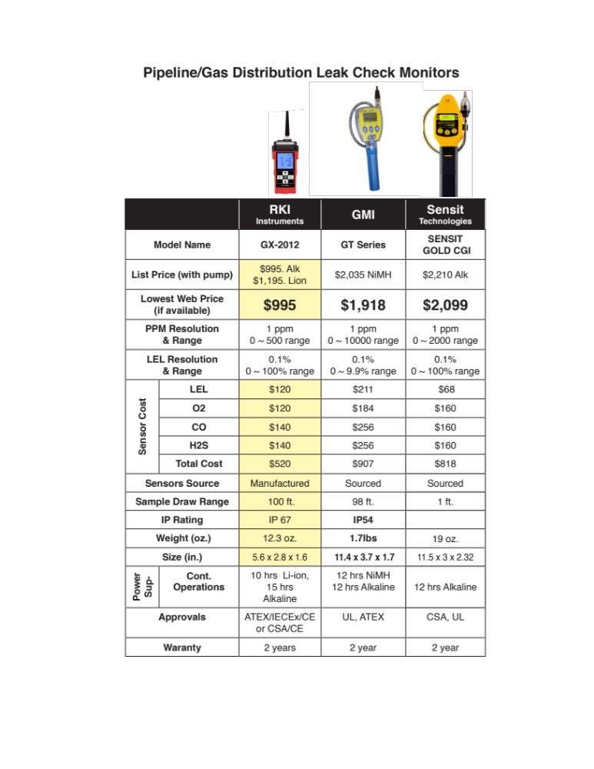
Stacking Up to the Competition

Slide 38

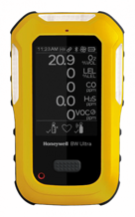
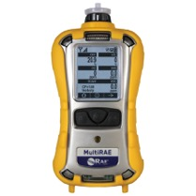

Stacking Up to the Competition
Feature | GX-6000 | BW ultra (PID) | RAE Systems MultiRAE
Size and weight | Smaller and lighter | Larger and heavier | Larger and heavier
# of PID options | 4 PID options | 1 PID option | 1 PID option
11.7 eV PID | 11.7 PID available | Not available | Not available
PID life | Longer PID life | Shorter PID life | Shorter PID life
Dual PID capable | Simultaneous dual PID | No | No
Benzene specific mode | Benzene specific mode | No | No
Leak check mode | Leak check mode | No | No
Bar hole mode | Bar hole mode | No | No
Sensor costs | Lower sensor costs | Higher sensor costs | Higher sensor costs
Battery life | Longer battery life | Shorter battery life | Shorter battery life
Cost of ownership | Lower cost of ownership | Higher cost of ownership | Higher cost of ownership

Slide 39
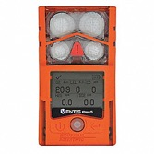
Stacking Up to the Competition
Feature | GX-6000 | Altair 5XR (PID) | Ventis Pro 5 (PID)
Size and weight | Smaller and lighter | Larger and heavier | Larger and heavier
# of PID options | 4 PID options | 1 PID option | 1 PID option
11.7 eV PID | 11.7 PID available | Not available | Not available
PID life | Longer PID life | Shorter PID life | Shorter PID life
Dual PID capable | Simultaneous dual PID | No | No
Benzene specific mode | Benzene specific mode | No | No
Leak check mode | Leak check mode | No | No
Bar hole mode | Bar hole mode | No | No
Sensor costs | Lower sensor costs | Higher sensor costs | Higher sensor costs
Battery life | Longer battery life | Shorter battery life | Shorter battery life
Cost of ownership | Lower cost of ownership | Higher cost of ownership | Higher cost of ownership

Slide 40
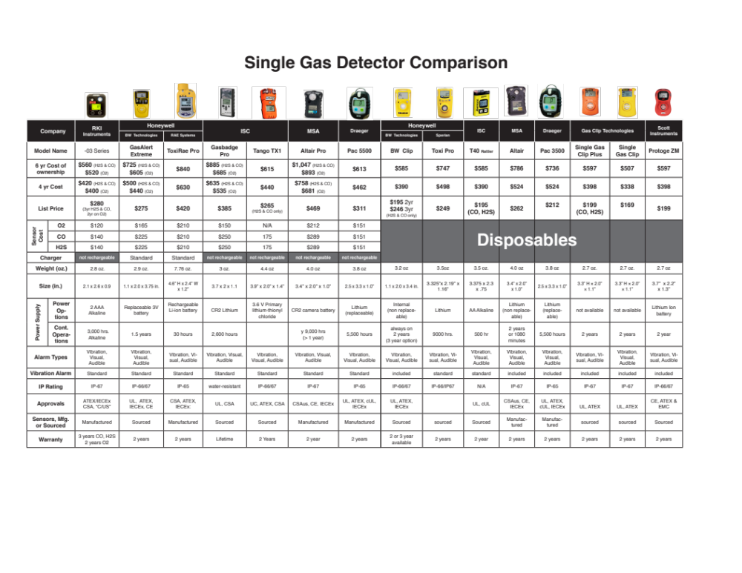
Stacking Up to the Competition

Slide 41

Stacking Up to the Competition

Slide 42

Selling to Gas Markets
GOOGLE
MI Pipelines
MI Pipeline Maps
Distribution
Transmission

Slide 43

Gas Utility Service Areas
Map prepared by Michigan Public Service Commission
May, 1999 - Revised April, 2006

Slide 44

Natural Gas Transmission Pipeline and Storage field map
Map prepared by Michigan Public Service Commission
May, 2000 - Revised December, 2002

Slide 45
Gas Associations
American Gas Association (AGA) www.aga.com
Natural Gas Supply Association (NGSA) www.ngsa.org
American Petroleum Institute (API) www.api.org
Interstate Natural Gas Association of America (INGAA) www.ingaa.org
Independent Petroleum Association of America (IPAA) www.ipaa.org
NaturalGas.org (An educational association) www.naturalgas.org

Slide 46

Networking
One company leads to another
Different regions w/ in the same company
Different departments w/ in the same company eg: C&M - HSE, Operation & Field Operation Manager, Area Safety Mgr
Contractors – Safety Coordinator

Slide 47

New Construction
Generally, two or more companies will form a partnership on a new pipeline and give it its own name. One of the owners will be the operational manager

Slide 48

Project Offices
Titles to ask for Include
  HSE, Safety Manager
  Operation Supervisor
  Maintenance Supervisor

Slide 49
Coordination of efforts
Interstate & National aspects require
multi-regional coordination

Slide 50




















Slide 51

Questions?

Slide 52


