Slide 1


Slide 2
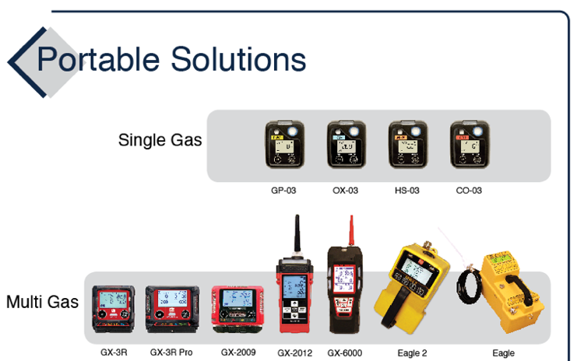
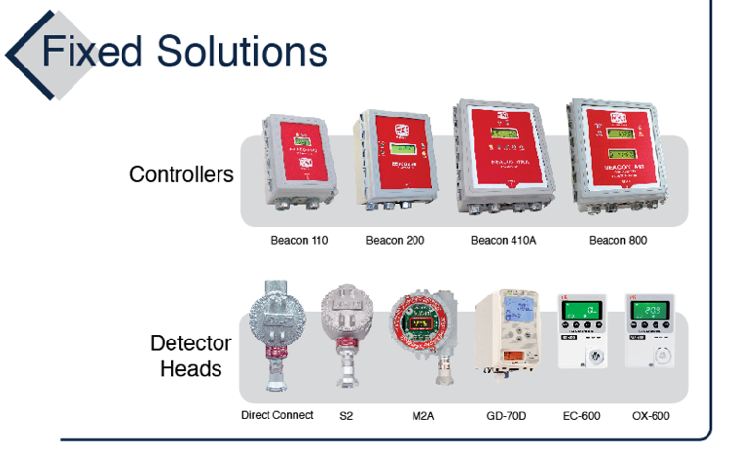
Product Family

Slide 3
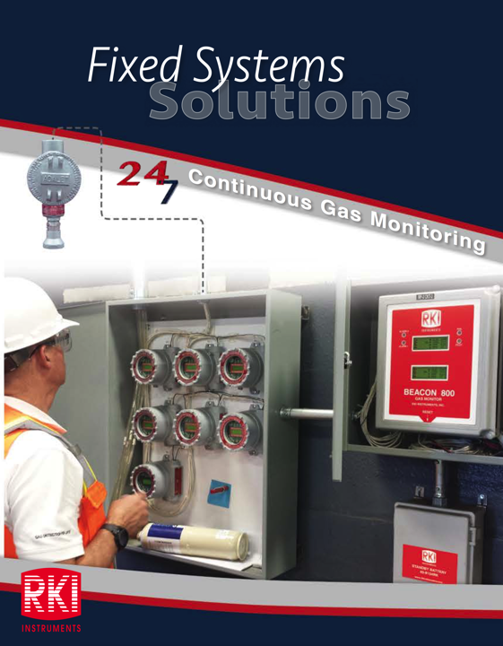

Slide 4

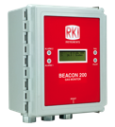
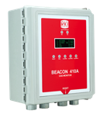
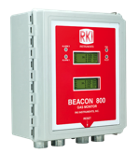
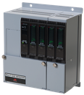
Controllers
Relays per channel
Alarm levels per channel
Common relays
Direct connect sensors
Channels
Beacon 110 | 1 | 2 | 3 | N/A | Yes
Beacon200 | 2 | 2 | 2 | 3 | Yes
Beacon 410A | 4 | 3 | 3 | 5 | Yes
Beacon 800 | 8 | 2 | 2 | 3 | No
RM-5000 | Up to 12 | 2 | 2 | 3 | Yes
Beacon 110
Beacon 200
1 – 8 Channel fixed systems controllers
Digital Readout
Weather proof NEMA 4X enclosure
Audible alarm
Alarm reset button
Optional strobe & battery backup
Beacon 410A
Beacon 800
RM-5000

Slide 5
Coming 2021
Beacon 3200
Will accept M2As, S2, and direct connects
8 card slots for sensor (4 channel per card) or relay (8 relays per card) cards
Maximum of 32 channels (but no relay cards in this case)
Touch panel LCD for user interface

Slide 6


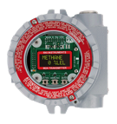
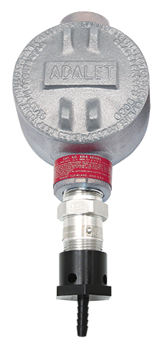
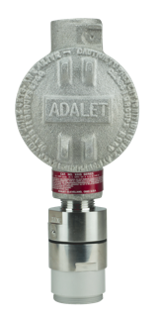
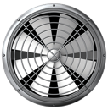
Common Fixed System Components
Beacon 410A Controller
M2A Transmitter
Remote Mount Sensor
with Cal Cup
S2 Transmitter
Direct Connect Sensor
RKI’s diffusion style remote mount detectors allow for easy calibrations in difficult access areas
Alarm Relays Activate Ventilation / Exhaust System

Slide 7
These are totally different!
Direct Connect Sensor
S2 Transmitter

Slide 8
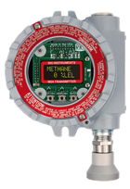
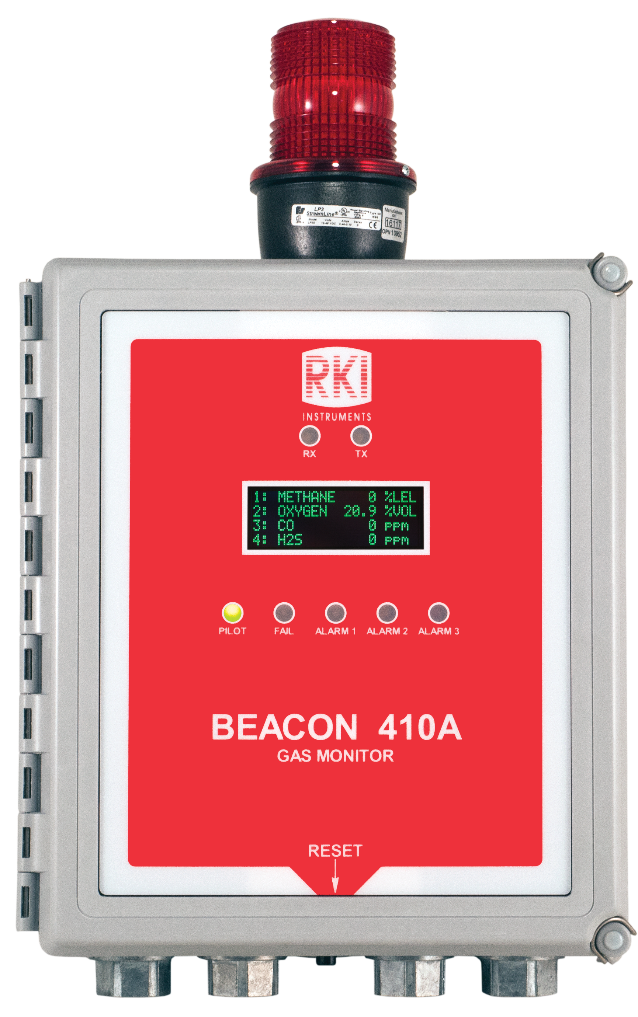
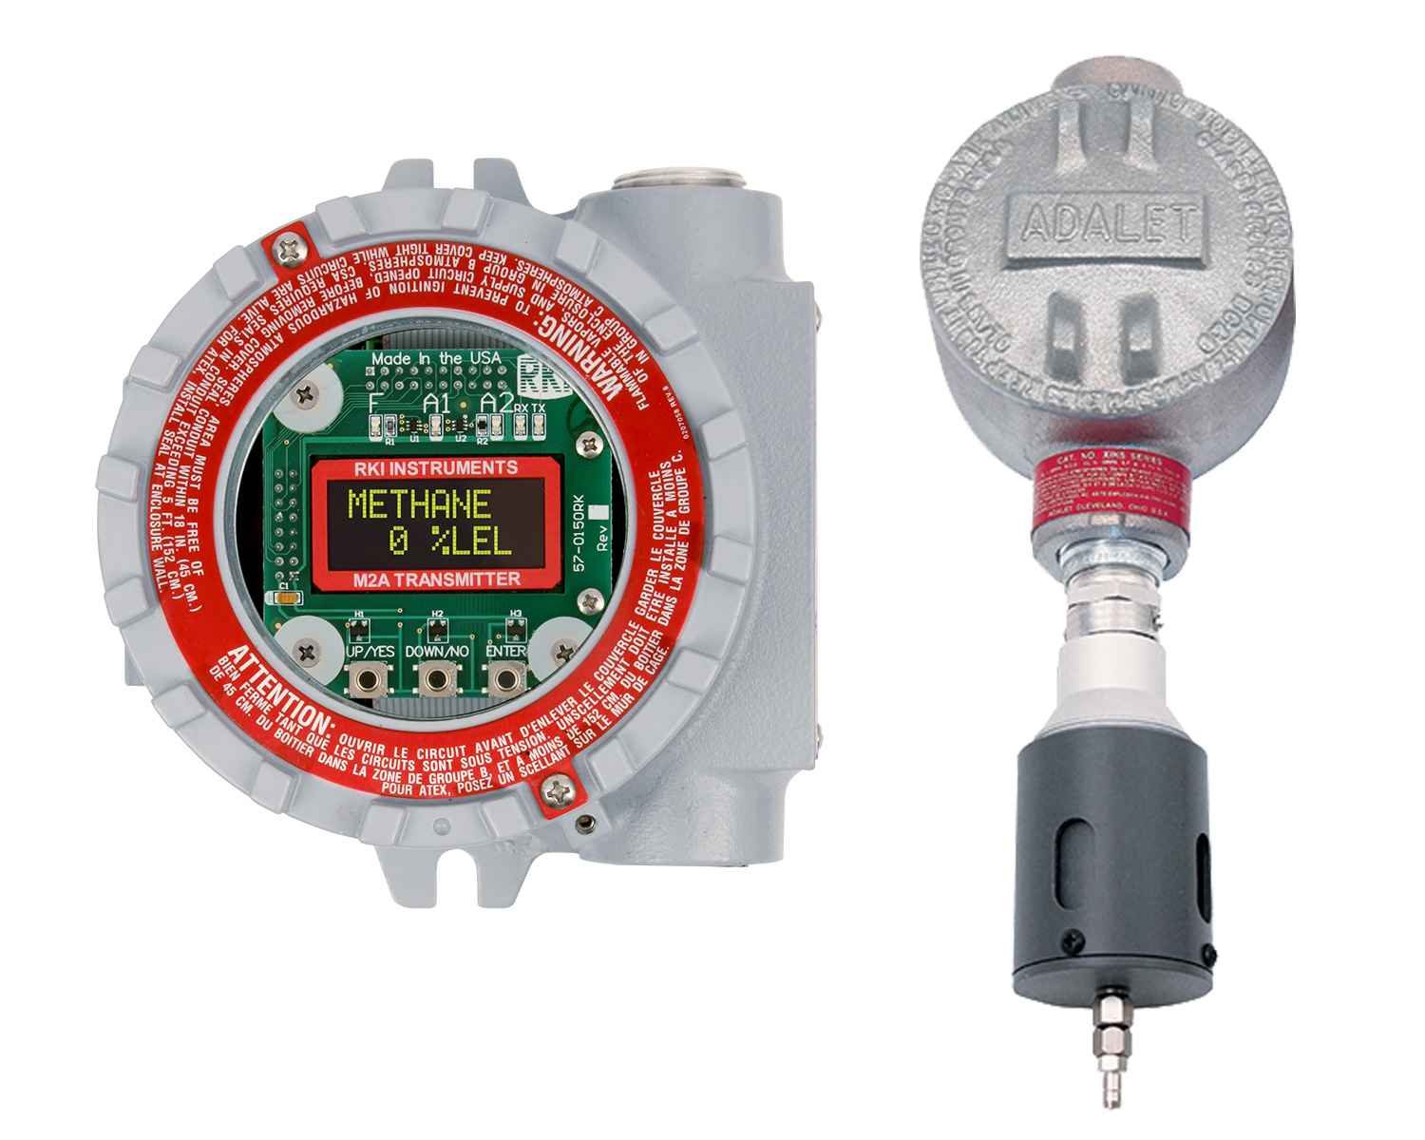
To Stand Alone or Not to Stand Alone
Operate Independently with 2 available alarm relays
…Or as part of a system connected to any controller
Remote mounted sensors available

Slide 9

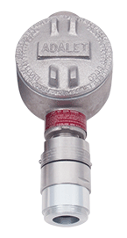
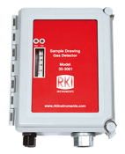
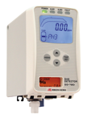
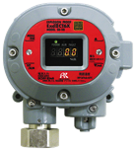

Fixed Sensors and Transmitters
Direct Connect
S2 Transmitter
M2A Transmitter
Cost Effective
Water repellent sensor coating
Explosion Proof
Transmitters 4-20mA output
Explosion Proof
Stainless steel option
Operates with or without controller
OLED display
2 programmable alarm relays
Non intrusive calibration
4-20mA and Modbus outputs
GD-70D
35-3001 Sample Draw
Smart Sample Draw
Wide range of plug & play sensors
Large LCD Display
SD-1 Series
LEL, O2, H2S, CO CO2, & H2 available
Multigas versions
Internal sample pump with 100’ range
Monitor ppm or % LEL ranges
Explosion proof, IP-65/67
Available for H2, IPA, CAN, and ETO

Slide 10
H2 Specific Sensors & Transmitters
Proprietary sensor technology for either % LEL or PPM H2 ranges
Highly specific to H2
Eliminates false alarms from IPA and other gases
Superior resistance to catalyst poisons
Available in Direct Connect Sensor, S2, or M2A transmitters
Ideal for Semiconductor, Power Plants, Battery Rooms, H2 Fueling Stations, and Gas Plants
M2A Transmitter
Direct Connect / S2

Slide 11
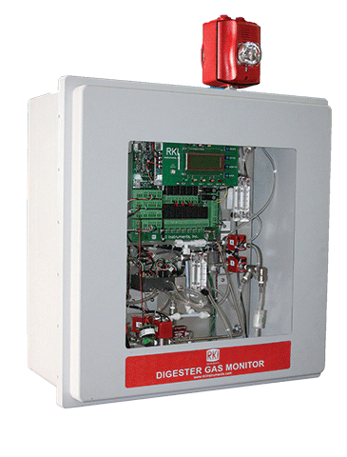
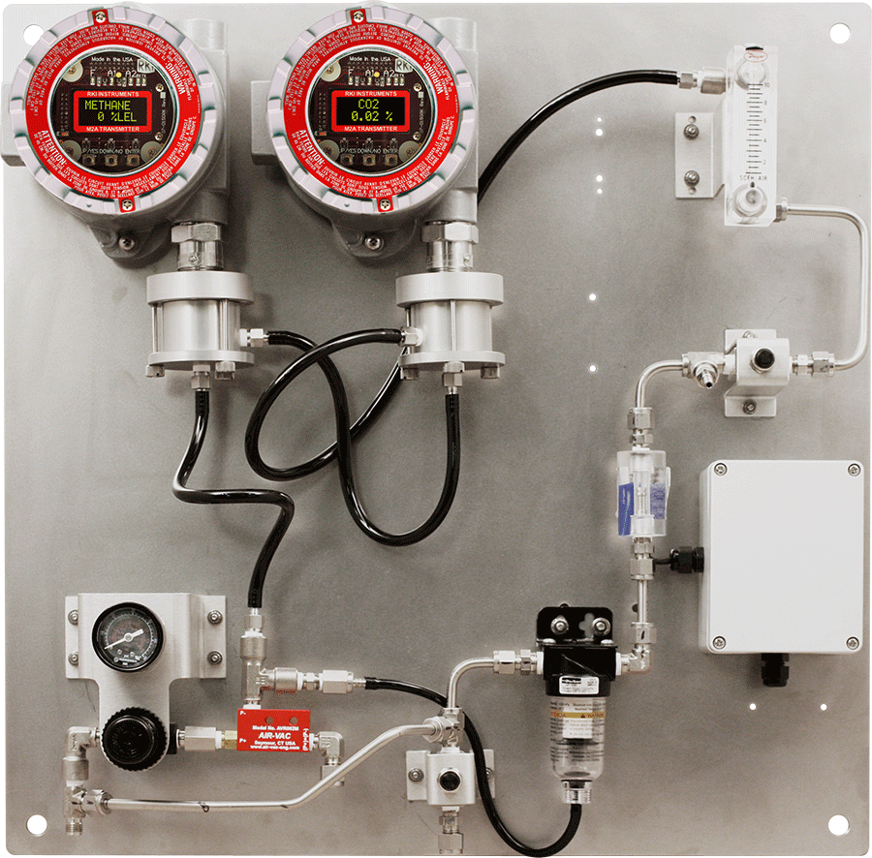
Nasty Environments
Biofuel Digester Monitor
Aspirator Panel

Slide 12
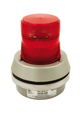

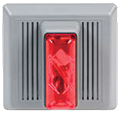
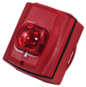
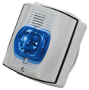
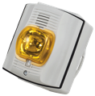
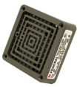
Horns & Strobes
Non Hazardous Location
Lights or Strobes with Horns
4 wire ( Strobe and Horn wired separately)
Lights or strobes with horns
2 wire
Lights, Strobes, or Horns
Rotating Alarm 120V
Green, Amber, Red or Blue
Horn with Strobe
115 VAC / 24 VDC , 4 wire
Amber, Blue or Red
Flashing Alarm Light with Horn
115 VAC / 24 VDC
Red, Blue or Amber
Strobe NEMA 3R / 4X Red Housing
Amber, Red or Blue
Horn with Strobe
NEMA 3R, 4 Wire, 24 VDC
Amber or Red
Strobe with Horn
115 VAC / 24 VDC, NEMA 4X / 3R
Amber, Blue or Red
24 VDC Vibrating Horn

Slide 13
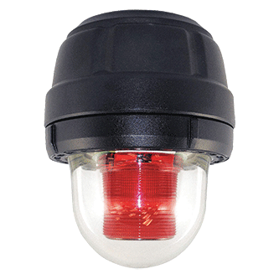
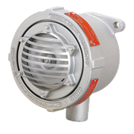
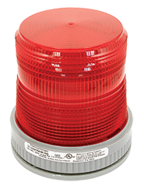
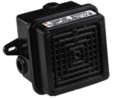
Horns & Strobes
Hazardous Location
Class I Div 1 Strobes or Horns
Class I Div 2 Strobes or Horns
Horn with Strobe
115 VAC / 24 VDC , 4 wire
Amber, Blue or Red
Horn 115 VAC
Strobe Light
115 VAC / 24 VDC
Red or Amber
Horn 115 VAC

