Slide 1


Slide 2


Partners in Gas Detection 2020
Partnership:
Providing Problem Free Solutions Through Professional Sales Teams at Fair Pricing, On Time!

Slide 3
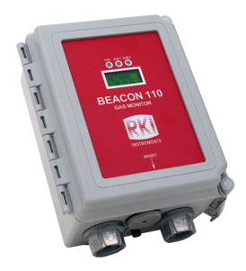
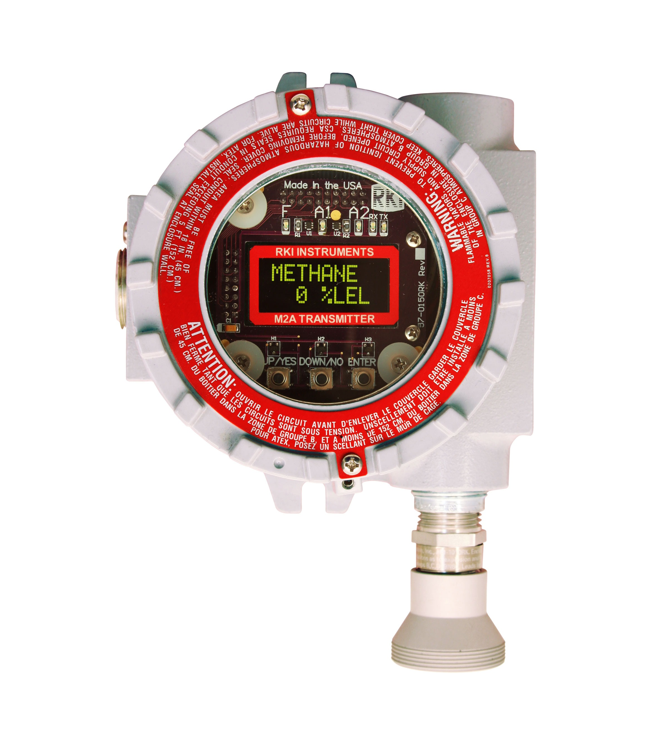
Who is RKI
Founded in 1994
Based in Union City CA
Partner with Riken Keiki-Japan
Superior Sensor Technologies
Superior Quality and Ruggedness
Superior Deliveries
Superior Product Support
Superior Applications Support
Superior Field Representation throughout North America

Slide 4
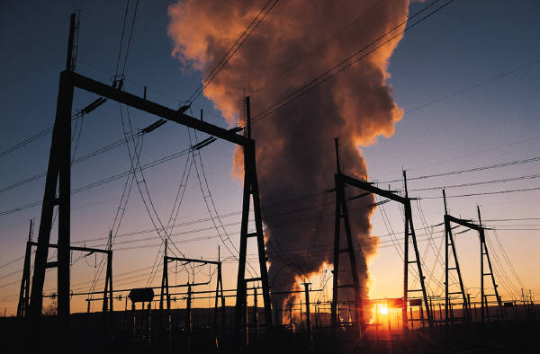
Fixed System Applications
Refineries
Chemical & Petrochemical Plants
Water & Wastewater
Fuel Storage
Breweries
Wineries
Oil and Gas

Slide 5
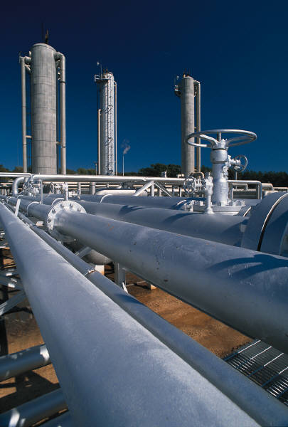
Fixed System Uses
Monitor Combustible, toxic, and inert gas hazards
Room air monitoring for employee protection
Fence line or perimeter monitoring
Process control
Gas cabinet exhaust monitoring
Industrial point gas monitoring

Slide 6
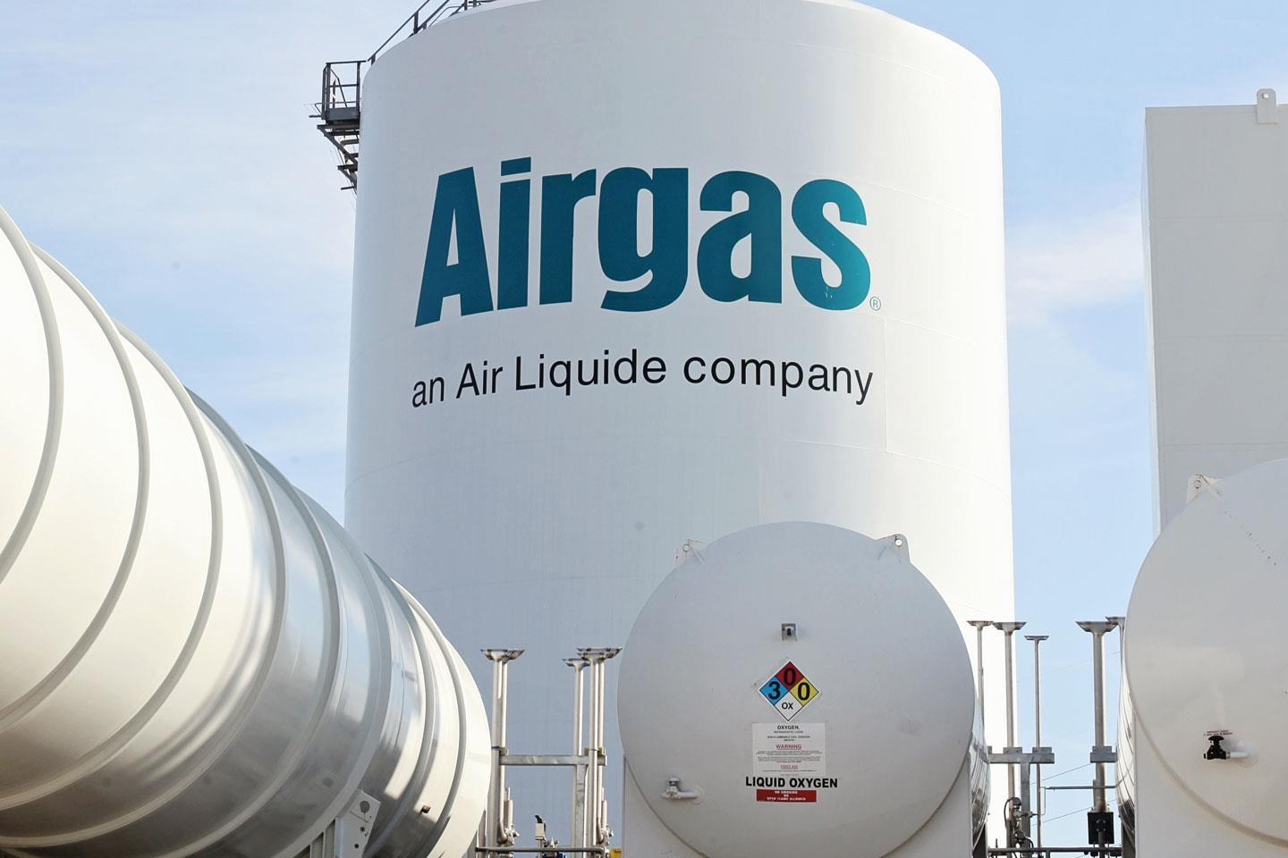
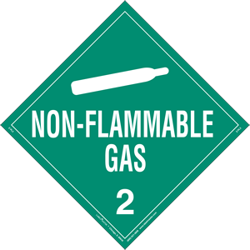
Fixed Applications – Inert
Inert Gases: Inert gases do not react chemically to any great extent. They do not burn or support combustion. They can create a dangerous environment by displacing oxygen
    Examples of this group
    Nitrogen
    Helium
    Neon
    Argon
    Krypton
    Carbon Dioxide

Slide 7
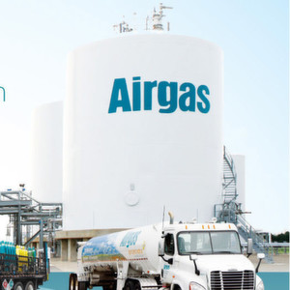

Fixed Applications – Combustible
Combustible Gas
A combustible gas is one that will burn when mixed with air (or oxygen) and ignited. Combustible gas-air mixtures can be burned over a wide range of concentrations. The actual minimum concentration varies from about 0.5% to about 15% by volume in air for most common CHCs. This concentration is always referred to as 100% LEL or LFL for that gas.
  Combustible Gas Hazards
    Combustion
  Combustible gases encountered:
    Hydrogen
    Methane
    Propane
    Butane
    Ammonia

Slide 8
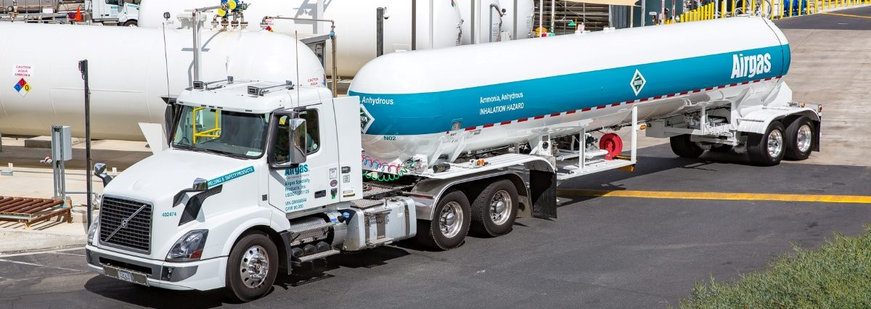

Fixed Applications - Toxic
Toxic Gases
A toxic gas can cause damage to living tissue, the central nervous system, severe illness, or even death. Some toxic gases are not visible, cannot be smelled, and/or they may not have an immediate effect but can be the cause of death.
  Toxic Gas Hazards
    Poisoning
    Asphyxiation
  Gases encountered
    NH3
    CL2

Slide 9

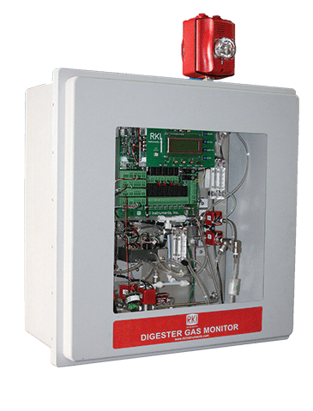
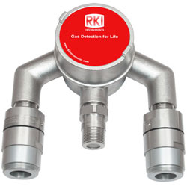

Products and Market
Water & Waste Water, CoGen
  Gases Encountered
    Combustibles
    O2 deficiency
    H2S, CO, CO2
    Ammonia, Chlorine, Ozone, Sulfur Dioxide, & VOC’s
    Fixed System Products
      High range H2S solutions for extreme environments
      Multipoint fixed applications

Slide 10
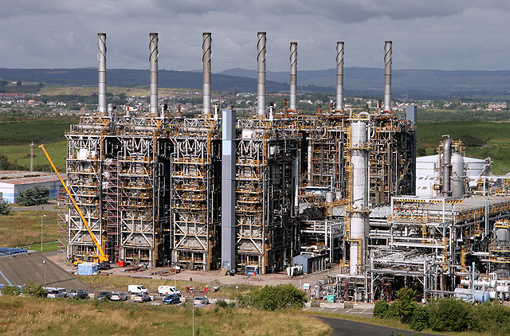
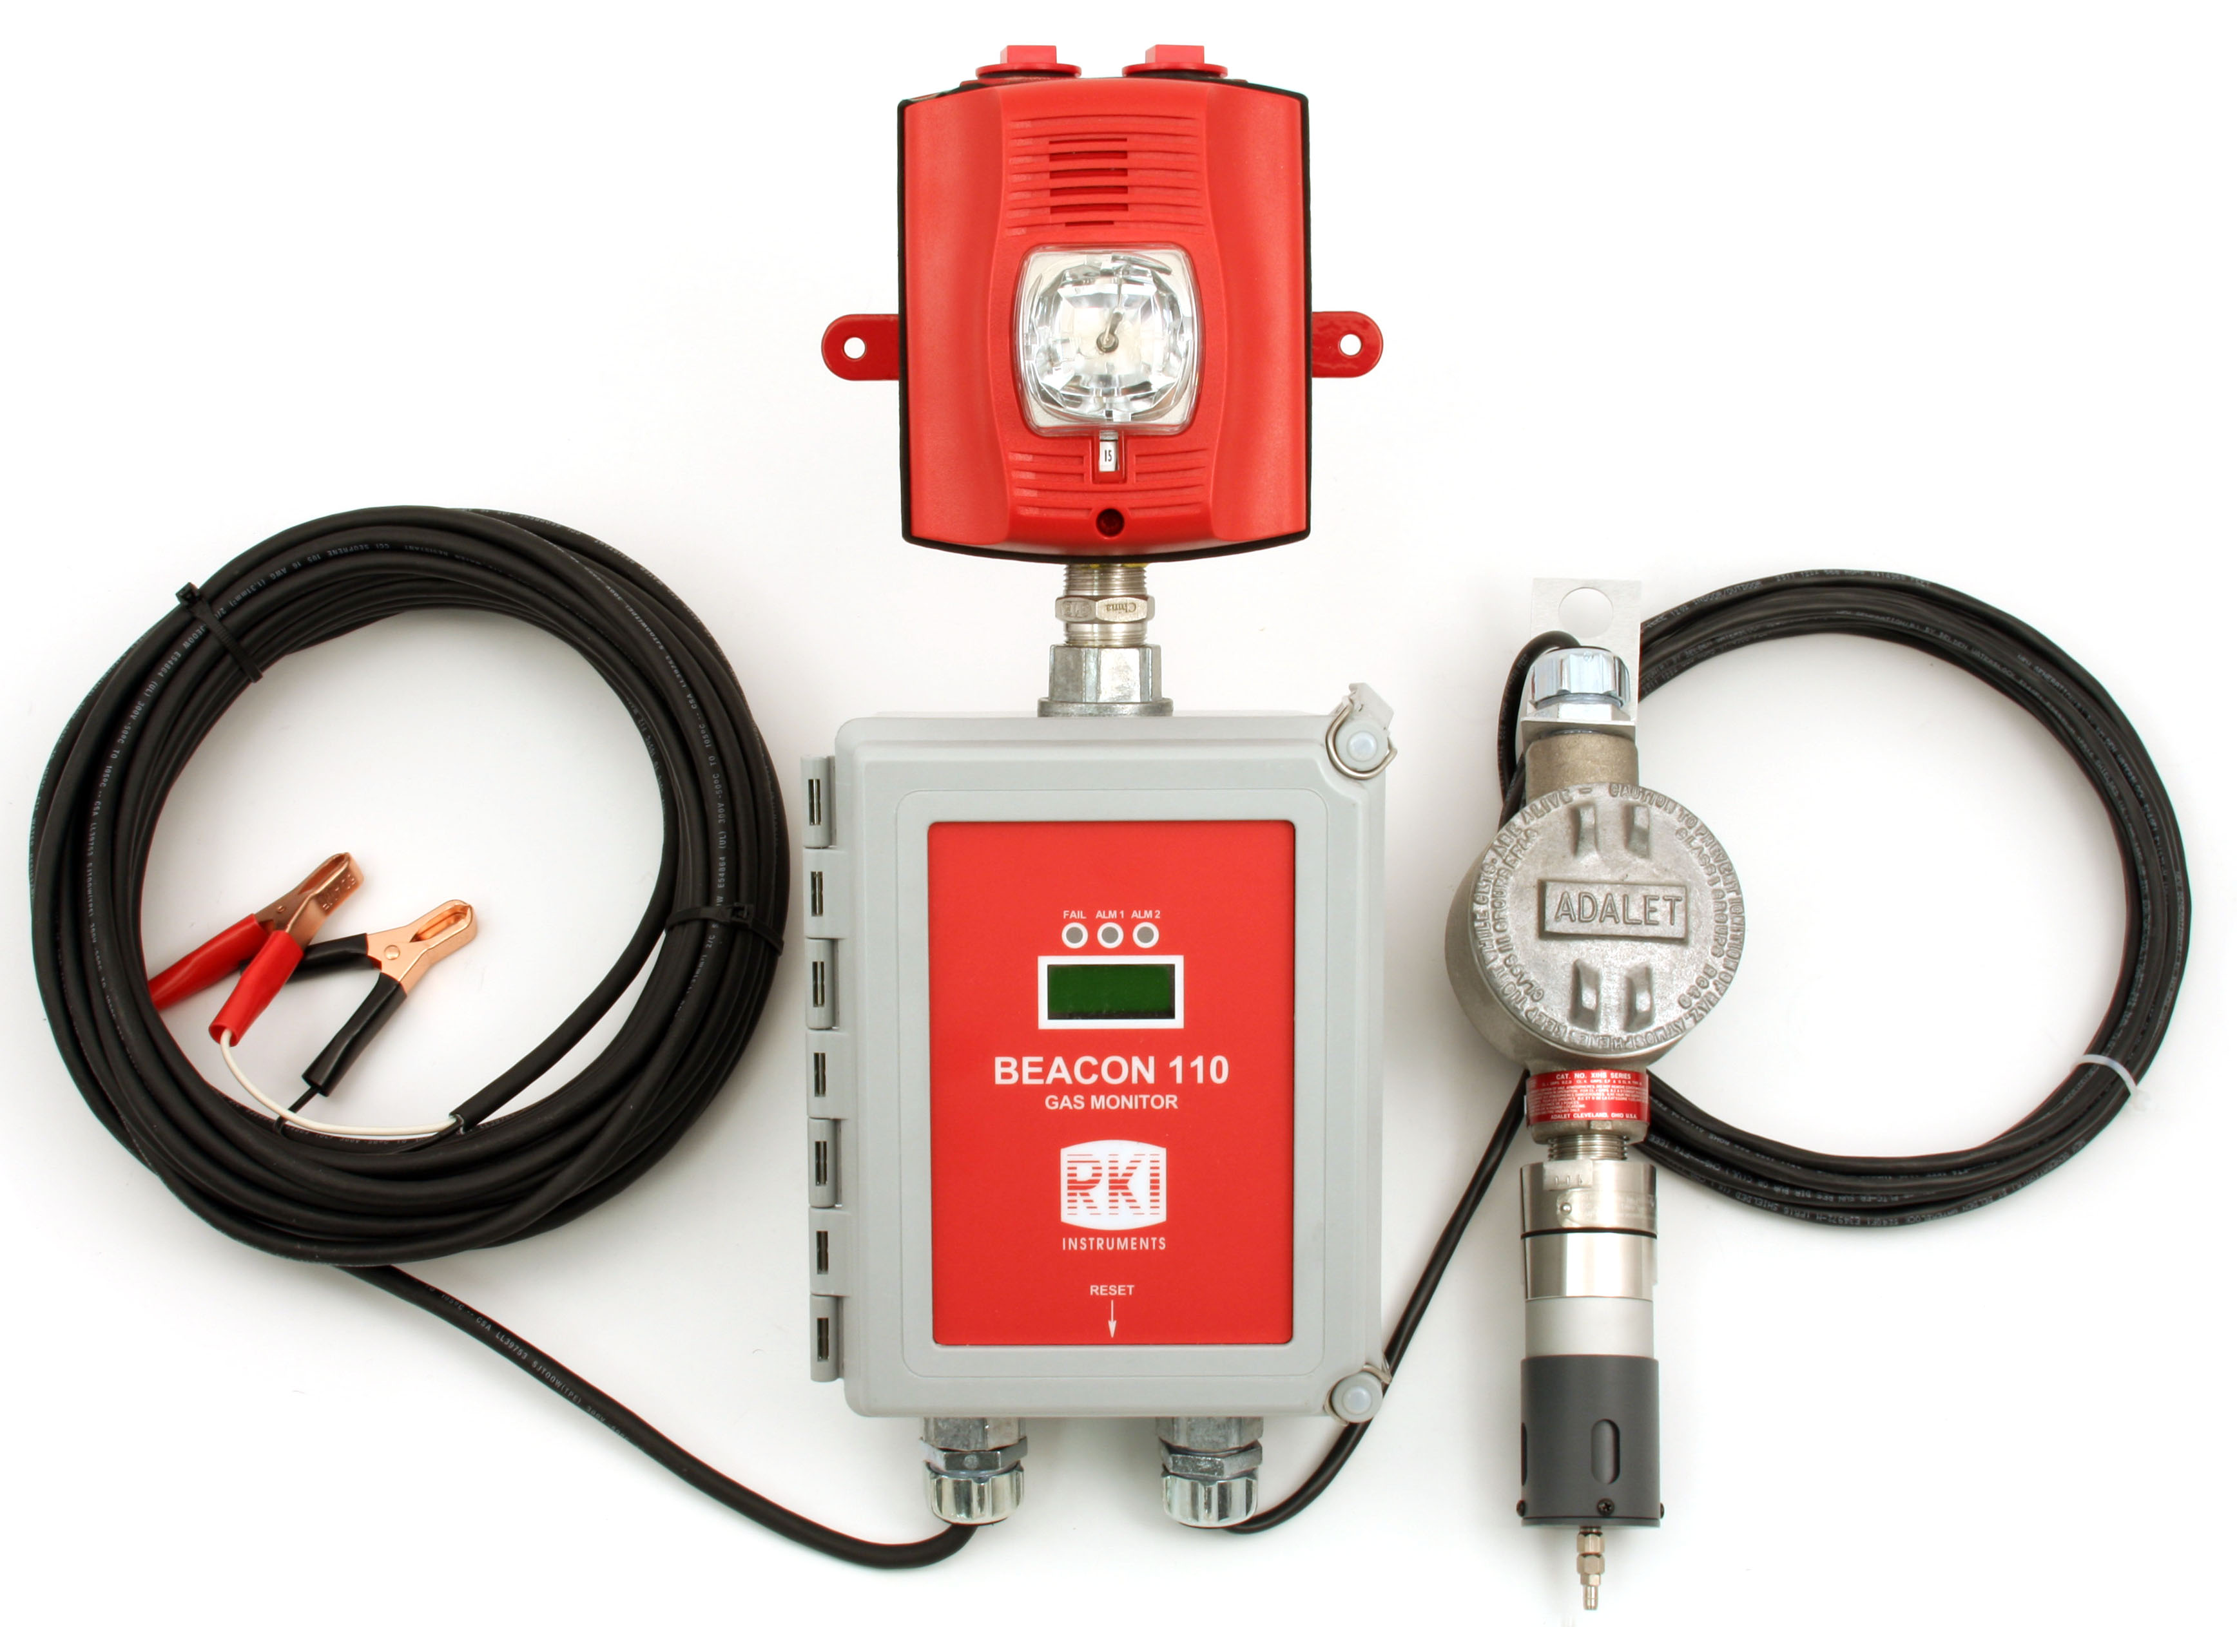

Products and Market
Chemical/Refinery
  Gases Encountered
    Combustibles
    O2 deficiency
    H2S, CO, CO2, HCL, HF, Benzene
    Ammonia, Chlorine, Ozone, Sulfur Dioxide, & VOC’s
This Photo by Unknown Author is licensed under CC BY-SA
    Fixed System Products
      Controllers and Fixed Head Detection

Slide 11
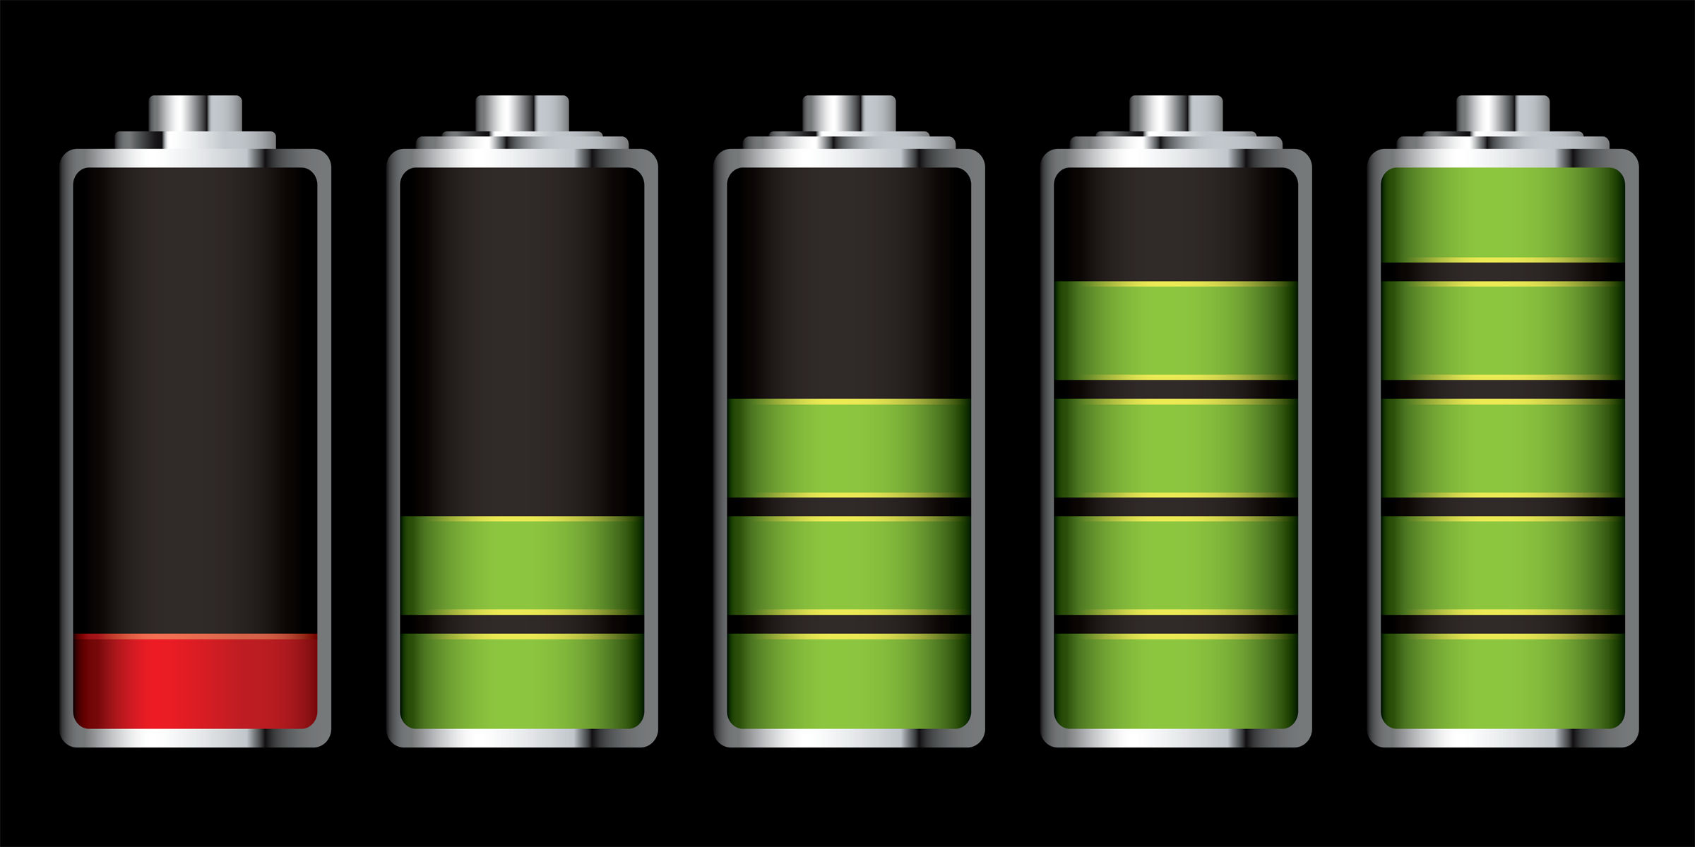

Products and Market
Battery Manufacturing
  Gases Encountered
    O2, H2
    H2S, CO, HF, CH4,
This Photo by Unknown Author is licensed under CC BY-SA-NC
    Fixed System Products
      Controllers and Fixed Head Detection

Slide 12
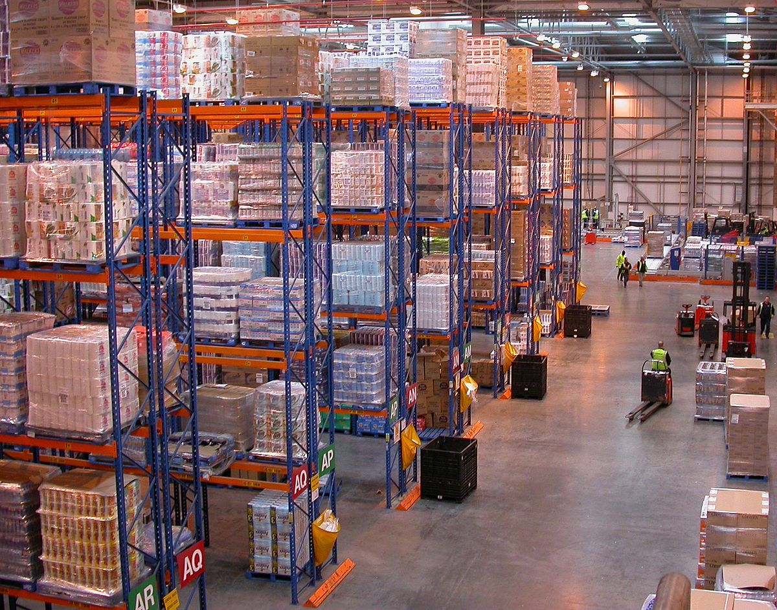
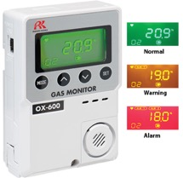

Products and Market
Distribution Facilities
  Gases Encountered
    O2, H2
    CO, CH4,
This Photo by Unknown Author is licensed under CC BY-SA
    Fixed System Products
      Controllers and Fixed Head Detection

Slide 13
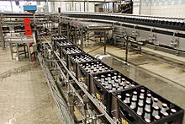
Products and Market
Food & Beverage
  Gases Encountered
    CO2
    Combustibles, O2 deficiency
    H2S, CO, Refrigerants
    HCN, NH3, PH3
This Photo by Unknown Author is licensed under CC BY-SA
  RKI Products
    Fixed System Products
      Continuously monitor for oxygen deficiency,
      NH3 refrigeration leaks, CO2 levels in beverage
      dispensing locations

Slide 14

Products and Market
Science and Education
  Gases Encountered
    CO2,N2, Combustibles
    O2 Deficiency and Abundance
    H2S, CO, Refrigerants
    HCN, NH3, PH3 Etc
This Photo by Unknown Author is licensed under CC BY-SA
  RKI Products
    Fixed System Products
      Continuously monitor for oxygen deficiency,
      NH3 refrigeration leaks, CO2 levels in beverage
      dispensing locations

Slide 15
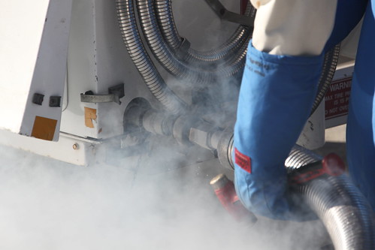
Products and Market
Cryogenics
  Gases Encountered
    CO2
    Oxygen
    Hydrogen
    Argon
    Nitrogen
    Helium
This Photo by Unknown Author is licensed under CC BY-SA-NC
  RKI Products
    Fixed System Products
      Continuously monitor for oxygen deficiency or CO2 levels

Slide 16


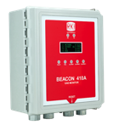

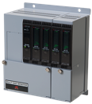
Controllers
Relays per channel
Alarm levels per channel
Common relays
Direct connect sensors
Channels
Beacon 110 | 1 | 2 | 3 | N/A | Yes
Beacon200 | 2 | 2 | 2 | 3 | Yes
Beacon 410A | 4 | 3 | 3 | 5 | Yes
Beacon 800 | 8 | 2 | 2 | 3 | No
RM-5000 | Up to 12 | 2 | 2 | 3 | Yes
Beacon 110
Beacon 200
1 – 8 Channel fixed systems controllers
Digital Readout
Weather proof NEMA 4X enclosure
Audible alarm
Alarm reset button
Optional strobe & battery backup
Beacon 410A
Beacon 800
RM-5000

Slide 17
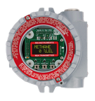
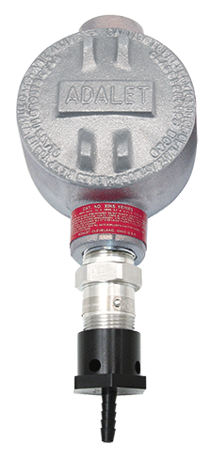
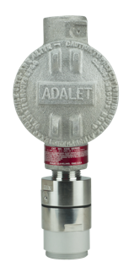
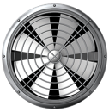
Common Fixed System Components
Beacon 410A Controller
M2A Transmitter
Remote Mount Sensor
with Cal Cup
S2 Transmitter
Direct Connect Sensor
RKI’s diffusion style remote mount detectors allow for easy calibrations in difficult access areas
Alarm Relays Activate Ventilation / Exhaust System

Slide 18

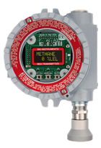
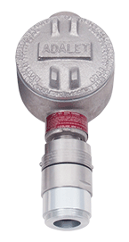
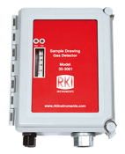


Fixed Sensors and Transmitters
Direct Connect
S2 Transmitter
M2A Transmitter
Cost Effective
Water repellent sensor coating
Explosion Proof
Transmitters 4-20mA output
Explosion Proof
Stainless steel option
Operates with or without controller
OLED display
2 programmable alarm relays
Non intrusive calibration
4-20mA and Modbus outputs
GD-70D
35-3001 Sample Draw
Smart Sample Draw
Wide range of plug & play sensors
Large LCD Display
SD-1 Series
LEL, O2, H2S, CO CO2, & H2 available
Multigas versions
Internal sample pump with 100’ range
Explosion proof, IP-65/67
Monitor ppm or % LEL ranges
Available for H2, IPA, CAN, and ETO

Slide 19
H2 Specific Sensors and Transmitters
Proprietary sensor technology for either % LEL or PPM H2 ranges
Highly specific to H2
Eliminates false alarms from IPA and other gases
Superior resistance to catalyst poisons
Available in Direct Connect Sensor, S2, or M2A transmitters
Direct Connect / S2
M2A Transmitter
Ideal for Semiconductor, Power Plants, Battery Rooms, H2 Fueling Stations, and Gas Plants

Slide 20

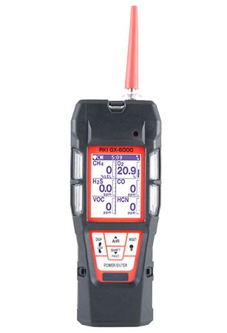
Continuous Running Portables
Non-Permanent
Continuous Monitoring
Eagle 2 and GX-6000

Slide 21


Slide 22
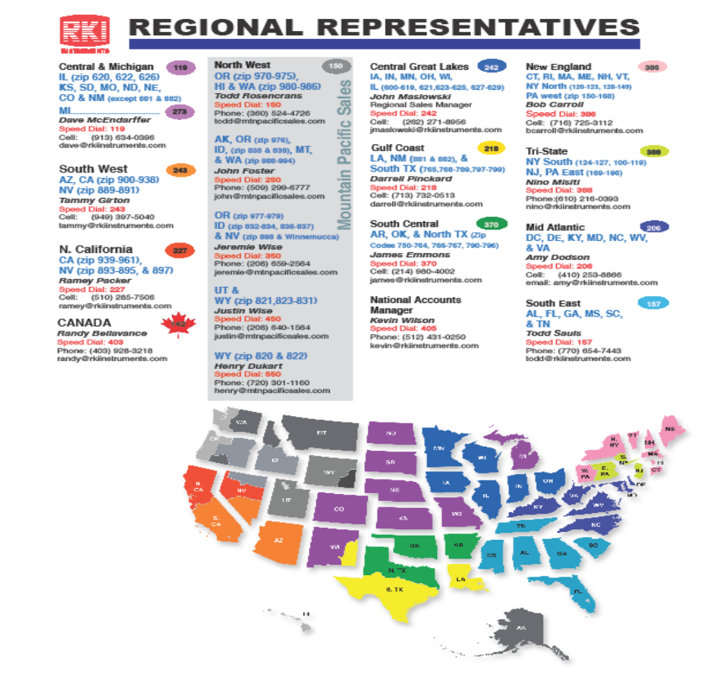

Slide 23

Questions?

Slide 24


