Slide 1

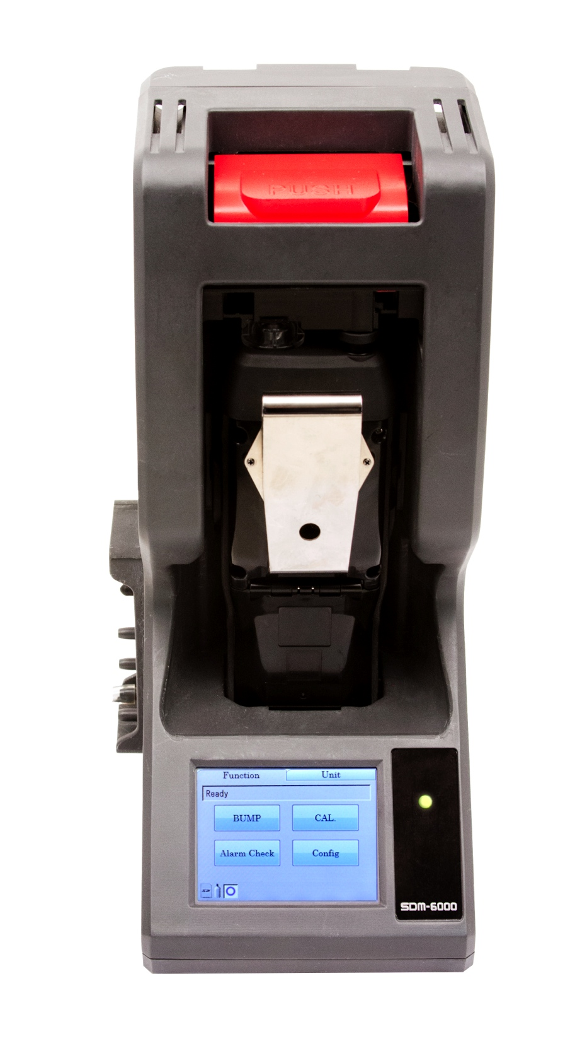
Multi Module System with PC Controller
SDM-6000 Docking Station

Slide 2
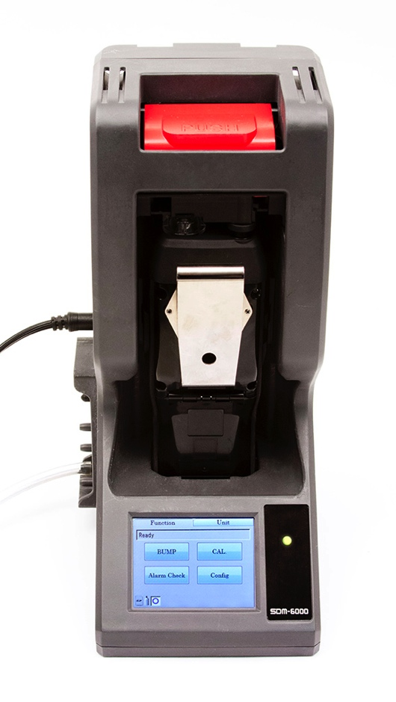
SDM-6000 Docking Station
  Stand alone station (no PC required)
  Charge
  Bump, Calibrate, and Alarm tests
  Touch screen menu display
  Save calibration, bump tests, alarm history and exposure data to an SD memory card or to a computer
  Automatically power on or off for scheduled maintenance
  Up to 3 ports for separate calibration gas cylinders
Notes:
Can be connected up to 10 units

Slide 3
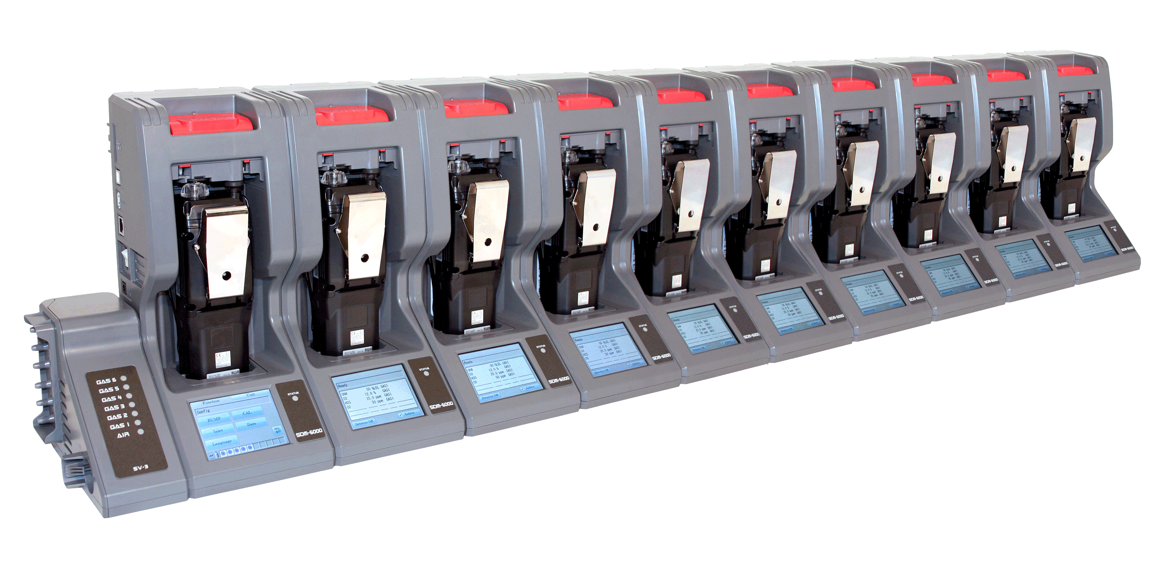
Multi Module System with PC Controller
  Manage up to 10 instruments with one power source, calibration source, and computer
  Configure GX-6000 parameters
  SV-3 unit expands calibration ports up to 6 ports
Notes:
Can be connected up to 10 units

Slide 4
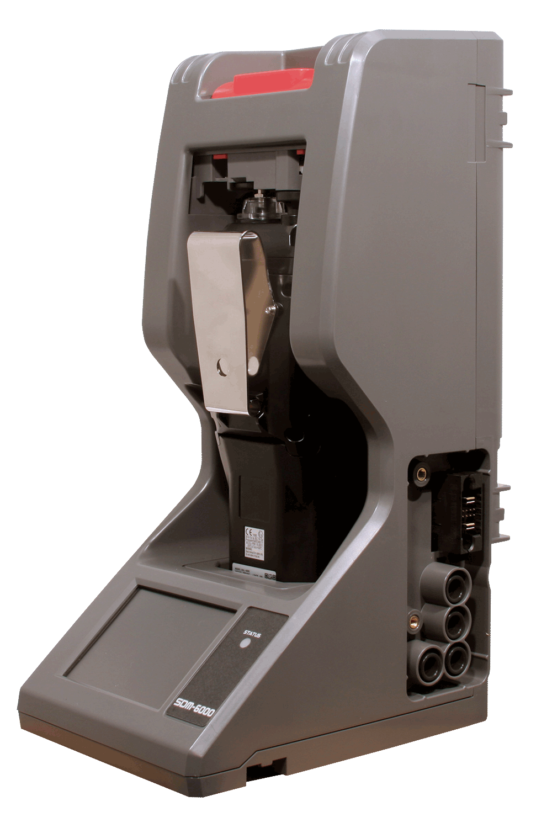
  Easily connects to adjacent docks
  Automatically distributes power, calibration gas, and data once connected
  DIN Rail wall mount
  Local print out of calibration/bump and alarm test results

Slide 5
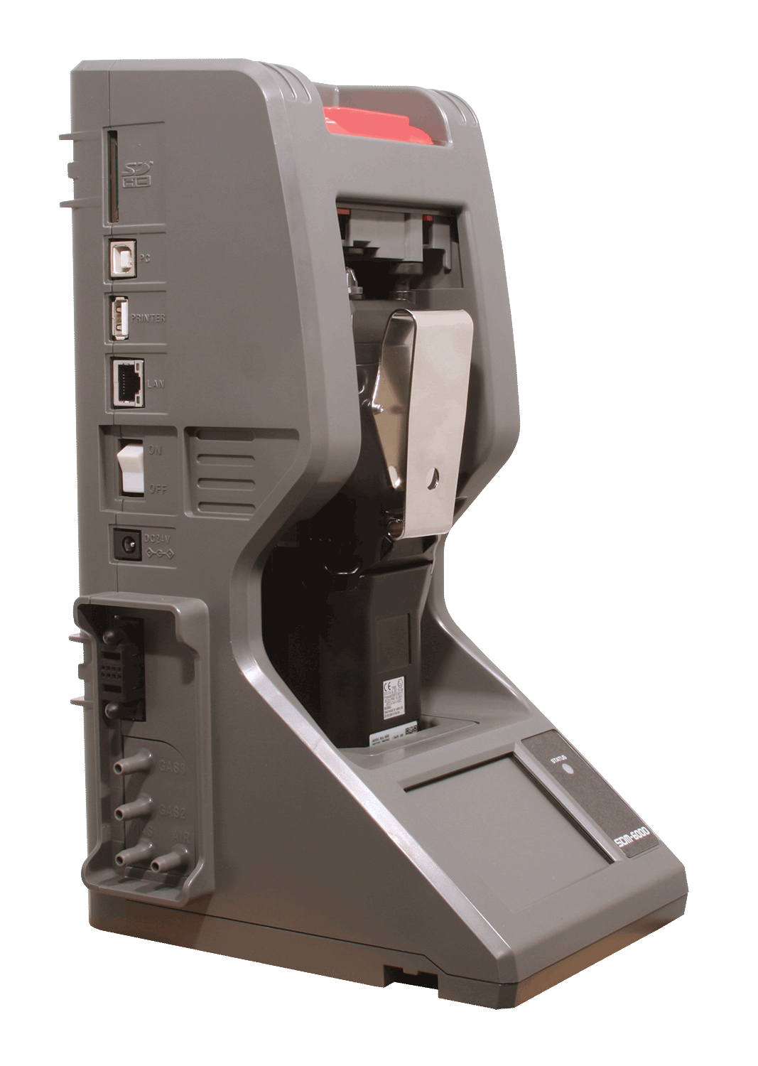
SD / Memory Card Slot
USB PC Connection
USB Printer Connection
LAN Connection
Power Switch
AC Adaptor
Power/Data Joint Connector
3 Calibration Gas Ports
1 Fresh Air Port

Slide 6
LETS TURN IT ON

Slide 7
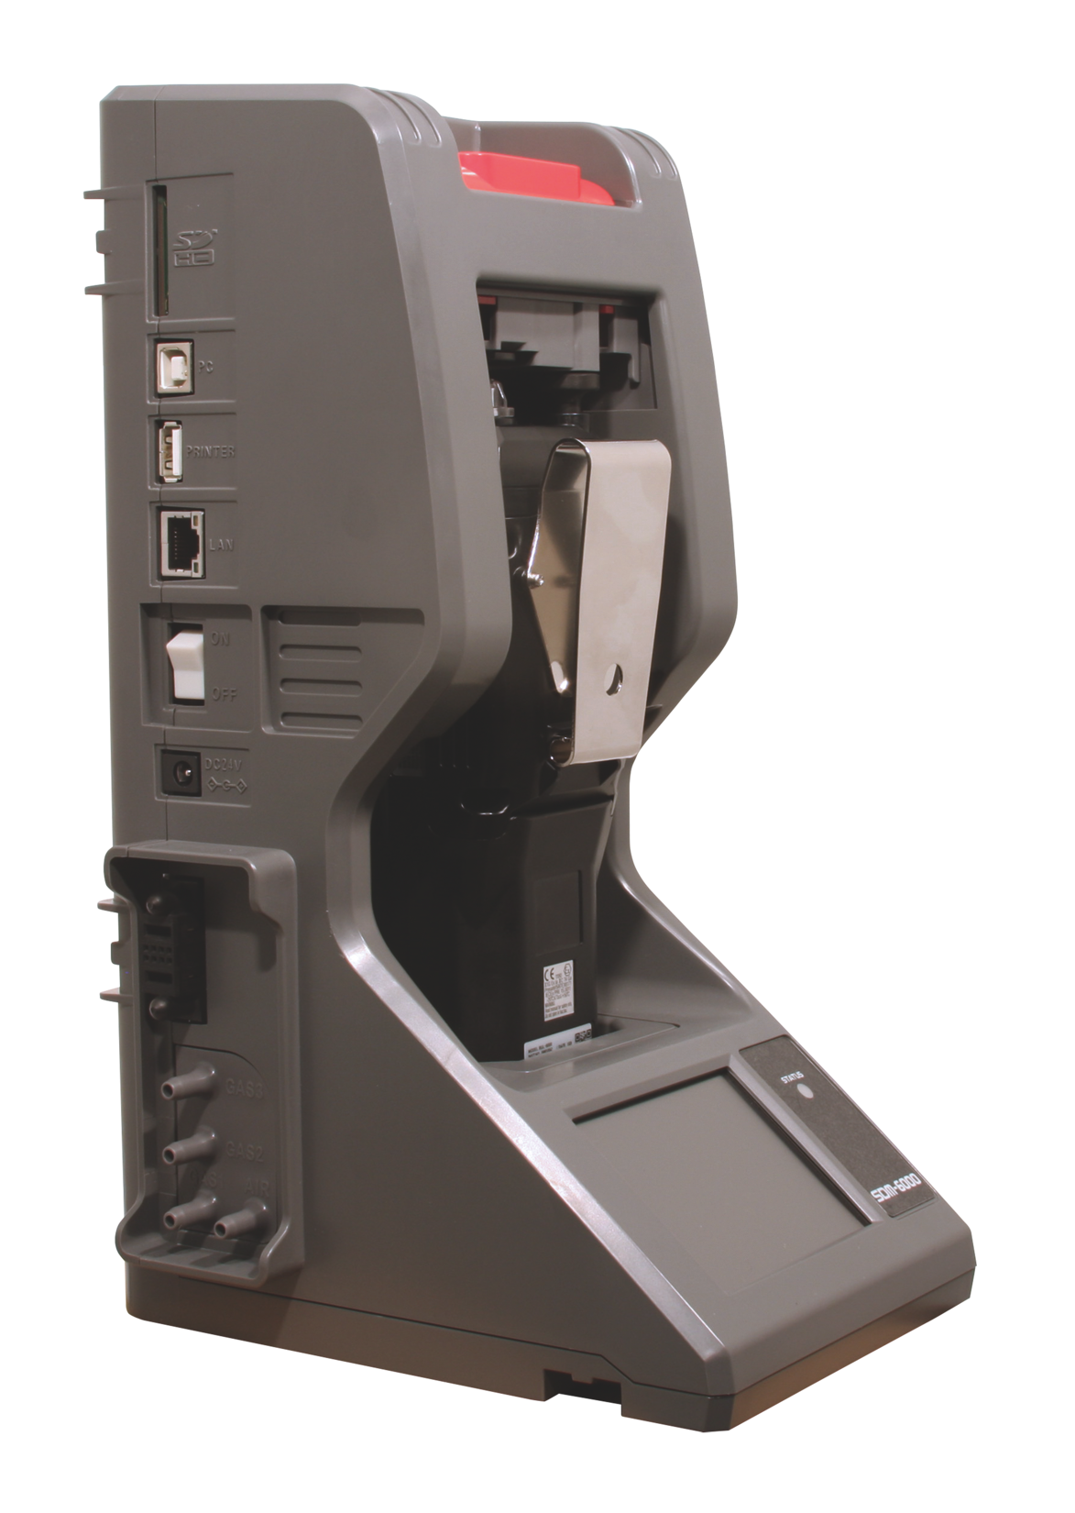
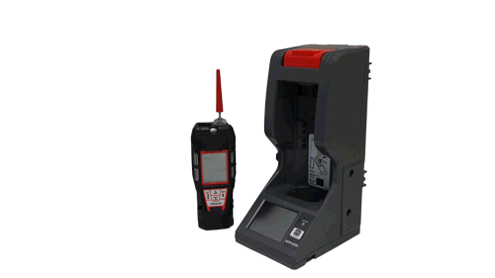
Install GX-6000
  Orient the GX-6000 so the belt clip is facing away from the SDM-6000.
  Set the bottom of the GX-6000 in the bottom of the instrument cradle and push the top of the GX-6000 toward the SDM-6000
  Push the red gas in/gas out cover down until it touches the GX-6000 and then release it

Slide 8
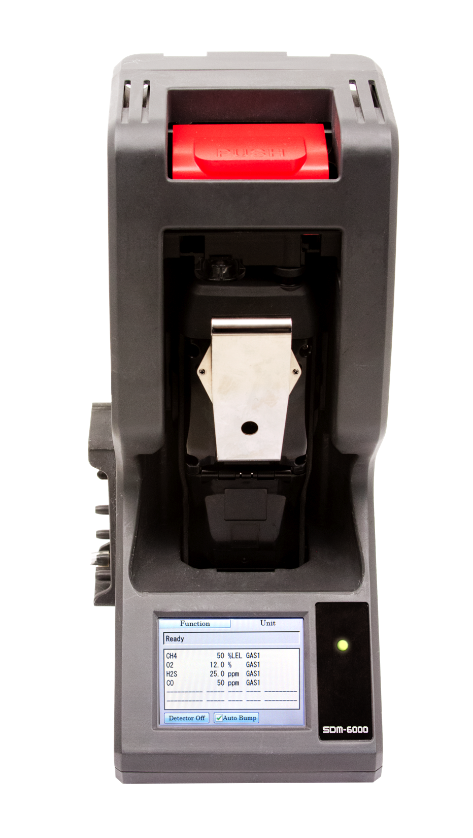
Instrument Connected
  If a successful connection between the GX-6000 and the SDM-6000 occurs, the Unit Tab screen will indicate the instrument’s active channels and the auto calibration values for each channel.

Slide 9
LETS PERFORM A BUMP TEST

Slide 10
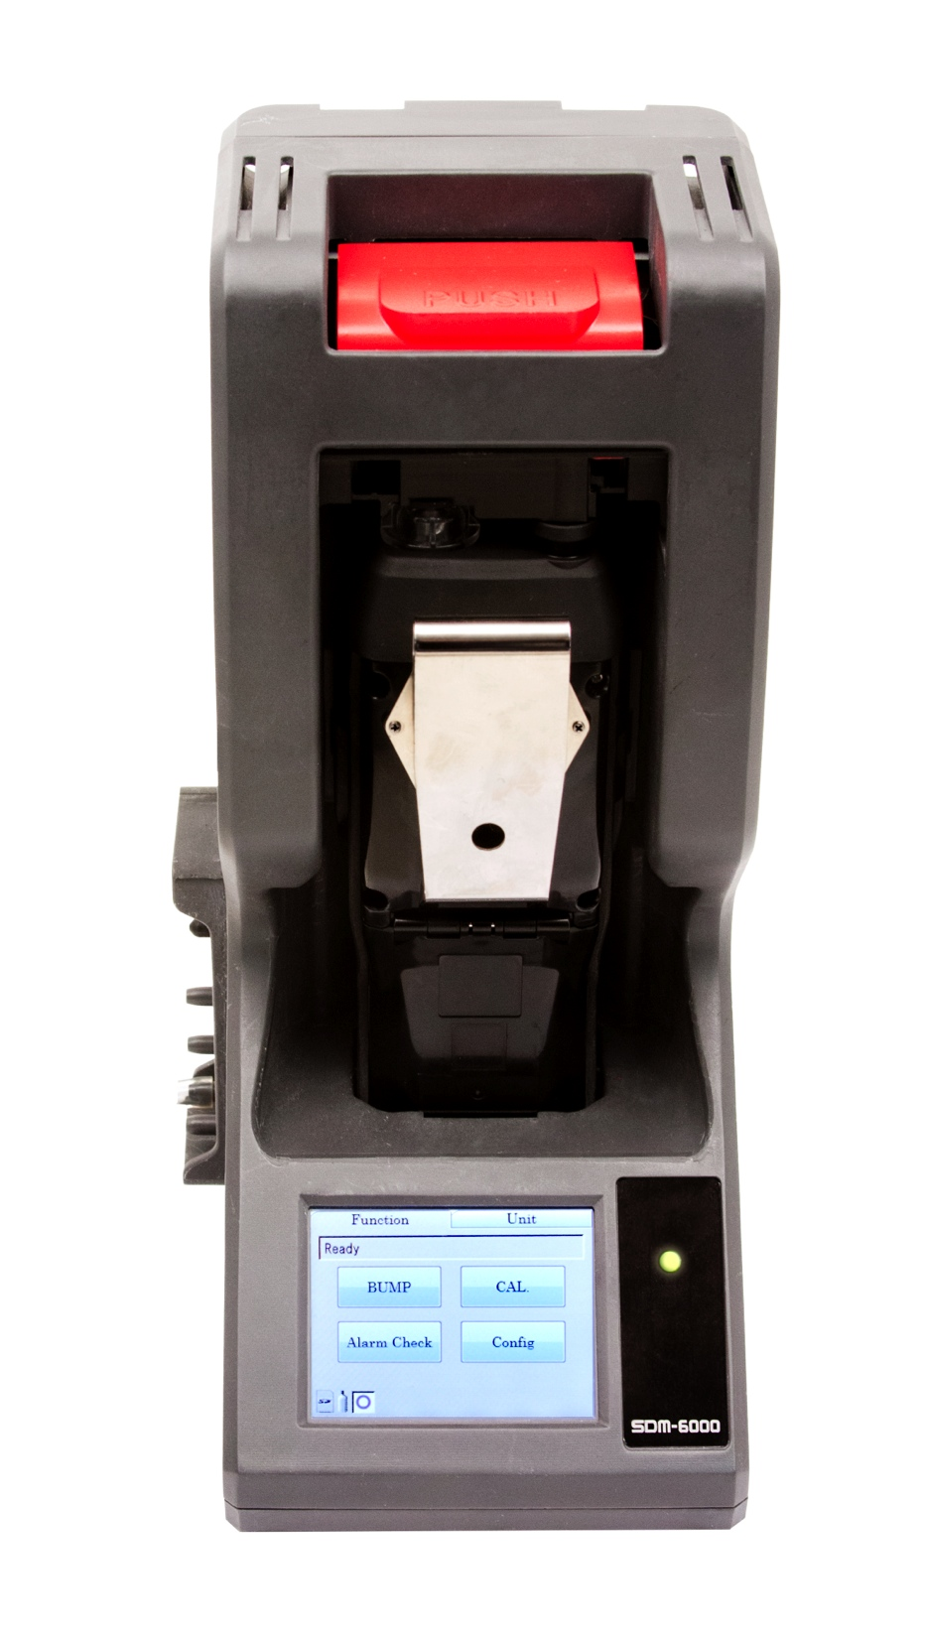
Start Bump Test
  Press the Function button in the upper left corner to get the Function Tab to appear
  Press the Bump button to initiate a bump test
  If you wish to cancel the bump test, press the BUMP Cancel button in the Function Tab and press Yes in the window that appears

Slide 11

Fresh Air Adjustment
  The SDM 6000 will apply fresh air to the GX-6000 to the time defined by the AIR Flush bump test parameter.
  If one or more of the sensors fails the fresh air adjustment, the SDM-6000 will abort the bump test and will not apply calibration gas.

Slide 12

Bump Testing
  The SDM 6000 will apply calibration gas in the order of the active gas inlet fittings. The SDM-6000 will analyze the results after the end of each gas application.
  The GX-6000 will shut off after 15 seconds. If the bump test failed, the GX-6000 will shut off after 10 minutes.

Slide 13
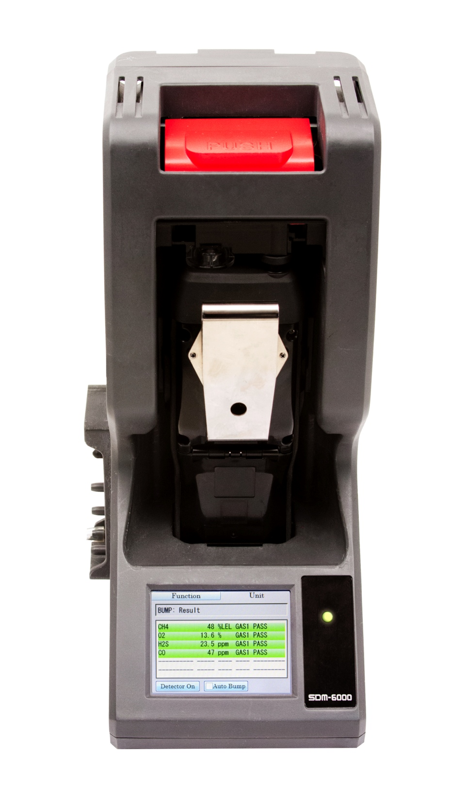
Bump Test Results
  Once the bump test is over, the Function Tab will display a BUMP End Button. To view the test results, press the Unit Button to display the Unit Tab. The displayed results will alternate between bump test results and alarm check results.
  The test results will display on the Unit Tab until you press the BUMP End Button in the Function Tab even if the results of the bump test will be stored in the SDM-6000’s SD card

Slide 14

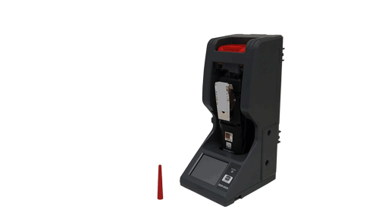
Remove GX-6000
  Push the red gas in/gas out cover toward the GX-6000 and then release it. It should return to its unused state at the top of the SDM-6000.
  Remove the GX-6000 from the SDM-6000.

Slide 15
HOW ABOUT WE CALIBRATE IT

Slide 16
Start Calibration
  Press the Function Button in the upper left corner to get the Function Tab to appear
  Press the CAL button to initiate a calibration
  If you wish to cancel the calibration, press the Cancel button in the Function Tab and press Yes in the window that appears

Slide 17

Fresh Air Adjustment
  The SDM-6000 will apply fresh air to the GX-6000 for the time defined by the AIR Flush calibration parameter.
  If one or more of the sensors fails the fresh air adjustment, the SDM-6000 will abort the calibration and will not apply calibration gas. If this happens, the Unit Tab will indicate which channels passed and failed the fresh air adjustment.

Slide 18

Calibration
  The SDM-6000 will then apply calibration gas in the order of the active gas inlet fittings. The SDM-6000 will analyze the results after the end of each gas application.
  The GX-6000 will shut off after 15 seconds. If the calibration failed, the GX-6000 will shut off after 10 minutes.

Slide 19
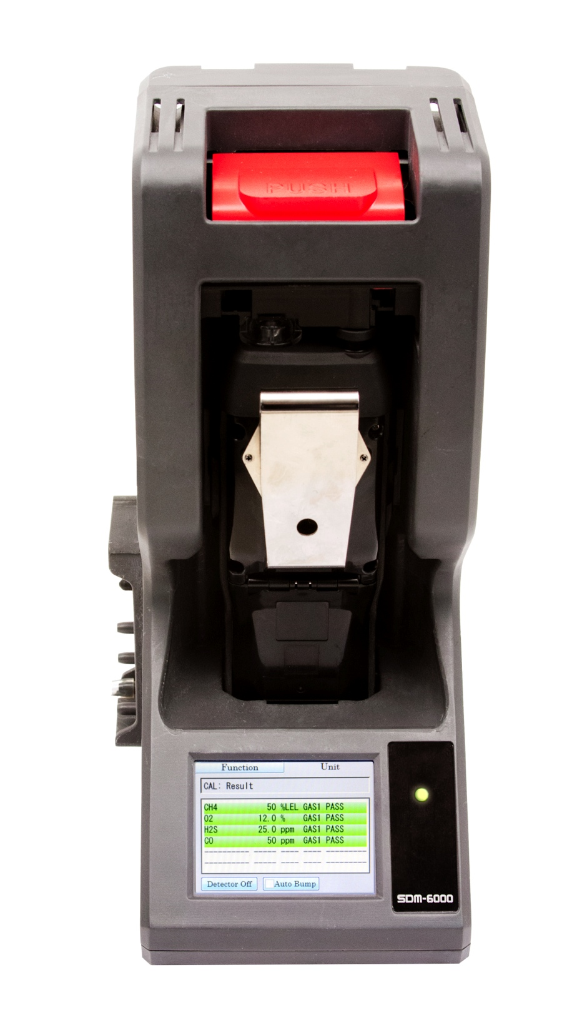
Calibration Results
  Once the calibration is over, the Function Tab will display a CAL END button. To view the test results, press the Unit button to display the Unit Tab. The displayed results will alternate between calibration results and alarm check results. The test results will display on the Unit Tab until you press the CAL End button in the Function Tab even in the GX-6000 is turned off.

Slide 20
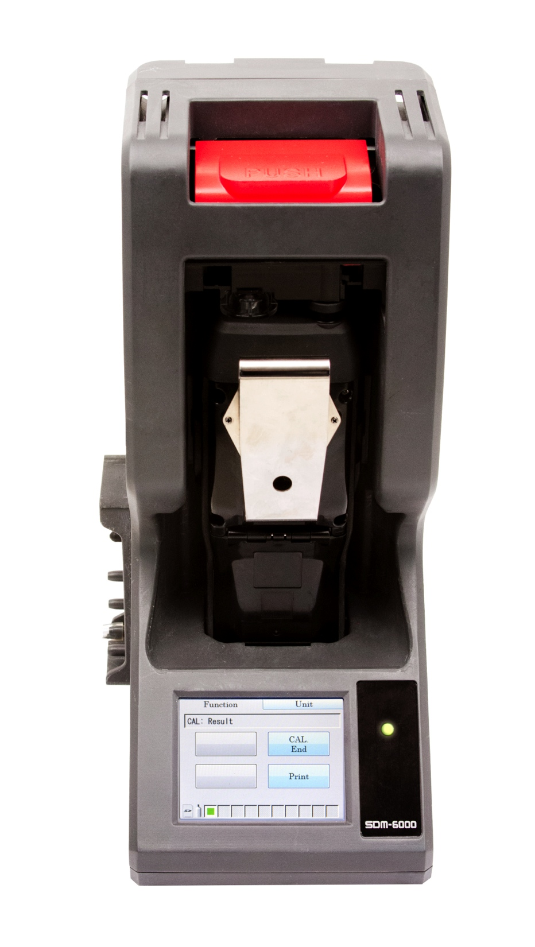
Remove GX-6000
  Push the red gas In/gas out cover toward the GX-6000 and then release it. It should return to its unused state at the top of the SDM-6000.
  Remove the GX-6000 from the SDM-6000.
  The results of the calibration will be stored in the SDM-6000’s SD card.

Slide 21
PERFORM AN ALARM CHECK

Slide 22
To perform an alarm check
  Press the Function button in the upper left corner to get the Function Tab to appear
  Press the Alarm Check button to initiate an alarm check
  The buzzer will sound, the LED’s will turn on for a few seconds, the vibrator will vibrate, and the SDM-6000 will determine if these actions were completed successfully. After the alarm check, the Function Tab will display. To view the test results, press the Unit button to display the Unit Tab. The test results will display on the Unit Tab until you press the Alarm Check End Button in the Function Tab even if the GX-6000 is turned off.

