Slide 1
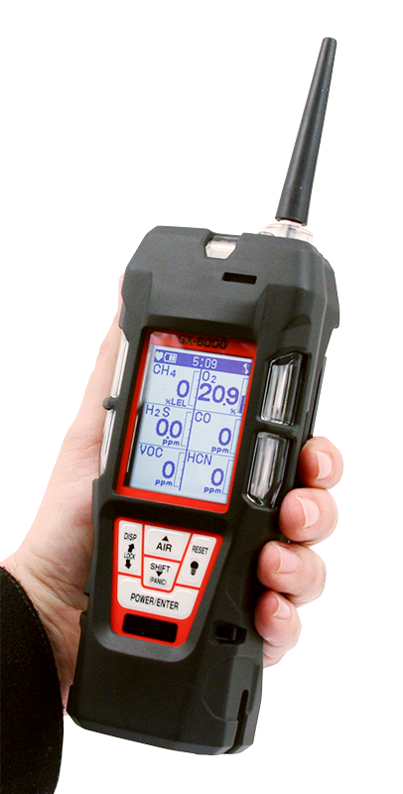
You Have Choices
Introducing
GX-6000
6 gas, sample draw with smart PID, IR & super toxics

Slide 2
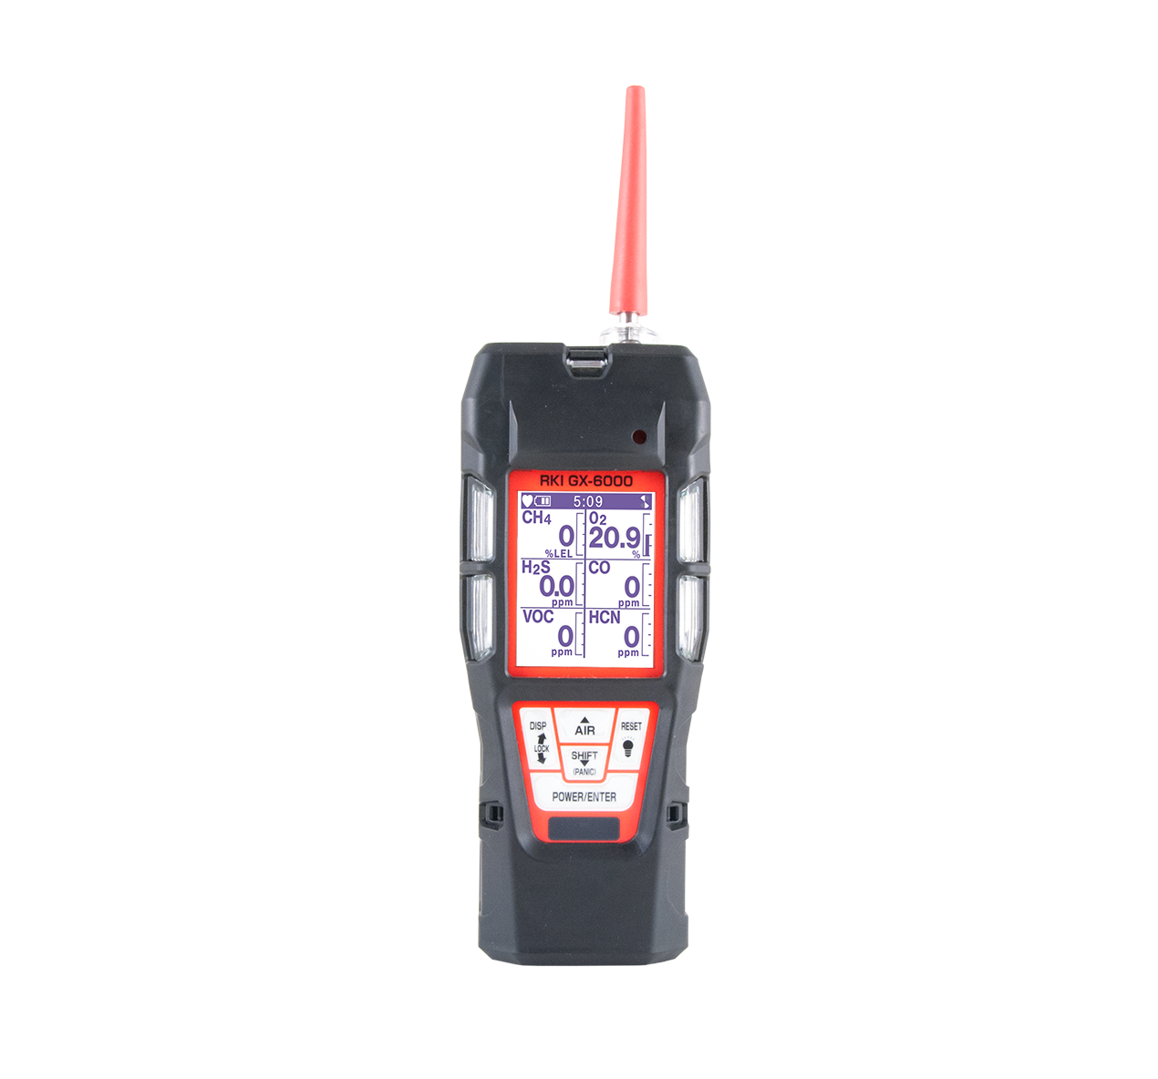
Monitor up to 6 Gases
H2S, CO, O2, LEL
2 smart sensor slots
  PID for VOC’s
  IR for CH4, HC, & CO2
  EC for NH3, Cl2, HCN, NO2, & SO2
PID library of more than 600 VOC’s
Accepts 10.6 and / or 10.0 PID lamps
50,000 ppb / 6,000 ppm ranges
10.0 Lamp for Benzene Specific
11.7 Lamp available Q4 2018
11.7 Lamp for carbon tetrachloride, acrylonitrile, chloroform, methanol, and refrigerants (R-143, R-132A)
PID sensors can be combined
Easily choose a target VOC
  User defined VOC list of 30
  Recently used VOC list last 8
6 operating modes
Normal
Leak check
Inert
Bar hole
Snap Log
Benzene Specific Mode
LCD display
Auto flip display
Peak bar graphs
Adjustable auto backlight
Customize order of gases
Single gas view with large font & auto sequence
LEL Protection mode
Shields LEL sensor from damaging VOC exposure

Slide 3
Smallest 6 gas sample draw
Lightweight & Ergonomic
High impact rubber boot
Ergonomic design fits comfortable in hand
Alarms
2 adjustable gas alarms per channel Plus STEL & TWA
Man Down alarm
Panic Alarm
4 alarm LED’s
Audible and vibration alarms
Trouble alarms for low flow, sensor connection, low battery, circuit error, & calibration
Intrinsically Safe
ATEX / IECEX
cCSAus
Interchangeable battery options
Lithium-ion pack operates 14 hours
  Complete recharge in 3 hours
Alkaline pack operates 8 hours
Weather & Dust Resistant
IP-67
9 Languages
English, German, Italian, French, Portuguese, Spanish, Japanese, Korean, Russian
LED Flashlight
On demand light source

Slide 4
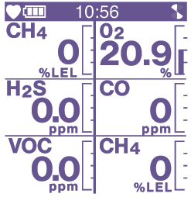
6 Operating Modes
1. Normal Mode
Simultaneous gas measurement readings in real-time are shown for all the sensors installed

Slide 5
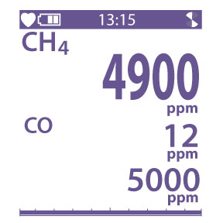
6 Operating Modes
2. Leak Check Mode
Used when performing leak checks above ground.
CH4 and CO (optional) are shown in ppm readings

Slide 6
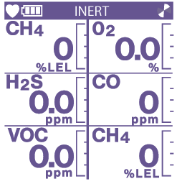
6 Operating Modes
3. Inert Mode
Inverts the O2 alarm points to 5% vol alarm 1 and 10% vol alarm 2.
Used to alert users when there is O2 present in the area where there is supposed to be little to none.

Slide 7
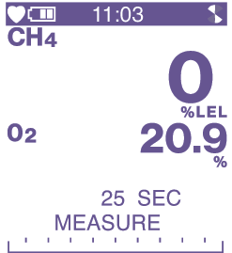
6 Operating Modes
4. Bar Hole Mode
Used to perform timed leak checks underground, IR combustible sensor and oxygen (if installed) are used. To be used with bar a hole probe.

Slide 8
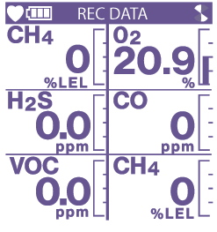
6 Operating Modes
5. Snap Log Mode
Allows the user to record data at a specific time and have it saved to the data logger. The data is assigned a snap log ID and is saved with the instrument’s station ID.

Slide 9
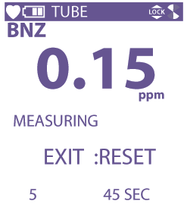
6 Operating Modes
6. Benzene Mode
A special mode used to measure benzene gas specifically. Has to be used with the benzene
pre-filter tube and tube holder.

Slide 10
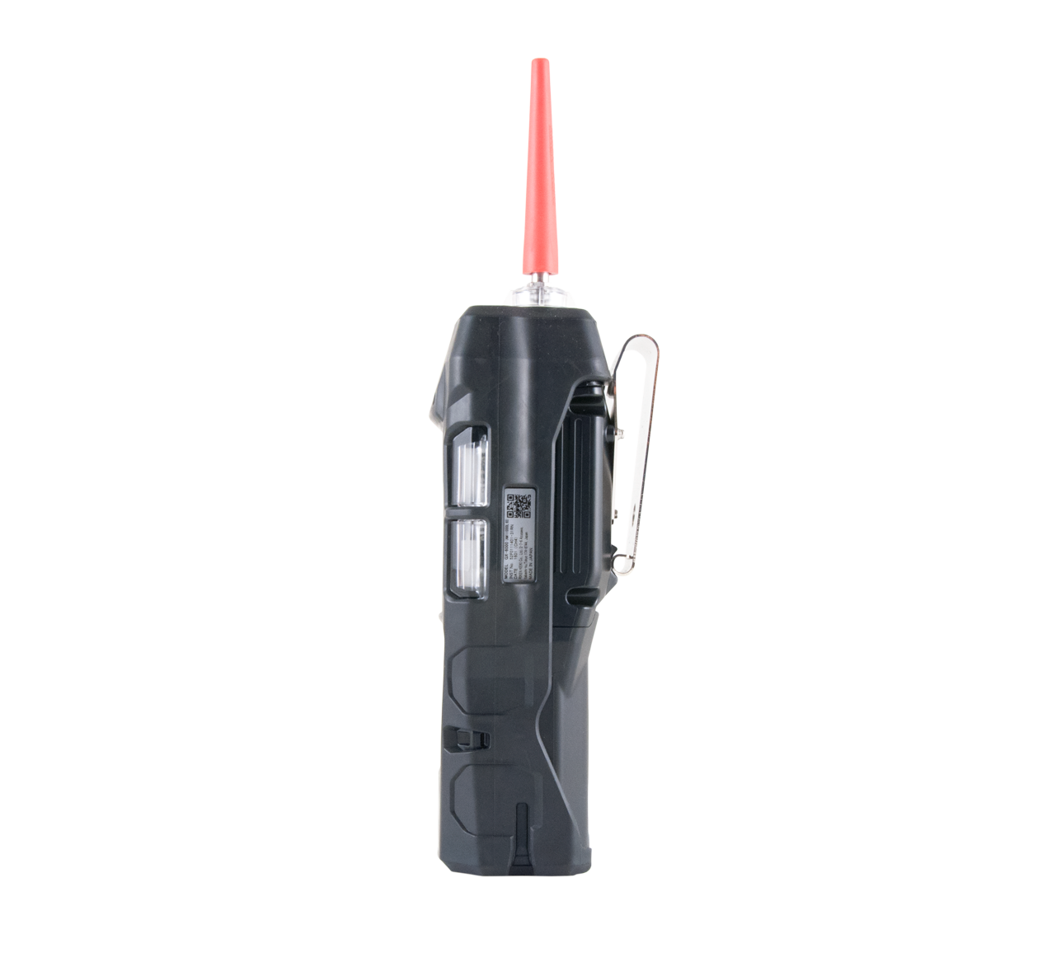
Compact & lightweight
Dimensions
7.87” (H) x 2.67” (W) x 2.04” (D)
MultiRAE= 7.6” x 3.8” x 2.6”
Weight
Approx. 400g / 14.1 ounce
MultiRAE: 880g / 31 ounce
7.87”
50 % LIGHTER!
2.67”
2.04”

Slide 11
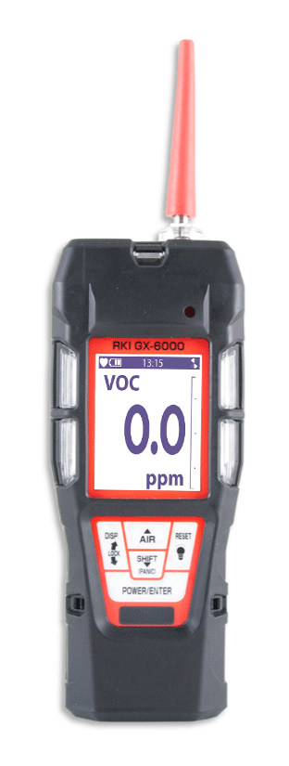
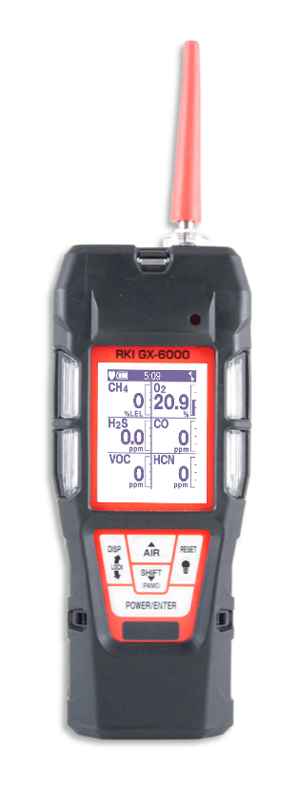
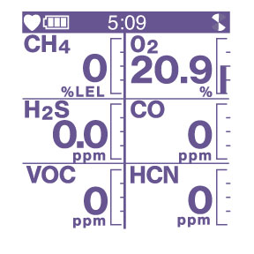
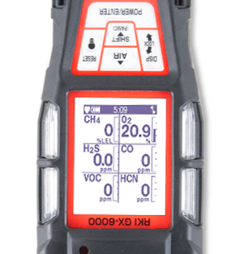
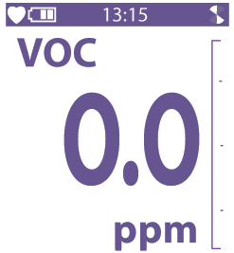
LCD Display Options
Multi-gas view displays all 6 channels
Single gas view shows one channel in large scale with auto scrolling for each channel
Auto rotation when instrument upside down

Slide 12
LCD Display Options
Peak bar graph

Slide 13
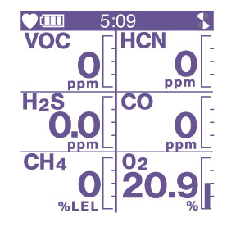
Customize Gas Order
Customize your gas readings in any order

Slide 14
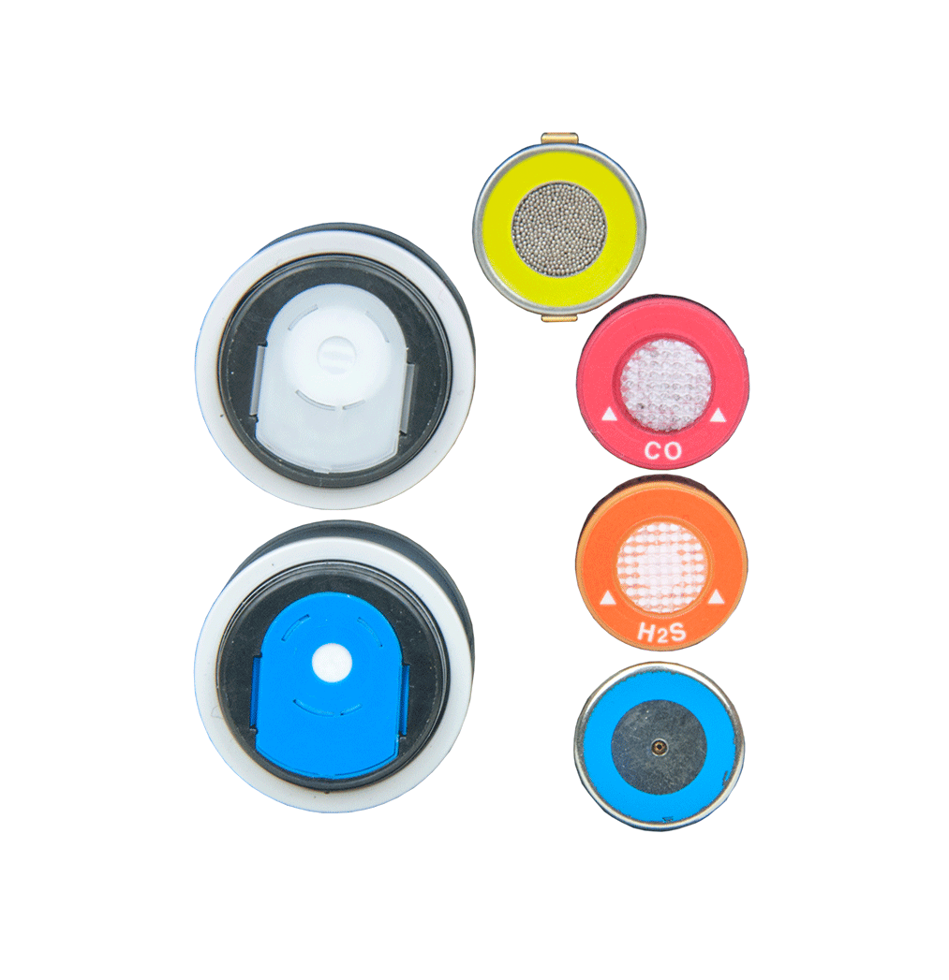
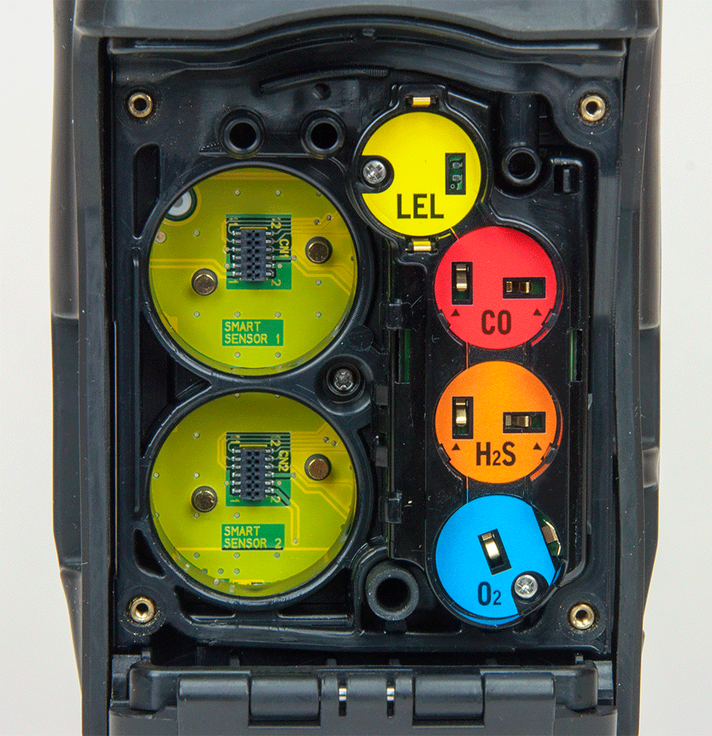
Sensors
Smart Sensor
Slots
Standard 4 Gas Sensors

Slide 15
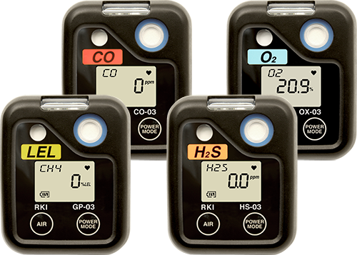
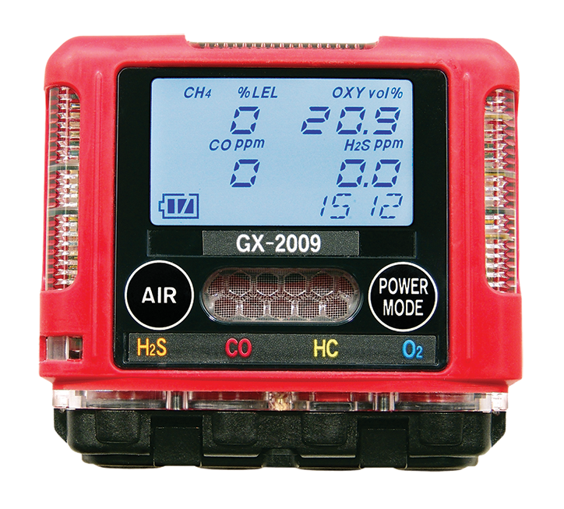
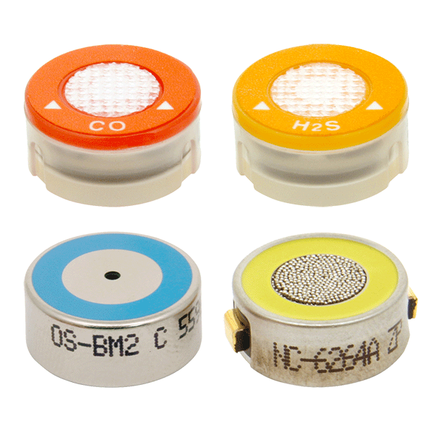
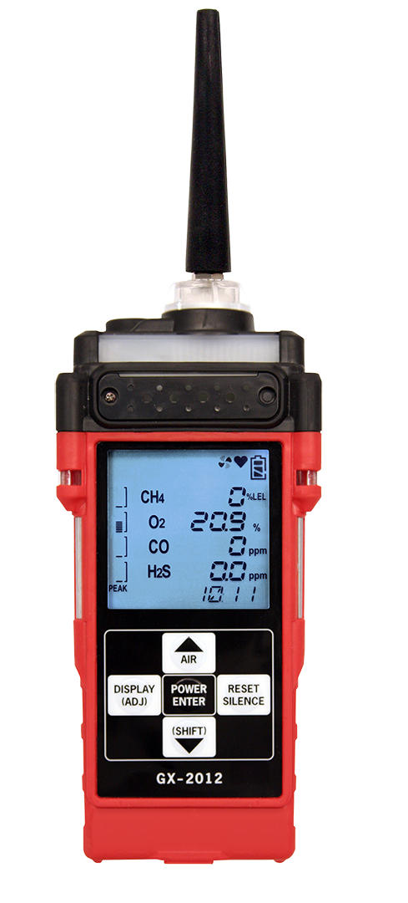
Interchangeable Sensors
03 Series
GX-2009
GX-2012
GX-6000
4 standard micro sensors are interchangeable with the 03 Series, GX-2009, GX-2012, and GX-6000

Slide 16
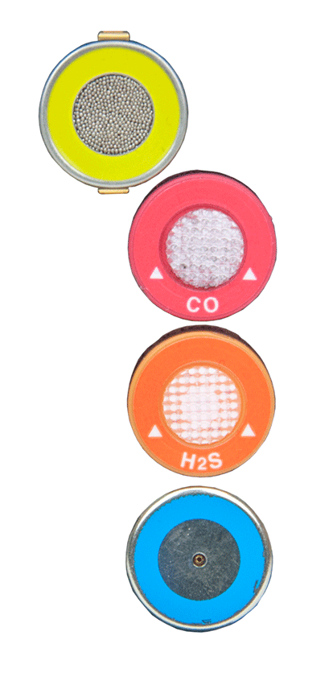
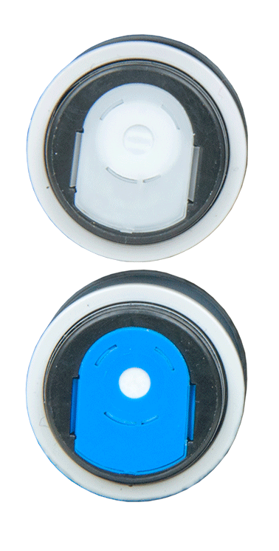
Smart Sensor Slots
Smart sensor slots auto-recognize any sensor you install
- No re-cal or user
setup required

Slide 17
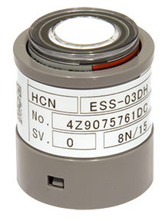
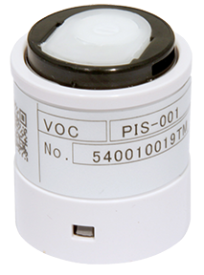
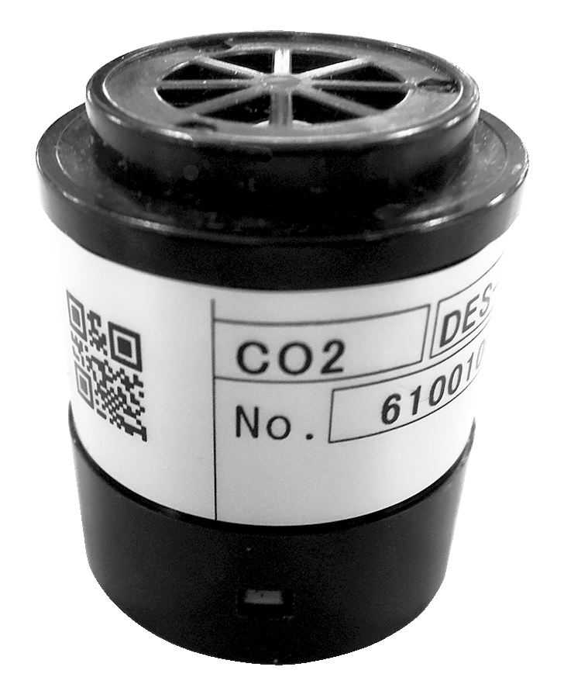
Smart Sensor Technology
Smart Electrochemical (ESS-03DH-XXX)
GAS | RANGE
Ammonia (NH3) | 0-400 ppm
Chlorine (Cl2) | 0-10ppm
Hydrogen Cyanide (HCN) | 0-15ppm
Nitrogen Dioxide (NO2) | 0-20 ppm
Sulfur Dioxide (SO2) | 0-99.9 ppm
Monitor a wide variety of toxic gases. Smart plug and play sensors are auto recognized and can be remotely calibrated
Photo Ionization Detection PID
GAS |  | RANGE
10.6 Lamp | 600 VOC’s | 0-50,000 ppb
 |  | 0-6,000 ppm
10.0 Lamp | Benzene Specific | 0.1-50 ppm
 | 300 VOC’s | 0-100 ppm
Monitor low ppm VOC gases.
Infrared (DES-3311-1/2)
GAS | RANGE
Carbon Dioxide (CO2) | 0-10,000 ppm 0-10% Vol.
Methane (CH4) | 0-100% LEL 0-100% Vol.
Hydrocarbons | 0-100% LEL 0-30% Vol.
Monitor Combustible gases in inert environments. Monitor wide range of CO2.

Slide 18
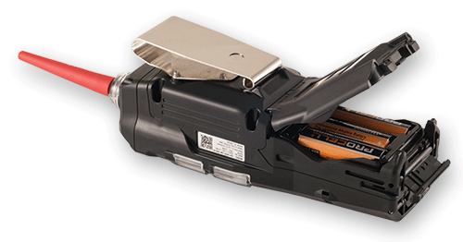
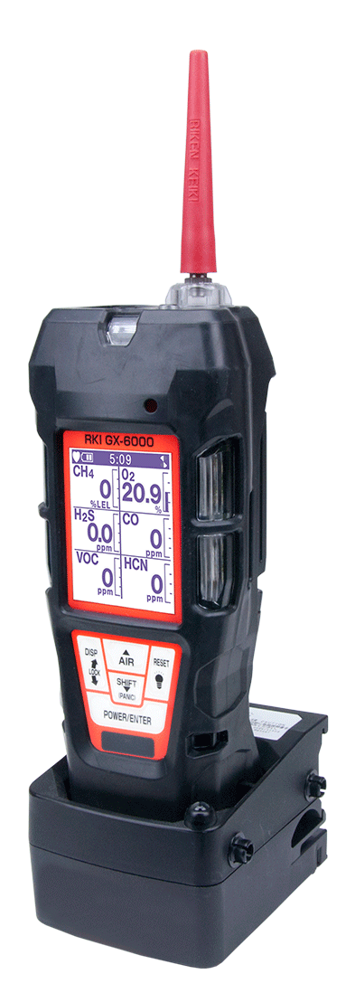
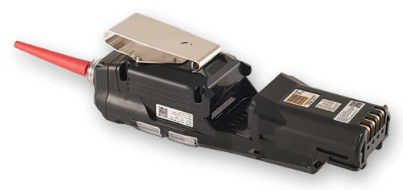
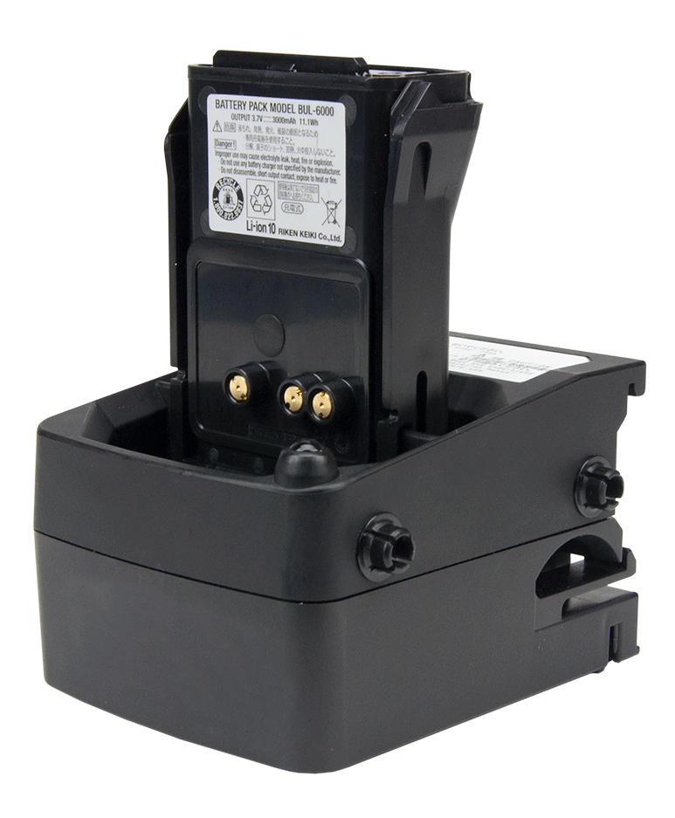
Interchangeable Power Supply
Alkaline
AA size battery x 3 pieces
More than 8 hours operation
Rechargeable
More than 14 hours operation
A complete charge in 3 hours

Slide 19
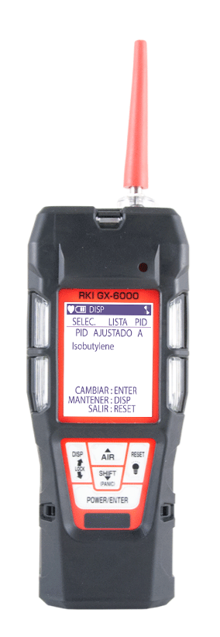
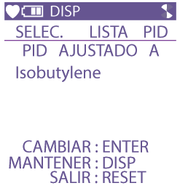
9 Languages
One of 9 languages can be selected by software.
  English, German, Italian, French, Portuguese, Spanish, Japanese, Korean, Russian

Slide 20
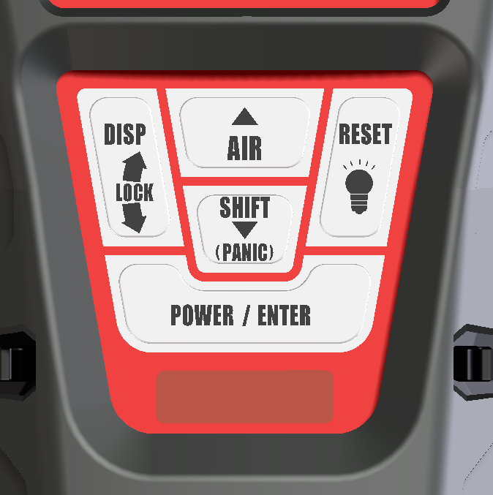
Control Panel
Glove friendly buttons can be operated with one hand.
New functions are easily identifiable
  LED light
  Panic alarm

Slide 21

Applications
Confined Space Entry
Monitor LEL, O2, CO, AND H2S
Pre – Entry testing with sample draw pump
-Pull samples up to 40’
-Maintain steady sample flow to
sensors
Continuously monitor confined space
Utilize as a personal monitor within the confined space

Slide 22

Applications
Environmental Monitoring
GX-6000 is Method 21 compliant
  monitor ppm level combustibles
Hazardous waste monitoring to determine proper PPE
Soil Remediation from leaking underground storage tanks
  PID measures BTEX and THC’s

Slide 23

Applications
Oil Refineries
Toxicity screening
-H2S detection during extraction, storage,
transport, and processing stage.
Limited Hot Work compliant
-With the alarm silenced, the GX-6000 can
be operated in a Class I, Div. 1,
Group A,B,C, & D environment.
VOC and Benzene monitoring

Slide 24

Applications
Aircraft Maintenance
Monitoring for jet fuels before and during wing tanks maintenance

Slide 25

Applications
Leak Investigation
Provides ppm detection of combustible gas
Bar hole mode for tracking leak migration
Leak check with changing blink / pulsing rate
-LED’s and alarm tones increase in
frequency as gas concentration
increases
Audible alarm silence
-Perform leak investigations without
alarming residents

Slide 26
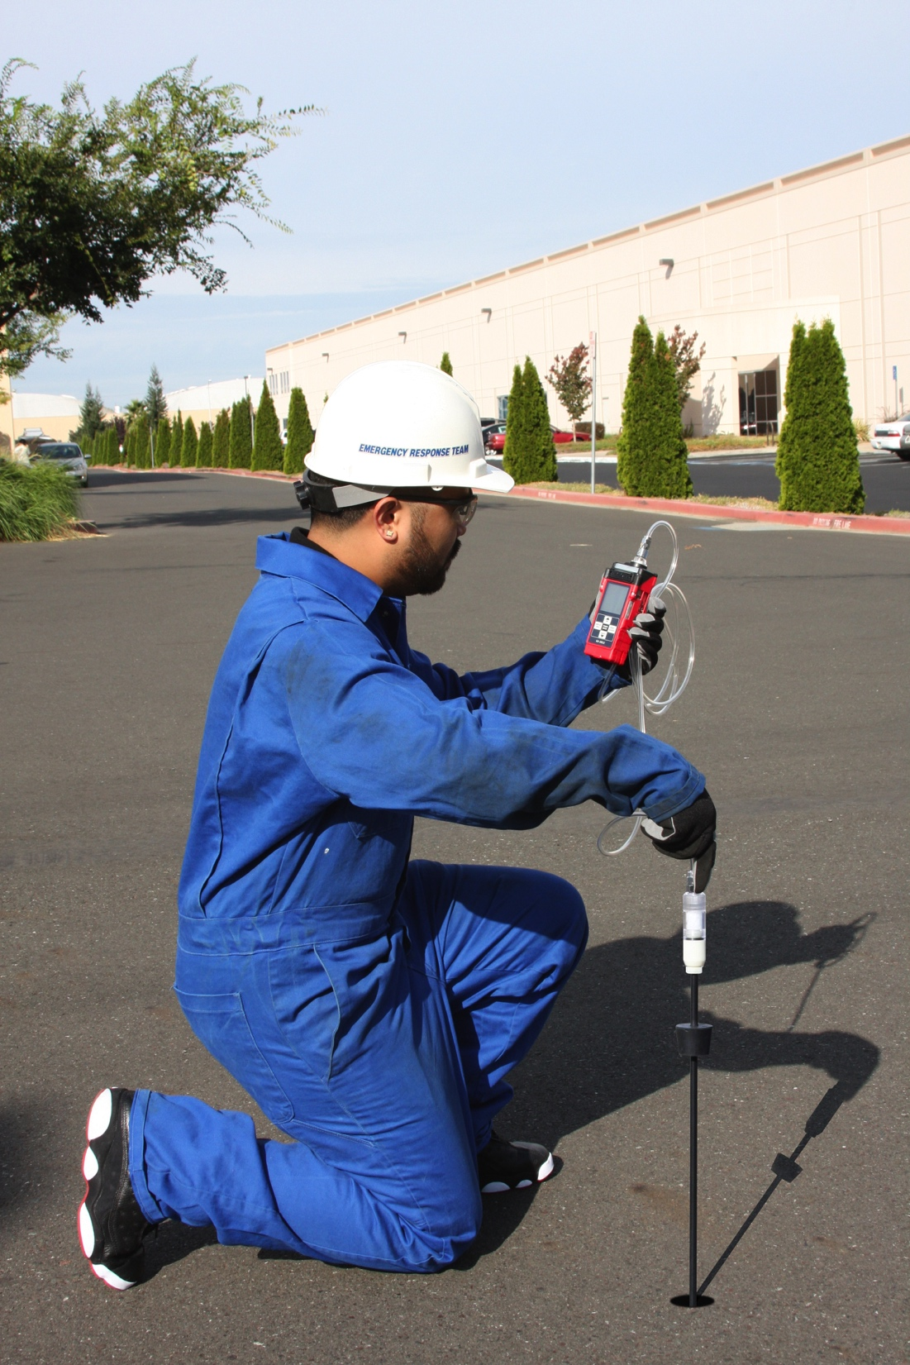
Applications
Leak Investigation
Commonly used by utility companies
Used for both above and below investigations
-Leak Checks (above) Bar Hole (below)
Natural gas

Slide 27
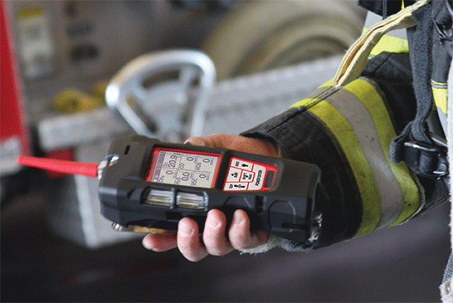
Applications
Fire Industry
Hazmat Perimeter / Safe Zone perimeter
-Chemical spills
Emergency response to toxic gas leaks
-Chemical tanks
Confined space entry / rescue
Arson Investigation
-HCN (i.e. melted plastic)
-PID used to pick up trace levels of
accelerants
Meth lab investigation
-Ammonia

Slide 28
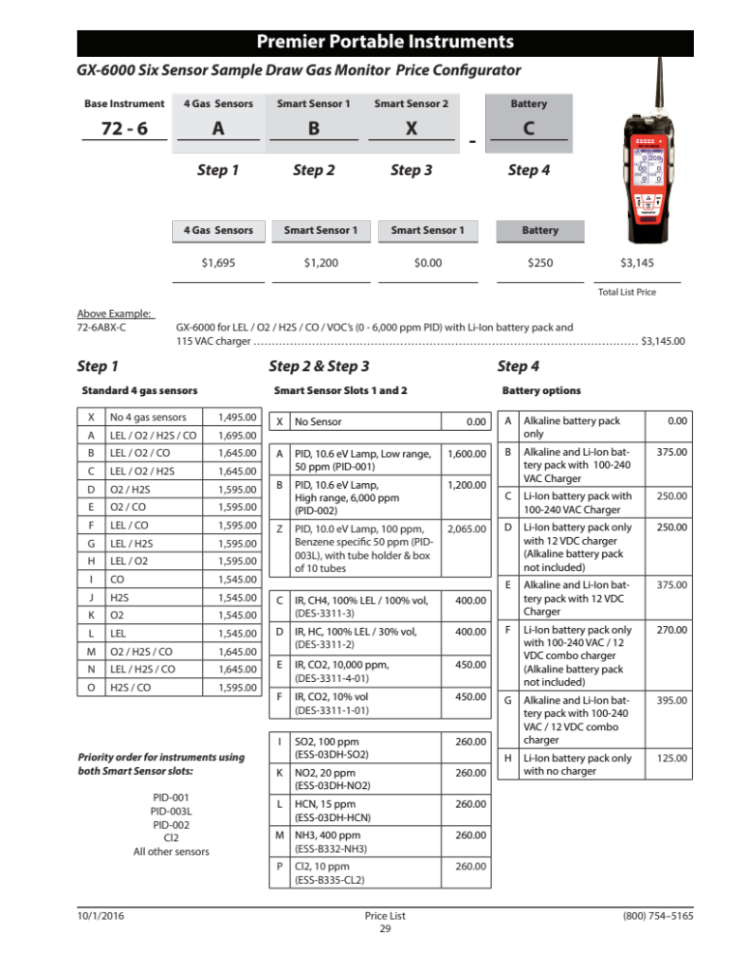
Price List
Configurator

Slide 29
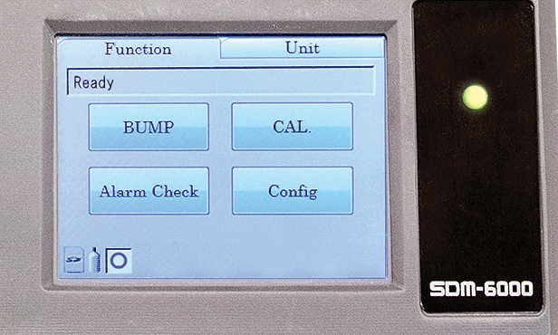
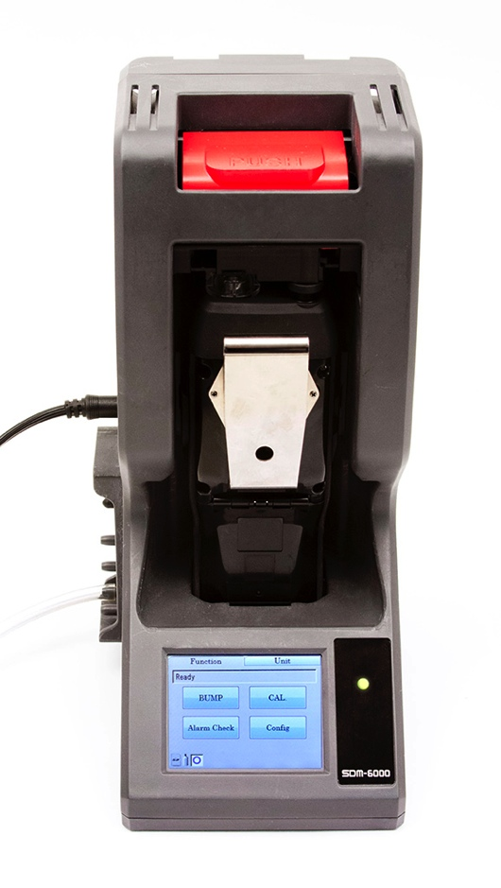
SDM-6000 Docking Station
  Stand alone station (no PC required)
  Bump, Calibrate, and Alarm tests
  Charge
  Touch screen menu display
  Save calibration, bump tests, alarm history and exposure data to an SD memory card or to a computer
  Automatically power on or off for scheduled maintenance
Notes:
Can be connected up to 10 units

Slide 30
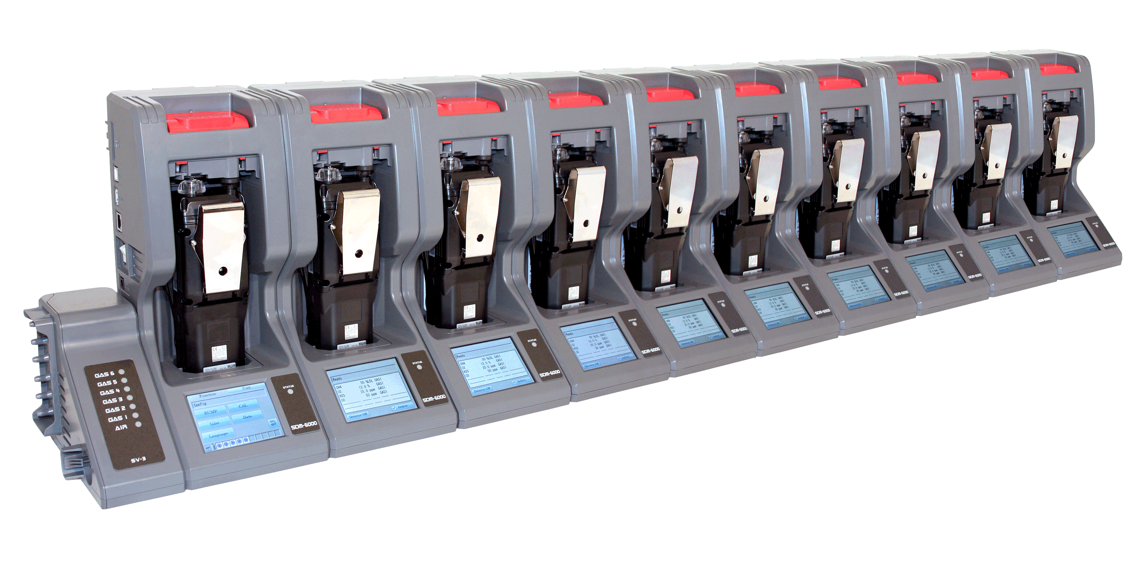
Multi Module System with PC Controller
  Manage up to 10 instruments with one power source, calibration source, and computer
  Configure GX-6000 parameters
  SV-3 unit expands calibration ports up to 6 ports
Notes:
Can be connected up to 10 units

Slide 31
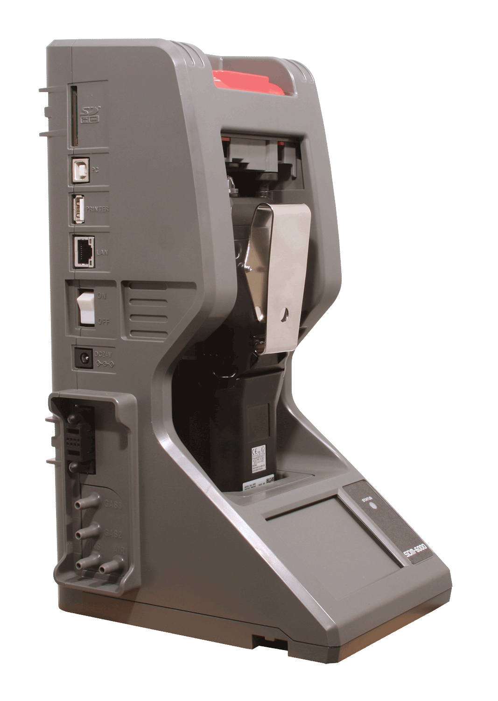
SDM-6000 Docking Station
SD / SDH Memory card slot
USB PC connection
USB Printer connection
LAN connection
Power Switch
AC adaptor
Power/Data Joint Connector
3 calibration gas ports
1 fresh air port

Slide 32
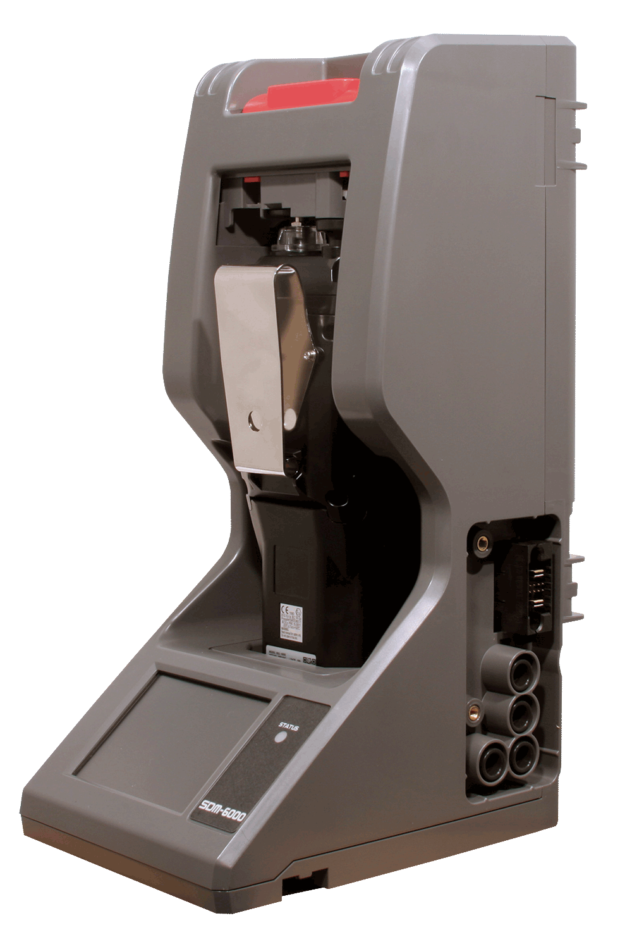
SDM-6000 Docking Station
  Easily connects to adjacent docks
  No extra tubing required
  Automatically distributes power, calibration gas, and data once connected
  DIN Rail wall mount

Slide 33
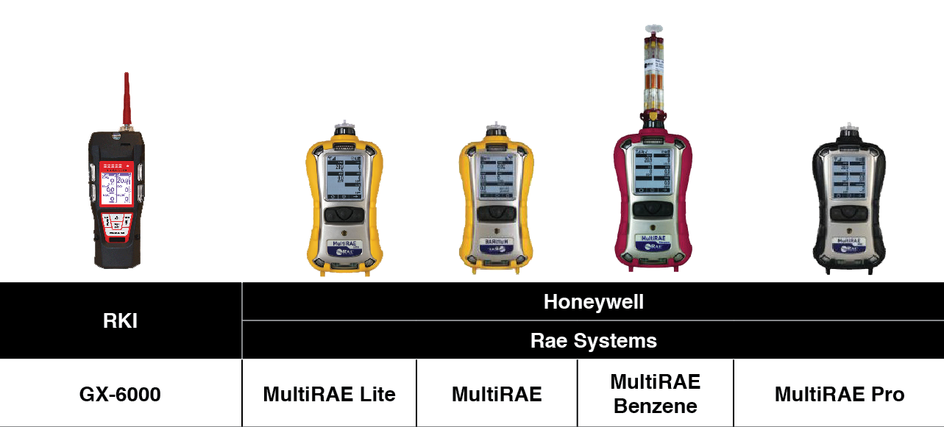
GX-6000 vs MultiRAE
Similarities
Sample Draw Instruments
6 Gas Channels
PID capability
Alkaline and Rechargeable options
Man-down alarm

Slide 34
GX-6000 vs MultiRAE
GX-6000 Advantages
Features MultiRAE’s do not have
Size: GX-6000 is half the weight of MultiRAE’s
  GX-6000 14 oz.
  MultiRAE’s 30 oz.
GX-6000 PID Advantages
  Built in VOC Library: 600 vs 190
  PID Lamp options: 10.6, 10,0, & 11.7 available in 1 instrument
  Dual PID capability: Use 2 different PID lamps simultaneously
  Wider range of VOC’s with 10.6 lamp: 6,000 vs 1,000 / 5,000 ppm
  Easy access to VOC library
    Previously Used menu stores last 8 VOC’s
    User defined list of 30 VOC’s
Smart Sensor Slots
6 Operating Modes:
  Normal, Leak Check, Inert Mode, Bar Hole, Snap Log, & Benzene

Slide 35
Questions?

