Slide 1
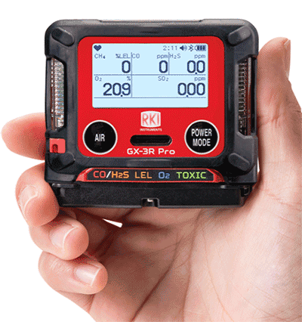
The GX-3R Pro
The World’s Smallest 5-Gas Detection Unit
Evolution In Gas Detection

Slide 2
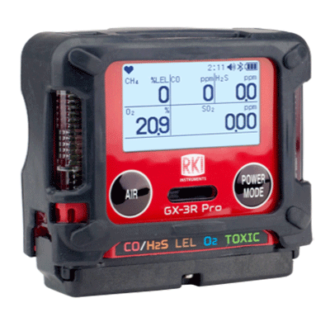
GX-3R Pro
The GX-3R Pro
The World’s Smallest 5-Gas Detection Unit
D: 1.06”
H: 2.6”
W: 2.9”
And it weighs only 4.58 ounces!

Slide 3
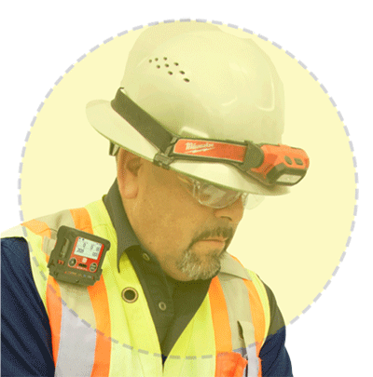
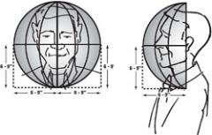

Size Matters
In the “Breathing Zone”
GX-3R Pro
The GX-3R Pro’s small size enables it to easily be clipped into the “Breathing Zone.”
“The breathing zone is within a ten inch radius of the worker's nose and mouth. OSHA requires that worker exposure monitoring air samples be collected in the breathing zone. Air sampling filters may be attached to the collar or lapel.”

Slide 4
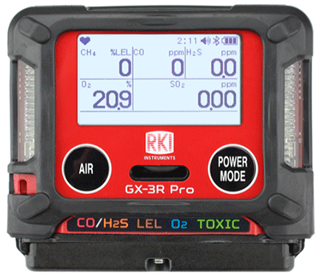




Simultaneously Monitor 5 Gasses
GX-3R Pro
The GX-3R Pro monitors your standard 4-gasses, plus a 5th channel for toxic and IR sensors
CO – Carbon Monoxide
Dual sensor for CO and H2S in one channel
H2S – Hydrogen Sulfide
Dual filament design gives added silicone poisoning resistance to LEL sensor
LEL – Combustibles
O2 – Oxygen
Lead free electro-chemical sensor design gives O2 sensor a 3-5 year lifespan
H2 compensated CO sensor available)
And Toxics
Eliminate H2 interference with CO readings with optional H2 compensated O2 sensor
All gas readings displayed

Slide 5
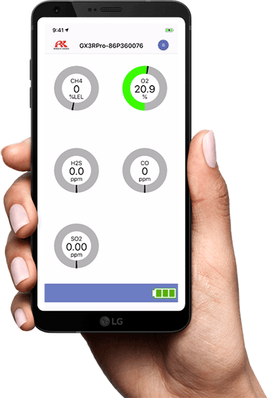

RK Link App
GX-3R Pro
Bluetooth connectivity
Direct readings from instrument
Digital values
Graphical display
Alarm indications
Available on iOS and Android

Slide 6
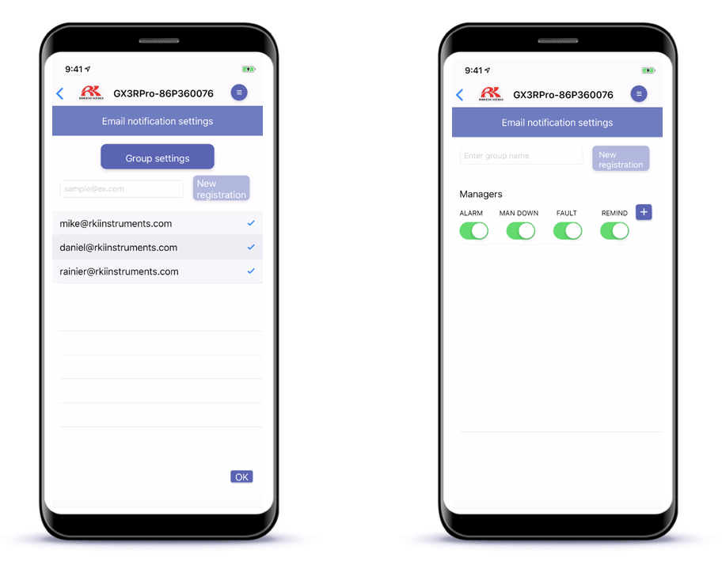
Configurable Alarm Notifications
Configure who you want to receive your alarm notifications
Configure which types of alarms you want notifications sent for

Slide 7

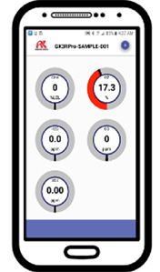





Bluetooth Communication
GX-3R Pro
Automatically send alarm notifications to configured contacts with alarm data and GPS location of the user.
Alarm Notification

Slide 8
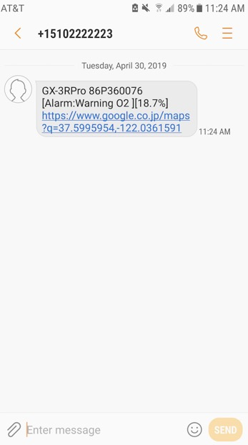
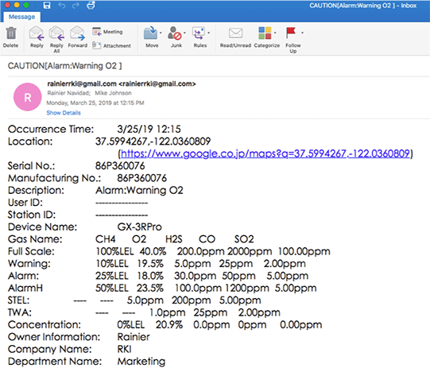
Alarm Location
The RK Link App uses your phone’s GPS location to notify your contacts where the alarm occurred
*SMS notifications available on Android only

Slide 9
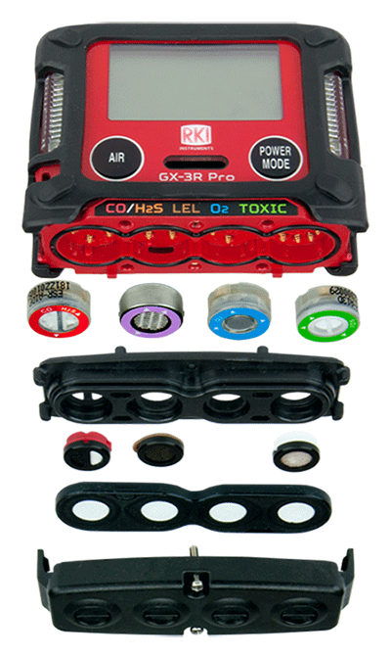
Sensors
GX-3R Pro
Sensors are field replaceable
(as easy as changing a clock battery)
Can be configured with interchangeable combos to detect a multitude of gasses
Long-lasting with a 3-year warranty

Slide 10

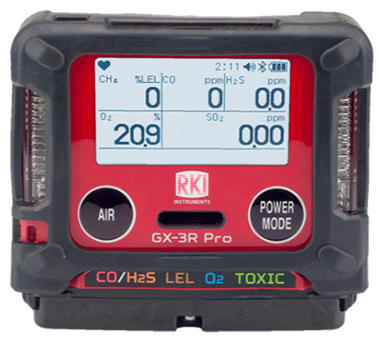
Non-compliance Indicator
GX-3R Pro
Easily identify workers using instruments that have not been calibrated, bump tested, or have been in alarm. Red LED’s flash every 30 seconds.

Slide 11
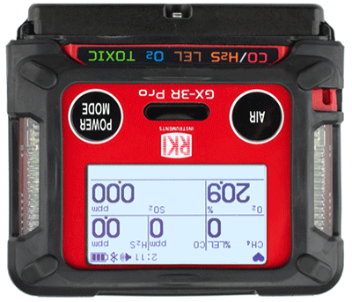
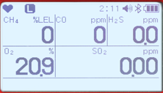
Display
GX-3R Pro
Full dot LCD display with low-light auto-backlight and auto rotation
Easy to read in adverse environments! The screen can illuminate automatically in dark environments and rotates automatically

Slide 12
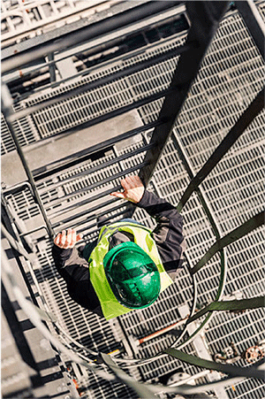
Concussion Resistant
GX-3R Pro
The GX-3R Pro has been drop-tested from over 23 feet.
It can handle the rugged conditions of your work environment

Slide 13
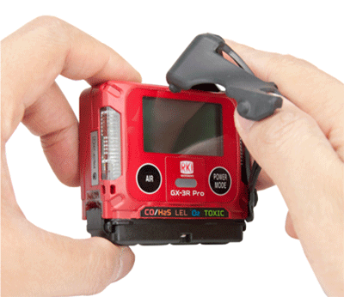
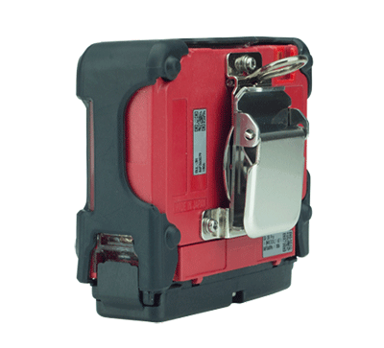
Removable Rubber Boot
GX-3R Pro
Clean or replace to protect the instrument from the dirtiest environments.
Alligator Clip
Low profile alligator clip rotates 360°. Comfortably view the instrument display from a variety of positions.

Slide 14
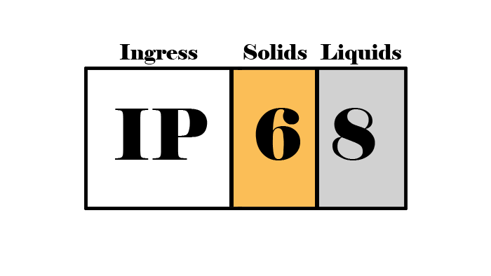
IP-66 / IP-68 Rating
GX-3R Pro
The GX-3R Pro is IP-66 rated because it can withstand jets of water
It is also IP-68 rated because it can withstand submersion in water
Critical for withstanding harsh industrial environments
The first digit shows that it is dust proof
The second digit shows it is waterproof

Slide 15
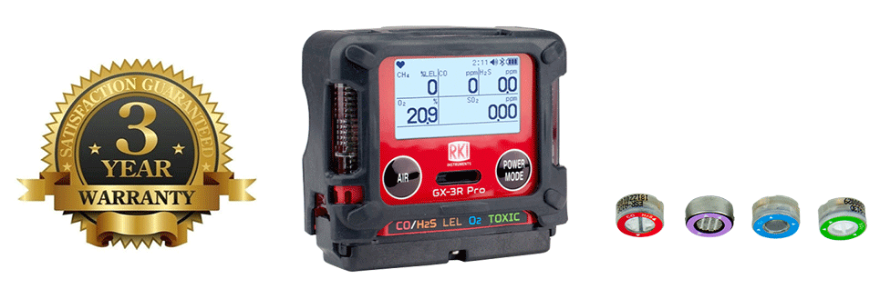
3 Year Warranty
The GX-3R Pro has a 3 year warranty
The warranty covers workmanship of the device
AND the sensors.

Slide 16


Panic Alarm
GX-3R Pro
User can trigger instrument into alarm by tapping it twice to notify others of an immediate hazard.

Slide 17
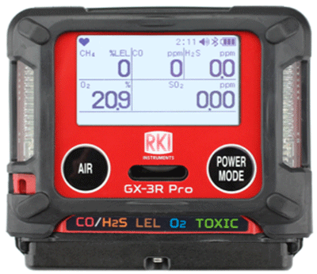

Man Down Alarm
GX-3R Pro
Man-down alarm sounds if no motion is detected for 30 seconds, increasing worker safety.

Slide 18
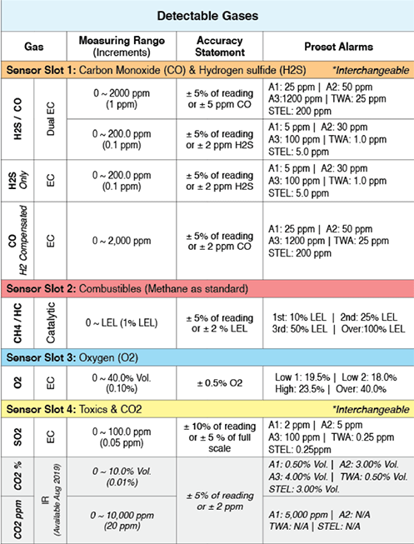
3 Adjustable Alarm Levels
GX-3R Pro
Three adjustable alarm points let you customize your instrument to fit your needs.
Revert back to standard factory settings any time.

Slide 19


3 Alarm Types
GX-3R Pro
Visual
LED light indicators
Alert you to gas, low battery, and failure alarms
Audible
95 decibel buzzer
Buzzer sounds for gas alarms, malfunctions, low battery voltage, and as an indicator
Vibration
An internal motor vibrates for gas alarms, unit malfunctions, and as an indicator

Slide 20
2 Button Operation
GX-3R Pro
2 Glove-friendly Buttons

Slide 21
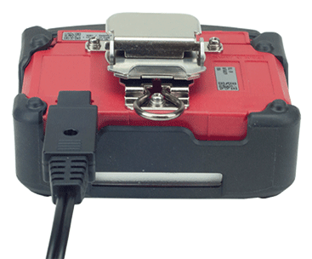
Rechargeable Lithium-Ion Battery
GX-3R Pro
Lithium Ion battery gives 25 hours of continuous operation minutes, with a complete recharge in 90.
Alkaline option available
It has an easy and convenient charging cable, no cradle required!

Slide 22
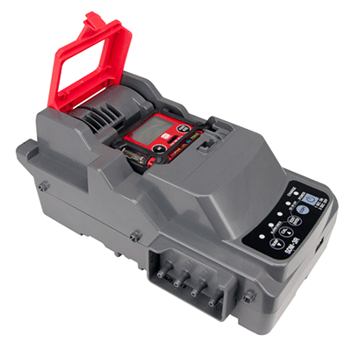
SDM-3R Calibration Station
GX-3R Pro
Charge, bump test, and alarm test instruments using less calibration gas
Automatically schedule tests
Bank up to 10 units with tubeless connection
and has ethernet and USB outputs for data logging

Slide 23
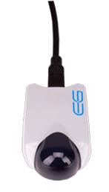
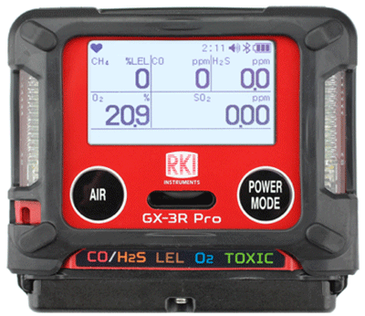
Infrared Communication Port
GX-3R Pro
High Capacity Data Logging
The GX-3R Pro automatically logs data every 5 minutes for 300 hours of measurement. (note: logging interval can be changed in settings)
Transfer data from the instrument to a PC with a USB/IR adaptor, no cradle required.

Slide 24
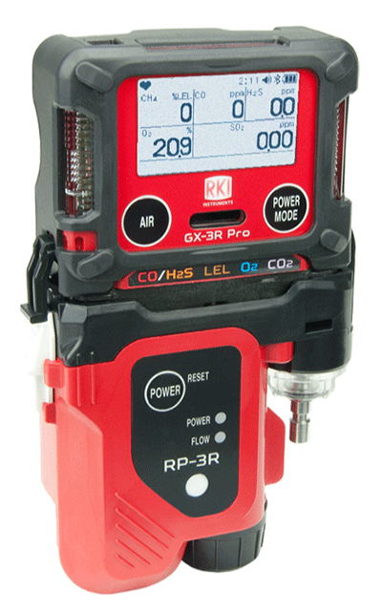
RP-3R Sampling Pump
GX-3R Pro
Clip-on sampling pump has a 50’ range and independent power supply
Continuously operates for 10 hours
Eco mode will operate up to 16 hours

Slide 25

Lunch Break Mode
GX-3R Pro
Retain TWA and PEAK values from last use to pick up where you left off.
Stealth Mode
Set the alarm to notify silently—perfect for law enforcement and other applications

Slide 26

Low Cost of Ownership
GX-3R Pro
The GX-3R Pro is a complete instrument. It is easy to maintain and is NOT disposable.
Long lasting sensors, low parts replacement costs, plus a history of long-term product support makes this the best value of any 5-gas instrument

Slide 27
9 Languages
GX-3R Pro
Available in 9 languages:
English
日本語 (Japanese)
Español
Deutsch
Français
Italiano
Pусский (Russian)
中文 (Chinese)
한국어 (Korean)

Slide 28
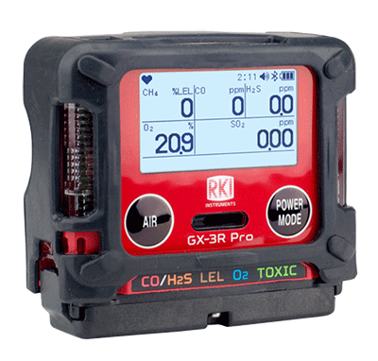
GX-3R Pro
GX-3R Pro

Slide 29

GX-3R Pro

