Slide 1

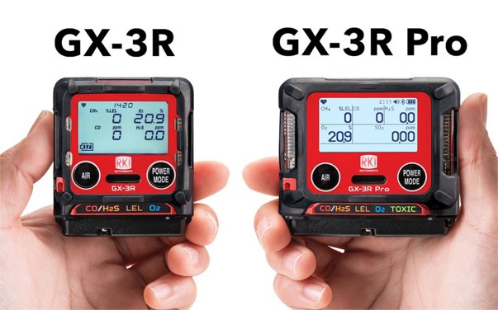
GX-3R and GX-3R Pro
Product Introduction
Evolution In Gas Detection

Slide 2
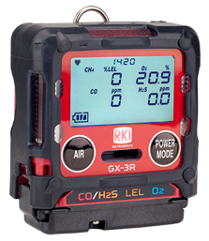
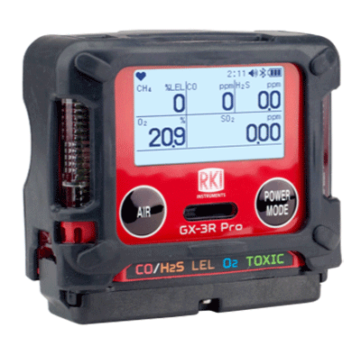
2 Models—Depending on Need
Standard 4-gas model
Pro 5-gas model
GX-3R
GX-3R Pro
  4-gas plus extra slot for toxic or IR sensor
  Wireless communication with mobile app
  Man-down and panic alarms
  Alkaline/Rechargeable option
Worlds smallest and lightest 4-gas monitor
Low cost of ownership

Slide 3
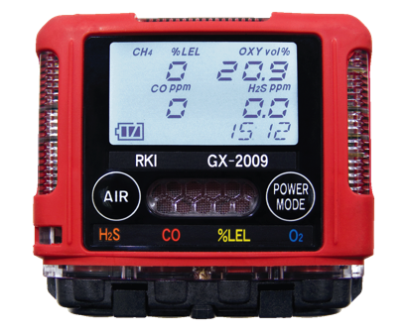
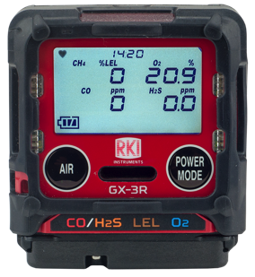
Advancements from GX-2009
Size & Weight
Smallest
— Meet Smaller!
The NEW Smallest and Lightest 4-gas Monitor
3” x 2.7” x 1”
4.6 ounces
GX-2009
2.2” x 2.55” x 1”
3.7 ounces
GX-3R

Slide 4
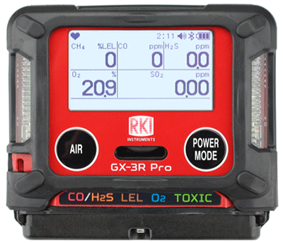
Advancements from GX-2009
Size & Weight
Advanced 5-gas version is the same size as GX-2009
3” x 2.7” x 1”
4.6 ounces
GX-2009
2.9” x 2.6” x 1.06”
4.6 ounces
GX-3R Pro

Slide 5

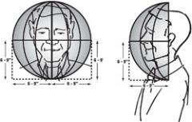

Size Matters
In the “Breathing Zone”
The GX-3R and GX-3R Pro’s small size enables them to easily be clipped into the “Breathing Zone.”
“The breathing zone is within a ten inch radius of the worker's nose and mouth. OSHA requires that worker exposure monitoring air samples be collected in the breathing zone. Air sampling filters may be attached to the collar or lapel.”
Source: https://webapps.dol.gov/elaws/osha/lead/glossary.asp#breathingzone

Slide 6

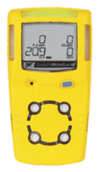
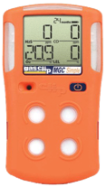
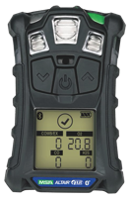
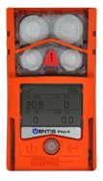
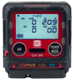
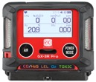
Competitor Comparison
Size & Weight
2.2” x 2.55” x 1”
3.7 ounces
2.9” x 2.66” x 1.06”
4.6 ounces
4.4” x 2.4” x 1.2
6.3 ounces
4.1” x 2.3” x 1.4”
6.4 ounces
4.7” x 2.7” x 1.2”
7.67 ounces
4.4” x 3.0” x 1.4”
7.9 ounces
5.12” x 1.9” x 1.8”
8 ounces
The GX-3R weighs about half of the average 4-gas detector!

Slide 7
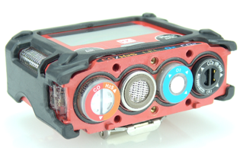
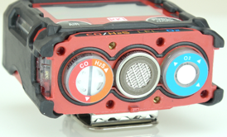

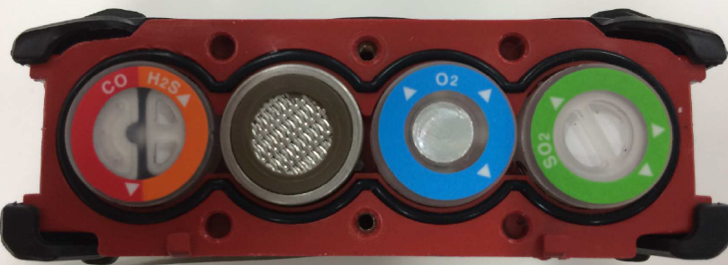
Sensor Advancements
4 Sensors slots for 5 gas channels
GX-3R Pro
3 Sensors slots for 4 gas channels
Dual Sensor
GX-3R
CO/H2S

Slide 8
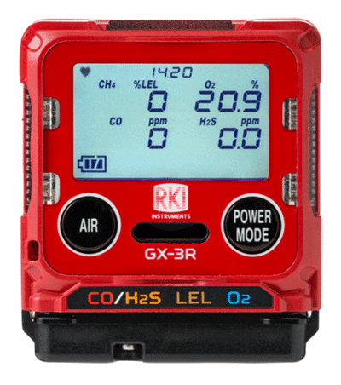

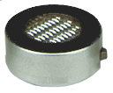

Sensor Advancements
The GX-3R simultaneously monitors:
Dual sensor for CO and H2S in one channel
CO – Carbon Monoxide
Dual filament design gives added silicone poisoning resistance to LEL sensor
H2S – Hydrogen Sulfide
LEL – Combustibles
Lead free electro-chemical sensor design gives O2 sensor a 3-5 year lifespan
and O2 – Oxygen
H2 compensated CO sensor available
Eliminate H2 interference with CO readings with optional H2 compensated O2 sensor
All gas readings displayed

Slide 9
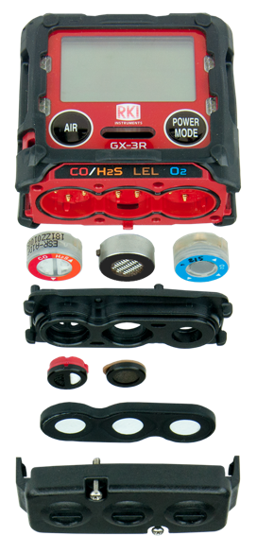
Sensor Advancements
Interference Gas Scrubber Disc
Gas scrubber disc’s are replaceable, lowering cost by eliminating need to replace entire sensor

Slide 10


Sensor Advancements
GX-3R Pro
Simultaneously monitor the four standard gases
5th channel for toxic and IR sensors
Toxic Channel
CO – Carbon Monoxide
EC sensor for SO2
(0-100 ppm)
IR sensor can monitor CO2 in ppm or % vol.
(available 8/19)
HCN, NO2, NH3 and Cl2 planned for 2020
H2S – Hydrogen Sulfide
LEL – Combustibles
O2 – Oxygen
H2 compensated CO sensor available
And Toxics

Slide 11

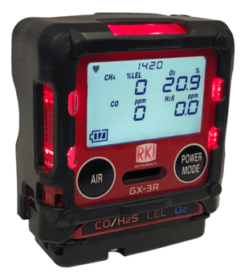
Non-compliance Indicator
Easily identify workers using instruments that have not been calibrated, bump tested, or have been in alarm.
Red LED’s flash every 30 seconds.
Non-compliance indicator in both GX-3R and GX-3R Pro

Slide 12
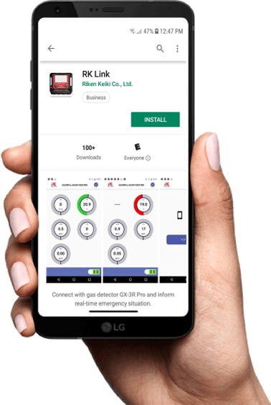

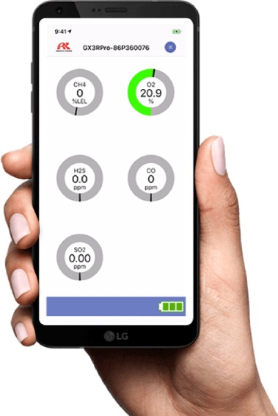
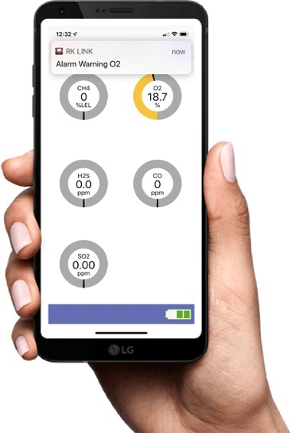
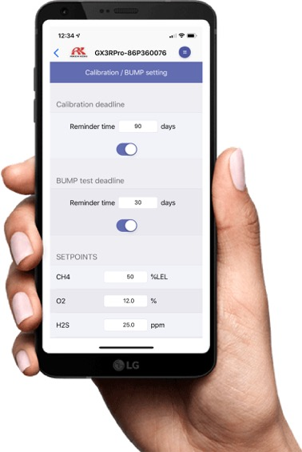

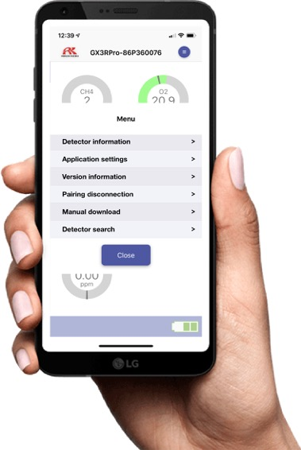
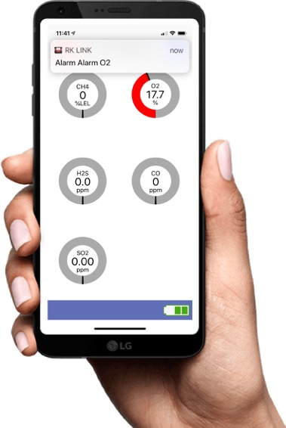
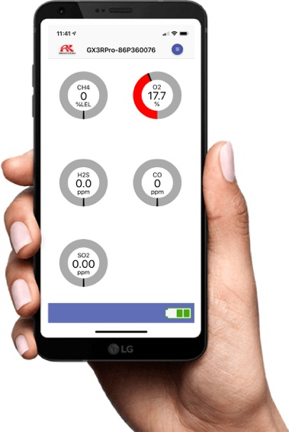

GX-3R Pro—Connectivity
RK Link App
Bluetooth connectivity
Direct readings from instrument
Digital values/Graphical display
Alarm indications
Set bump/cal reminders, alarm parameters, and other
GX-3R Pro settings
Configure alarm notifications to desired contacts
Find my instrument feature
Available on iOS and Android

Slide 13
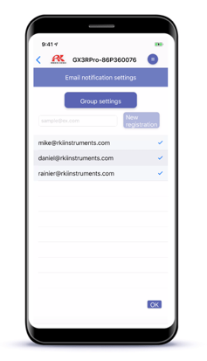
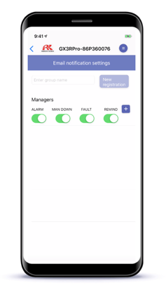
Configurable Alarm Notifications
GX-3R Pro—Connectivity
Configure who you want to receive your alarm notifications
Configure which types of alarms you want notifications sent for

Slide 14
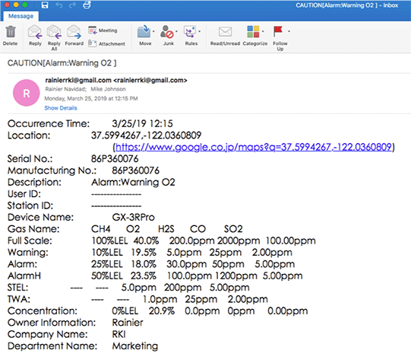
Alarm Location
GX-3R Pro—Connectivity
The RK Link app notifies your assigned contacts when it goes into alarm
And uses your phone’s GPS location to notify your contacts where the alarm occurred
by text*
by e-mail

Slide 15

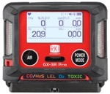


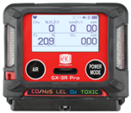

GX-3R Pro—Alarms
Panic Alarm
User can trigger instrument into alarm by tapping it twice to notify others of an immediate hazard.
Man Down Alarm
Man-down alarm sounds if no motion is detected for 30 seconds, increasing worker safety.

Slide 16
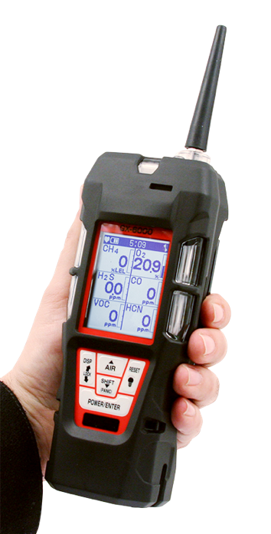
You Have Choices
Introducing
GX-6000
6 gas, sample draw with smart PID, IR & super toxics

Slide 17
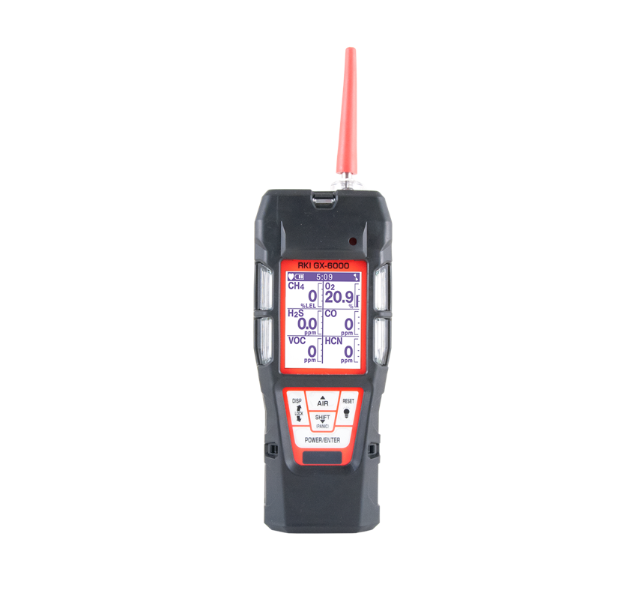
Monitor up to 6 Gases
H2S, CO, O2, LEL
2 smart sensor slots
  PID for VOC’s
  IR for CH4, HC, & CO2
  EC for NH3, Cl2, HCN, NO2, & SO2
PID library of more than 600 VOC’s
Accepts 10.6 and / or 10.0 PID lamps
50,000 ppb / 6,000 ppm ranges
10.0 Lamp for Benzene Specific
11.7 Lamp available Q4 2018
11.7 Lamp for carbon tetrachloride, acrylonitrile, chloroform, methanol, and refrigerants (R-143, R-132A)
PID sensors can be combined
Easily choose a target VOC
  User defined VOC list of 30
  Recently used VOC list last 8
6 operating modes
Normal
Leak check
Inert
Bar hole
Snap Log
Benzene Specific Mode
LCD display
Auto flip display
Peak bar graphs
Adjustable auto backlight
Customize order of gases
Single gas view with large font & auto sequence
LEL Protection mode
Shields LEL sensor from damaging VOC exposure

Slide 18
Smallest 6 gas sample draw
Lightweight & Ergonomic
High impact rubber boot
Ergonomic design fits comfortable in hand
Alarms
2 adjustable gas alarms per channel Plus STEL & TWA
Man Down alarm
Panic Alarm
4 alarm LED’s
Audible and vibration alarms
Trouble alarms for low flow, sensor connection, low battery, circuit error, & calibration
Intrinsically Safe
ATEX / IECEX
cCSAus
Interchangeable battery options
Lithium-ion pack operates 14 hours
  Complete recharge in 3 hours
Alkaline pack operates 8 hours
Weather & Dust Resistant
IP-67
9 Languages
English, German, Italian, French, Portuguese, Spanish, Japanese, Korean, Russian
LED Flashlight
On demand light source

Slide 19
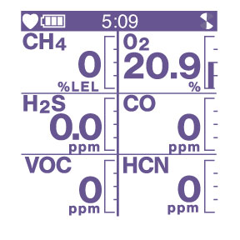
LCD Display Options
Peak bar graph

Slide 20
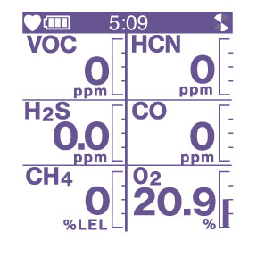
Customize Gas Order
Customize your gas readings in any order

Slide 21
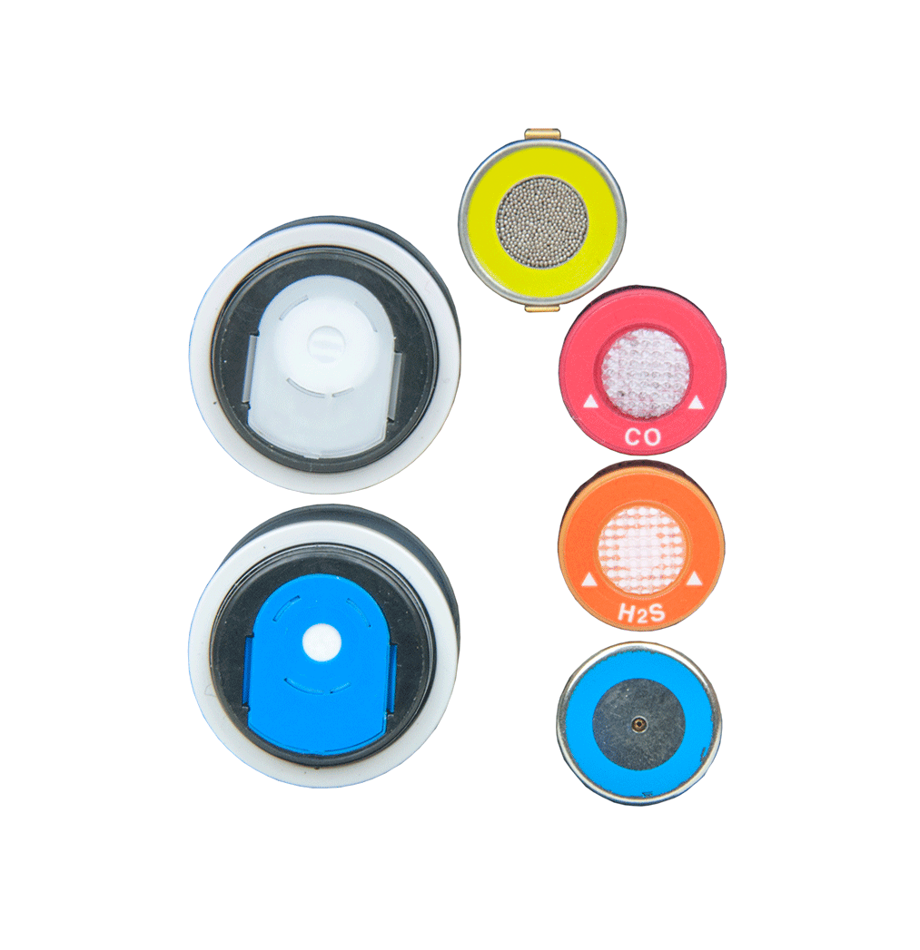
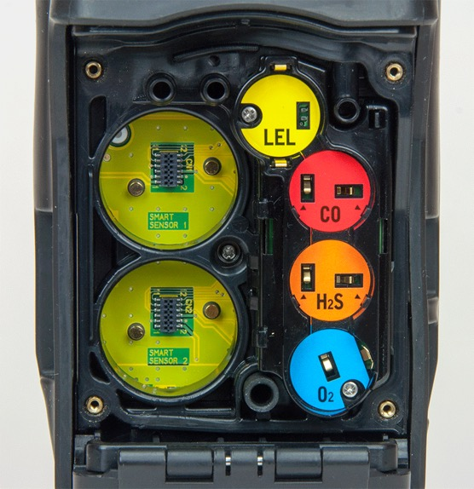
Sensors
Smart Sensor
Slots
Standard 4 Gas Sensors

Slide 22
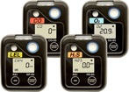
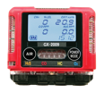
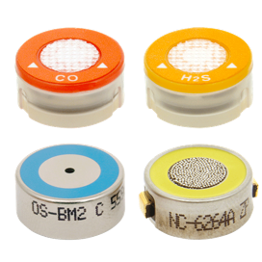

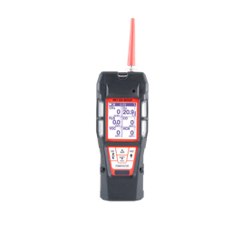
Interchangeable Sensors
03 Series
GX-2009
GX-2012
GX-6000
4 standard micro sensors are interchangeable with the 03 Series, GX-2009, GX-2012, and GX-6000

Slide 23
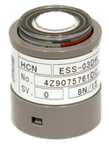
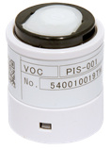
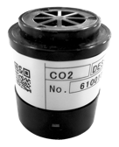
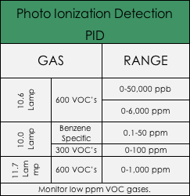
Smart Sensor Technology
Smart Electrochemical (ESS-03DH-XXX)
GAS | RANGE
Ammonia (NH3) | 0-400 ppm
Chlorine (Cl2) | 0-10ppm
Hydrogen Cyanide (HCN) | 0-15ppm
Nitrogen Dioxide (NO2) | 0-20 ppm
Sulfur Dioxide (SO2) | 0-99.9 ppm
Monitor a wide variety of toxic gases. Smart plug and play sensors are auto recognized and can be remotely calibrated
Infrared (DES-3311-1/2)
GAS | RANGE
Carbon Dioxide (CO2) | 0-10,000 ppm 0-10% Vol.
Methane (CH4) | 0-100% LEL 0-100% Vol.
Hydrocarbons | 0-100% LEL 0-30% Vol.
Monitor Combustible gases in inert environments. Monitor wide range of CO2.

Slide 24
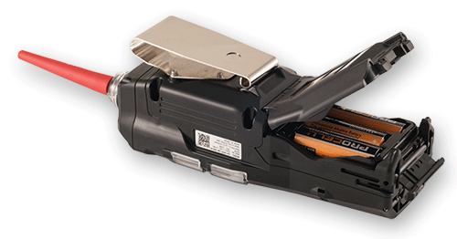
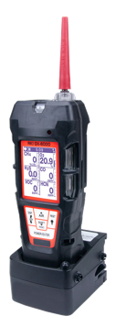
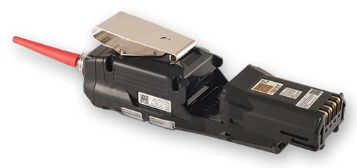

Interchangeable Power Supply
Alkaline
AA size battery x 3 pieces
More than 8 hours operation
Rechargeable
More than 14 hours operation
A complete charge in 3 hours

Slide 25

Applications
Confined Space Entry
Monitor LEL, O2, CO, AND H2S
Pre – Entry testing with sample draw pump
-Pull samples up to 40’
-Maintain steady sample flow to
sensors
Continuously monitor confined space
Utilize as a personal monitor within the confined space

Slide 26
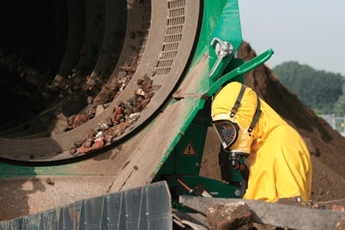
Applications
Environmental Monitoring
GX-6000 is Method 21 compliant
  monitor ppm level combustibles
Hazardous waste monitoring to determine proper PPE
Soil Remediation from leaking underground storage tanks
  PID measures BTEX and THC’s

Slide 27

Applications
Oil Refineries
Toxicity screening
-H2S detection during extraction, storage,
transport, and processing stage.
Limited Hot Work compliant
-With the alarm silenced, the GX-6000 can
be operated in a Class I, Div. 1,
Group A,B,C, & D environment.
VOC and Benzene monitoring

Slide 28

Applications
Aircraft Maintenance
Monitoring for jet fuels before and during wing tanks maintenance

Slide 29

Applications
Leak Investigation
Provides ppm detection of combustible gas
Bar hole mode for tracking leak migration
Leak check with changing blink / pulsing rate
-LED’s and alarm tones increase in
frequency as gas concentration
increases
Audible alarm silence
-Perform leak investigations without
alarming residents

Slide 30

Applications
Leak Investigation
Commonly used by utility companies
Used for both above and below investigations
-Leak Checks (above) Bar Hole (below)
Natural gas

Slide 31

Applications
Fire Industry
Hazmat Perimeter / Safe Zone perimeter
-Chemical spills
Emergency response to toxic gas leaks
-Chemical tanks
Confined space entry / rescue
Arson Investigation
-HCN (i.e. melted plastic)
-PID used to pick up trace levels of
accelerants
Meth lab investigation
-Ammonia

Slide 32

Price List
Configurator

Slide 33

GX-6000 vs MultiRAE
Similarities
Sample Draw Instruments
6 Gas Channels
PID capability
Alkaline and Rechargeable options
Man-down alarm

Slide 34
GX-6000 vs MultiRAE
GX-6000 Advantages
Features MultiRAE’s do not have
Size: GX-6000 is half the weight of MultiRAE’s
  GX-6000 14 oz.
  MultiRAE’s 30 oz.
GX-6000 PID Advantages
  Built in VOC Library: 600 vs 190
  PID Lamp options: 10.6, 10,0, & 11.7 available in 1 instrument
  Dual PID capability: Use 2 different PID lamps simultaneously
  Wider range of VOC’s with 10.6 lamp: 6,000 vs 1,000 / 5,000 ppm
  Easy access to VOC library
    Previously Used menu stores last 8 VOC’s
    User defined list of 30 VOC’s
Smart Sensor Slots
6 Operating Modes:
  Normal, Leak Check, Inert Mode, Bar Hole, Snap Log, & Benzene

Slide 35
Questions?

Slide 36


EAGLE vs EAGLE 2

Slide 37
Common Features
One to six gases
Push button PPM / LEL monitoring
Internal sample pump with 125’ range
Glove friendly buttons

Slide 38

Feature Differences
EAGLE 2
3 Operation modes: normal, leak check, & bar hole sampling
3 Smart sensor slots
TC sensor available for volume CH4 & H2
PID sensor
5 languages

Slide 39

Feature Differences
EAGLE
Over 400 configurations available
Toxic gases: ClO2, HF, F2, HCl, H2Se, NO2, NO, O3, SiH4

Slide 40



Confined Space Gases

Slide 41

Toxic Gases

Slide 42

VOC Gases

Slide 43

Infrared Gases

Slide 44

% volume Hydrogen

Slide 45


What is a Transformer?

Slide 46

Why Gas Testing?
Transformer head space is inerted (made oxygen-free) using nitrogen
Internal failures cause electrical arcing between coils which causes the transformer oil to break down and produce flammable gases into the headspace (H2 typical)
The Eagle can be used to detect these gases as an early indication of problems

Slide 47

Features and Benefits
Detects Hydrogen in % LEL / % Vol / ppm
Built-in dual pump dilution sampling system
Durable long life catalytic bead sensor
Sample positive or negative pressure transformers
No need for sample bags or external dilution fitting
Calibration automatically compensates for dilution of sample
Accurately detects flammable gases in inert atmosphere

Slide 48
Questions?

Slide 49


