Slide 1


Partners in Gas Detection

Slide 2
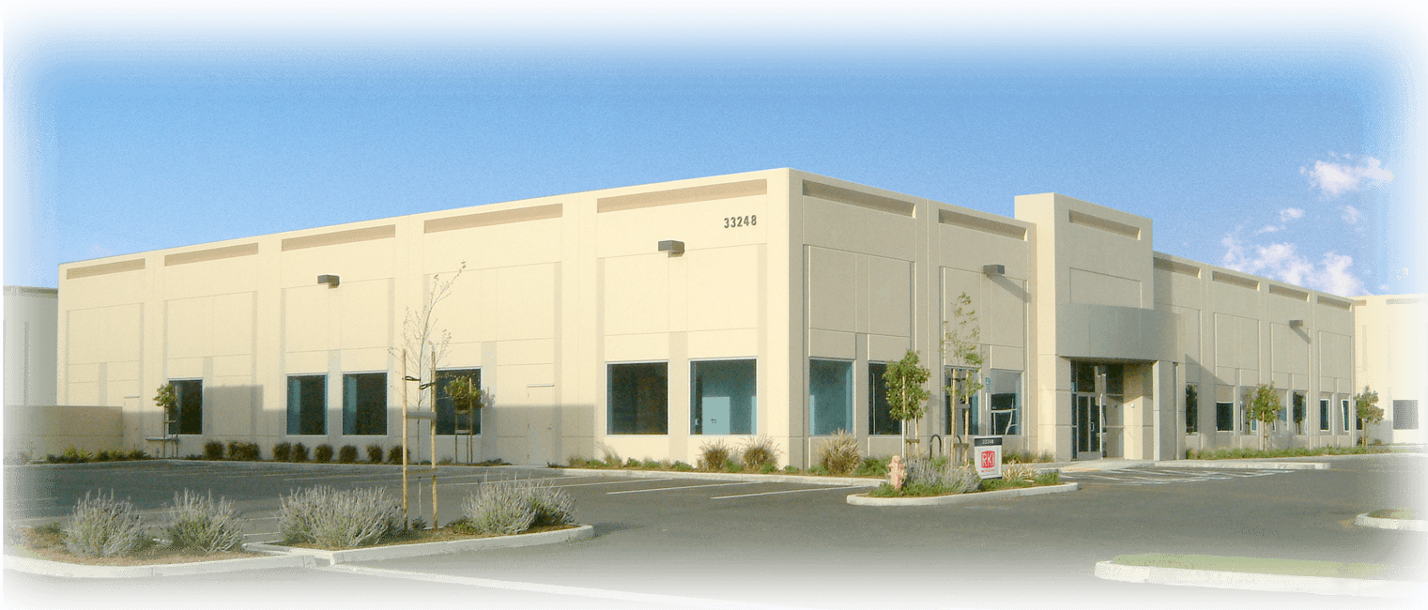
Company Background
RKI founded in 1994
Partner company: Riken Keiki
  Leader In Gas Detection & Sensor Technology for over 75 years
California Corporation
Average employee gas detection experience is 12 years

Slide 3
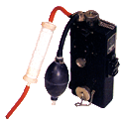
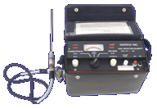
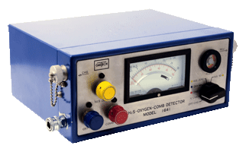
75 Years of Milestones
First combustible interferometer
1938
First 2 gas monitor
LEL, O2
GX-3
1969
First 3 gas monitor
LEL, O2, CO
Model 1641
1978

Slide 4

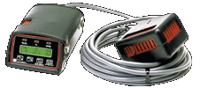
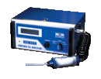
75 Years of Milestones
Pocket size
Single gas monitor for O2, CO or H2S
HS-80
1980
First belt worn
3 gas
GX-82
1982
Portable IR
For CO2
RI-411
1983

Slide 5


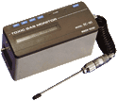
75 Years of Milestones
Portable IR
for Freon gases
RI-413
1984
First belt worn
4 gas monitor
GX-86
1986
Portable
Super Toxic
SC-90
1990

Slide 6

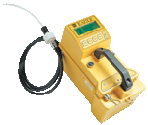

75 Years of Milestones
Portable 4 gas
with datalogging
and autocal
GX-94
1994
First 6 gas portable
EAGLE
1995
First wrist worn
GasWatch
1997

Slide 7
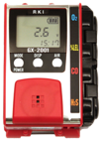

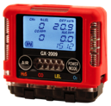
75 Years of Milestones
Smallest 4 gas
GX-2001
2001
Smallest tri-mode
Portable
GX-2003
2003
Smallest
confined space monitor
GX-2009
2009

Slide 8
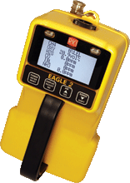


75 Years of Milestones
6 gas portable
with PID capabilty
EAGLE 2
2010
Advanced tri-mode portable
Gas Tracer / GX-2012
2012
6 gas, sample draw with PID, IR & Super Toxics
GX-6000
2016

Slide 9
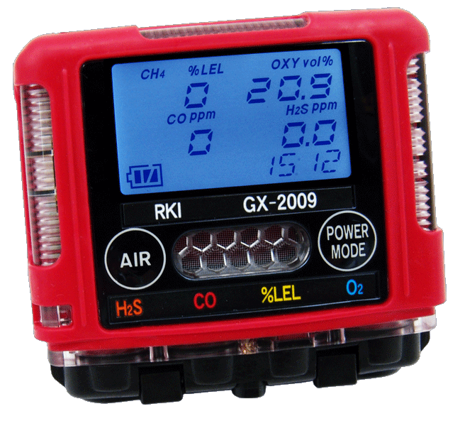
GX-2009
The Smallest 4 Gas Monitor Available!

Slide 10

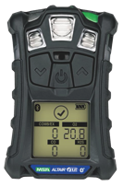
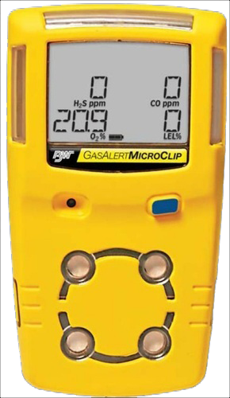
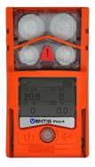
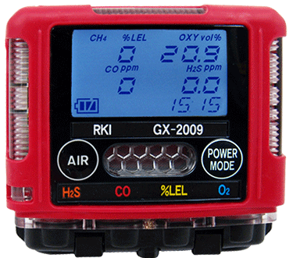
GX-2009
Repeat…. THE smallest 4 gas monitor available!
2.7” x 3” x 1”
4.6 ounces
4.4” x 2.4” x 1.2”
6.7 ounces
5” x 1.9” x 1.2”
7.8 ounces
4.1” x 2.3” x 1.4”
7.05 ounces
4.4” x 3.0” x 1.4”
8.07 ounces

Slide 11
GX-2009
All gas readings displayed

Slide 12
GX-2009
3 Large visual alarms on 3 sides

Slide 13
GX-2009
2 audible alarms ports, 95 dB

Slide 14
GX-2009
2 glove friendly buttons

Slide 15
GX-2009
Dust and water proof, IP 67 rating
www.rkiinstruments.com
Notes:
15

Slide 16
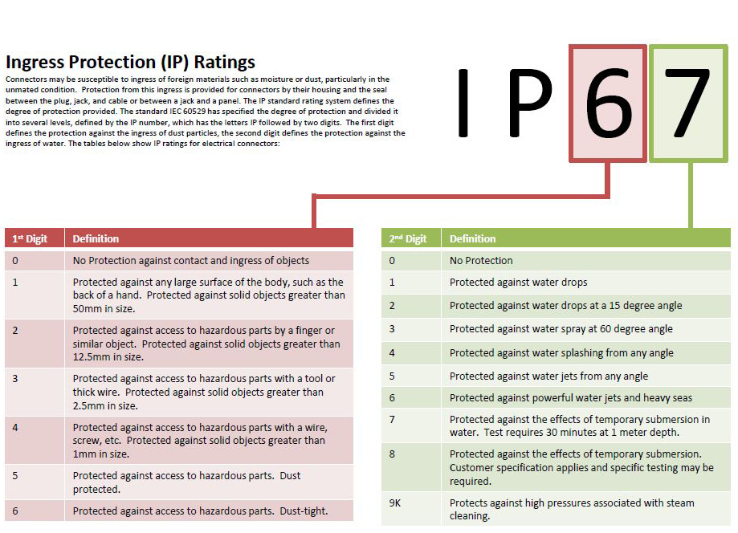
GX-2009
www.rkiinstruments.com
Notes:
16

Slide 17
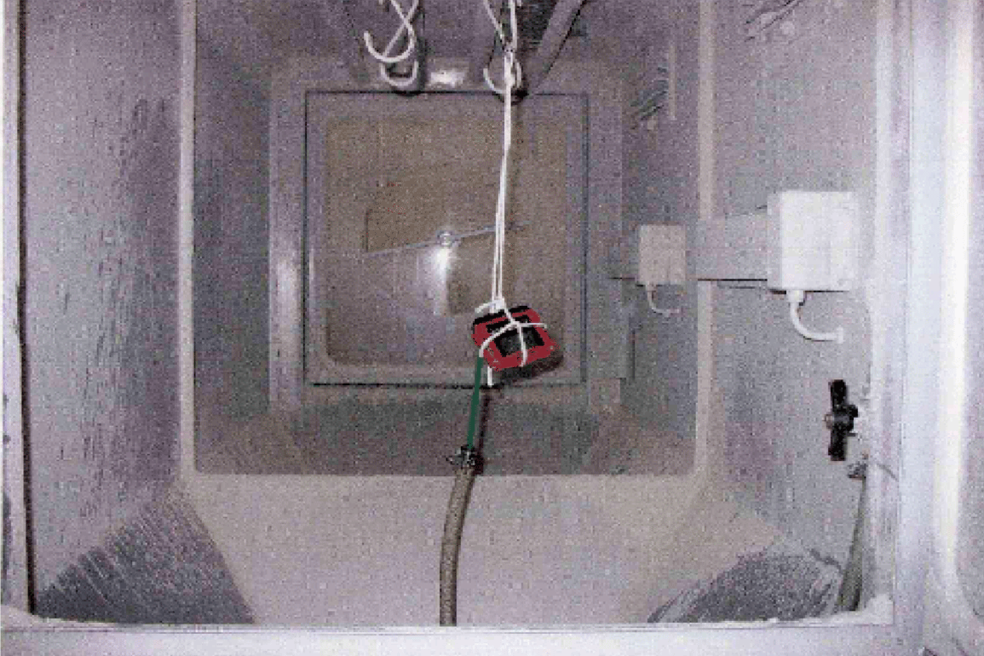
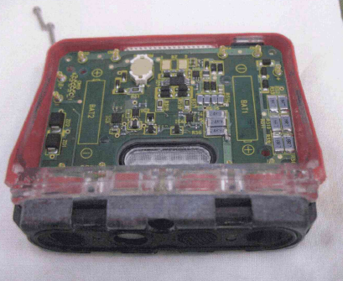
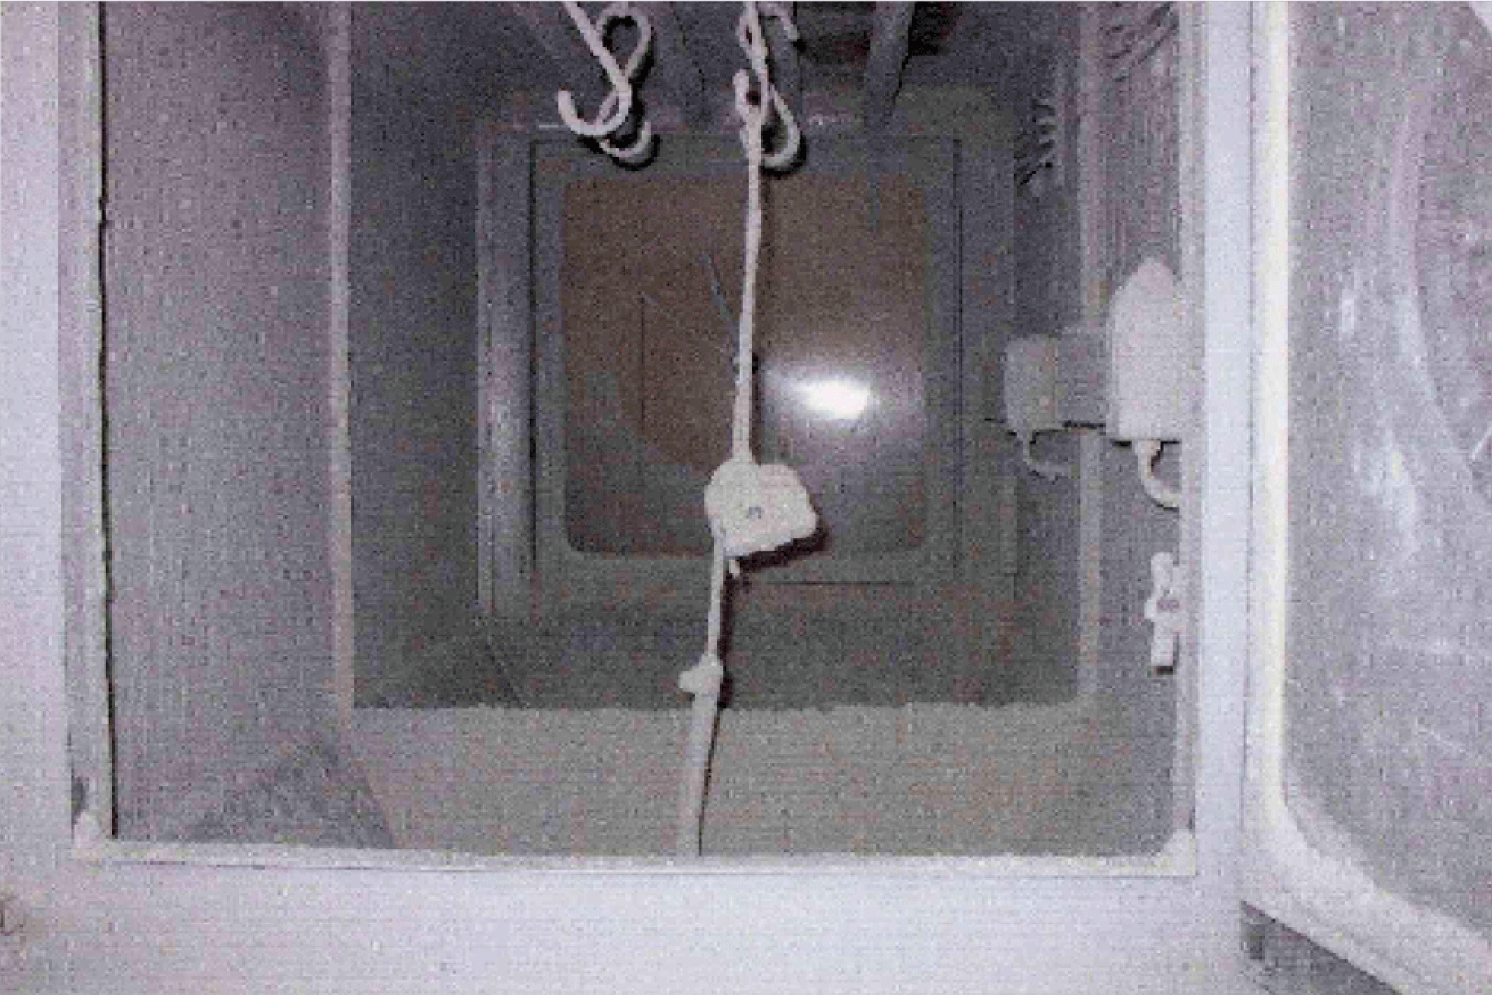
GX-2009
Dust Rating - IP 67
before
Subjected to talc dust vacuum chamber for 8 hours
after
www.rkiinstruments.com
Notes:
17

Slide 18
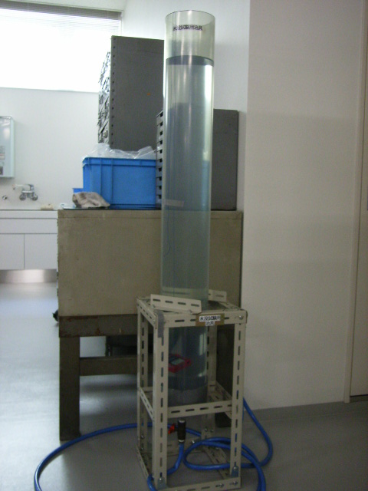
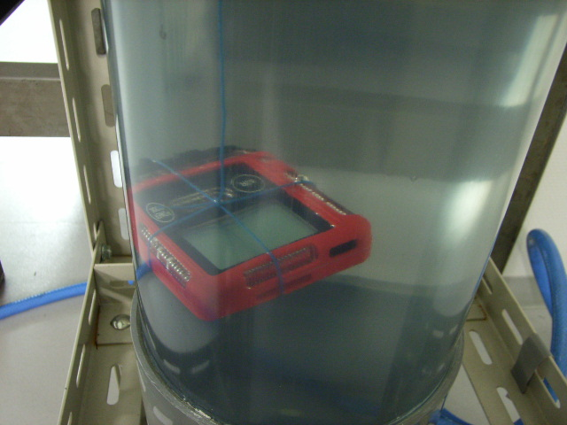
GX-2009
Water Proof Rating - IP 67
Submerged in 1 meter of water
for 30 minutes
１ｍ
www.rkiinstruments.com
Notes:
18

Slide 19
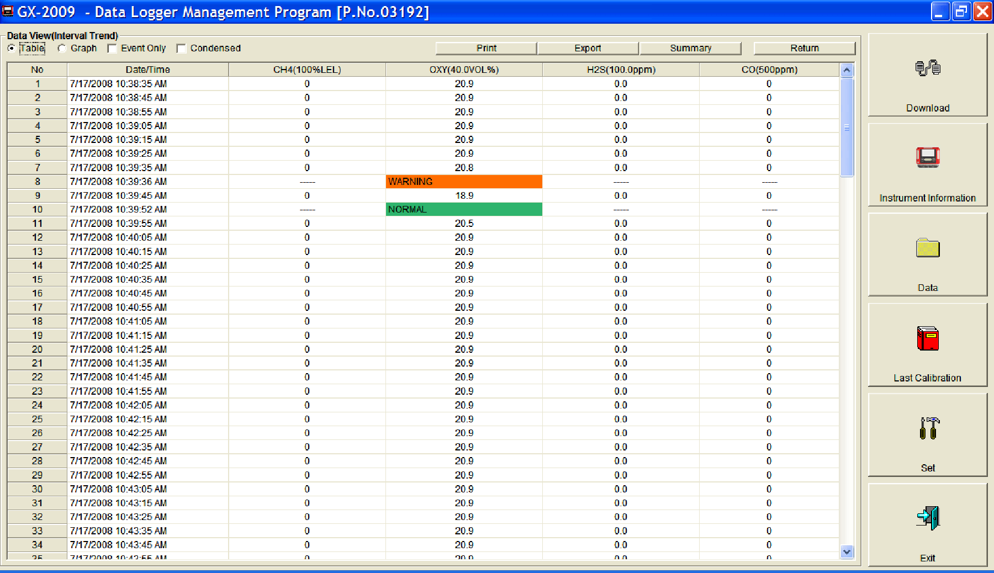
GX-2009
Increased data logging capacity
 | Alarm trend every 5 sec. | Interval trend | Cal. history
ＧＸ－２００１ | Before & after 15min.1event | 480 sessions | Last calibration record
ＧＸ－２００９ | Before & after 30min.8 events | 3,600 sessions | Last 100 calibration records

Slide 20
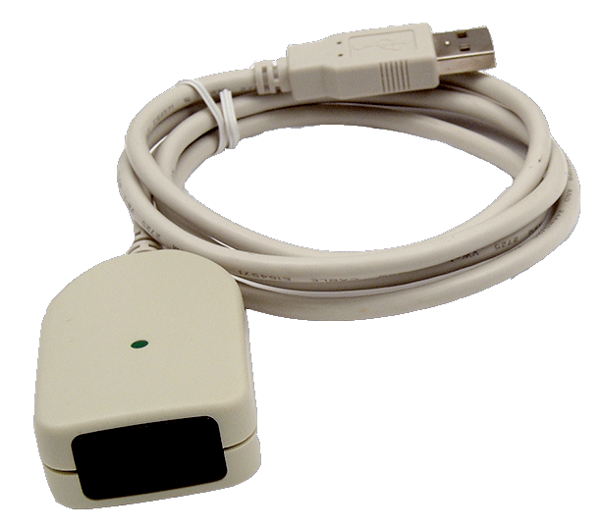
GX-2009
Only a USB / IR adaptor required for
data downloading
www.rkiinstruments.com
Notes:
20

Slide 21
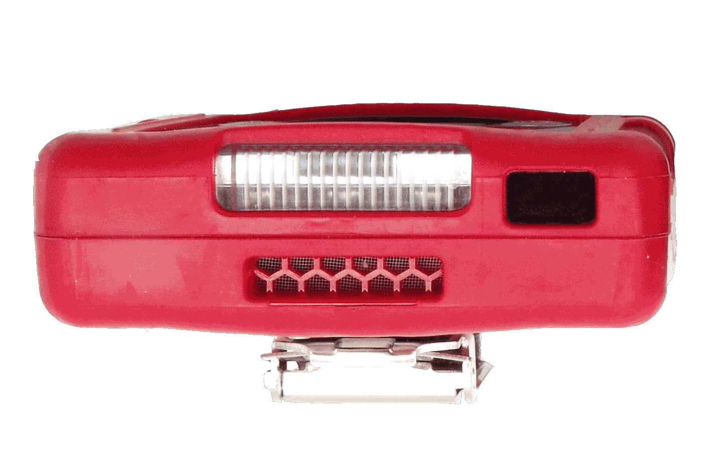
GX-2009
Air-tight IR data portal
www.rkiinstruments.com
Notes:
21

Slide 22
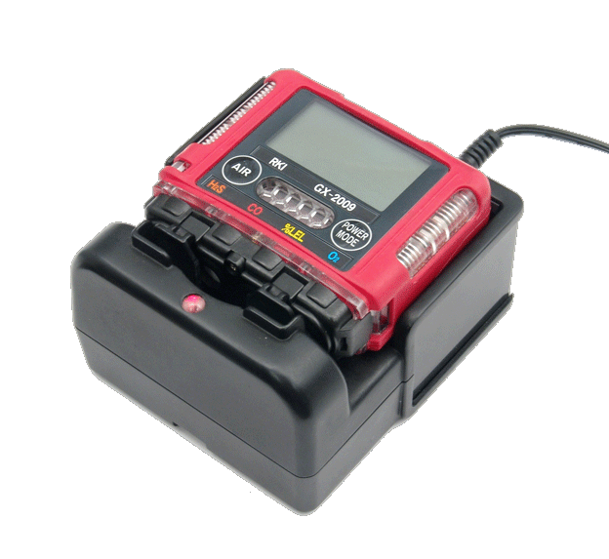
GX-2009
Operates for 20 hours on
NiMH batteries
www.rkiinstruments.com
Notes:
22

Slide 23
GX-2009
Operates 14 hours after only 90 minute charge
www.rkiinstruments.com
Notes:
23

Slide 24
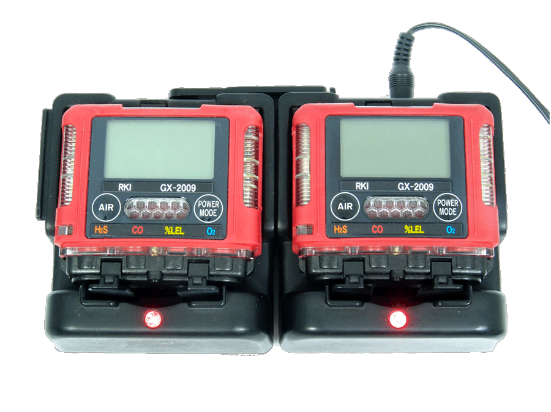
GX-2009
Modular gang charging, up to 5 cradles for one power source
www.rkiinstruments.com
Notes:
24

Slide 25
GX-2009
Impact resistant over-mold body

Slide 26
GX-2009
2.75” H x 2.95” W x .98” D, 4.6 oz
2.7”

Slide 27
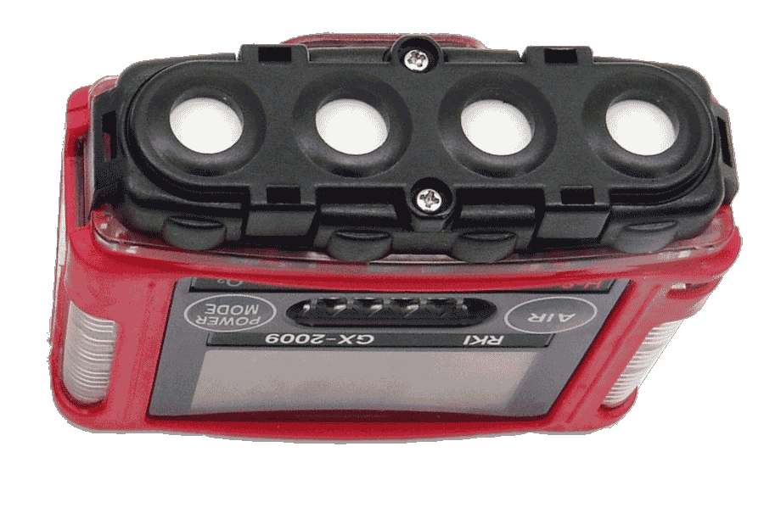
GX-2009
2.75” H x 2.95” W x .98” D, 4.6 oz
1”

Slide 28
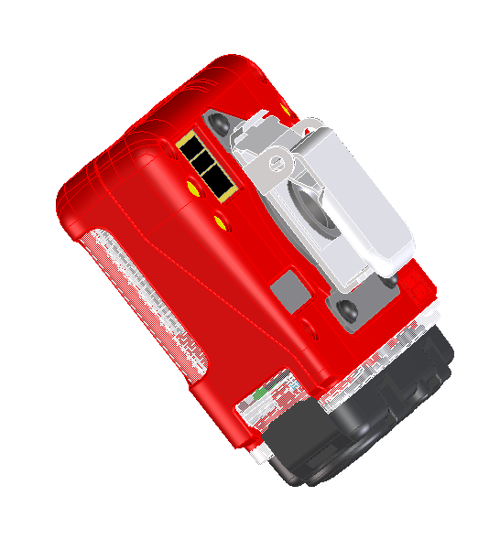
GX-2009
Low profile alligator, 360° rotation

Slide 29
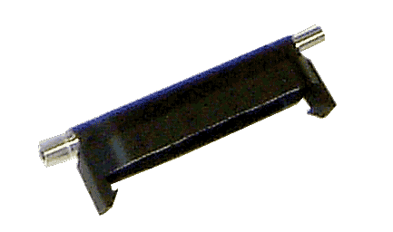
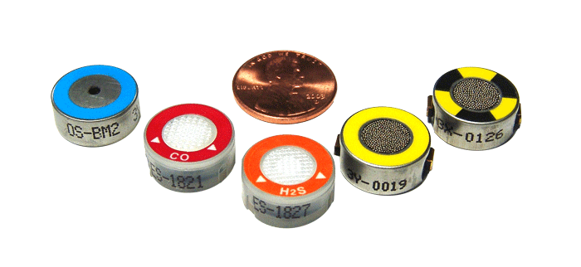
GX-2009
Replacement sensors
…and calibration cup

Slide 30
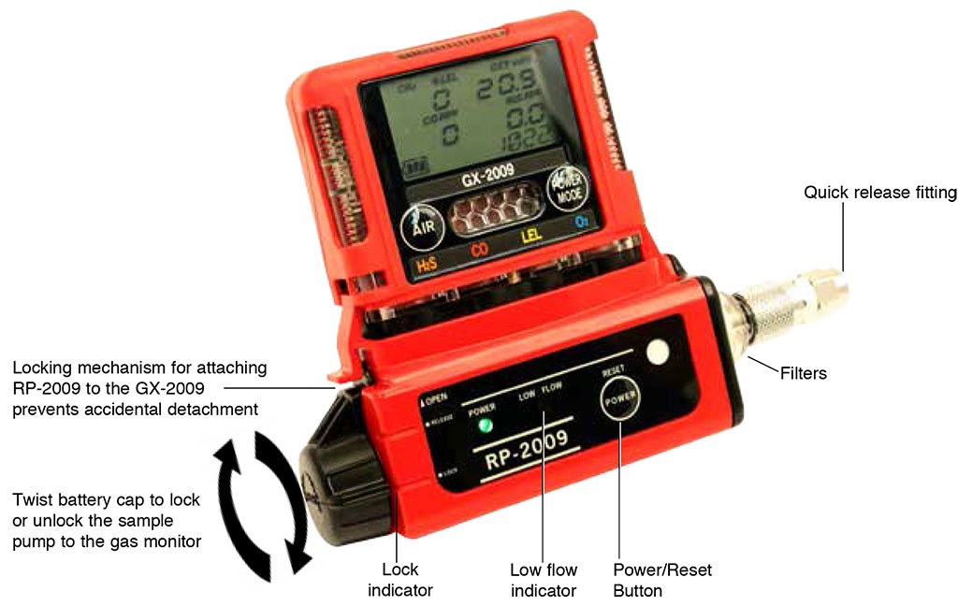
RP-2009
Compatible with the RP-2009 attachable sample drawing pump
www.rkiinstruments.com
Notes:
30

Slide 31
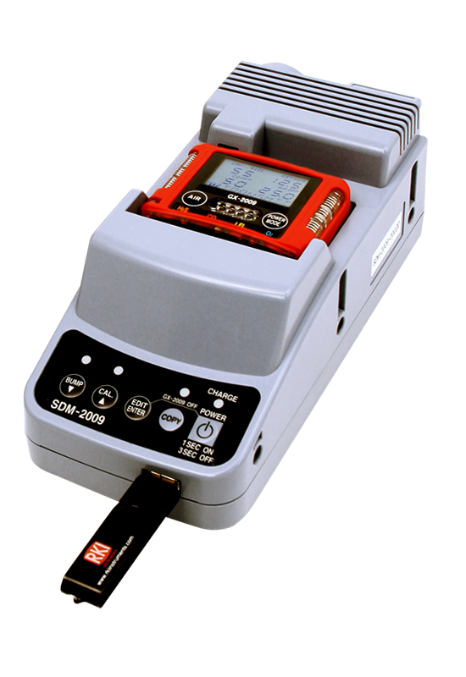
SDM-2009
Stand Alone Station
Stand-alone station (no PC Required)
Charging
Calibration
Bump Test
Save Bump Test and Calibration records
Bump test and calibration records copy to USB jump drive
Includes PC software for viewing/ archiving bump test and calibration records

Slide 32
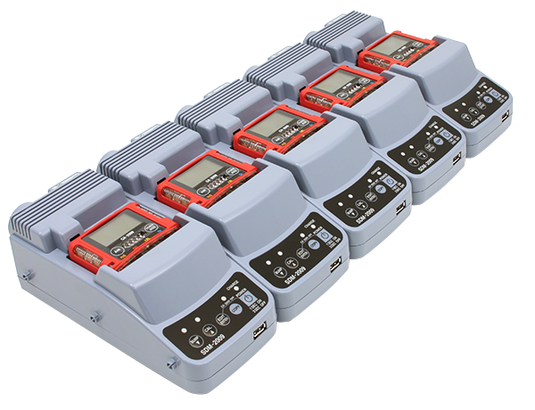
SDM-2009
Multi Module System
Multiple modules connected to a PC (10 max)
Charging
Calibration
Bump Test
Automatic calibration/bump test option
Configure GX-2009 parameters
Archive Bump Test and Calibration records
Archive data to network location
Software controlled data retrieval
Windows 7 compatible

Slide 33
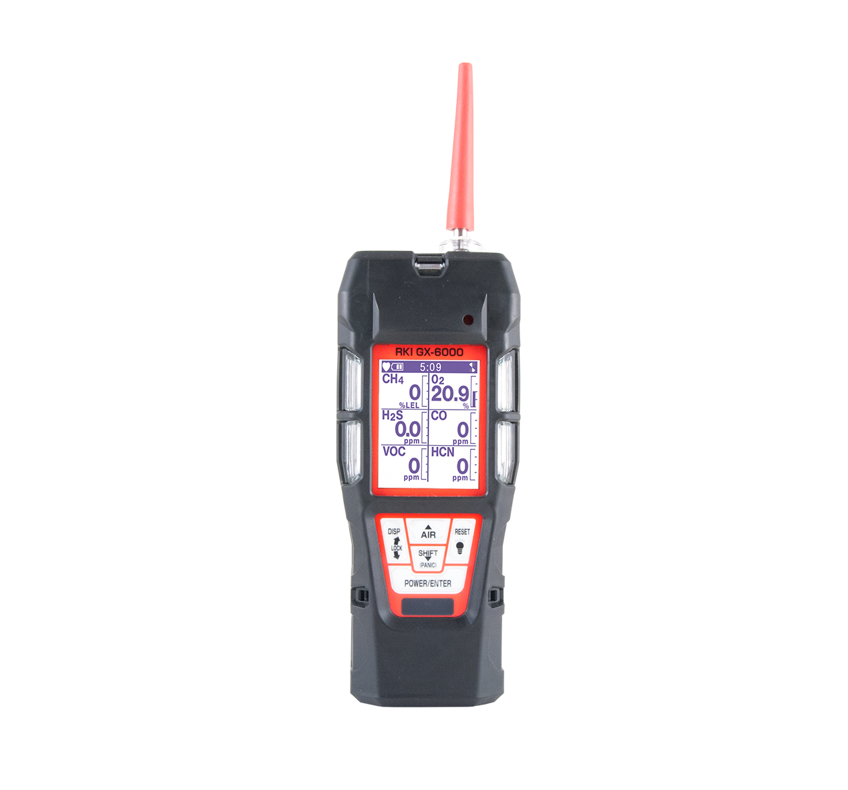
GX-6000
Monitor up to 6 Gases
H2S, CO, O2, LEL
2 smart sensor slots
  PID for VOC’s
  IR for CH4, HC, & CO2
  EC for NH3, Cl2, HCN, NO2, & SO2
PID library of more than 600 VOC’s
Accepts 10.6 and / or 10.0 PID lamps
50,000 ppb / 6,000 ppm ranges
10.0 Lamp for Benzene Specific
11.7 Lamp available Q4 2018
11.7 Lamp for carbon tetrachloride, acrylonitrile, chloroform, methanol, and refrigerants (R-143, R-132A)
PID sensors can be combined
Easily choose a target VOC
  User defined VOC list of 30
  Recently used VOC list last 8
6 Operating Modes of GX-6000
Normal
Leak check
Inert
Bar hole
Snap Log
Benzene Specific Mode
LEL Protection mode
Shields LEL sensor from damaging VOC exposure
LCD display
Auto flip display
Peak bar graphs
Adjustable auto backlight
Customize order of gases
Single gas view with large font & auto sequence

Slide 34
GX-6000
Smallest 6 gas sample draw
Lightweight & Ergonomic
High impact rubber boot
Ergonomic design fits comfortable in hand
Interchangeable battery options
Lithium-ion pack operates 14 hours
  Complete recharge in 3 hours
Alkaline pack operates 8 hours
Alarms
2 adjustable gas alarms per channel
Man Down alarm
Panic Alarm
4 alarm LED’s
Audible and vibration alarms
Trouble alarms for low flow, sensor connection, low battery, circuit error, & calibration
Intrinsically Safe
ATEX / IECEX
cCSAus
Weather & Dust Resistant
IP-67
9 Languages
English, Germany, Italian, French, Portuguese, Spanish, Japanese, Korean, Russian
LED Flashlight
On demand light source

Slide 35
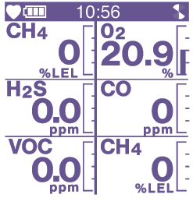
6 Operating Modes of GX-6000 of GX-6000
1. Normal Mode
Simultaneous gas measurement readings in real-time are shown for all the sensors installed.

Slide 36
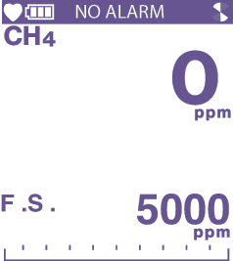
6 Operating Modes of GX-6000
2. Leak Check Mode
Used when performing leak checks above ground.
CH4 and CO (optional) are shown in ppm readings.

Slide 37
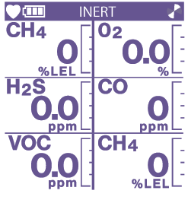
6 Operating Modes of GX-6000
3. Inert Mode
Inverts the O2 alarm points to
5% vol alarm 1 and 10% vol alarm 2.
Used to alert users when there is O2 present in the area where there is supposed to be little to none.

Slide 38
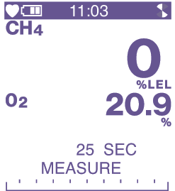
6 Operating Modes of GX-6000
4. Bar Hole Mode
Used to perform timed leak checks underground, IR combustible sensor and oxygen (if installed) are used. To be used with bar a hole probe.

Slide 39
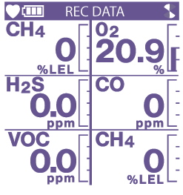
6 Operating Modes of GX-6000
5. Snap Log Mode
Allows the user to record data at a specific time and have it saved to the data logger. The data is assigned a snap log ID and is saved with the instrument’s station ID.

Slide 40
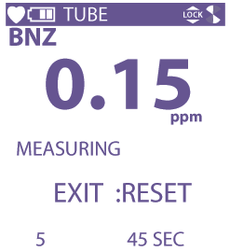
6 Operating Modes of GX-6000
6. Benzene Mode
A special mode used to measure benzene gas specifically. Has to be used with the benzene
pre-filter tube and tube holder.

Slide 41
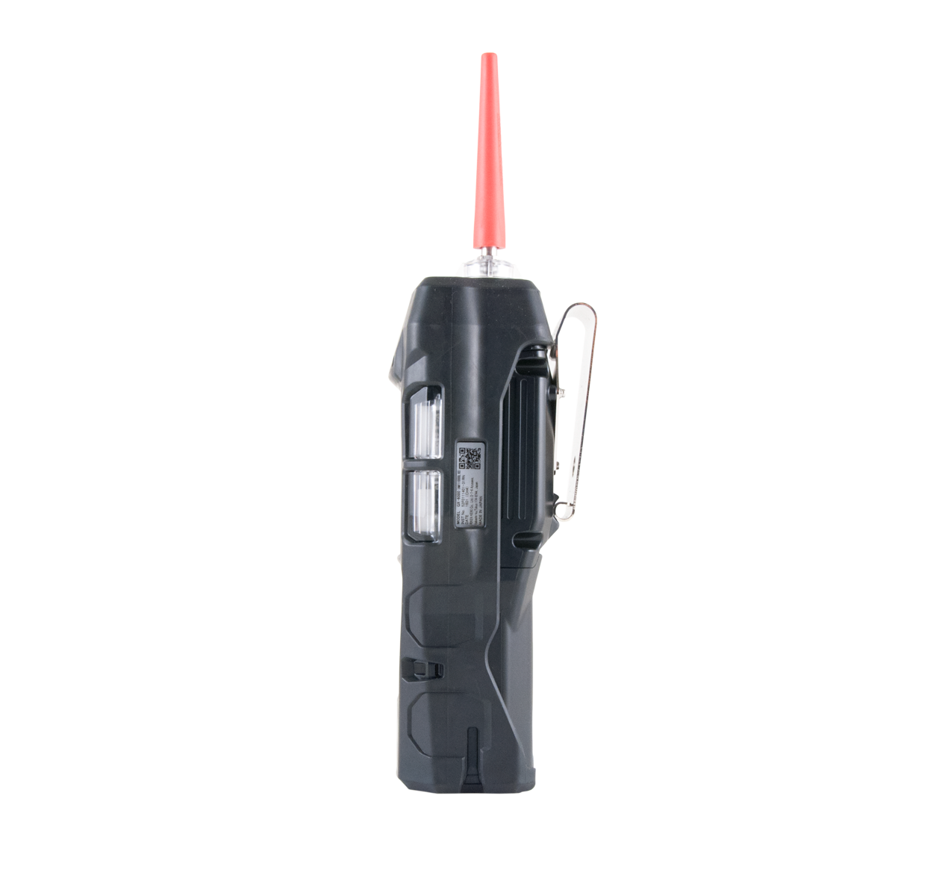
Compact & lightweight
Dimensions
7.87” (H) x 2.67” (W) x 2.04” (D)
MultiRAE= 7.6” x 3.8” x 2.6”
Weight
Approx. 400g / 14.1 ounce
MultiRAE: 880g / 31 ounce
7.87”
50 % LIGHTER!
2.67”
2.04”

Slide 42
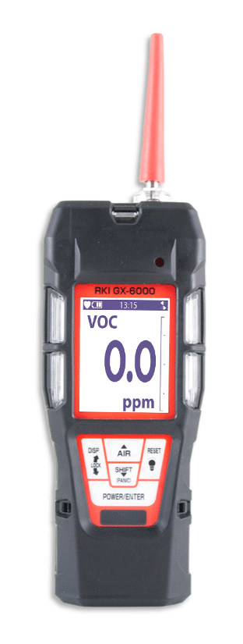
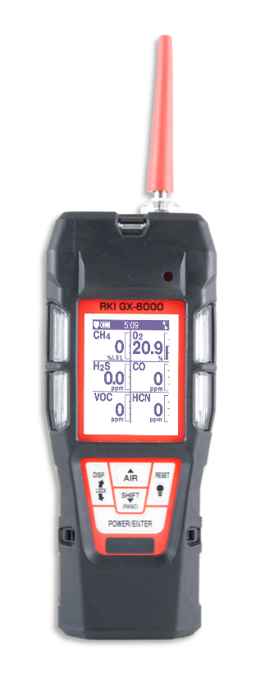
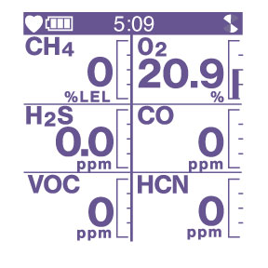
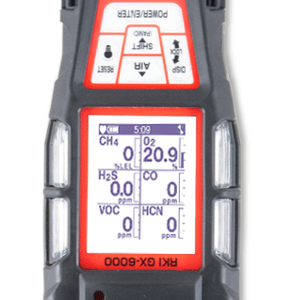
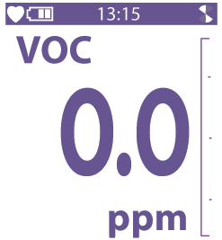
LCD Display Options
Multi-gas view displays all 6 channels
Single gas view shows one channel in large scale with auto scrolling for each channel
Auto rotation when instrument upside down

Slide 43
LCD Display Options
Peak bar graph

Slide 44
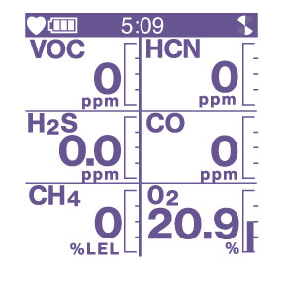
Customize Gas Order
Customize your gas readings in any order

Slide 45
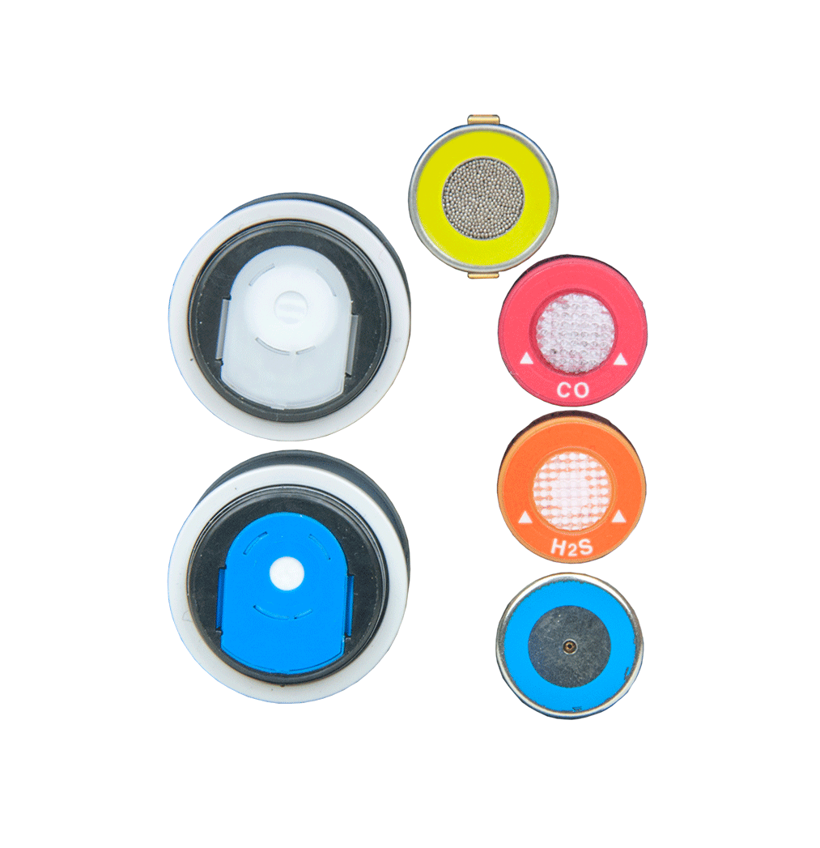
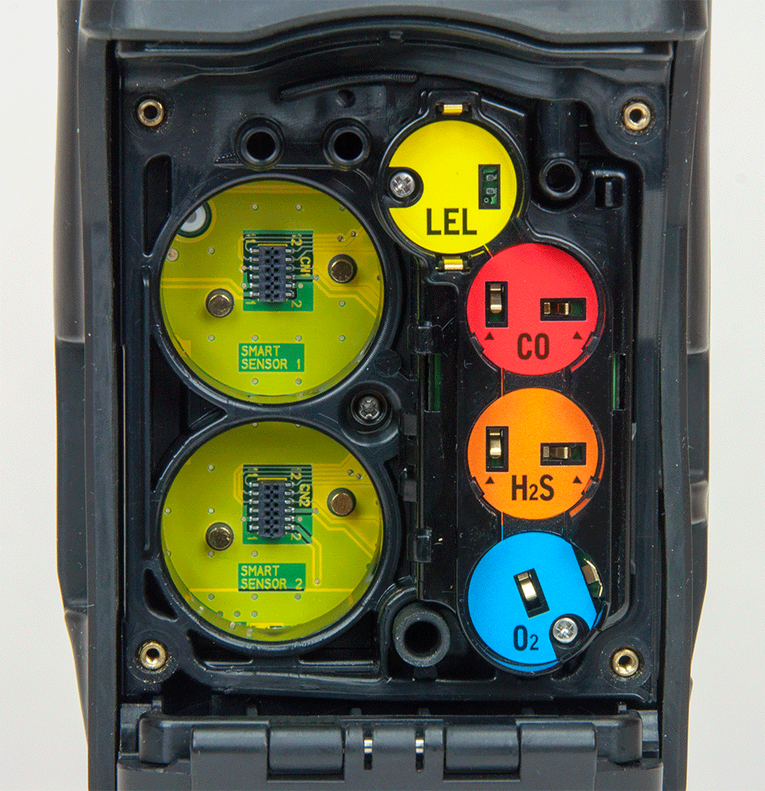
Sensors
Smart Sensor
Slots
Standard 4 Gas Sensors

Slide 46




Interchangeable Sensors
03 Series
GX-2009
GX-2012
GX-6000
4 standard micro sensors are interchangeable with the 03 Series, GX-2009, GX-2012, and GX-6000

Slide 47


Smart Sensor Slots
Smart sensor slots auto-recognize any sensor you install
- No re-cal or user
setup required

Slide 48



Smart Sensor Technology
Smart Electrochemical (ESS-03DH-XXX)
GAS | RANGE
Ammonia (NH3) | 0-400 ppm
Chlorine (Cl2) | 0-10ppm
Hydrogen Cyanide (HCN) | 0-15ppm
Nitrogen Dioxide (NO2) | 0-20 ppm
Sulfur Dioxide (SO2) | 0-99.9 ppm
Monitor a wide variety of toxic gases. Smart plug and play sensors are auto recognized and can be remotely calibrated
Photo Ionization Detection PID
GAS |  | RANGE
10.6 Lamp | 600 VOC’s | 0-50,000 ppb
 |  | 0-6,000 ppm
10.0 Lamp | Benzene Specific | 0.1-50 ppm
 | 300 VOC’s | 0-100 ppm
Monitor low ppm VOC gases.
Infrared (DES-3311-1/2)
GAS | RANGE
Carbon Dioxide (CO2) | 0-10,000 ppm 0-10% Vol.
Methane (CH4) | 0-100% LEL 0-100% Vol.
Hydrocarbons | 0-100% LEL 0-30% Vol.
Monitor Combustible gases in inert environments. Monitor wide range of CO2.

Slide 49




Interchangeable Power Supply
Alkaline
AA size battery x 3 pieces
More than 8 hours operation
Rechargeable
More than 14 hours operation
A complete charge in 3 hours

Slide 50


9 Languages
One of 9 languages can be selected by software.
  English, Germany, Italian, French, Portuguese, Spanish, Japanese, Korean, Russian

Slide 51

Control Panel
Glove friendly buttons can be operated with one hand.
New functions are easily identifiable
  LED light
  Panic alarm

Slide 52

Applications
Confined Space Entry
Monitor LEL, O2, CO, AND H2S
Pre – Entry testing with sample draw pump
-Pull samples up to 40’
-Maintain steady sample flow to
sensors
Continuously monitor confined space
Utilize as a personal monitor within the confined space

Slide 53

Applications
Environmental Monitoring
GX-6000 is Method 21 compliant
  monitor ppm level combustibles
Hazardous waste monitoring to determine proper PPE
Soil Remediation from leaking underground storage tanks
  PID measures BTEX and THC’s

Slide 54

Applications
Leak Investigation
Common with gas supply & utility companies
Above ground leak detection utilize Leak Check Mode for ppm detection of combustible gas
  LED’s and alarm tones increase in frequency as gas concentration increases
  Audible alarm silence Perform leak investigations without alarming residents
Below ground leak investigation will use Bar hole mode for tracking leak migration

Slide 55

Applications
Fire Industry
Hazmat Perimeter / Safe Zone verification
Emergency response to toxic gas leaks
Confined space entry / rescue
Arson Investigation
Meth lab investigation

Slide 56

Price List
Configurator

Slide 57

SDM-6000 Docking Station
  Stand alone station (no PC required)
  Bump, Calibrate, and Alarm tests
  Charge
  Touch screen menu display
  Save calibration, bump tests, alarm history and exposure data to an SD memory card or to a computer
  Automatically power on or off for scheduled maintenance
  Up to 3 ports for separate calibration gas cylinders
Notes:
Can be connected up to 10 units

Slide 58

Multi Module System with PC Controller
  Manage up to 10 instruments with one power source, calibration source, and computer
  Configure GX-6000 parameters
  SV-3 unit expands calibration ports up to 6 ports
Notes:
Can be connected up to 10 units

Slide 59

SDM-6000 Docking Station
SD / SDH Memory card slot
USB PC connection
USB Printer connection
LAN connection
Power Switch
AC adaptor
Power/Data Joint Connector
3 calibration gas ports
1 fresh air port

Slide 60

SDM-6000 Docking Station
  Easily connects to adjacent docks
  No extra tubing required
  Automatically distributes power, calibration gas, and data once connected
  DIN Rail wall mount

Slide 61

GX-6000 vs MultiRAE
Similarities
Sample Draw Instruments
6 Gas Channels
PID capability
Alkaline and Rechargeable options
Man-down alarm

Slide 62
GX-6000 vs MultiRAE
GX-6000 Advantages
Features MultiRAE’s do not have
Size: GX-6000 is half the weight of MultiRAE’s
  GX-6000 14 oz.
  MultiRAE’s 30 oz.
GX-6000 PID Advantages
  Built in VOC Library: 600 vs 190
  PID Lamp options: 10.6, 10,0, & 11.7 available in 1 instrument
  Dual PID capability: Use 2 different PID lamps simultaneously
  Wider range of VOC’s with 10.6 lamp: 6,000 vs 1,000 / 5,000 ppm
  Easy access to VOC library
    Previously Used menu stores last 8 VOC’s
    User defined list of 30 VOC’s
Smart Sensor Slots
6 Operating Modes of GX-6000:
  Normal, Leak Check, Inert Mode, Bar Hole, Snap Log, & Benzene

Slide 63

Questions?

