Slide 1

Gas Detection Boot Camp

Slide 2
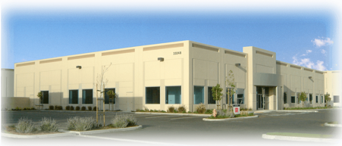
Who is RKI?
RKI founded in 1994
Partner company: Riken Keiki
  Leader In Gas Detection & Sensor Technology for over 80 years
California Corporation
Average employee’s gas detection experience is 10 years

Slide 4




Company Culture
Customer Service
Technical Service
Fast Delivery
Quality

Slide 5


Safety vs Process Control
RKI’s products mostly address safety applications
A few of RKI’s products may also address some process control applications
SAFETY
  Protecting life and property/assets
  Gases normally not present
  Detect occasional leaks if they occur
PROCESS CONTROL
  Adjusting processes based on the gas present
  Gases normally present

Slide 6
Some Gas Detection Basics
Largest market for portable gas detection is for Confined Space Entry.
  Confined spaces are defined by the fact they they are large enough to permit a worker access, but that they are not designed for continuous occupancy.
  DOL Confined Space detailed definition link.
    https://www.osha.gov/confined-spaces
  Calibrating and Testing Direct-Reading Portable Gas Monitors (DRPGMs. Review the link below
  https://www.osha.gov/publications/shib093013

Slide 7
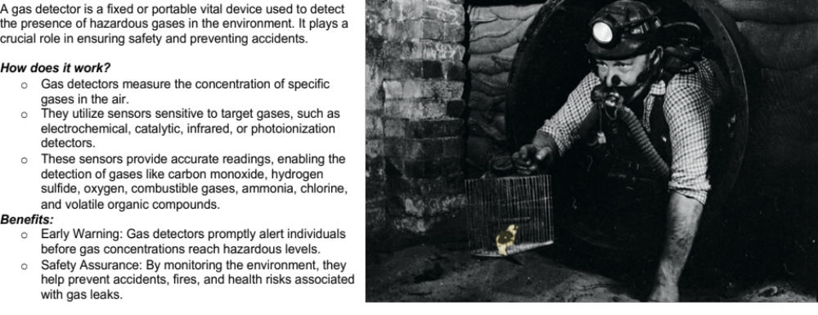
What is a Gas Detector

Slide 8



Primary Protection
Combustibles
LEL
Toxics
CO H2S
Oxygen Deficiency
‘I can’t breath’
N2, Argon

Slide 9

Realities of Confined Space

Slide 10

Applicable Standard
OSHA Code of Federal Regulations 29
  Section 1910.146
    Permit-required confined space
    Confined spaces in General Industry
  Section 1926.1204
    Permit-required confined space
    Confined spaces in Construction

Slide 11
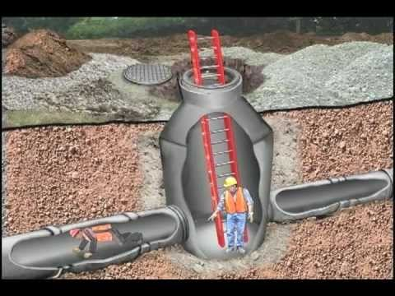
What is a Confined Space?
A confined space is a space that
  is large enough for a person to enter and work
  has limited or restricted means of entry and exit
  is not designed for continuous occupancy

Slide 12

Permit-Required
A permit-required confined space has at least one of the following characteristics
  contains or has the potential to contain a hazardous atmosphere
  contains a material that has the potential to engulf an entrant
  has an internal configuration such that an entrant could be trapped or asphyxiated
  contains any other recognized serious safety and health hazard

Slide 13


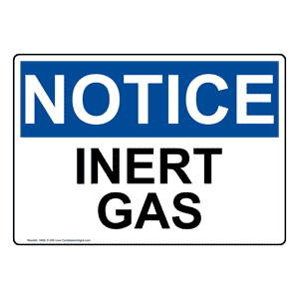
Types of Gases/Compounds
Combustibles
  Flammable gases and vapors
    Most are also toxic
    Organic compounds (HC’s)
“Toxics”
  Usually refers to non-hydrocarbons
    Inorganic compounds (Non-HC’s)
    Several inorganic compounds are also
    combustible
Inerts
  Non-reactive gases
    Usually are N2, He, Ar

Slide 14

Flammability Monitoring
Measured in % LEL
  LEL-Lower Explosion Limit
    Least amount of gas needed to support combustion
Described as:
  Flammability
  Combustibility
  LEL-Lower explosion limit
  LFL-lower flammable limit
  Boom!

Slide 15
Flammability Band
Percent LEL
Upper Explosive Limit (UEL)
0
10
100
100% Vol
(LEL)
(UEL)
Lean
Explosive
Rich
0
Infrared Sensor
Catalytic Bead Sensor
Thermal Conductivity Sensor
Ammonia 12.0 Vol. %
Methane 5.0 Vol. %
Hydrogen 4.0 Vol. %
Hexane 1.1 Vol. %
Lower Explosive Limit

Slide 16
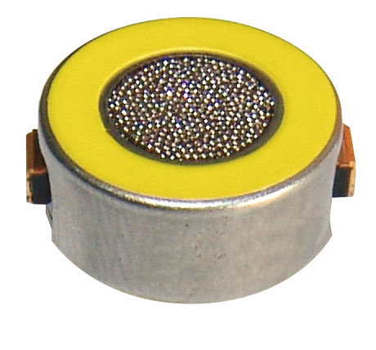
Combustible Sensor
Traditional combustible sensors respond to most combustible gases and vapors
They are considered “non-specific”
This is a good thing.
Traditional combustible sensors are called catalytic bead sensors
The gas or vapor combusting raises the temperature and that creates a resistance change. Increased resistance is relative to the displayed value on the detector.

Slide 17
Catalytic Bead Sensor
Platinum Catalyst
Deactivator
Platinum Alloy Wire
Ceramic Coating
Active
Reference
Four Wire Catalytic Bead Combustible Gas Sensor
Constant Current
Notes:
Different sensors have different sensor voltages, however the principles of operation are the same.

Slide 18
Catalytic Oxidation
Active
Reference

Slide 19
Understanding LEL
 |  |  | Meter Readings |  |  | Meter Reading |  |  | Meter Reading
100% LEL Concentrations |  |  | Methane |  |  | Propane |  |  | Hydrogen
 | % Volume
 | 0 |  | 0 | % LEL |  | 0 | % LEL |  | 0 | % LEL
 | 1 |  | 1 | % LEL |  | 1 | % LEL |  | 1 | % LEL
LEL Propane | 2.1 |  | 5 | % LEL |  | 5 | % LEL |  | 5 | % LEL
 | 3 |  | 10 | % LEL |  | 10 | % LEL |  | 10 | % LEL
LEL Hydrogen | 4 |  | 30 | % LEL |  | 30 | % LEL |  | 30 | % LEL
LEL Methane | 5 |  | 50 | % LEL |  | 50 | % LEL |  | 50 | % LEL
 | 10 |  | 70 | % LEL |  | 70 | % LEL |  | 70 | % LEL
 | 15 |  | 100 | % LEL |  | 100 | % LEL |  | 100 | % LEL
 | 20
 | 30
 | 40
 | 50
 | 60
 | 70
 | 80
 | 90

Slide 20
100% LEL
100% LEL
50% LEL
50% LEL
100% LEL
50% LEL

Slide 21
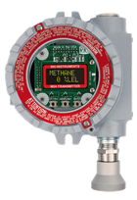
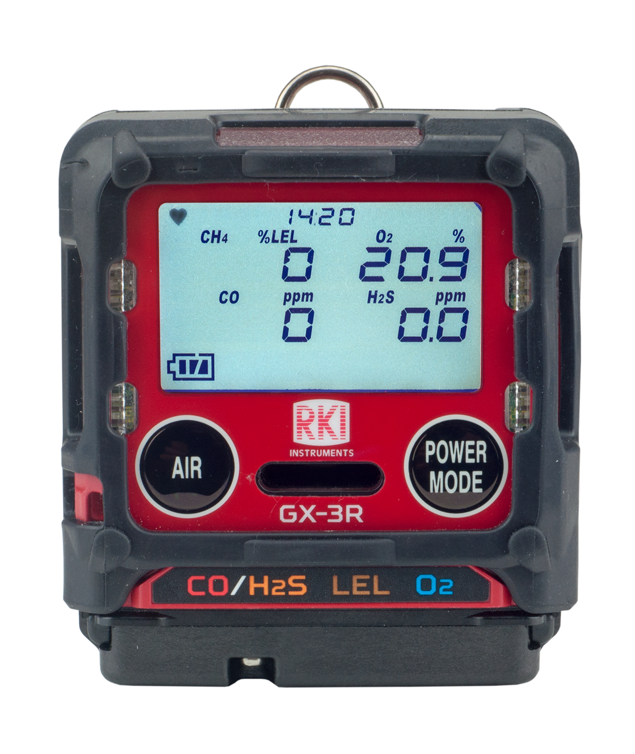
Combustible Alarm Points
Portable Devices
Typically 10%, 25% and 50% LEL
Fixed Systems
Typically 10% and 50% LEL

Slide 22
Toxicity
TLV’s & PEL’s: Threshold Limit Values & Permissible Exposure Levels
  TWA
    Time Weighted Average:
      -Average Exposure over 8 hours
  STEL
    Short Term Exposure Limit:
      -Average Exposure over 15 minutes
  C
    Ceiling:
  -Not to be exceeded for any length of time
  IDLH
    Immediately Dangerous to Life and Health:
      -30 minutes of exposure may result in permanent physiological damage
Agencies
ACGIH: American Conference of Governmental Industrial Hygienists
NIOSH: National Institute of Occupational Safety and Health
OSHA: Occupational Safety and Health Administration

Slide 23
TWA, PEL, REL TLV
Q: What are TWA, PEL and REL?
A: The Threshold Limit Value (TLV^{(R)} ) of a chemical substance establishes the reasonable level to which a worker may be repeatedly exposed, day after day, over a working lifetime without adverse health effects. TLV^{(R)} is a reserved term of the American Conference of Governmental Industrial Hygienists (ACGIH)^{(R)} . It is however sometimes loosely used to refer to other similar concepts used in occupational health and toxicology. A list of current TLVs^{(R)} and biological exposure indices (BEIs) are published annually by the ACGIH^{(R)} .
The Canada Labour Code and OH&S regulations of most of the provinces require monitoring to ensure that no worker is exposed to a concentration of a chemical substance above the TLV established by ACGIH^{(R)} .
A Time Weighted Average (TWA) is a TLV^{(R)} based on a 8-hour workday and a 40-hour workweek. For example the TWA for carbon monoxide is 25 ppm. This means that an average of 25 ppm is considered to be the safe TLV^{(R)} for an 8-hour workday.
A Short Term Exposure Limit (STEL) is a TLV^{(R)} based on a 15 minute average.
A Ceiling is a TLV that should not be exceeded during any part of the work experience.
The Permissible Exposure Limit (PEL or OSHA PEL) is a TLV^{(R)} established by OSHA in the U S for exposure of an employee to a substance or physical agent, and may differ from TLVs^{(R)} in other jurisdictions. Permissible Exposure Limits are established by the Occupational Safety and Health Administration (OSHA). A PEL is usually given as a time-weighted average (TWA), although some are Short Term Exposure Limits (STEL) or Ceiling Limits.
RELs or Recommended Exposure Limits are TLVs^{(R)} established by NIOSH for exposure of an employee to a substance or physical agent.

Slide 24
TWA, STEL, IDLH
TWA Time weighted average (TWA) is the average workplace exposure to any hazardous contaminant or agent using the baseline of an 8 hour per day or 40 hours per week work schedule. The TWA reflects the maximum average exposure to such hazardous contaminants to which workers may be exposed without experiencing significant adverse health effects over the standardized eight-hour work period.
The TWA is expressed in units of parts per million (ppm) or mg/m3.
Short-term exposure limit (STEL) is the acceptable exposure limit to a toxic or an irritant substance over a short period of time (time-weighted average), usually 15 minutes. STEL is the maximum concentration of a chemical to which workers may be exposed continuously for a short period of time without any danger to health, safety or work efficiency. This term is used in occupational health, industrial hygiene and toxicology.
Short-term exposure limit may also be known as short-term exposure value (STEV)
“Immediately Dangerous to Life or Health” (IDLH) is a term used to describe hazards in which an acute exposure to the hazard poses a severe risk of immediate health damage, injury, or death. This immediate danger could be a result of the high level of damage that could occur due to short-term exposure to the hazard or due to the hazard’s ability to impair the ability of the employee to leave the hazard area.

Slide 25
Toxic Sensor Technology
For our purposes, the toxic sensor technology can be listed as Electrochemical or Photo-Ionization
  Electrochemical
    Principle of Operation Electrochemical sensors operate by reacting with the gas of interest and producing an electrical signal proportional to the gas concentration. A typical electrochemical sensor consists of a sensing electrode (or working electrode), and a counter electrode separated by a thin layer of electrolyte
  Photo-Ionization (PID)
  The PID is a non-specific sensor much like the cat bead but for low level toxic monitoring. This sensor is very useful for toxic monitoring where we don’t have a specific sensor for the contaminant. The sensors have a lamp with an ionization wattage. If the contaminant ionizes under the lamp wattage value, the gas can be seen. We offer four different lamps.

Slide 26
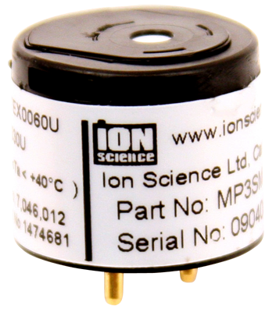
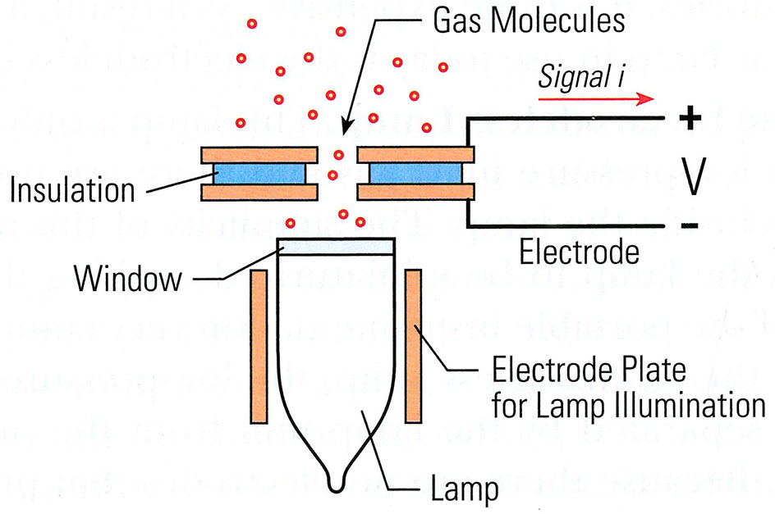
Photo Ionization Detector
A PID is a broadband VOC detection technique

Slide 27
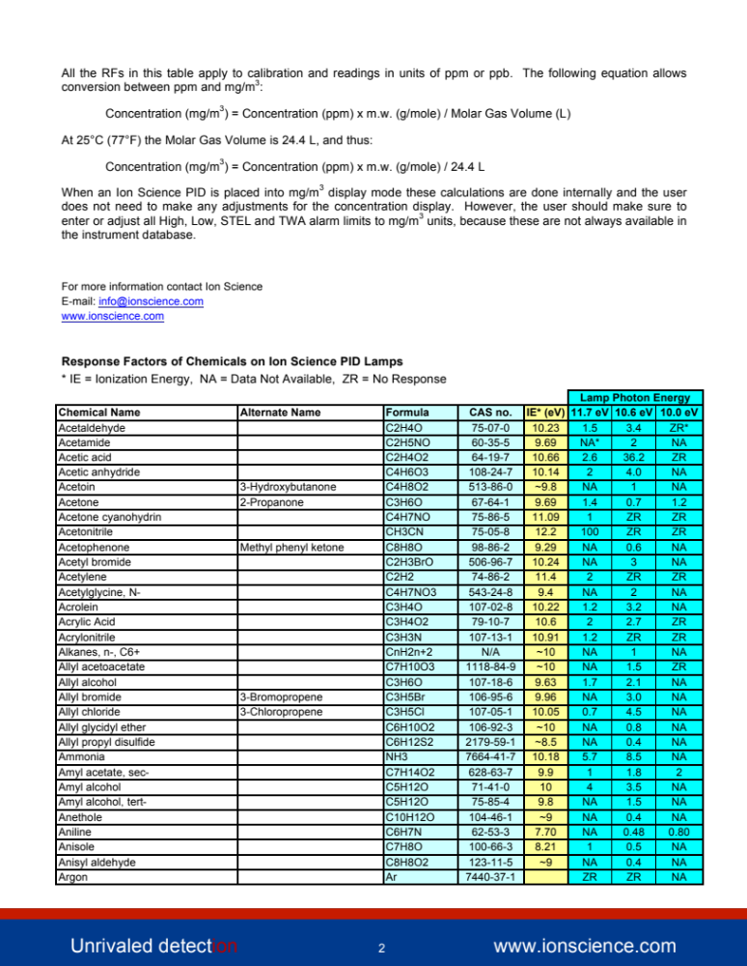
Partial List of PID Detectable Compounds

Slide 28
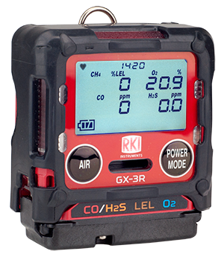
Toxic Monitoring
Toxicity
25ppm Hydrogen Sulfide
Measured in Parts per Million (ppm)
Very low measurement
Toxic relates to health issues, not combustibility.

Slide 29
Monitoring Toxicity with O2 Sensor
    78.09% Nitrogen equals 780,900 ppm
    20.95% Oxygen equals 209,500 ppm
    .93% Argon equals 9,200 ppm
    .04% CO2 equals 400 ppm
    Equals 1,000,000 ppm
    Infusion of 1000ppm of H2S into the environment
    780119.1 Nitrogen 78.0%
    209,290.5 Oxygen 20.92%
    9190.8 Argon .92%
    399.6 CO2 .0399%
    1000 H2S Ten times the IDLH Level
So, if someone tells you that an O2 sensor can cover you for toxic monitoring, here is why it won’t.

Slide 30
Examples of some Toxic Gases
Chlorine TWA .5 ppm STEL 1 ppm IDLH 30 ppm
Ammonia TWA 25 ppm STEL 35 ppm IDLH 500 ppm
Nitrogen Dioxide TWA .2 ppm STEL 1 ppm IDLH 13 ppm
Sulfur Dioxide TWA 2 ppm STEL 5 ppm IDLH 100 ppm
Carbon Monoxide TWA 35 ppm STEL 200 ppm IDLH 1500 ppm
Hydrogen Sulfide TWA 10 ppm STEL 15 ppm IDLH 100 ppm
Hydrogen Cyanide TWA 10 ppm STEL 4.7 ppm IDLH 50 ppm
Carobon Dioxide TWA 5000 ppm STEL 30,000 ppm IDLH 50,000 ppm
Benzene TWA 1 ppm STEL 5 ppm IDLH 3000 ppm
MEK TWA 200 ppm STEL 300 ppm IDLH 3000 ppm
Acetone TWA 750 ppm STEL 1000 ppm IDLH 20,000 ppm

Slide 31
Gas Detection Basics
Oxygen Monitoring
  Confined Space Monitoring-With detectors the read-out is in % volume. This is a large measurement.

Slide 32
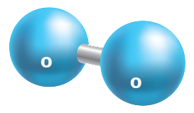

Oxygen Monitoring
Oxygen Monitoring
  Confined Space Monitoring-The detectors read-out is in % volume.
  Fresh Air = 78 % Nitrogen / 20.9 % Oxygen / 1.1 % misc gases.

Slide 33
Oxygen Monitoring
Leading cause of deaths in confined spaces regarding gas monitoring.
Low O2 might be caused by microbial activity (such as the process of fermentation); it could be due to the oxidization (rusting) of the internal surface of a tank or pipe; or it might be that the oxygen has been displaced by another gas such as nitrogen or argon.
OSHA requires low and HIGH oxygen monitoring. High levels of oxygen can enhance combustion.
Oxygen sensors are always working unless they are kept in an zero oxygen environment.
Oxygen sensors are easy to test.

Slide 34
Oxygen Alarms
23.5
19.5

Slide 35
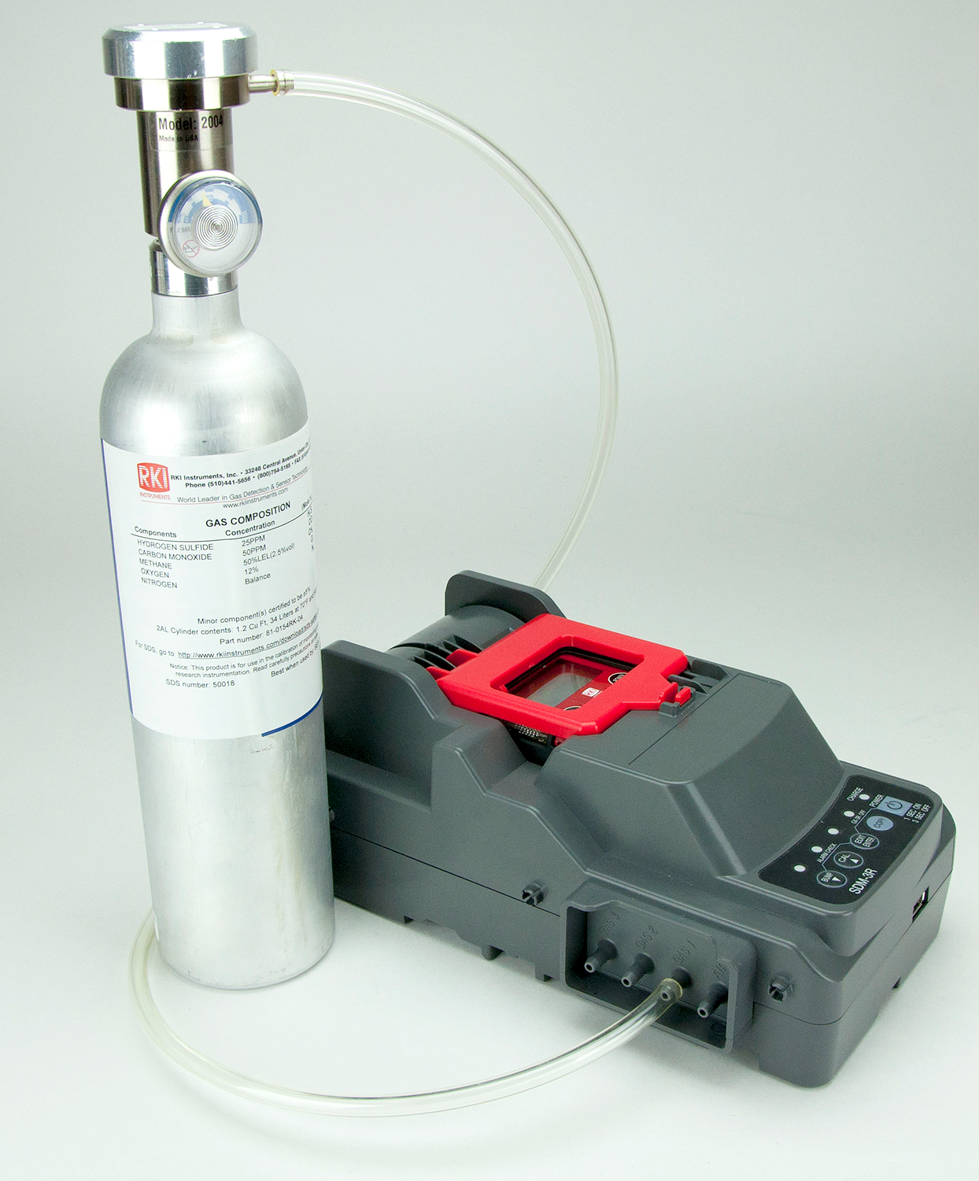
Calibration vs Bump vs Response check
What exactly is a Bump Check?
How often do I have to Bump?
How often do I have to calibrate?

Slide 36
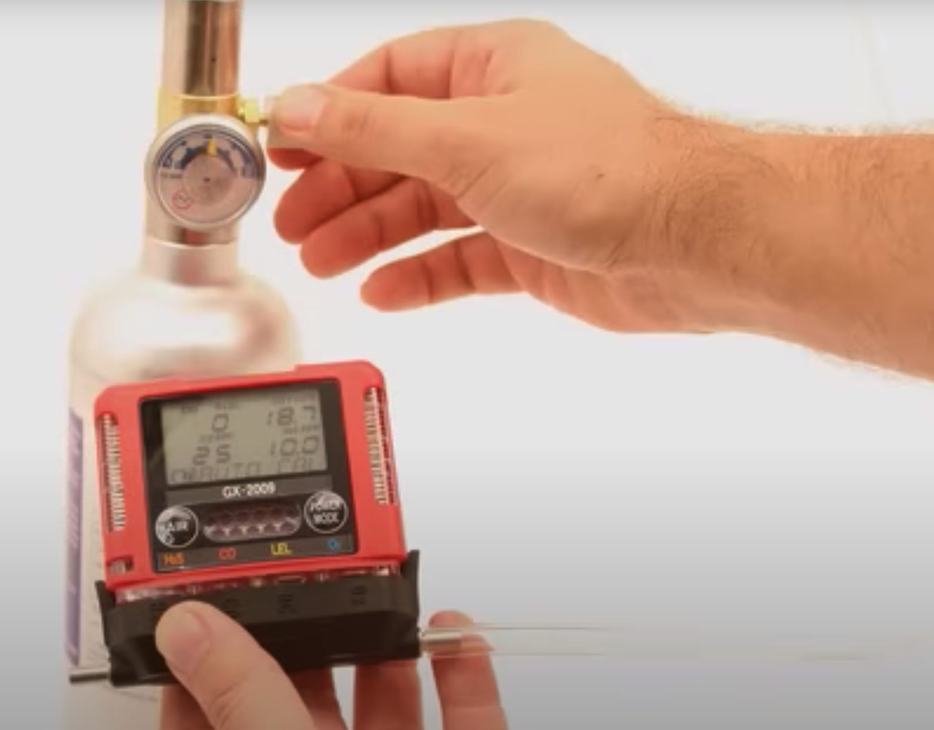
Bump versus Calibration
  Functional Check - A qualitative function check where a challenge gas (Example-25 ppm Hydrogen Sulfide, 50 ppm Carbon Monoxide, 50% LEL Methane, 12% Oxygen Balance N2) is passed over the sensor(s) at a concentration and exposure time sufficient to activate all alarm indicators to present at least their lower alarm setting. The purpose of this check is to confirm that gas can get to the sensor(s) and that all the alarms present are functional. This is typically dependent on the response time of the sensor(s) or a minimum level of response achieved, such as 80% of gas concentration applied. Note this check is not intended to provide a measure of calibration accuracy.
  Bump Check - A quantitative test utilizing a known traceable concentration of test gas to demonstrate that the sensor(s) and alarms respond to the gas within manufacturer’s acceptable limits. This is typically ±10-20% of the test gas concentration applied unless otherwise specified by the manufacturer, internal company policy, or a regulatory agency. This test can be done through the menu system which will record the “bump test” within the datalogger.
  Full calibration – The adjustment of the sensor(s) response to match the desired value compared to a known traceable concentration of test gas. This should be done in accordance with the manufacturer's instructions.

Slide 37
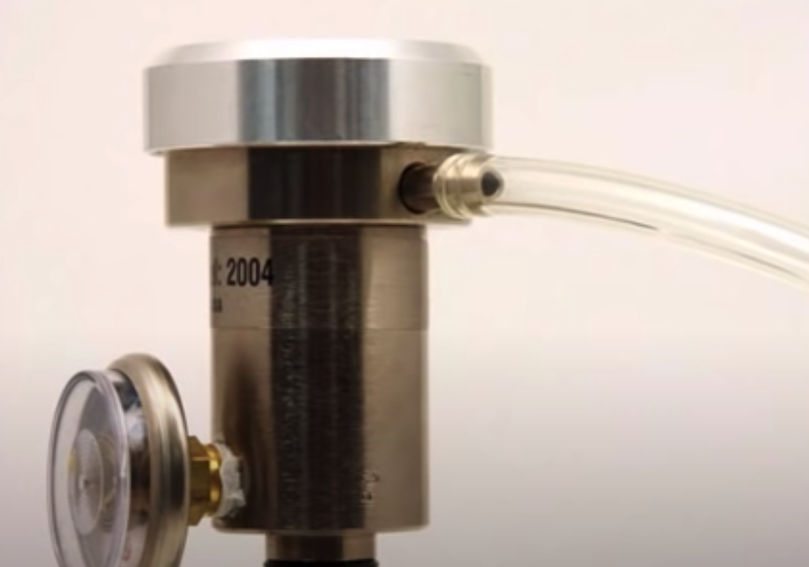
How often do I have to calibrate?
Customers want to hear the answer ‘you never have to calibrate’.
RKI generally recommends users develop a frequency of calibration that is tailored to their application and usage.
Actual calibration frequency ends up being somewhere between one and three months.
For users who “bump test” their instrument prior to each use, the calibration cycle can be extended until the bump test fails.
Instruments subjected to any condition that could have an adverse effect on the unit (sensor poisons, high gas concentrations, extreme temperature) should be calibrated before the next use.
RKI ships portables instruments defaulted with a 90-day calibration reminder.

Slide 38
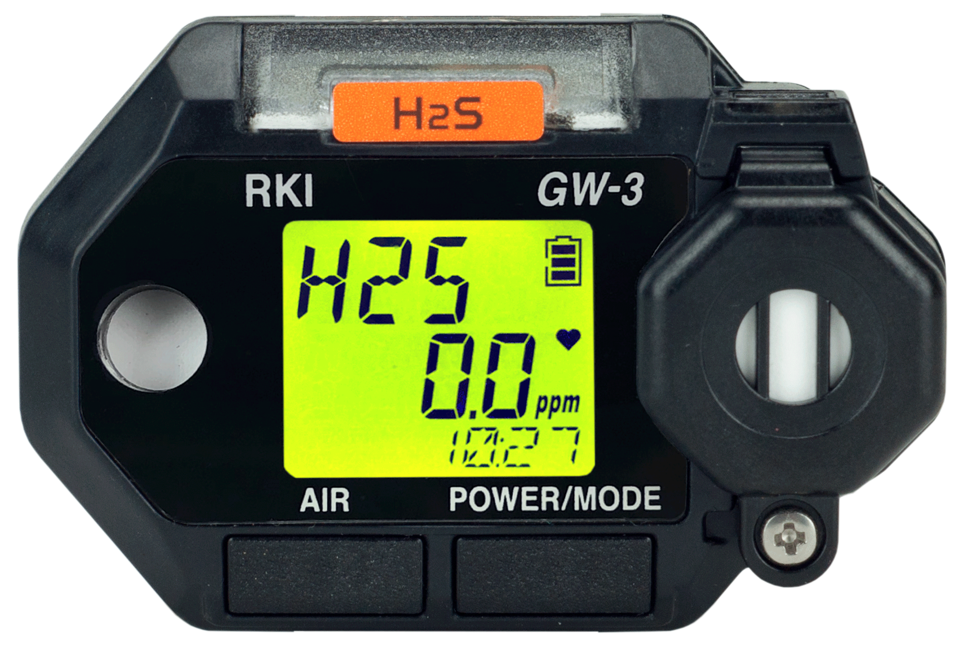
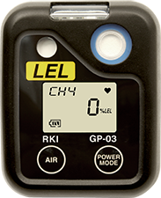
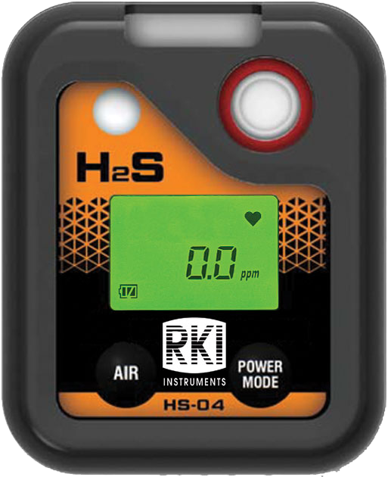
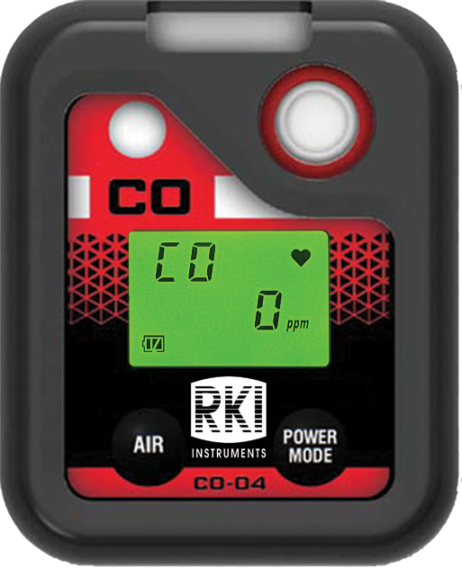
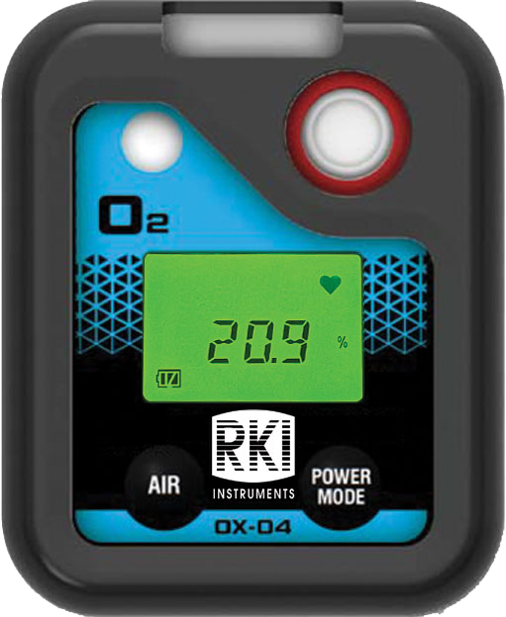
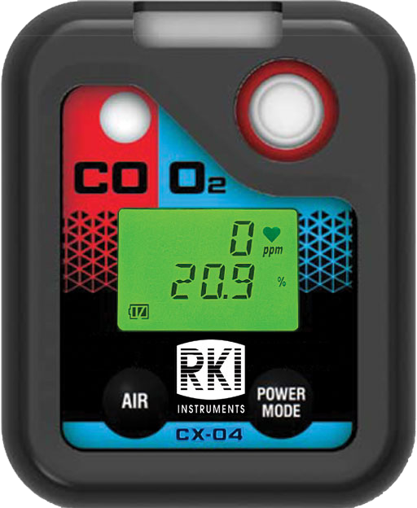
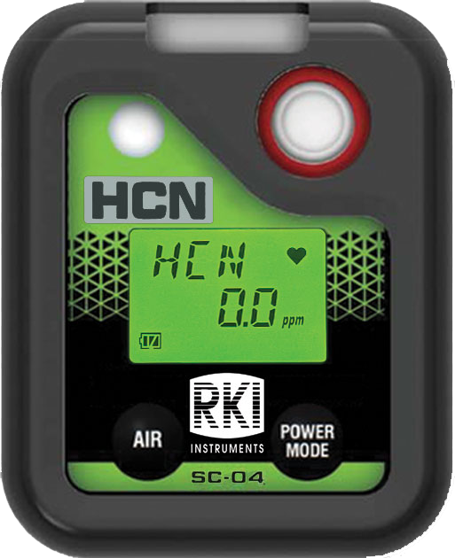
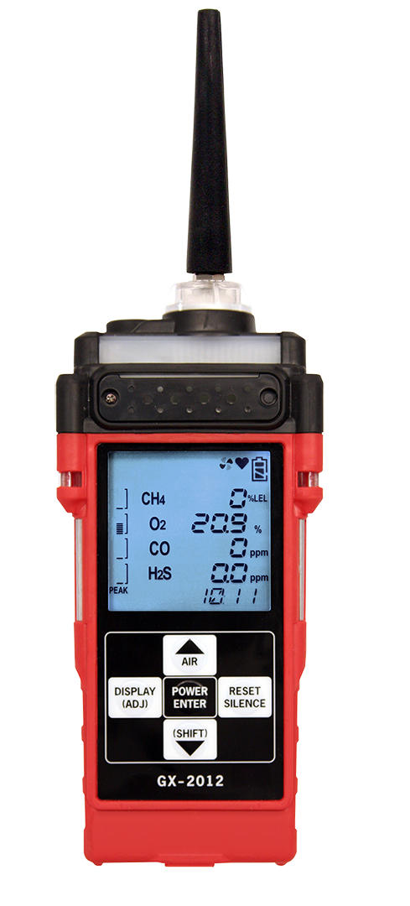
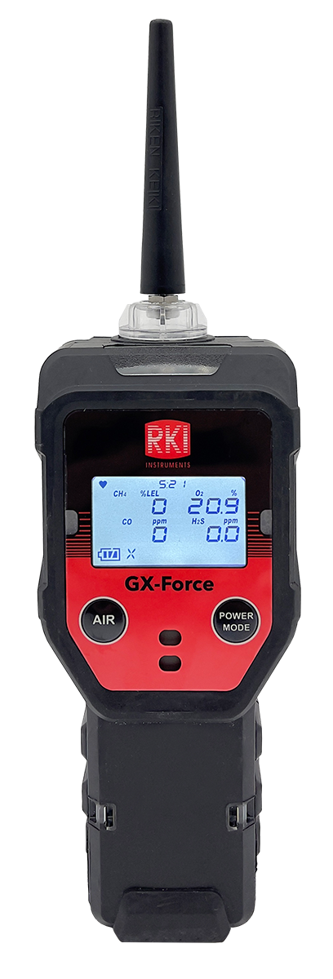
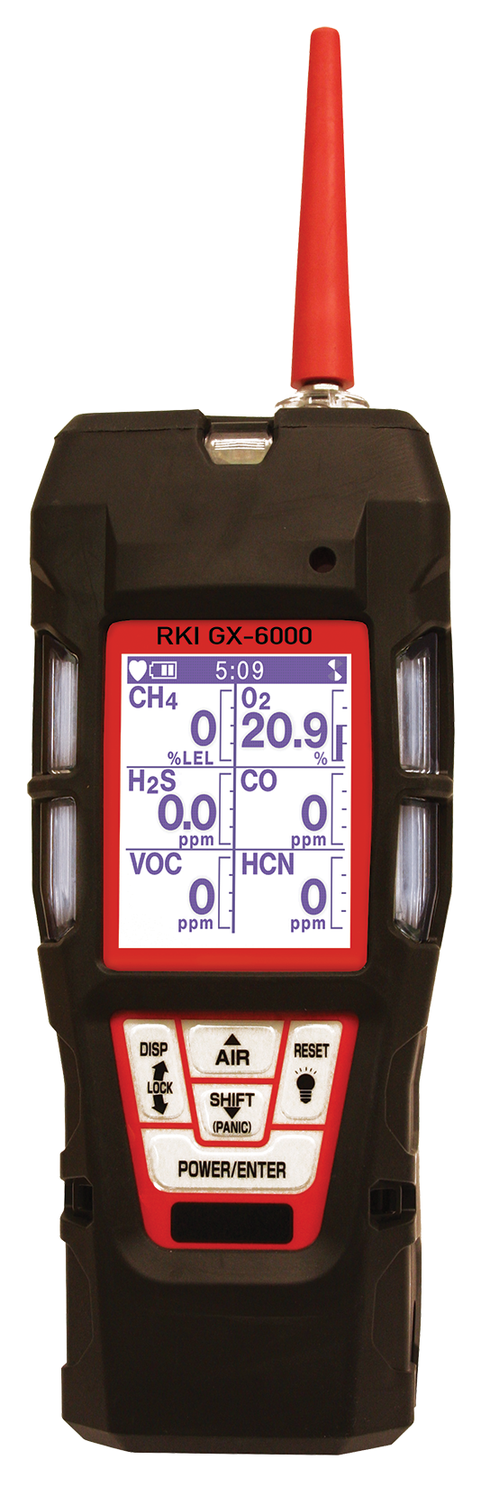
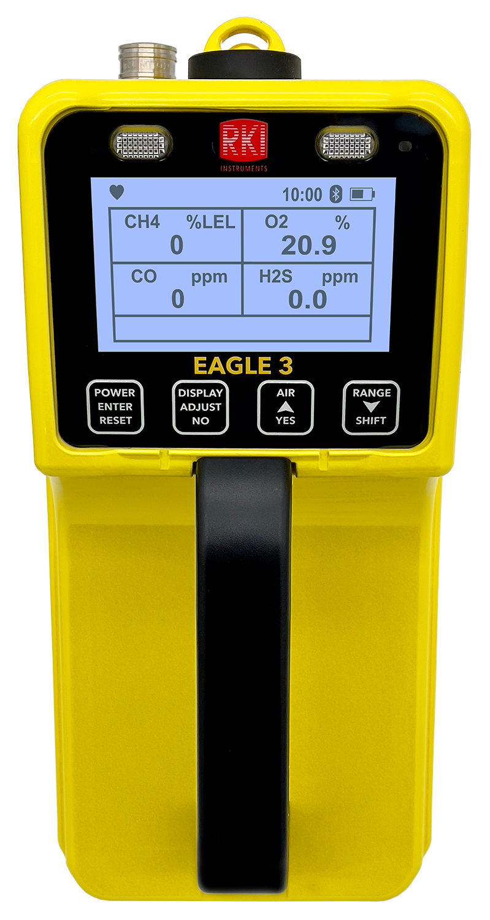
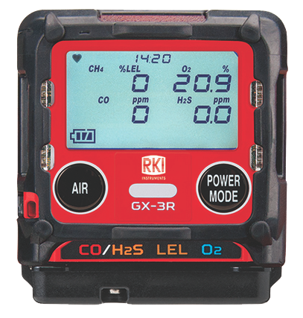
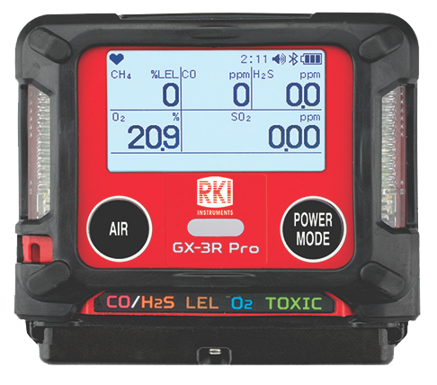
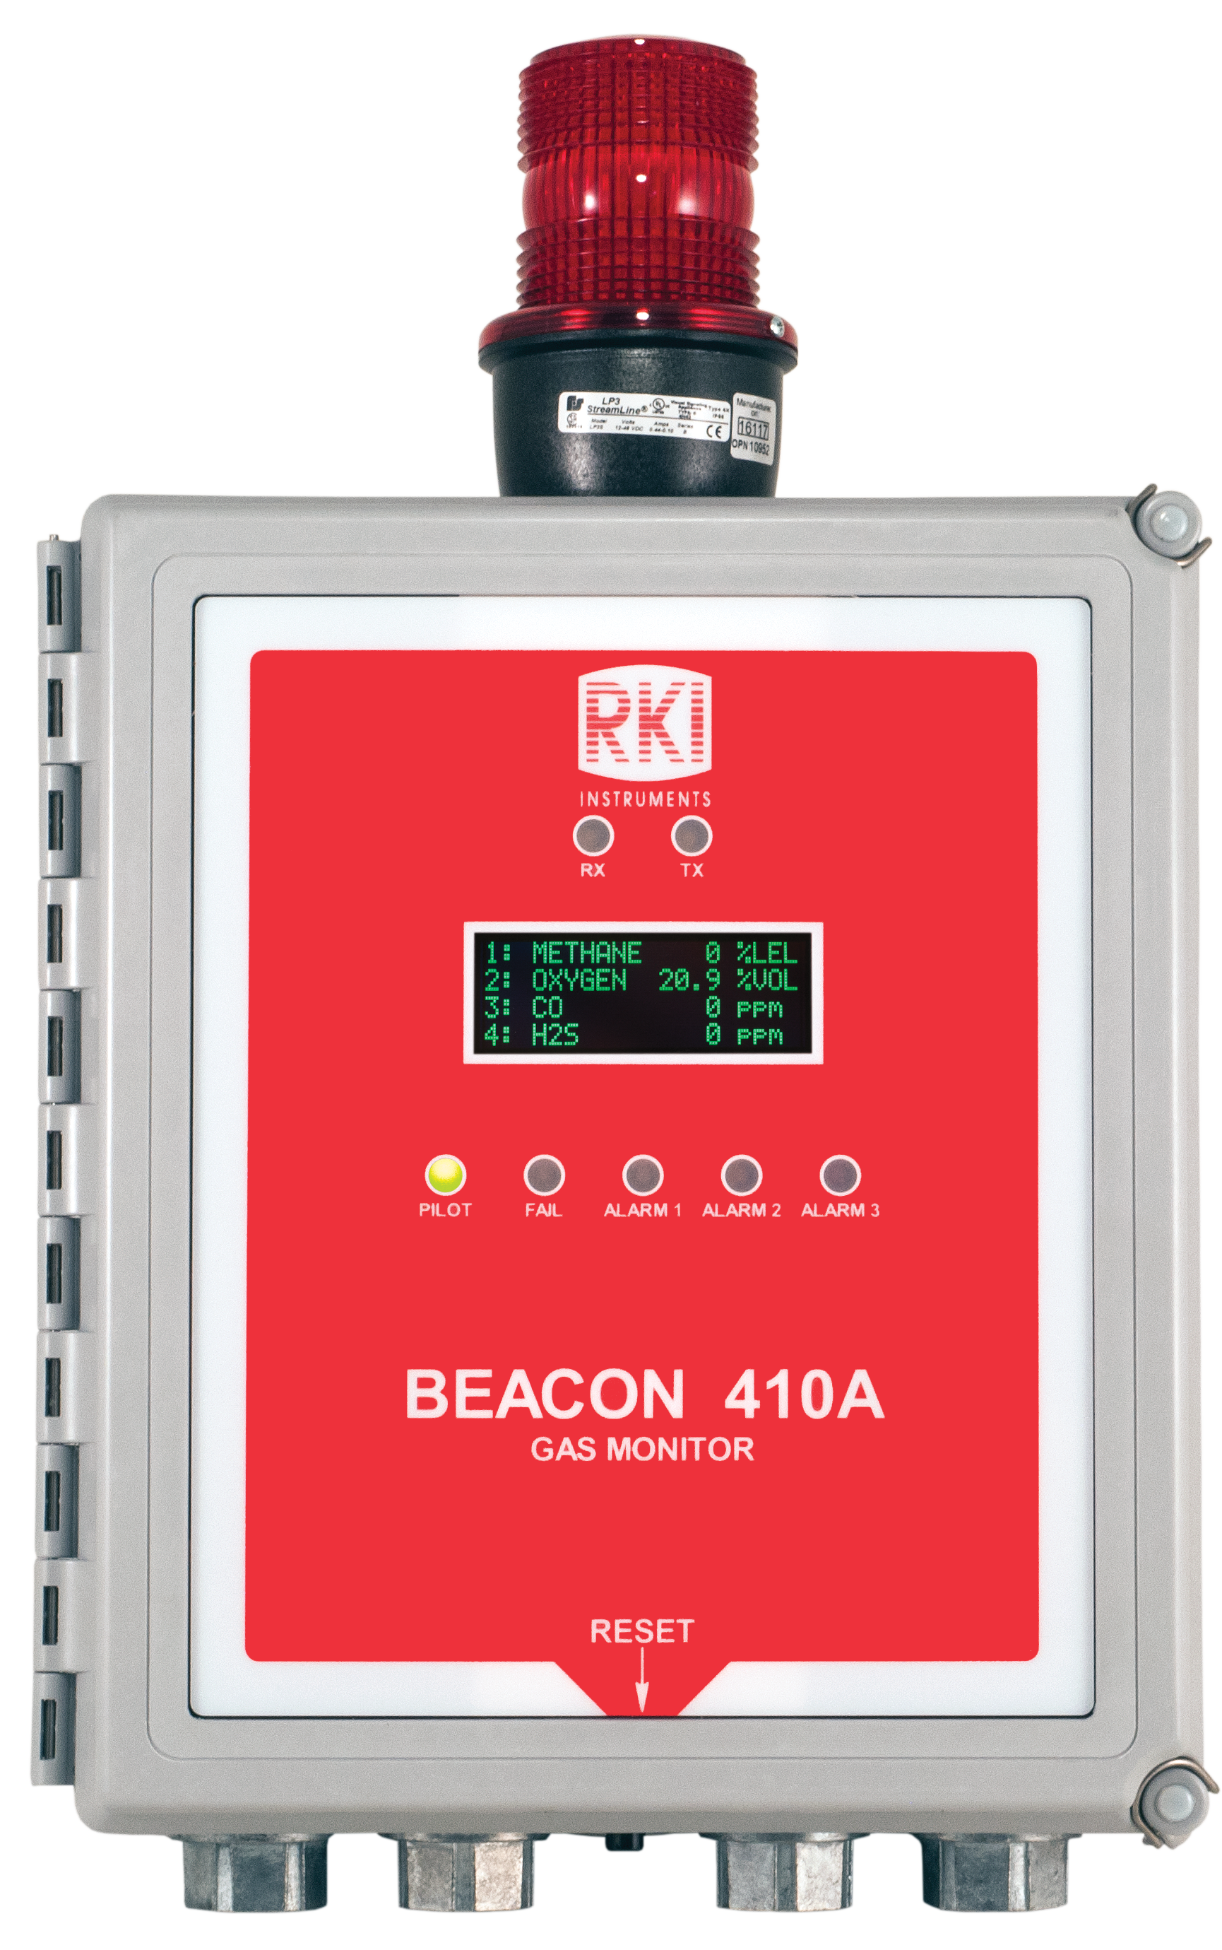
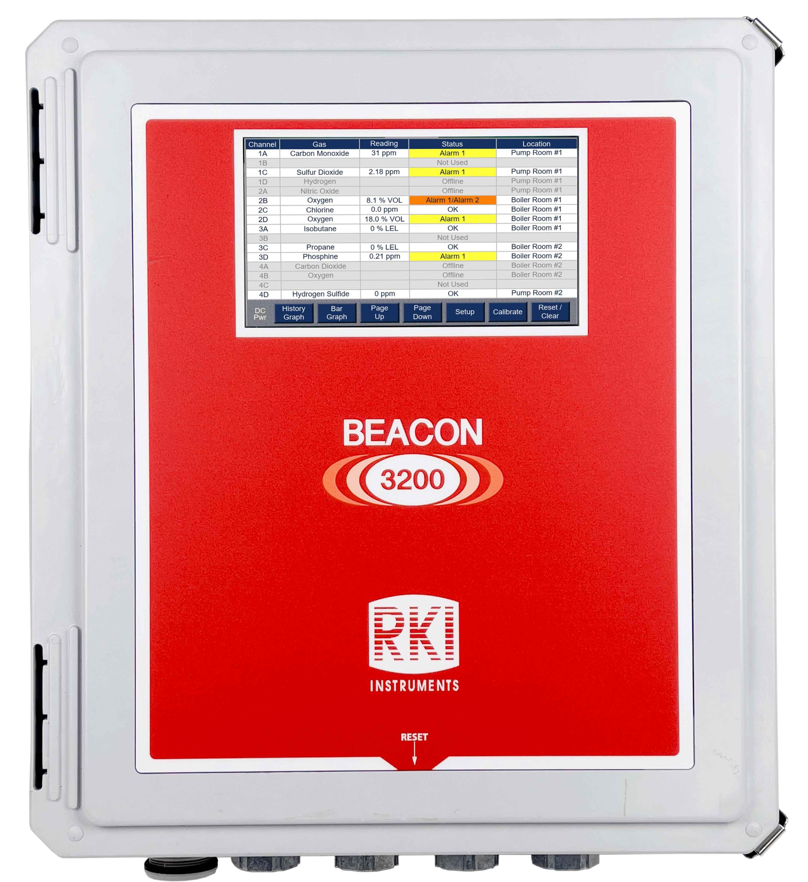
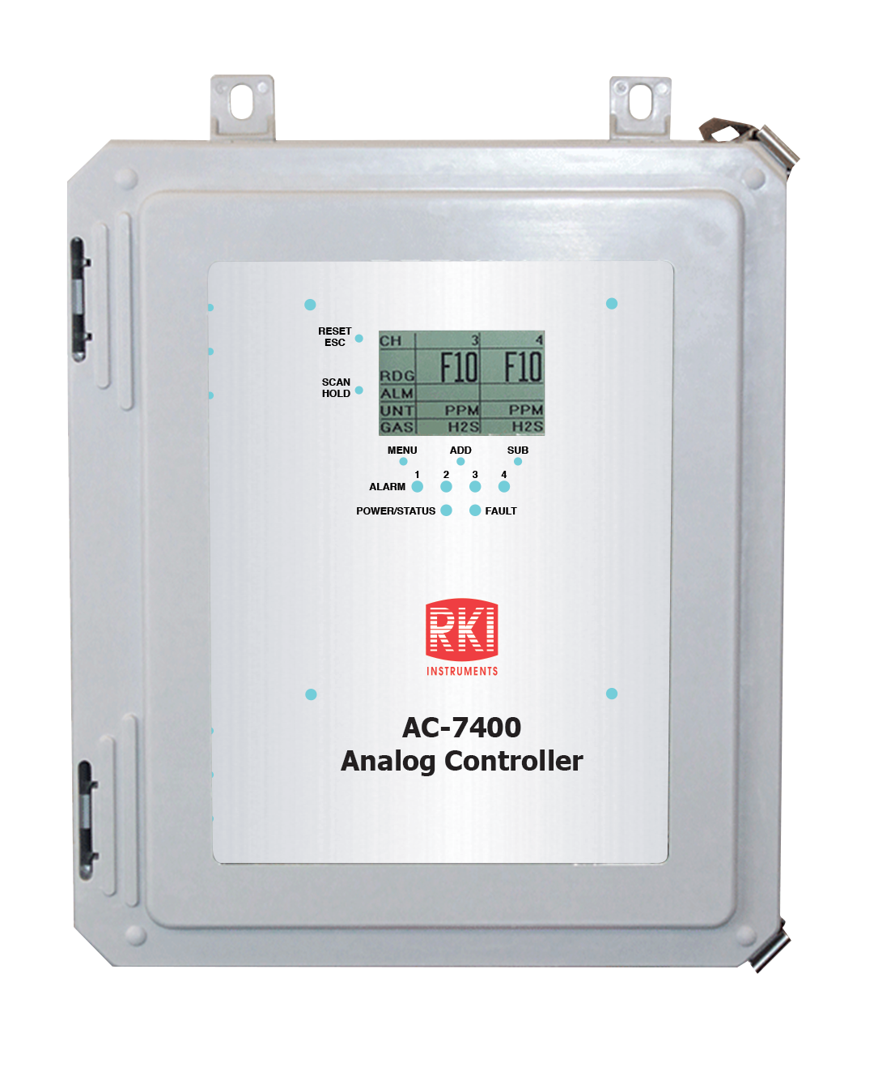
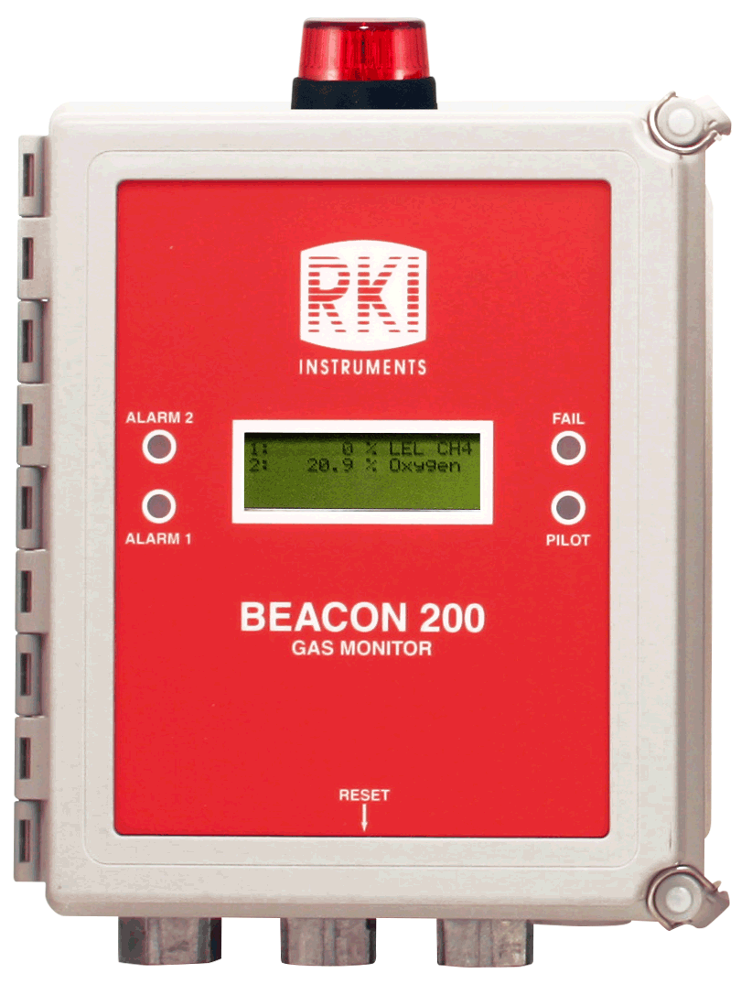
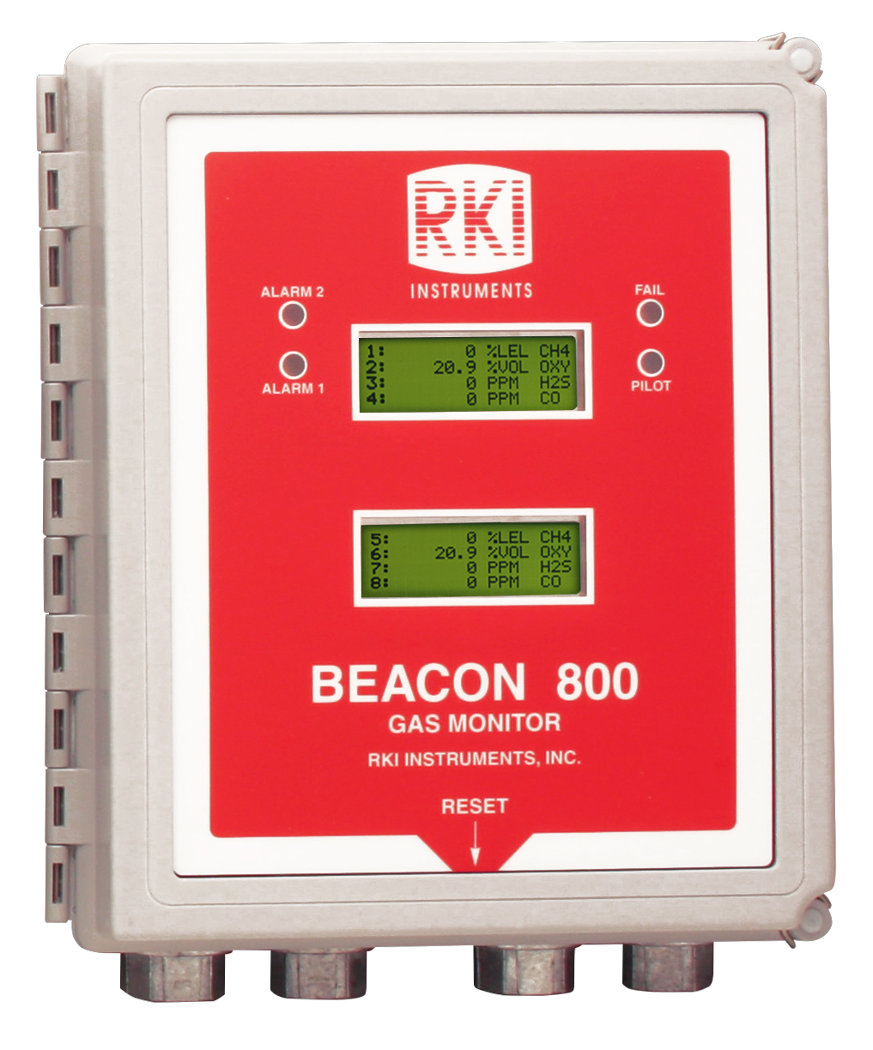
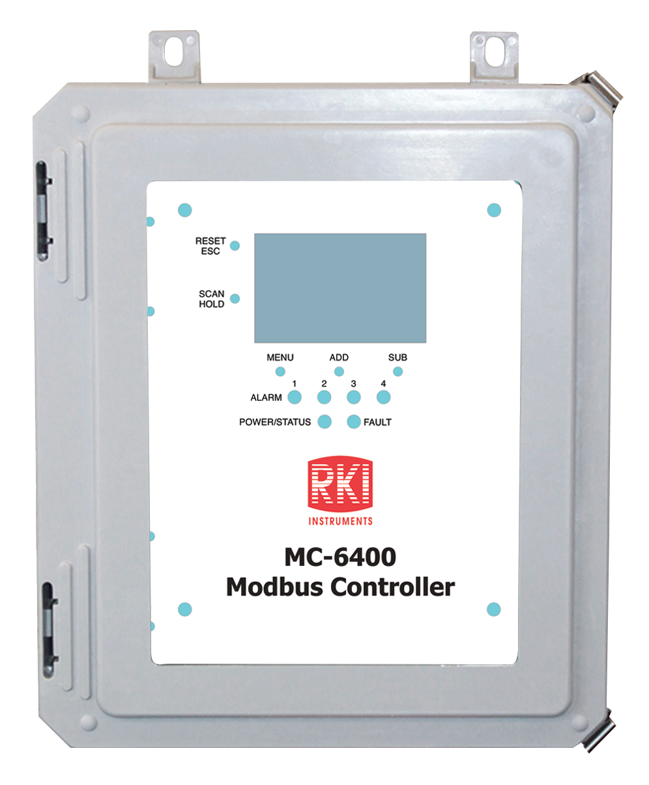
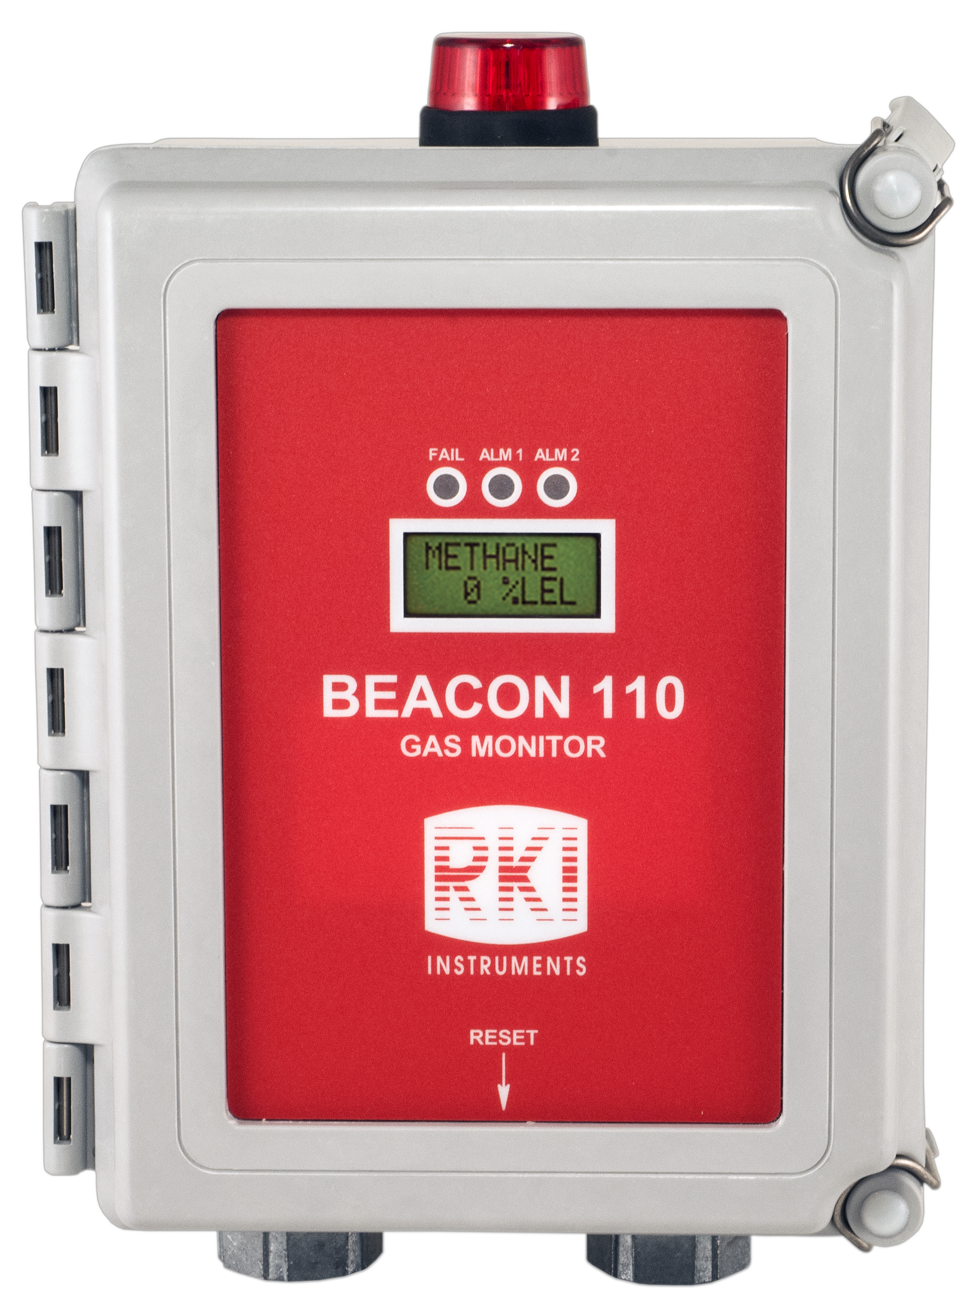
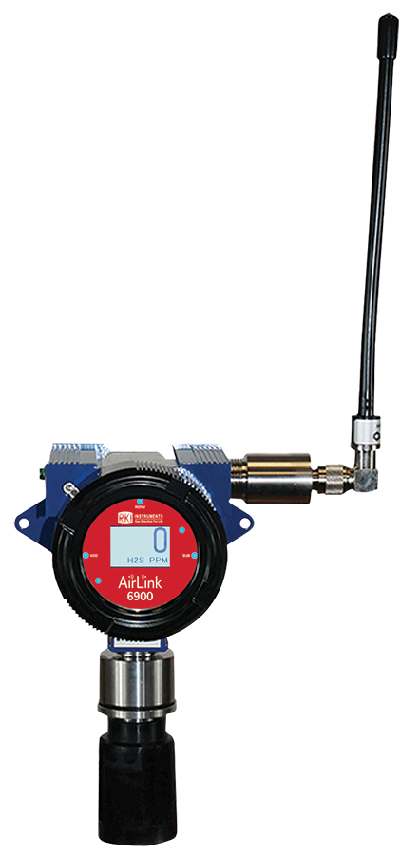
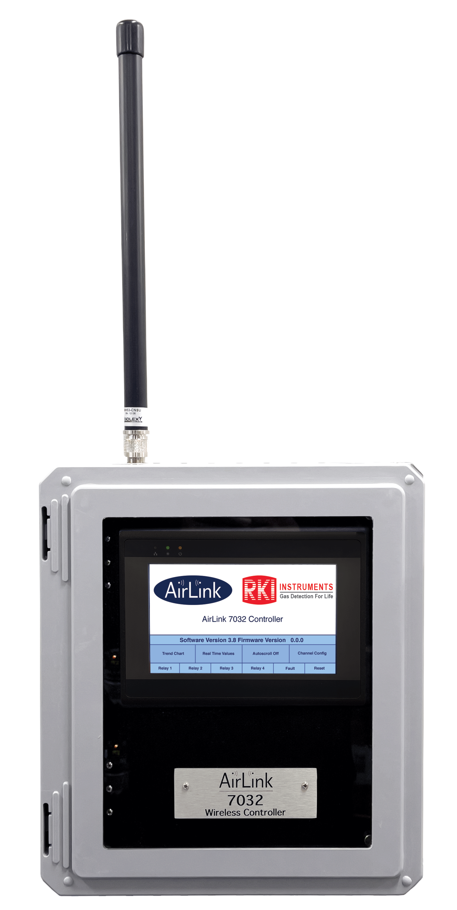
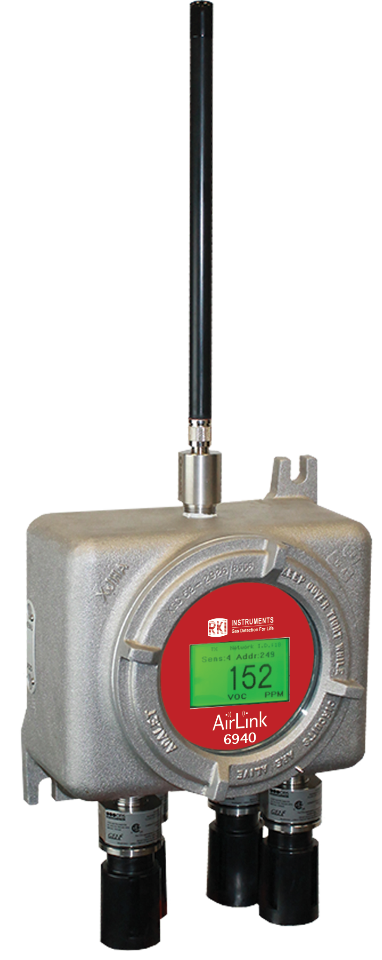
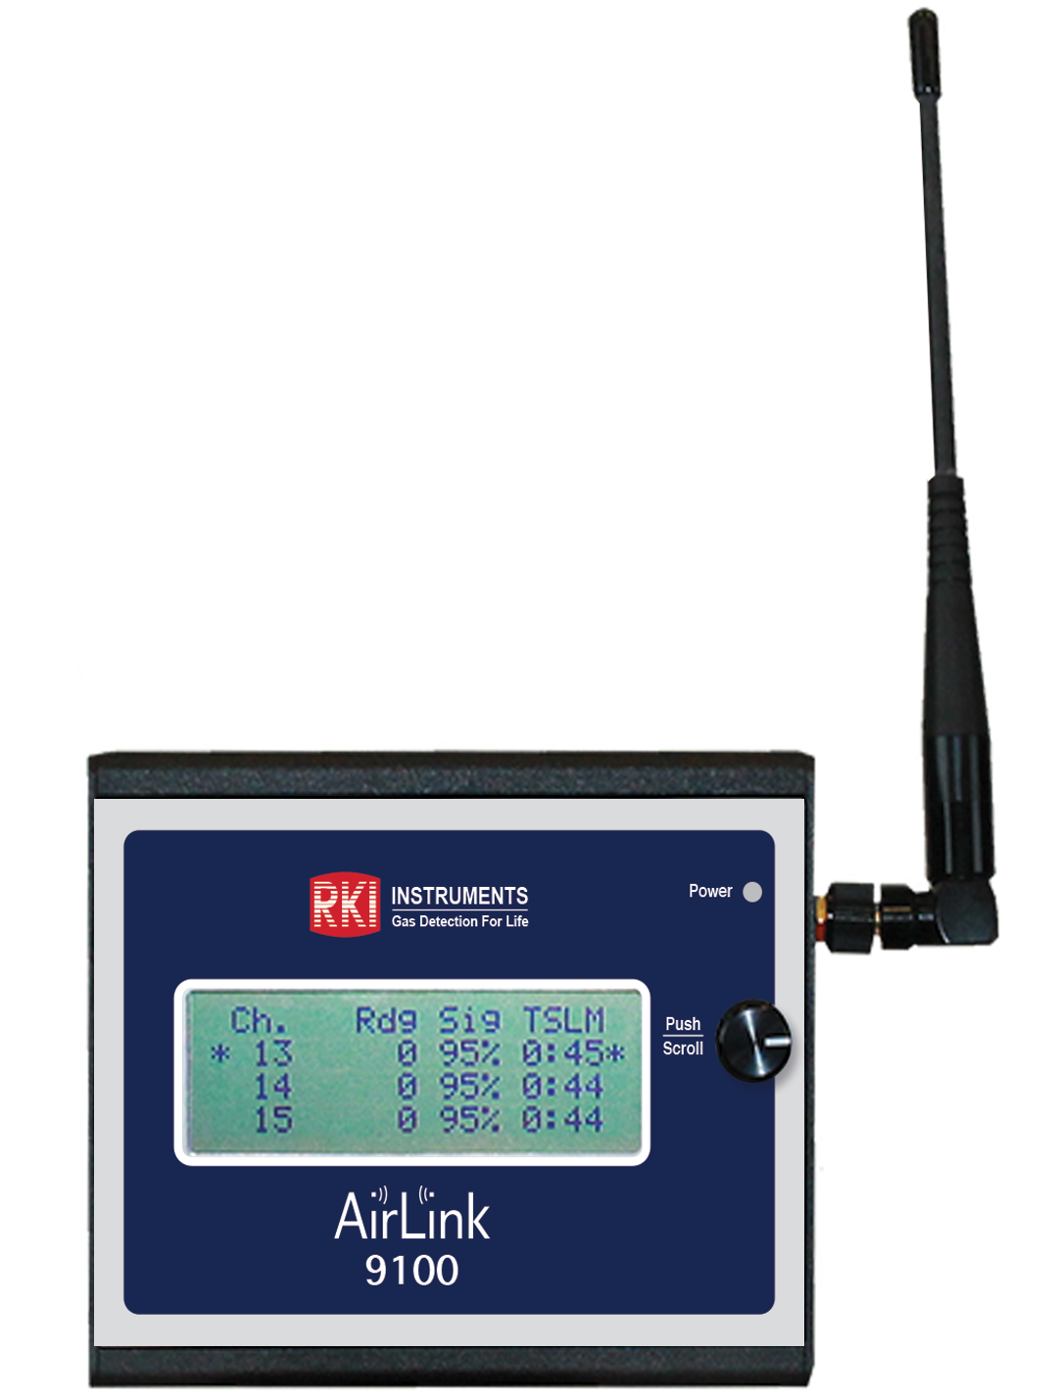
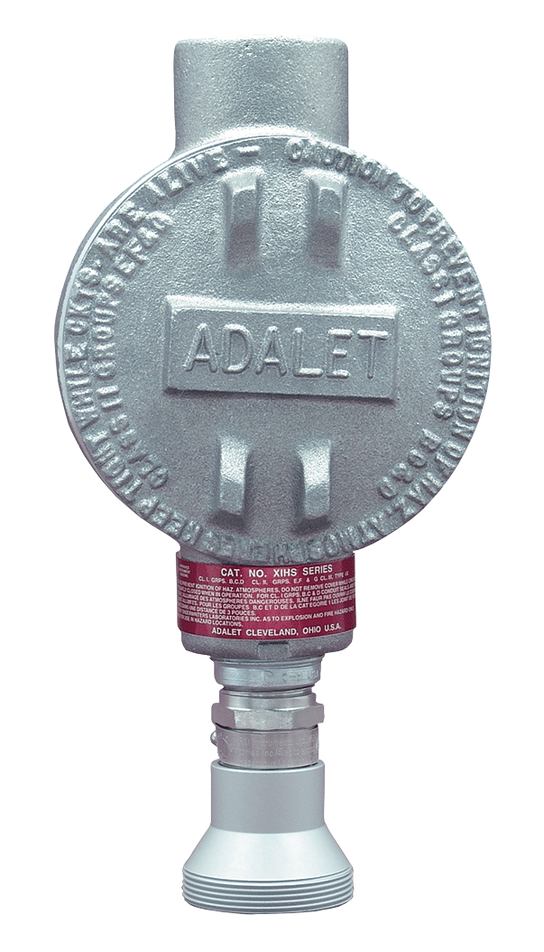
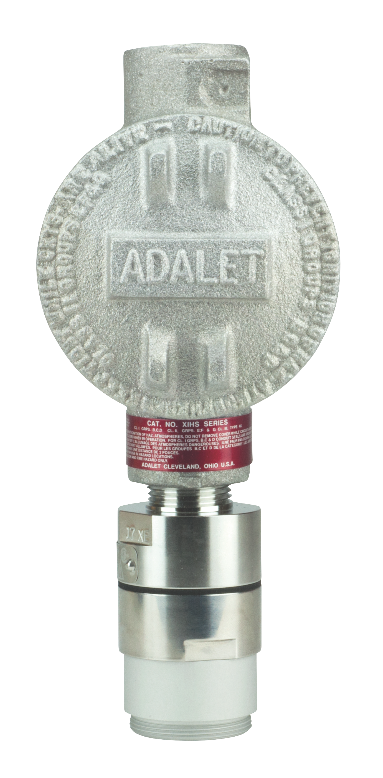
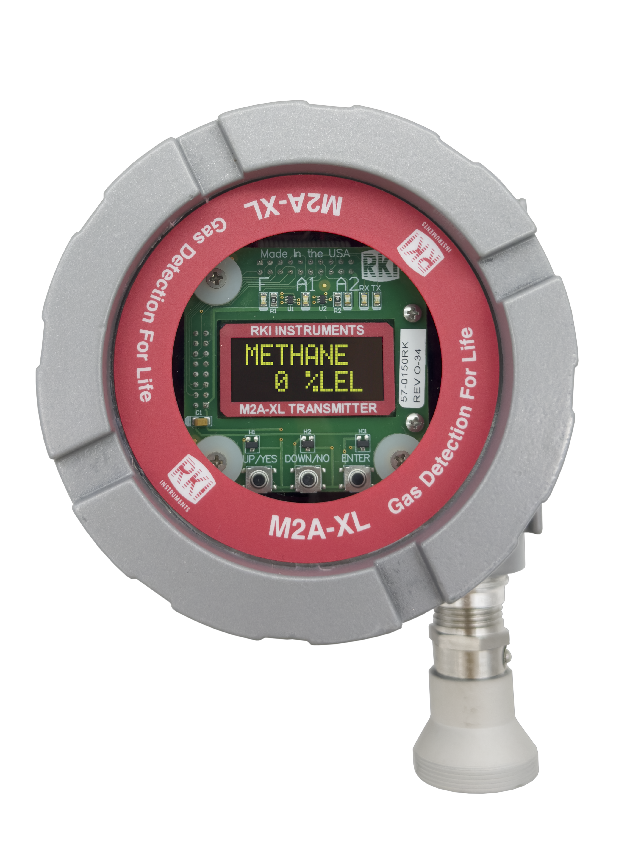
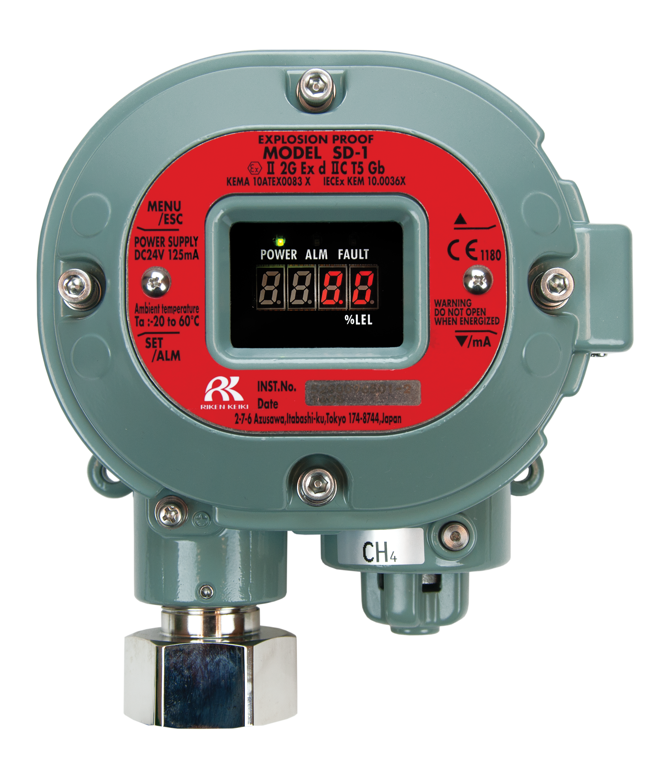
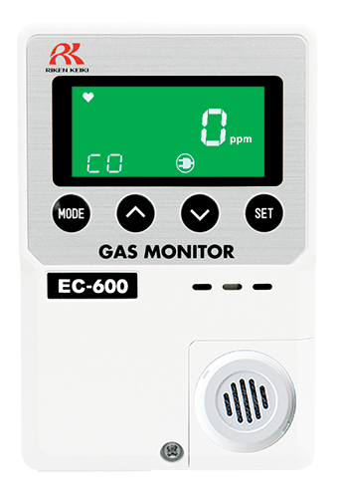
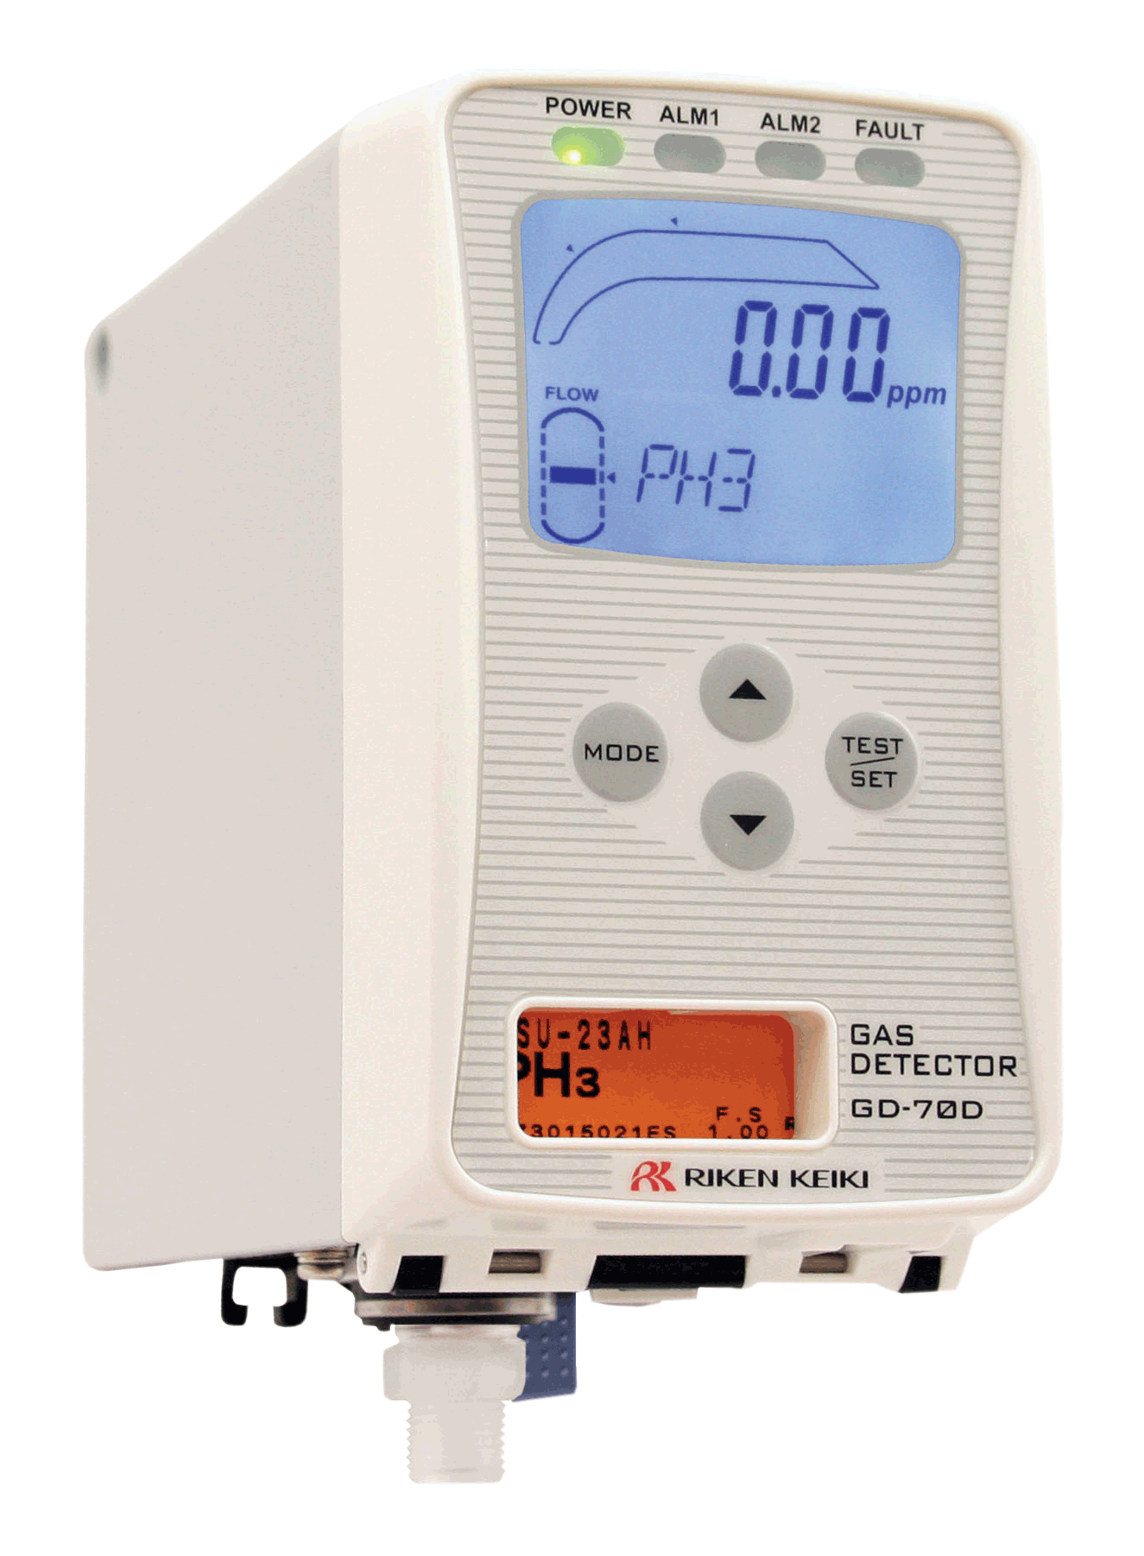

Comprehensive Offering
Portable Solutions
Single Gas
GasWatch 3
GP-03
HS-04
CO-04
OX-04
CX-04
SC-04
Multi Gas
GX-3R
GX-3R Pro
GX-2012
GX-Force
GX-6000
EAGLE 3
Fixed Solutions
Controllers
Beacon 110
Beacon 200
Beacon 410A
Beacon 800
Beacon 3200
MC-6400
AC-7400
Detector
Heads
Wireless
Solutions
S2
Series
Direct
Connect
M2A-XL
SD-1
Series
600
Series
GD-70D
Hybrid
Controllers
Quad Heads
Transmitters
Signal Meters

Slide 39
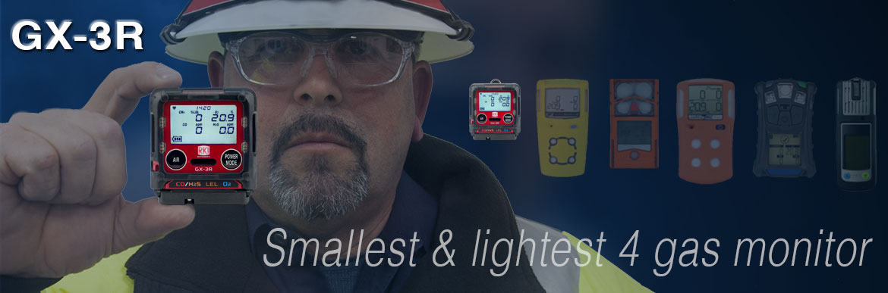
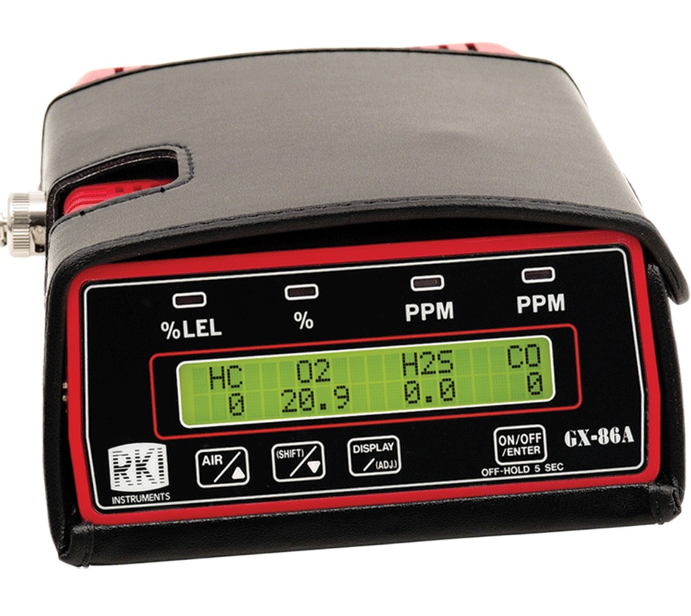
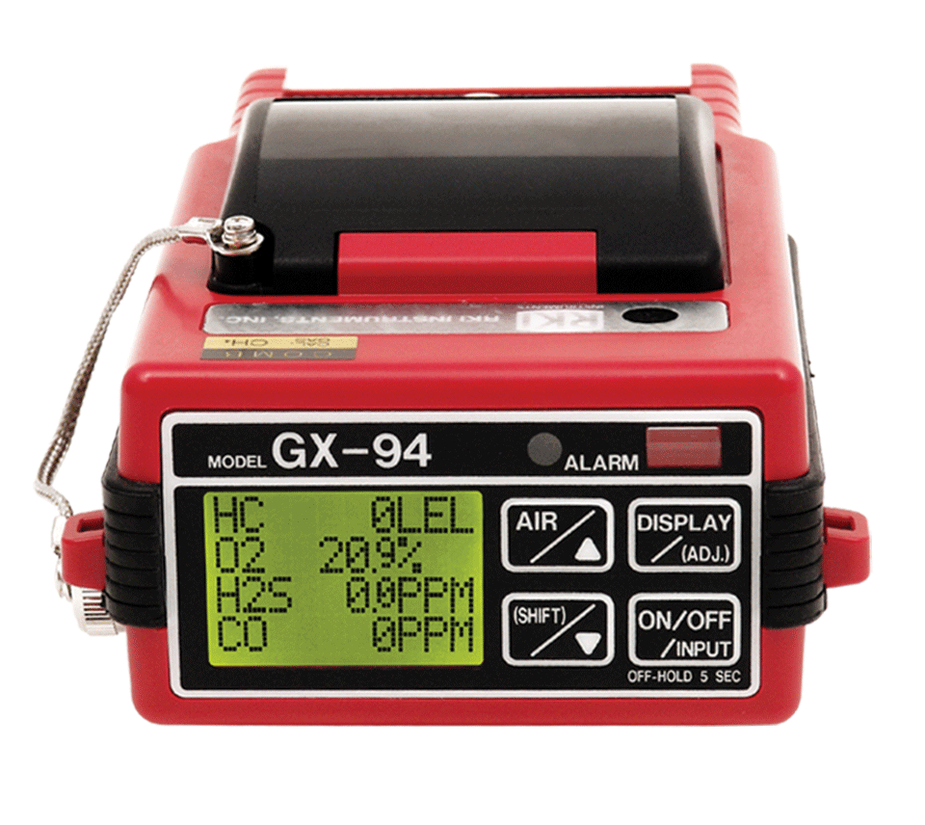
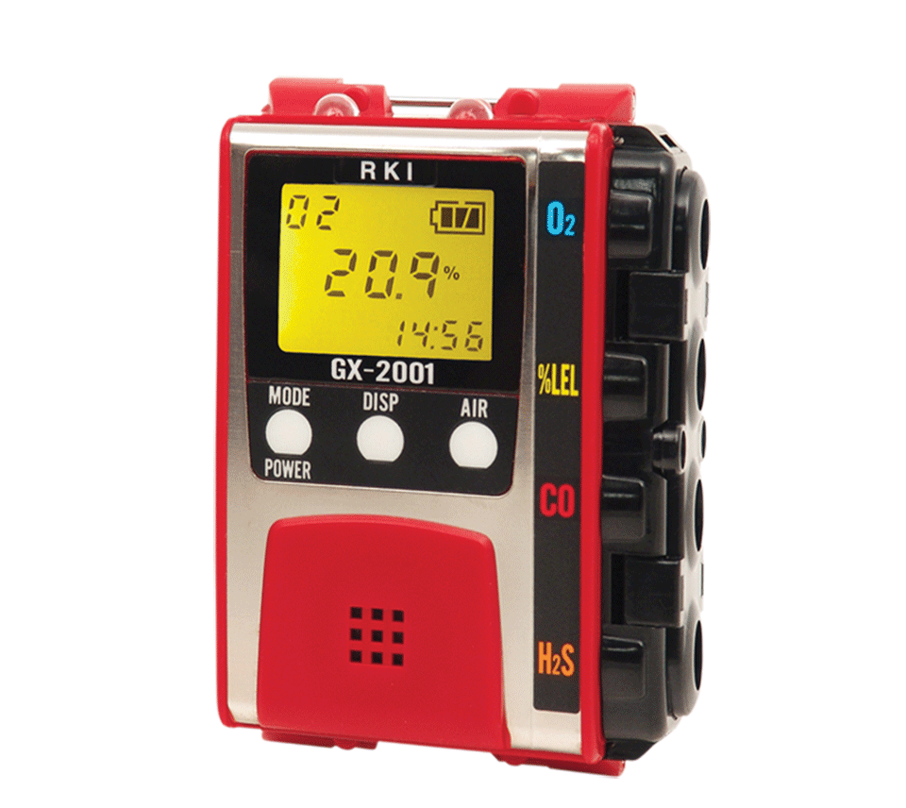
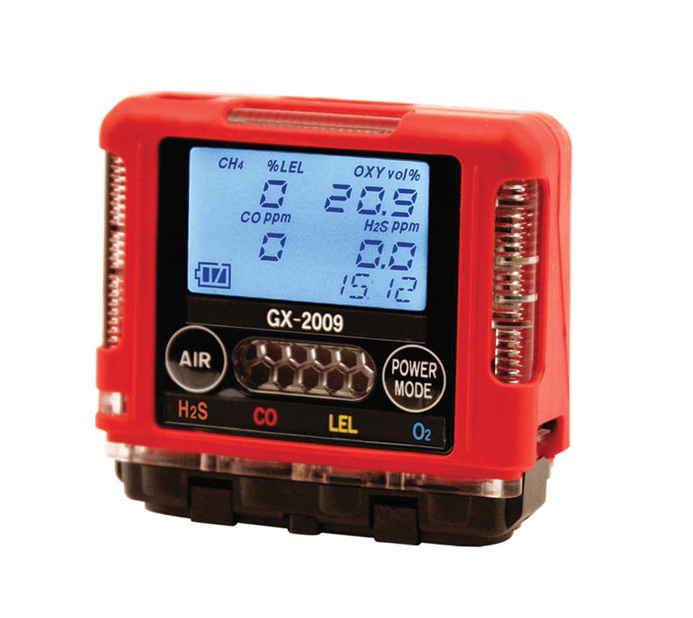

Evolution In Gas Detection

Slide 40

GX-3R & GX-3R Pro
2 Models—Depending on Need
4-gas compliance model
5-gas pro model
GX-3R
GX-3R Pro
Worlds smallest and lightest
4-gas monitor
Impact, water, & dust resistant
3-year Warranty
  4-gas plus extra slot for toxic or IR sensor
  Wireless communication with mobile app
  Man-down and panic alarms
  Alkaline & Rechargeable options

Slide 41







Competitor Comparison
Size & Weight
2.2” x 2.55” x 1”
3.7 ounces
2.9” x 2.66” x 1.06”
4.6 ounces
4.4” x 2.4” x 1.2
6.3 ounces
4.1” x 2.3” x 1.4”
6.4 ounces
4.7” x 2.7” x 1.2”
7.67 ounces
4.4” x 3.0” x 1.4”
7.9 ounces
5.12” x 1.9” x 1.8”
8 ounces
The GX-3R weighs about half of the average 4-gas detector!

Slide 42



GX-3R
The world’s smallest and lightest 4-gas monitor
Size matters in the “Breathing Zone!”
Field replaceable sensors and parts
Non-compliance indicator
Concussion resistant – drop tested at > 20ft.
IP-68 and IP-66 rated
3-year warranty
3 adjustable alarm levels
Datalogging
Low cost of ownership
“The breathing zone is within a ten inch radius of the worker's nose and mouth. OSHA requires that worker exposure monitoring air samples be collected in the breathing zone. Air sampling filters may be attached to the collar or lapel.”

Slide 43



GX-3R Pro
All of the great features of the GX-3R, plus:
An extra sensor slot for IR or toxic sensors
Man down and panic alarms
Full-dot LCD display with auto-rotate and auto-backlight
Bluetooth (BLE) connectivity
RK Link mobile app
RK Link app:
Text or Email alarm notifications with GPS location
Direct readings from instrument
Alarm indications
Configure instrument settings
Instrument locator
Available on iOS and Android

Slide 44




No-Fee Lone Worker Solution
Text and / or Email alarm notifications with alarm data and GPS location of the worker.
Text and / or email up to 150 recipients
RK Link is a free download on iOS or Android.
No monthly service fees.
Stay connected with no fee!

Slide 45




Alert Different Team Members
Based on Alarm Type
EMS Group
Compliance / Maintenance

Slide 46



Send Alerts By SMS or E-mail

Slide 47





Alerts Include Alarm Data and GPS Location

Slide 48



Automatically Send Compliance Notifications
Compliance / Maintenance

Slide 49



Sensors
The Heart of Every Instrument
We manufacture our own sensors
Our micro-sensors allow us to make the smallest gas detectors in the world
3-year warranty
New LEL sensor’s dual-filament design is silicon resistant
Lead-free EC tech gives O2 sensor 3-5 year lifespan
Dual sensor – 2 channels in one sensor slot
Dual filament
LEL sensor
F1
Dual Sensor
F2
+ Si removal filter
CO/H2S

Slide 50



Sensor Options
GX-3R and GX-3R Pro
3-year warranty on all GX-3R and GX-3R Pro Sensors!
GX-3R and GX-3R Pro | GX-3R Pro Only | Coming in 2020 (GX-3R Pro only)
CO/H2S | CO2 ppm (IR) | HCN
LEL | CO2 % vol (IR) | NH3
O2 | SO2 | NO2
H2S |  | Cl2
CO
(-H2) CO

Slide 51



Attachable Pump and Cal Station
GX-3R & GX-3R Pro
RP-3R Sample Draw Pump:
Compatible with both GX-3R and GX-3R Pro
Flow rate: 500ml / min
Distance to draw: 50 feet
Operation time: 10h
Independent power supply
RP-3R
SDM-3R Calibration Station:
Accepts both GX-3R and GX-3R Pro
Bump Time: 10 seconds
Gas Consumption: 250 ml / min
Output: Internal memory / USB drive / LAN cable / USB Cable to PC
SDM-3R

Slide 52




Stacking Up to the Competition
Feature | GX-3R | BW Clip4 | Multi Gas Clip Simple
Price | Lower list price | Higher list price | Same list price
Size and weight | Smaller and lighter | Larger and heavier | Larger and heavier
Sensor ranges | Better sensor ranges | Narrower sensor ranges | Narrower sensor ranges
Alarm points | 3 adjustable alarm points | 2 alarm points | 2 alarm points
Warranty | 3 year warranty | 2 year warranty | 2 year warranty
Attachable sample draw pump | Available sample draw pump | No sample draw option | No sample draw pump option
Cost of ownership | Lower cost of ownership | Disposable | Disposable

Slide 53


Stacking Up to the Competition
Feature | GX-3R | MSA Altair 4XR | ISC Ventis Pro 5
Price | Lower list price | Higher list price | Even Higher List Price
Size and weight | Smaller and lighter | Larger and heavier | Larger and heavier
Replacement sensors | Less expensive | More Expensive | More Expensive
Alarm points | 3 adjustable alarm points | 2 alarm points | 2 alarm points
Durability | IP-66 AND IP-68 rating | Only IP-68 | Only IP-68
Attachable sample draw | Available sample draw attachment | More expensive sample draw | More expensive sample draw
Cost of ownership | Lower cost of ownership | Higher cost of ownership | Higher cost of ownership

Slide 54


Stacking Up to the Competition
Feature | GX-3R Pro | BW Ultra (5-gas)
Price | Lower list price | Higher list price
Size and weight | Smaller and lighter | Larger and Heavier
Sensor ranges | Better sensor ranges | Narrower sensor ranges
Sensor costs | Lower sensor costs | Higher sensors costs
Battery life | Longer battery life | Shorter Battery Life
Alarm points | 3 alarm points | 2 alarm points
Warranty | 3 Years – Instrument and Sensors | Instrument – 3 years, Sensors – 2 or 3 years, Battery – 2 years

Slide 55


Single Gas
Single Sensor Personal Detection
Features
Disposable Price Point
  Quantity Discounts: $79.00 Ritz Cost when buying 100
  (CO,HS,O2)
Full 3-year warranty including sensors
  (excludes Ammonia and Chlorine)
Run Time 9,000 Hours (H2S & CO) on AA Alkaline
Gas Readings Displayed
Toxic gases include:
  NH3, Cl2, HCN, NO2, PH3, CO, H2S & SO2
Pocket size 2.1”(W) x 2.6”(H) x 0.9”(D), 2.8 ounces
Field serviceable

Slide 56


Compliance & Confined Space Plus
GX-3R
Features
GX3R Pro
GX-3R: $595.00 List
  2.2” x 2.55” x1”3.7 ounces
  IP66/68 Submersible
  25 Hours Run Time
  Simple two-button operation
  3-Year warranty, including sensors
GX-3R Pro: $980 basic 4-gas
  Bluetooth with Connected Worker Options
  Non-compliance indicator
  Panic Alarm & Man Down Alarms
  Toxics/IR Sensors:
    HCN, NH3, NO2, PH3, SO2, and CO2
    – H2 Compensated CO sensor available

Slide 57


4 Gas with Internal Pump
Features
GX-Force
Priced to compete with BW GasAlert Max XT II
  List Price = $860
  Quantity discounts same as GX-3R
2 Operating modes
  Normal and Leak Check
Internal sample pump with 100′ sample range
30 hours of operation (Lithium-ion battery)
USB Type-C charging & data connection
Easy to grip lightweight design
  2.5″ W x 6.81″ H x 1.85″ D, 9.87 ounces

Slide 58





GX-2012
One Monitor – Four Functions
Leak Investigation
Confined Space Monitoring
Line Purge Testing
Bar Hole Sampling
Monitor LEL, O2, CO, H2S
Detects down to 100 ppm CH4
0-100% vol methane range
Internal sample pump
pulls samples up to 50’
Auto-ranging (from %LEL to %. vol)

Slide 59


Stacking Up to the Competition
Feature | GX-2012 | BW GasAlertMax XT II
Battery options | Alkaline or rechargeable | Rechargeable only
Operating modes | Normal – Confined space Leak Check – ppm CH4 and CO surveying Line Purge – 100% vol CH4 Bar Hole – Timed underground CH4 sampling | One operating mode
Sensor slots | 5 sensor slots | 4 sensor slots
ppm/LEL/%vol auto-ranging | Auto-range readings from ppm → LEL → %vol* | LEL range only
Pump | 100’ max sample distance | 75’ max sample distance
*Requires optional TC sensor

Slide 60


GX-6000
6-gas, sample draw with smart PID, IR & super toxics
VOC MONITORING
PID library of over 600 VOCs (10.6eV lamp)
Two ranges available:
    0-50,000 ppb or 0-6,000 ppm
Accepts 10.6eV/10.0eV/11.7eV PID lamps
Robust photo ionization detector (PID)
Can be combined with other sensors to maximize capacity
Benzene specific pre-filter tube available

Slide 61

GX-6000
6-gas, sample draw with smart PID, IR & super toxics
FIRE INDUSTRY
Monitor low ppm levels of dangerous gases like NH3 or H2S commonly found in meth labs
Simultaneously monitor typical confined space hazards like LEL combustibles, O2 deficiency, CO & H2S
Find trace levels of flammables or HCN in arson investigation
Detect CO leaks or strange odors confidently
Man down alarm

Slide 62

GX-6000
6-gas, sample draw with smart PID, IR & super toxics
CONFINED SPACE ENTRY
Monitor LEL, O2, CO & H2S
Internal sample pump
Audible, visual and vibration alarms
Ideal for refinery applications
Man down alarm
Panic alarm
Optional sensors for toxic gases

Slide 63

GX-6000
6-gas, sample draw with smart PID, IR & super toxics
LEAK INVESTIGATION
Provides ppm detection of combustible gas
Leak check with changing blink/pulsing rate
    LEDs and alarm tones increase in frequency as gas concentration increases
Leak check mode displays both CO & combustible levels
Audible alarm silence
    Investigate leaks without alarming residents
Barhole mode for tracking leak migration

Slide 64
Compliance & Confined Space Plus
GX-3R
Features
GX3R Pro
GX-3R: $595.00 List
  2.2” x 2.55” x1”3.7 ounces
  IP66/68 Submersible
  25 Hours Run Time
  Simple two-button operation
  3-Year warranty, including sensors
GX-3R Pro: $980 basic 4-gas
  Bluetooth with Connected Worker Options
  Non-compliance indicator
  Panic Alarm & Man Down Alarms
  Toxics/IR Sensors:
    HCN, NH3, NO2, PH3, SO2, and CO2
    – H2 Compensated CO sensor available

Slide 65
4 Gas with Internal Pump
Features
GX-Force
Priced to compete with BW GasAlert Max XT II
  List Price = $860
  Quantity discounts same as GX-3R
2 Operating modes
  Normal and Leak Check
Internal sample pump with 100′ sample range
30 hours of operation (Lithium-ion battery)
USB Type-C charging & data connection
Easy to grip lightweight design
  2.5″ W x 6.81″ H x 1.85″ D, 9.87 ounces

Slide 66

Features
Monitor up to 6 Gases
H2S, CO, O2, LEL
2 smart sensor slots
  PID for VOC’s (10.0, 10.6 & 11.7 eV)
  IR for CH4, HC, & CO2
  EC for NH3, Cl2, HCN, NO2, & SO2
  Dual PID capability
LCD display
Auto flip display
Peak bar graphs
Adjustable auto backlight
Customize order of gases
Single gas view with large font & auto sequence
5 operating modes
Normal
Leak check
Inert
Bar hole
Snap Log
Alarms
2 adjustable gas alarms per channel
Man Down alarm
4 alarm LED’s
Audible and vibration alarms
Trouble alarms for low flow, sensor connection, low battery, circuit error, & calibration
PID library of more than 600 VOC’s
0-6,000 ppm/ 0-50,000 ppb ranges
Easily choose a target VOC
  User defined VOC list of 30
  Recently used VOC list last 8
LEL Protection mode
Shields LEL sensor from damaging VOC exposure

Slide 67
Features
Smallest 6 gas sample draw
Lightweight & Ergonomic
High impact rubber boot
Ergonomic design fits comfortable in hand
Custom Unit Identification
User & Station ID selection Menu
Assign multiple users to select within one instrument
Internal Sample Pump
50’ sampling range
Weather & Dust Resistant
IP-67
Interchangeable battery options
Lithium-ion pack operates 14 hours
  Complete recharge in 3 hours
Alkaline pack operates 8 hours
9 Languages
English, Germany, Italian, French, Portuguese, Spanish, Japanese, Korean, Russian

Slide 68


SDM-6000 Docking Station
  Stand alone station (no PC required)
  Charging
  Bump, Calibrate, and Alarm tests
  Touch screen menu display
  Save calibration, bump tests, alarm history and exposure data to an SD memory card or to a computer
  Automatically power on or off for scheduled maintenance
  Up to 3 ports for separate calibration gas cylinders
  Manage up to 10 instruments with one power source, calibration source, and computer
  Configure GX-6000 parameters
  SV-3 unit expands calibration ports up to 6 ports
  Easily connects to adjacent docks
  Automatically distributes power, calibration gas, and data once connected
  DIN Rail wall mount
  Local print out of calibration/bump and alarm test results

Slide 69




PID Options – GX-6000
4 PID’s to choose from:
PID /gas |  | Range | Accuracy
10.6 eV low | 600 VOC’s | 0-50,000 ppb | +/- 10% of reading, +/- 1 digit
10.6 eV high |  | 0-6,000 ppm
10.0 eV | Benzene specific | 0.1-50 ppm
 | 300 VOC’s | 0-100 ppm
11.7 eV | High- voltage lamp | 0-1,000 ppm
Standard 4-gas sensor slots
The GX-6000 is the only multi-gas monitor with simultaneous dual-PID capability
Long life 11.7 eV lamp
  Typical 9 to 12 month life!
  Monitor carbon tetrachloride, acrylonitrile, chloroform, methanol, refrigerants (R-143, R-132A), and more
Two PID / smart sensor slots

Slide 70




Stacking Up to the Competition
Feature | GX-6000 | BW ultra (PID) | RAE Systems MultiRAE
Size and weight | Smaller and lighter | Larger and heavier | Larger and heavier
# of PID options | 4 PID options | 1 PID option | 1 PID option
11.7 eV PID | 11.7 PID available | Not available | Not available
PID life | Longer PID life | Shorter PID life | Shorter PID life
Dual PID capable | Simultaneous dual PID | No | No
Benzene specific mode | Benzene specific mode | No | No
Leak check mode | Leak check mode | No | No
Bar hole mode | Bar hole mode | No | No
Sensor costs | Lower sensor costs | Higher sensor costs | Higher sensor costs
Battery life | Longer battery life | Shorter battery life | Shorter battery life
Cost of ownership | Lower cost of ownership | Higher cost of ownership | Higher cost of ownership

Slide 71
Stacking Up to the Competition
Feature | GX-6000 | Altair 4XR (PID) | Ventis Pro 5 (PID)
Size and weight | Smaller and lighter | Larger and heavier | Larger and heavier
# of PID options | 4 PID options | 1 PID option | 1 PID option
11.7 eV PID | 11.7 PID available | Not available | Not available
PID life | Longer PID life | Shorter PID life | Shorter PID life
Dual PID capable | Simultaneous dual PID | No | No
Benzene specific mode | Benzene specific mode | No | No
Leak check mode | Leak check mode | No | No
Bar hole mode | Bar hole mode | No | No
Sensor costs | Lower sensor costs | Higher sensor costs | Higher sensor costs
Battery life | Longer battery life | Shorter battery life | Shorter battery life
Cost of ownership | Lower cost of ownership | Higher cost of ownership | Higher cost of ownership

Slide 72
Common Gas Hazards by Industry
Industry | Hazards/Gases | Portable Products
Oil & Gas | LEL, O2, H2S, CO, SO2, HCN, NH3, Benzene (C6H6) | GX-3R & GX-3R Pro, GX-2012, GX-6000, Eagle 2
Energy/Utilities | LEL, O2, H2S, CO, SO2, H2 | GX-3R & GX-3R Pro, GX-2012, Eagle 2
Construction | LEL, O2, H2S, CO, NO2 | GX-3R & GX-3R Pro, GX-2009 MSHA (for NO2), GX-6000
Water/Wastewater | LEL, O2, H2S, CO, NH3, Cl, O3, SO2, VOC’s | GX-3R & GX-3R Pro, GX-6000
Landfill/Waste | CH4, CO2, NH3, CL2, NMOC’s, VOC’s | GX-6000, Eagle 2
Fire/First Responders | LEL, O2, H2S, CO, HCN, NH3, VOC’s | CO-03, GX-3R & GX-3R Pro, GX-6000
Food and Beverage Production | LEL, O2, H2S, CO, HCN, NH3, CO2, PH3 | GX-3R & GX-3R Pro, GX-6000
Manufacturing | LEL, O2, H2S, CO, Process gases like CO2, NH3 | GX-3R & GX-3R Pro, GX-6000
Chemical | LEL, O2, H2S, CO, Cl2, H2, HCl, NO2, SO2, VOC’s | GX-3R & GX-3R Pro, GX-6000, Eagle 2

Slide 73






Common Fixed System Components
Beacon 410A Controller
M2A Transmitter
Remote Mount Sensor
with Cal Cup
S2 Transmitter
Direct Connect Sensor
RKI’s diffusion style remote mount detectors allow for easy calibrations in difficult access areas
Alarm Relays Activate Ventilation / Exhaust System

Slide 74






Fixed Sensors and Transmitters
Direct Connect
S2 Transmitter
M2A Transmitter
Cost Effective
Water repellent sensor coating
Explosion Proof
Transmitters 4-20mA output
Explosion Proof
Stainless steel option
Operates with or without controller
OLED display
2 programmable alarm relays
Non intrusive calibration
4-20mA and Modbus outputs
GD-70D
35-3001 Sample Draw
Smart Sample Draw
Wide range of plug & play sensors
Large LCD Display
SD-1 Series
LEL, O2, H2S, CO CO2, & H2 available
Multigas versions
Internal sample pump with 100’ range
Explosion proof, IP-65/67
Monitor ppm or % LEL ranges
Available for H2, IPA, CAN, and ETO

Slide 75



















Slide 76

Questions?

Slide 77


