Slide 1
Promotions

Slide 2
Traditional Promotions
Traditional Promotional Efforts
Competitive trade-ins
Quantity discounts
POS Material
Marketing Coop Funds
Market Specific Literature
Local Training & Product demo’s

Slide 3
Marketing Coop Program
RKI offers 1% of RKI purchases as coop funds to distributors.
For example, if a distributor purchases $100,000, RKI offer $1,000 of coop funds.
Coop funds can be used for
  Trade shows expenses
  Demo equipment
  Purchase of Instruments for Rental
  Training Classes
  RKI branded merchandise
  Print Brochures & Catalogues

Slide 4



Market Specific Brochures
Natural Gas
Construction
Brewery CO2
Fire & Hazmat
Hospital Nitrogen Storage Monitoring
Marijuana Grow Houses/Cannabis Oil Producers

Slide 5
Promotional Brainstorming
Open to new ideas and concepts
Free calibration days
Try before you buy – demo instruments
Rental Business – GX-6000 & GX-2009 are ideal rental products
Offer Fixed Systems

Slide 6
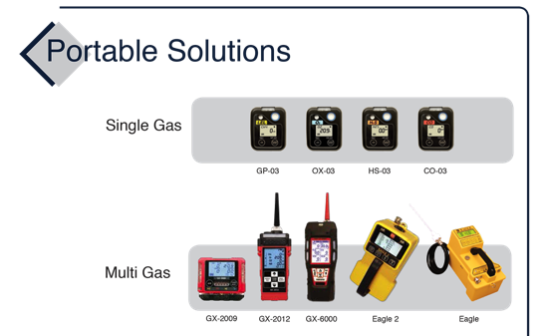
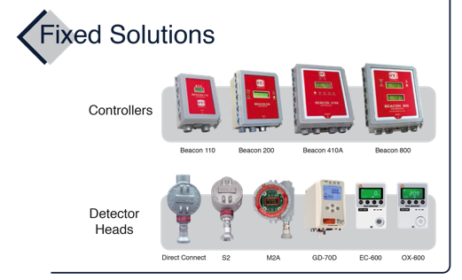
Portable & Fixed Products

Slide 7
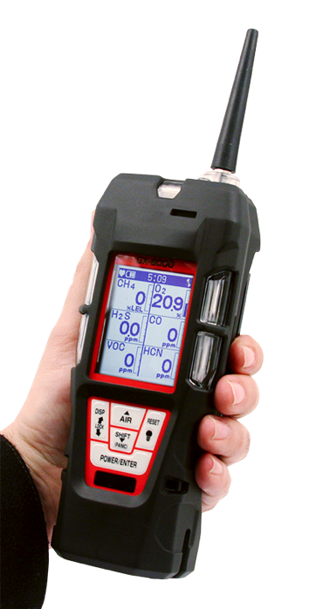
Maximum Flexibility
Model GX-6000
6 gas, sample draw with smart PID, IR & super toxics

Slide 8
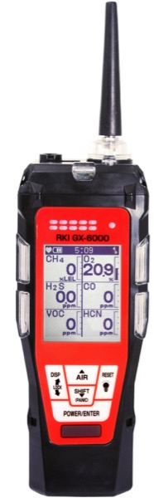
Monitor up to 6 Gases
H2S, CO, O2, LEL
2 smart sensor slots
  PID for VOC’s (10.0, 10.6 & 11.7 eV)
  IR for CH4, HC, & CO2
  EC for NH3, Cl2, HCN, NO2, & SO2
LCD display
Auto flip display
Peak bar graphs
Adjustable auto backlight
Customize order of gases
Single gas view with large font & auto sequence
5 operating modes
Normal
Leak check
Inert
Bar hole
Snap Log
Alarms
2 adjustable gas alarms per channel
Man Down alarm
4 alarm LED’s
Audible and vibration alarms
Trouble alarms for low flow, sensor connection, low battery, circuit error, & calibration
PID library of more than 600 VOC’s
50 ppm / 6,000 ppm ranges
Easily choose a target VOC
  User defined VOC list of 30
  Recently used VOC list last 8
LEL Protection mode
Shields LEL sensor from damaging VOC exposure
Internal Sample Pump
50’ sampling range

