Slide 1


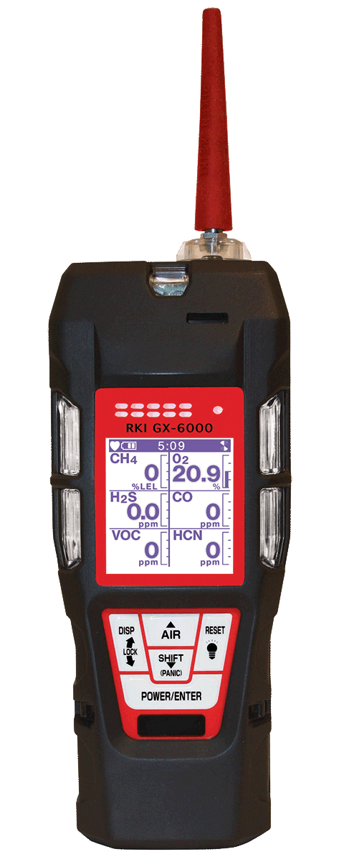
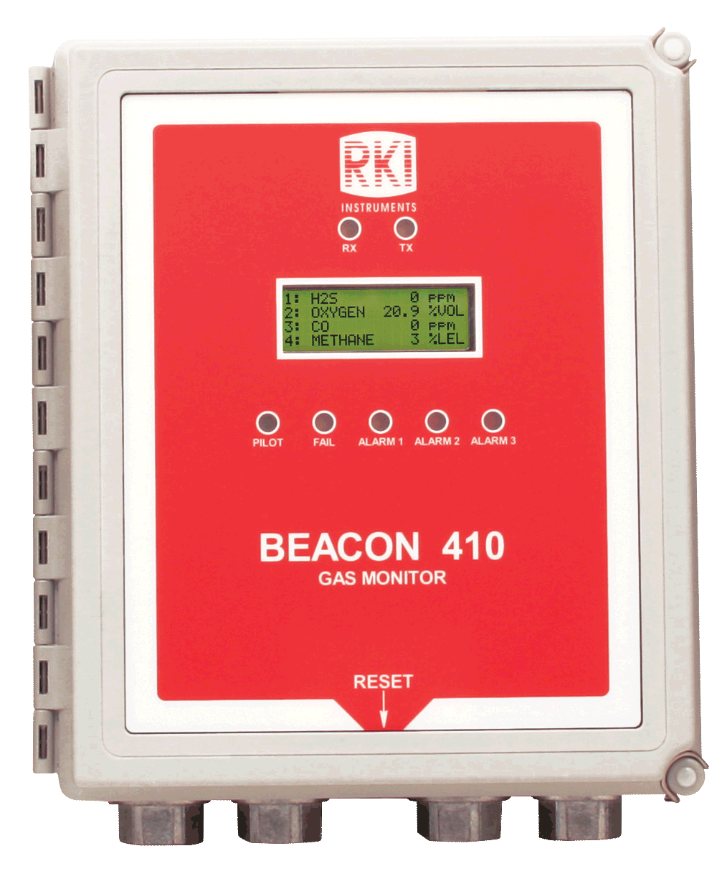
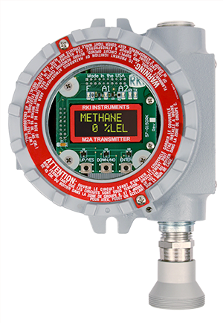
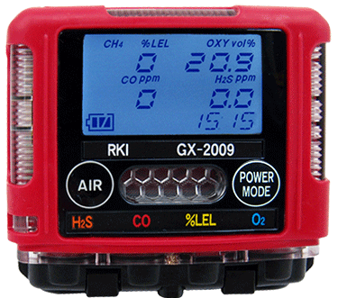

Slide 2
Distributor Partnership Program
Stocking distributor: provide immediate delivery
  Increased sales
Service Center: provide immediate local instrument service, calibration and repair parts.
  Increased profits
Regional RKI Representative provide ongoing partner service center/distributor product training.
  Increased confidence
RKI business culture is unlike any other gas detection manufacture in the industry. We provide the highest quality product, immediate and exceptional customer service and technical support (USA).
  Increased reliability
RKI believes in working with partner distributors to develop their markets by provide you with orders (not sales leads) from area end-users.
  Increased team loyalty and trust.

Slide 3
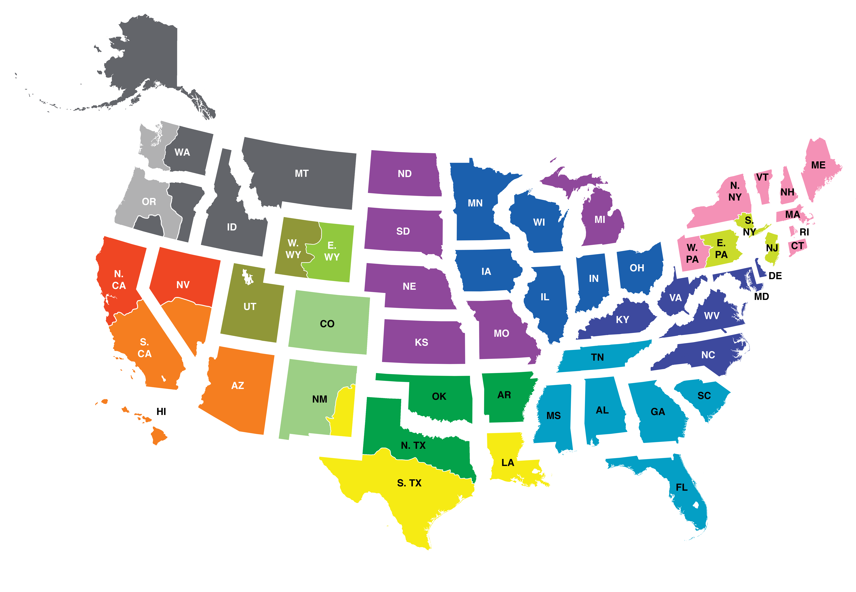
RKI Regional Reps
NORTH WEST
John Foster
Cell: (509) 299-6777
Todd Rosencrans
Cell: (509) 299-6777
CENTRAL & MICHIGAN
Dave McEndarffer
Cell: (913) 634-0396
CENTRAL GREAT LAKES
John Maslowski
Cell: (262) 271-8956
NEW ENGLAND
Bob Carroll
Cell: (716) 725-3112
N. CALIFORNIA
Ramey Packer
Cell: (510) 285-7506
TRI-STATE
Nino Misiti
Cell: (610) 216-0393
SOUTH WEST
Tammy Girton
Cell: (949) 397-5040
MID ATLANTIC
Don Brauninger
Cell: (571) 278-0478
ROCKY MOUNTAIN
Glenn H. Yamada
Cell: (303) 489-1145
Riley Dellalucia
Cell: (385) 405-4585
Marc Malezija
Cell: (303) 726-9989
Joseph M. Malezija
Cell: (303) 489-3249
SOUTH EAST
Todd Sauls
Cell: (770) 654-7443
GULF COAST
Darrell Pinckard
Cell: (713) 732-0513
SOUTH CENTRAL
James Emmons
Cell: (214) 980-4002

Slide 4




Company Culture
Customer Service
Technical Service
Fast Delivery
Quality

Slide 5
Growth Plan for RKI
2018 - 2019

Slide 9
Howard Supply Shipments
2017 Shipments $28,832
GX-2009 57 units HS-03 23 units
2018 Shipments $63,503 Ytd (as of 9/28)
GX-2009 209 units $84,670 Annualized
294% increase
2019 Growth Target 294% increase
GX-2009 628 units $248,647

Slide 10
