Slide 1
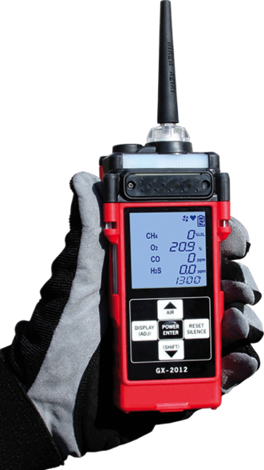
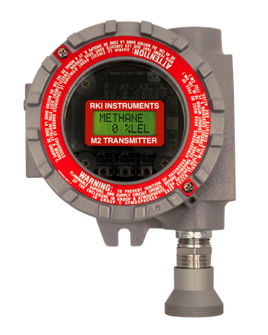
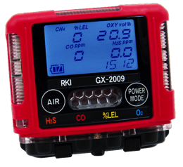
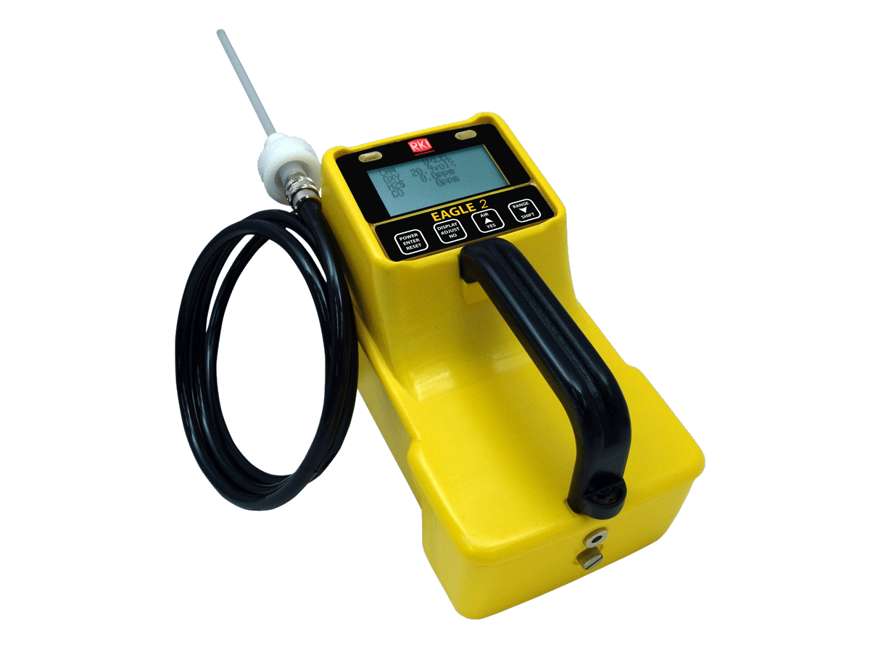
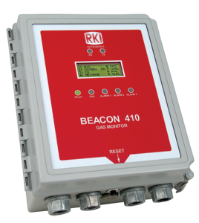
World Leader In Gas Detection and
Sensor Technology

Slide 2
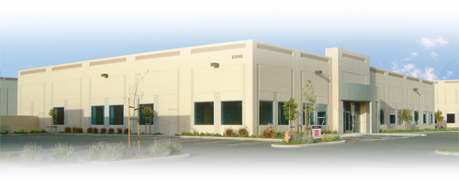
Company Background
Founded in 1994
Partnered with Riken Keiki
  Leader In Gas Detection & Sensor Technology for over 75 years
California Corporation
Average employee gas detection experience is 12 years

Slide 3
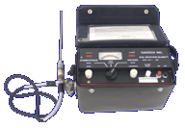
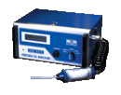
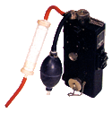
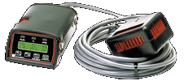

65 Years of Milestones
1938
1969
1978
1980
1982
1983
1984
Worlds first combustible interferometer
World’s first
2 gas monitor
LEL, O2
GX-3
World’s first
3 gas monitor
LEL, O2, CO
Model 1641
Pocket size single gas
OX/CO/HS-80
World’s first belt worn
3-gas
GX-82
Portable IR
for CO2
RI-411
Portable IR for Freons
RI-413

Slide 4
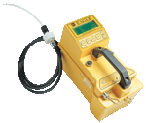
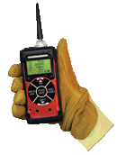

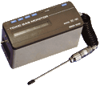
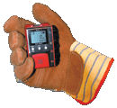


Milestones
1986
1990
1994
1995
1997
2001
2003
World’s first
belt worn 4 gas monitor
GX-86
Portable
super toxic
SC-90
Portable 4 gas with datalogging
& autocal
GX-94
World’s first
6 gas portable
EAGLE
World’s first wrist worn
GasWatch
World’s smallest
4 gas
GX-2001
Smallest tri-mode
portable
GX-2003

Slide 5
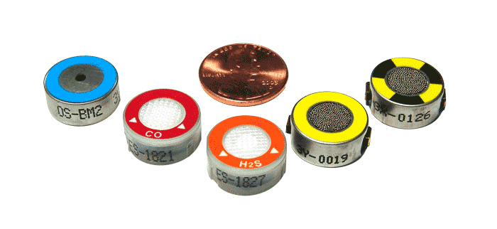
Sensors
Manufactured not purchased
Enormous sensor manufacturing capacity
Over 500,000 sensors produced each year
Large testing capacity
Aged and tested for 1 to 3 months
ISO 9001:2000 & 14001 (Riken Keiki), ISO 9001:2000 (RKI)

Slide 6
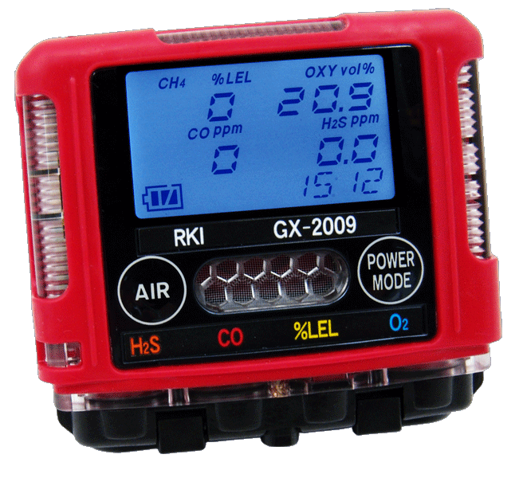
The GX-2009
INTRODUCING
Evolution In Gas Detection

Slide 7
GX-2009
All gas readings displayed

Slide 8
GX-2009
3 Large visual alarms on 3 sides

Slide 9
GX-2009
2 audible alarms ports, 95 dB

Slide 10
GX-2009
2 glove friendly buttons

Slide 11
GX-2009
Dust and water proof, IP 67 rating
www.rkiinstruments.com
Notes:
11

Slide 12
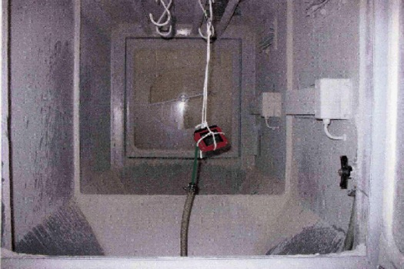
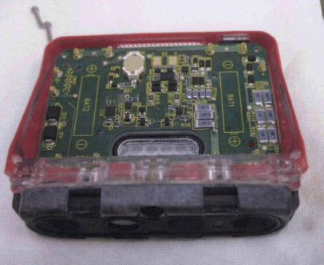
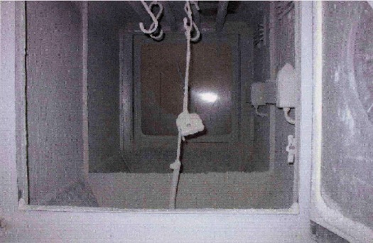
GX-2009
Dust Rating - IP 67
before
Subjected to talc dust vacuum chamber for 8 hours
after
www.rkiinstruments.com
Notes:
12

Slide 13
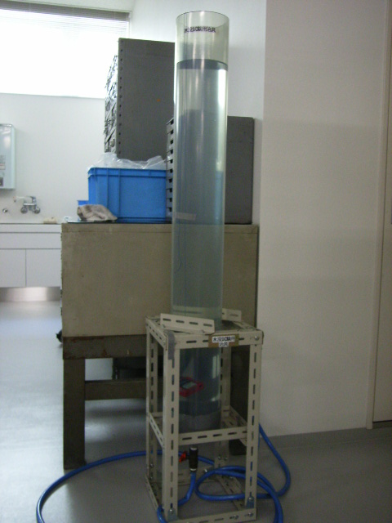
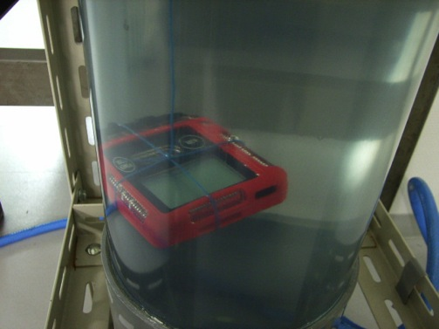
GX-2009
Water Proof Rating - IP 67
Submerged in 1 meter of water
for 30 minutes
１ｍ
www.rkiinstruments.com
Notes:
13

Slide 14
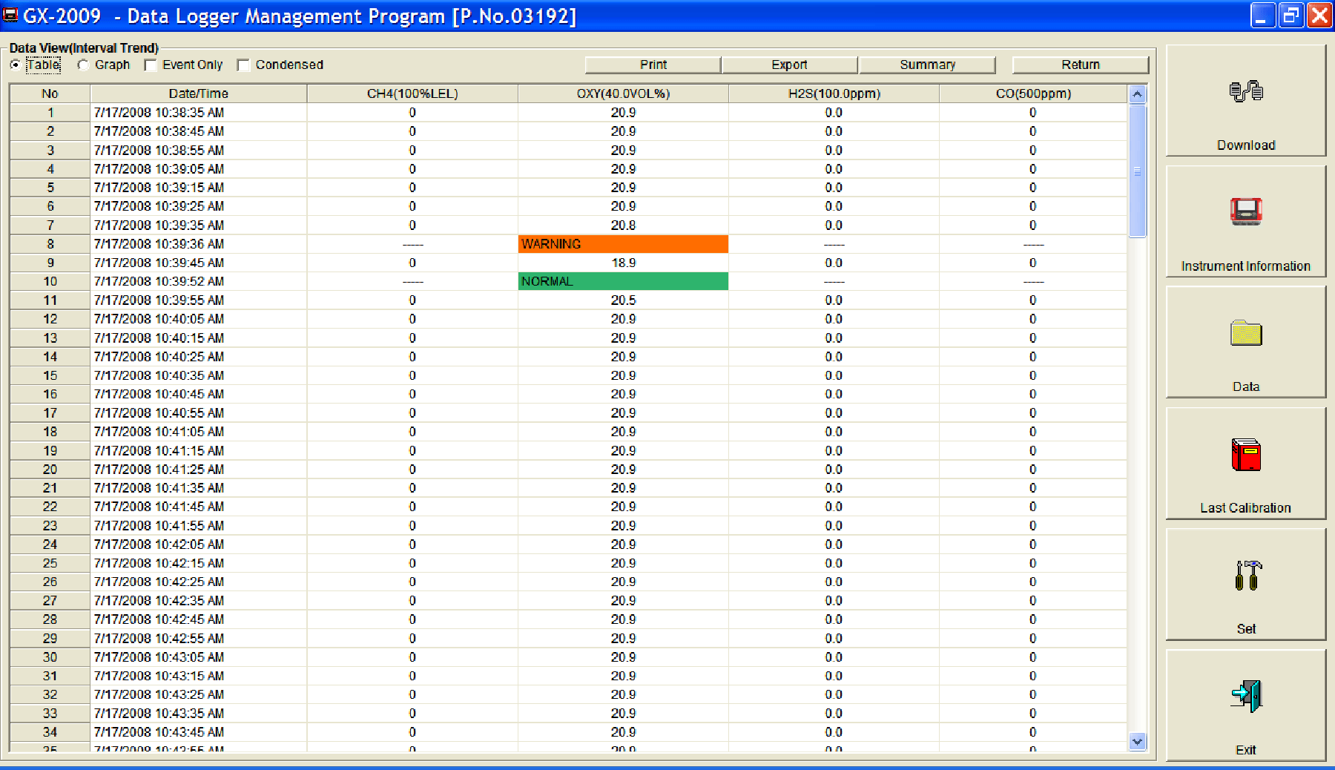
GX-2009
Increased data logging capacity
 | Alarm trend every 5 sec. | Interval trend | Cal. history
ＧＸ－２００１ | Before & after 15min.1event | 480 sessions | Last calibration record
ＧＸ－２００９ | Before & after 30min.8 events | 3,600 sessions | Last 100 calibration records

Slide 15
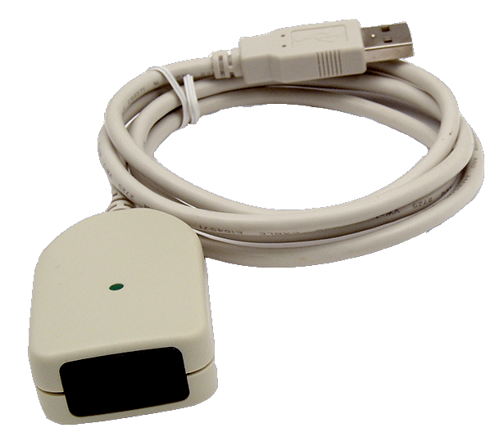
GX-2009
Only a USB / IR adaptor required for
data downloading
www.rkiinstruments.com
Notes:
15

Slide 16
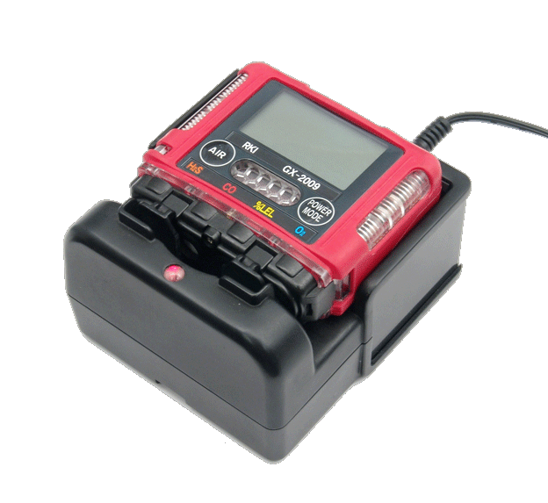
GX-2009
Operates for 20 hours on
NiMH batteries
www.rkiinstruments.com
Notes:
16

Slide 17
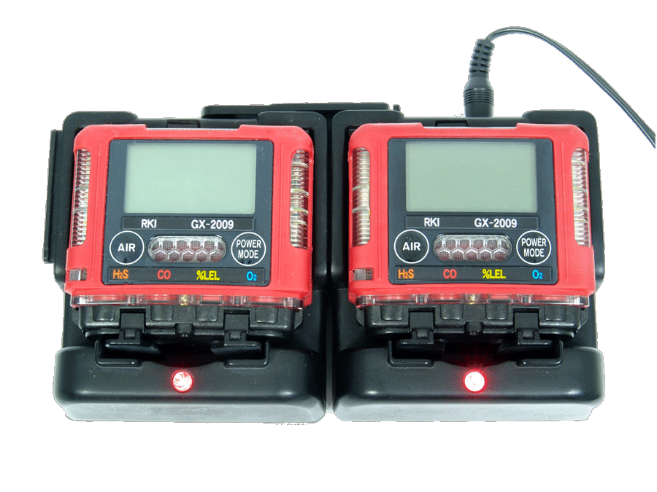
GX-2009
Modular gang charging, up to 5 cradles for one power source
www.rkiinstruments.com
Notes:
17

Slide 18
GX-2009
Impact resistant over-mold body

Slide 19
GX-2009
2.75” H x 2.95” W x .98” D, 4.6 oz
2.7”

Slide 20
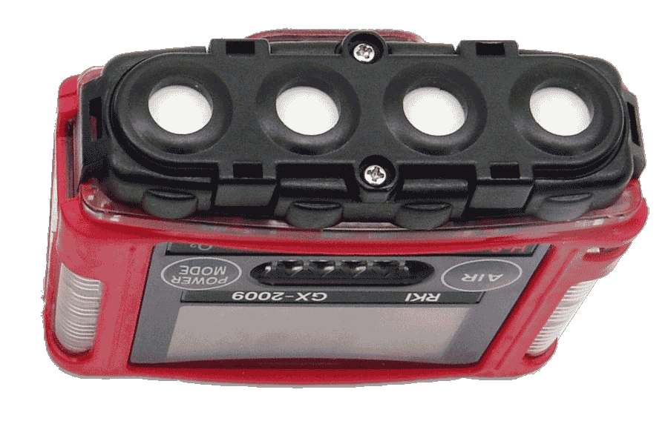
GX-2009
2.75” H x 2.95” W x .98” D, 4.6 oz
1”

Slide 21
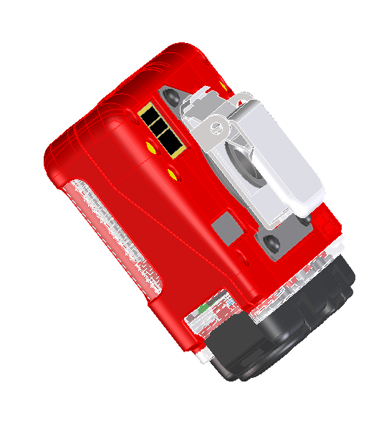
GX-2009
Low profile alligator, 360° rotation

Slide 22
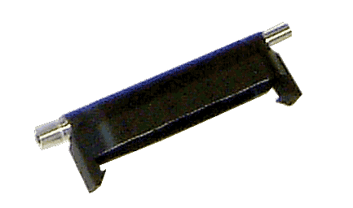

GX-2009
Replacement sensors
…and calibration cup

Slide 23
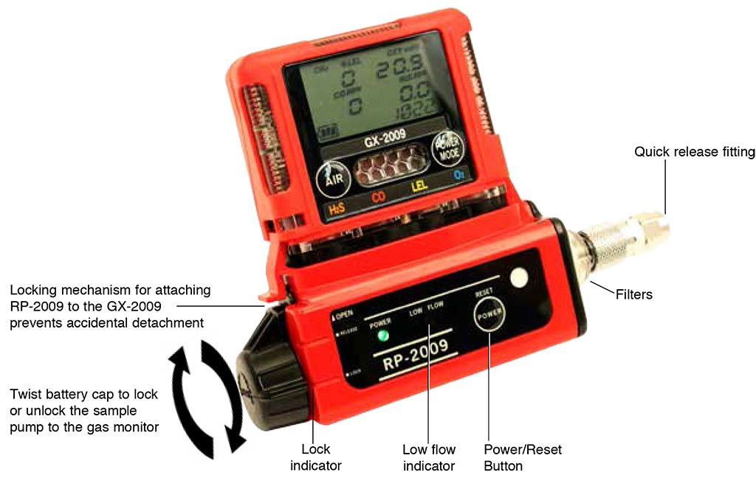
GX-2009
Compatible with the RP-2009 attachable sample drawing pump
www.rkiinstruments.com
Notes:
23

Slide 24

GX-2009
Air-tight IR data portal
www.rkiinstruments.com
Notes:
24

Slide 25
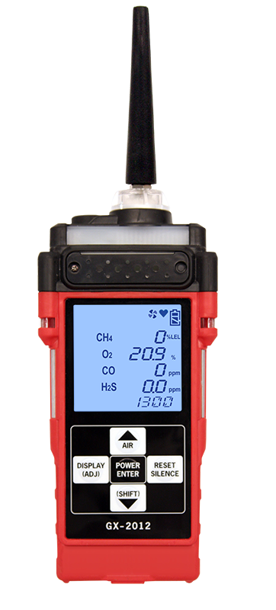
GX-2012
Confined Space Sample Draw Monitor

Slide 26
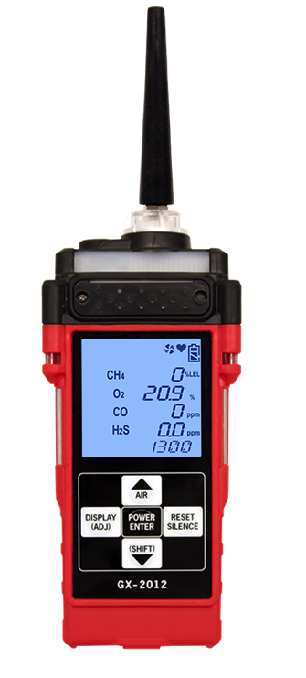
GX-2012
Tapered Nozzle
Buzzer
(more than 95dB)
Alarm Lamp 1
LCD
Alarm Lamp 3
Alarm Lamp 2
IrDA

Slide 27
GX-2012 Features
Monitors Lel, And % Volume Methane, Oxygen, Carbon Monoxide And Hydrogen Sulfide
0-100% Volume Methane Optional
Auto-ranging Display Of % By Volume And % Lel
Internal Sample Drawing Pump
With Up To 50 Foot Range
Vibration, Visual, And Audible Alarms
Automatic Backlight During Alarms
Calibration Reminder With Lock
Out Option
Lithium Or Alkaline Power Source (Interchangeable)
Quick Charge (Fully Charged In 90 Minutes)
Glove Friendly Large Buttons
Alarm Latching Or Non-latching
High Impact Protective Rubber Over Molding
Up To 600 Hours Of Data Logging With Alarm Trends
Auto Calibration Or Single Calibration
Twa And Stel Readings With Lunch-break Mode
Intrinsically Safe, Csa, C/Us Classified, Atex/IECEX Approval
IP-66 Water And Dust Resistant
2 Year Warranty

Slide 28
Specifications
GX-2012 Model
Gas Detected | Combustible Gases (Methane as Standard) | % Volume Methane | Oxygen (O2) | Hydrogen Sulfide (H2S) | Carbon Monoxide (CO)
Detection Principle | Catalytic Combustion | Thermal Conductivity | Galvanic Cell | Electrochemical Cell
Detection Range | 0-100% LEL | 0-100% Vol. | 0-40% Vol. | 0-100 ppm | 0-500 ppm
Accuracy Statement (whichever is greater) | ± 5% of reading or ± 2% LEL | ± 5% of reading or ± 2% of full scale | ±0.5% O2 | ± 5% of reading or ± 2ppm H2S | ± 5% of reading or ± 5ppm CO
Sampling Method | Internal sample pump, flow rate monimal 0.5 LPM, includes hydrophobic filter
Display | Digital LCD with 7 segments, auto backlight during alarm
Preset Alarms (User Adjustable) | 1st Alarm 10% LEL 2nd Alarm 50% LEL Over Alarm 100% LEL | N/A | 1st Alarm 19.5% 2nd Alarm 23.5% Over Alarm 40.0% | 1st 10ppm 2nd 30ppm TWA 10ppm STEL 15ppm Over 100ppm | 1st 25ppm 2nd 50ppm TWA 25ppm STEL 200ppm Over 500ppm
Alarm Types | Gas Alarms: 1st and 2nd (user adjustable), STEL, TWA and Over Trouble Alarms: Sensor connection, low battery, low flow, circuit trouble and calibration error
Alarm Methods | Gas Alarms: Flashing lights, two tone buzzer, and vibration Trouble Alarms: Flashing lights, trouble displayed, intermittent buzzer, and vibration

Slide 29
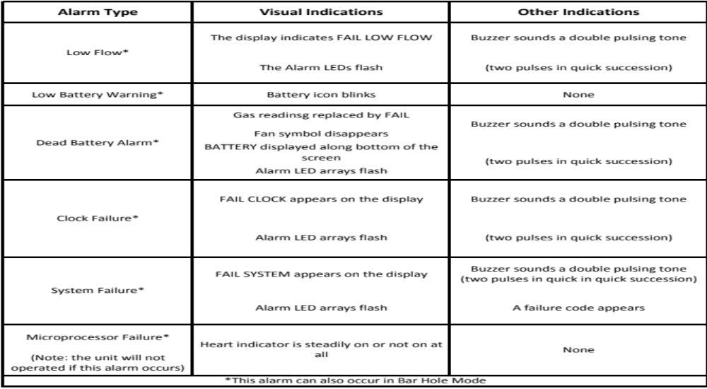
Alarm Types and Indications

Slide 30
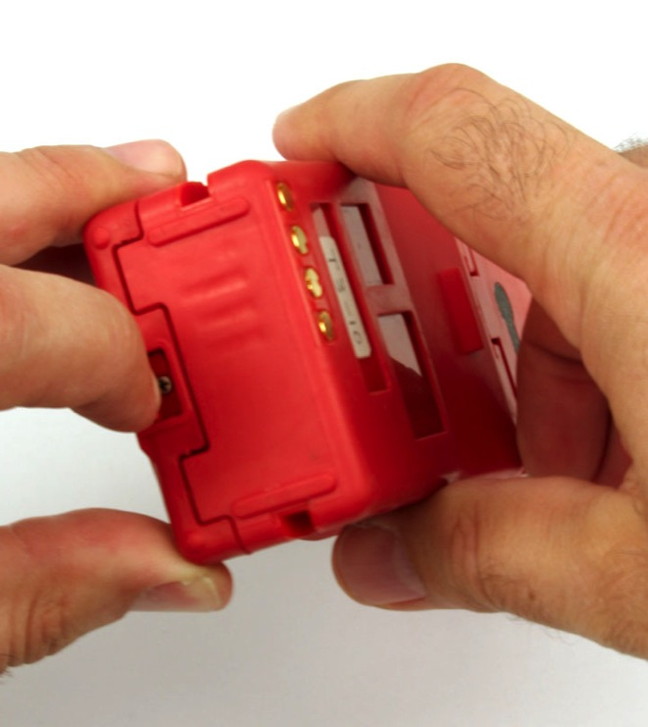
Replacing the Batteries
Turn off the GX-2012
Push the latch on the bottom of the GX-2012 toward the front of the instrument to release the battery pack
Slide

Slide 31
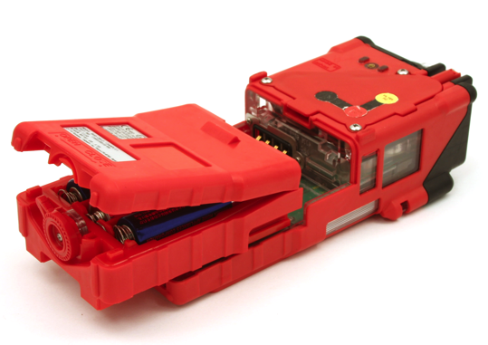
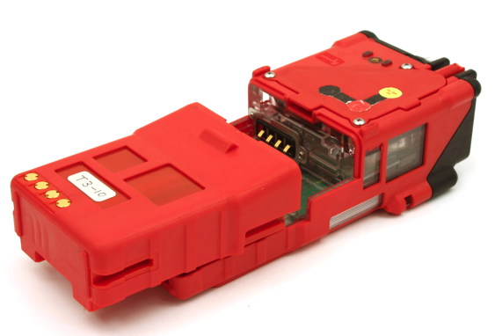
Replacing the Batteries
Alkaline Battery Pack
Slide the battery pack away from the instrument
Insert a new battery pack
  Push the battery pack into the instrument until you hear a click.
Li-Ion Battery Pack

Slide 32
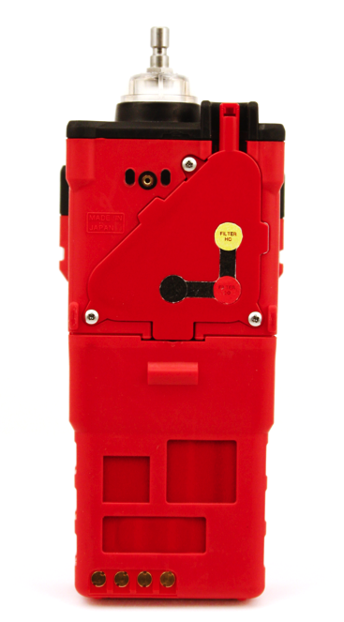
Replacing the Sensors
Use a screwdriver to remove the three screws holding the flow chamber
Grab the exhaust tube and pull it gently away from the unit to slide the flow chamber out of the unit

Slide 33
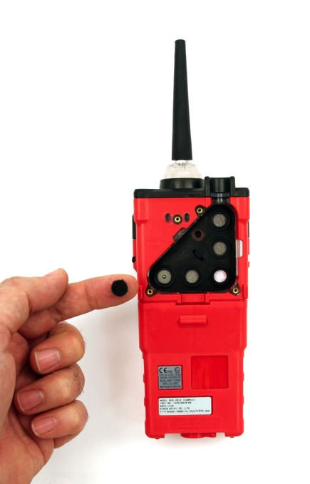
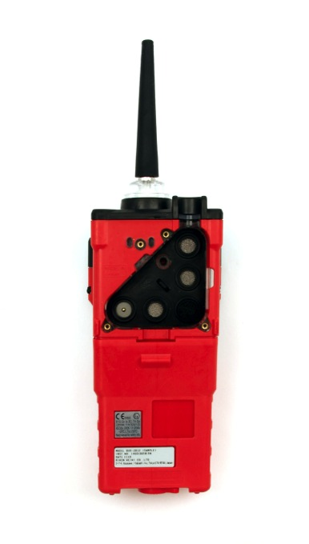
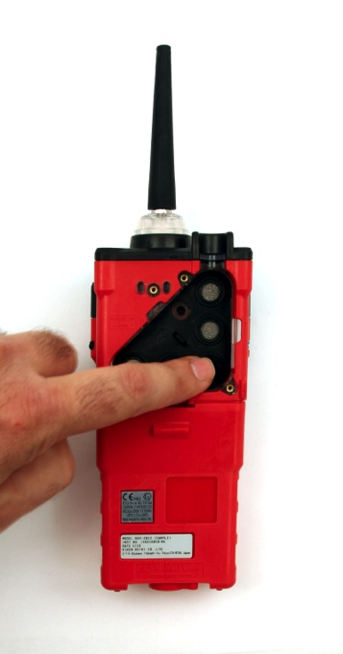
Replacing the Scrubber Filters
Place the charcoal filter over the CO sensor

Slide 34
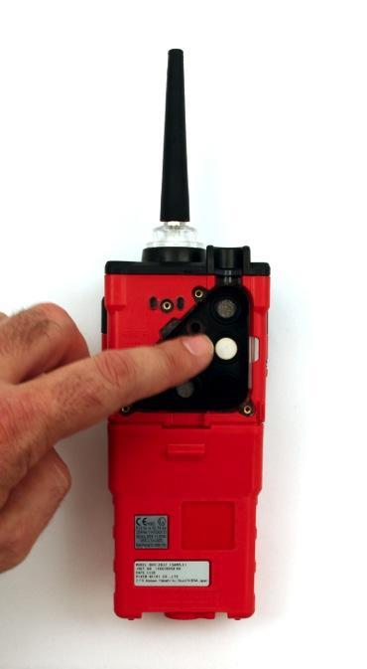
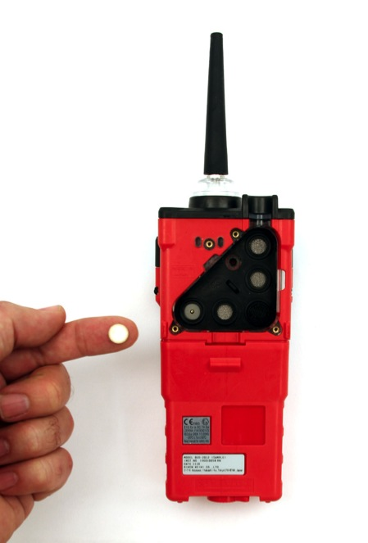
Replacing the Scrubber Filters
Place the H2S Scrubber over the LEL sensor

Slide 35
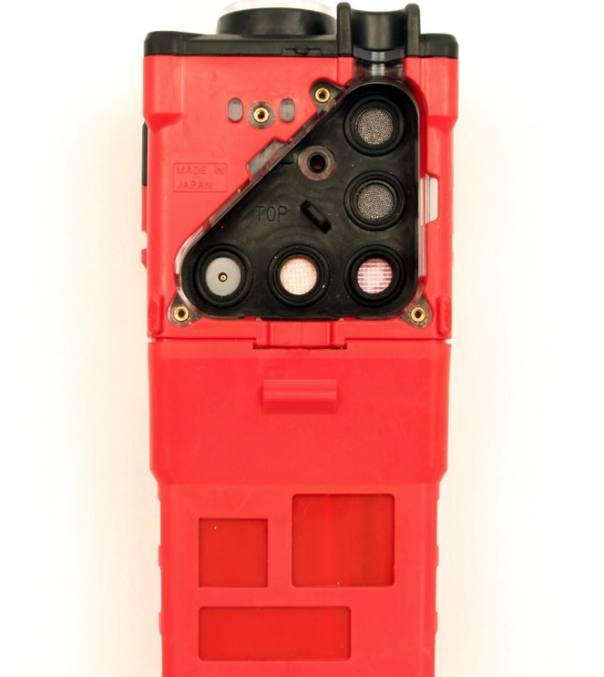
Replacing the Sensors
Gently pull the tab of the sensor gasket to remove it. Be sure not to lose any of the scrubber filters that are currently installed. Note: the sensors will be exposed.
Sensor Filters
Tab

Slide 36
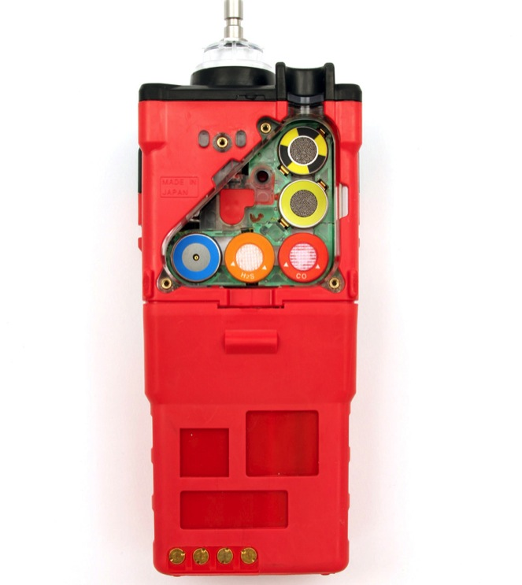
Replacing the Sensors
Remove the sensors from their sockets

Slide 37
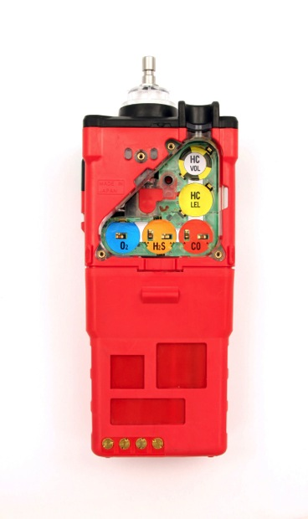
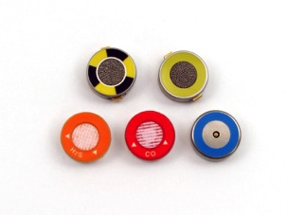
Replacing the Sensors
GX-2012 Sensors
%Volume
Methane
Thermal Conductivity
%LEL
Catalytic
Oxygen
Hydrogen Sulfide
Carbon Monoxide
Carefully insert the replacement sensor in the correct key color coded socket

Slide 38
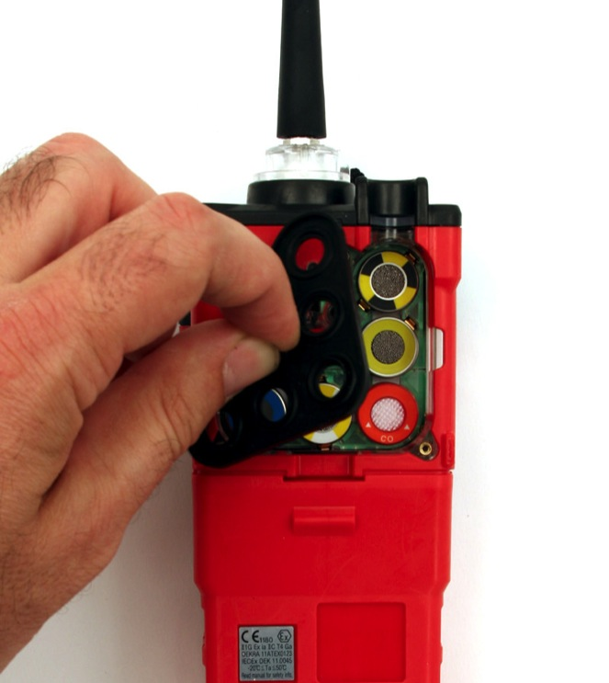
Replacing the Sensors
Place the sensor gasket and filters back into the chamber ensuring that it seals with the sensors and the edge of the chamber
Ensure that the sensor filters are in place
Place the flow chamber in position over the sensor area and press it into the case until it is flush with the back of the case
Place the sensor gasket and filters back into the chamber ensuring that it seals with the sensors and the edge of the chamber.

Slide 39
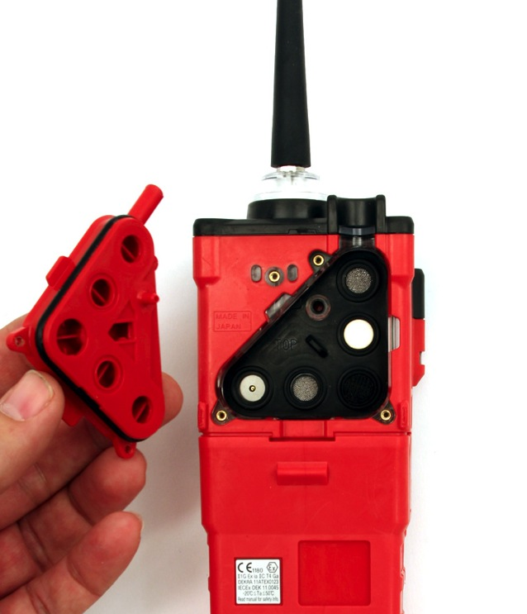
Replacing the Sensors
Place the flow chamber in position over the sensor area and press it into the case until it is flush with the back of the case.
Tighten the top screw of the flow chamber completely.
Place the belt clip into position and tighten the three screws retaining it

Slide 40
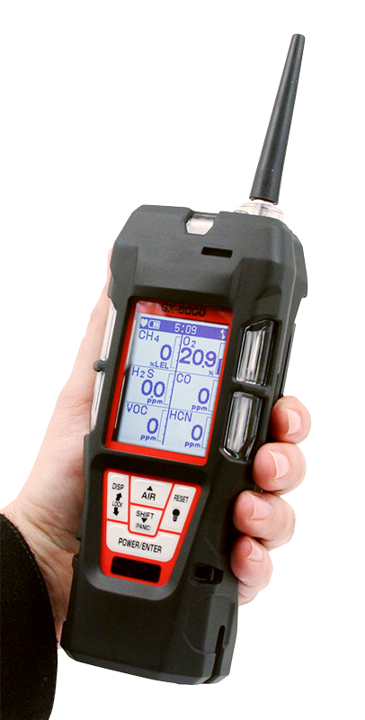
You Have Choices
Introducing
GX-6000
6 gas, sample draw with PID & super toxics

Slide 41
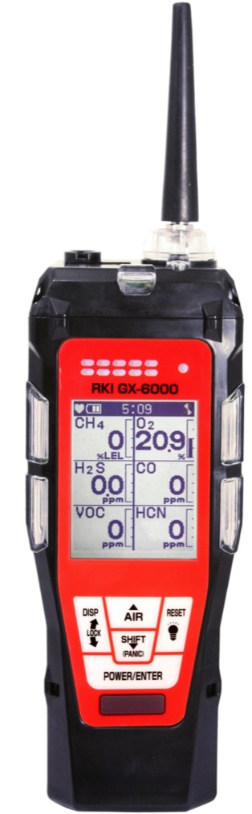
Features
Monitor up to 6 gases
4 standard micro-sensors
2 smart sensor slots for PID, IR, & Super toxics
Library of over 600 VOC’s
Internal Sample Pump
New Features
  Man-down alarm
  LED flashlight
  Panic alarm
  Auto display rotation 180

Slide 42
Features
New Features
Lightweight & Ergonomic
High impact rubber boot
Ergonomic design fits comfortable in hand
IP 67
Operating Hours
Rechargeable – 14 hours
Alkaline – 8 hours

Slide 43
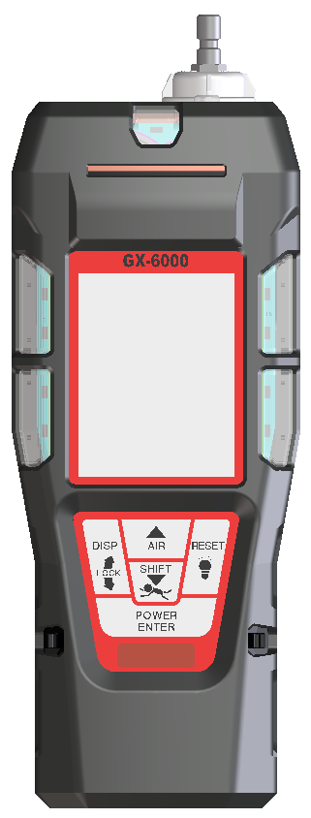

Compact & lightweight
Dimensions
7.87” (H) x 2.67” (W) x 2.04” (D)
GX-2012 = 6.81” x 2.79” x 1.69”
Weight
Approx. 400g / 14.1 ounce
GX-2012 : 360g / 12.7 ounce
7.87”
2.67”
2.04”

Slide 44

Control Panel
Glove friendly buttons can be operated with one hand
Functionality of each button is very similar to other RKI gas detectors (like GX-2012)
New functions are easily identifiable
  LED light
  Panic alarm
  Auto display rotation

Slide 45



LCD Display
Display Examples
Full dot-matrix user-friendly LCD.
One of 9 languages can be selected by software.
  English, Germany, Italian, French, Portuguese, Spanish, Japanese, Korean, Russian

Slide 46


LCD Display Options
Multi-gas view displays all 6 channels
Single gas view shows one channel in large scale with auto scrolling for each channel
Auto rotation when instrument upside down

Slide 47





Sensors
Standard 4 gas sensors
CH4 or HC …..NC-6264A
O2 …..OS-BM2
H2S ..…ES-1827i
CO …..ES-1821
Smart sensors
PID …..PIS-00x (White)
ES …..ESS-03xx (Grey)
IR …..DES-3311-x (Black)
*Any two “smart” sensors can be combined in GX-6000, as long as PID sensor is located in the first position of gas through path.

Slide 48



Smart Sensor Gases
PID
Library of over 600 target gases
Iso-Butylene (C4H8) will be a standard calibration gas.
EC (in order of development)
SO2 0-6 ppm
NO2 0-9 ppm
HCN 0-15 ppm
NH3 0-75 ppm
NH3 0-400 ppm
Cl2 0-3 ppm
Cl2 0-10 ppm
IR
CO2 0-5% vol
HC 0-100% LEL
HC 0-30% vol
CH4 0-100% LEL
CH4 0-100% vol
CO2 0-5000 ppm
CO2 0-10000 ppm
*New sensors will be considered after development of above sensors.

Slide 49









Power Supply
Alkaline
BUD-6000
AA size battery x 3 pieces
More than 8 hours operation
Rechargeable
BUL-6000
More than 14 hours operation
Battery charger BC-6000

Slide 50

SDM-6000 Docking Station
Available in 2015
  New docking station can be connected to single PC (up to 10 units).
Notes:
Can be connected up to 10 units

Slide 51
Development Schedule
1st quarter of 2015
ATEX & IECEx is expected to be approved.
2nd quarter of 2015
The first production lot will be ready for supply.
2nd ~ 3rd quarter of 2015
The second production lot will be ready for supply.

