Slide 1
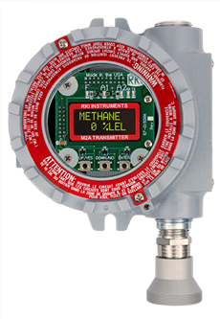
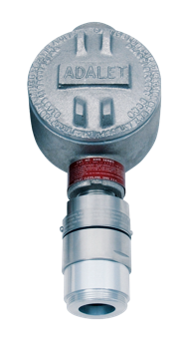
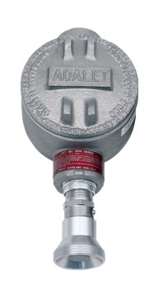
Continuous Monitoring

Slide 2
Controllers
Wall mount NEMA 4X enclosures
1 – 8 channels
Built in audible and visual alarms
Optional strobe lights
Alarm Reset button
Digital display of all channels

Slide 3
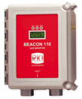
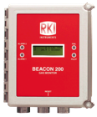
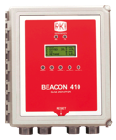
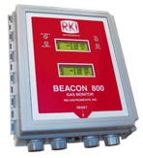
Controllers
 | Channels | Alarm Levels per Channel | Relays per Channel | Common Relays | Direct Connect Sensors
Beacon 110 | 1 | 2 | 2 | N / A | Yes
Beacon 200 | 2 | 2 | 2 | 3 | Yes
Beacon 410 | 4 | 3 | 3 | 5 | Yes
Beacon 800 | 8 | 2 | 2 | 3 | No

Slide 4
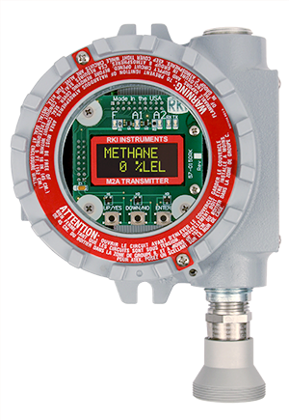
Detector Heads
M2A
Explosion Proof Stand Alone Transmitter with Display
Operates independent of a controller
Non-intrusive calibration via magnetic wand
4-20 mA & digital Modbus outputs standard
Cold temp LCD digital readout
2 fully programmable alarm relays
& fail relay
Explosion proof housing
Available for LEL, H2S, CO, and O2
H2 specific version available

Slide 5
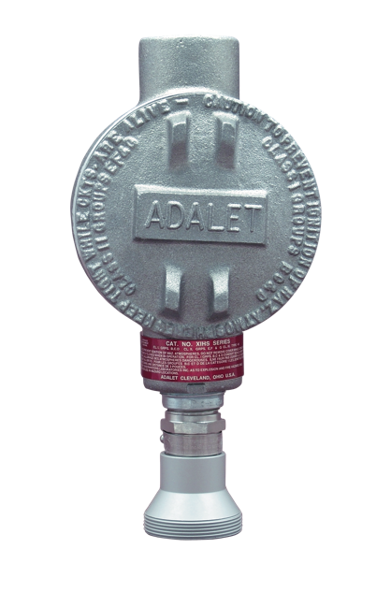
Detector Heads
S2 & Direct Connect
Explosion Proof Sensors
Available gases include
  LEL, H2S, CO, PPM H2, and CO2
  Toxic gases include NH3, SO2, HCN, and more
Infrared sensor for combustibles and CO2
Hydrogen-Specific now available
Patented water repellent sensor coating
4-20 mA output (S2 only)
Explosion proof construction

Slide 6

Peripheral Devices
Auto dialers
  Notify authorities
Recorder
  Document readings
UPS
  Supplies back-up power to system and enunciators

Slide 7
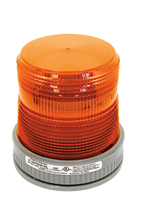
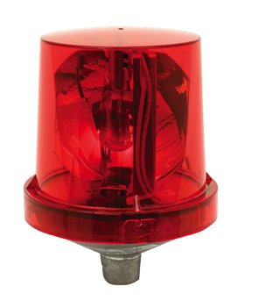
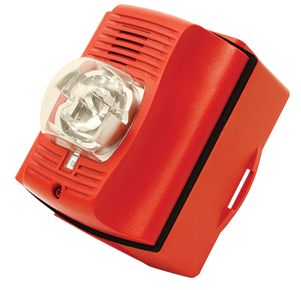
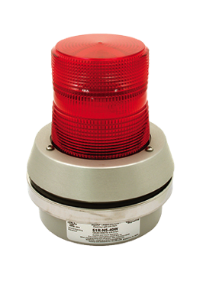
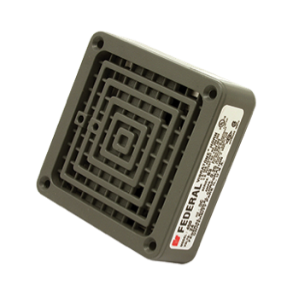
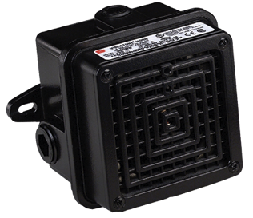
Peripheral Devices
Horns
  For warning or evacuation
Strobes
  To alert workers to danger
Solenoid valves
  Shut off leaking gas supply

