Slide 1


GX-3R
User Training

Slide 2
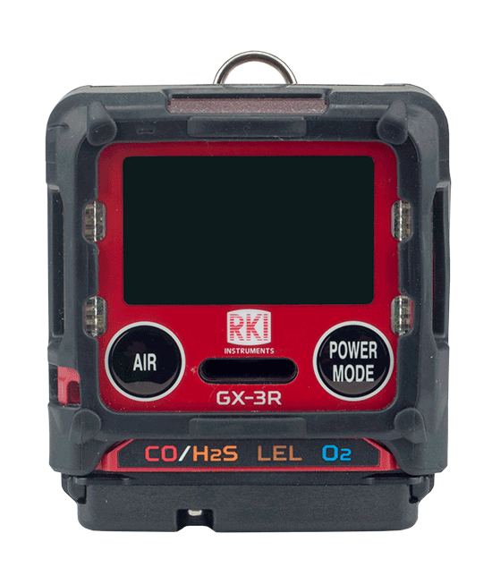
Turn on
Turn on the GX-3R by pressing and holding the POWER MODE button until you hear one beep

Slide 3
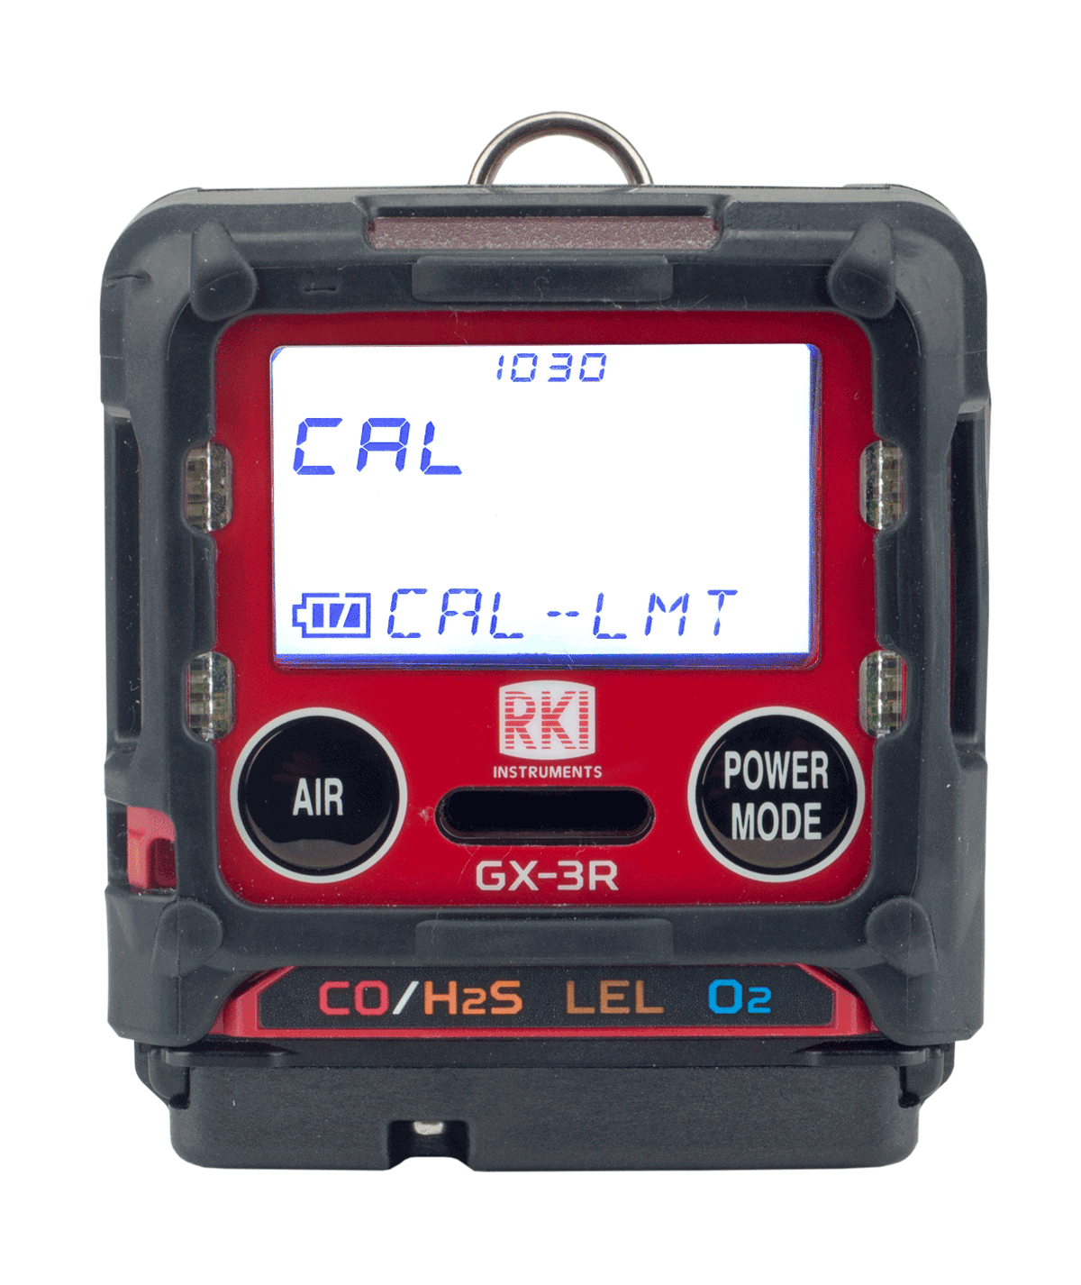
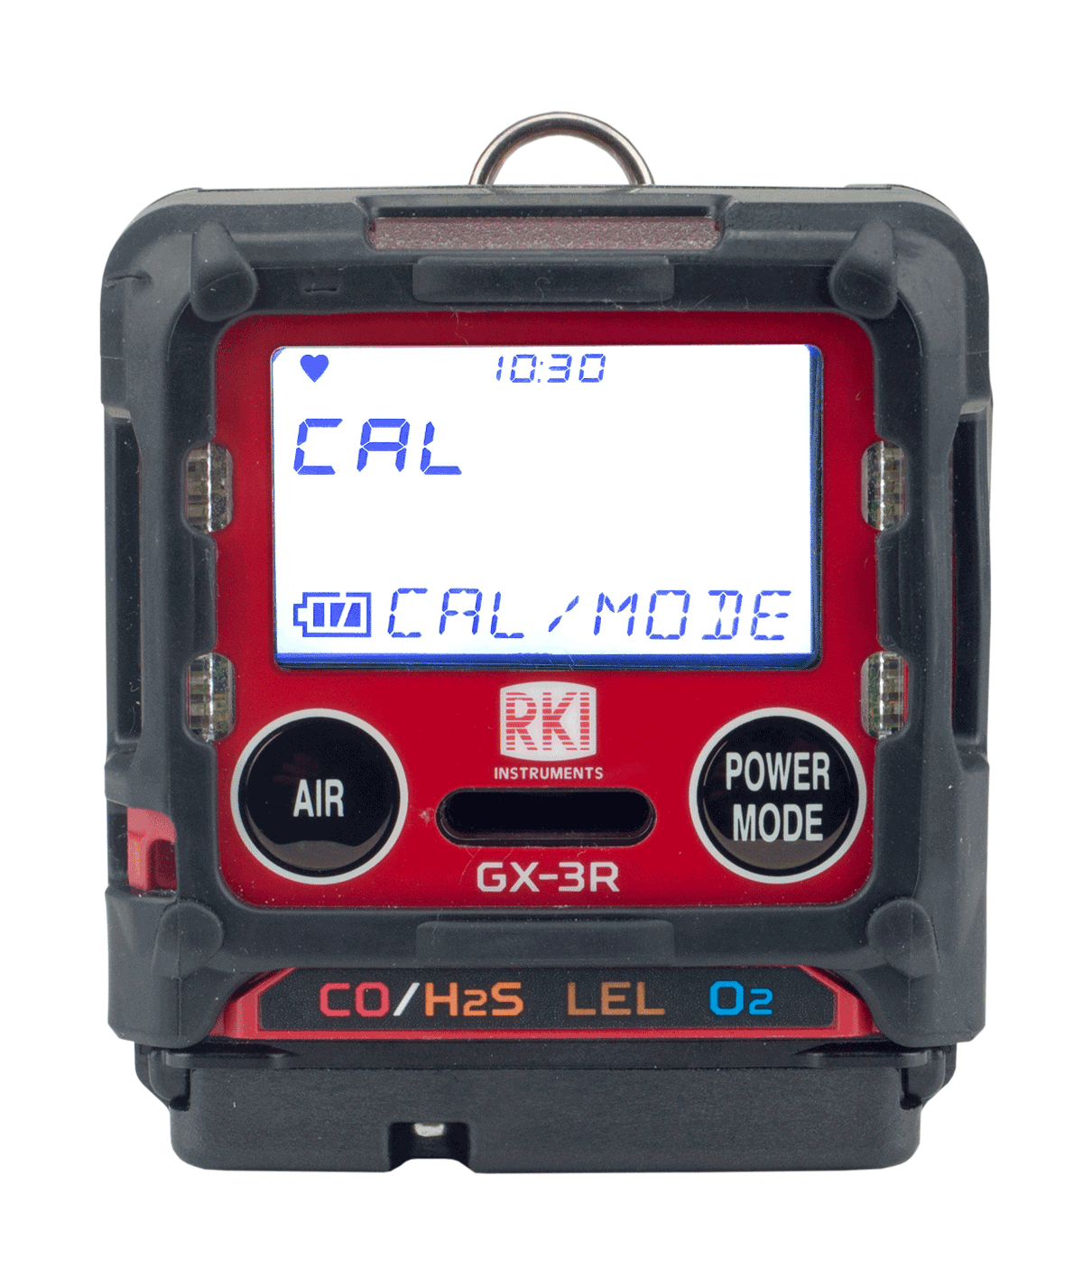
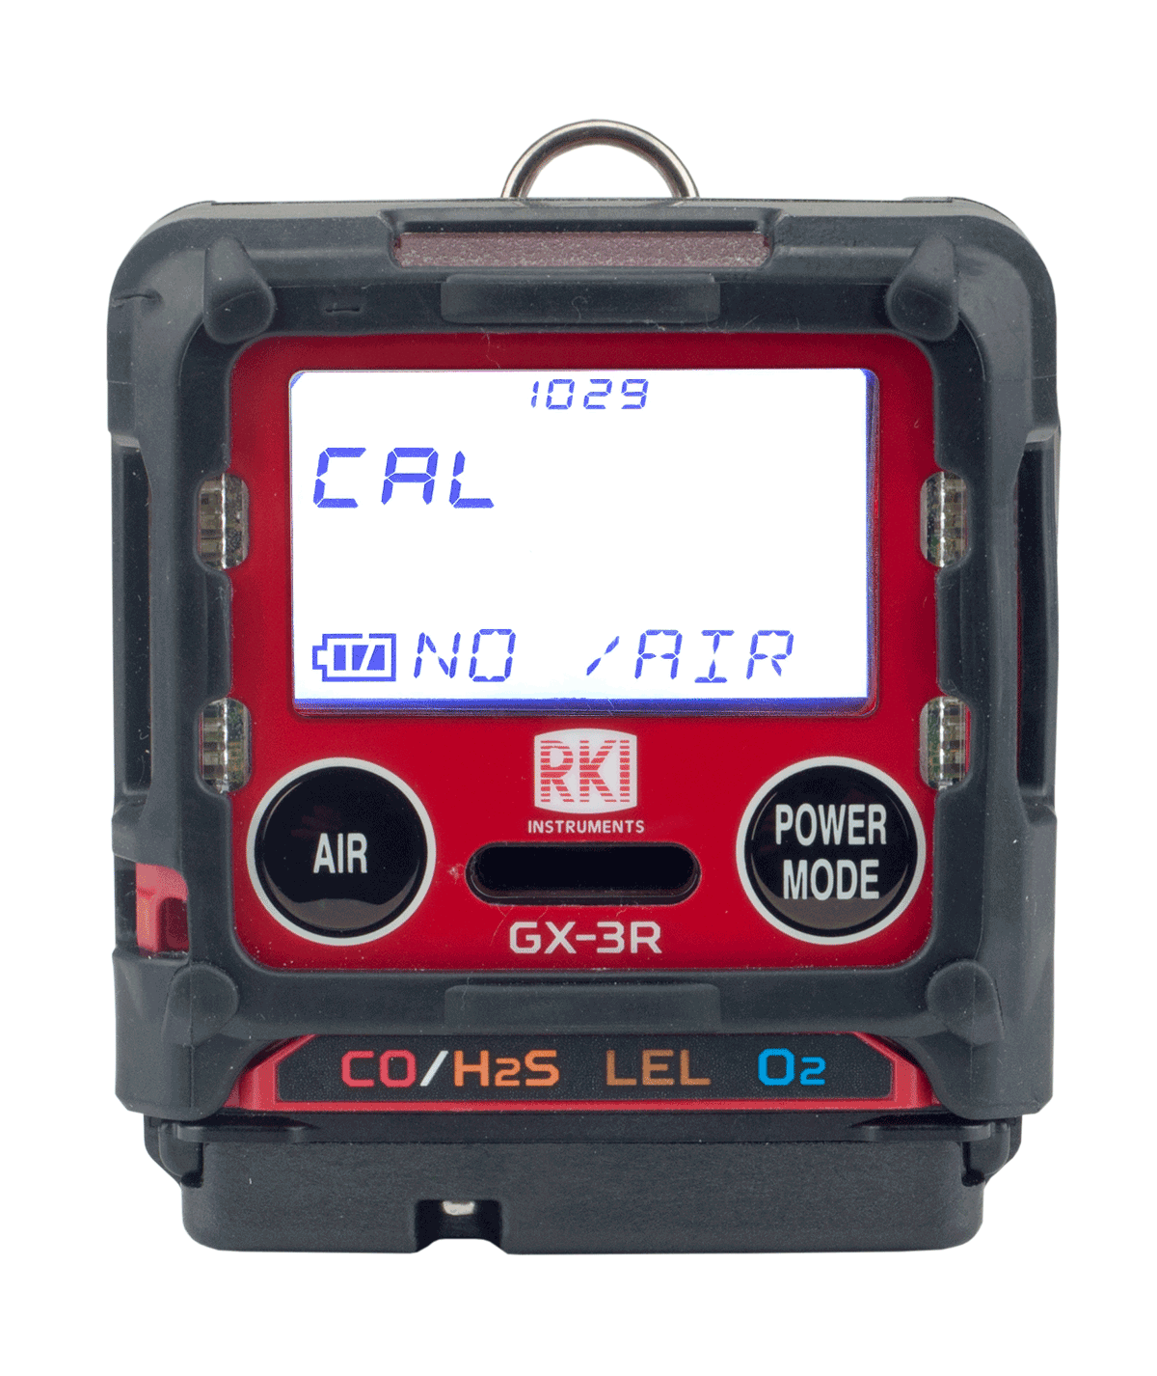
Cal Reminder
Acknowledge and use
If your instrument is past its 30 day calibration limit, you will see a CAL-LMT reminder at start-up
Perform a calibration
Press the POWER/MODE button to perform calibration.
Press AIR button to continue without performing a calibration

Slide 4
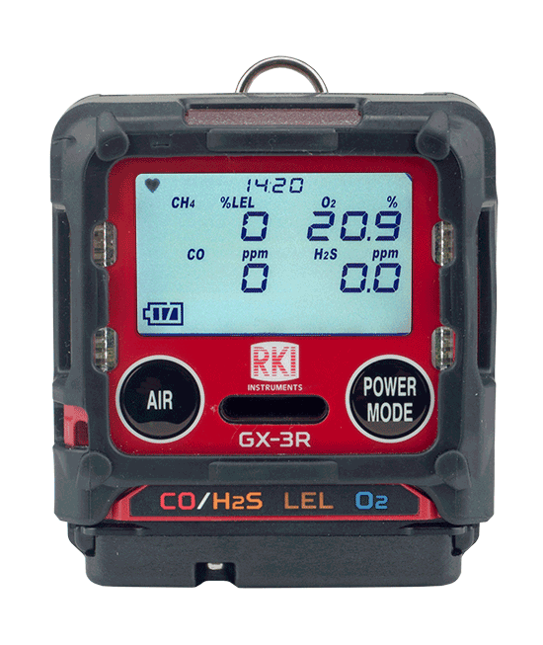
Normal Mode
After warm-up, the normal screen will appear.

Slide 5
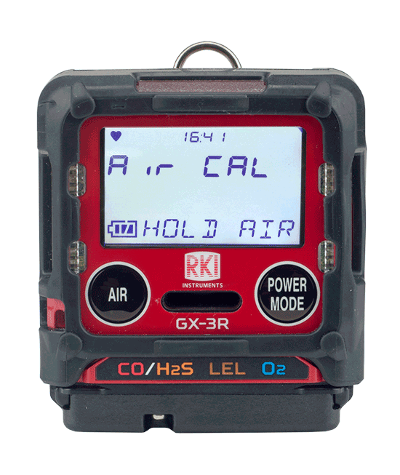
Fresh Air
To perform a fresh air adjustment, make sure you’re in a fresh air environment.

Slide 6
Fresh Air
Press and hold the AIR button

Slide 7
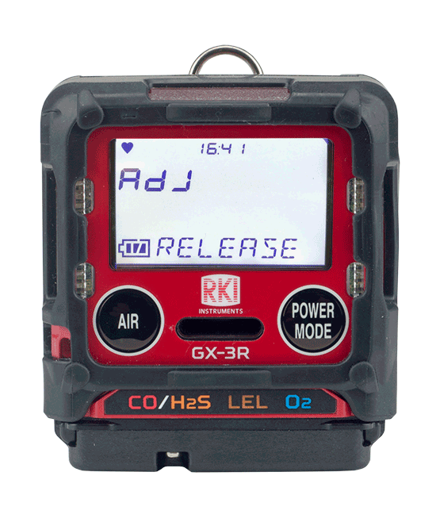
Fresh Air
When prompted, release the AIR button
The GX-3R will beep once and return to normal mode after the fresh air adjust is complete

Slide 8
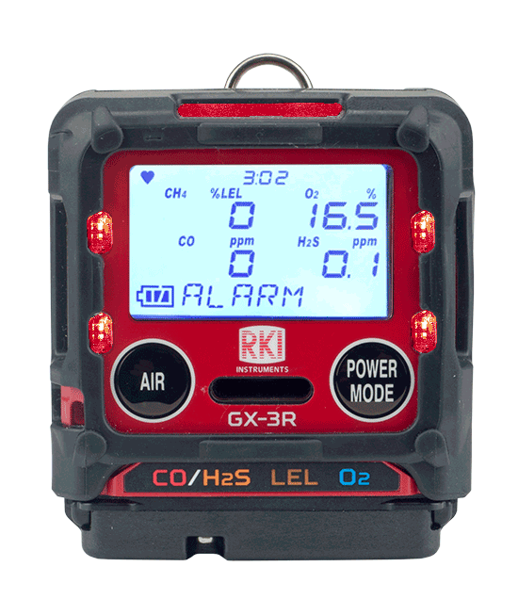
Alarm
In the event of an alarm, the GX-3R’s visual, audible and vibration alarms will alert you.
The readout will identify which sensor is in alarm.
The visual, audible, and vibration alarms will stop.
To reset the instrument, go to a safe location. Once the readings return to fresh air values, then press the POWER/MODE button.

Slide 9
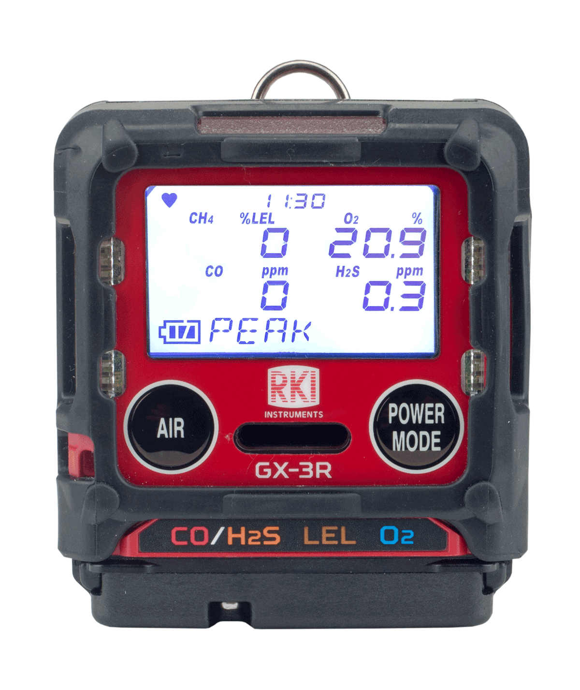
Display Mode
To enter display mode, press and release the Power Mode button

Slide 10
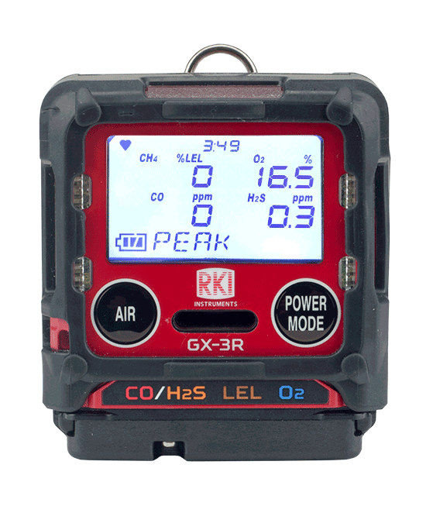
Display mode vs. Normal Operation
PEAK
STEL
TWA
HC GAS LIST
USER ID
STN ID
CAL DATA
BUMP DATA
TEMPERATURE
ALARM-PT
You will know you are in display mode if you see a display mode menu title on the bottom of your screen
To return to normal operation, scroll all the way through the display menu using the AIR button, or wait 20 seconds and the GX-3R will automatically return to normal mode

Slide 11
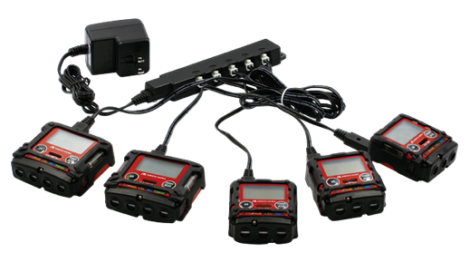
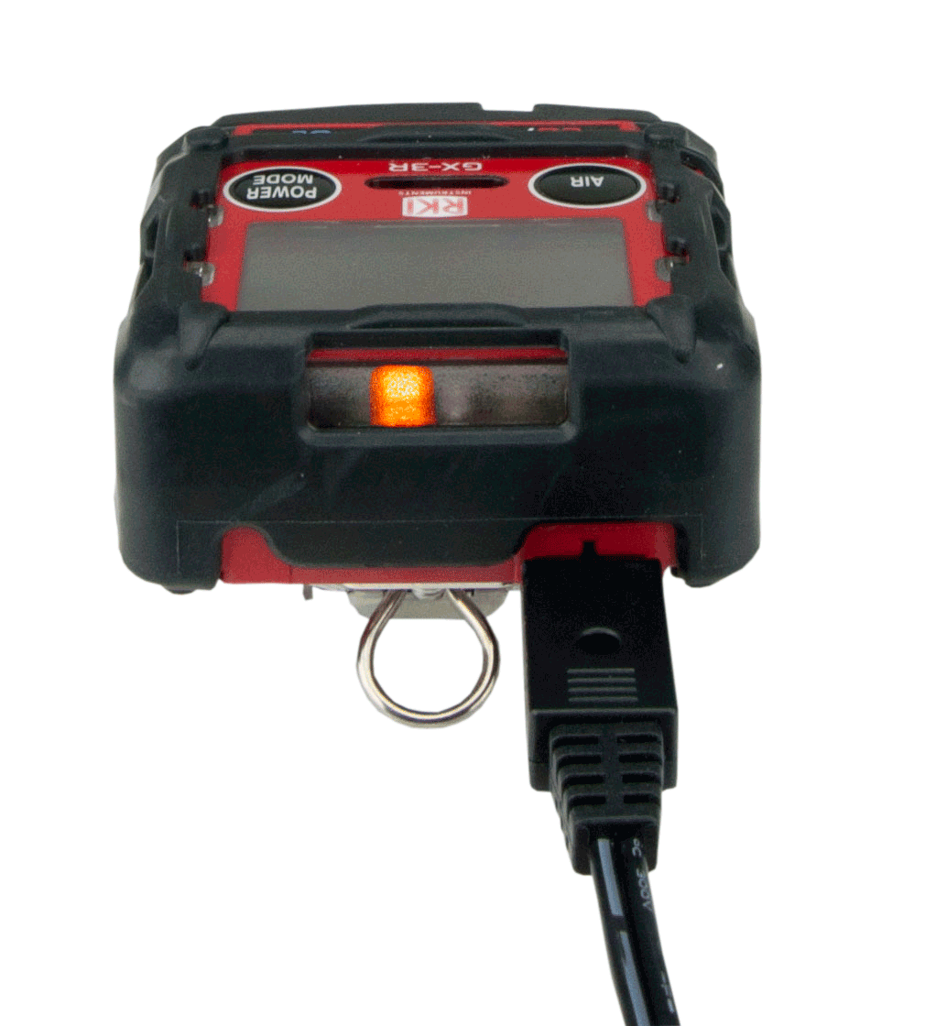
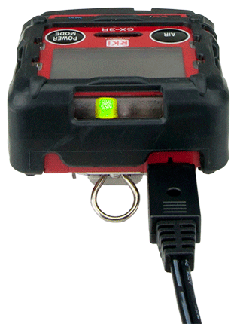
Charging the instrument
Plug the charger into the instrument. A full charge takes 3 hours, and will power the instrument up to 25 hours.
Once the GX-3R is charged, the light will go from orange to green
A 30 minute charge will provide 8 hours of operation time.
Multi-unit AC Adapter is available
(#49-0134)

Slide 12
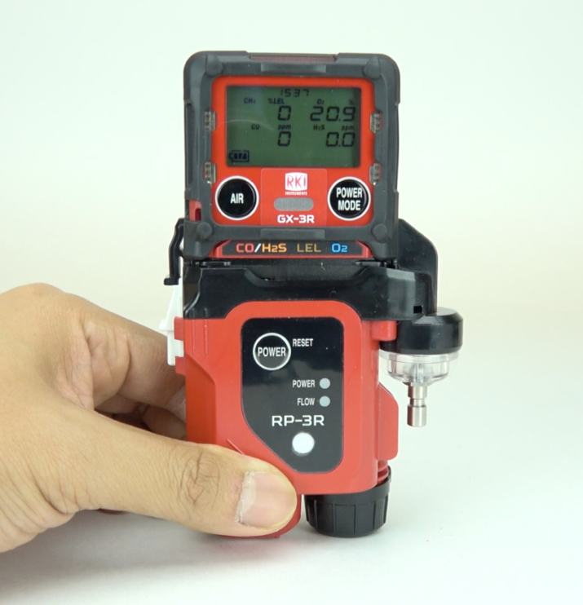
RP-3R Attachable Pump

Slide 13
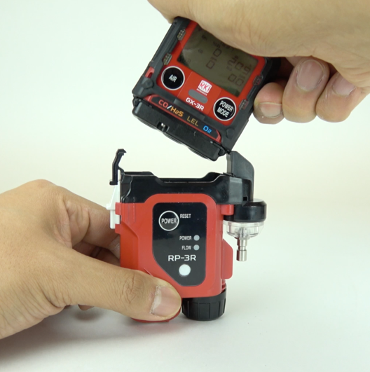

RP-3R Pump
Place the GX-3R right bottom first (as illustrated above) and then seat the left side until the clip latches.

Slide 14
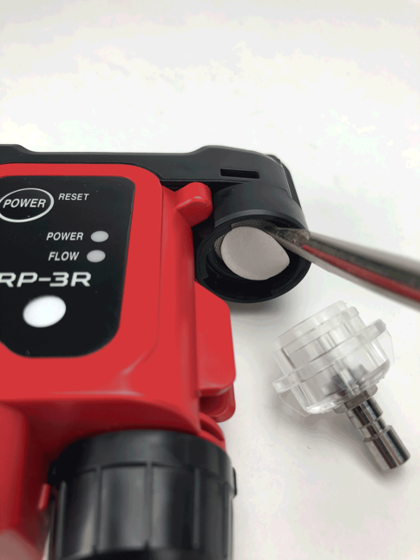
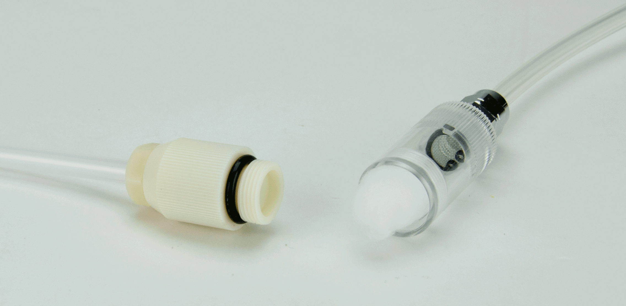
RP-3R Pump
The inlet filter housing contains a hydrophobic filter
The attachable probe has a dust filter to ensure the quality of your samples

Slide 15
Turn off
Turn off the GX-3R by pressing and holding the POWER MODE button

Slide 16
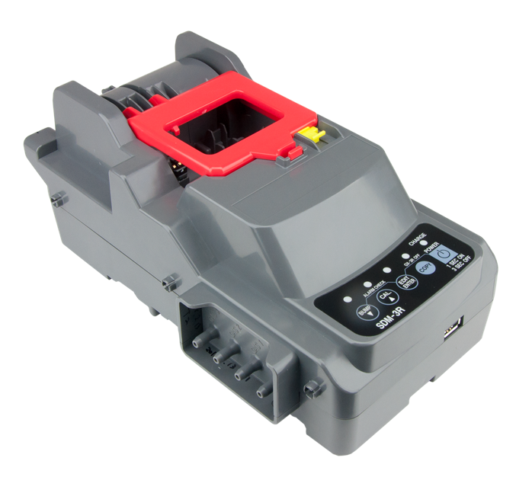
SDM-3R Calibration Station

Slide 17
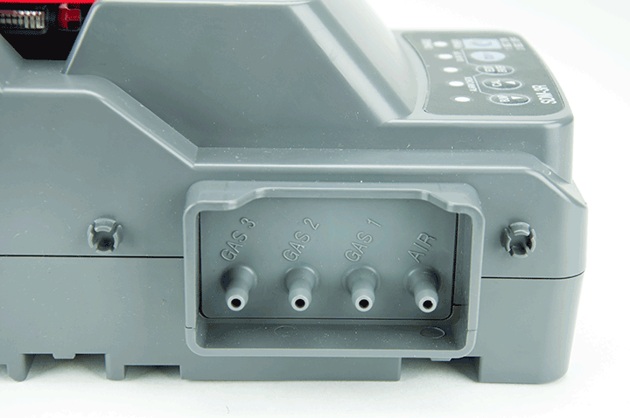
SDM-3R: Gas Ports
Gas 3
Not used
Gas 2:
Not used
Gas 1:
4 gas mix
Air port:
Dust Filter

Slide 18
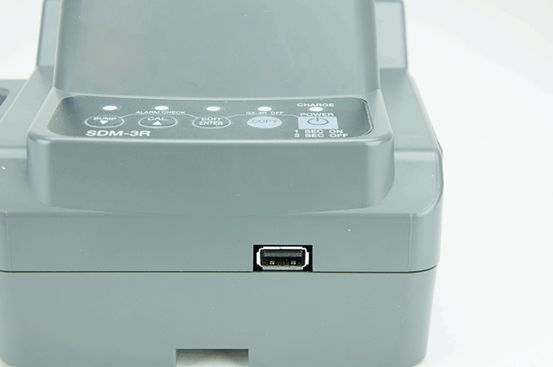
SDM-3R: USB port
USB port

Slide 19
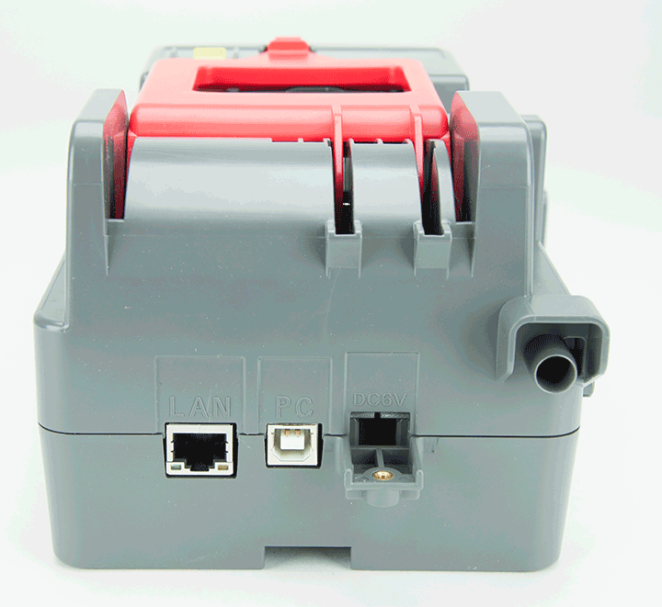
SDM-3R: Rear ports
Ethernet
PC Connection
AC power

Slide 20
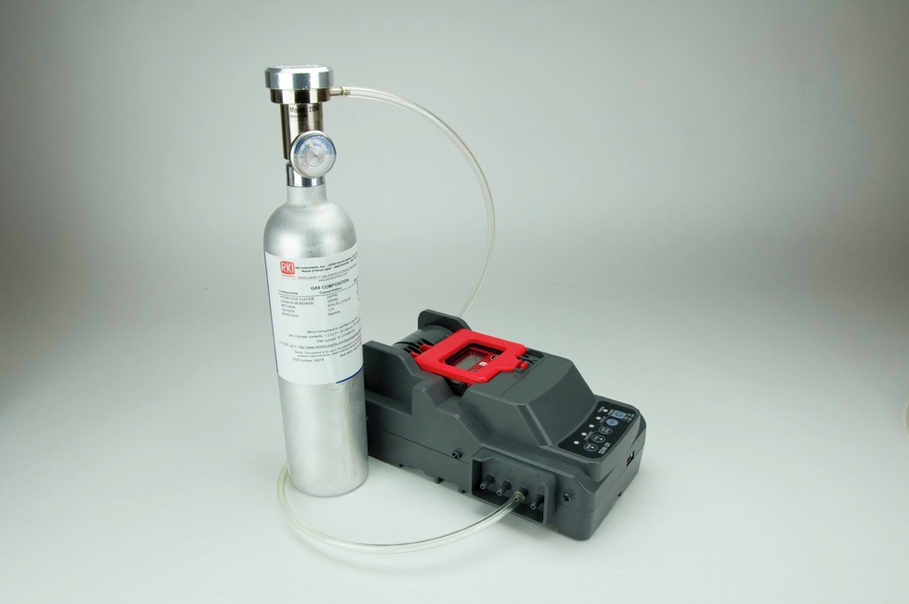
Connect Cylinder to SDM-3R
Connect a 4 gas mix cylinder into “Gas 1 “ port.
Make sure to use a demand flow regulator

Slide 21
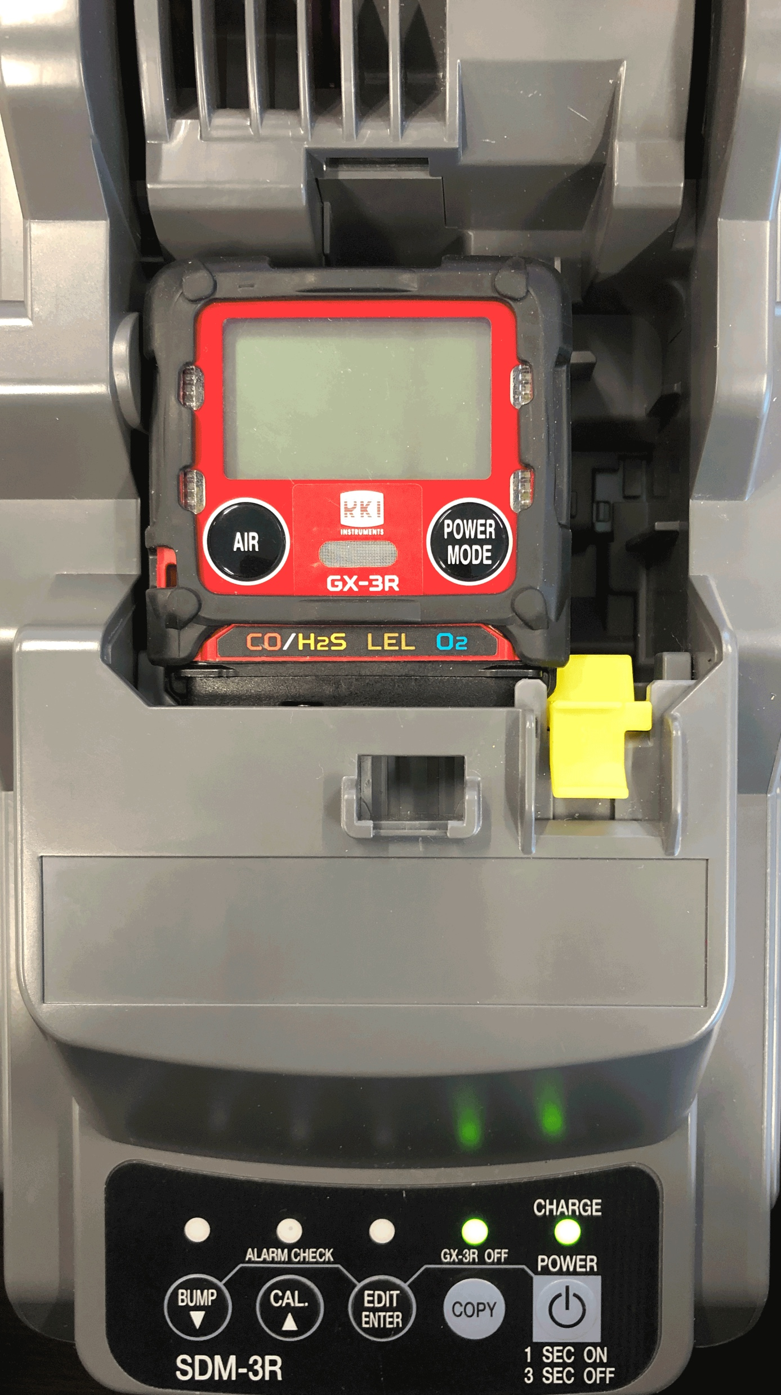
SDM-3R: GX-3R Placement
Plug in power adaptor and turn on the SDM-3R
Make sure the GX-3R is powered off before installing into the SDM-3R
When placing the GX-3R into the docking station, remember to have the yellow tab engaged upwards

Slide 22
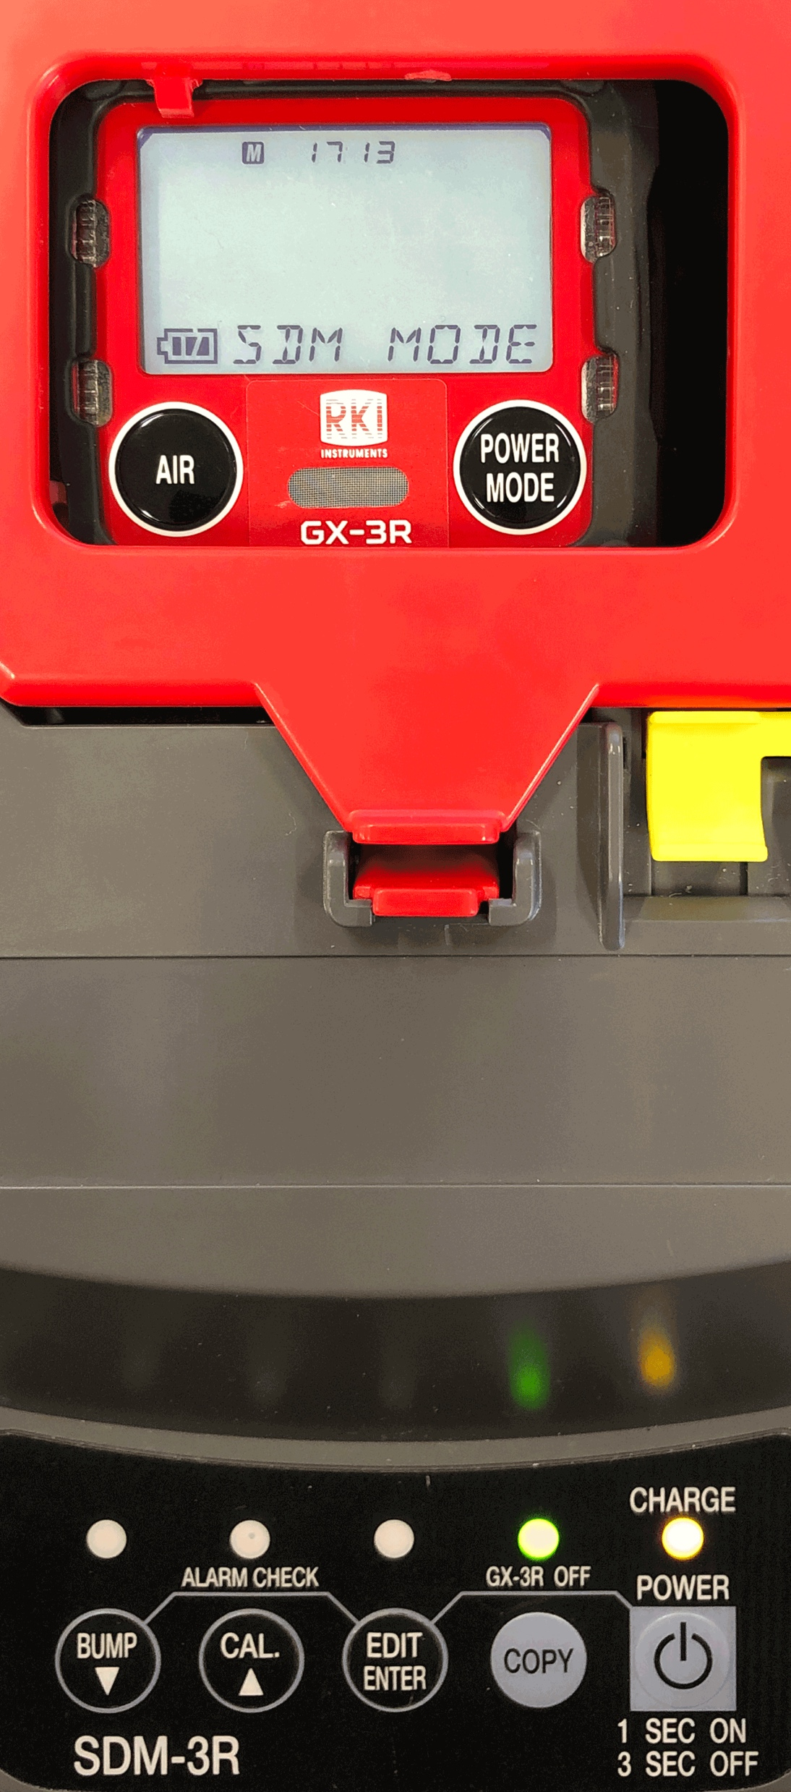
Turn on
Close the red door completely, the GX-3R will turn on automatically
When the GX-3R is connected to the SDM-3R, the GX-3R’s date and time are automatically updated to the SDM-3R’s current time and date
If an automatic test is set up to occur, it will start as soon as the GX-3R is connected to the SDM-3R

Slide 23
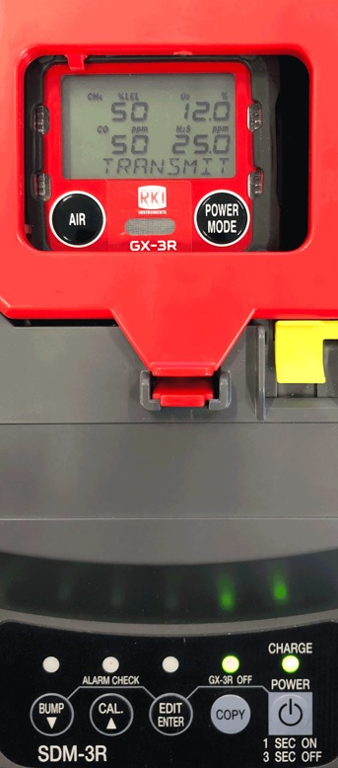
Bump Test
Press the BUMP button to start bump test
Note: Verify that the appropriate calibration gas cylinder is connected to the gas 1 fitting on the left side of the SDM-3R

Slide 24
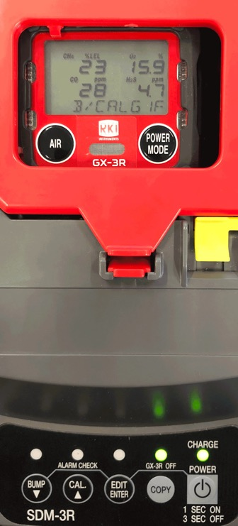
Bump Test
During the bump test, the GX-3R’s screen will display the current gas readings

Slide 25
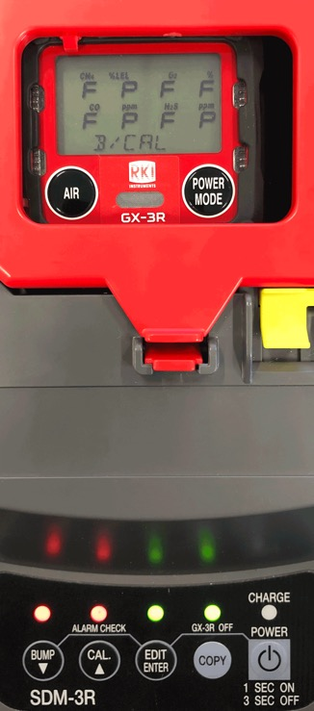
Bump Test
Once a bump test is complete, the LCD screen will alternate between the gas concentration and pass/fail status (shown as P or F on screen) for each sensor.
The “BUMP” LED light on the SDM-3R will be green when a bump test passes.
The GX-3R will shut off automatically after successful bump test.

Slide 26
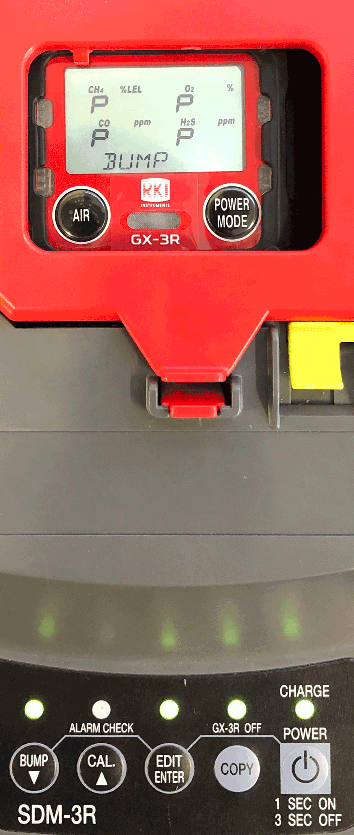
Bump Test
If the bump test fails, ”BUMP” LED light is red. The SDM-3R will then automatically perform a calibration
The LCD screen will alternate between the gas concentration and pass/fail status (shown as P or F on screen) for each sensor for both bump test and calibration
If calibration is successful, the GX-3R will automatically power off

Slide 27

Calibration
Press the CAL button until you hear the pump to start calibration
Make sure calibration gas concentrations match values shown on display

Slide 28
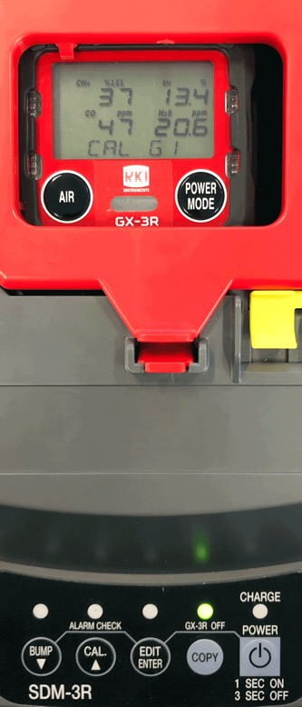
Calibration
During calibration, the display shows current gas readings.
Calibration will take approximately 90 seconds.

Slide 29
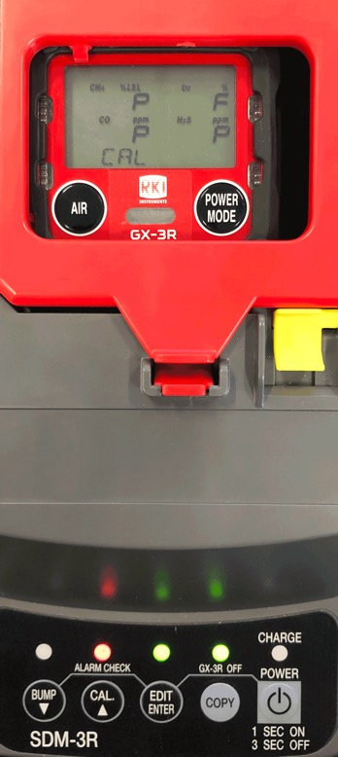
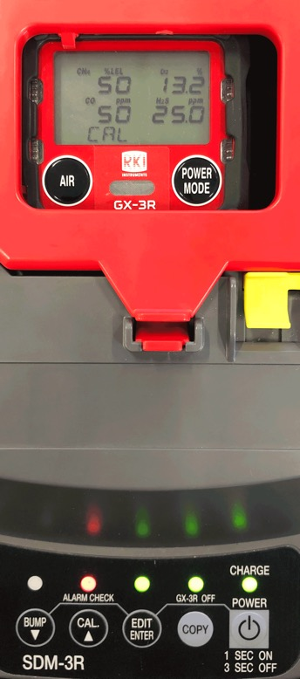
Calibration
Once calibration is complete, the LCD screen will alternate between the gas concentration and the letter “P” for pass or an “F” for fail for each sensor
The “CAL” LED light on the SDM-3R will be green when calibration is passed
“CAL” LED light is red if there if a failure. The GX-3R will power off after a successful calibration

Slide 30
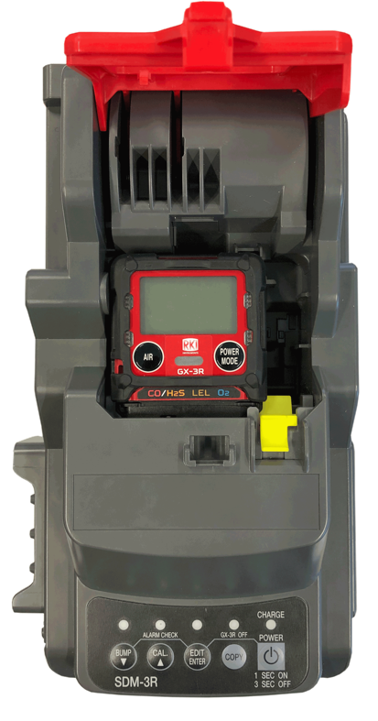
Removing from SDM-3R
Release the tab on the red door
Remove the GX-3R

Slide 31
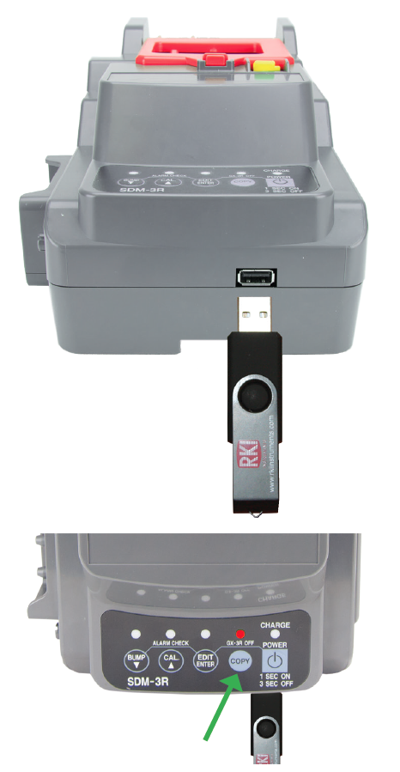
Data Transfer
Insert a USB flash drive with unit powered on.
To download the calibration and bump test data, press and hold COPY until the COPY LED is solid red, then release.
To download stored data from the gas monitor, keep pressing the COPY button until LED is flashing orange.
The USB flash drive can be removed when the COPY LED flashes green

Slide 32
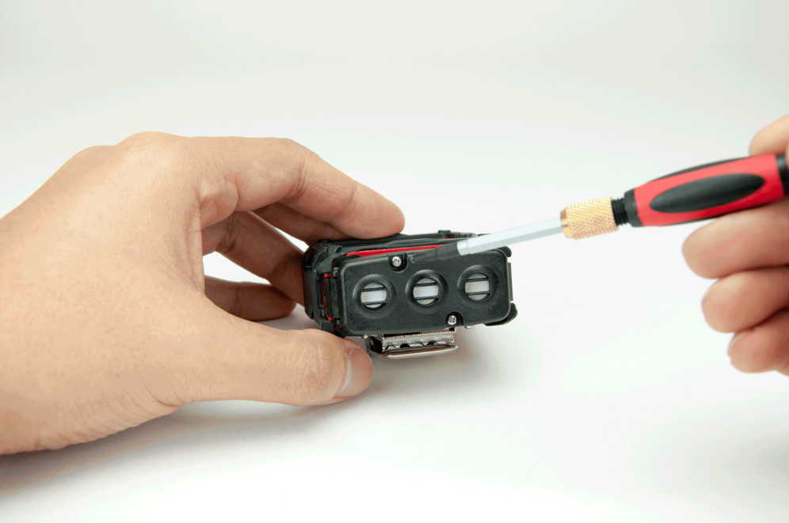
Sensor/Filter replacement
Unscrew the captive screws on the GX-3R.

Slide 33
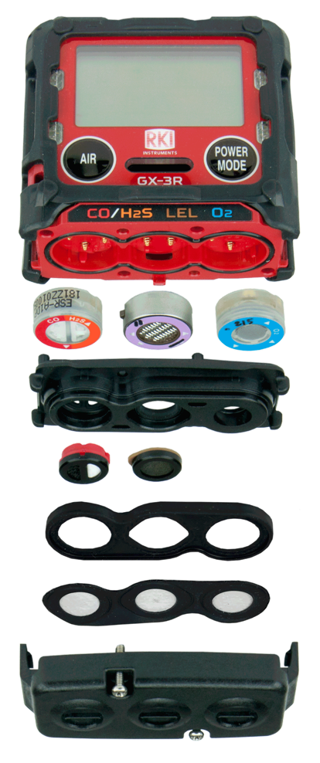
Sensor/Filter replacement
H2S/CO:
ESR-A1DP
O2 Sensor:
ESR-X13P
Scrubber Disk Filter for H2S/CO:
33-7130 (5 pk)
LEL Sensor:
NCR-6309
Scrubber Disk Filter for LEL:
33-7131 (5 pk)
Sensor Dust Filter:
33-0181-10 (10 pk)

Slide 34

Questions?

Slide 35


