Slide 1
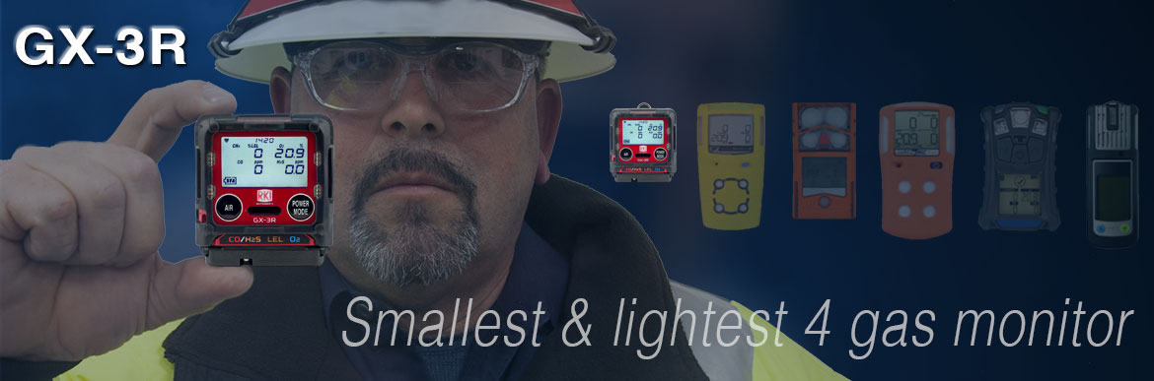
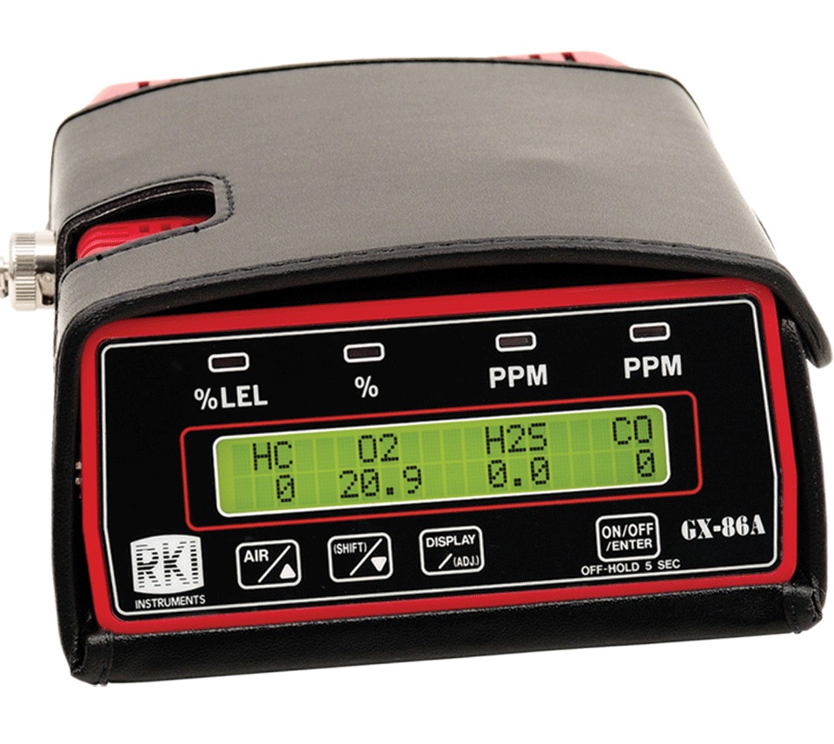
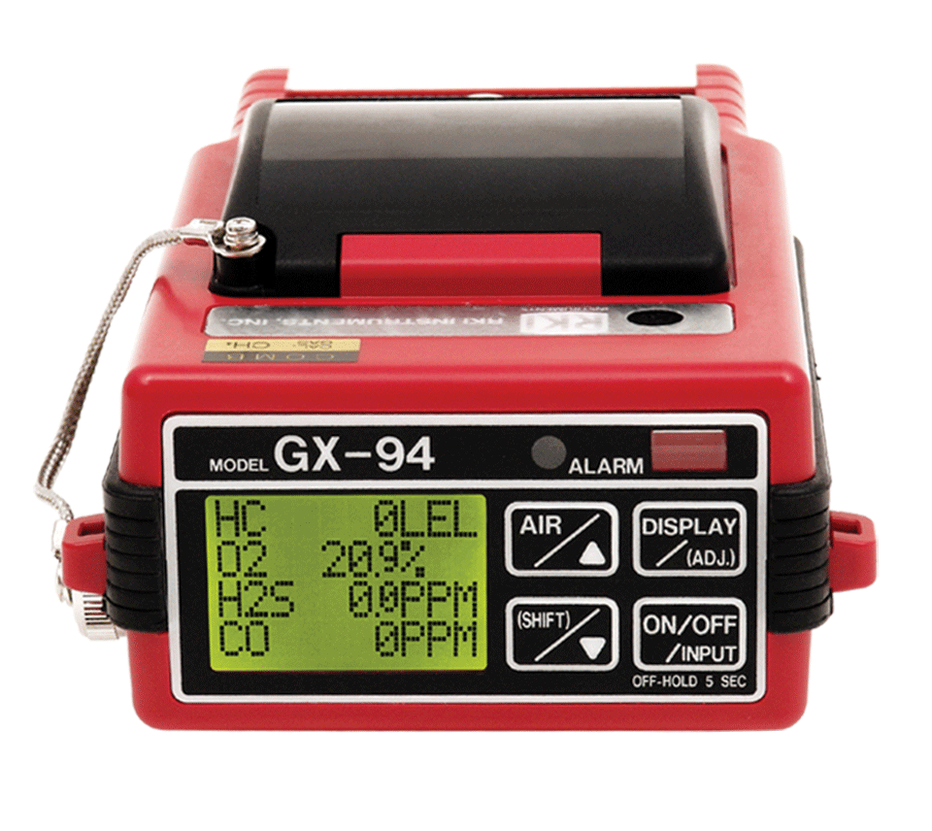
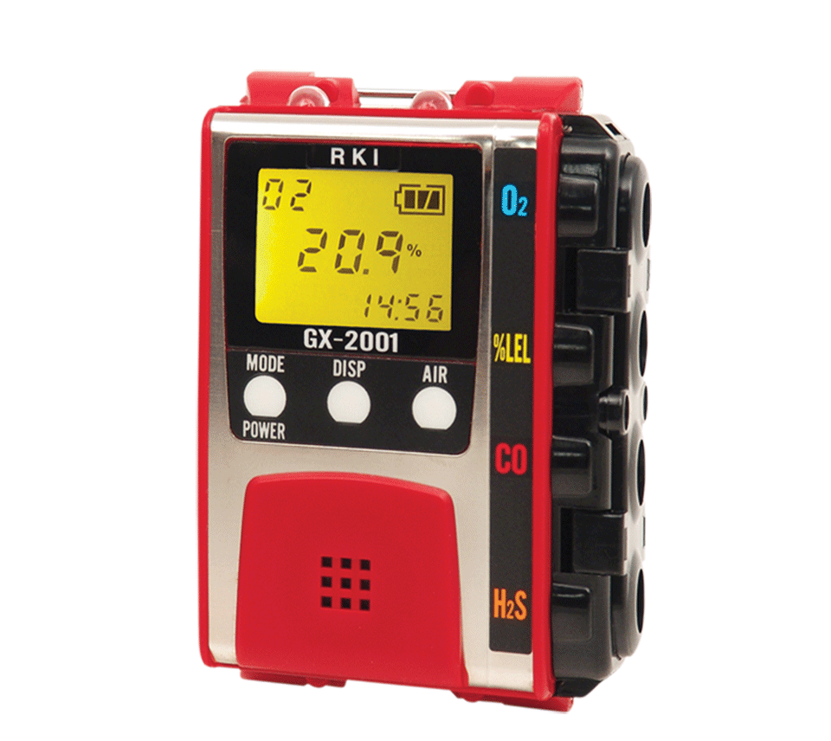
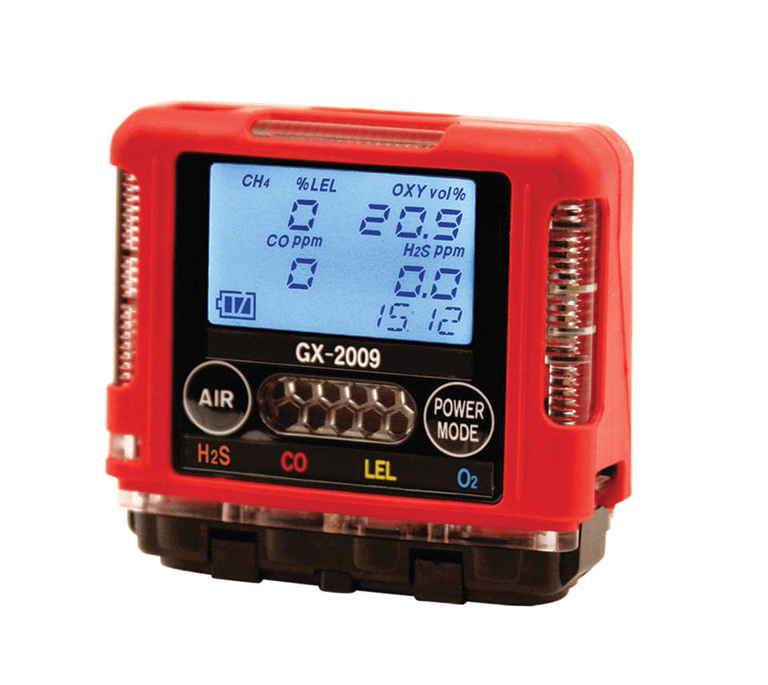
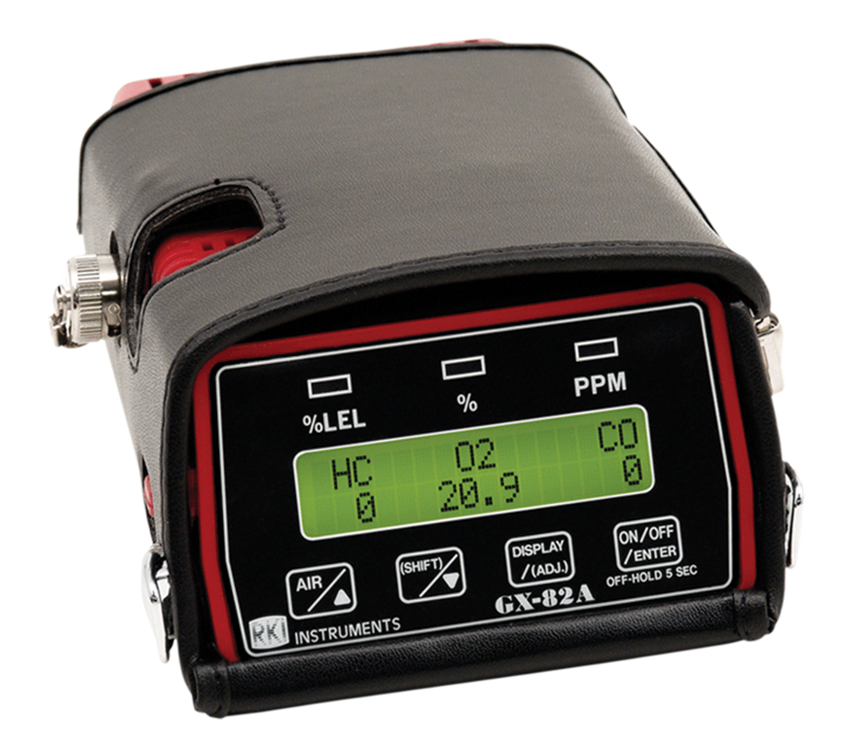

Evolution In Gas Detection

Slide 2
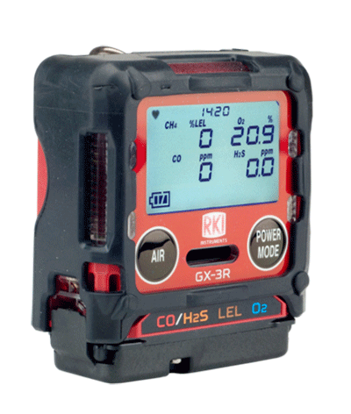
The GX-3R
The Smallest and Lightest 4-gas Monitor
D: 1.02”
H: 2.55”
W: 2.2”
And it weighs only 3.52 ounces!

Slide 3
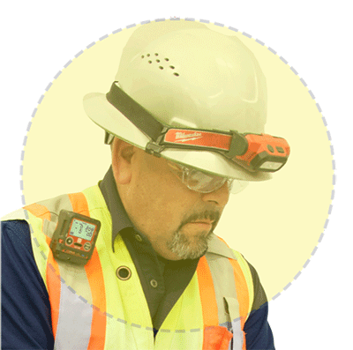
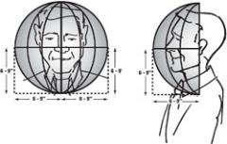

Size Matters
In the “Breathing Zone”
GX-3R
So small and light, the GX-3R clips comfortably in the breathing zone.
“The breathing zone is within a ten inch radius of the worker's nose and mouth. OSHA requires that worker exposure monitoring air samples be collected in the breathing zone. Air sampling filters may be attached to the collar or lapel.”

Slide 4
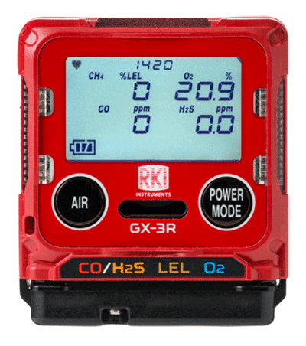



Simultaneously Monitor 4 Gasses
GX-3R
The GX-3R monitors:
LEL – Combustibles
O2 – Oxygen
Dual sensor for CO and H2S in one channel
CO – Carbon Monoxide
Dual filament design gives added silicone poisoning resistance to LEL sensor
(H2 compensated CO sensor available)
Lead free electro-chemical sensor design gives O2 sensor a 3-5 year lifespan
Eliminate H2 interference with CO readings with optional H2 compensated O2 sensor
All gas readings displayed

Slide 5
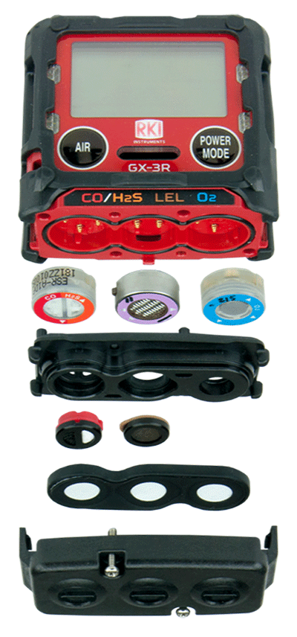
Sensors
GX-3R
Sensors are field replaceable
(as easy as changing a clock battery)
Can be configured with interchangeable combos to detect a multitude of gasses
Long-lasting with a 3-year warranty

Slide 6

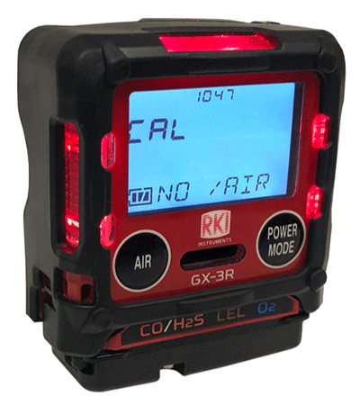
Non-compliance Indicator
GX-3R
Easily identify workers using instruments that have not been calibrated, bump tested, or have been in alarm. Red LED’s flash every 30 seconds.

Slide 7

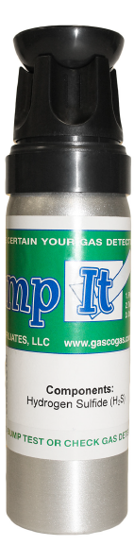
GASCO Calibration Gas
Single Gas Detector Verification
30 Bumps Per Cylinder
No hazardous material shipping cost
A Functional “Bump” test should be performed before each use
Many single gas mixes available
If you don’t check – you don’t know
Make Certain Your Gas Detector Works!

Slide 8
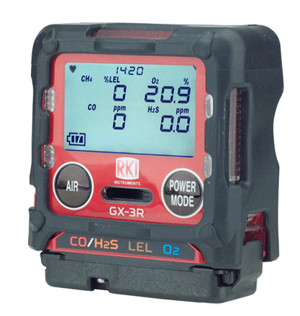
Large LCD Auto-backlit Display
GX-3R
Full dot LCD display is easy to read even in adverse conditions

Slide 9
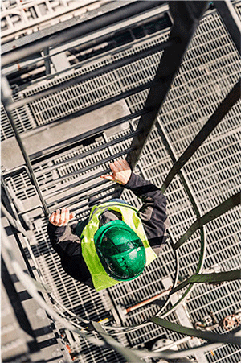
Concussion Resistant
GX-3R
The GX-3R has been drop-tested from over 23 feet.
It can handle the conditions of your rugged work environment

Slide 10
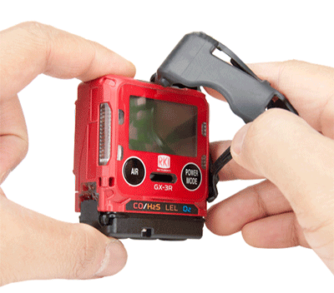
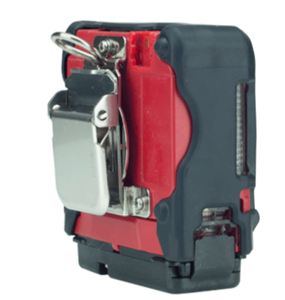
Removable Rubber Boot
GX-3R
The removable rubber boot adds impact protection, can be removed when cleaning and replaced if necessary.
Alligator Clip
Low profile alligator clip rotates 360°. Comfortably view the instrument display from a variety of positions.

Slide 11
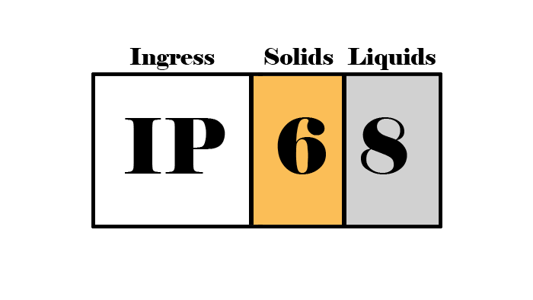
IP-66 / IP-68 Rating
GX-3R
The GX-3R is IP-66 rated because it can withstand jets of water
It is also IP-68 rated because it can withstand submersion in water
Critical for withstanding harsh industrial environments
The first digit shows that it is dust proof
The second digit shows it is waterproof

Slide 12
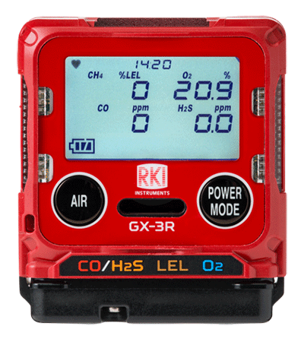


3 Year Warranty
GX-3R
The GX-3R has a 3 year warranty
The warranty covers workmanship of the device
AND the sensors.

Slide 13
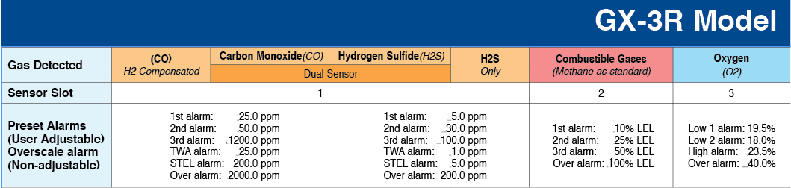
3 Adjustable Alarm Levels
GX-3R
Three adjustable alarm points let you customize your instrument to fit your needs.
Revert back to standard factory settings any time.

Slide 14


3 Alarm Types
GX-3R
Visual
LED light indicators
Alert you to gas, low battery, and failure alarms
Audible
95 decibel buzzer
Buzzer sounds for gas alarms, malfunctions, low battery voltage, and as an indicator
Vibration
An internal motor vibrates for gas alarms, unit malfunctions, and as an indicator

Slide 15

2 Button Operation
GX-3R
2 Glove -friendly Buttons
Easy to use!

Slide 16
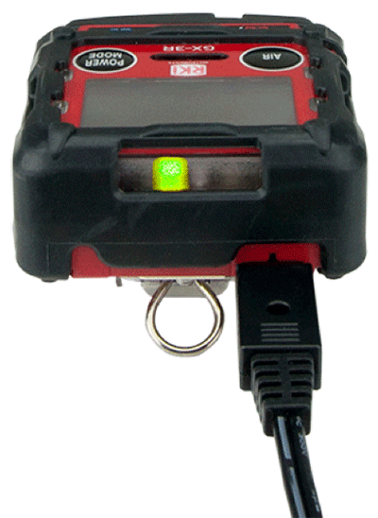
GX-3R
Rechargeable Lithium-Ion Battery
Lithium Ion battery gives 25 hours of continuous operation minutes, with a complete recharge in 90.
It has an easy and convenient charging cable, no cradle required!

Slide 17
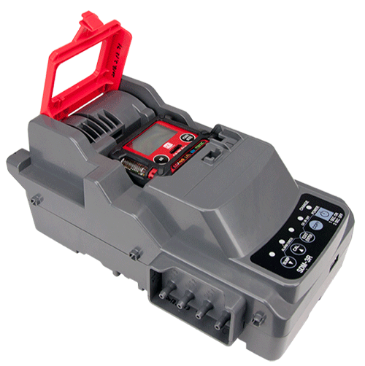
SDM 3R Calibration Station
GX-3R
Charge, bump test, calibrate and alarm test instruments using less calibration gas
Automatically schedule tests
Bank up to 10 units with tubeless connection
Access instrument data via USB or ethernet

Slide 18
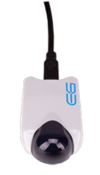
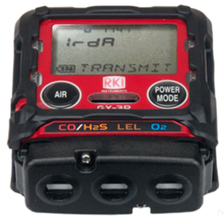
High Capacity Data Logging
GX-3R
The GX-3R automatically logs data every 5 minutes for 300 hours of measurement.
(note: logging interval can be changed in settings)
Infrared Communication Port
Transfer data from the instrument to a PC with a USB/IR adaptor, no cradle required.

Slide 19
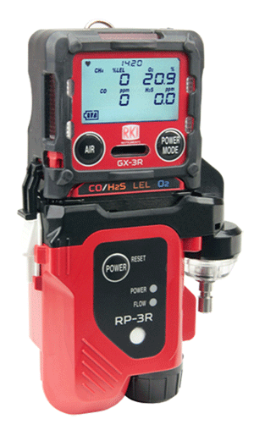
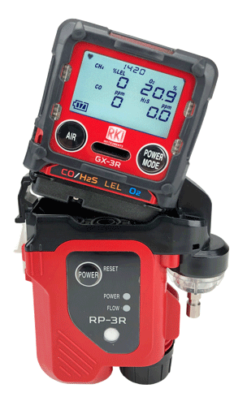
RP-3R Sampling Pump
GX-3R
Clip-on sampling pump has a 50’ range and independent power supply
Continuously operates for 10 hours
Eco mode will operate up to 16 hours

Slide 20

Lunch Break Mode
GX-3R
Retain TWA and PEAK values from last use to pick up where you left off.
Stealth Mode
Set the alarm to notify silently—perfect for law enforcement and other applications

Slide 21

Low Cost of Ownership
GX-3R
The GX-3R is a complete instrument. It is easy to maintain and is NOT disposable.
Long lasting sensors, low parts replacement costs, plus a history of long-term product support makes this the best value of any 4-gas instrument

Slide 22
9 Languages
GX-3R
Available in 9 languages:
English
日本語 (Japanese)
Español (Spanish)
Deutsch (German)
Français (French)
Italiano (Italian)
Pусский (Russian)
中文 (Chinese)
한국어 (Korean)

Slide 23
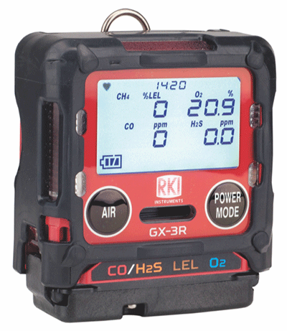
The GX-3R
GX-3R

Slide 24
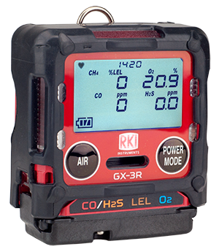
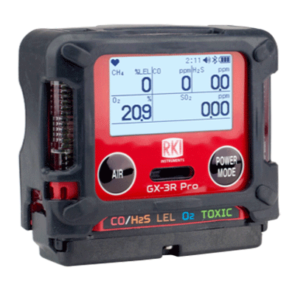
2 Models—Depending on Need
Compliance 4-gas model
5-gas pro model
GX-3R
GX-3R Pro
Worlds smallest and lightest 4-gas monitor
Impact, water, & dust resistant
3 year Warranty
  4-gas plus extra slot for toxic or IR sensor
  Wireless communication with mobile app
  Man-down and panic alarms
  Alkaline/Rechargeable option

Slide 25


GX-3R
User Training

Slide 26
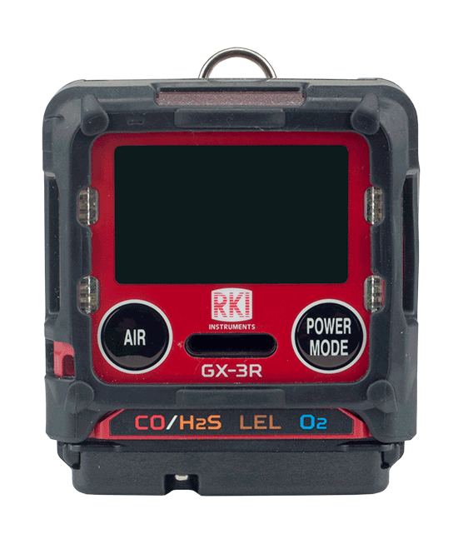
Turn on
Turn on the GX-3R by pressing and holding the POWER MODE button until you hear one beep

Slide 27
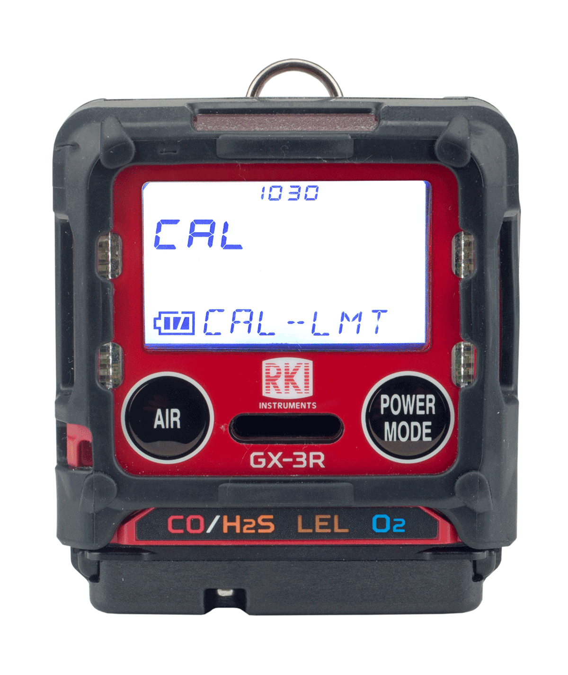
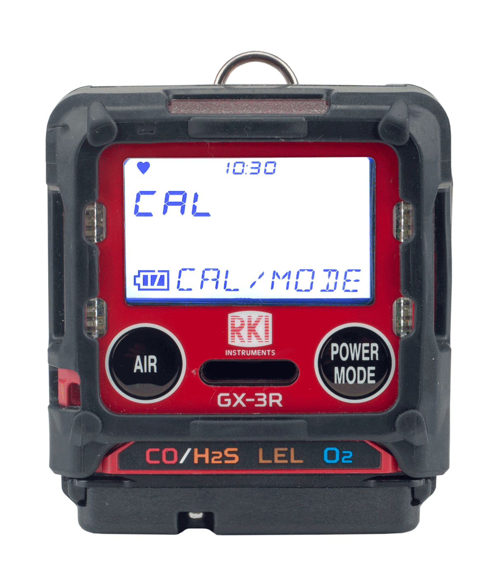
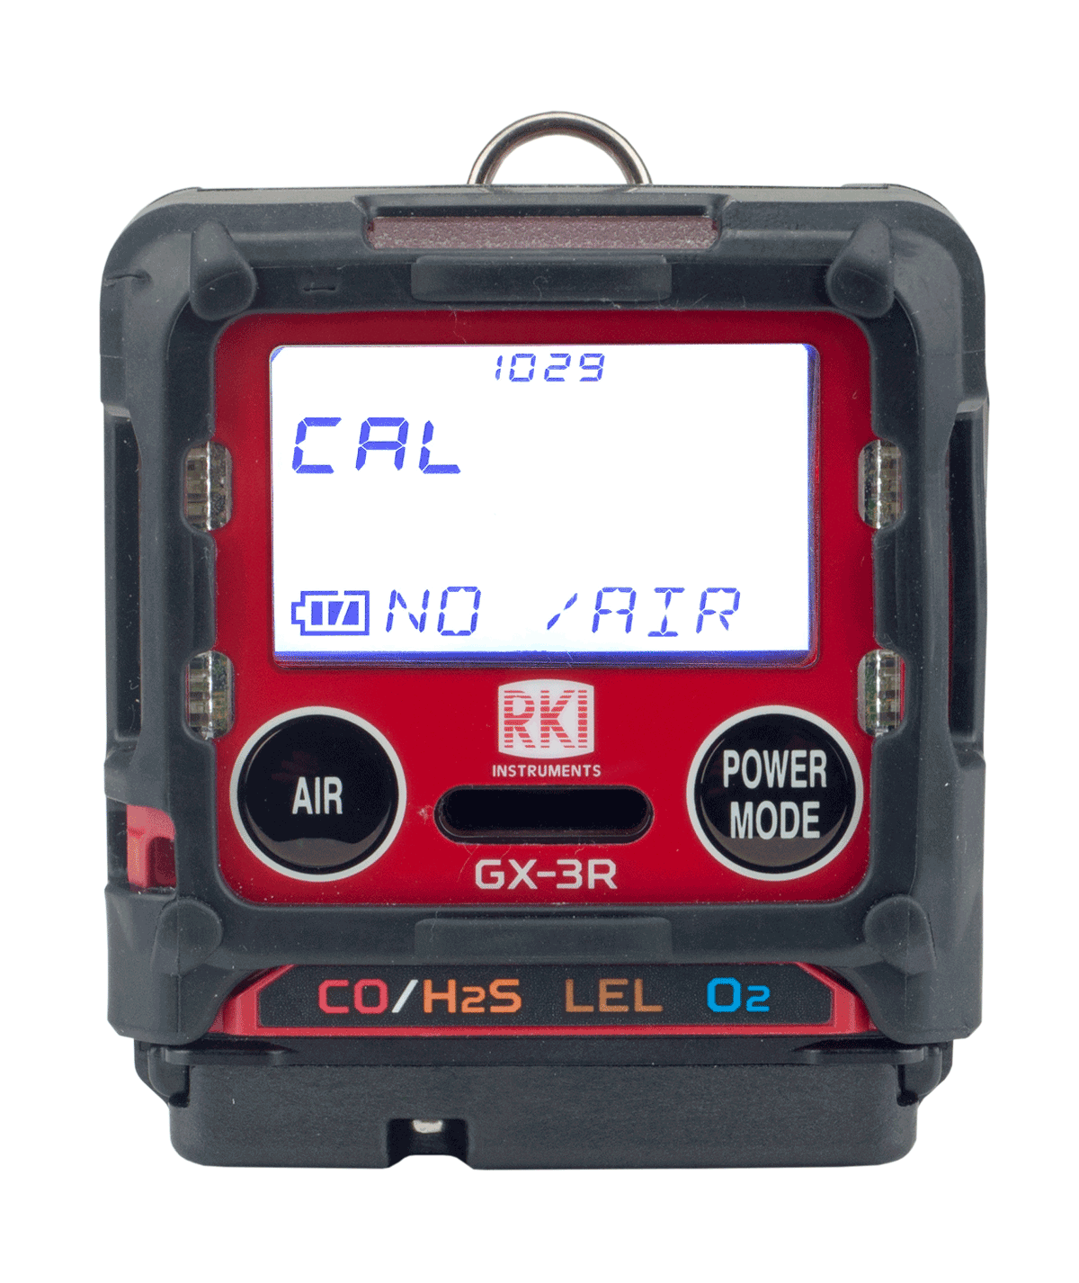
Cal Reminder
Acknowledge and use
If your instrument is past its 30 day calibration limit, you will see a CAL-LMT reminder at start-up
Perform a calibration
Press the POWER/MODE button to perform calibration.
Press AIR button to continue without performing a calibration

Slide 28
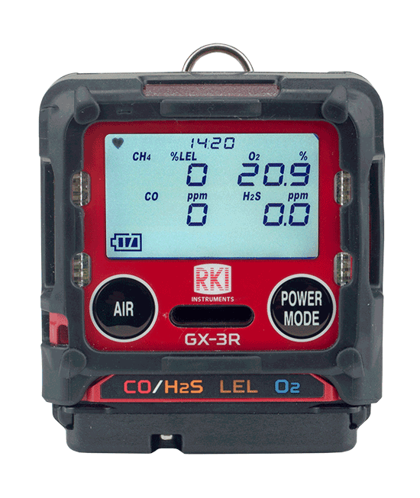
Normal Mode
After warm-up, the normal screen will appear.

Slide 29
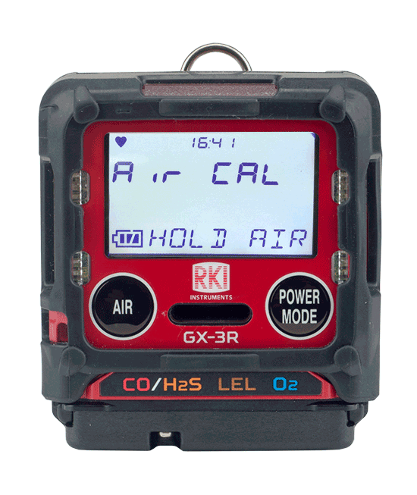
Fresh Air
To perform a fresh air adjustment, make sure you’re in a fresh air environment.

Slide 30
Fresh Air
Press and hold the AIR button

Slide 31
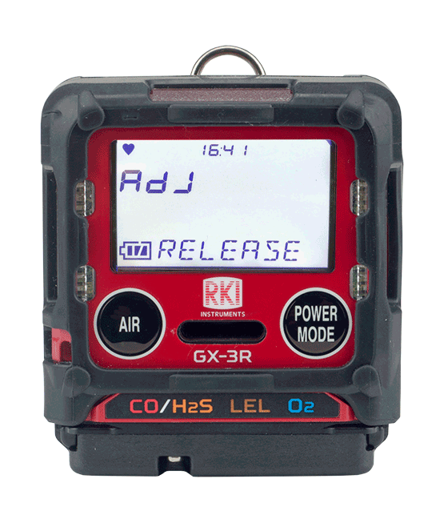
Fresh Air
When prompted, release the AIR button
The GX-3R will beep once and return to normal mode after the fresh air adjust is complete

Slide 32
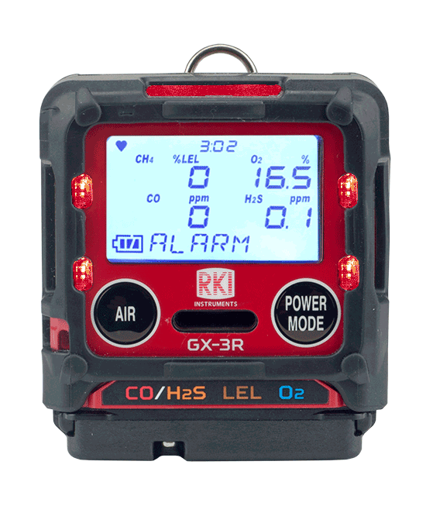
Alarm
In the event of an alarm, the GX-3R’s visual, audible and vibration alarms will alert you.
The readout will identify which sensor is in alarm.
The visual, audible, and vibration alarms will stop.
To reset the instrument, go to a safe location. Once the readings return to fresh air values, then press the POWER/MODE button.

Slide 33
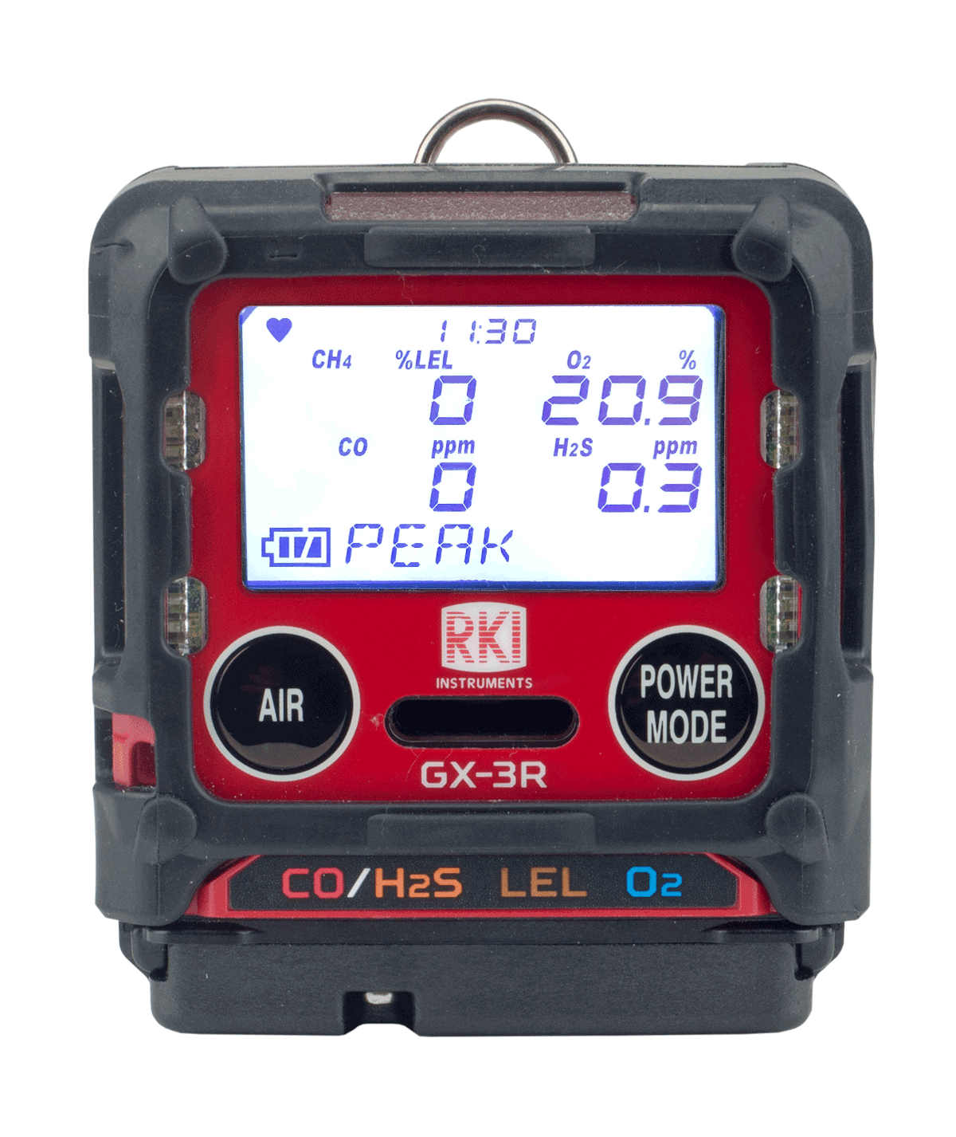
Display Mode
To enter display mode, press and release the Power Mode button

Slide 34
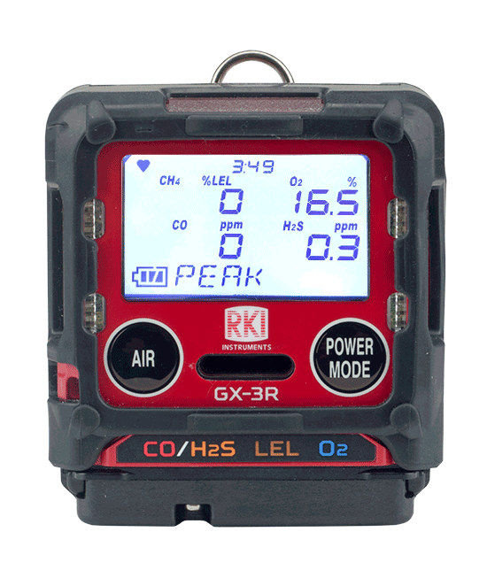
Display mode vs. Normal Operation
PEAK
STEL
TWA
HC GAS LIST
USER ID
STN ID
CAL DATA
BUMP DATA
TEMPERATURE
ALARM-PT
You will know you are in display mode if you see a display mode menu title on the bottom of your screen
To return to normal operation, scroll all the way through the display menu using the AIR button, or wait 20 seconds and the GX-3R will automatically return to normal mode

Slide 35
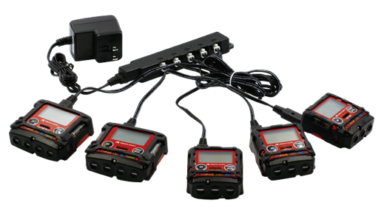
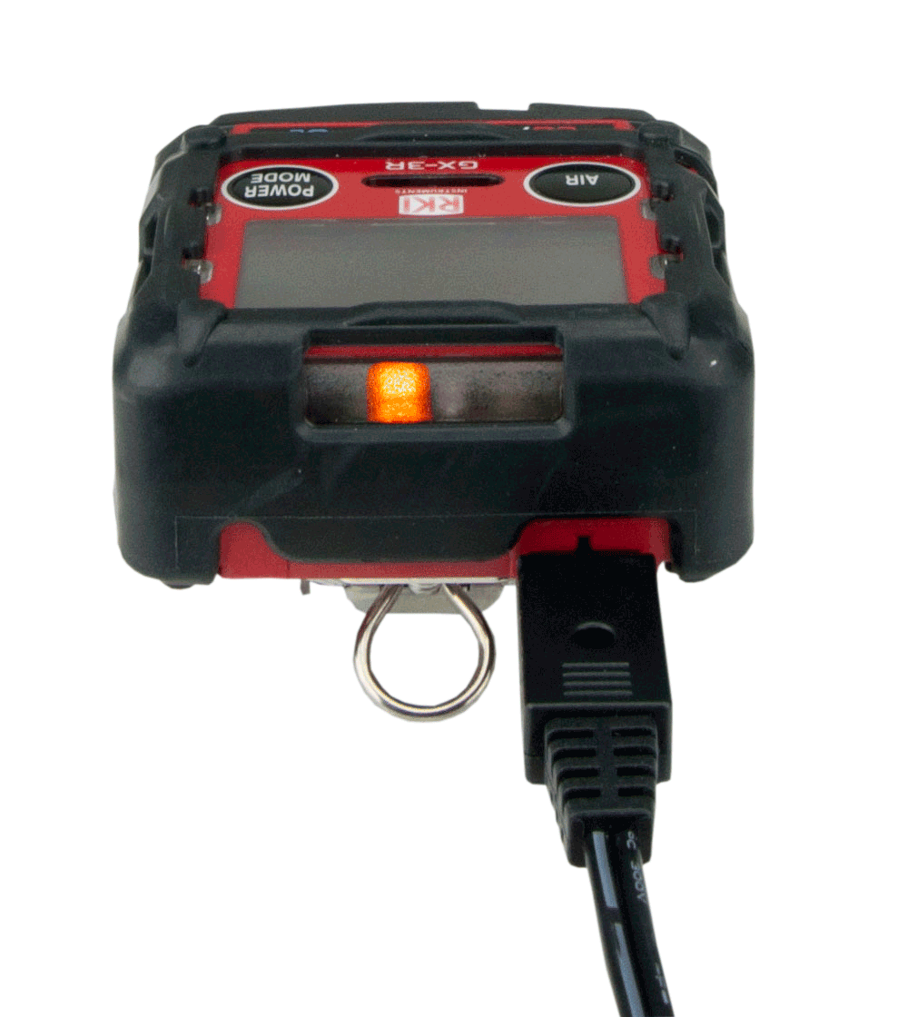

Charging the instrument
Plug the charger into the instrument. A full charge takes 3 hours, and will power the instrument up to 25 hours.
Once the GX-3R is charged, the light will go from orange to green
A 30 minute charge will provide 8 hours of operation time.
Multi-unit AC Adapter is available
(#49-0134)

Slide 36
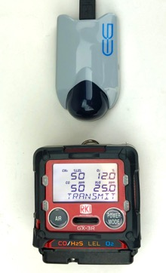
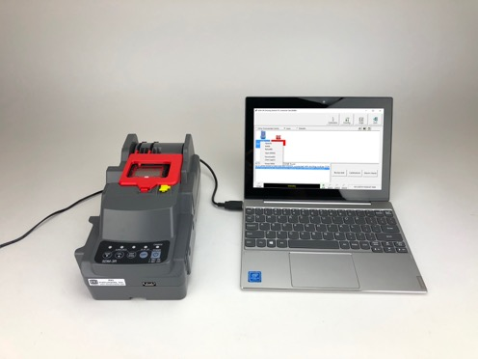
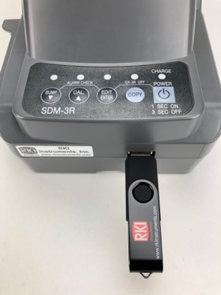
Downloading Data
IrDA cable to PC
SDM-3R to PC
SDM-3R to flash drive to PC
Three methods to downloading data from the GX-3R

Slide 37
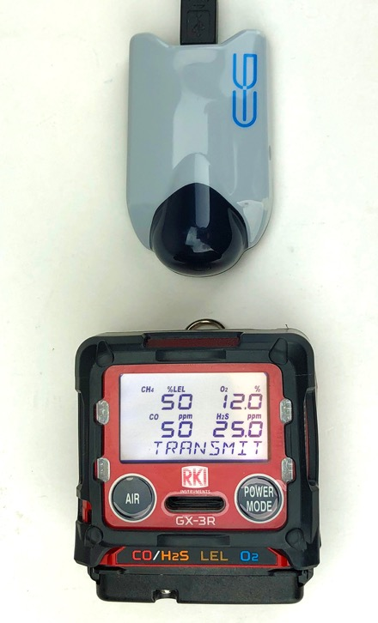
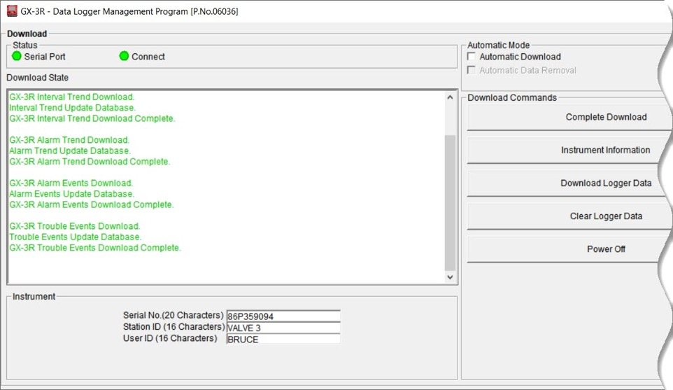
IrDA cable to PC
Launch the GX-3R Datalogging program
Align the infrared ports
Turn on GX-3R
IrDA Cable
For More detailed instructions:
www.gasdetecting.com/files/GX3R_IrDA_to_PC.pdf

Slide 38
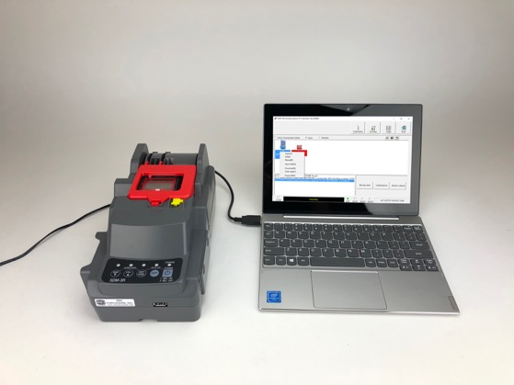
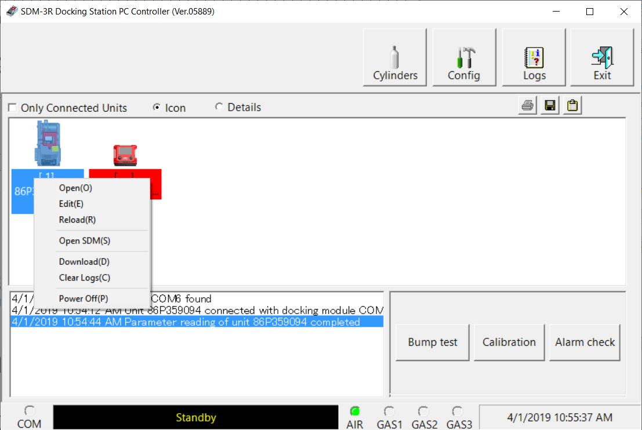
SDM-3R to PC
SDM-3R to PC
Launch the SDM-3R PC Controller
Place GX-3R in the SDM-3R docking station
Turn on SDM-3R
For More detailed instructions:
www.gasdetecting.com/files/SDM3R_to_flashdrive_to_PC.pdf

Slide 39
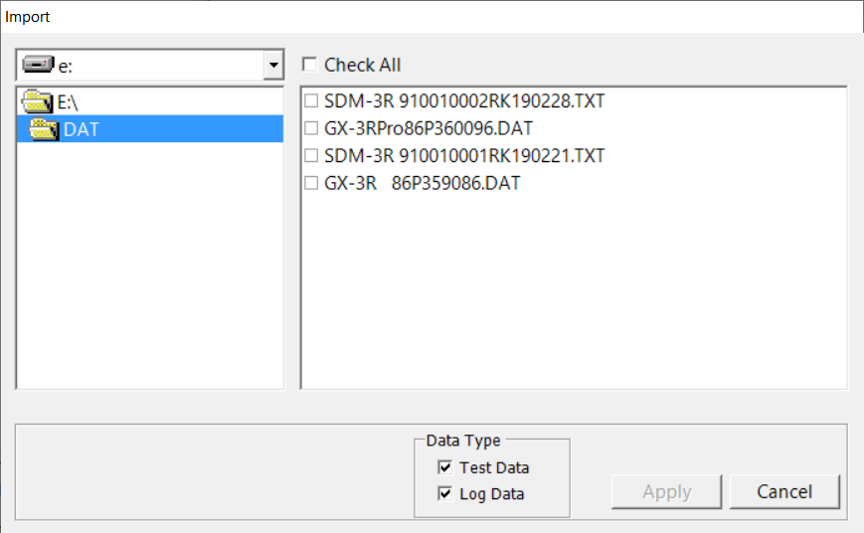
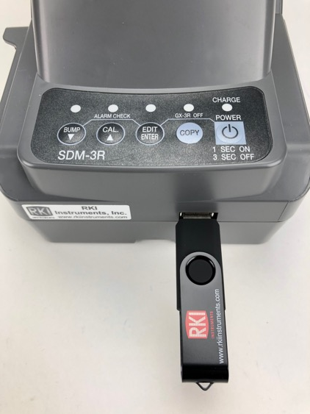
SDM-3R to Flash drive to PC
Flash drive
Insert flash drive into the SDM-3R and press COPY
Launch the SDM-3R PC Controller
Insert flash drive into the computer’s USB slot
For More detailed instructions:
www.gasdetecting.com/files/SDM3R_to_PC.pdf

Slide 40

RP-3R Attachable Pump

Slide 41



RP-3R Pump
Place the GX-3R right bottom first (as illustrated above) and then seat the left side until the clip latches.

Slide 42


RP-3R Pump
The inlet filter housing contains a hydrophobic filter
The attachable probe has a dust filter to ensure the quality of your samples

Slide 43

RP-3R Pump
Low flow alarm
If the sample line is blocked, the amber flow LED will flash and the buzzer with intermittently sound

Slide 44

RP-3R Pump
Other Alarm Types

Slide 45

Turn off
Turn off the GX-3R by pressing and holding the POWER MODE button for approximately 5 seconds

Slide 46

SDM-3R Calibration Station

Slide 47

SDM-3R: Gas Ports
Gas 3
Not used
Gas 2:
Not used
Gas 1:
4 gas mix
Air port:
Dust Filter

Slide 48

SDM-3R: USB port
USB port

Slide 49

SDM-3R: Rear ports
Ethernet
PC Connection
AC power

Slide 50

Connect Cylinder to SDM-3R
Connect a 4 gas mix cylinder into “Gas 1 “ port.
Make sure to use a demand flow regulator

Slide 51

SDM-3R: GX-3R Placement
Plug in power adaptor and turn on the SDM-3R
Make sure the GX-3R is powered off before installing into the SDM-3R
When placing the GX-3R into the docking station, remember to have the yellow tab engaged upwards

Slide 52

Turn on
Close the red door completely, the GX-3R will turn on automatically
When the GX-3R is connected to the SDM-3R, the GX-3R’s date and time are automatically updated to the SDM-3R’s current time and date
If an automatic test is set up to occur, it will start as soon as the GX-3R is connected to the SDM-3R

Slide 53

Bump Test
Press the BUMP button to start bump test
Note: Verify that the appropriate calibration gas cylinder is connected to the gas 1 fitting on the left side of the SDM-3R

Slide 54

Bump Test
During the bump test, the GX-3R’s screen will display the current gas readings

Slide 55

Bump Test
Once a bump test is complete, the LCD screen will alternate between the gas concentration and pass/fail status (shown as P or F on screen) for each sensor.
The “BUMP” LED light on the SDM-3R will be green when a bump test passes.
The GX-3R will shut off automatically after successful bump test.

Slide 56

Bump Test
If the bump test fails, ”BUMP” LED light is red. The SDM-3R will then automatically perform a calibration
The LCD screen will alternate between the gas concentration and pass/fail status (shown as P or F on screen) for each sensor for both bump test and calibration
If calibration is successful, the GX-3R will automatically power off

Slide 57

Calibration
Press the CAL button until you hear the pump to start calibration
Make sure calibration gas concentrations match values shown on display

Slide 58

Calibration
During calibration, the display shows current gas readings.
Calibration will take approximately 90 seconds.

Slide 59


Calibration
Once calibration is complete, the LCD screen will alternate between the gas concentration and the letter “P” for pass or an “F” for fail for each sensor
The “CAL” LED light on the SDM-3R will be green when calibration is passed
“CAL” LED light is red if there if a failure. The GX-3R will power off after a successful calibration

Slide 60


Setting Date/time
Insert GX-3R into the SDM-3R docking station
Press POWER

Slide 61


Setting Date/time
Press EDIT/ENTER to enter settings menu
Press BUMP to scroll to date and press
EDIT/ENTER

Slide 62

Setting Date/time
Use BUMP and CAL to scroll to the date or time, and press EDIT/ENTER
Use BUMP and CAL to change the value, and press EDIT/ENTER to accept changes.

Slide 63

Removing from SDM-3R
Release the tab on the red door
Remove the GX-3R

Slide 64

Training Resources
SDM-3R Cal Station Poster
Ships with each SDM-3R

Slide 65

Training Resources
YouTube GX-3R Play List
  https://www.youtube.com/playlist

Slide 66

Training Resources
GX-3R webpage

