Slide 1
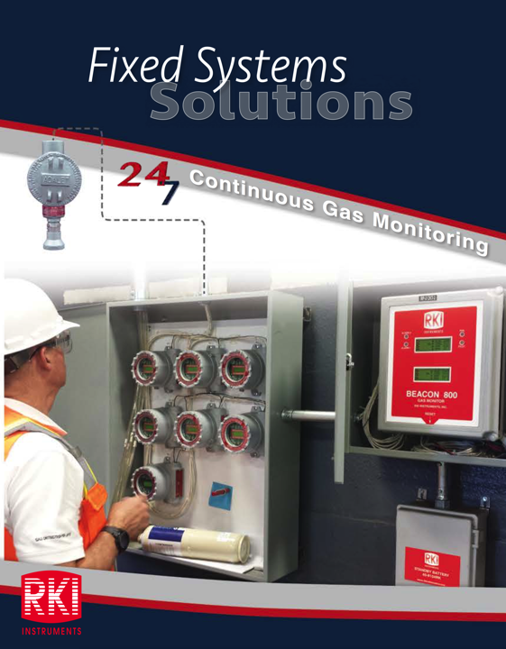

Slide 2
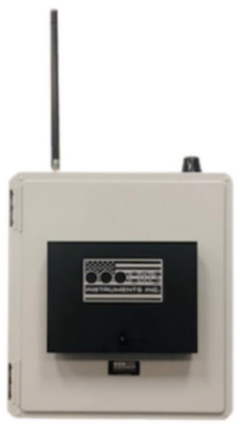
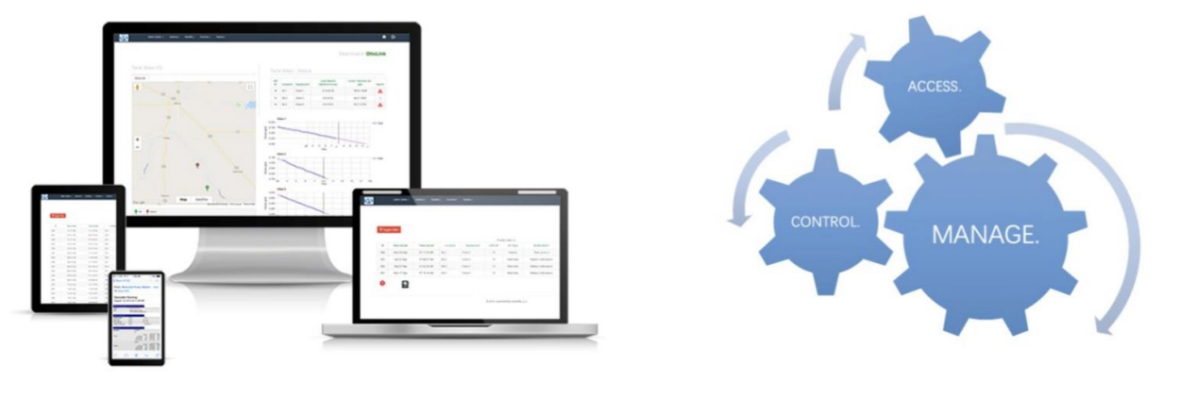
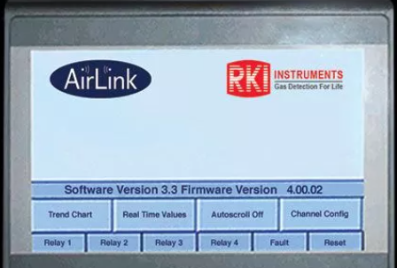
Telemetry Capabilities
Remote Monitoring / Reports & Charts / Alerts / Controls
Cloud Link provides gas detection devices and related data services. Cloud Link devices send alarms by email and SMS text message along with real-time data viewable on an easy to use website.
Cloud Link Telemetry
Cloud Link Automation & controls

Slide 3

Security Features for viewing and controlling equipment and data

Slide 4

Keeping you connected—all the time and anywhere

Slide 5

Cloud secure access to data and controls

Slide 6

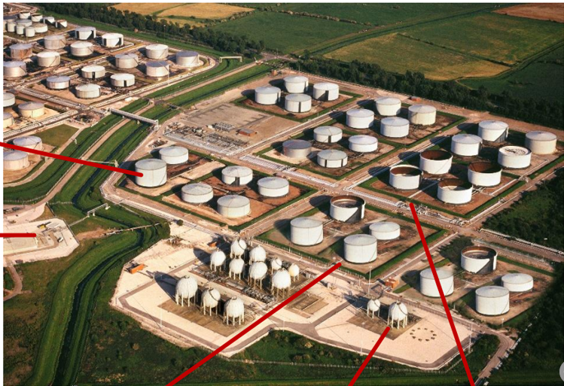

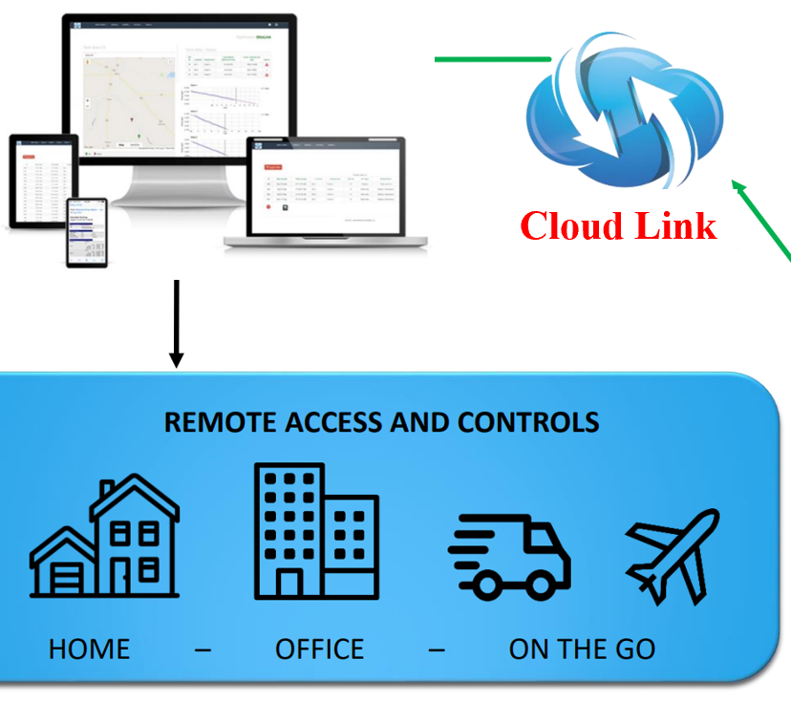

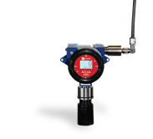
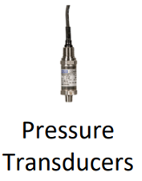
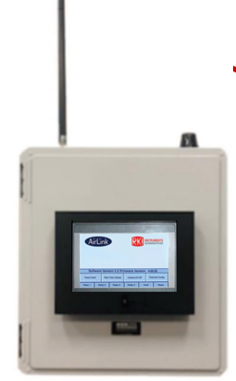
Tank Level
Gas Detection

Slide 7
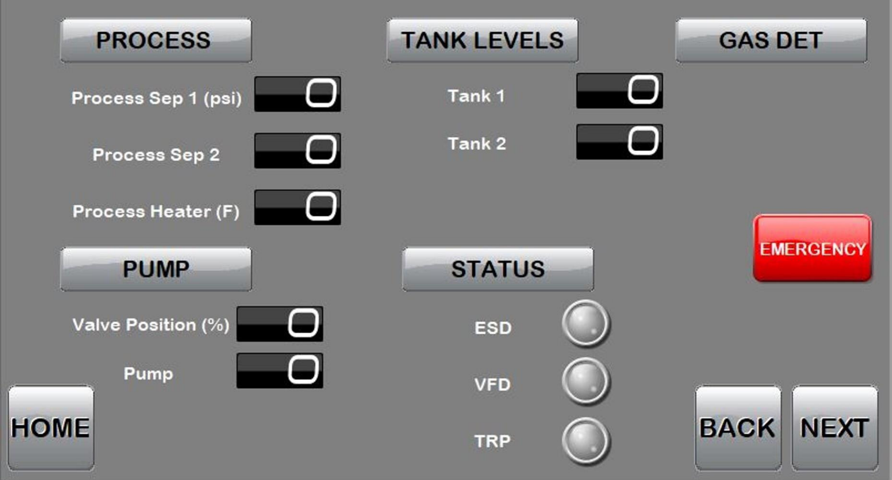

Full Site Data Screen
H2S #1
H2S #2

