Slide 1


Slide 2



Fixed Gas Detection Solutions
Noses
4-20 ma
Brain
Direct connect
Modbus
HART
Wireless
Contacts
Controller
Sensors/Transmitters

Slide 3




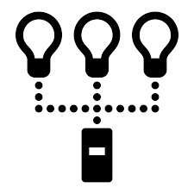
Communication Protocols
4-20 ma analog signal
  When using a 4-20 ma wired output signal devices, the 4-20 ma defines the current loop analog signal range with 4 ma representing the lowest end of the range and 20 ma the highest. The relationship between the current loop and the gas value is linear.
Direct connect
  No amplifier board
Modbus
  Modbus supports communication to and from multiple devices connected to the same cable or Ethernet network. For example, there can be 20 gas detection sensors reporting to 1 controller through a 3 conductor cable.
    Daisy chain
    Non-controlled
HART
  Highway Addressable Remote Transducer
  hybrid analog+digital industrial automation open protocol
    Daisy Chain
    Controlled
Wireless
  900 MHz or 2.4 GHz
Contacts
  Relays

Slide 4
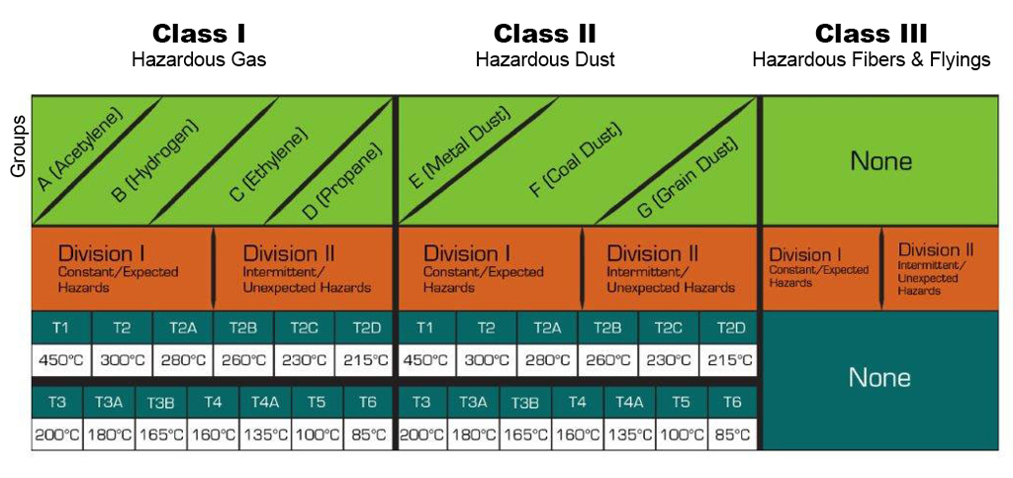
Explosion Proof Certifications

Slide 5
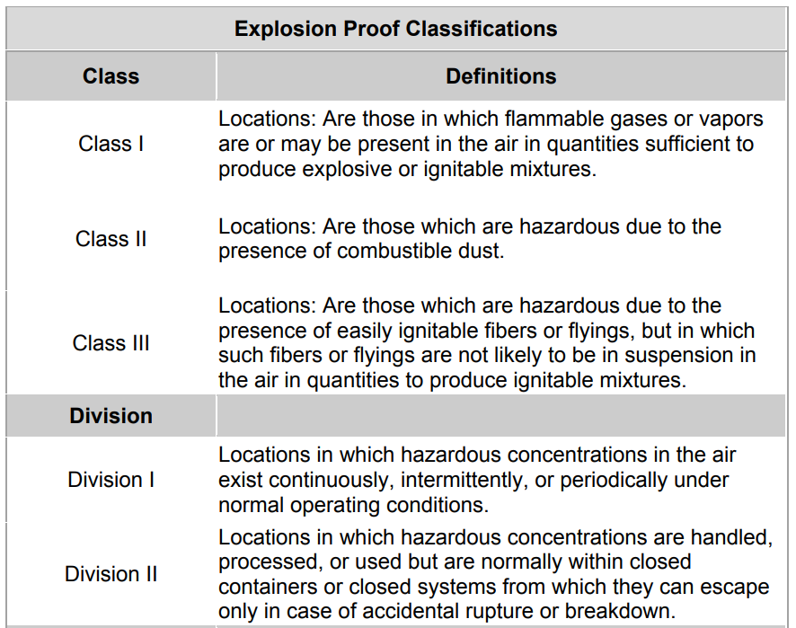
Explosion Proof Certifications

Slide 6
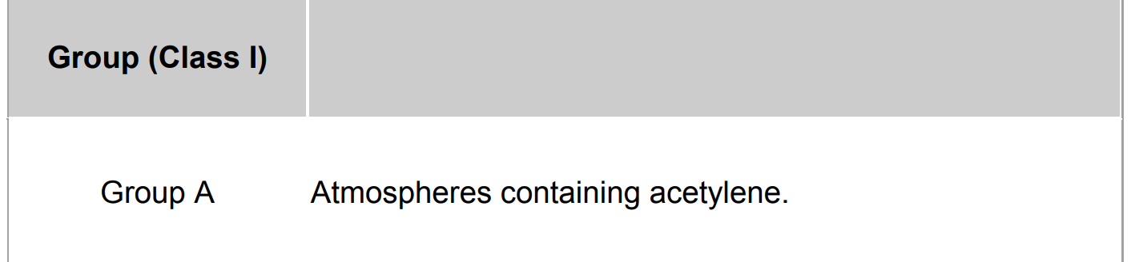
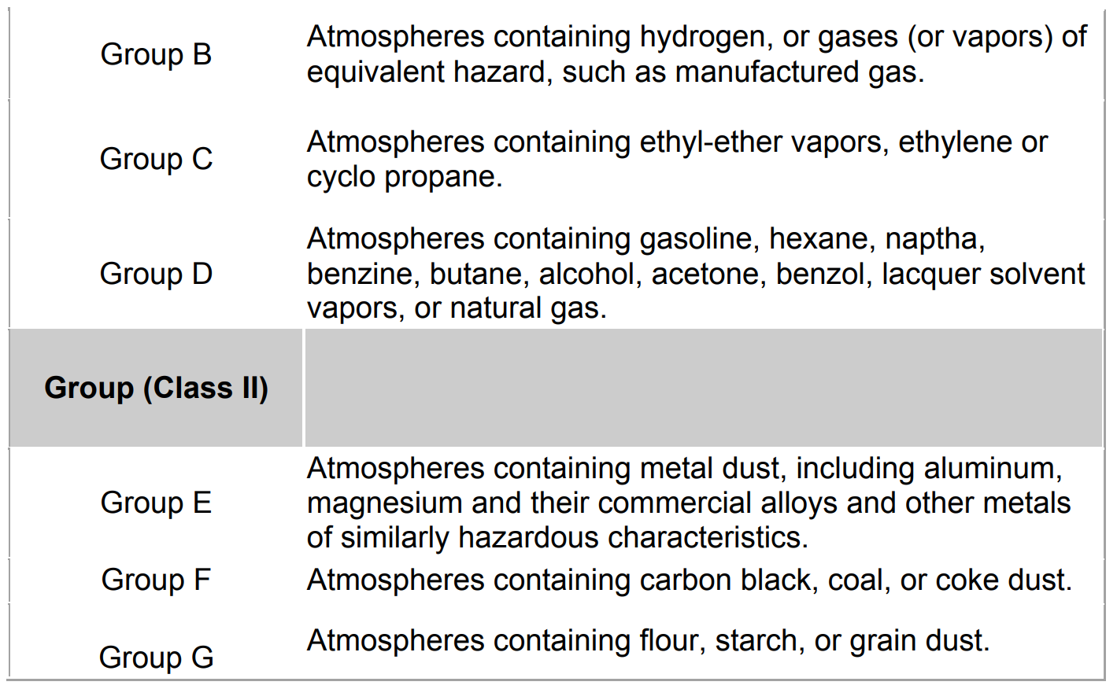
Explosion Proof Certifications

Slide 7
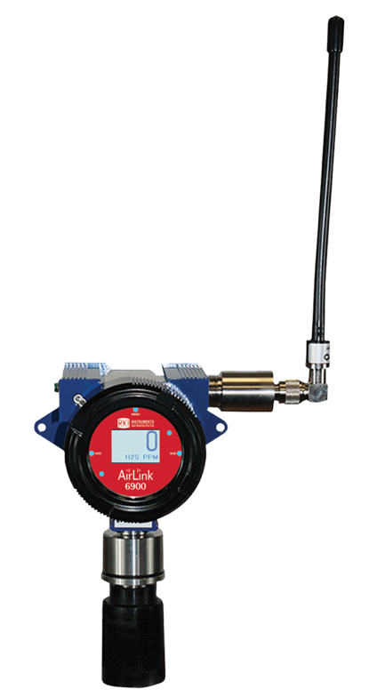
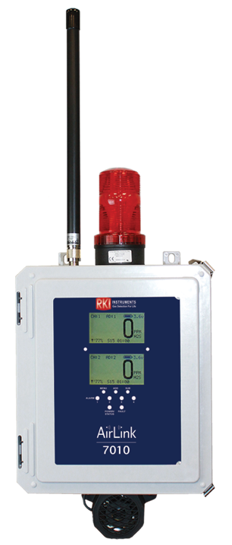

Wireless Solutions
Controllers
Transmitters

Slide 8
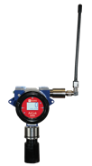

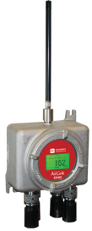
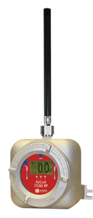
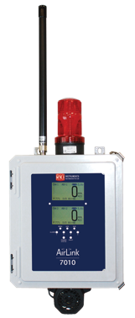
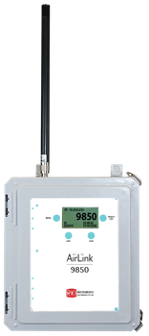
Typical Components
AirLink 6900
Explosion Proof Transmitter
AirLink 6940
Quad Sensor Transmitter
AirLink 7530
Secondary Controller
(Relay Module)
AirLink 7010
Primary Controller
AirLink 9850
Secondary Controller
(255 channel Interface)

Slide 9
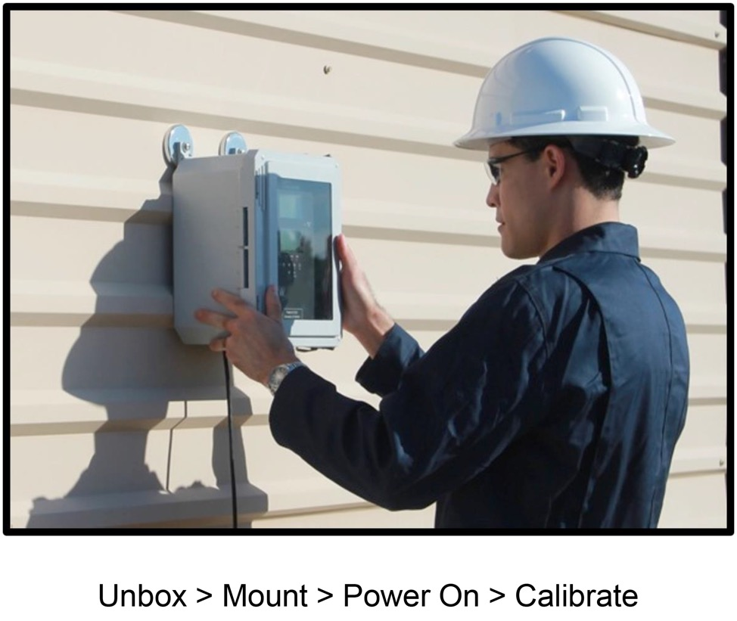
Easy Installation

Slide 10
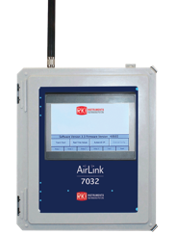
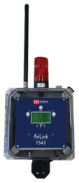
Wireless Controllers
Programmable relays
Hybrid wireless & wired input
4-20 mA Output
Modbus Out
WirelessHART ®
Channels
AirLink 7543 | 6 | 3 |  |  | 🔵 | 🔵
AirLink 7010 | 32 | 2 | 🔵 |  | 🔵
AirLink 7032 | 32 | 3 | 🔵 |  | 🔵
AirLink 9850 | 255 | 0 |  | 🔵 | 🔵
AirLink 7032
32 Channel Touchscreen Hybrid
AirLink 7010
32 Channel Hybrid
900 MHz or 2.4 GHz radio options
Digital Display of Gas Readings
Weather proof NEMA 4X enclosure
Multi color LED Alarm Indicators
Optional strobe, horn & battery backup options
AirLink 9850
255 Channel Interface
AirLink 7543
6 Channel with Modbus

Slide 11
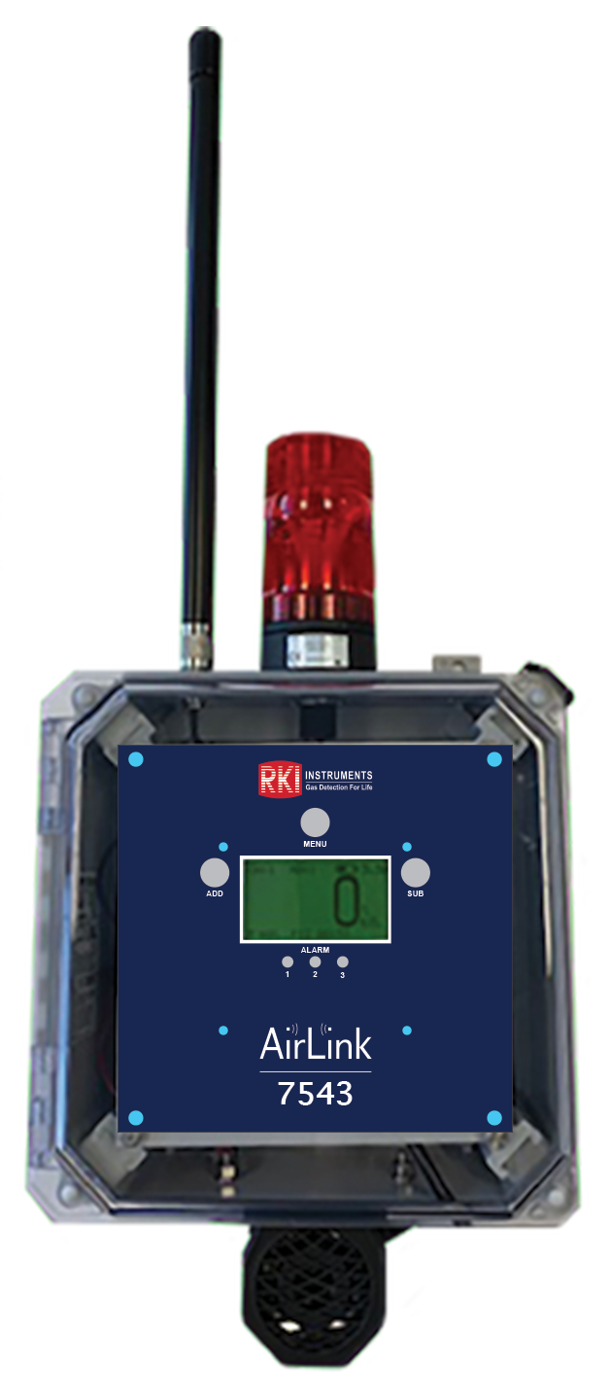
Wireless controllers continued
6 channel wireless controller
3 Programmable Alarm Relays
Modbus or HART output
24 VDC or 110 VAC
NEMA 4X enclosure
6 Channel with Modbus
Airlink 7543

Slide 12
How to access menus
Airlink 7543
  Basic Configuration Menu
    Press and hold MENU for five seconds
    Channel Selection, Channel On/Off, Radio Address Setting, Relay On/Off, Relay Setting-Type (Rise/Fall), Relay Value Setting, Relay Latching/Unlatching, Duplicate Channel.
  Advanced Configuration Menu
    Cycle the unit's power (turn OFF, then ON). Power off the device by turning off the voltage supply at the power source (DC power), or by unplugging the unit (AC power). Power on the device by supplying voltage to the unit.
    When the RKI Logo is shown on the Display Screen, press MENU
    Adjust LCD Contrast, Restore Factory Default Settings, Fault Relay Setup: Relay 3 Fault Relay, Fault Relay Setup: Latching or Unlatching, Relay Failsafe Setup: Relay 1 Failsafe (right), Relay Failsafe Setup: Relay 2 Failsafe (below), Relay Failsafe Setup: Relay 3 Failsafe (right), Relay Failsafe Setup: Fault Terminal Failsafe (below), Radio Timeout Setting, Network Channel Setting, Primary/Secondary Setting
  Relay Alarm test mode
    Press and hold MENU and SUB for five seconds to enter Alarm Test Mode
6 Channel with Modbus

Slide 13


Wireless Explosion Proof Transmitter
Continuously monitor wide range of gases using advanced sensor technology
  Electrochemical
  IR
  PID
Wireless communication:
  900 MHz radio and 52 networks
  2.4 GHz radio and 78 networks
Dual battery power
  2 year max – electrochemical
  1 to 1.5 years max – IR
  2-weeks plus for PID
  Easy to replace
Airlink 6900 Battery Powered

Slide 14

How to access menus
Airlink 6900
  Product Settings and Configuration menu
    press and hold the MENU button, for approximately 6 seconds
    Alarm Test, Network ID, System Information, Zero/Calibration Timer Information, Unit Information, Background Setting, Calibration Method, Display Screen Contrast Setting, Return to Factory Default Settings, Reset Zero & Calibration Values
  Operation Settings menu
    Press and release the menu button once.
    Zeroing the Sensor, Calibrating the Sensor, Sensor Radio Address

Slide 15
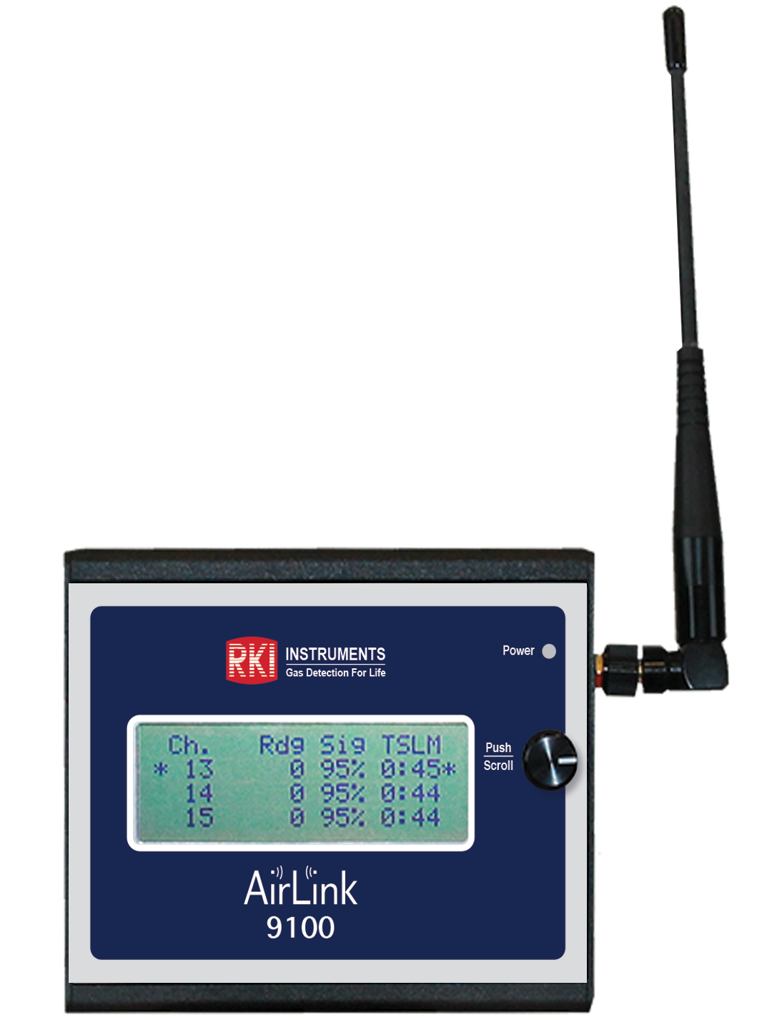
Wireless Add-Ons
AirLink 9100 Portable Signal Strength Meter (Handheld Portable)

Slide 16
How to access menus
Airlink 9100
  Operation Settings
    Turn the unit off if it is on.
    Press and hold PUSH/SCROLL during boot up
    Power on the unit.
    Network ID, Primary or secondary setting

Slide 17
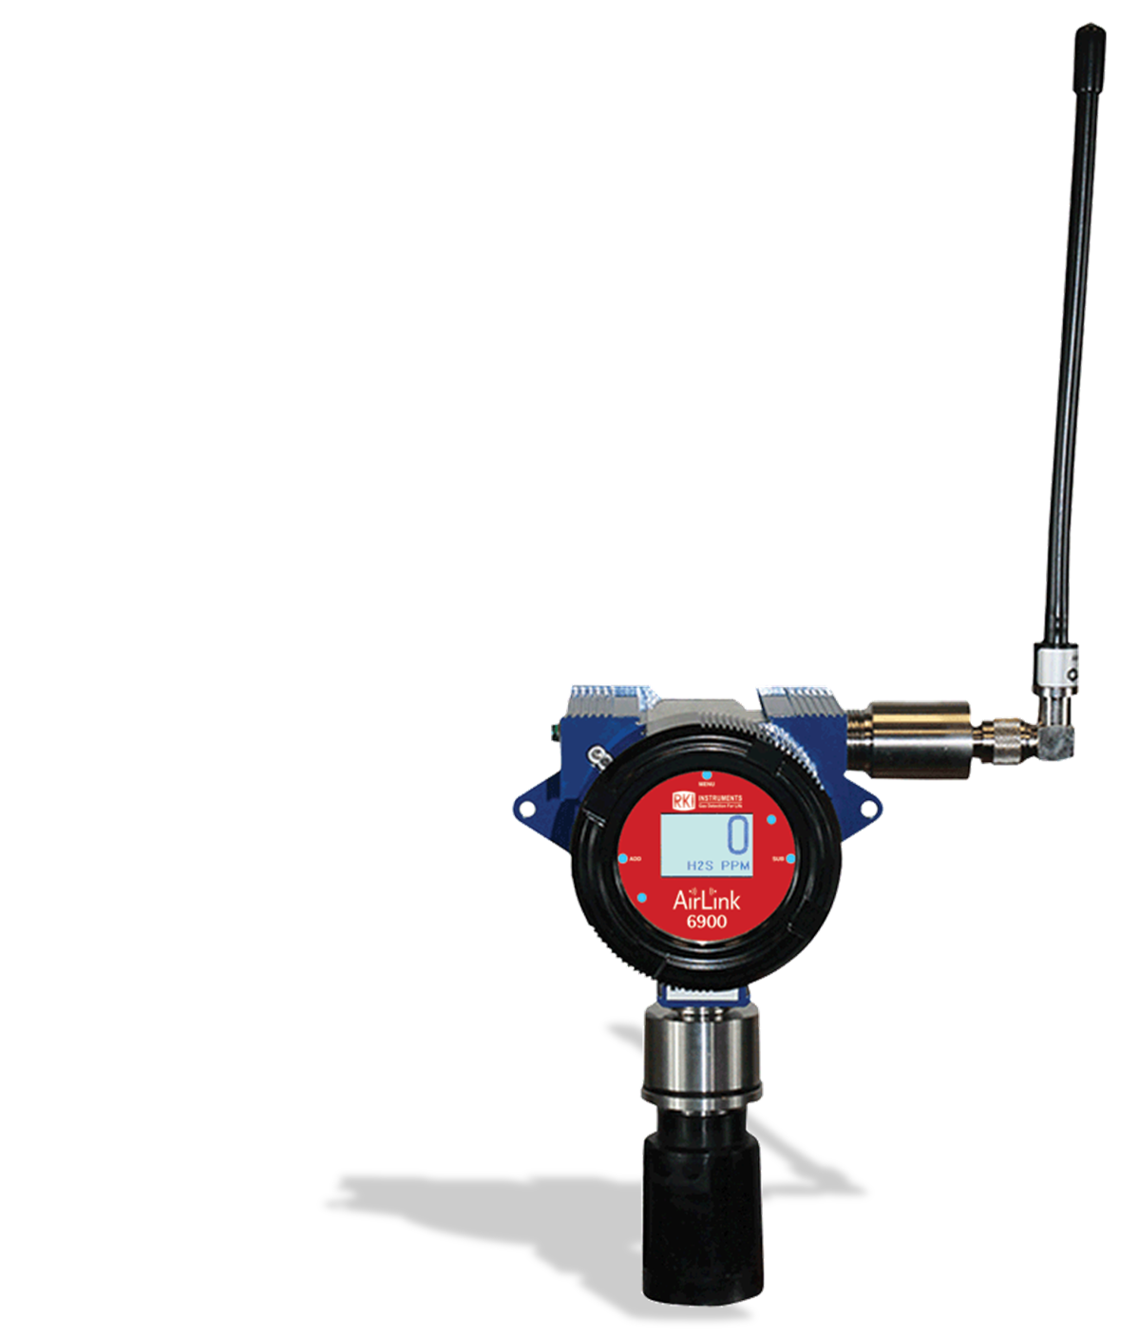
How to do a signal propagation test
Use Airlink 9100 and Airlink 6900
  Check what the Network ID is in the 6900
  Set the Airlink 9100’s Network ID to the same as the 6900
  Place the 6900 in relay test mode.
    Press the Add and Sub buttons every 3-5 seconds. This will generate a signal to the Airlink 9100.
The signal strength needs to be >40%

Slide 18
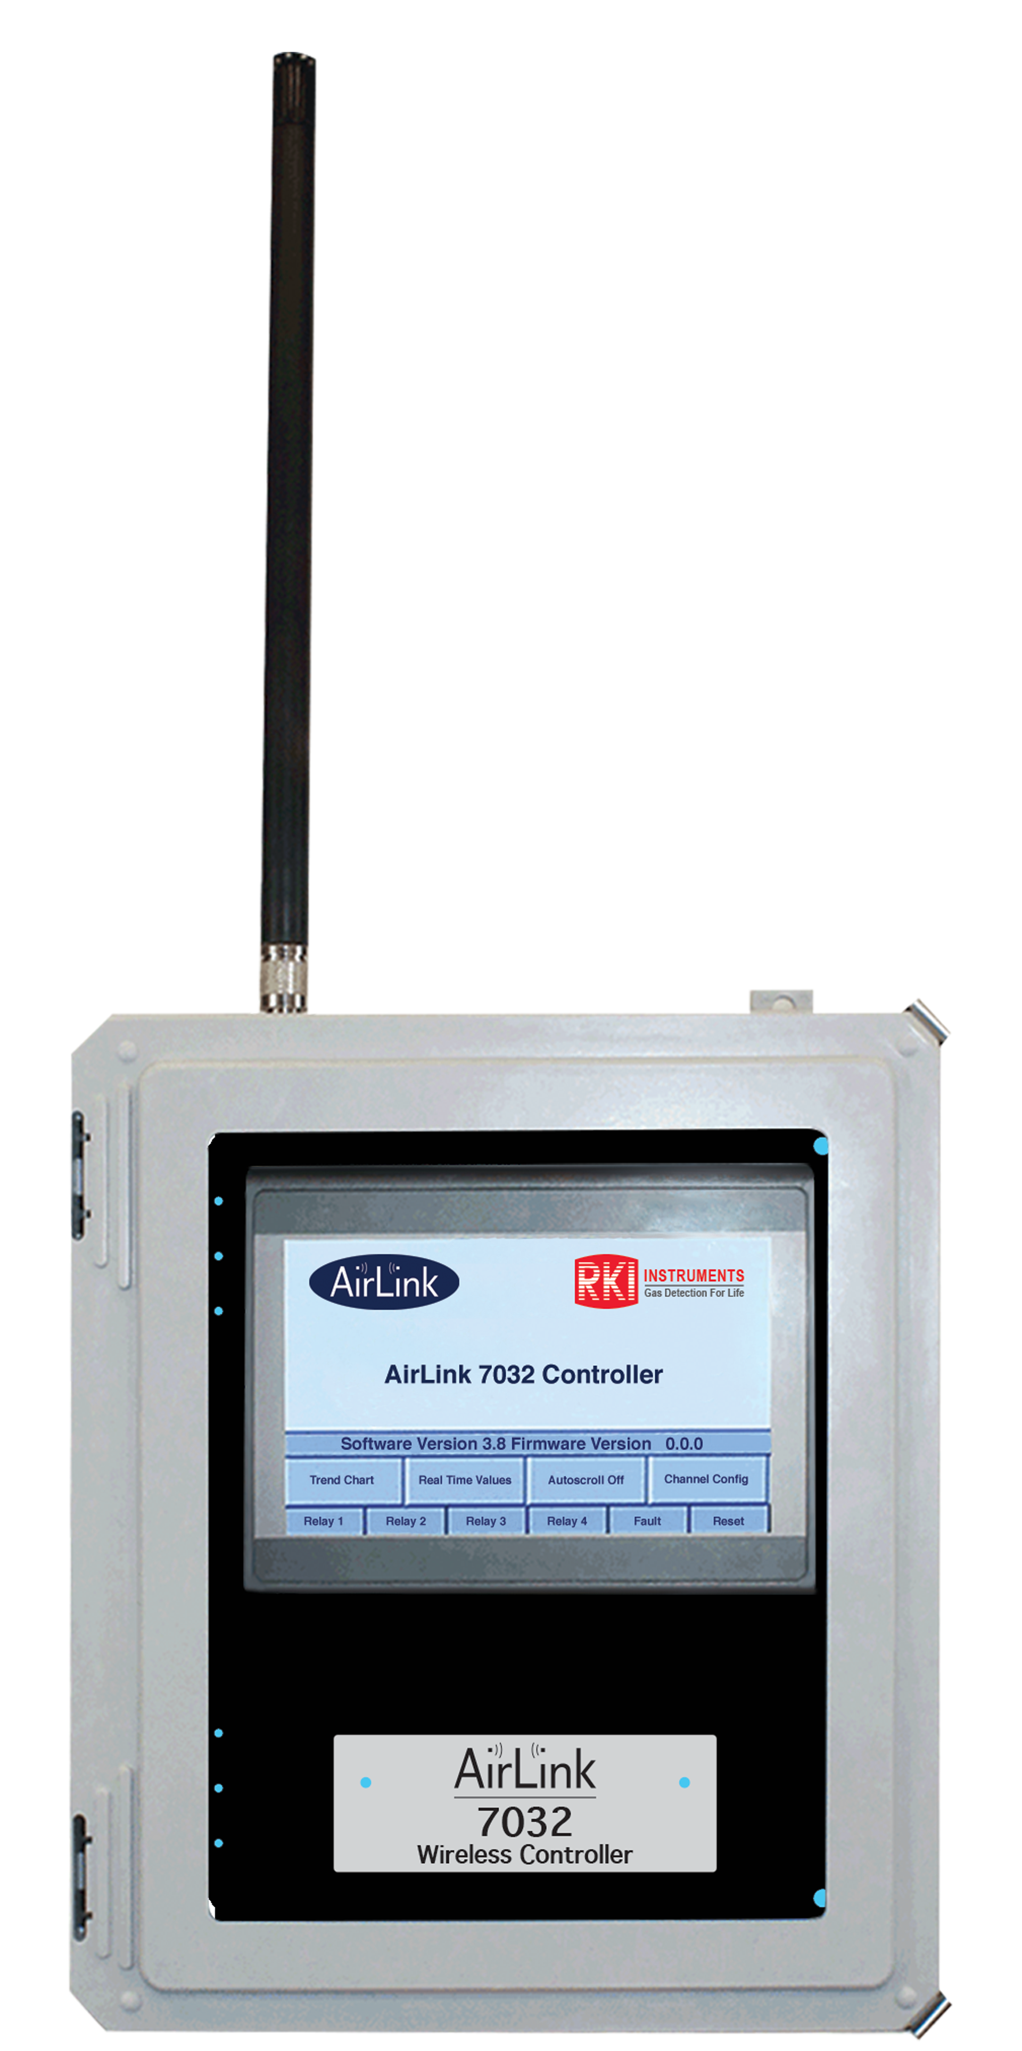
Wireless controllers continued
32 channel controller.
  Accepts 4 wired transmitters
Wireless communication
  900 MHz radio and 52 networks
  2.4 GHz radio and 78 networks
Four Programmable Alarm Relays
NEMA 4X weather resistant enclosure (stainless-steel option available)
Modbus output
24 VDC or 110 VAC
Color touchscreen
32 Channel Touchscreen Controller
Airlink 7032

Slide 19
How to access menus
Airlink 7032
  Channel configuration
    Press the WireFree logo to enable the “Channel Config” button on the Home Screen
    Press “Channel Config” to enter Channel Configuration Mode
    Wired or wirefree, relay configuration, radio address (wirefree), scale (wired), sensor location, duplicate settings, turn channel off
  Configuration menu
    Touch the AirLink logo, then Press and hold the RKI logo until the Touchscreen shows the Configuration Menu.
    View serial #, view date manufactured, calibration mode, relay tests, restart, VIEW Modbus Output Settings: Baud Rate, VIEW Radio Settings: Radio Timeout, VIEW Gen II Radio Settings: Network ID, VIEW Gen II Radio Settings: Primary or Secondary Monitor, VIEW OI-7032 Reset to Factory Default, VIEW Relay Settings: Relays 1-4 (Failsafe), VIEW Relay Settings: Fault Terminal, VIEW Relay Settings: Fault Relay Assign
  Configuration Menu Modifications (Second-Level Configuration Menu)
    To modify certain items in the Configuration Menu, the AirLink 7032 Terminal Board must be reset (while in the Configuration Menu). To reset the board, complete the following steps
      Press “Restart AirLink 7032”
      Wait for the pop-up window to disappear and the grayed-out buttons to become black
    Modbus Address, Baud Rate, Radio Timeout, Network ID, Primary or Secondary Monitor, Reset to Factory Default, Relays 1-4 (Failsafe), Fault Terminal, Fault Relay Assign

Slide 20
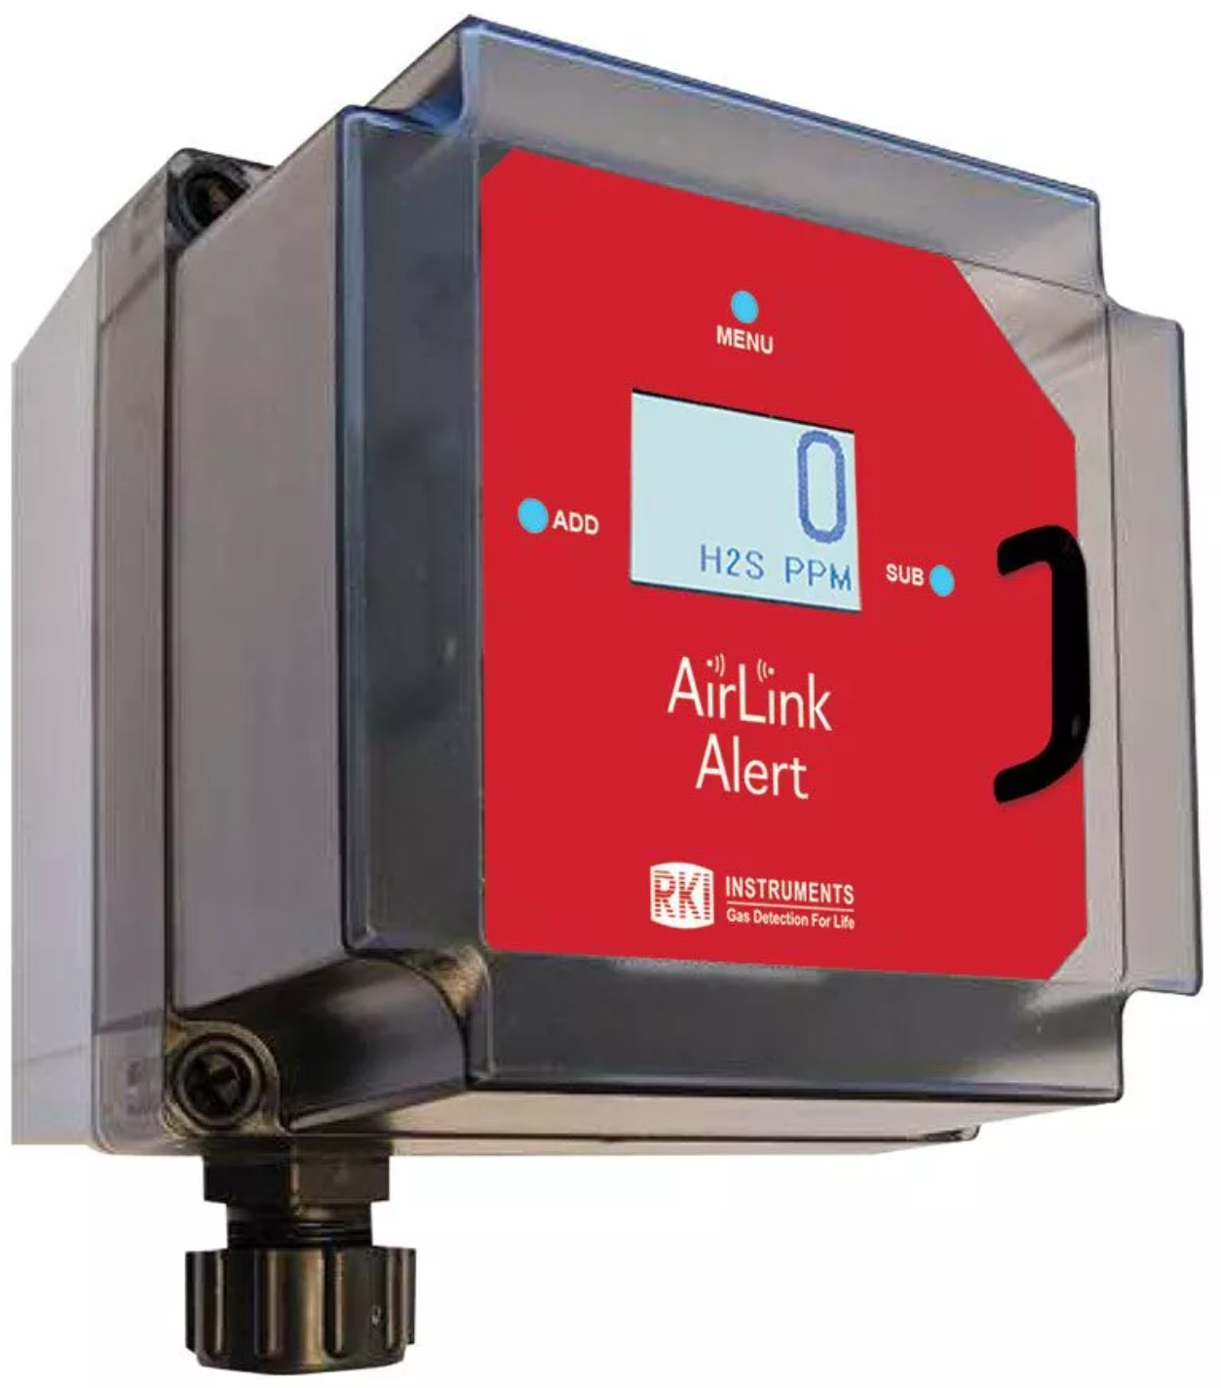
NXP Wireless Transmitter
Electrochemical, Infrared, or PID sensors
Graphical LCD with LED backlight
Battery-operated
Wireless
AirLink Alert
Airlink Alert Battery Powered

Slide 21

How to access menus
Airlink Alert
  Product Settings and Configuration menu
    press and hold the MENU button, for approximately 6 seconds
    Alarm Test, Network ID, System Information, Zero/Calibration Timer Information, Unit Information, Background Setting, Calibration Method, Display Screen Contrast Setting, Return to Factory Default Settings, Reset Zero & Calibration Values
  Operation Settings menu
    Press and release the menu button once.
    Zeroing the Sensor, Calibrating the Sensor, Sensor Radio Address

Slide 22
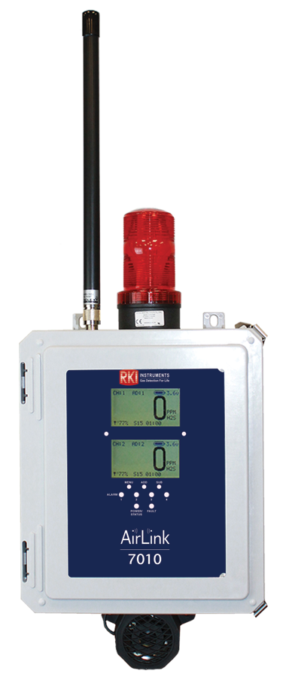
Wireless controllers continued
32 channel controller.
  Accepts 4 wired transmitters
Wireless communication:
  900 MHz radio and 52 networks
  2.4 GHz radio and 78 networks
Four Programmable Alarm Relays
NEMA 4X weather resistant enclosure (stainless-steel option available)
Modbus output
24 VDC or 110 VAC
32 Channel Hybrid Controller
Airlink 7010

Slide 23
How to access menus
Airlink 7010
  Channel Configuration Menu
    Press and hold MENU, ADD and SUB for five seconds
    Channel selection, Channel on/off, Channel type—wired or wirefree, sensor type (wired only), scale (wired only), # of decimals (wired only), radio address (wirefree only), relay on/off, relay rise/fall, relay value, relay latching/unlatching, system information
  Advanced Configuration Menu (Global Settings)
    Cycle the unit's power by using the switch on the PCB. When the Display Screens illuminate, press MENU.
    LCD contrast (upper), LCD contrast (lower), restore factory default settings, relay 4 fault relay, fault relay failsafe setting, fault terminal failsafe setting, Modbus address, Baud setting, Radio Timeout, Network channel, Monitor setup—primary or secondary
  Calibration menu
    Press and hold MENU for five seconds.
    Zero, and span
  Relay test mode
    Press and hold RESET. Relay 1 will activate after five seconds, Relay 2 will activate after an additional five seconds, etc.

Slide 24


Wireless Transmitter, Wire Powered
Continuously monitor wide range of gases using advanced sensor technology
  Electrochemical
  IR
Wireless communication:
  900 MHz radio and 52 networks
  2.4 GHz radio and 78 networks
12– 35 VDC Powered
Airlink T3A

Slide 25
How to access menus
T3A
  Product Settings and Configuration menu
    press and hold the MENU button, for approximately 6 seconds
    Alarm Test, System Information, Zero/Calibration Timers, Unit Info, Relay 1: Latching/Auto Resetting Setting, Relay 2: Latching/Auto Resetting Setting, Relay 1: Fail-Safe Setting, Relay 2: Fail-Safe Setting, Fault Terminal Fail-Safe Setting, Calibration Method, RS-485 Modbus Address Setting, RS-485 Modbus Baud Setting, 4-20 mA Offset Settings: Zero Offset Setting, Full-Scale Offset Setting, Display Screen Contrast Setting, Return to Factory Default Settings, Reset Zero and Calibration Values Only
  Operation Settings menu
    Press and release the menu button once.
    Zero, Span, Alarm settings

Slide 26
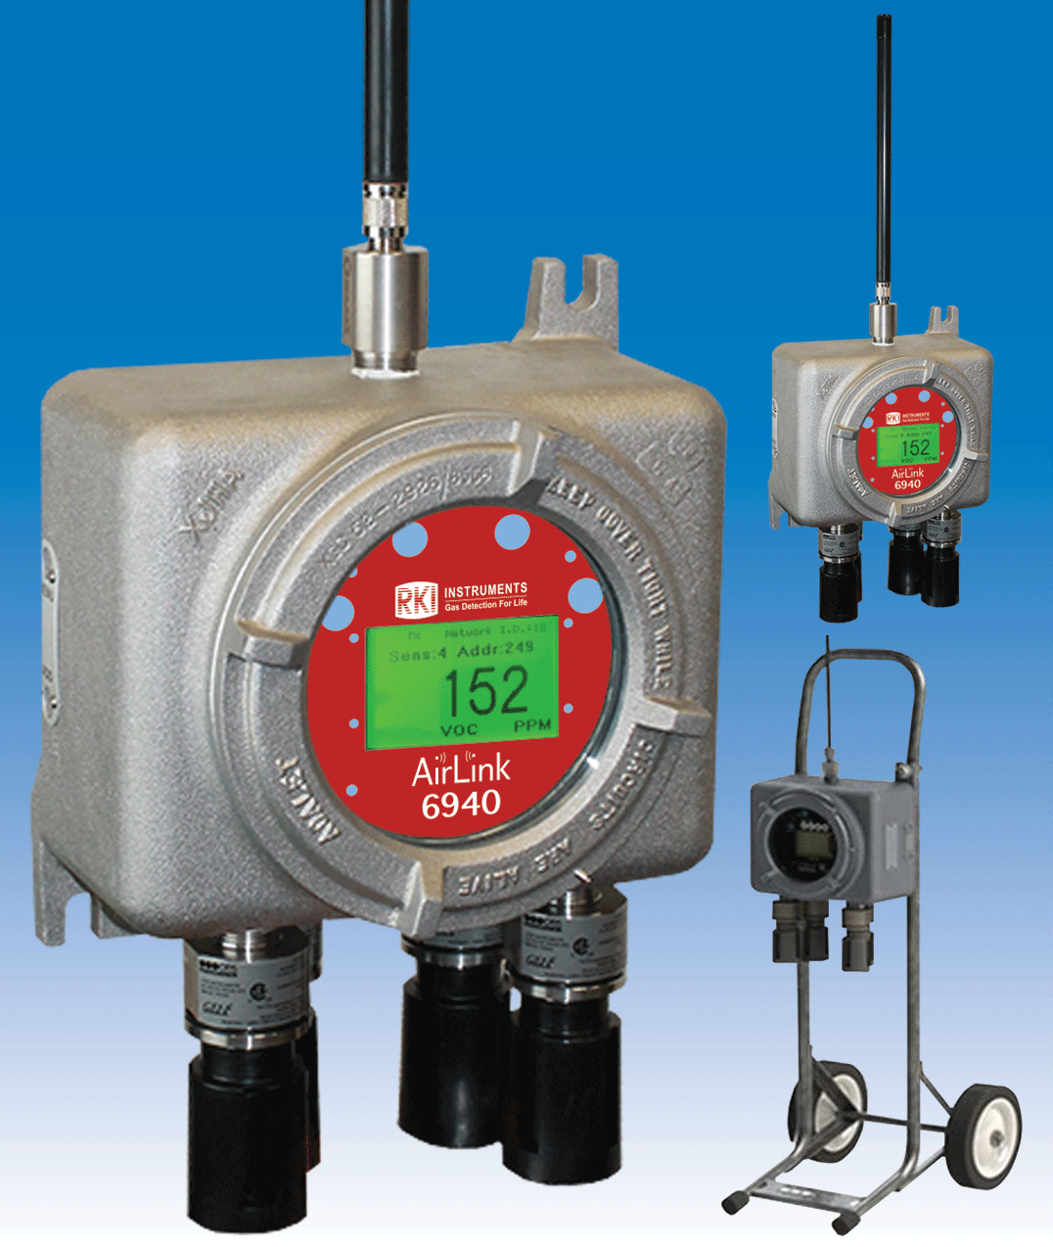
4 Sensor Transmitter
Continuously monitor up to 4 gases with one transmitter
Wireless communication:
  900 MHz radio and 52 networks
  2.4 GHz radio and 78 networks
Battery life:
  6-months maximum
  2-weeks plus for PID
Electrochemical, PID, or IR sensors available
Explosion and non-explosion proof versions.
Airlink 6940 Battery Powered

Slide 27
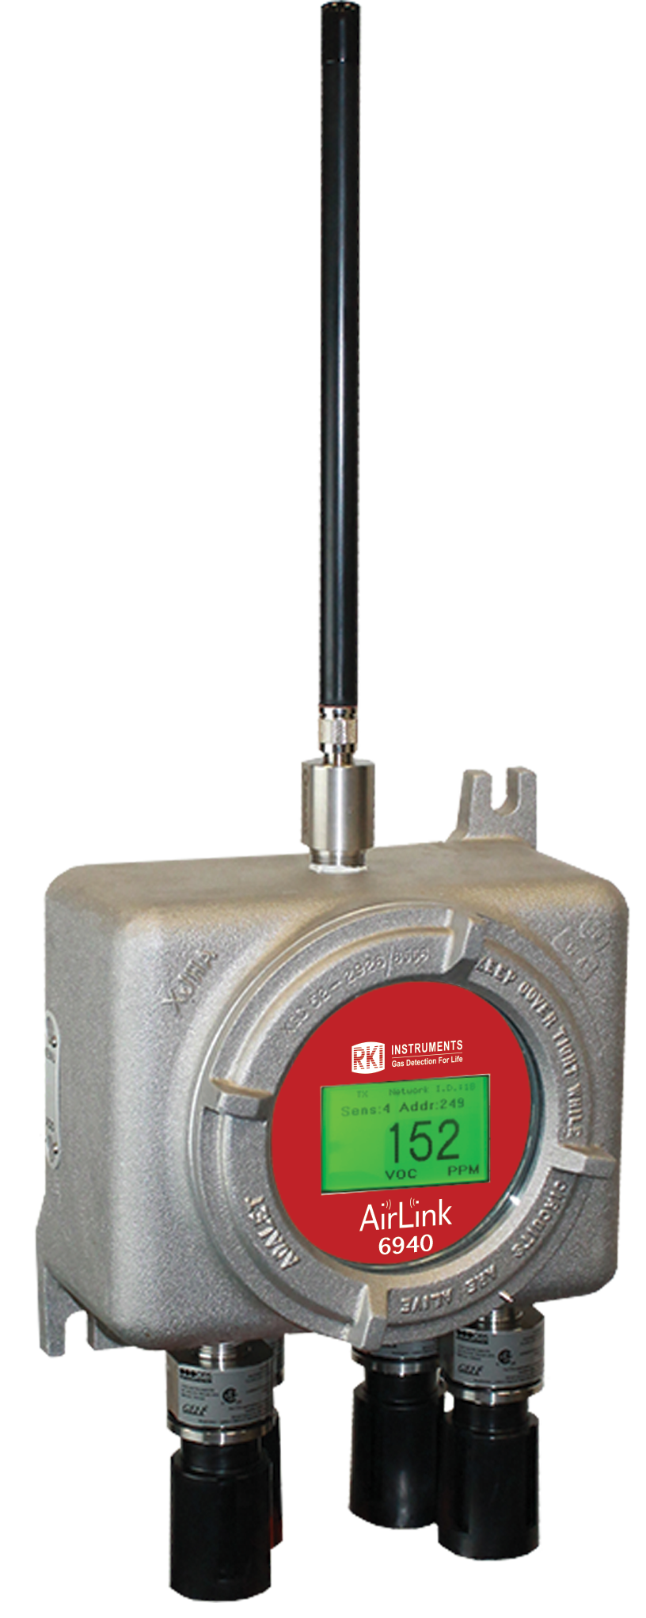
How to access menus
Airlink 6940
  Product Settings and Configuration menu
    press and hold the MENU button, for approximately 6 seconds
    Global settings, Network ID, Unit information, Contrast setting, factory default settings, back menu, sensor settings, sensor on/off, nulling the sensor, calibrating the sensor, sensor radio address, sensor relay test, sensor background setting, sensor background setting, sensor background high setting, sensor background low setting, calibration method, sensor information, null calibration timer information, reset sensor null/cal
  Operation Settings menu
    Press and release the menu button once.
    Powering on, powering off, display behavior above background

Slide 28
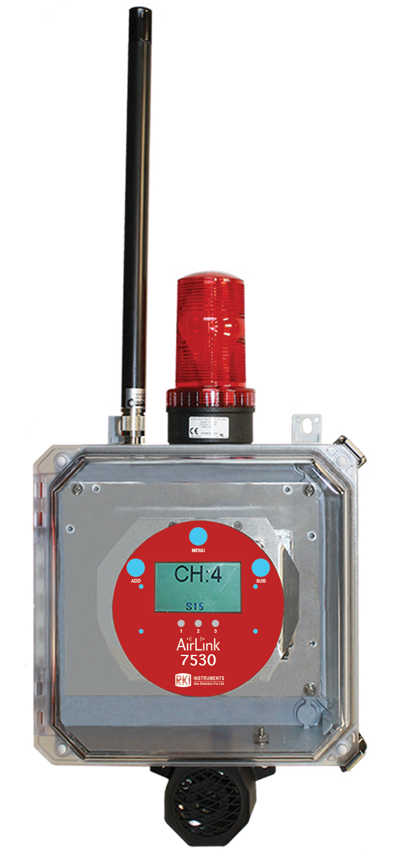
Wireless Add Ons continued
AirLink 7530 Relay Module
Accepts up to 32 wireless transmitters
3 programmable alarm relays out
Optional light and horn available (uses 1 relay)
Available in explosion and non-explosion proof

Slide 29
How to access menus
Airlink 7530
  Configuration mode
    Press and hold MENU for five seconds
    Channel Selection, Channel On/Off, Radio Address Setting, Relay On/Off, Relay Setting-Type (Rise/Fall), Relay Value Setting, Relay Latching/Unlatching, Duplicate Channel.
  Advanced Configuration menu
    Cycle the unit's power (turn OFF, then ON). Power off the device by turning off the voltage supply at the power source (DC power), or by unplugging the unit (AC power). Power on the device by supplying voltage to the unit.
    When the RKI Logo is shown on the Display Screen, press and hold the MENU button.
    Adjusting LCD Contrast, Restore Factory Default Settings, Fault Relay Setup: Relay 3 Fault Relay, Fault Relay Setup: Latching or Unlatching, Radio Timeout Setting, Network Channel Setting, Primary/Secondary Setting.
  Relay test mode
    Touch and hold the MENU and SUB buttons for five seconds to enter Alarm Test Mode.

Slide 30
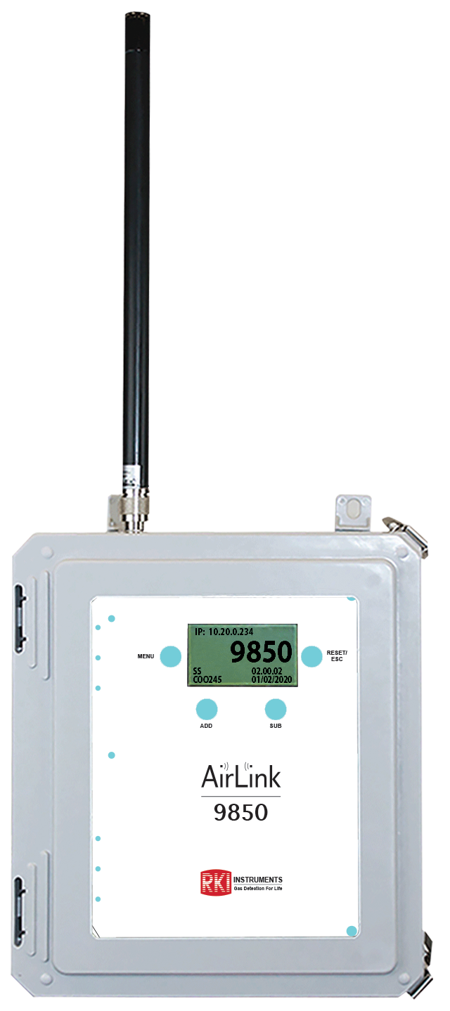
Wireless controllers continued
255 channel wireless or Modbus input
Modbus output, or up to thirty-two 4-20
24 VDC or 110 VAC
NEMA 4X enclosure
255 Channel Interface
Airlink 9850 Receiver Interface

Slide 31
How to access menus
Airlink 9850
  Basic Configuration Menu
    Press and hold MENU for five seconds
    Modbus Setup Address Setting, Modbus Setup Baud, Modbus Setup Float Swap, Modbus Setup 485 or 232, 4-20 Port Setup, 4-20 Port Setup On/Off, 4-20 Port Setup Address, 4-20 Port Setup Output 1:1/Scaled, 4-20 Port Setup Min Scale, 4-20 Port Setup Max Scale, 4-20 Port Setup 4mA Offset, 4-20 Port Setup 20mA Offset, IP Address Setup Type, Address Selection for relay, Address On/Off Setup for relay, Address Rise/Fall Low Setup for relay, Low Alarm Setup for relay, Address Rise/Fall High Setup for relay, High Alarm Setup for relay, Address Setup: Duplicate.
  Advanced Configuration Menu
    Cycle the unit's power (turn OFF, then ON). Power off the device by turning off the voltage supply at the power source (DC power), or by unplugging the unit (AC power). Power on the device by supplying voltage to the unit.
    When the RKI Logo is shown on the Display Screen, press MENU
    Adjust LCD Contrast, Radio Timeout, Network ID, Primary/Secondary Monitor Setting.
255 Channel Interface

Slide 32

Wireless Add-Ons
AirLink 9900 Signal Repeater, Explosion Proof

Slide 33
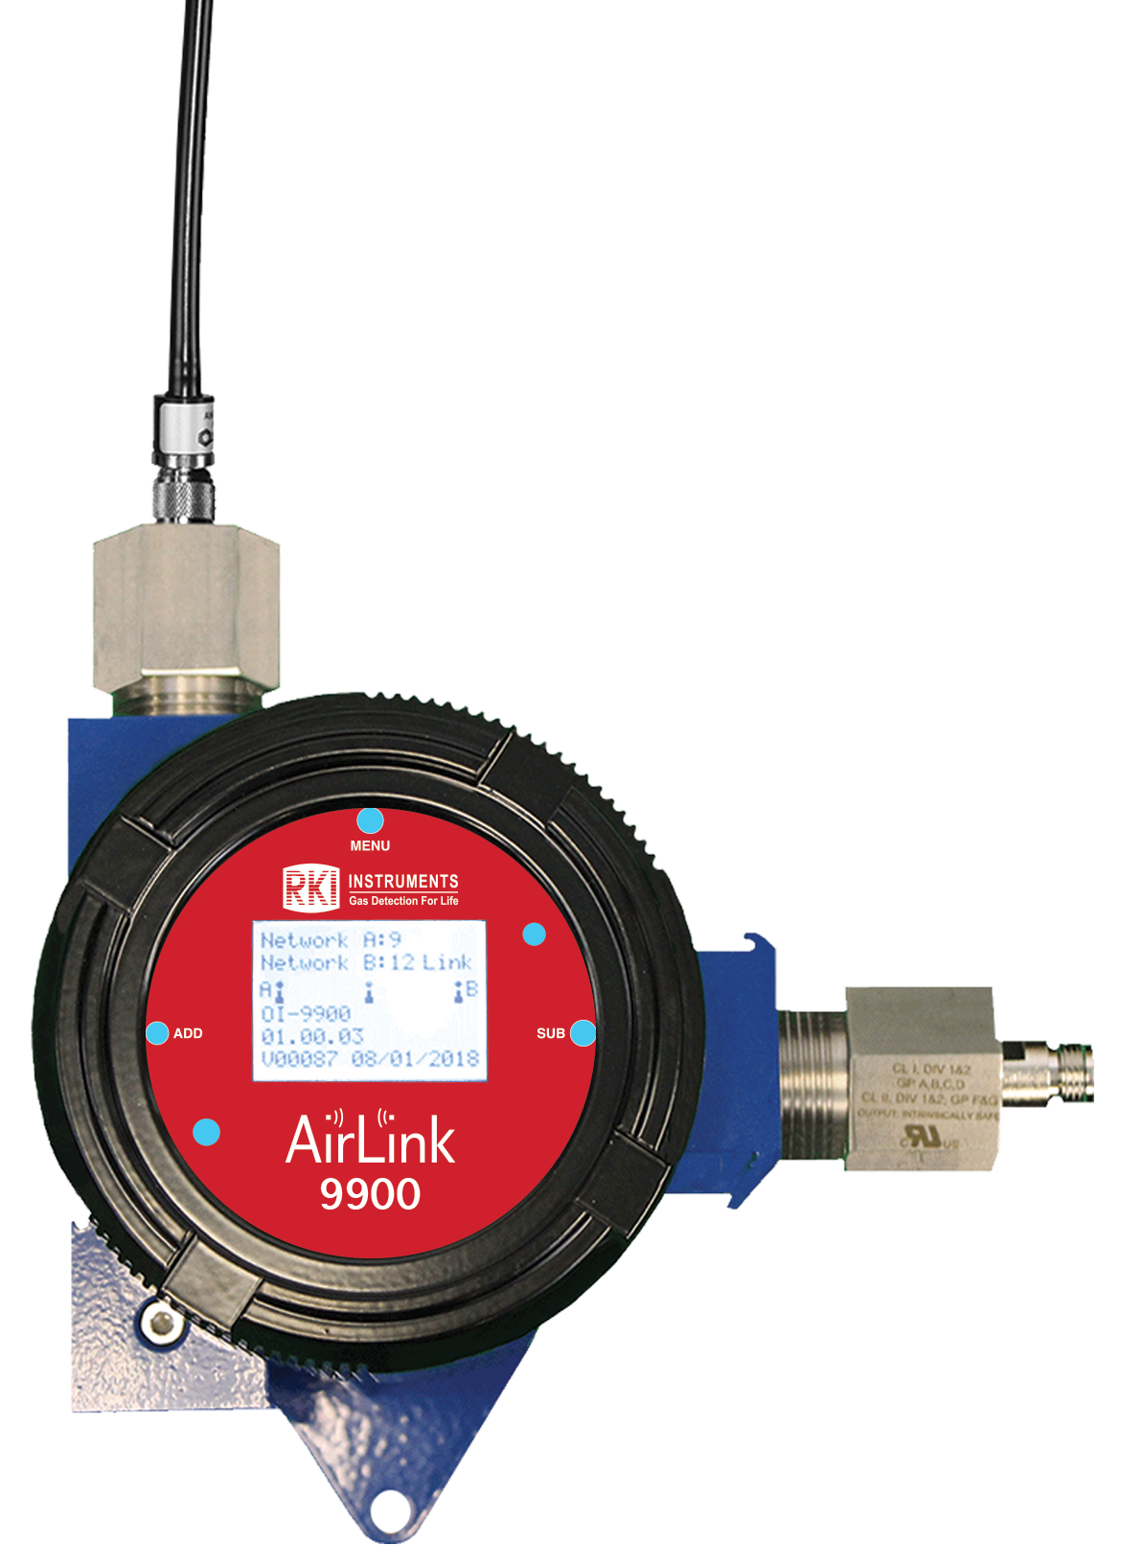
How to access menus
Airlink 9900
  Menu mode
    press and hold the MENU button, for approximately 6 seconds
    Network ID A, Network ID B, setting contrast

Slide 34

Wireless PID Transmitter,
Wire Powered
Continuously monitor wide range of VOC using a variety of PID sensors
  10.6 eV low range 0-50 ppm
  10.6 eV high range, 0-2000 ppm
  10.0 eV 0-100 ppm
  11.7 eV 0-1000 ppm
Replaceable Lamps & Electrode Stacks
Wireless communication:
  900 MHz radio and 52 networks
  2.4 GHz radio and 78 networks
12– 35 VDC Powered
Airlink VOC Pro

Slide 35

How to access menus
Airlink VOC Pro
  Product Settings and Configuration menu
    press and hold the MENU button, for approximately 6 seconds
    Alarm Test, System Information, Zero/Calibration Timers, Unit Info, Relay 1: Latching/Auto Resetting Setting, Relay 2: Latching/Auto Resetting Setting, Relay 1: Fail-Safe Setting, Relay 2: Fail-Safe Setting, Fault Terminal Fail-Safe Setting, Calibration Method, RS-485 Modbus Address Setting, RS-485 Modbus Baud Setting, 4-20 mA Offset Settings: Zero Offset Setting, Full-Scale Offset Setting, Display Screen Contrast Setting, Return to Factory Default Settings, Reset Zero and Calibration Values Only
  Operation Settings menu
    Press and release the menu button once.
    Zero, Span, Alarm settings

Slide 36
Wireless Add Ons continued
The AirLink 5900 makes any 4-20 ma transmitter into a Wireless transmitter
24 VDC
5900 powers connected transmitter.
Accepts 2 or 3 wire 4-20 ma input
No relays
Explosion proof
5900
Airlink 5900

Slide 37
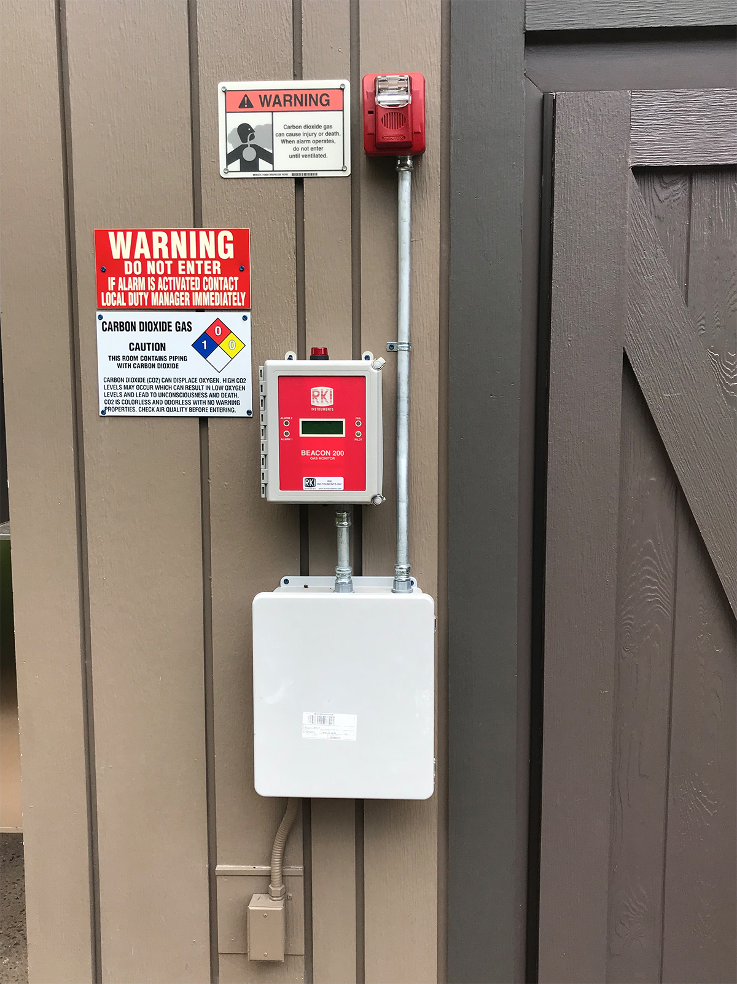
Peripheral Devices
Battery back-up for many devices
Auto dialers-voice recordings
  Notify authorities
WiFi text and email generators
Datalogger
  Document readings
UPS
  Supplies back-up power to system and enunciators

Slide 38
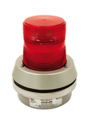

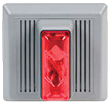
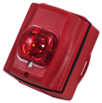
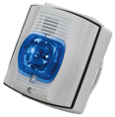

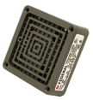
Horns & Strobes
Non Hazardous Location
Lights or Strobes with Horns
4 wire ( Strobe and Horn wired separately)
Lights or strobes with horns
2 wire
Lights, Strobes, or Horns
Rotating Alarm 120V
Green, Amber, Red or Blue
Horn with Strobe
115 VAC / 24 VDC , 4 wire
Amber, Blue or Red
Flashing Alarm Light with Horn
115 VAC / 24 VDC
Red, Blue or Amber
Strobe NEMA 3R / 4X Red Housing
Amber, Red or Blue
Horn with Strobe
NEMA 3R, 4 Wire, 24 VDC
Amber or Red
Strobe with Horn
115 VAC / 24 VDC, NEMA 4X / 3R
Amber, Blue or Red
24 VDC Vibrating Horn

Slide 39

Horns & Strobes
Non Hazardous Location
Stack lights and audibles

Slide 40
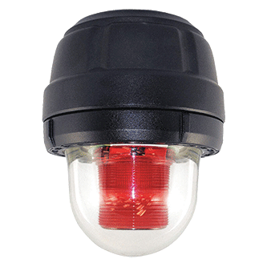

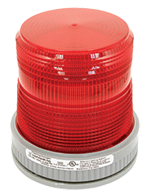
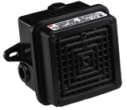
Horns & Strobes
Hazardous Location
Class I Div 1 Strobes or Horns
Class I Div 2 Strobes or Horns
Horn with Strobe
115 VAC / 24 VDC , 4 wire
Amber, Blue or Red
Horn 115 VAC
Strobe Light
115 VAC / 24 VDC
Red or Amber
Horn 115 VAC

Slide 41
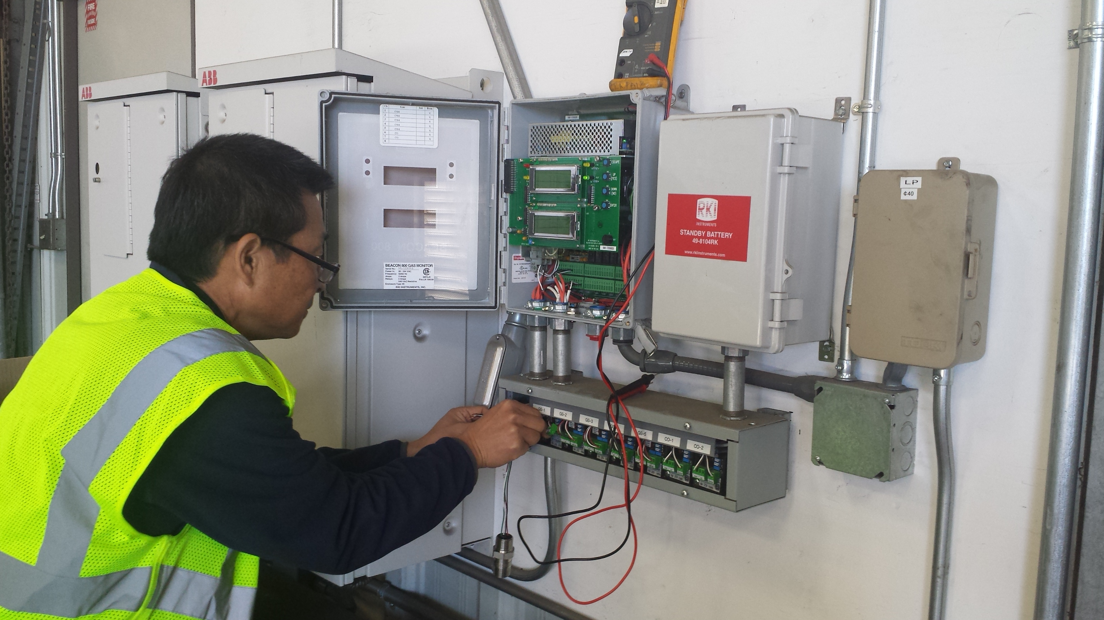
Fixed System Services
Start-up
Installation

Slide 42

Questions?

