Slide 1
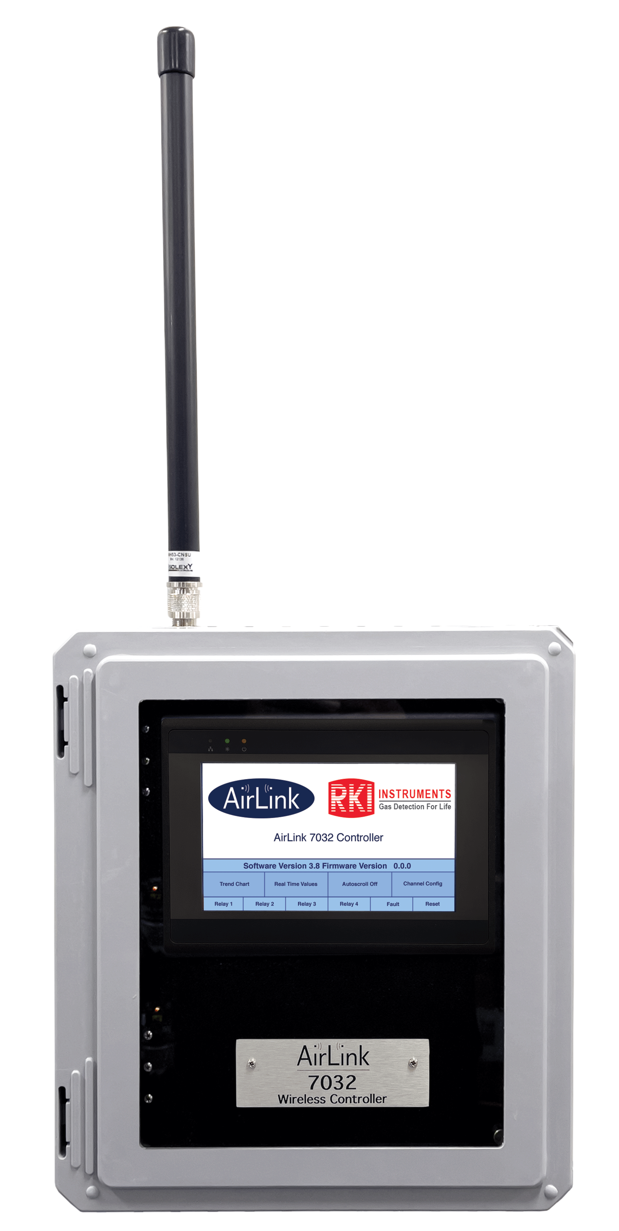
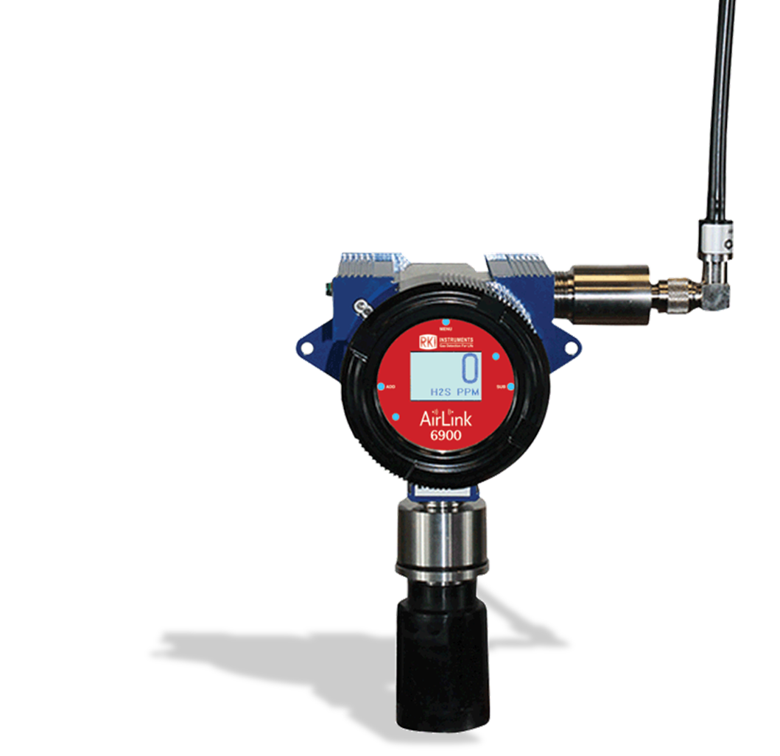
When & Where Wireless?

Slide 2

When Wireless?
Long wire runs
  Receiver to transmitter
  Ancillary equipment
Power not available at transmitter locations
Need multiple lights and horns
Need multiple receivers
Explosion proof areas at transmitter locations
Clean room areas
Mobility needed
Rental for a short time
  Turn-arounds

Slide 3
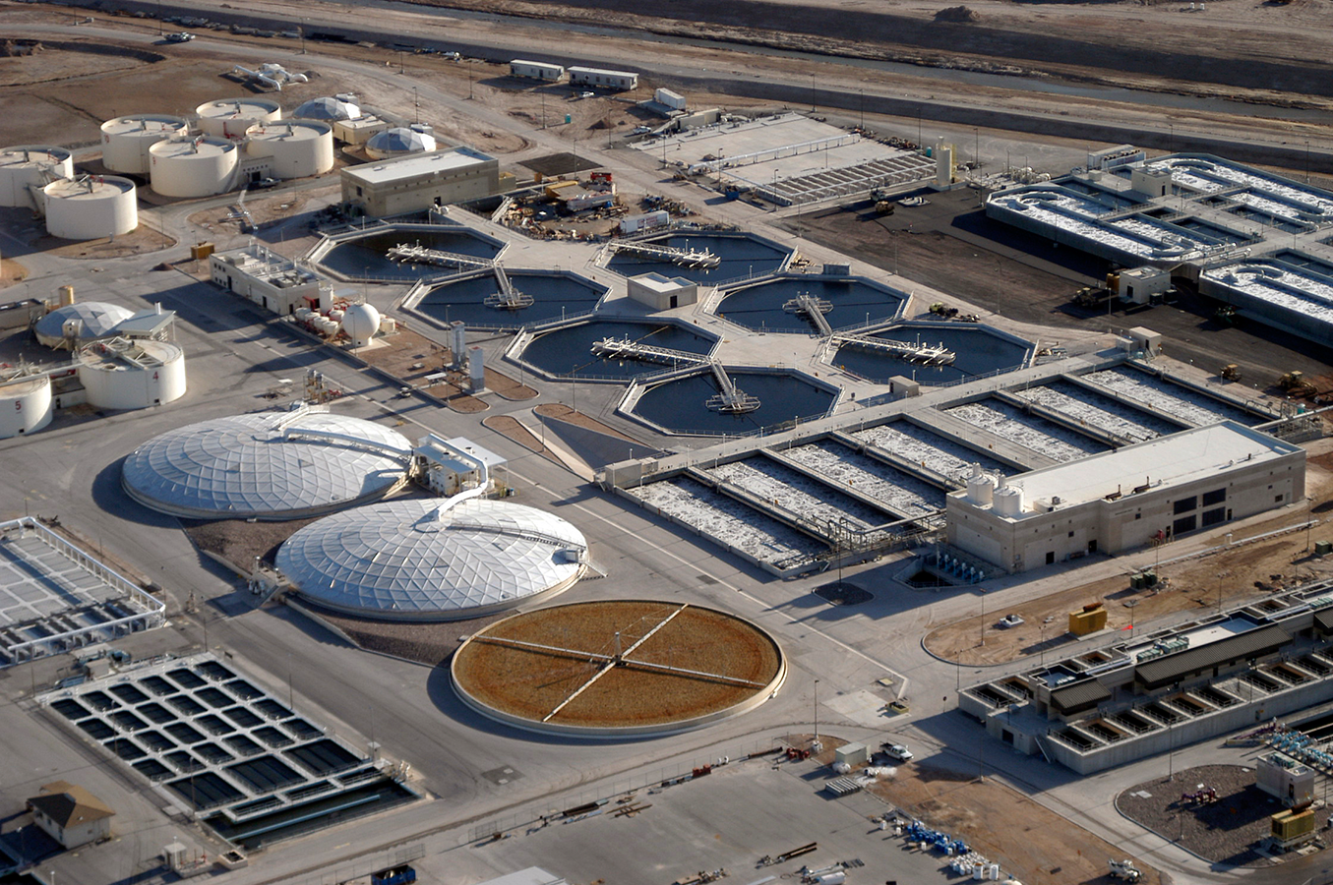
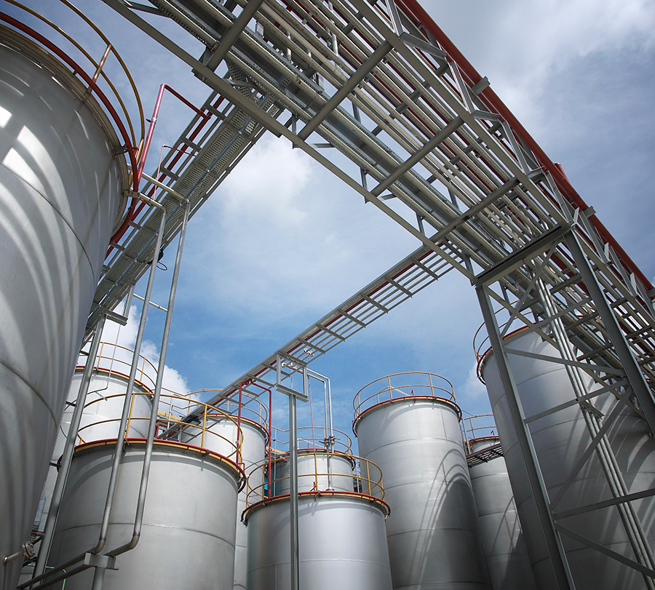
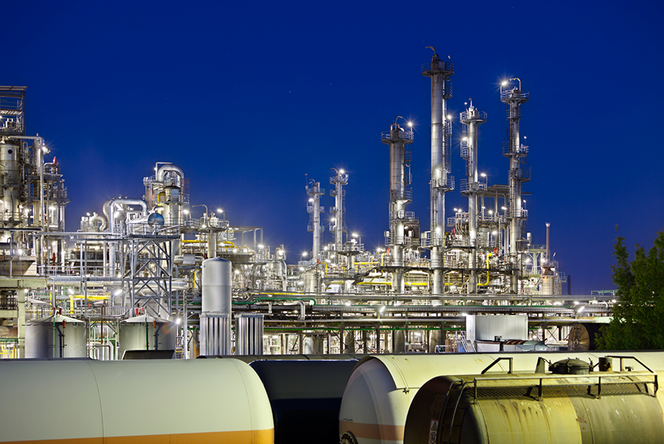
Where Wireless?
INDUSTRIES & APPLICATIONS
Steel industry
Power generation
Marine
Oil & gas exploration & production
Water & Waste Water treatment
Waste disposal on landfill sites
Chemicals
Tank Farms
Pharmaceuticals, hospitals & laboratories
Food & beverage
Oil & gas distribution & storage
Paper & pulp industry
Automotive & aviation
Mining
Manufacturing

Slide 4
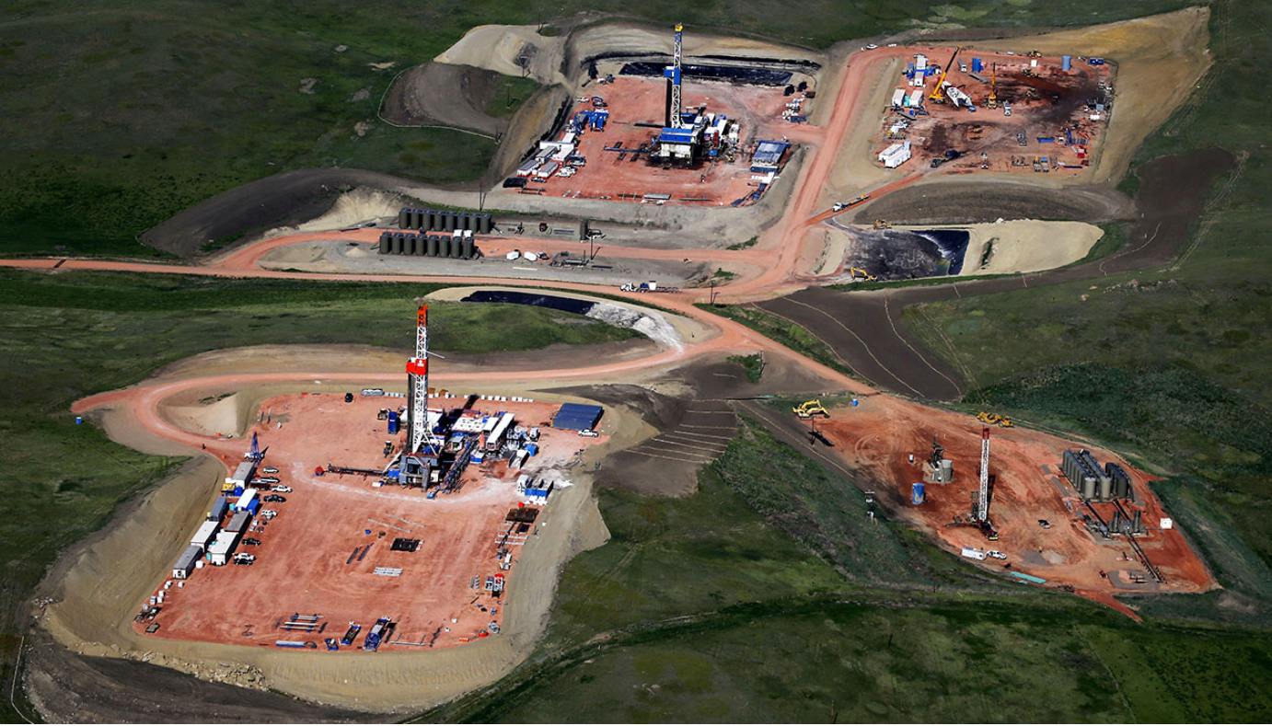
Oil & Gas Drilling

Slide 5
Oil & Gas Drilling
This gas field has 200 shallow sweet gas wells and 9 very deep, high-pressure, sour-gas wells that range from 24,000 to 25,000 feet deep. H2S was the danger.

Slide 6
Oil & Gas Drilling
The original fixed gas system was mounted in a pickup truck bed filled with wires on spools. The wires needed to be trenched to each of the well sites and then connected to sensor heads mounted on tripods. The trenching and rigging process could take up to 2 weeks, depending on the size of the site.

Slide 7
Oil & Gas Drilling
The first actual deployment of the wireless H2S system took less than 2 days, already saving time.

Slide 8
Oil & Gas Drilling
The deployment time saved was more than enough to pay for the entire system.

Slide 9
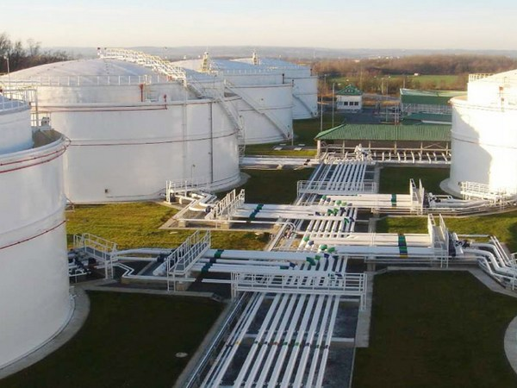
Tank Farms
Extension cables
Antennas
Multiple receivers
Repeaters
Water channel between sensors and receivers

Slide 10
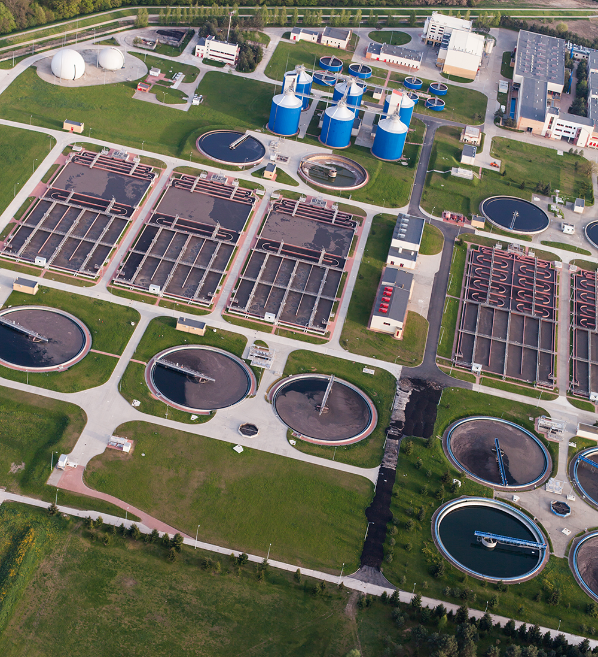
Water & wastewater treatment
O2, Cl2, H2S, SO2, flammable
Detection needed for entire site

Slide 11
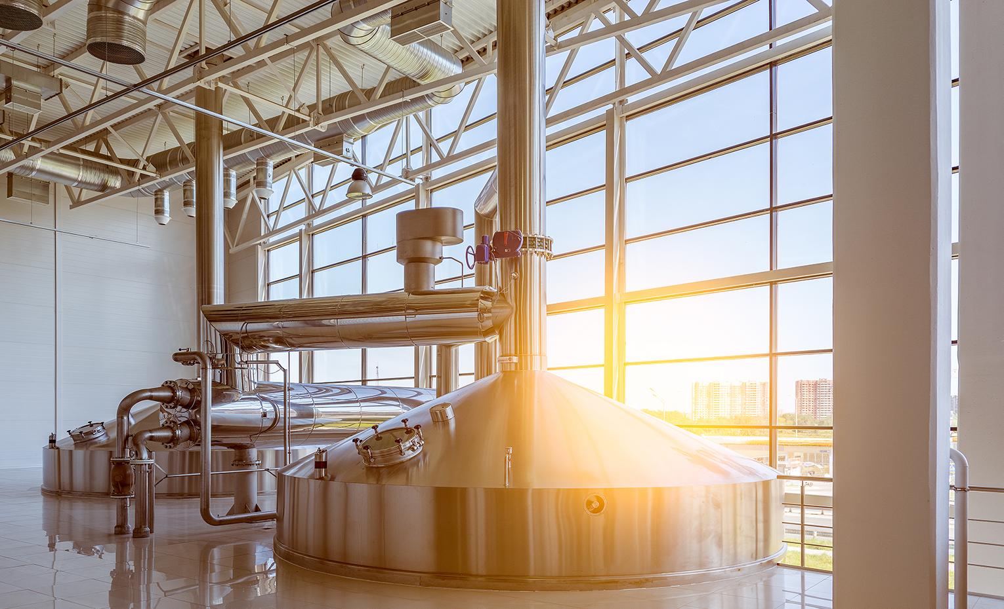
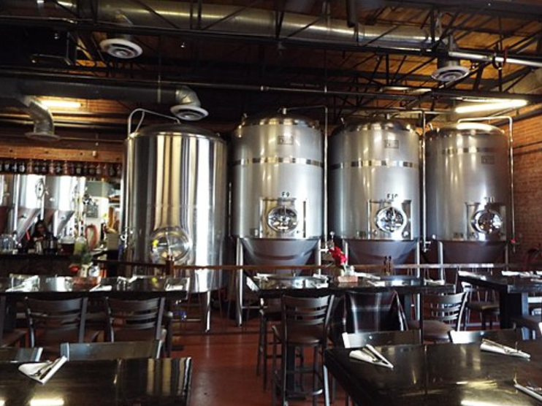
Food and Beverage
Wineries
Distilleries
Breweries
Food processing
  Ammonia as refrigerant
Amusement parks
  CO2 where drinks are served

Slide 12
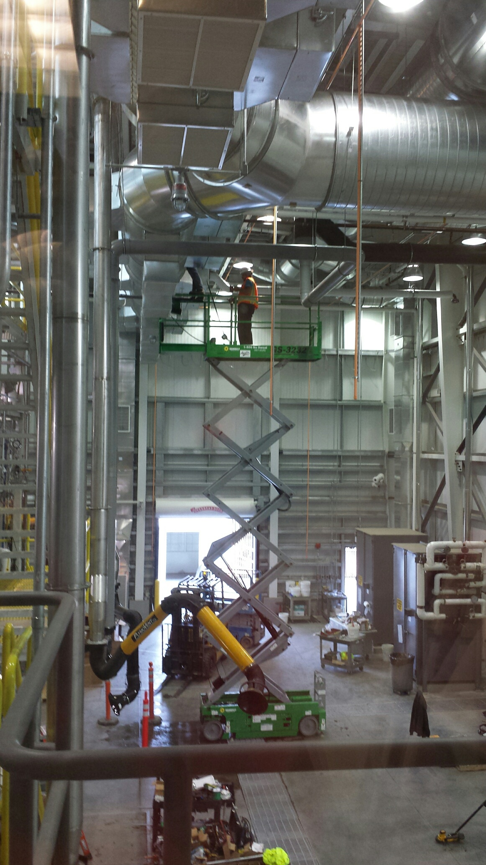
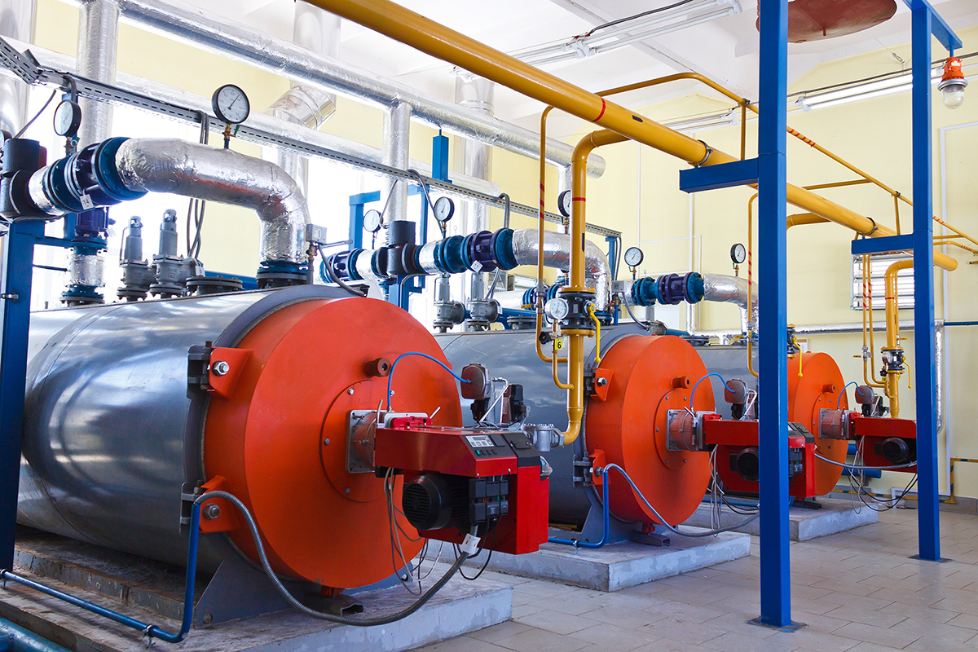
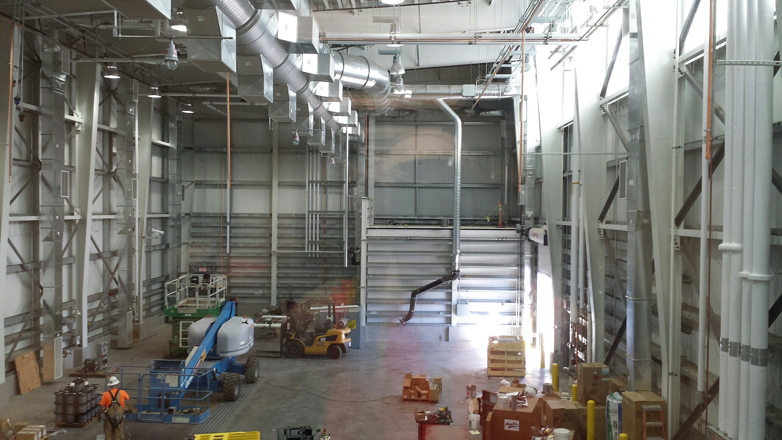
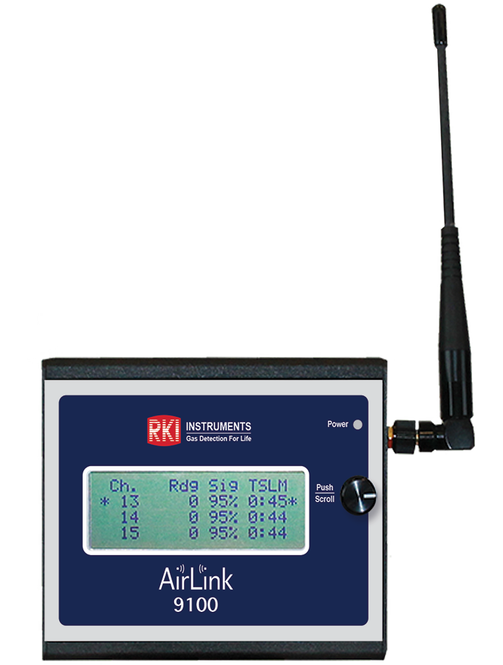
Industrial Plants
Height is our friend
Don’t let a wall stop you
  Signal propagation test
High voltage and low voltage can’t be ran together
Connection to customer’s PLC, SCADA, etc.
  Airlink 9850 - 250 channel

Slide 13
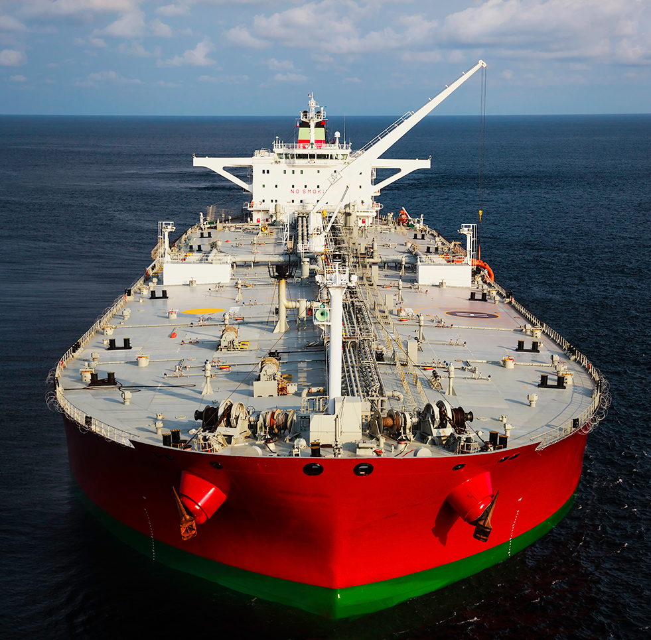
Marine Vessels
FPSO, TANKERS, FERRIES & SUBMARINES
O₂ deficiency & combustible gas
Pump room
Cleaning & maintenance of vessels, valves, pipes & fittings
Tank purging
Unloading of hazardous cargo
Vehicle exhausts
Bilge areas
Inert tank voids
Control & engine room

