Slide 1
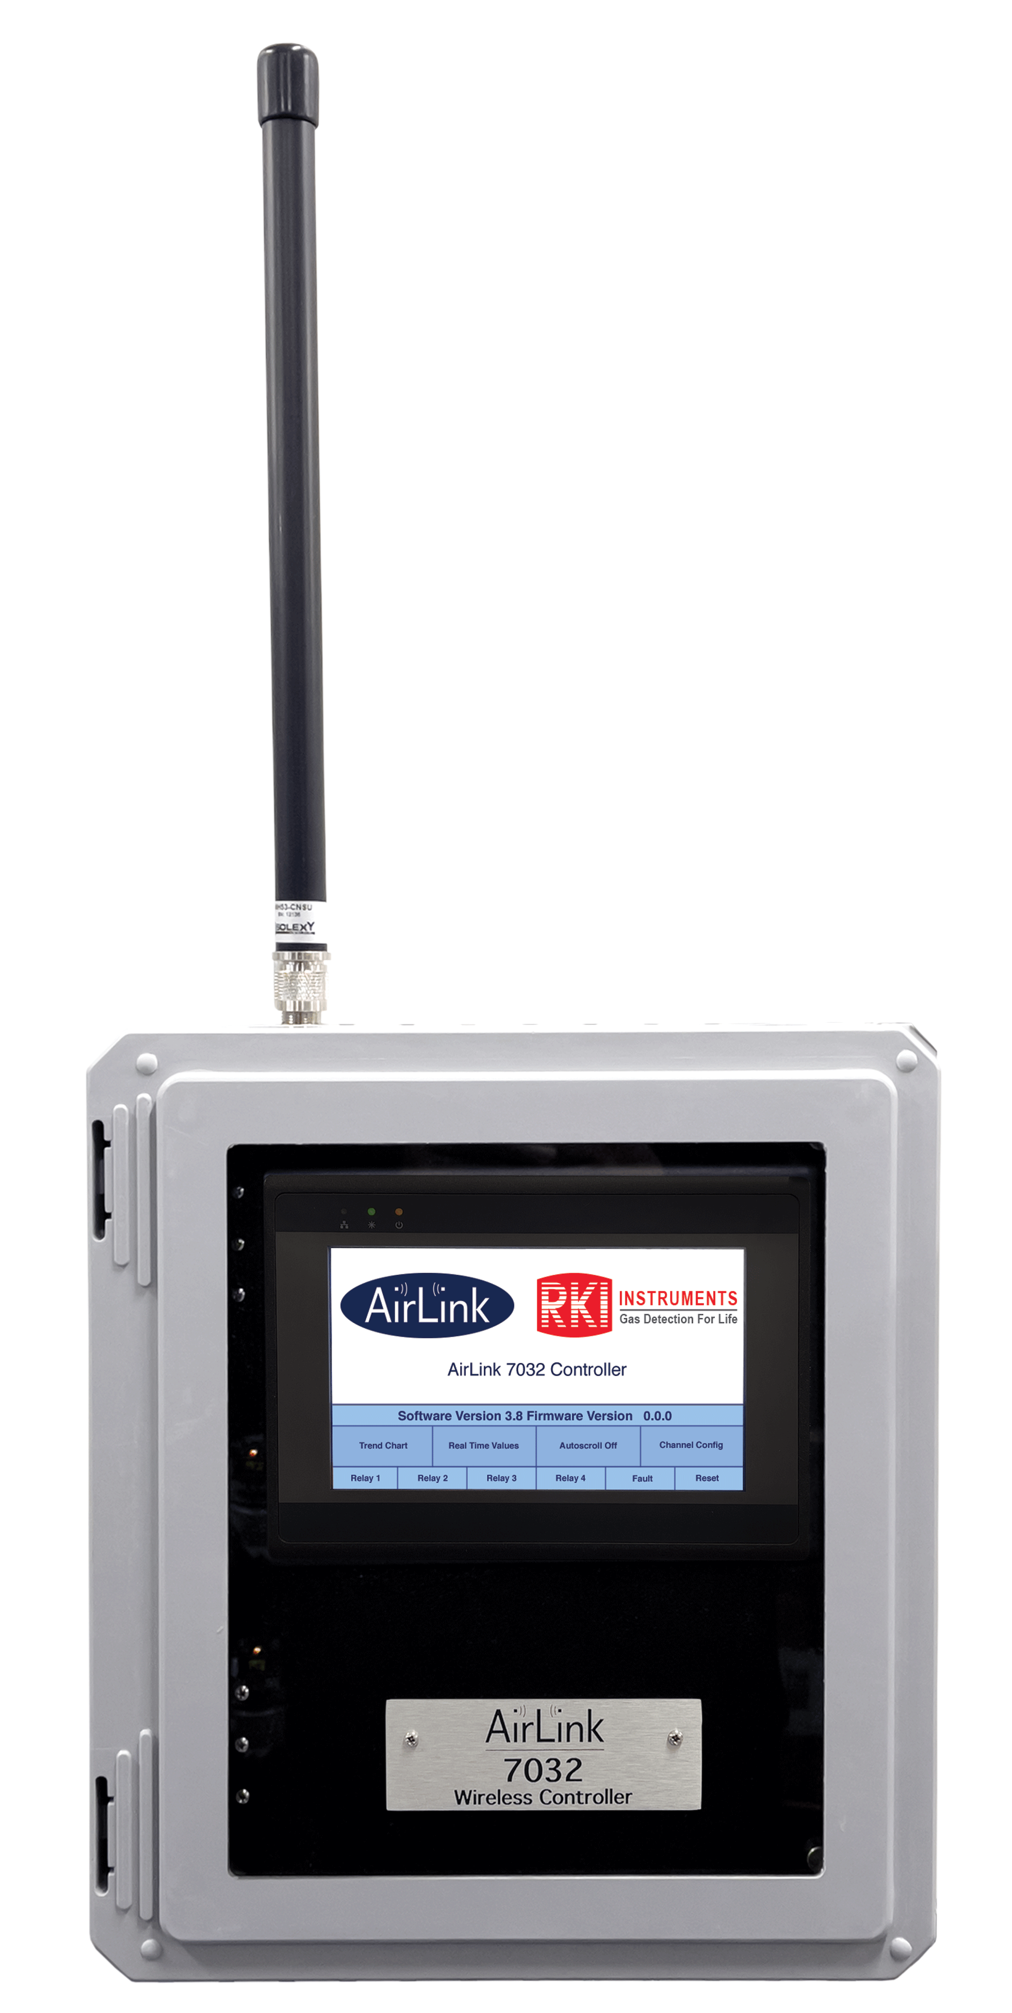
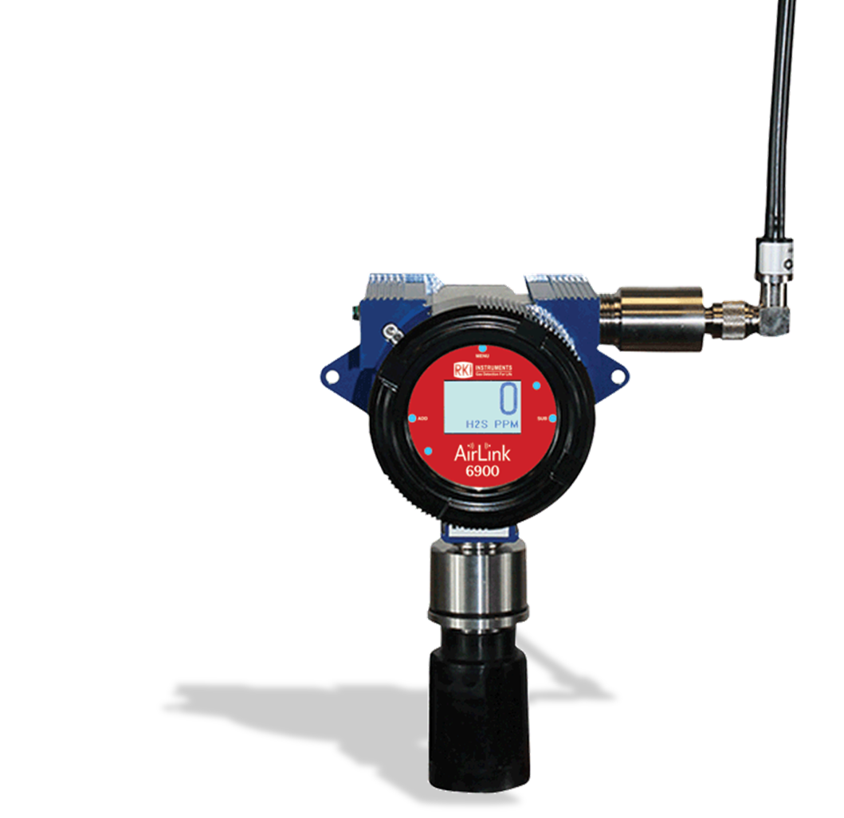
Why Wireless

Slide 2

Including installations, Wireless systems can be less expensive
Hardwired system cost: 30% hardware 70% installation
Wireless system cost: 90% hardware 10% installation

Slide 3
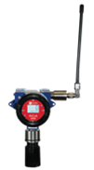

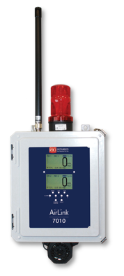
Placement of products
Wireless products can be mounted in places that a wired system cannot without a huge expense.
  Over lakes and rivers.
  Over highways

Slide 4
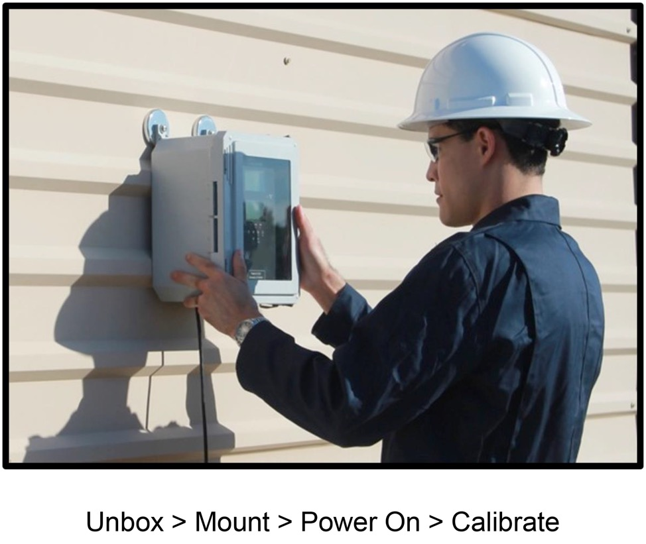
Easy to use and implement
When setting up a wireless system, you simply mount the units and turn them on.
No wiring is required from the controller to the sensor.
RKI has both battery-operated wireless transmitters and DC powered transmitters sending readings wirelessly to a controller.

Slide 5
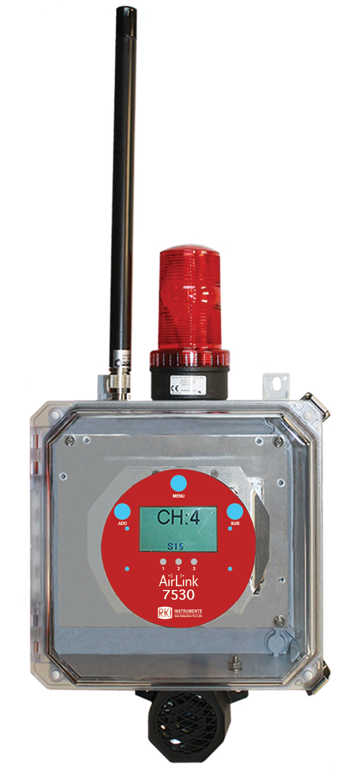
Wireless relay modules
No need to wire lights, horns, fans, doors, etc. to relays at your controller.
AirLink 7530 Relayer is a 32-channel gas alarm ystem which simultaneously provides 3 Relays and monitors wireless gas detectors.
Magnetic switches allow for non-intrusive system settings and diagnostics.
3 relays can be configured to activate up to the full-scale reading
Set to either latching or non-latching.
Local display shows real time instantaneous readings for each transmitter.

Slide 6
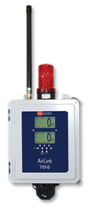

Multiple Receivers
With RKI’s wireless platform you can have as many receivers as you need on the same Network ID. You program one of the receivers as the “Primary”, and all the rest of the receivers as “secondary”.
Secondary
Primary
Secondary
Secondary
Secondary
Secondary

Slide 7
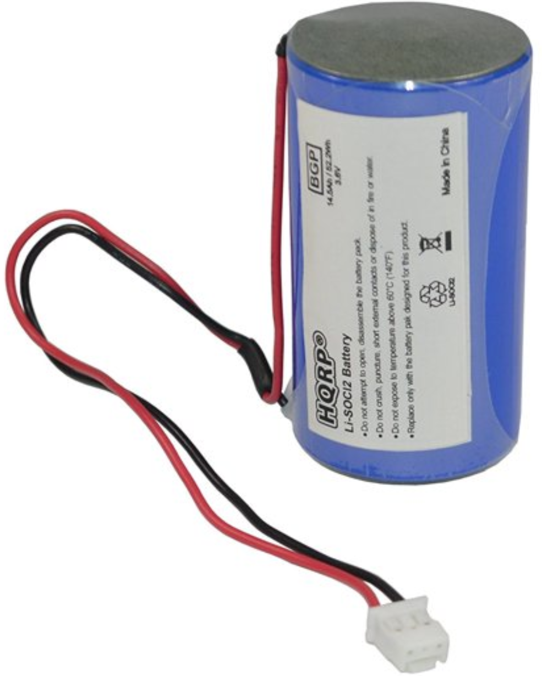
RKI’s Wireless Battery Life
  3.6 V Lithium-Thionyl Chloride battery
    Dual battery operation
  Super-easy to replace
  10 year shelf live
  Battery Life
    EC = 2 years
    IR = 1 to 1.5 years

Slide 8

Dependable and Safe
Another benefit of a wireless gas detection system is that they are one of the lowest risk gas detection systems on the market. They are safe and dependable. There are no wires that need to be connected or can become cut. So, there are low risks of damaging the system or employees injuring themselves during the install. They are also dependable because you can be assured of their accuracy.

