Slide 1
Gas Detection Boot Camp

Slide 2

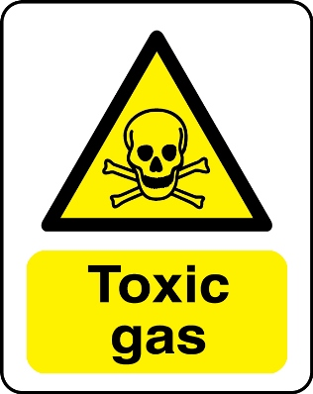

Types of Gases/Compounds
Combustibles
  Flammable gases and vapors
    Most are also toxic
    Organic compounds (HC’s)
“Toxics”
  Usually refers to non-hydrocarbons
Inerts
  Non-reactive gases
    Usually are N2, He, Ar

Slide 3
Flammability Band
Percent LEL
Upper Explosive Limit (UEL)
0
10
100
100% Vol
(LEL)
(UEL)
Lean
Explosive
Rich
0
Infrared Sensor
Catalytic Bead Sensor
Thermal Conductivity Sensor
Ammonia 12.0 Vol. %
Methane 5.0 Vol. %
Hydrogen 4.0 Vol. %
Hexane 1.1 Vol. %
Lower Explosive Limit

Slide 4
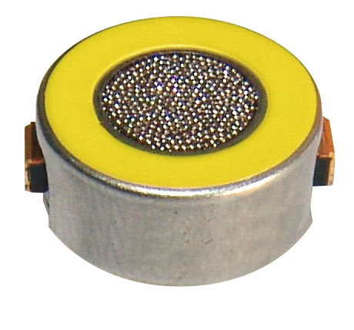
Combustible Sensor
Traditional combustible sensors respond to most combustible gases and vapors
They are considered “non-specific”
This is a good thing.
Traditional combustible sensors are called catalytic bead sensors
The gas or vapor combusting raises the temperature and that creates a resistance change. Increased resistance is relative to the displayed value on the detector.

Slide 5
Catalytic Bead Sensor
Platinum Catalyst
Deactivator
Platinum Alloy Wire
Ceramic Coating
Active
Reference
Four Wire Catalytic Bead Combustible Gas Sensor
Constant Current
Notes:
Different sensors have different sensor voltages, however the principles of operation are the same.

Slide 6
Catalytic Oxidation
Active
Reference

Slide 7
100% LEL
100% LEL
50% LEL
50% LEL
100% LEL
50% LEL

Slide 8
Toxic Sensor Technology
For our purposes, the toxic sensor technology can be listed as Electrochemical or Photo-Ionization
  Electrochemical
    Principle of Operation Electrochemical sensors operate by reacting with the gas of interest and producing an electrical signal proportional to the gas concentration. A typical electrochemical sensor consists of a sensing electrode (or working electrode), and a counter electrode separated by a thin layer of electrolyte
  Photo-Ionization (PID)
  The PID is a non-specific sensor much like the cat bead but for low level toxic monitoring. This sensor is very useful for toxic monitoring where we don’t have a specific sensor for the contaminant. The sensors have a lamp with an ionization wattage. If the contaminant ionizes under the lamp wattage value, the gas can be seen. We offer four different lamps.

Slide 9
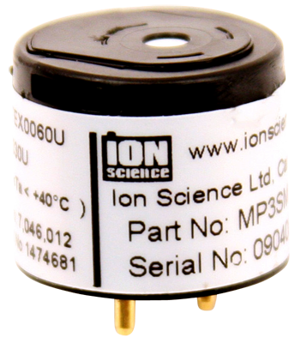
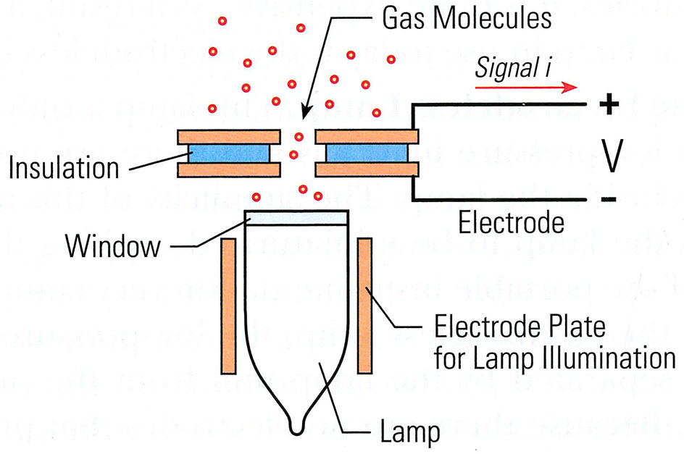
Photo Ionization Detector
A PID is a broadband VOC detection technique

Slide 10
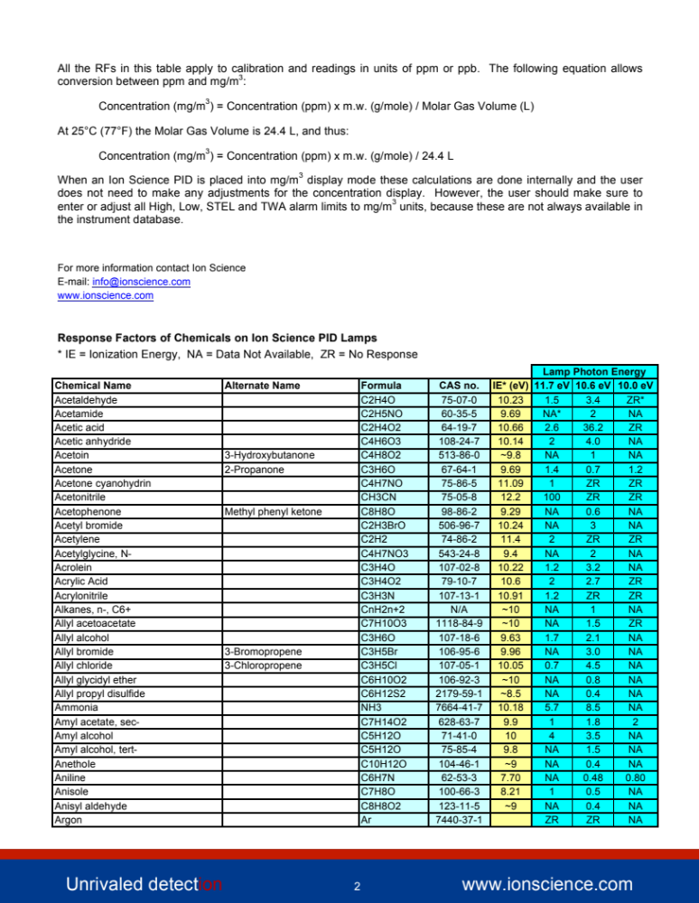
Partial List of PID Detectable Compounds

Slide 11
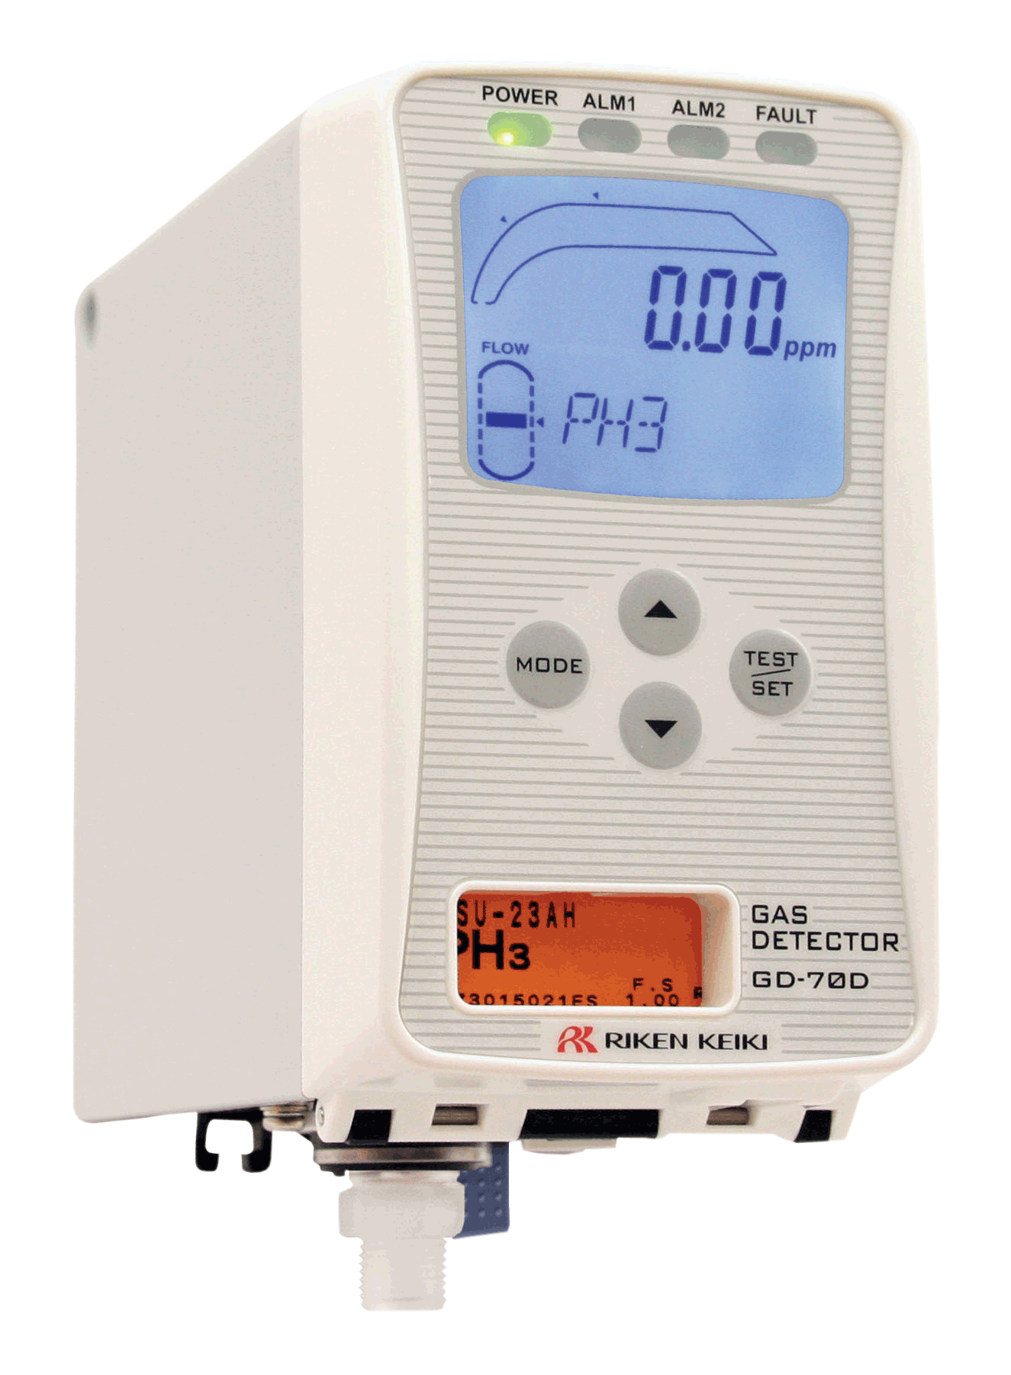
Toxic Monitoring
Toxicity
25ppm Hydrogen Sulfide
Measured in Parts per Million (ppm)
Very low measurement
Toxic relates to health issues, not combustibility.

Slide 12
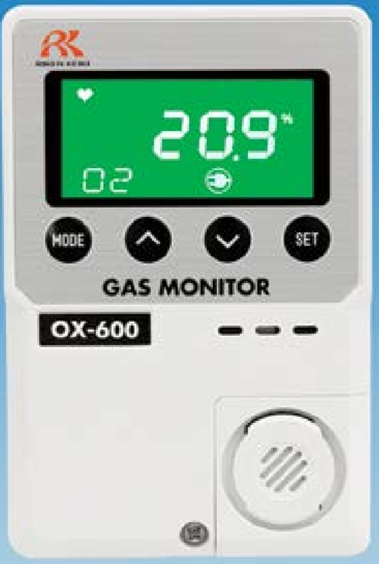
Gas Detection Basics
Oxygen Monitoring
  Confined Space Monitoring
    With detectors the read-out is in % volume. This is a large measurement.

Slide 13
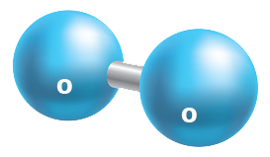

Oxygen Monitoring
Oxygen Monitoring
  Confined Space Monitoring-The detectors read-out is in % volume.
  Fresh Air = 78 % Nitrogen / 20.9 % Oxygen / 1.1 % misc gases.

Slide 14
Oxygen Monitoring
Leading cause of deaths in confined spaces regarding gas monitoring.
Low O2 might be caused by microbial activity (such as the process of fermentation); it could be due to the oxidization (rusting) of the internal surface of a tank or pipe; or it might be that the oxygen has been displaced by another gas such as nitrogen or argon.
OSHA requires low and HIGH oxygen monitoring. High levels of oxygen can enhance combustion.
Oxygen sensors are always working unless they are kept in an zero oxygen environment.
Oxygen sensors are easy to test.

Slide 15
Oxygen Alarms
23.5
19.5

Slide 16
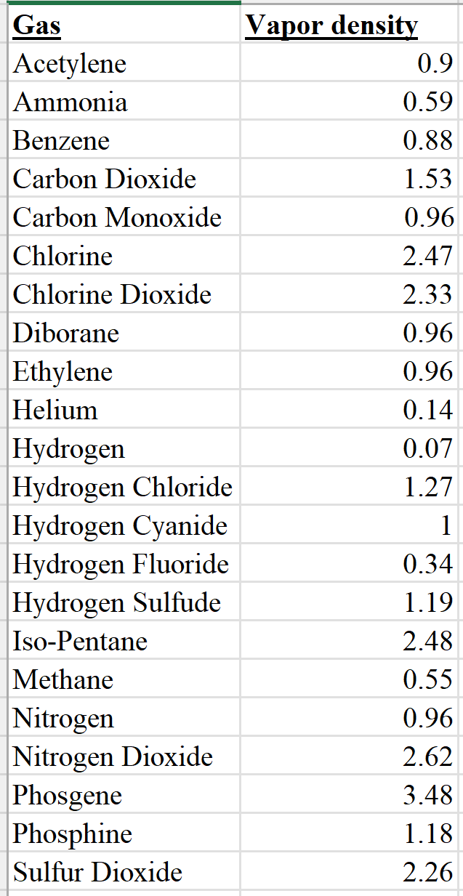
Vapor Density
Measure target gases at appropriate positions
Vapor density = the relative weight of gas compared to air

Slide 17

Questions?

