Slide 1

New Fixed System Turnkey
Start-up Services & Support

Slide 2


Slide 3
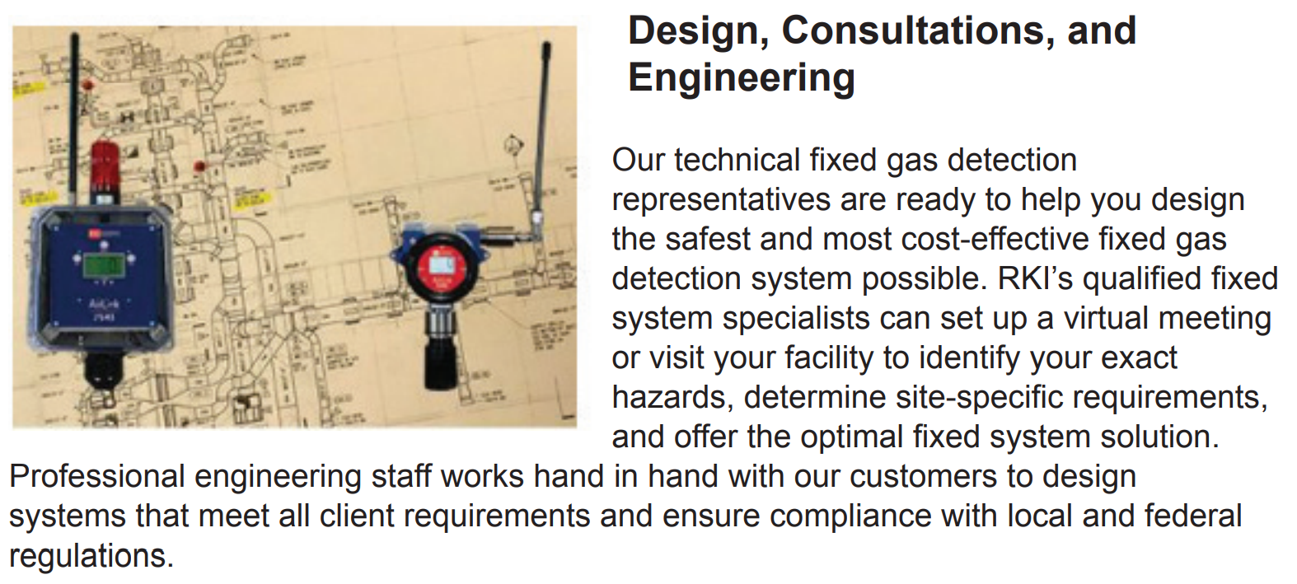

Slide 4
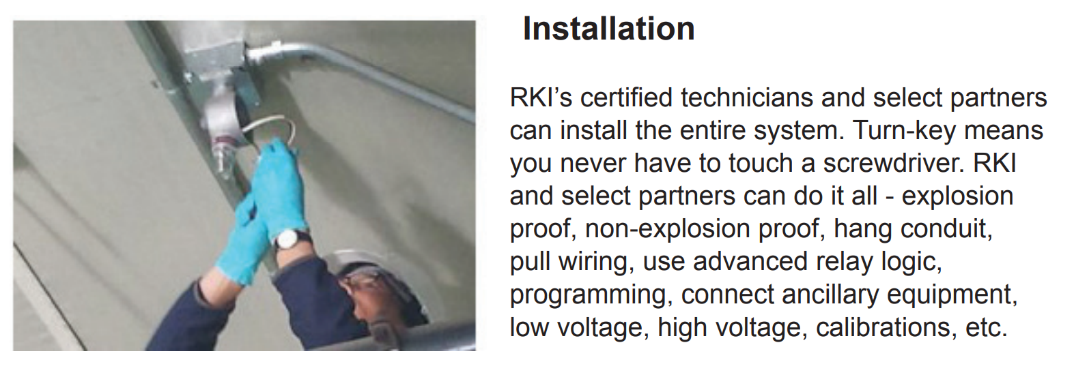

Slide 5
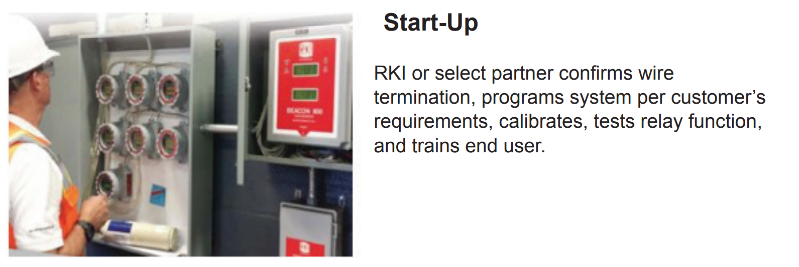

Slide 6
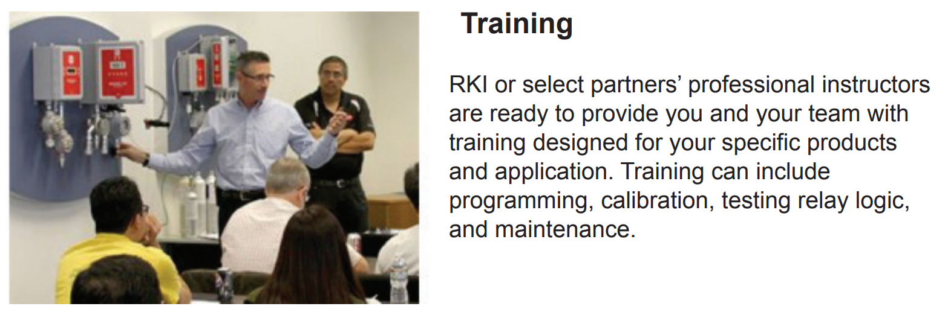

Slide 7
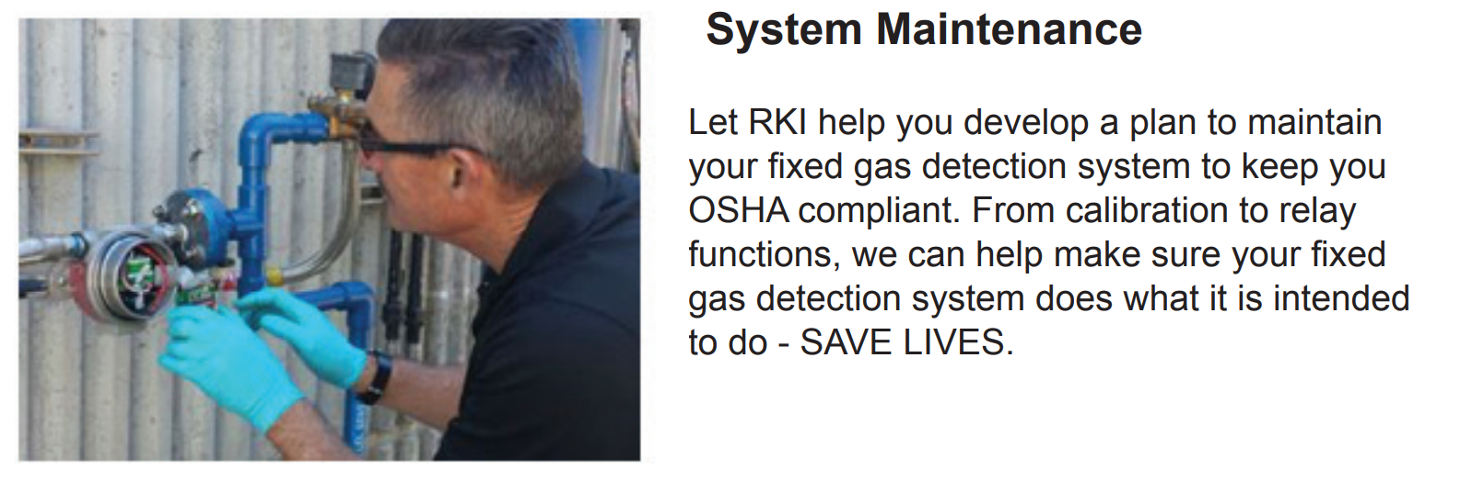

Slide 8
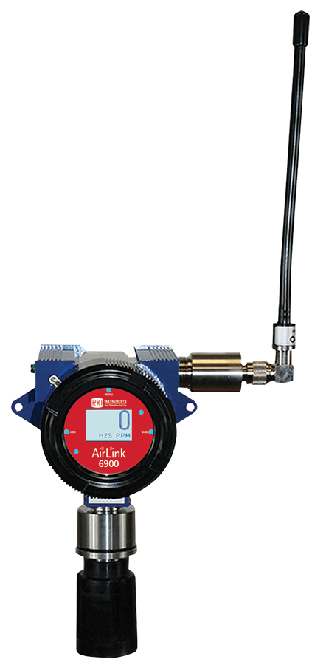
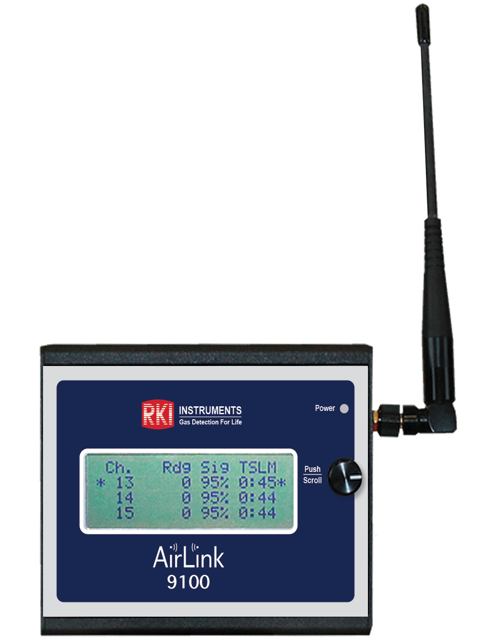
Airlink Training Demo Promo
Standard Discount = 25% off list
Sales Demo Discount = 40% off list
Training credit of $500 off any demo order
Bare Necessities:
  Signal Strength Meter
    74-9100-9: List price $1,200
  Transmitter AirLink 6900
    66-6902-W: List price $3,340
  Total Demo Cost: $2,224
    $720 + $2,004 - $500 = $2,224
Offer valid through 4/30/2022

Slide 9

Questions?

