Slide 1
Why RKI?

Slide 2

Presenters
Clint Anderson
 | RKI Instruments (2021-present) National Fixed Systems Manager Safety distribution (2002-2020) Operations manager Sales Manager Nationwide Fixed System Sales & Installation Project Manager Neotronics (1991-2002) Technician Inside sales Regional Sales Manager LTI graduate (1991)

Slide 3
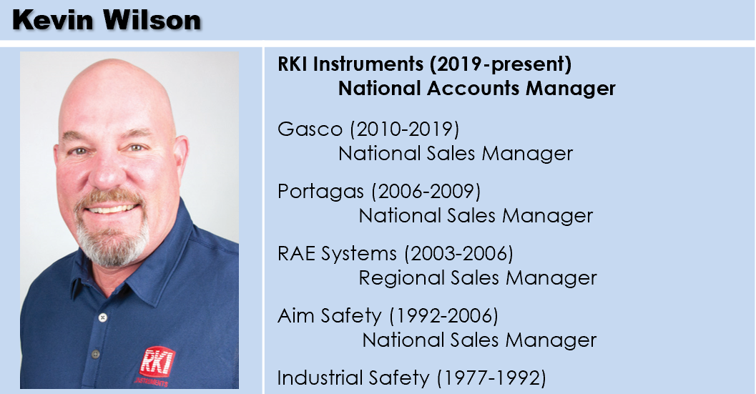
Presenters

Slide 4
Training topics
Why RKI
Gas detection 101
Why Wireless
Where Wireless
How does Wireless work
New RKI Wireless products
  Programming
  Wiring
  Calibration
  Troubleshooting
  Signal propagation test
Sales—asking the right questions
Common objections to overcome
New fixed system services

Slide 5

Company Background
RKI founded in 1994
Partner company: Riken Keiki
  Leader In Gas Detection & Sensor Technology for over 80 years
California Corporation
Average employee gas detection experience is 12 years

Slide 6




Company Culture
Customer Service
Technical Service
Fast Delivery
Quality

Slide 7
Company Culture
RKI was established in 1994 by Bob Pellissier and Sandra Gallagher.
RKI is partnered with Riken Keiki Company, Ltd., the world leader in gas detection and sensor technologies. Celebrating over 80 years in the gas detection business.

Slide 8
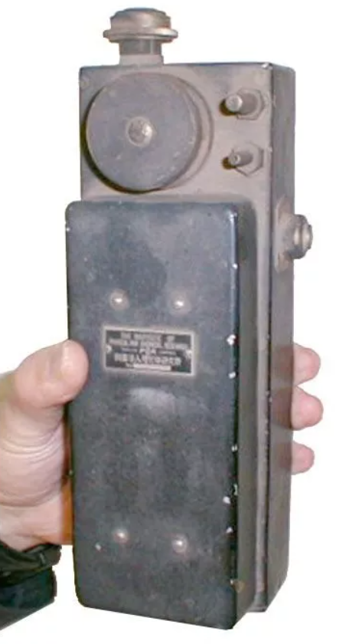





History of Innovation
1938
1969
1978
1982
1986
1995
First combustible gas monitor
Interferometer
First 2 gas monitor LEL/O2
GX-3
First 3 gas monitor LEL/O2/CO
Model 1641
First belt-worn 3 gas
LEL/O2/CO
GX-82A
First belt-worn 4 gas
LEL/O2/CO/H2S
GX-86A
First 6 gas
portable
EAGLE

Slide 9





History of Innovation
1997
2001
2009
2015
2019
First wrist-worn gas monitor
GasWatch
World’s smallest
4 gas monitor
GX-2001
World’s smallest
4 gas monitor
GX-2009
First 6 gas
with dual PID
GX-6000
World’s smallest
4 gas monitor
GX-3R

Slide 10


Largest product selection

Slide 11
PEOPLE!!

Slide 12
RKI isn’t going away
Looking to acquire companies not to be acquired
Huge internal investments
  18 new products in 2021 (wireless fixed gas detection)
  Many more new products on horizon
  New positions
  Spending big bucks on IT
  Marketing
    Website
    Announcements
    Joint flyers
  Training

