Slide 1
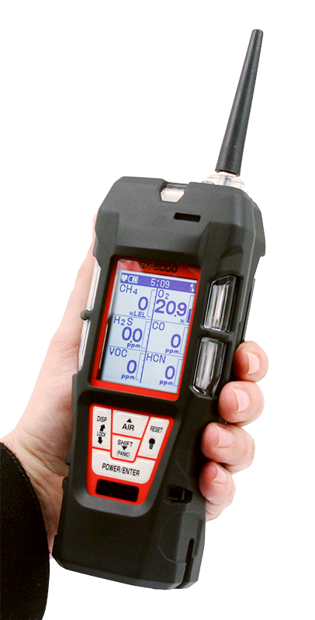
GX-6000
6 gas, sample draw with PID & Super Toxics

Slide 2
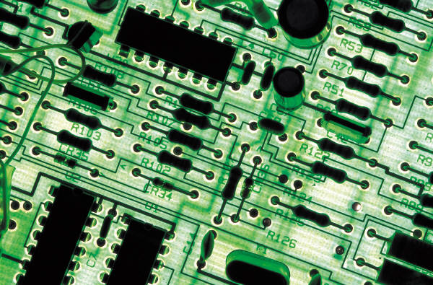
Calibration & Maintenance

Slide 3
Calibration, Standard 4 Gas Unit
Turn the GX-6000 on and allow to warm up.
Once warmed up, perform an AIR adjustment by pressing and holding the AIR key until “Release Air Key” is displayed.
Briefly press and hold the SHIFT key then press the DISP key. CAL will be displayed at the top of the LCD indicating that the GX-6000 is in the calibration mode.
  AIR CAL, AUTO CAL, SINGLE CAL and NORMAL MODE will be displayed.

Slide 4
Calibration
Press the SHIFT key to select AUTO CAL then press the POWER/ENTER key.
You will now see CONCENTRATION, GAS SELECT and ESCAPE.
Press the ENTER key to select CONCENTRATION to verify that the gas concentrations programmed in the instrument match the cylinder values.

Slide 5
Calibration
The cursor will be next to CH4. If the displayed value does not match the cylinder value, press the ENTER key to select CH4. The gas value will start blinking.
Using the AIR or SHIFT keys, raise or lower the reading to match the gas value in the cylinder.
Once completed, press the POWER / ENTER key to set.
Press the SHIFT key to scroll to the next gas.

Slide 6
Calibration
Adjust as required. Once completed use the SHIFT key to scroll to ESCAPE then press the POWER / ENTER key.
Press the SHIFT key to select GAS SELECT. Press the ENTER key.
All gases and calibration values will be displayed.

Slide 7
Calibration
Press the ENTER key and “APPLYGAS” will be flashing on the top of the LCD and all gases values will be flashing indicating that the instrument is ready for calibration gas.
Remove the red rubber tube from the top of the instrument and attach tube from gas cylinder to inlet fitting. Note: Must use a demand flow regulator or gas bag.
Allow gas to flow for a maximum of two minutes.

Slide 8
Calibration
Once reading stabilizes, press the POWER / ENTER key to calibrate the unit.
Once completed, the GX-6000 will show you the calibrated values.
Remove the tubing from the top of the GX-6000 and reattach the rubber tube.
Remove the demand flow regulator from the cylinder and store kit for future use.

Slide 9
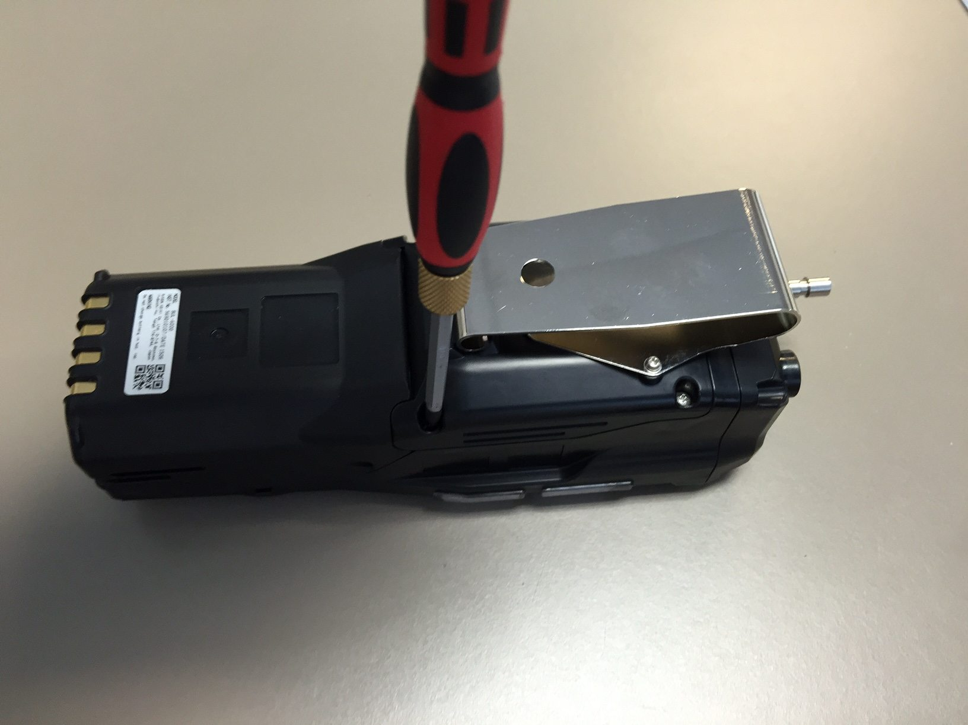
Sensor Replacement
Turn GX-6000 OFF
Remove rubber boot covering instrument
Loosen screws over flow chamber.

Slide 10
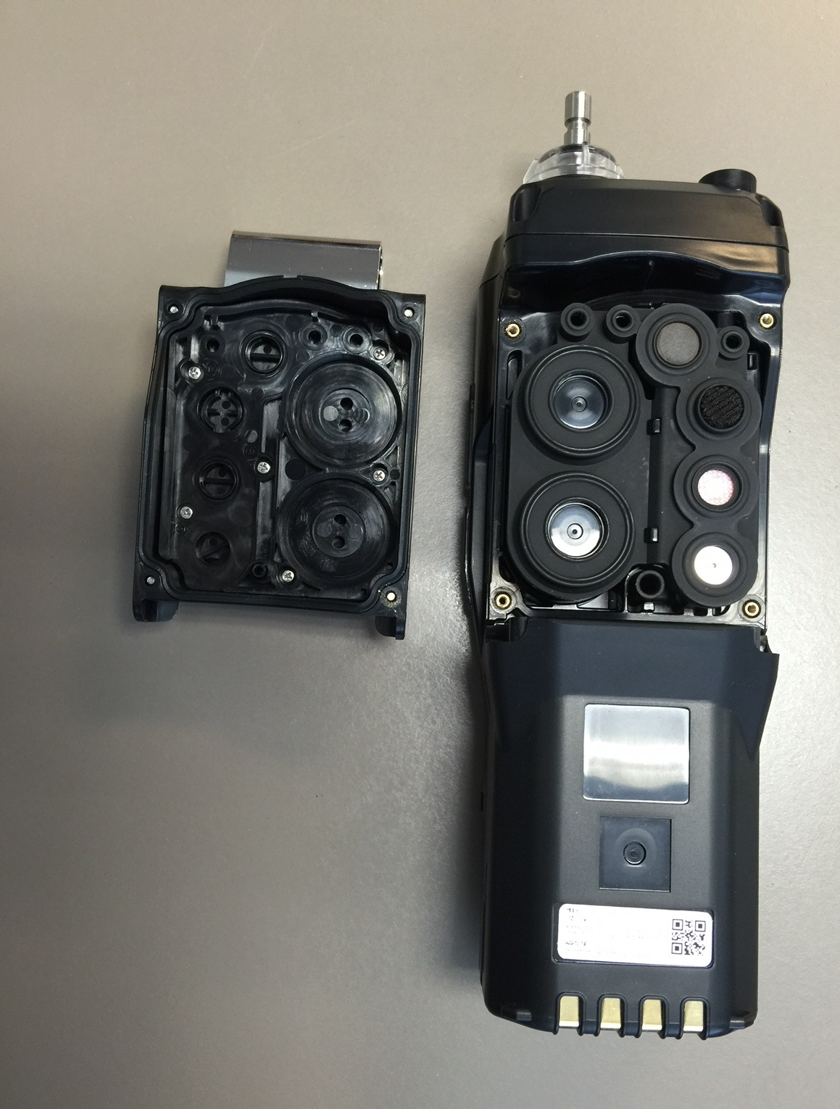
Sensor Replacement
Remove flow chamber exposing sensor gasket and scrubbers.

Slide 11
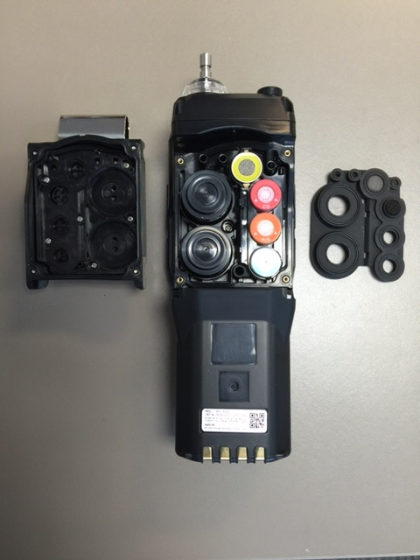
Sensor Replacement
Remove sensor gasket exposing sensors.
Remove and replace sensors as needed.

Slide 12
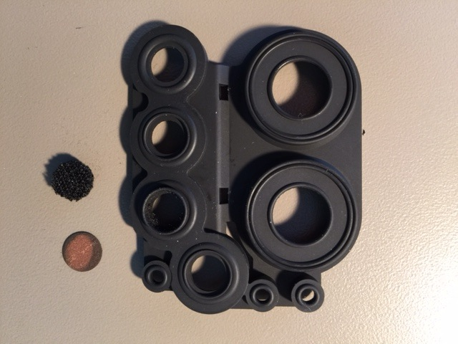
Replacement of Sensor Scrubbers
H2S scrubber for LEL sensor
  P/N 33-7114RK
H2S scrubber for CO sensor
  P/N 33-7102RK

Slide 13
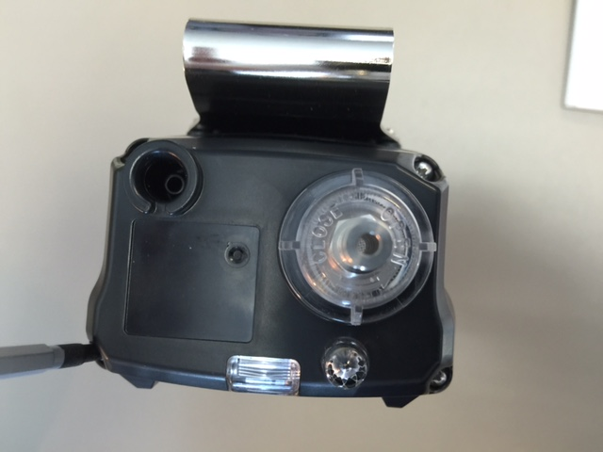
Pump Replacement
Using a small Phillips screwdriver, loosen the four screws on the top.
Pull to separate.

Slide 14
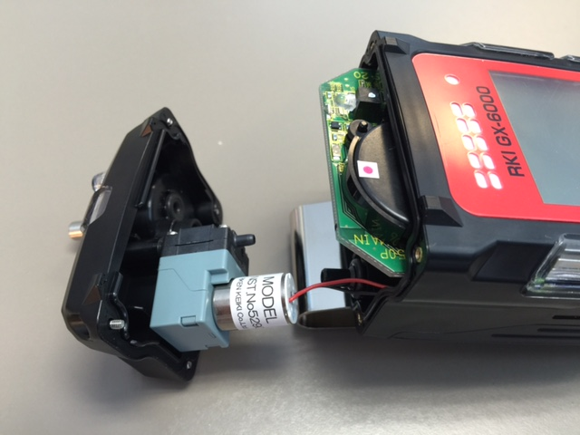
Pump Replacement
Grasp pump cable and unplug from PCB.
Remove pump from top.
Rebuild or replace as needed.
Pump P/N 30-0022

Slide 15
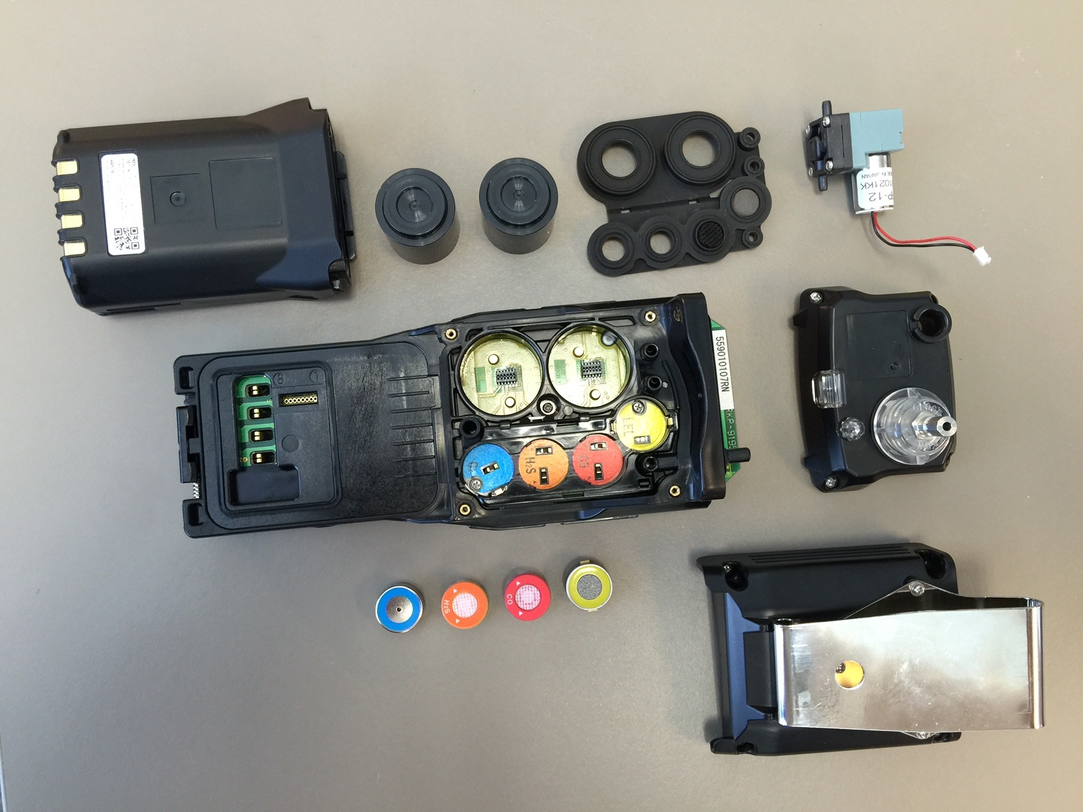
GX-6000 Exploded View

Slide 16
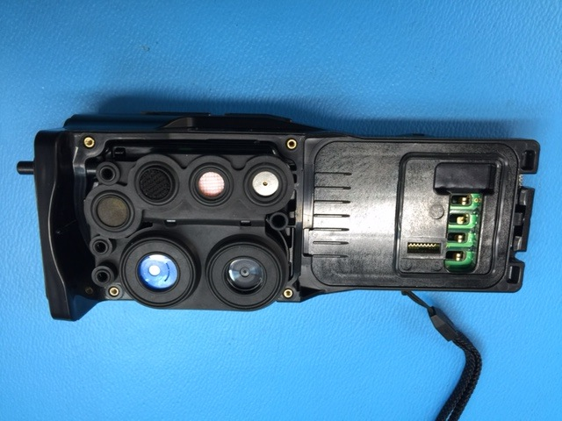
Removing the Main PCB
Remove battery and sensor cover from instrument.
Remove rubber boot and scrubbers.

Slide 17
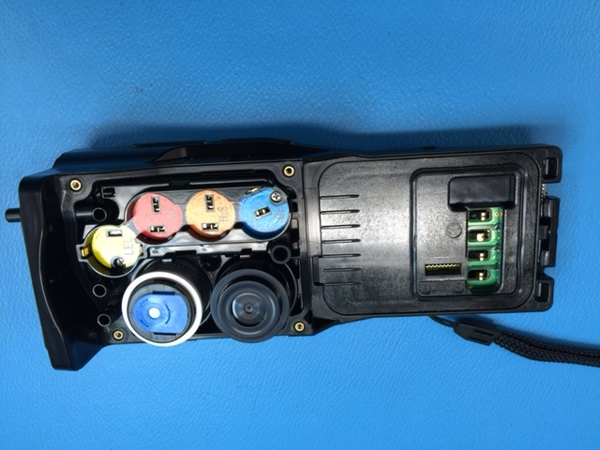
Removing the Main PCB
Remove the sensors including sensors that are installed into the Smart 1 and Smart 2 locations.

Slide 18
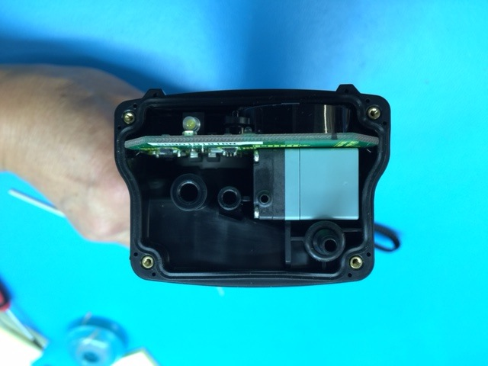
Removing the Main PCB
Unscrew the four Phillips screws securing the top of the detector.
Remove the top exposing the pump.
Grasp the pump and remove it from the unit.

Slide 19
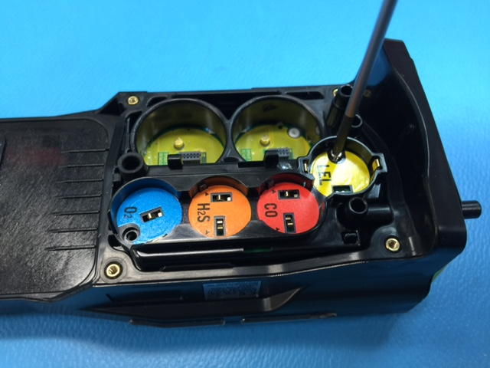
Removing the Main PCB
Remove screw as shown.

Slide 20
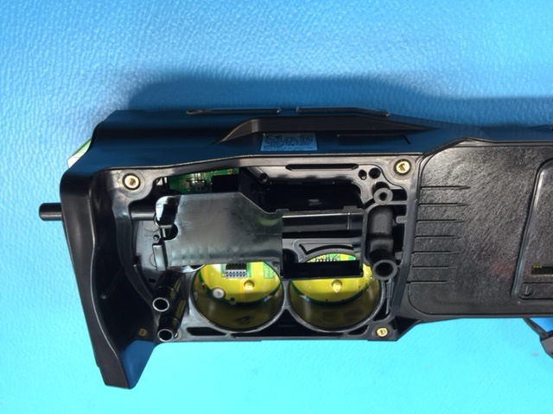
Removing the Main PCB
Lift chamber out of case.

Slide 21
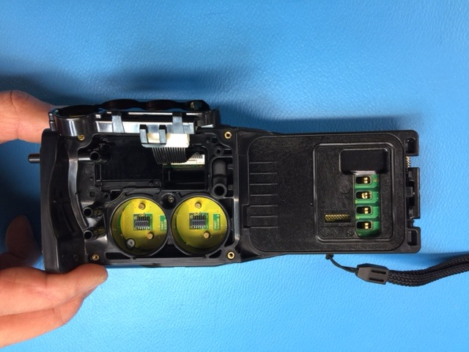
Removing the Main PCB
Pull chamber out and remove ribbon connector from main circuit board.

Slide 22
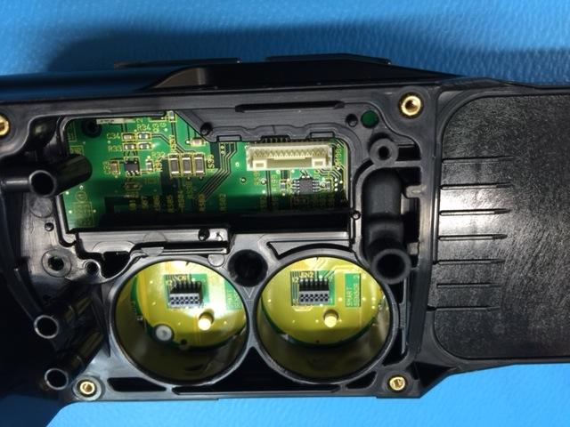
Removing the Main PCB
Chamber and ribbon cable have been removed.
Remove rubber joint for pressure sensor. P/N 07-6039

Slide 23
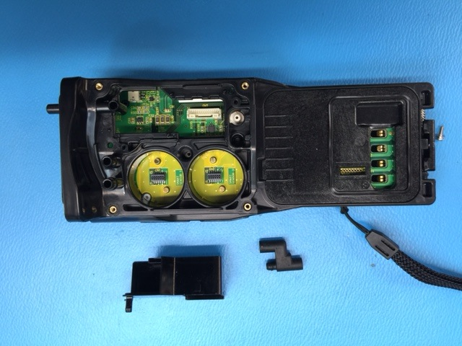
Removing the Main PCB
All parts removed.

Slide 24
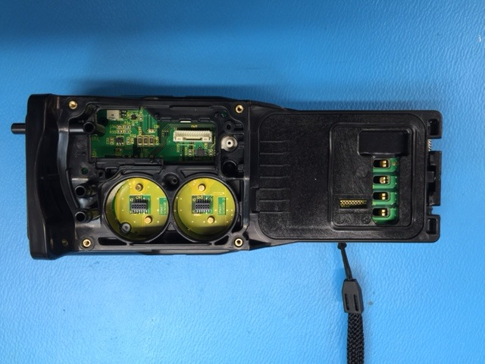
Removing the Main PCB
Gently slide circuit board towards the top of the instrument to remove.
Take care not to damage battery spring contacts.
SLIDE

Slide 25
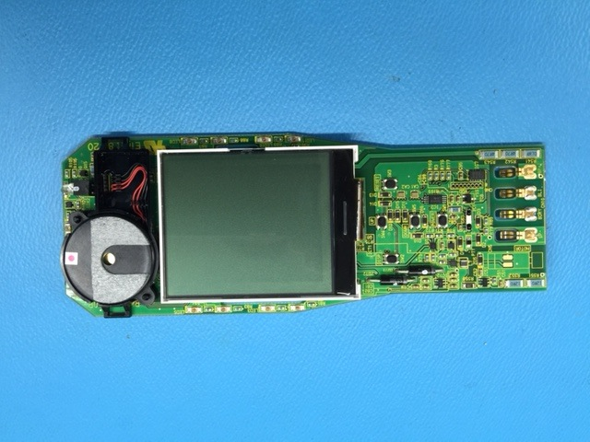
Removing the Main PCB
Main PCB with LCD shown.
Buzzer facing up.

Slide 26
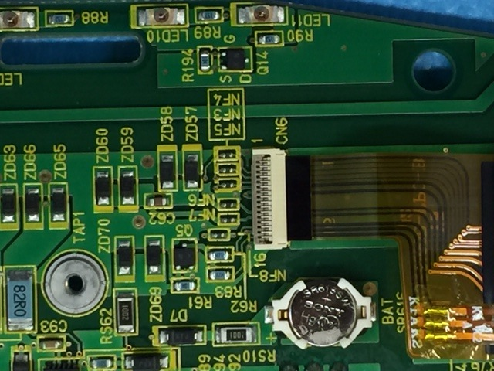
Removing the Main PCB
LCD connector has a lock that needs to be released before ribbon cable can be removed.
Memory battery shown can be easily replaced.
P/N 49-1050RK

Slide 27
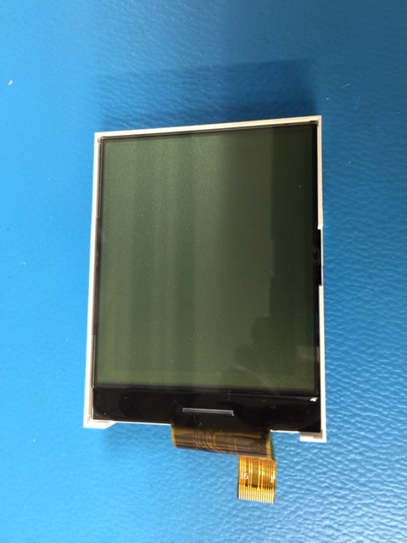
Removing the Main PCB
LCD P/N 51-1139
Clean LCD before installing to remove any fingerprints.

Slide 28
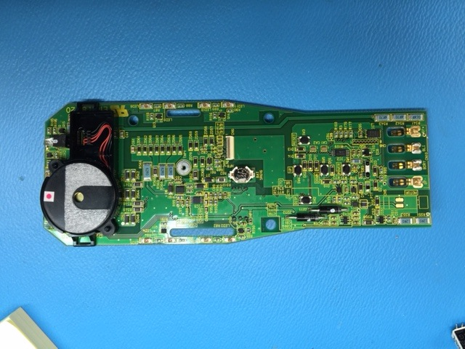
Removing the Main PCB
Main PCB, Component side.
P/N 57-1286

Slide 29
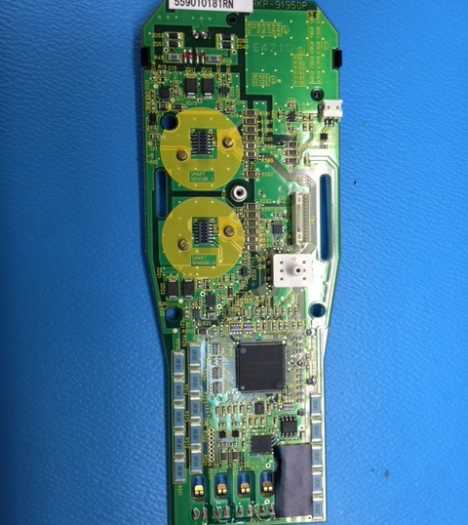
Removing the Main PCB
Main PCB, sensor side shown.
Differential Pressure switch.

Slide 30
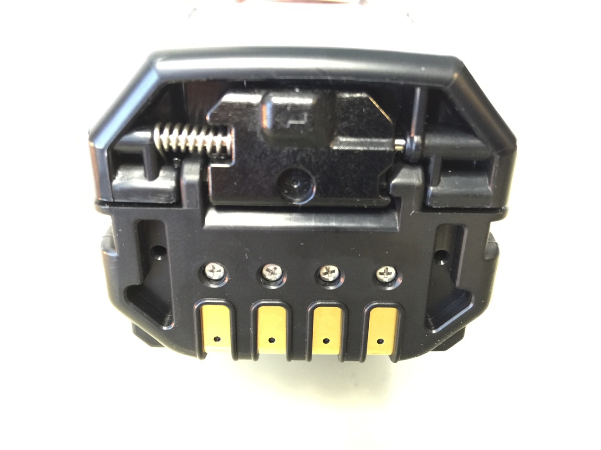
Li-ion Battery Replacement
Slide battery release tab in the direction of the arrow and push to release battery pack.
Pull up to remove battery pack.

Slide 31

Programming Modes

Slide 32
USER Mode
With the unit OFF, press and hold the AIR and SHIFT keys.
Press the POWER key to turn ON.
USER MODE and MAINTENANCE mode will be displayed.
Cursor will be next to USER MODE, press the POWER key to select.
USER will be displayed on the top.

Slide 33
USER Mode
The following menu will be displayed:
  DATE
  DATE FORMAT
  CONFIGURE CH
  LANGUAGE
  ROM/SUM
  PASSWORD
  START MEASURE

Slide 34
USER Mode
Using the AIR or SHIFT keys, select the function that you want and press the POWER/ENTER key to select.
When completed use the SHIFT key to scroll to START MEASURE to return to normal operation.

Slide 35
MAINTENANCE Mode
With the unit OFF, press and hold the AIR and SHIFT keys.
Press the POWER key to turn instrument ON.
USER MODE and MAINTENANCE mode will be displayed.
Cursor will be next to USER MODE, press the SHIFT key to move cursor to MAINTENANCE, then press POWER/ENTER.
INPUT PASSWORD will be displayed.

Slide 36
MAINTENANCE Mode
The password is 0006
Enter the password then press POWER/ENTER.
MAINTE will be displayed and the following menu will appear:
  DATE
  DATE FORMAT
  GAS CALIBRATION

Slide 37
MAINTENANCE Mode
MAINTENANCE MODE CONTINUED
  CAL SETTING*
  BUMP SETTING*
  ALARM SETTING*
  PUMP OFF DISP
  ID DISPLAY
  BACK LIGHT TIME
  LANGUAGE
  LUNCH BREAK
  AUTO ZERO

Slide 38
MAINTENANCE Mode
MAINTENANCE MODE CONTINUED
  DEMAND ZERO
  ZERO FOLLOWER
  ZERO SUPPRESS
  IR AUTO RANGE
  CONFIGURATION
  KEY TONE
  INERT MODE
  L./B. MODE
  BAR HOLE TIME

Slide 39
MAINTENANCE Mode
MAINTENANCE MODE CONTINUED
  CO DISPLAY
  MAN DOWN*
  LOG SETTING*
  FLOW ADJUST
  ROM/SUM
  PASSWORD
  RESTORE DEFAULT
  START MEASURE

Slide 40
MAINTENANCE Mode
Use the SHIFT or AIR keys to select the feature you would like.
Press the POWER/ENTER key to select.
Once completed, use the SHIFT key to scroll to START MEASUREMENT to return to normal operation.

Slide 41
Factory Mode
With the unit OFF, press and hold the AIR and SHIFT keys.
Press the POWER key to turn instrument ON.
USER MODE and MAINTENANCE mode will be displayed.
Cursor will be next to USER MODE, press the SHIFT key to move cursor to MAINTENANCE, then press POWER/ENTER.
  Note: There are two modes selected by unique passwords.

Slide 42
Factory Mode
INPUT PASSWORD will be displayed.
Input: 1994. You will see the following menu:
FACTORY
  DATE
  DATE FORMAT
  GAS COMB
  HC SELECT
  LOG TIME DISP
  CSA SETTING

Slide 43
Factory Mode
Maintenance Mode
  ALARM POINTS
  FLOW ADJUST
  ROM/SUM
  A/D VALUE
  SAVE DEFAULT
  LCD CONTRAST
  FACTORY DEFAULT
  START MEASURE

Slide 44
Factory Mode
Using the AIR/SHIFT key, scroll to the function that you want to view then press the POWER/ENTER key.
When completed, use the SHIFT key to scroll to START MEASURE then press the POWER/ENTER key to return to normal operation.

Slide 45
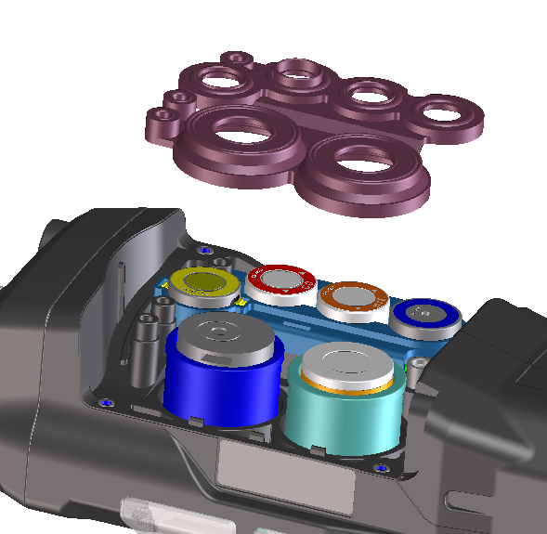
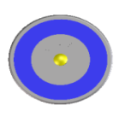
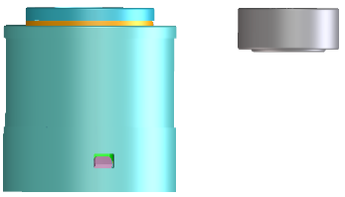
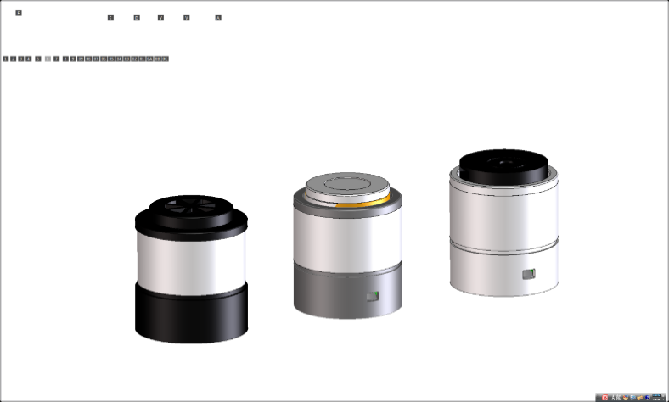
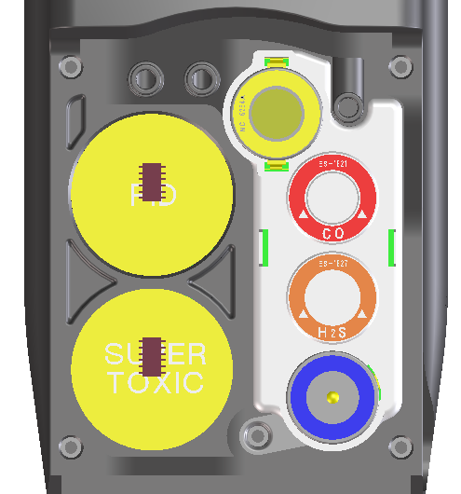
Sensors
Standard 4 gas sensors
CH4 or HC …..NC-6264A
O2 …..OS-BM2
H2S ..…ES-1827i
CO …..ES-1821
Smart sensors
PID …..PIS-00x (White)
ES …..ESS-03xx (Grey)
IR …..DES-3311-x (Black)
*Any two “smart” sensors can be combined in GX-6000, as long as PID sensor is located in the first position of gas through path.

Slide 46

Smart Sensor Gases
PID
Library of over 600 target gases
Iso-Butylene (C4H8) will be calibration gas standard.
0-50,000 ppb P/N PID-001, 0-6,000 ppm P/N PID-002
EC
SO2 0-6 ppm
NO2 0-9 ppm
HCN 0-15 ppm
NH3 0-75 ppm*
NH3 0-400 ppm*
Cl2 0-3 ppm*
Cl2 0-10 ppm*
IR
CO2 0-5% vol (DES-3311-1)
HC 0-100% LEL
HC 0-30% vol (DES-3311-2)
CH4 0-100% LEL*
CH4 0-100% vol*
CO2 0-5000 ppm*
CO2 0-10000 ppm*
*Sensors currently under development.

Slide 47
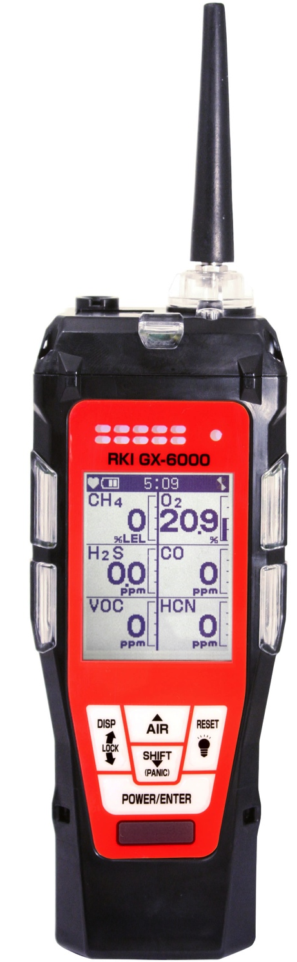
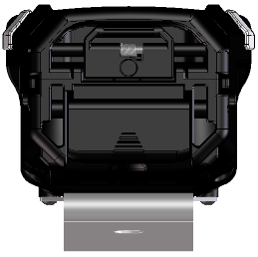
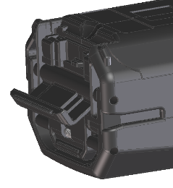
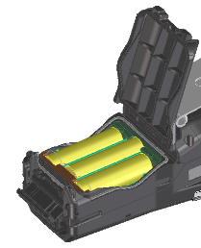
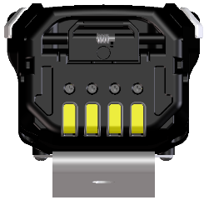
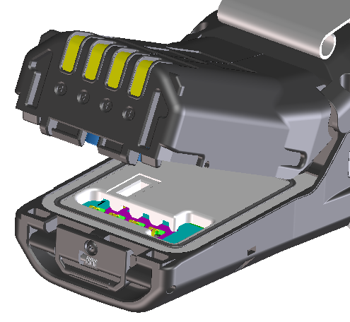
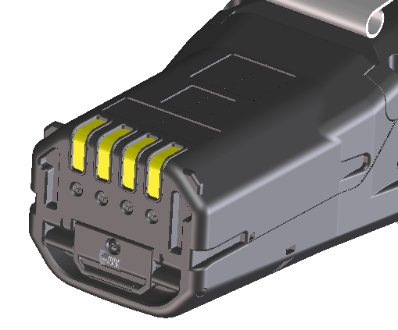
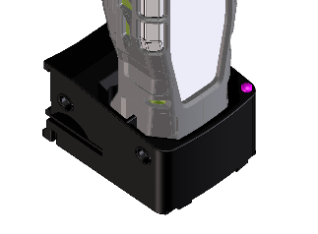
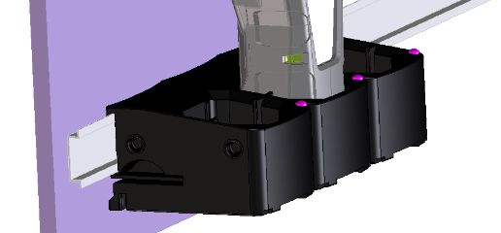
Power Supply
Alkaline
BUD-6000 (49-1620)
AA size battery x 3 pieces
More than 8 hours operation
Rechargeable
BUL-6000 (49-1619)
More than 14 hours operation
Battery charger BC-6000

Slide 48
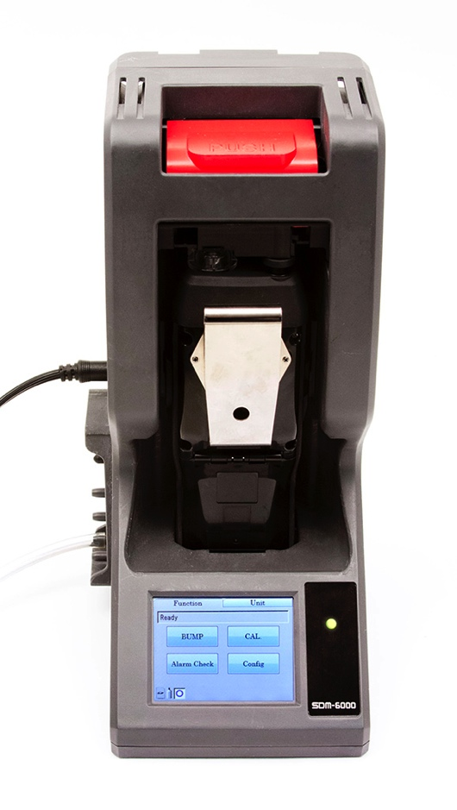
SDM-6000 Docking Station
Docking station can be connected to single PC (up to 10 units).
Notes:
Can be connected up to 10 units

Slide 49
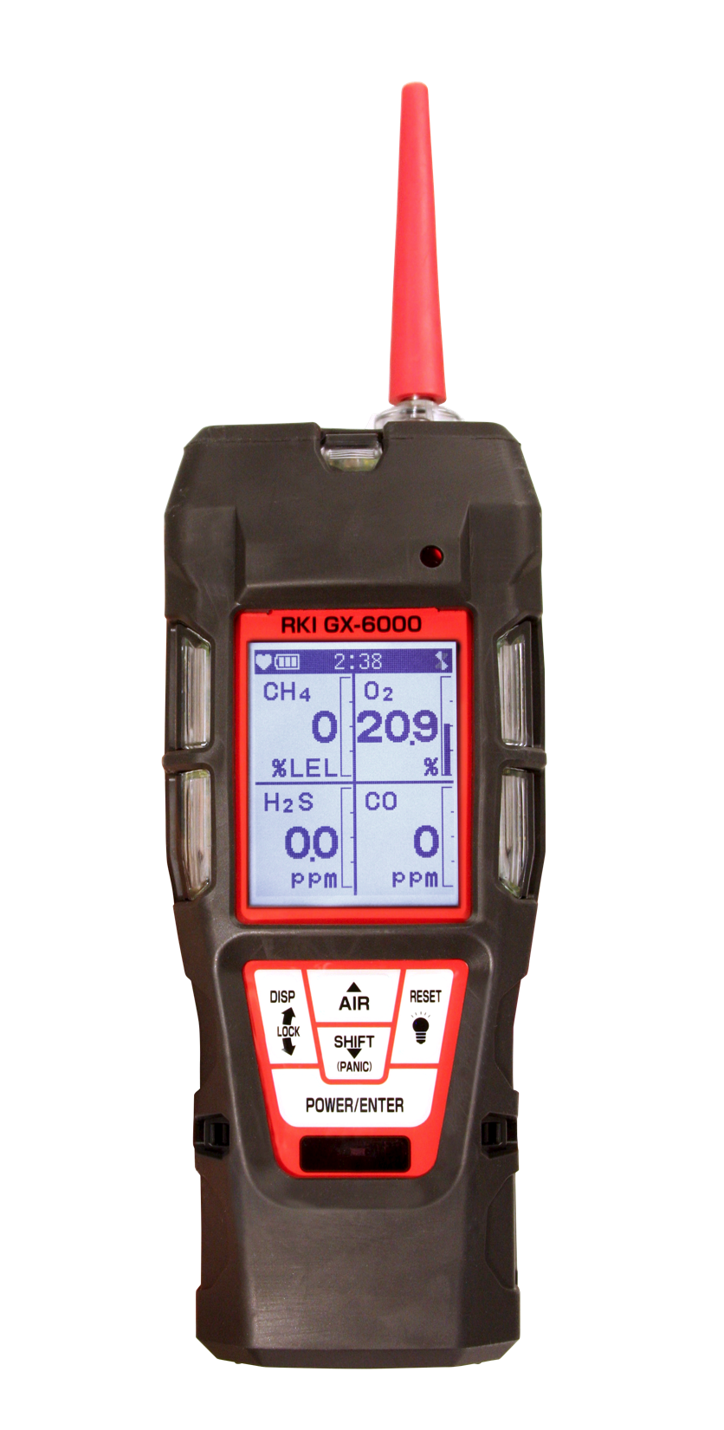
Questions?

