Slide 1
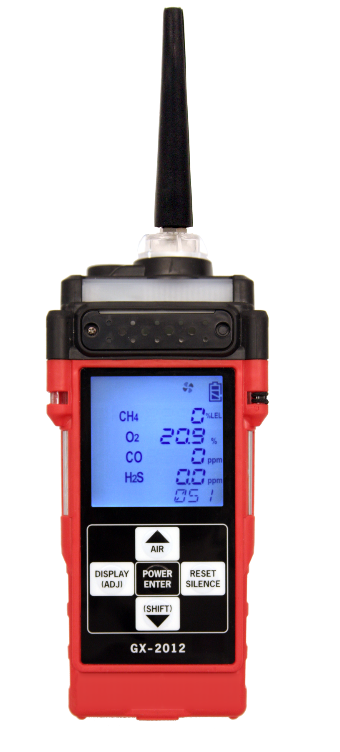
GX-2012
Service Training Module

Slide 2
Scope
Calibration
  Auto/Single Cal
Maintenance
  Inlet filter/Battery replacement
  Scrubber/Sensor Replacement
  Internal component replacement
Modes
  Display/Maintenance/Factory
Low Flow Adjustment
Common troubleshooting techniques

Slide 3
Calibration - Required Equipment
Demand Flow Regulator
Cylinder(s) of calibration gas
  If you have a 4-gas unit, you can get a 4-gas cylinder mix
  If your unit is a 5-gas unit, you will require the 4-gas mix AND a 100%vol or 50%vol cylinder
Tubing To go from regulator to GX-2012 inlet

Slide 4
Auto Calibration Mode
Enter Calibration Mode
  From Normal Operation press and hold the (SHIFT)▼button, then press the DISPLAY(ADJ) button.
If the unit prompts you for the password, enter it by using the ▲AIR and (SHIFT)▼ buttons to select each password number and then pressing and releasing POWER ENTER to confirm it.

Slide 5
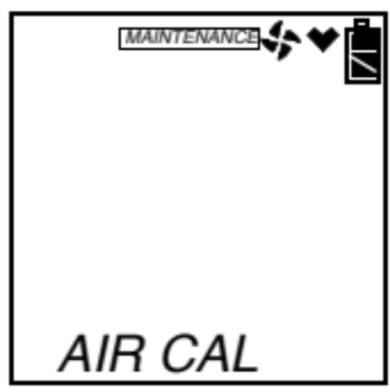
Auto Calibration Mode
MAINTENANCE will appear along the top of the screen.
AIR CAL will be displayed.
Press POWER to enter and perform an air adjust

Slide 6
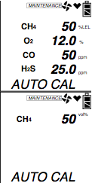
Auto Calibration Mode
Use the ▲AIR and (SHIFT)▼ buttons to display the AUTO CAL menu item, press and release the POWER ENTER button to display the calibration values screen.
  Use the ▲AIR or (SHIFT)▼ buttons to view the vol% calibration concentration.
The gas concentrations displayed in the calibration values screen must match the gas concentrations listed on the calibration cylinder.

Slide 7
Auto Calibration Mode
If concentrations do not match, continue with the following:
To adjust the values on the screen, hold down the (SHIFT)▼ button, then press the DISPLAY(ADJ) button and release both.
  The value for the combustible gas channel begin to flash.
If necessary, use the ▲AIR or (SHIFT)▼ buttons to set the correct combustible gas units (vol% or %LEL).
  Once value is set, press ENTER.

Slide 8
Auto Calibration Mode
Use the (SHIFT)▼ button to scroll to the oxygen channel settings.
  Use the ▲AIR or (SHIFT)▼ buttons to set the oxygen zero setting.
  Press the ENTER button when done.
NOTE: The RKI Four Gas Cylinder typically contains 12% O2 by volume. Be sure to set the “OXY” reading to agree with the concentration listed on the cylinder’s label, not zero. Also, DO NOT use calibration gas cylinders with O2 concentration values greater than 19% by Volume.

Slide 9
Auto Calibration Mode
Repeat steps above to set the correct values for the remaining channels. Use the ▲AIR button to scroll through the different channels. After the last channel is set, use the ▲AIR button to scroll to ESCAPE and press ENTER.

Slide 10
Auto Calibration Mode
With the calibration values screen displayed, press the POWER/ENTER button. AUTO CAL begins to flash and the current gas readings are displayed.
  If you want to exit back to the main menu without completing a calibration, press and release the DISPLAY (ADJ) button.
You may only calibrate either the standard 4 gases or the % volume combustible gas sensor at a time.
Once you are finished, you are returned to the initial AUTO CAL screen and must begin the auto calibration process again.

Slide 11
Auto Calibration Mode
Connect the tubing from the gas cylinder to the inlet fitting of the instrument.
  Allow the gas to flow for 2 minutes or until the readings stabilize
Press and release the POWER/ENTER button to set the calibration to programmed values.
If all channels passed calibration, PASS displays along the bottom of the screen, then the calibration menu displays.

Slide 12
Auto Calibration Mode
If any of the sensors cannot calibrate to the proper value, FAIL displays along the bottom of the screen and the GX-2012 lists the sensor(s) that failed to calibrate. The buzzer and alarm lights activate.
  Press and release the RESET SILENCE button to reset the alarm and return to the calibration menu. Attempt to calibrate again. If the failure continues, investigate the cause.

Slide 13
Auto Calibration Mode
Disconnect the tubing from the inlet fitting of the unit.
Unscrew the demand flow regulator from the calibration cylinder.
If you have a 5 sensor unit and wish to calibrate the % volume sensor, go back to the first step and repeat the process.
Once you are finished calibrating, use the (SHIFT)▼ button to navigate to the NORMAL menu item, then press and release the POWER ENTER button to return to Measuring Mode.

Slide 14
Single Calibration Mode
While in the calibration menu, use the ▲AIR or (SHIFT) ▼ button to navigate to the ONE CAL menu option.
Press and release the POWER/ENTER button to display the single calibration menu.
  CH4 and --- will be displayed.

Slide 15
Single Calibration Mode
Use the ▲AIR or (SHIFT)▼ button to display the channel you want to calibrate (in this example the combustible gas % LEL sensor). If you have a 5 sensor unit, pressing the ▲AIR button will display %vol and allow you to calibrate that sensor.

Slide 16
Single Calibration Mode
Press and release the POWER/ENTER button. The single calibration screen displays for the sensor you selected. The gas reading flashes.
Connect the tubing from the demand flow regulator to the inlet fitting of the instrument. Allow the calibration gas to flow for 2 minutes or until the readings stabilize.

Slide 17
Single Calibration Mode
If necessary, use the ▲AIR and (SHIFT)▼ buttons to adjust the reading to match the concentration listed on the calibration cylinder.
Press and release the POWER ENTER button to save the span value. The LCD will indicate that the calibration has ended, then will return to the ONE CAL screen.

Slide 18
Single Calibration Mode
Repeat previous steps for any other channels you want to calibrate. Make sure you use an appropriate calibration cylinder for each channel.
After the last channel is calibrated, disconnect the calibration tubing from the inlet fitting, then remove the demand flow regulator from the calibration cylinder.
Use the (SHIFT)▼ button to scroll to ESCAPE then press the POWER button.

Slide 19
Single Calibration Mode
With the ONE CAL menu option displayed, press the (SHIFT)▼ button until the NORMAL menu option is displayed.
Press and release the POWER ENTER button to return to Measuring Mode.

Slide 20
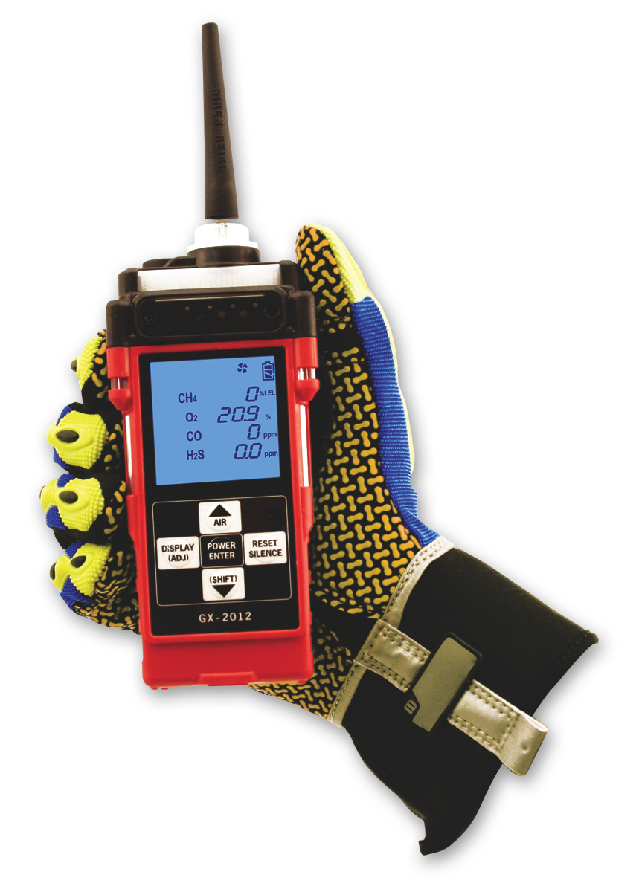
GX-2012 Maintenance

Slide 21
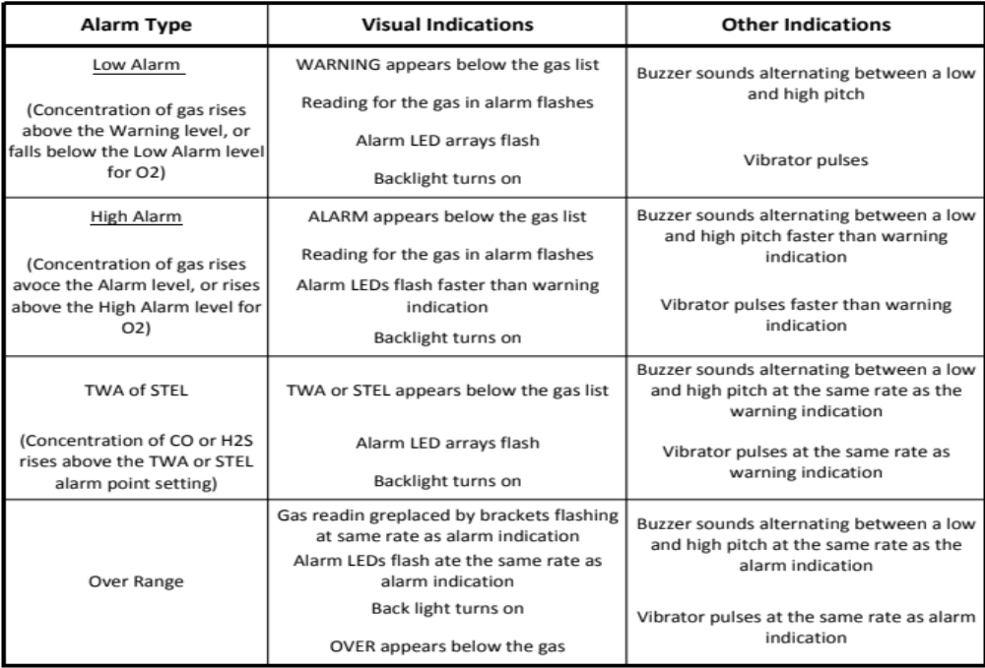
Alarm Types and Indications

Slide 22
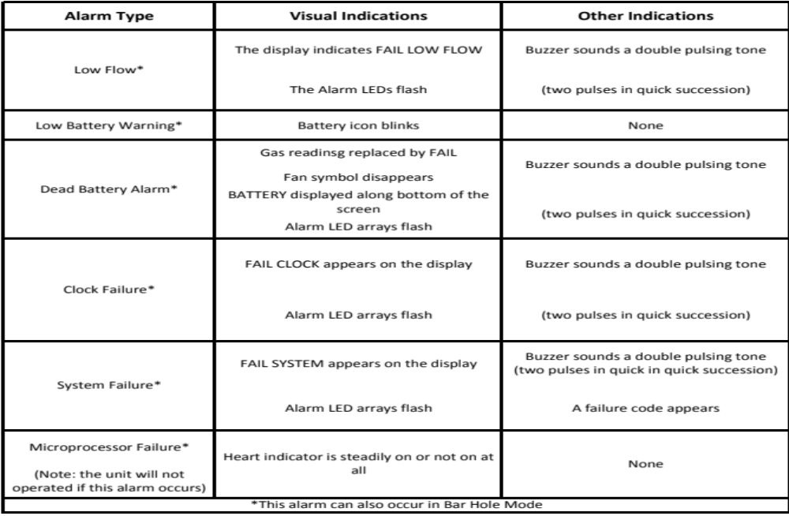
Alarm Types and Indications

Slide 23
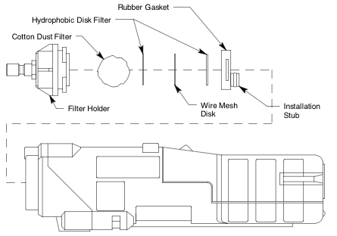
Replacing the Filters
Verify that the GX-2012 is off.
Locate the filter holder at the top of the unit.
Grasp the filter holder and turn it 1/4 turn counterclockwise.
Pull the filter holder away from the case.
Remove and replace hydrophobic filters and cotton ball if dirty.

Slide 24
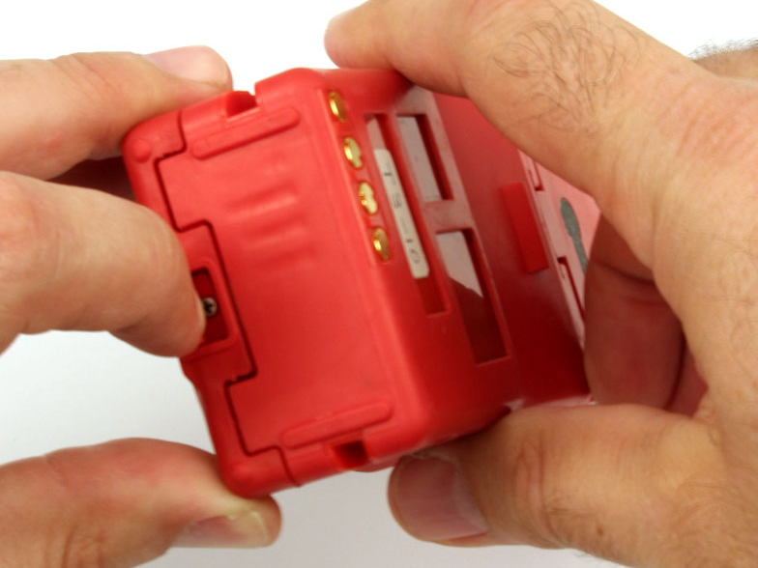
Replacing the Batteries
Turn off the GX-2012
Push the latch on the bottom of the GX-2012 toward the front of the instrument to release the battery pack.

Slide 25
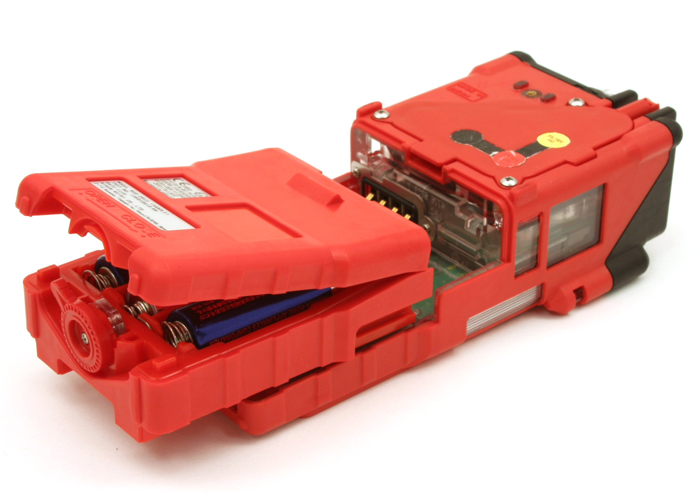
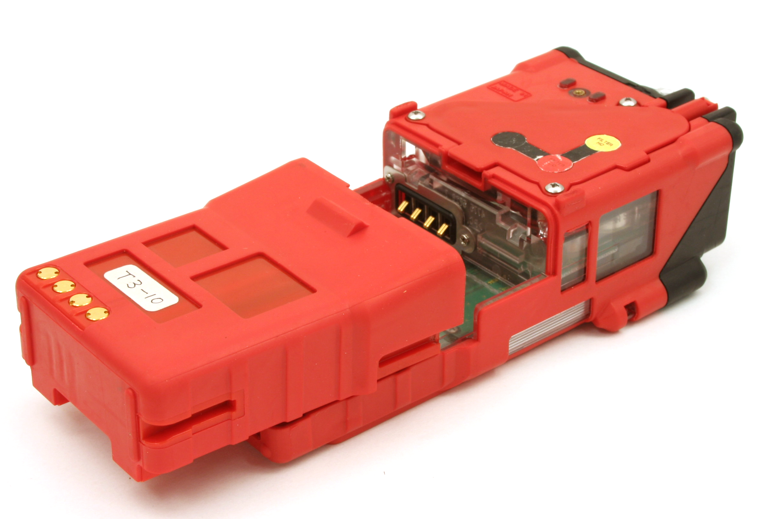
Replacing the Batteries
Alkaline Battery Pack
Slide the battery pack away from the instrument
Insert a new battery pack
Push the battery pack into the instrument until you hear a click as it locks in place.
Li-Ion Battery Pack

Slide 26
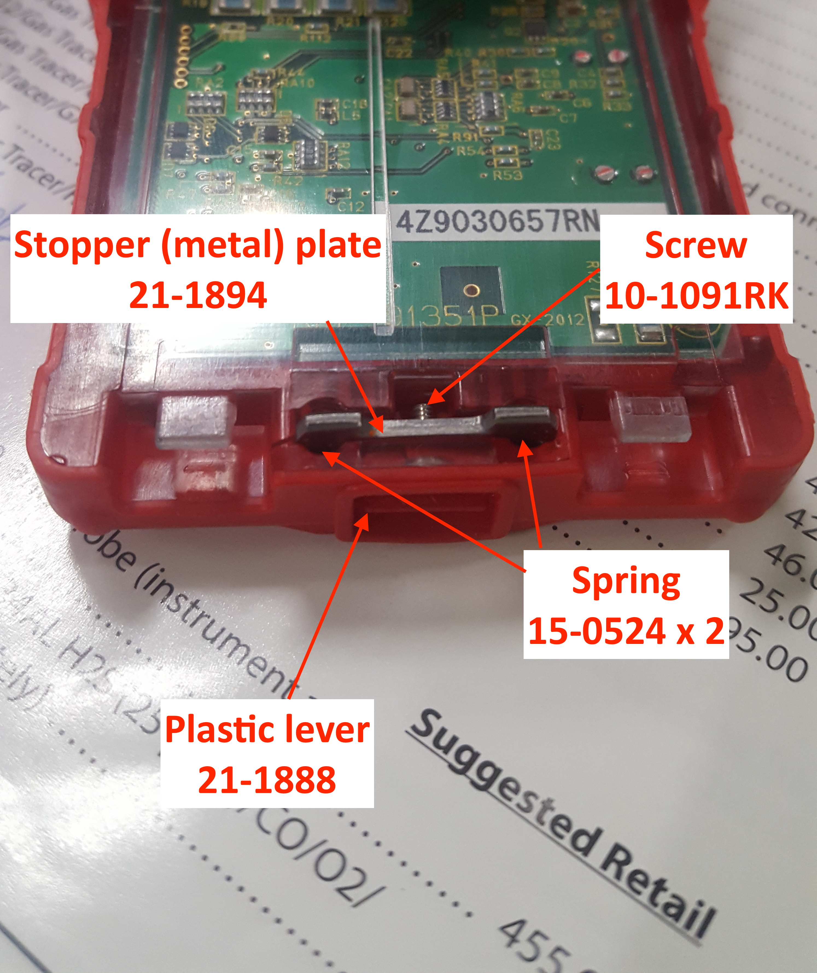
Replacing battery locking parts
Battery locking components can get lost when customers unnecessarily remove the screw on the plastic lever to change a battery.
See figure on right for these replacement part numbers.

Slide 27
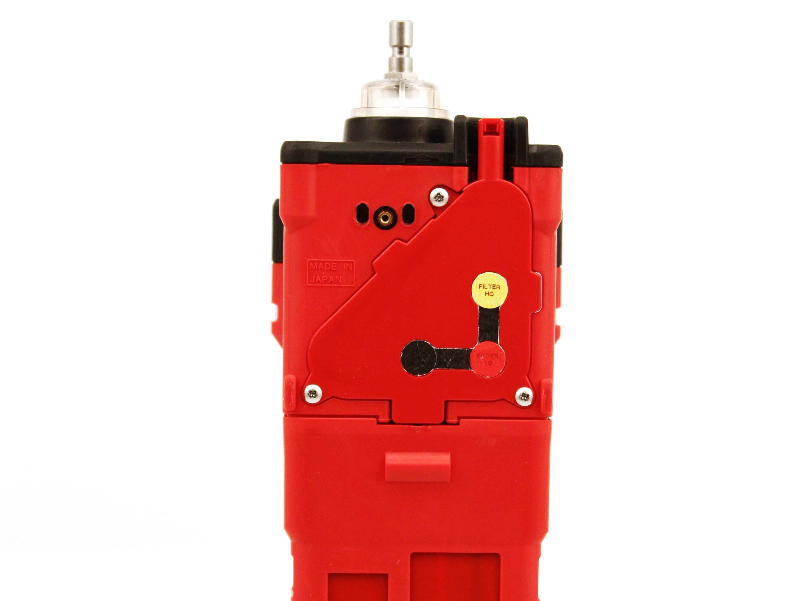
Replacing the Sensors
Use a screwdriver to remove the three screws holding the belt clip on
There will be one screw left holding the flow chamber to the instrument. Remove.
Remove the battery pack getting access to tab.
Grab the exhaust port and using a flat blade screwdriver on exposed tab, lift up on tab and port to remove flow chamber from unit.

Slide 28
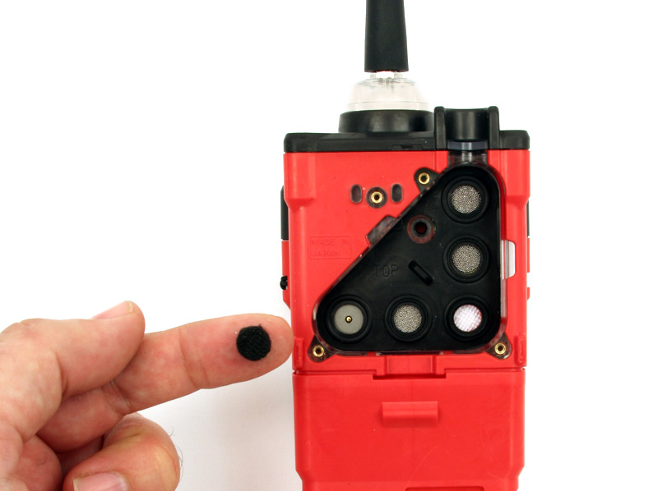
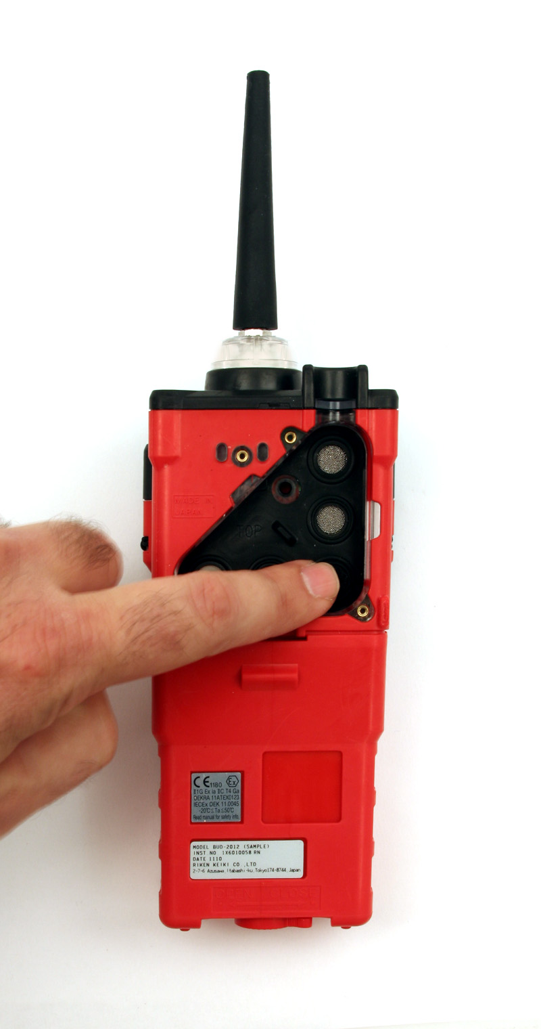
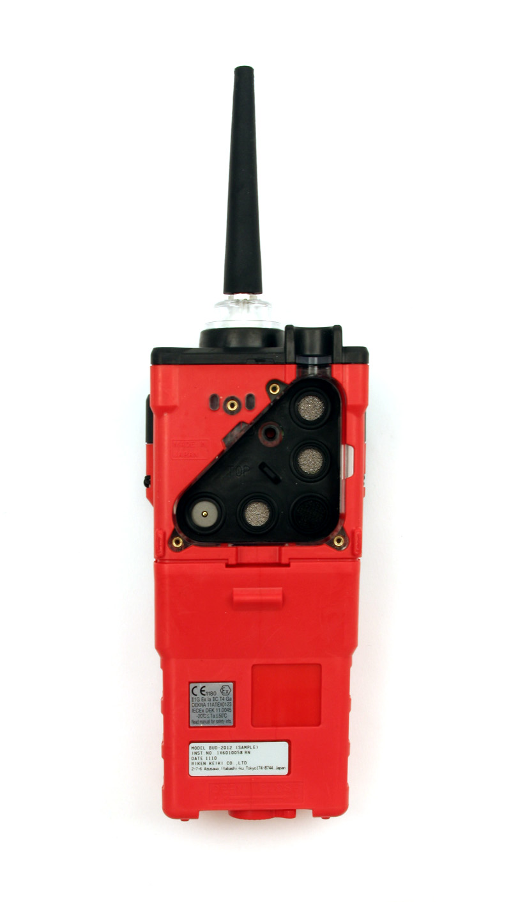
Replacing the Scrubbers
Place the charcoal filter over the CO sensor

Slide 29
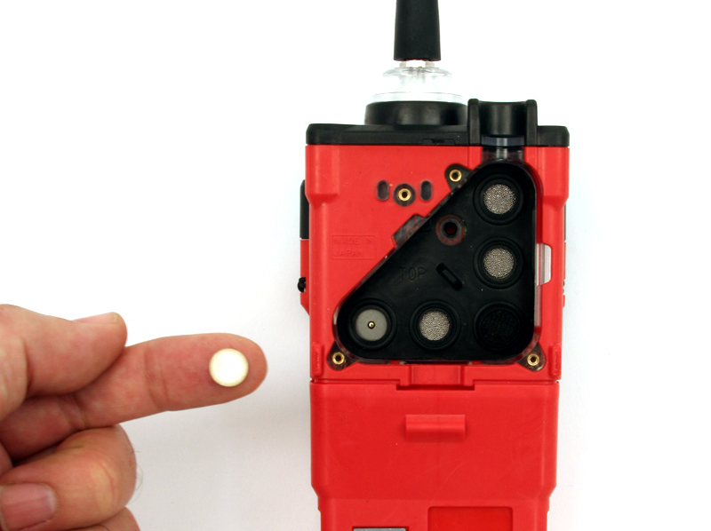
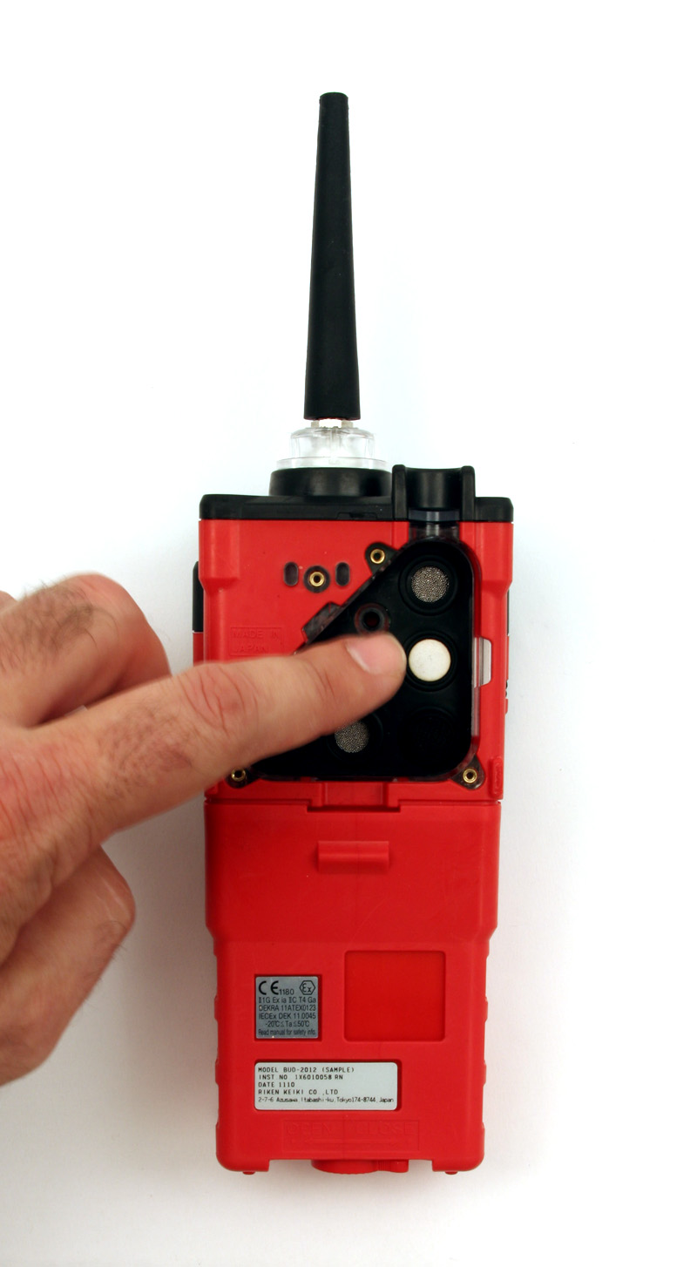
Replacing the Scrubbers
Place the H2S Scrubber over the LEL sensor

Slide 30
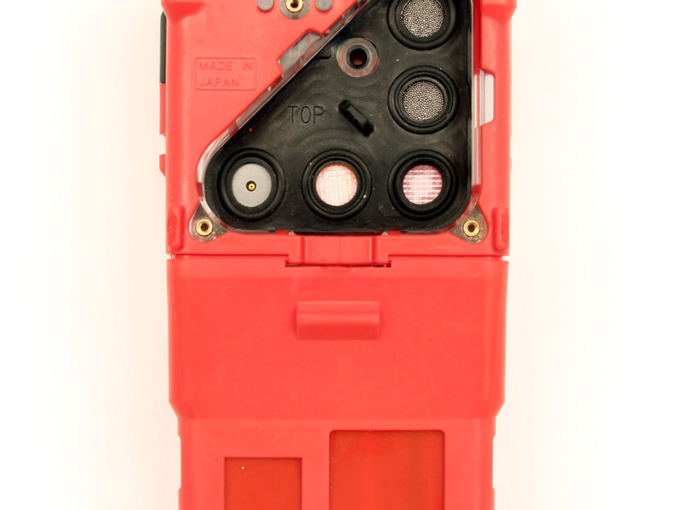
Replacing the Sensors
Tab
Gently pull the tab of the sensor gasket to remove it and expose sensors.
Do not lose any of the scrubber filters that are currently installed.

Slide 31
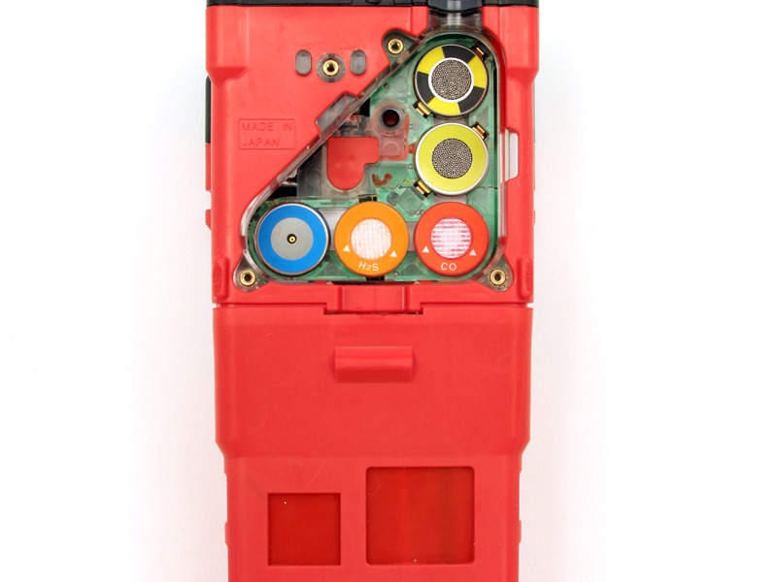
Replacing the Sensors
Remove the sensors from their sockets

Slide 32
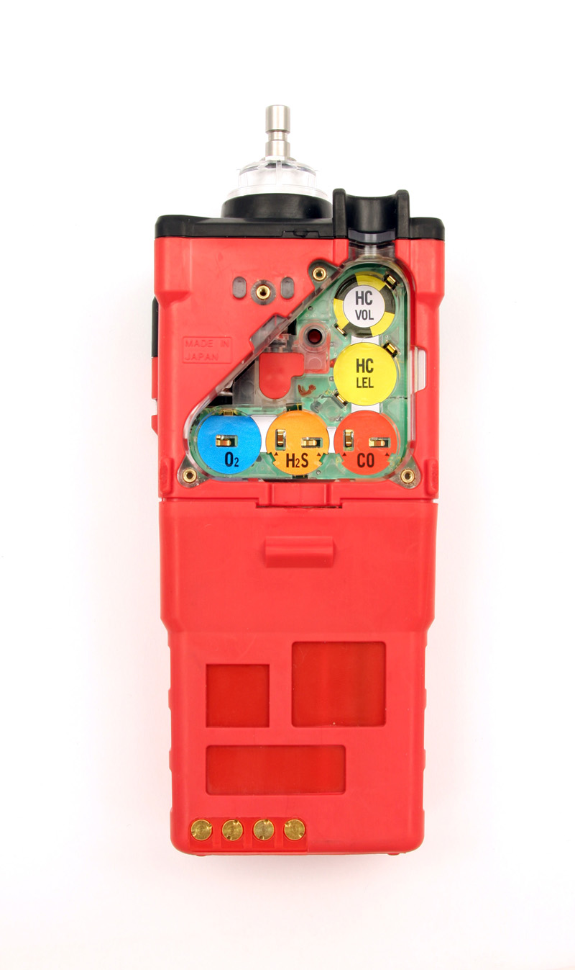
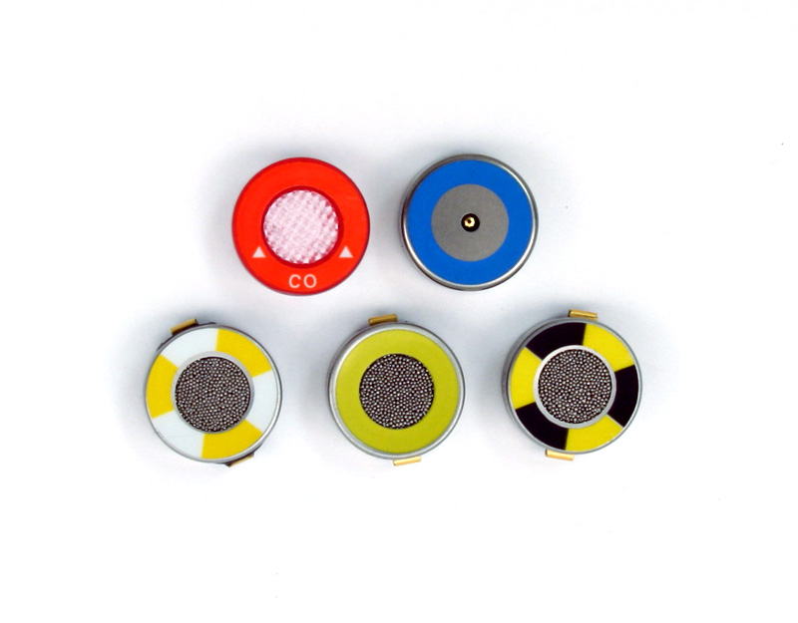
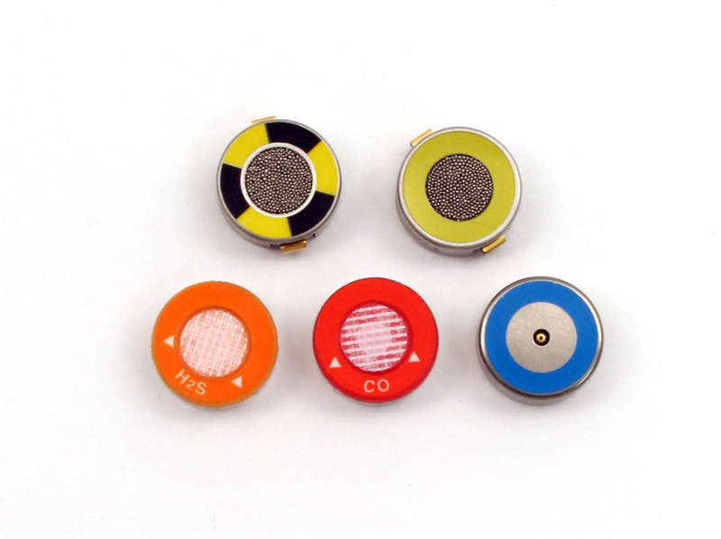
Replacing the Sensors
Gas Tracer Sensors
GX-2012 Sensors
Carbon Monoxide
Oxygen
%LEL
Catalytic
Oxygen
%LEL
Catalytic
Hydrogen Sulfide
Carbon Monoxide
PPM Methane
MOS/catalytic
%Volume Methane
Thermal Conductivity
Carefully insert the replacement sensor in the correct key color coded socket.

Slide 33
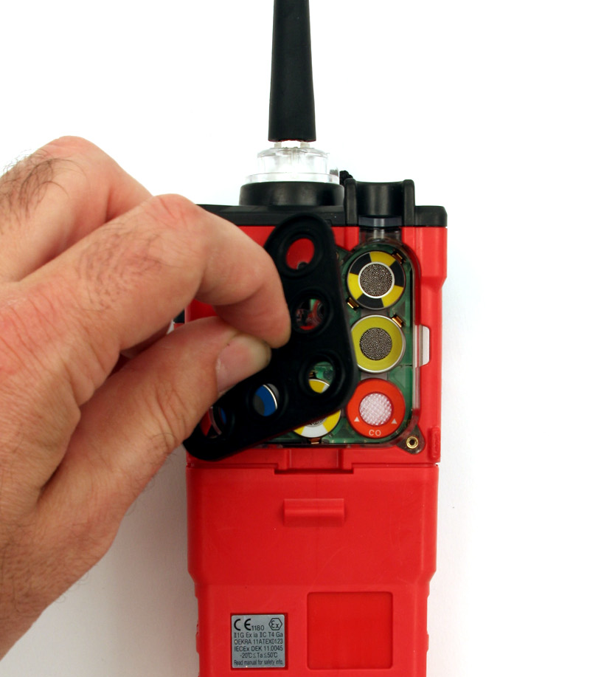
Replacing the Sensors
Place the sensor gasket and scrubbers back into the chamber.
Carefully tuck edge of sensor gasket inside case to seal.

Slide 34
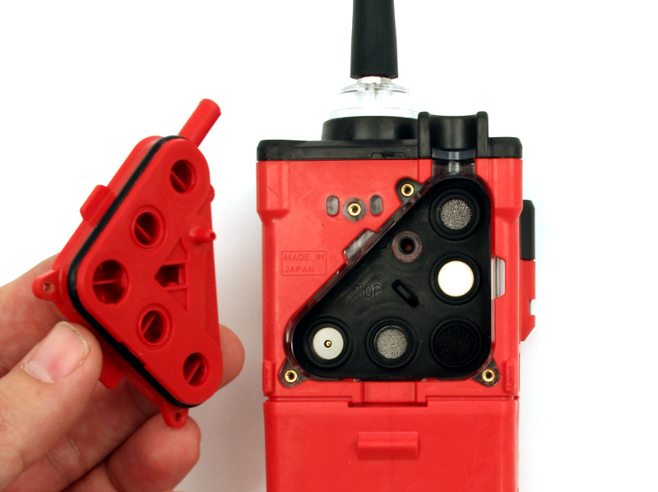
Replacing the Sensors
Place the flow chamber in position over the sensor area and press it into the case until it is flush with the back of the case.
Tighten the top screw of the flow chamber completely.
Place the belt clip into position and tighten the three screws retaining it.

Slide 35
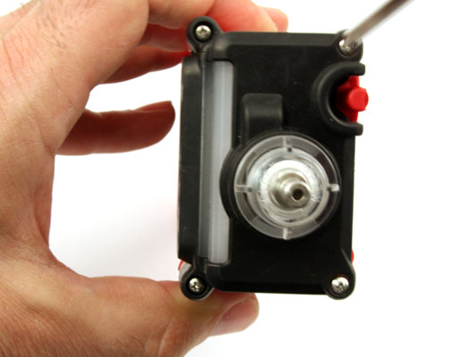
Replacing the Pump
Unscrew the 4 screws in the top of the unit

Slide 36
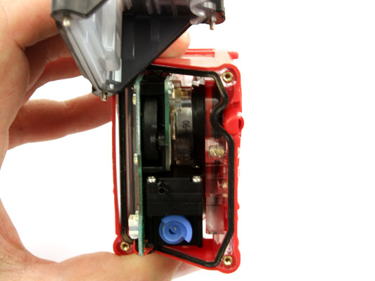
Replacing the Pump
Take off the top cover by pulling straight up

Slide 37
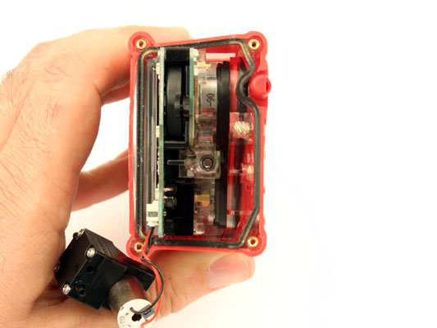
Replacing the Pump
Point at which the pump is connected to the board
Grasp the pump and gently pull it out of the unit. Unplug the connector from the circuit board.

Slide 38
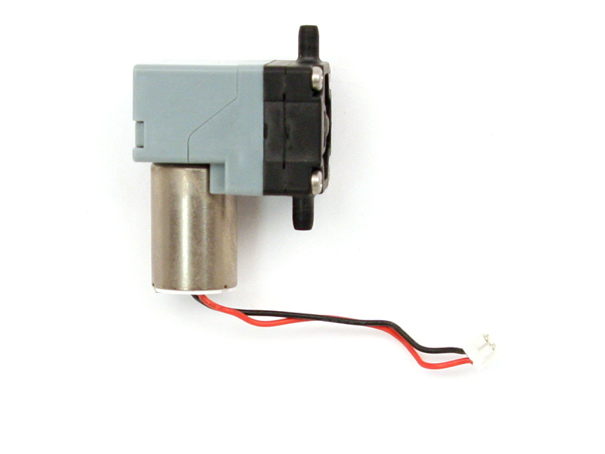
Replacing the Pump
Pump maintenance consists of cleaning diaphragm, valves, replacing diaphragm or replacing the entire pump assy.

Slide 39
Replacing the LCD
Remove the three screws holding the flow chamber and remove flow chamber from unit.

Slide 40
Replacing the LCD
Remove the sensors from their sockets

Slide 41
Replacing the LCD
Unscrew the 4 screws in the top of the unit.

Slide 42
Replacing the LCD
Take off the top cover by pulling straight up.

Slide 43
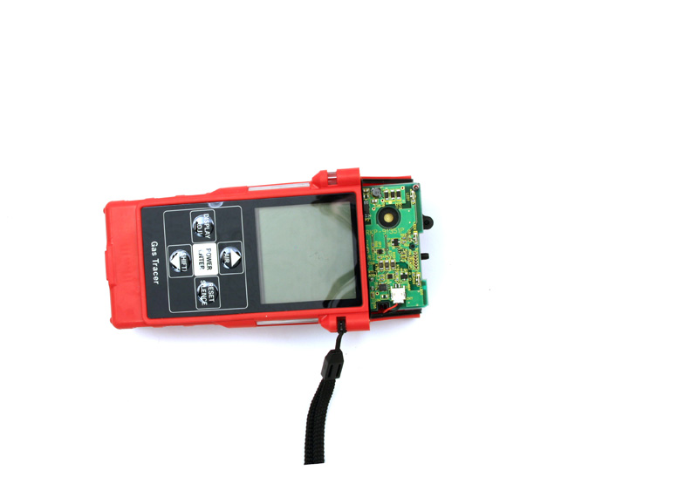
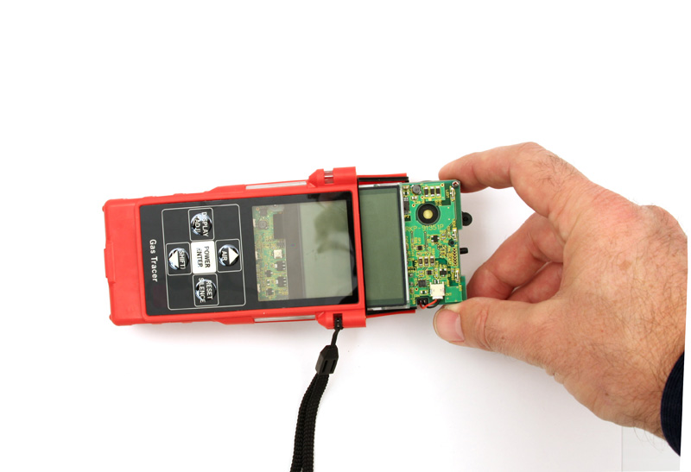
Replacing the LCD
Pull
Once the top is off the unit, gently pull the board out of the top of the unit

Slide 44
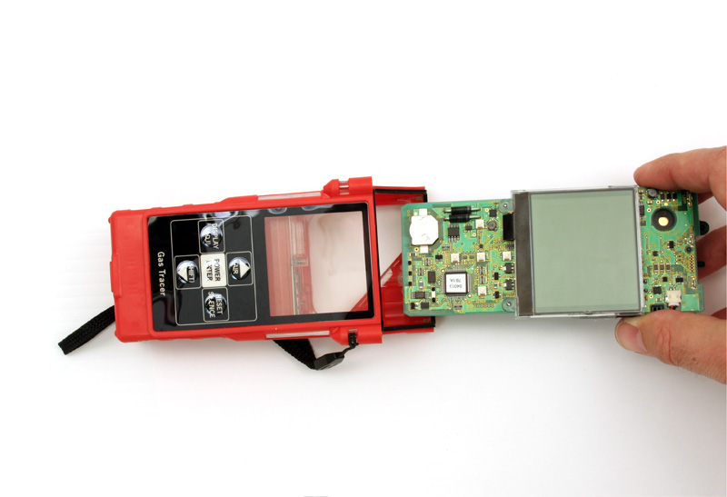
Replacing the LCD
The board should slide out easily.

Slide 45
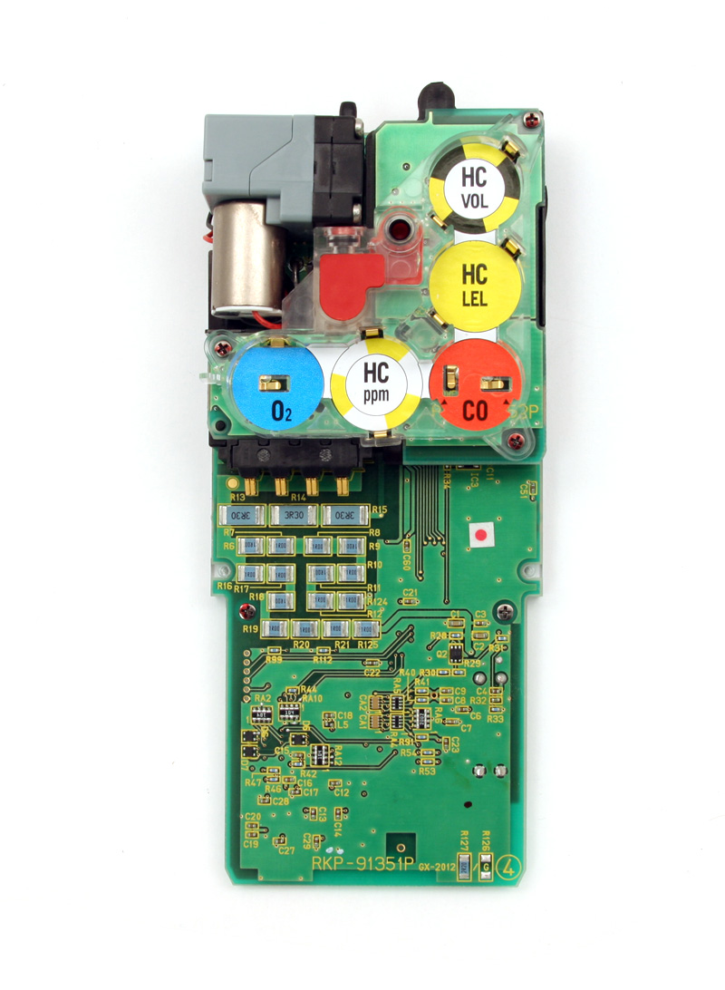
Replacing the LCD
Tabs
Tabs
Screw
Screw
Unscrew the 2 screws holding in the bottom of the LCD. Next locate the two tabs on the side of the board, under sensor board.
Use a flat head screw driver to gently unlock tabs from PCB.

Slide 46
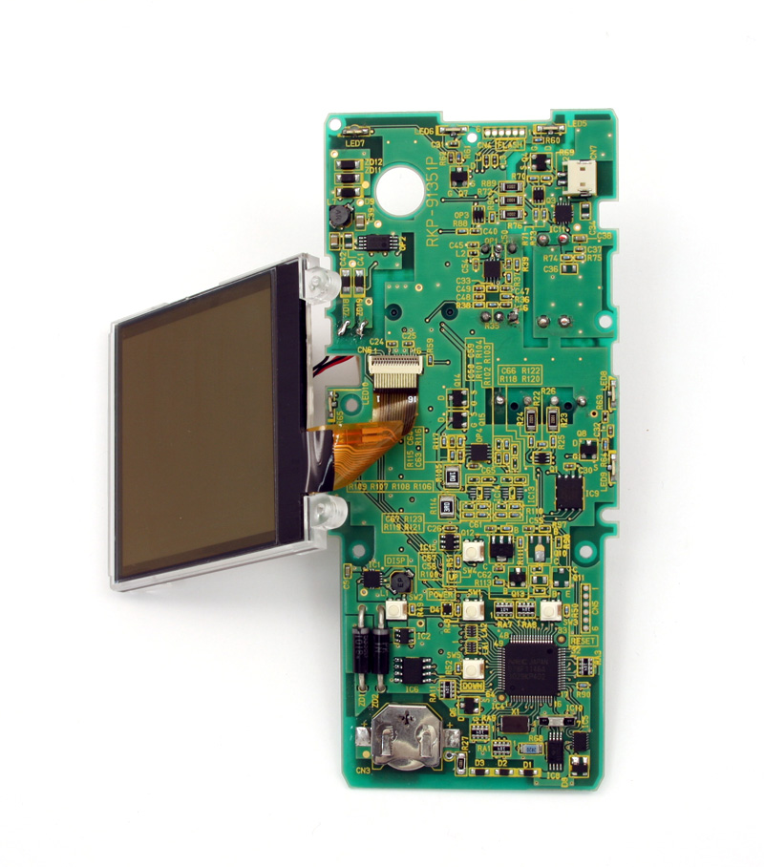
Replacing the LCD
Slide Latch up to release ribbon cable pins
The next step is to remove the ribbon cable and install the new LCD. Install in reverse order.

Slide 47
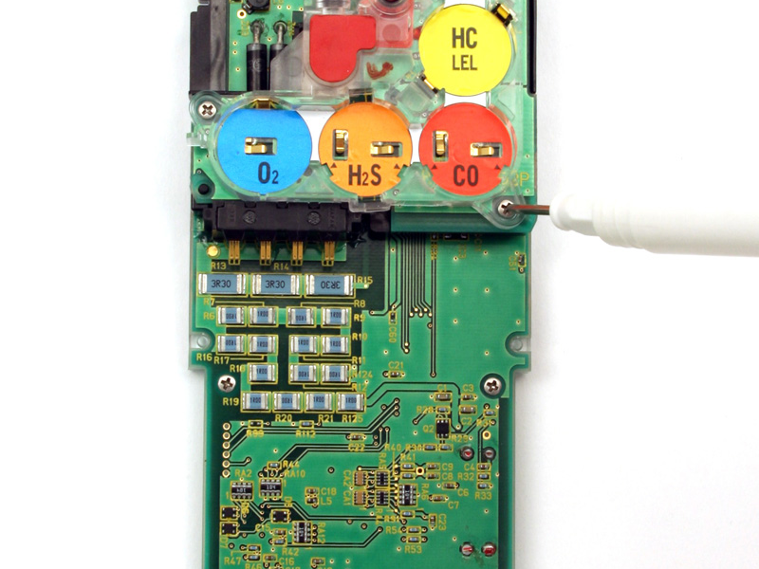
Replacing the Sensor Board
Remove the 3 screws holding in the Sensor board.

Slide 48
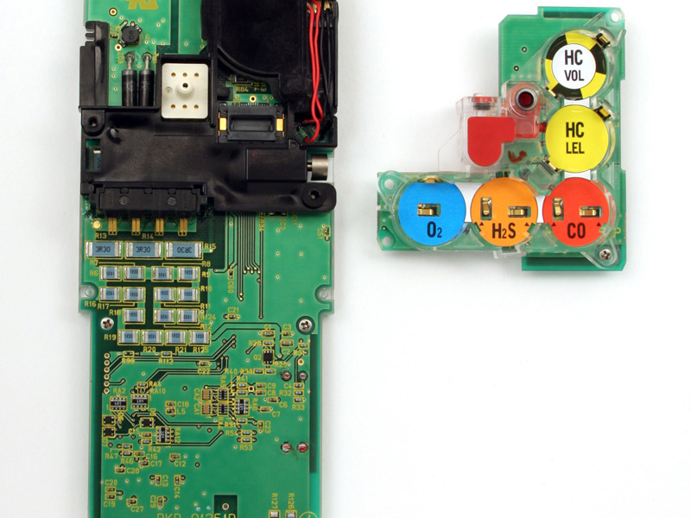
Replacing the Sensor Board
The next step is to remove the sensor board and install new one. Look for corrosion on the gold sensor contacts.

Slide 49
GX-2012
Display / Maintenance / Factory Modes

Slide 50
Display Mode
While in Normal Operation, push DISPLAY(ADJ) to cycle through
HC Range
  Only visible if %vol TC sensor installed
    Switch between %LEL/%vol/autorange for combustible units
Peak readings (reset when turned off and back on)
STEL - Short Time Exposure Limit (15min)
TWA – Time Weighted Average (8hr)
Alarm Points/full scale/STEL/TWA limits
Operation Time
Date/Time
Remaining Log Time
Clear Data Log
Pump Off
User/Station ID
Snap Log View
Peak Bar

Slide 51
Maintenance Mode
Take the GX-2012 to a non-hazardous location, and turn it off if it is on.
Press and hold the AIR▲ and (SHIFT)▼ buttons, then press and hold the POWER ENTER button. When you hear a beep, release the buttons. The unit will prompt you for a password.

Slide 52
Maintenance Mode
Enter the password by using the AIR▲ and (SHIFT)▼ buttons to select each password number and then press and release POWER ENTER to move on to the next one.
  A password is always needed to enter Maintenance Mode even if the PASSWORD menu item in Maintenance Mode has been turned off (factory setting). The factory set password is 2102. You may change this password by entering the PASSWORD menu item in Maintenance Mode.

Slide 53
Maintenance Mode
Once you enter Maintenance Mode, MAINTENANCE will appear along the top of the screen and DATE appears on the bottom of the LCD.
Use the (SHIFT)▼ button to move through the menu item screens.

Slide 54
Maintenance Mode
DATE – updating the date and time settings
AIR CAL – perform a fresh air adjustment
AUTO CAL – perform an automatic calibration on LEL/O2/CO/H2S at once or on %vol
ONE CAL – manual calibration of one sensor at a time
BUMP - The BUMP menu item will not appear unless BUMP DSP is set to “ON” (the factory setting is “OFF”).

Slide 55
Maintenance Mode
LNCH BRK - on/off
  With LNCH BRK “OFF” (factory setting), the GX-2012 automatically starts new TWA and PEAK reading collection and resets the time in operation at startup
  With LNCH BRK “ON”, the Resume Measurements Screen displays during startup. From this screen, you can choose to continue accumulating TWA and PEAK readings and the time in operation from the last time the GX-2012 was used or start collecting new readings and reset the time in operation.

Slide 56
Maintenance Mode
LATCHING - latching/non-latching
  With LATCHING set to ON (factory setting), the GX-2012 remains in alarm condition until the alarm condition passes and the POWER ENTER button is pressed.
  With LATCHING set to OFF, the GX-2012 automatically resets an alarm when the alarm condition passes.

Slide 57
Maintenance Mode
ALM SLNC - on/off
  With ALM SLNC set to ON (factory setting), pressing and releasing the RESET SILENCE button silences the buzzer when the GX-2012 is in alarm. The LEDs continue to flash and the display continues to show the alarm until the reset button is pushed after the alarm condition has passed.
  With ALM SLNC set to OFF, you cannot silence the buzzer. If an alarm condition occurs, and you enter Display Mode, the buzzer will not be silenced and the LEDs will continue to flash until the reset button is pushed after the alarm condition has passed.

Slide 58
Maintenance Mode
LG INTVL - interval trend time setting
  10 minutes, 5 minutes (factory set), 3 minutes, 1 minute, 30 seconds, 20 seconds, or 10 seconds

Slide 59
Maintenance Mode
ALARM--P - alarm point setting
DLOG DSP - data logger clear screen display setting
BUMP DSP - bump feature setting
  If “OFF”, the bump menu item in Calibration Mode and Maintenance Mode does not appear. In addition, the BUMP—SET, BP INTVL, BP RMNDR, and BP EXPRD menu items will not display in Maintenance Mode (the factory setting is OFF)

Slide 60
Maintenance Mode
POFF DSP - When set to ON, the Pump Off Screen appears in Display Mode and the user can turn off the pump in order to conserve battery power. If set to OFF (factory setting), the Pump Off Screen does not appear in Display Mode and the user cannot turn the pump off.

Slide 61
Maintenance Mode
BUMP -- SET - used to adjust the bump test parameters
  Press and release the POWER ENTER button. The values displayed are for GAS TIME, CHECK (bump test tolerance), CAL TIME, and AUTO CAL. The cursor on the left of the screen shows which setting is associated with the parameter shown at the bottom of the screen. Use the AIR or (SHIFT) buttons to scroll up or down along the list

Slide 62
Maintenance Mode
BEEP. SET – updating the confirmation beep setting
  With BEEP. SET set to ON, the GX-2012 beeps once every 5 minutes to verify that it is operating.
  With BEEP. SET set to OFF (factory setting), the GX-2012 does not sound a confirmation beep.
OVER WRT - data logging over write setting
  With OVER WRT set to ON (factory setting), the GX-2012 writes over the oldest data with new data when the data logger memory is full.
  With OVER WRT set to OFF, the GX-2012 stops saving data to the data logger when the data logger memory is full.

Slide 63
Maintenance Mode
CL INTVL - calibration interval setting
  The minimum setting is 1 day and the maximum setting is 255 days (The factory setting is 90 days).
CL RMNDR - calibration reminder on/off
  If “ON” (factory setting), the GX-2012 will give an indication at start up if it is due for calibration
CL EXPRD - calibration expired performance setting
  Confirm, Not Use, or No Effect (if CL RMNDR is set to “ON”)

Slide 64
Maintenance Mode
C--CHECK - calibration reminder 4 gas/ALL setting.
BP INTVL – minimum setting is 0 days and the maximum setting is 30 days.
BP RMNDR – With BP RMNDR set to ON, the GX-2012 will give an indication at start up if it is due for bump testing. The type of indication will depend on the BP EXPRD setting.

Slide 65
Maintenance Mode
BP EXPRD – CONFIRM, NOT USE, or NO EFFECT
B--CHECK - BUMP reminder 4 gas/ALL setting
ID DISP - on/off
  If ID DISP set to “ON”, the User ID Screen and Station ID Screens display during start up and in Display Mode (The ID’s can be updated in Display Mode).
  If ID DISP set to “OFF” (factory setting), the User ID Screen and Station ID Screens do not display during start up or in Display Mode.

Slide 66
Maintenance Mode
BCK LGHT - back light lighting time setting
  The minimum setting is 0 seconds; the maximum setting is 255 seconds (the factory setting is 30 seconds).
AUTOZERO - on/off
  If “ON”, the GX-2012 will automatically perform a fresh air adjust when it is turned on (the factory setting is “OFF”).

Slide 67
Maintenance Mode
DEMAND Z - Demand Zero on/off
  If “ON”, allows you to manually perform a fresh air adjust in normal operation by pressing the AIR▲ button (the factory setting is ON).
L./B. MODE - LB Mode setting
  If “OFF” (factory setting), the GX-2012 will automatically enter Normal Mode when it is turned on.
  If you wish to use this feature, you can choose between: BH, LC, BH LC

Slide 68
Maintenance Mode
B.H. TIME - Bar Hole measuring time setting
  30 seconds, 45 seconds or 60 seconds
PORTUGAL
  Changes instrument language to Portuguese
CO DISP
  Updating the Leak Check Mode CO channel display setting.

Slide 69
Maintenance Mode
ROM/SUM – Instrument’s firmware version and checksum
PASSWORD - password setting on/off
  If “ON”, the GX-2012 prompts you for a password when you enter Calibration Mode
  If “OFF” (factory setting), no password is required to enter Calibration Mode.
FLOW ADJ - low flow set point adjustment
START – Press POWER ENTER to return to normal operation.

Slide 70
Using Factory Mode
Press and hold the RESET/SILENCE, (SHIFT)▼ and DISPLY/(ADJ)buttons, then press and hold the POWER ENTER button. When you hear a beep, release the buttons. The unit will prompt you for a password.
Enter the password (1994) by using the AIR▲ and (SHIFT)▼ buttons to select each number.

Slide 71
Using Factory Mode
Once you enter Factory Mode, MAINTENANCE will appear along the top of the screen. The DATE Screen displays.
Use the AIR▲ or (SHIFT)▼ button to move through the menu item screens as needed.

Slide 72
Factory Mode
DATE – updating the date and time setting
GAS COMB - allows the user to turn on/off gas channels
HC SEL. – Select combustible gas
  (CH4, i-C4H10)
HC RANGE – Select combustible range
  LEL, VOL, Auto ranging
LATCHING - latching/non-latching
L./B. MODE - LB Mode setting
B.H. TIME - Bar Hole measuring time setting
ZR FLLWR - on/off

Slide 73
Factory Mode
ALM SLNC - on/off
LNCH BRK - on/off
LG INTVL - Interval trend time setting
DLOG DSP - data logger clear screen display setting
BUMP DSP - bump feature setting
ROM/SUM - ROM Number
A/D VAL
FLOW ADJ -low flow set point adjustment

Slide 74
Factory Mode
DSP AL--P - Full scale/Alarm point (alarm test)
DEFAULT – reverts to a 5-gas
START - Start Measurement

Slide 75
Setting Flow Alarm

Slide 76
Setting Flow Alarm
Entering Maintenance Mode
  Press and hold the AIR and SHIFT buttons, then press the POWER ENTER button and release all when the unit beeps
  First screen will prompt you for the password- Enter 2102
  Press ENTER

Slide 77
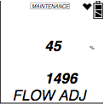
Setting Flow Alarm
Use the Air key to scroll through the menu items
Select FLOW ADJUSTMENT by pressing ENTER
Two values will be displayed
  The top value is a percentage
  The bottom value is the current low flow alarm point (this is the value we are most concerned with.)

Slide 78
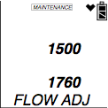
Setting Flow Alarm
Using the AIR or SHIFT button to set bottom value as close to 1500 then press ENTER.
The pump will turn on and two new values will be displayed. The top will be a reference value and the bottom will reflect the pump’s current draw.
Connect a flow meter to the inlet of the instrument and adjust it to 0.6 SCFH ± 0.1 SCFH. This will be the low flow set point.
Press the POWER ENTER button to set the trip point.
Use the SHIFT button to select START MEASURMENT then press POWER to exit.

Slide 79
Common troubleshooting techniques
Fail cal
  Gas expired - Old sensor
  Old filter - Auto cal value
  Correct regulator
Low Flow
  Sensor / filter missing / misplaced
  Gasket seated square
  Clogged inlet / hose / probe
Clock won’t reset / Fail clock
  Replace memory retention battery
Cal interval not reset
  Did a full cal? (4-gas vs 5-gas)
  Replace memory retention battery

Slide 80

Questions?

