Slide 1
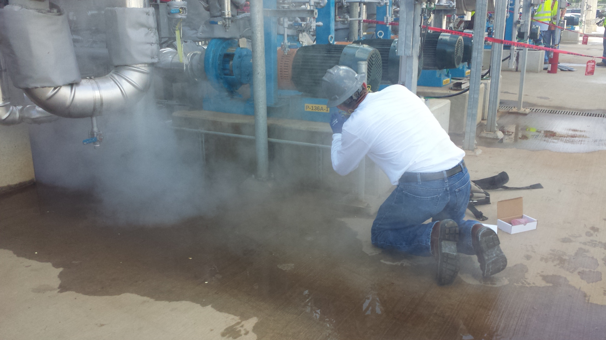
Fixed System Troubleshooting

Slide 2
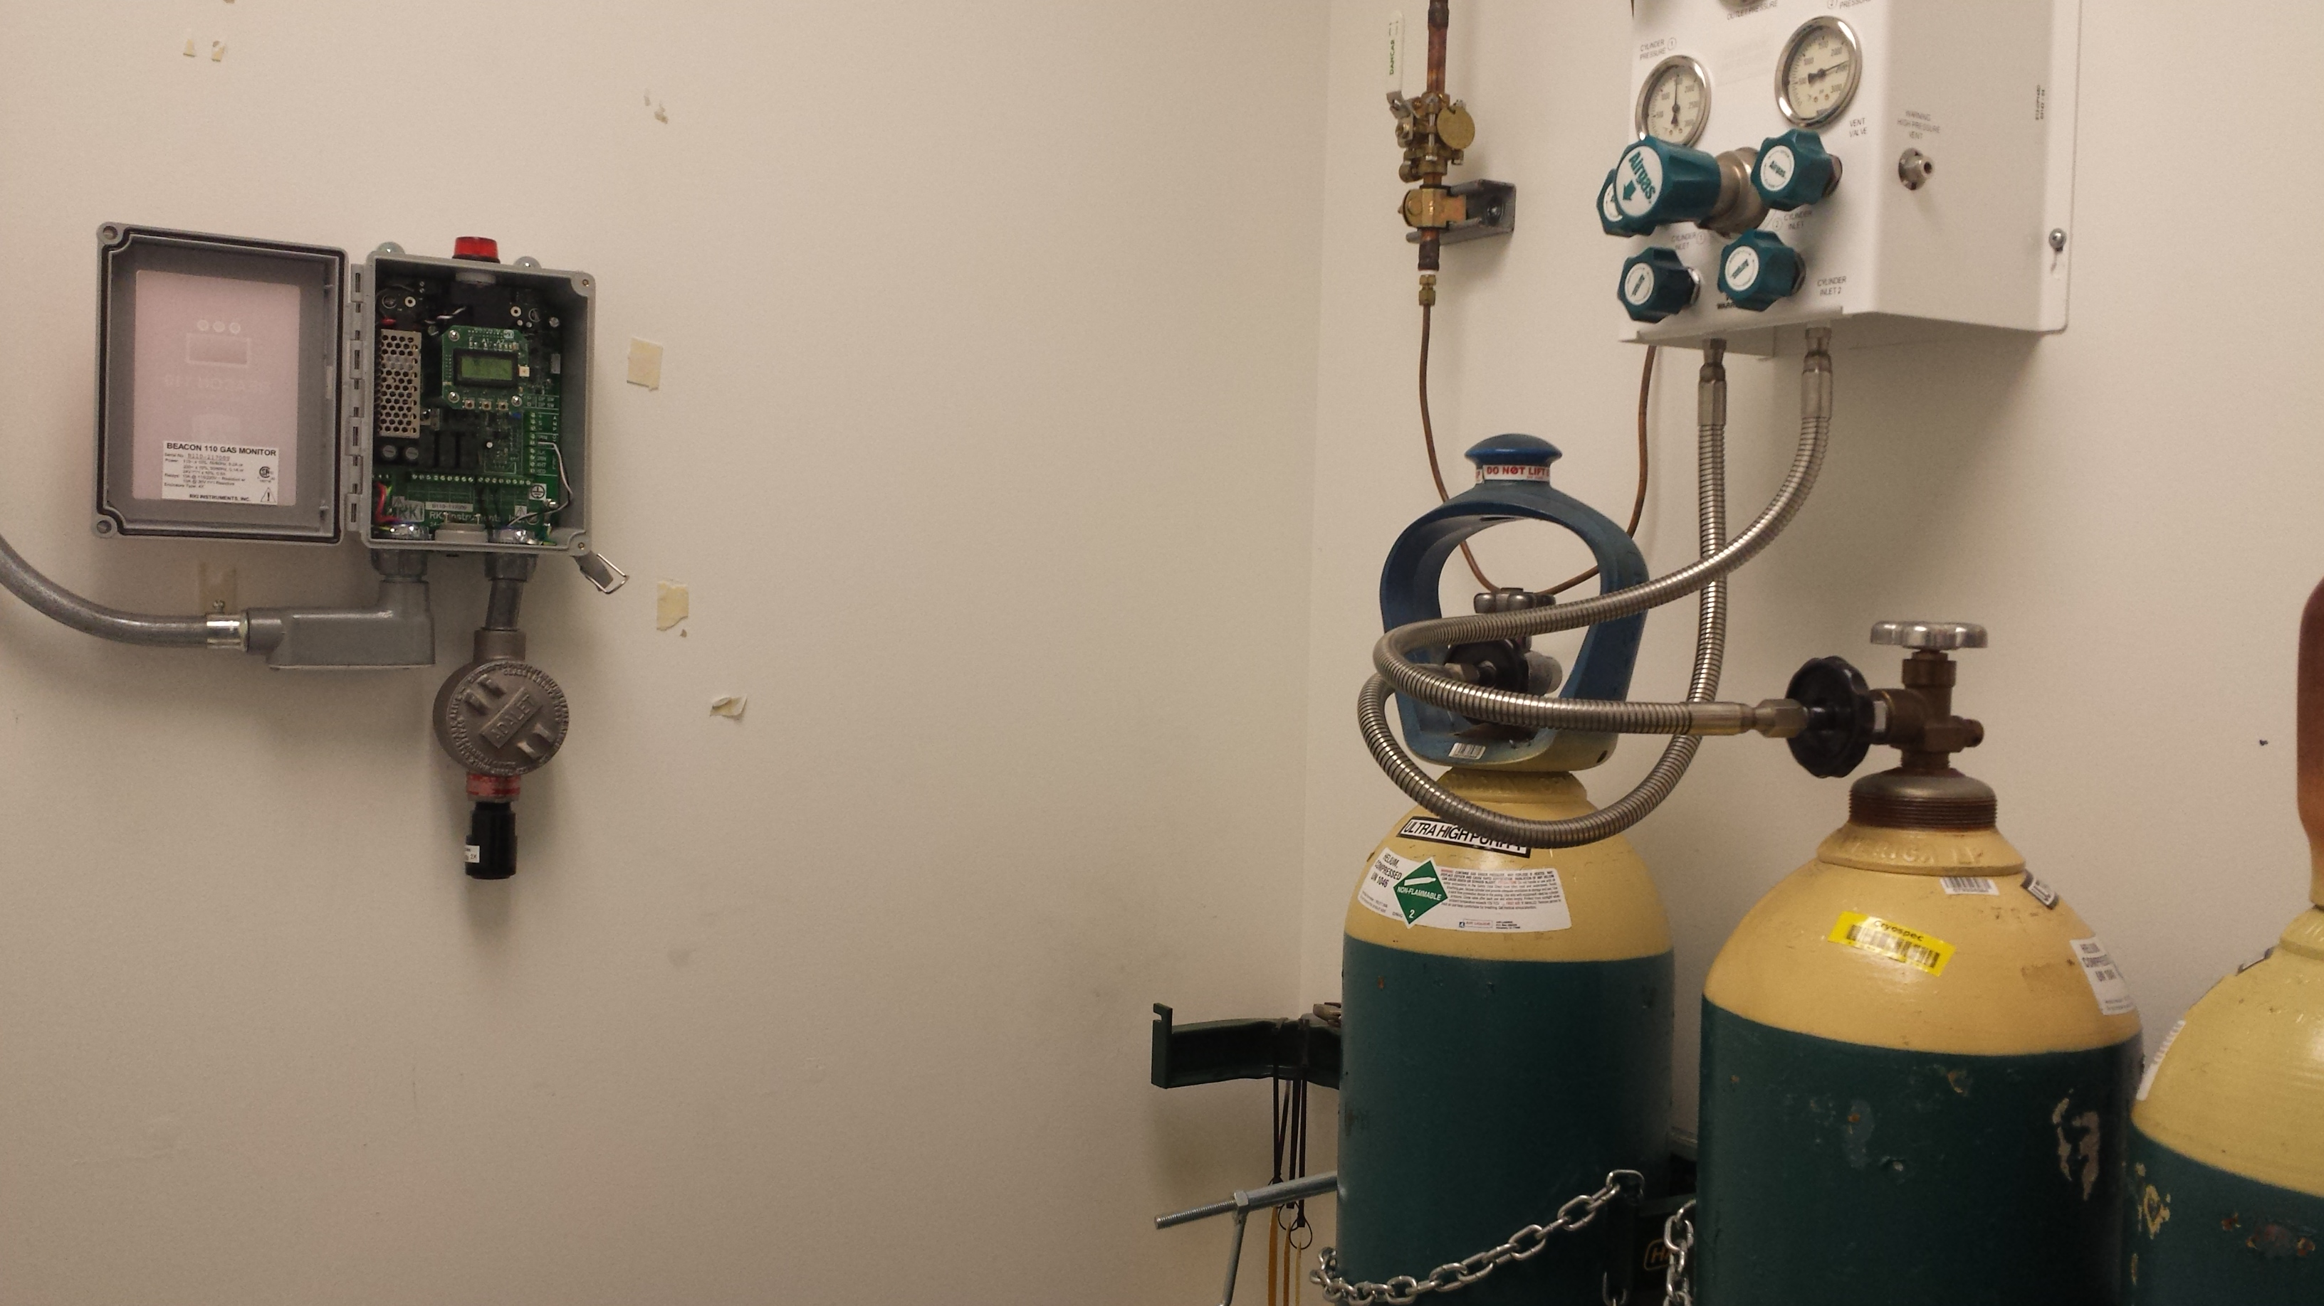
Gather Information
To repair a fixed system you need to determine first what the problem is.
Identify Customer’s complaint.
Could the problem be an actual gas leak?
If the problem is an alarm condition, has the customer tested the space with a portable?

Slide 3
Gather Information
Get Serial Number of the controller and/or transmitters in question.
This provides background information on what equipment the customer has.
Evaluate type of problem:
  Intermittent alarm
  Trouble alarm
  Unstable output
  Can’t calibrate
  Can’t zero
  No power
  No relay activation
  Other…

Slide 4
Gather Information
What types of sensors are affected?
What is the environmental conditions?
  Temperature
  Pressure
  Airflow
  Moisture
Is this a new problem or on-going?
Is the system wired to a fire alarm panel?
Process shut down?
BMS?
PLC?

Slide 5

Prepare
Always bring the manual or technical information on the instrument you are servicing.
Bring appropriate tools and test gas that will be needed to service the system.

Slide 6
Prepare
If problem is sensor/transmitter related, bring the parts necessary to repair or replace what ever may be damaged.
Example: M2A problem
  Bring replacement sensor
  Replacement Terminal Relay Board
  Replacement pre-amp (if applicable)
  Replacement display

Slide 7
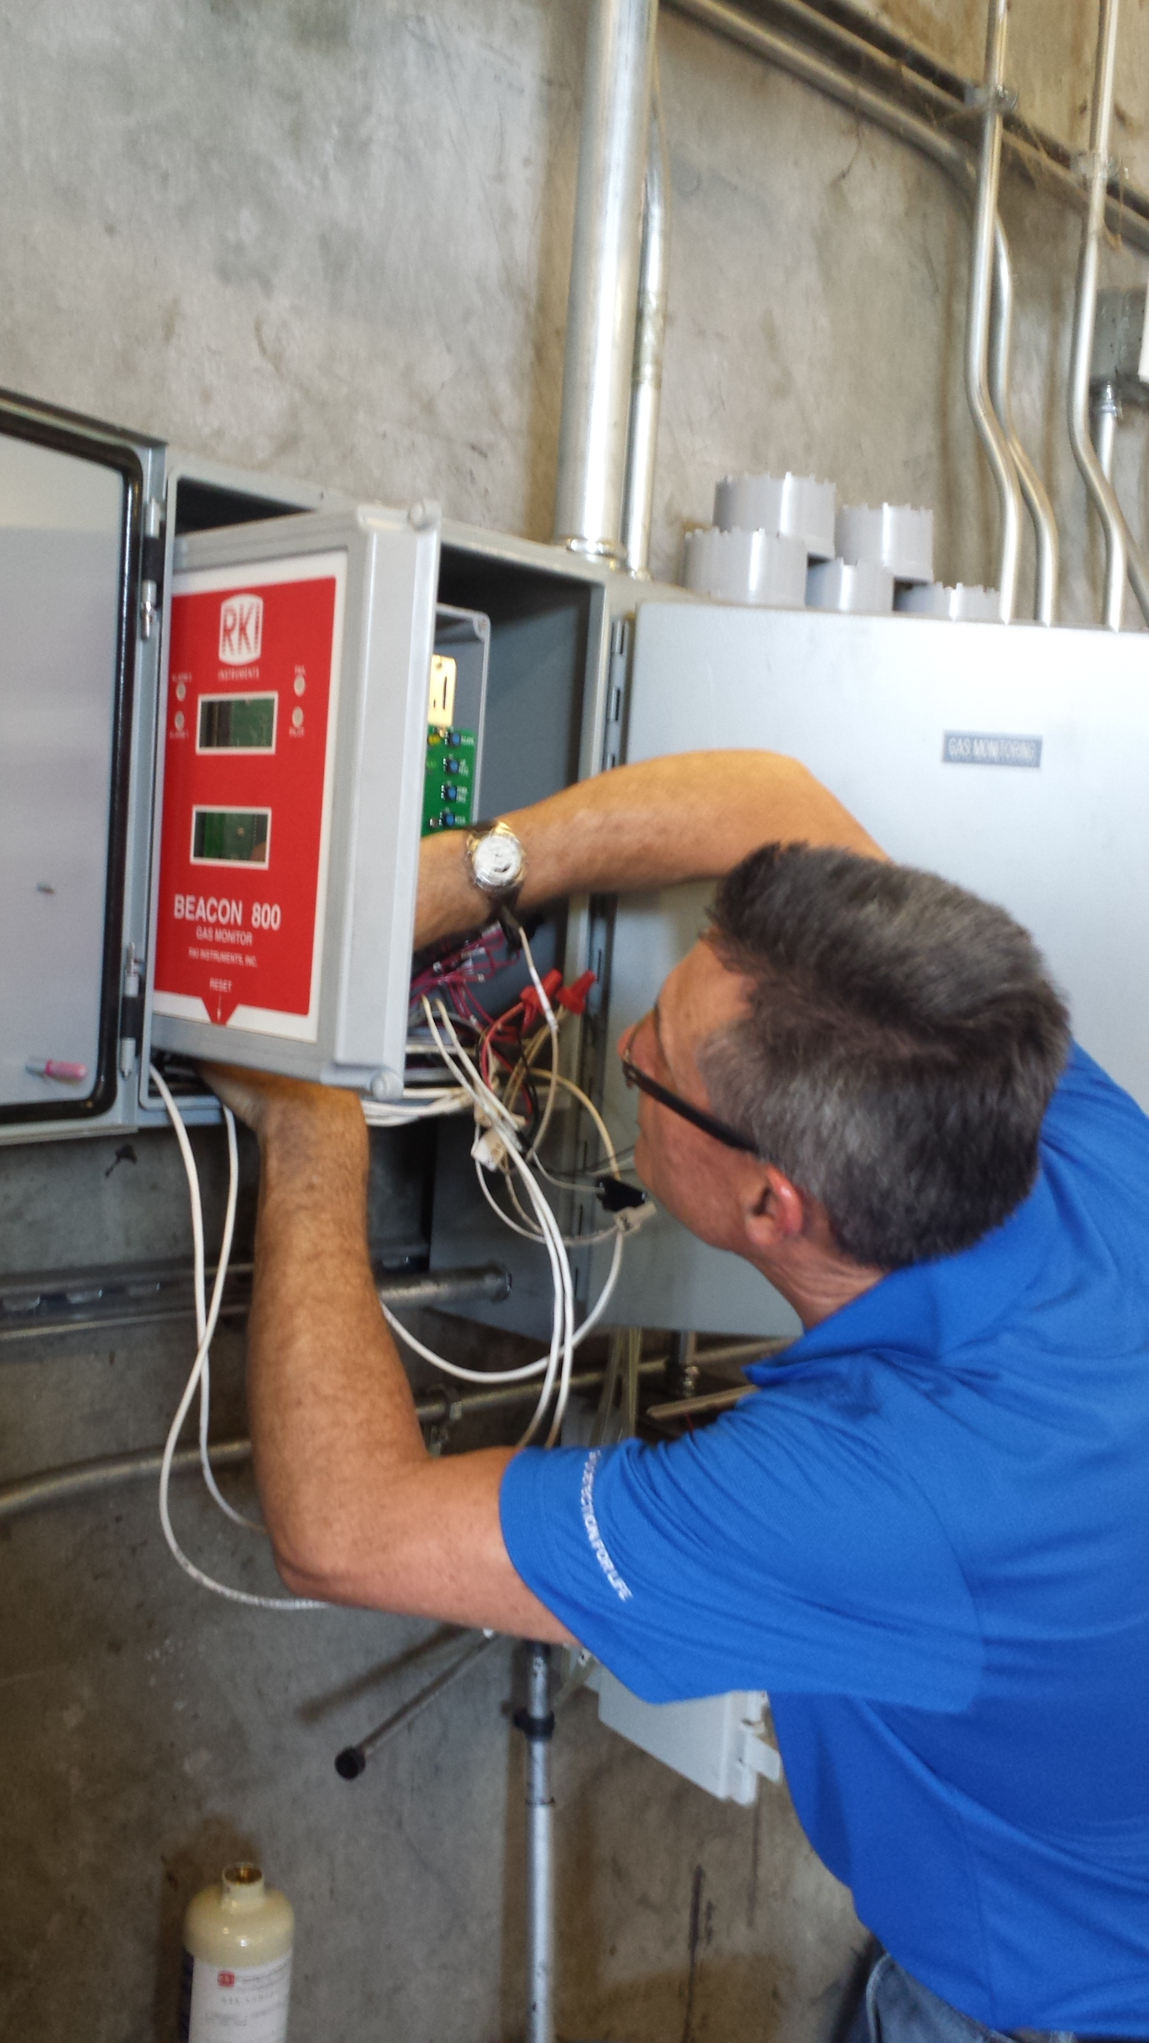
Prepare
If problem is controller related, it may be required that you bring a complete system to the site.
In this case the motherboard was bad and required replacement.

Slide 8
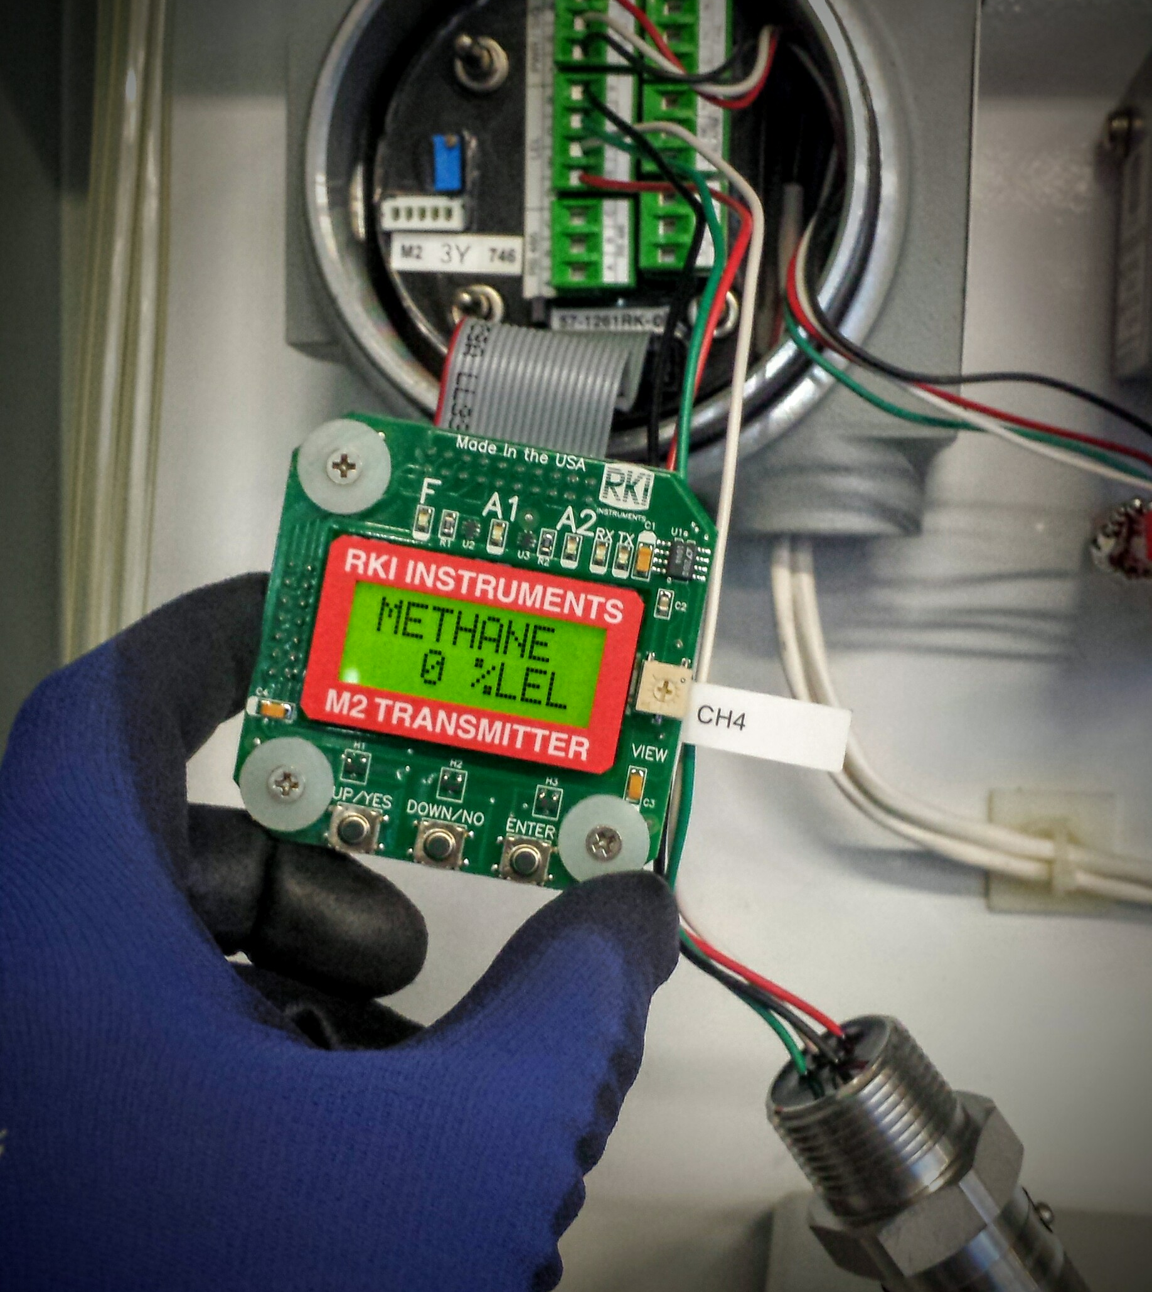
Exchange Method
If sensor is suspect, attach exchange sensor to transmitter and see if problem is resolved. If not then exchange amplifier.
Continue to exchange parts until defective part is identified.

Slide 9
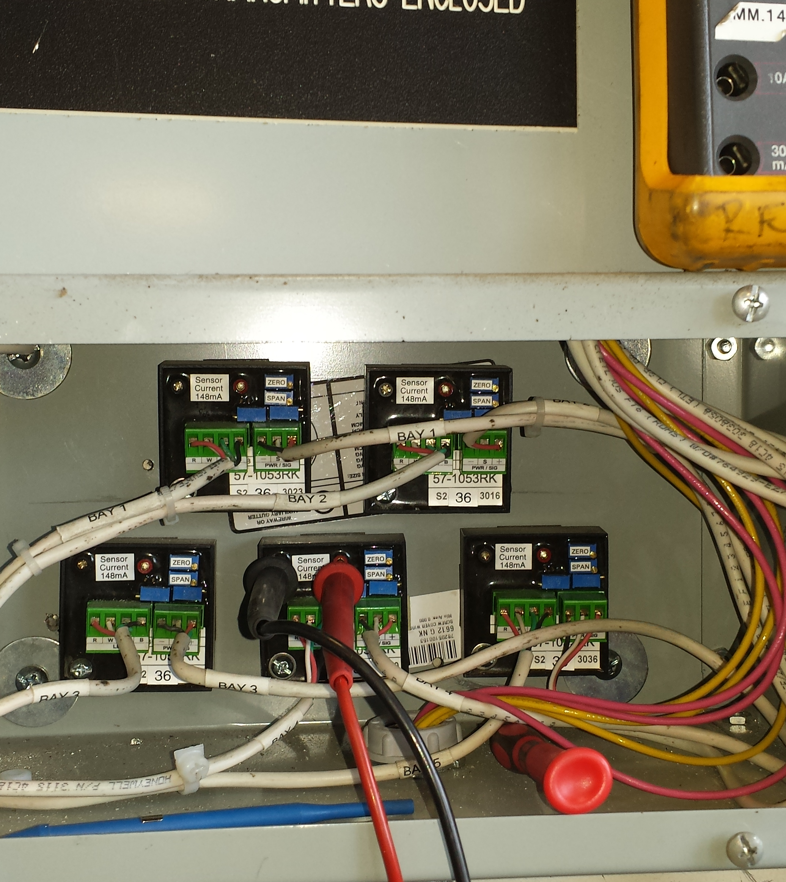
Wiring
Verify proper wiring or if problem is related to a specific cable.
Wire sensor/amp to controller using a short piece of cable to confirm proper operation.

Slide 10
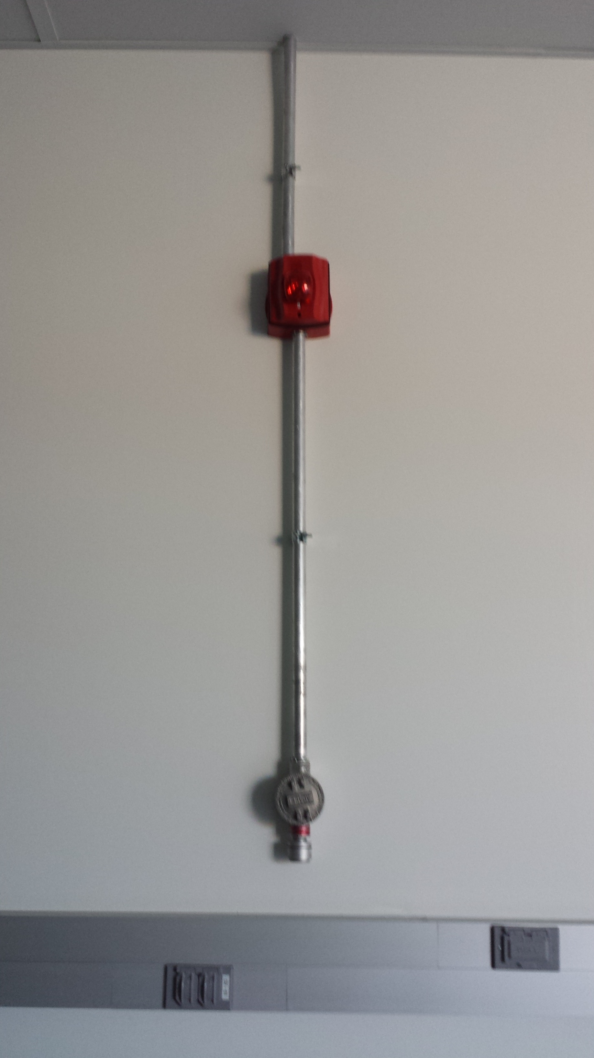
Wiring
Make sure that detector and AC wires are not run in the same conduit.
Do not run external load conductors in the same conduit as sensor or transmitter wires.

Slide 11
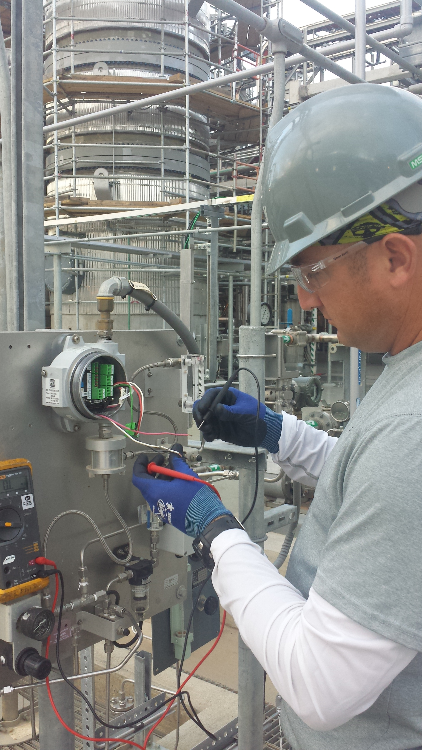
Wiring
Cable can be damaged during installation
Ringing out wiring to controller may be required.
Measure resistance from each conductor to conductor and to ground.

Slide 12
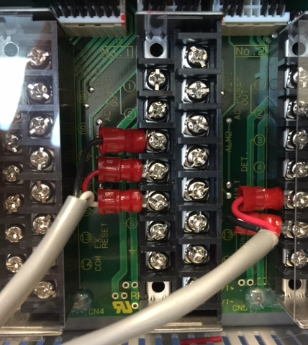
Wiring
Look for wiring errors such as transmitters wired to improper channels.
Loose or frayed wires.
Loose terminal connections.
Improper wire type or gauge.

Slide 13
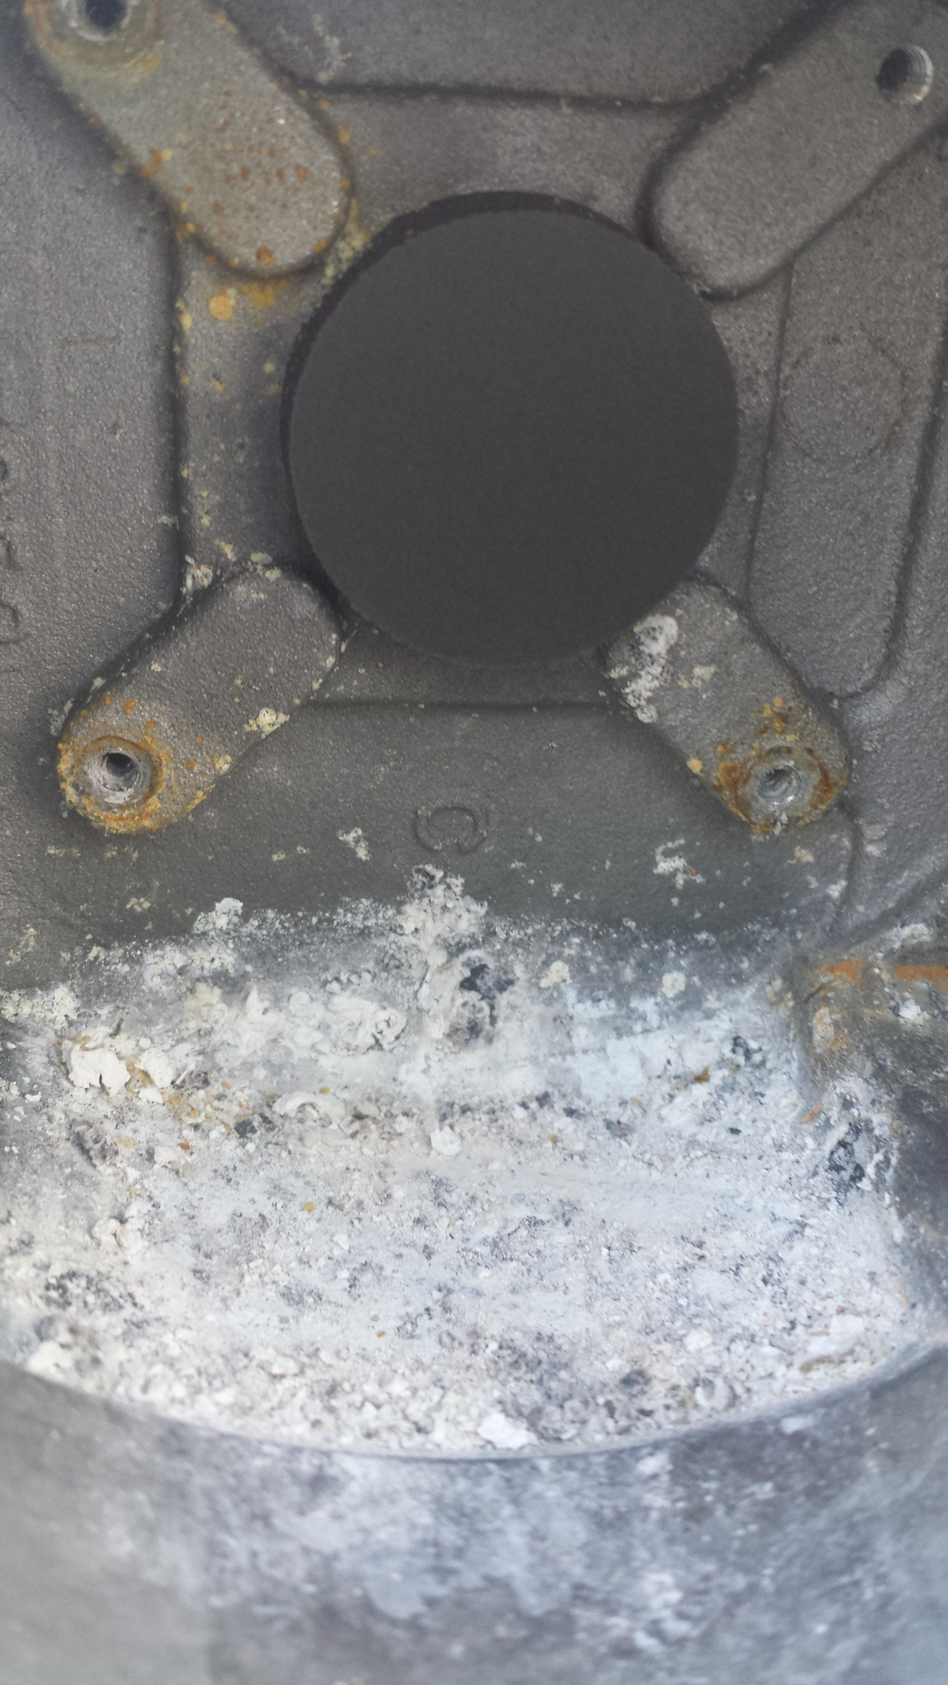
Moisture & Corrosion
Moisture can damage electronics.
Inspect each installation for moisture intrusion.
Seal conduit to prevent moisture damage
Remove corrosion.

Slide 14
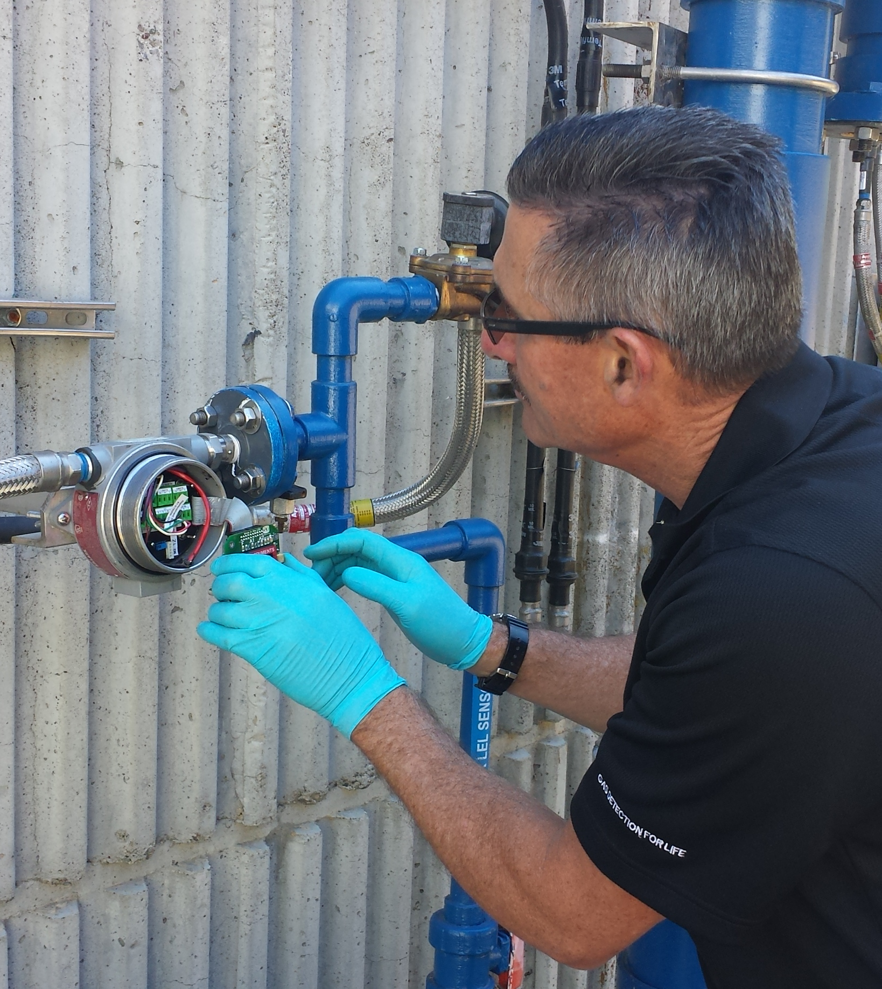
Vibration
Excessive vibration can damage sensors.
Isolate sensors from vibration as needed.

Slide 15
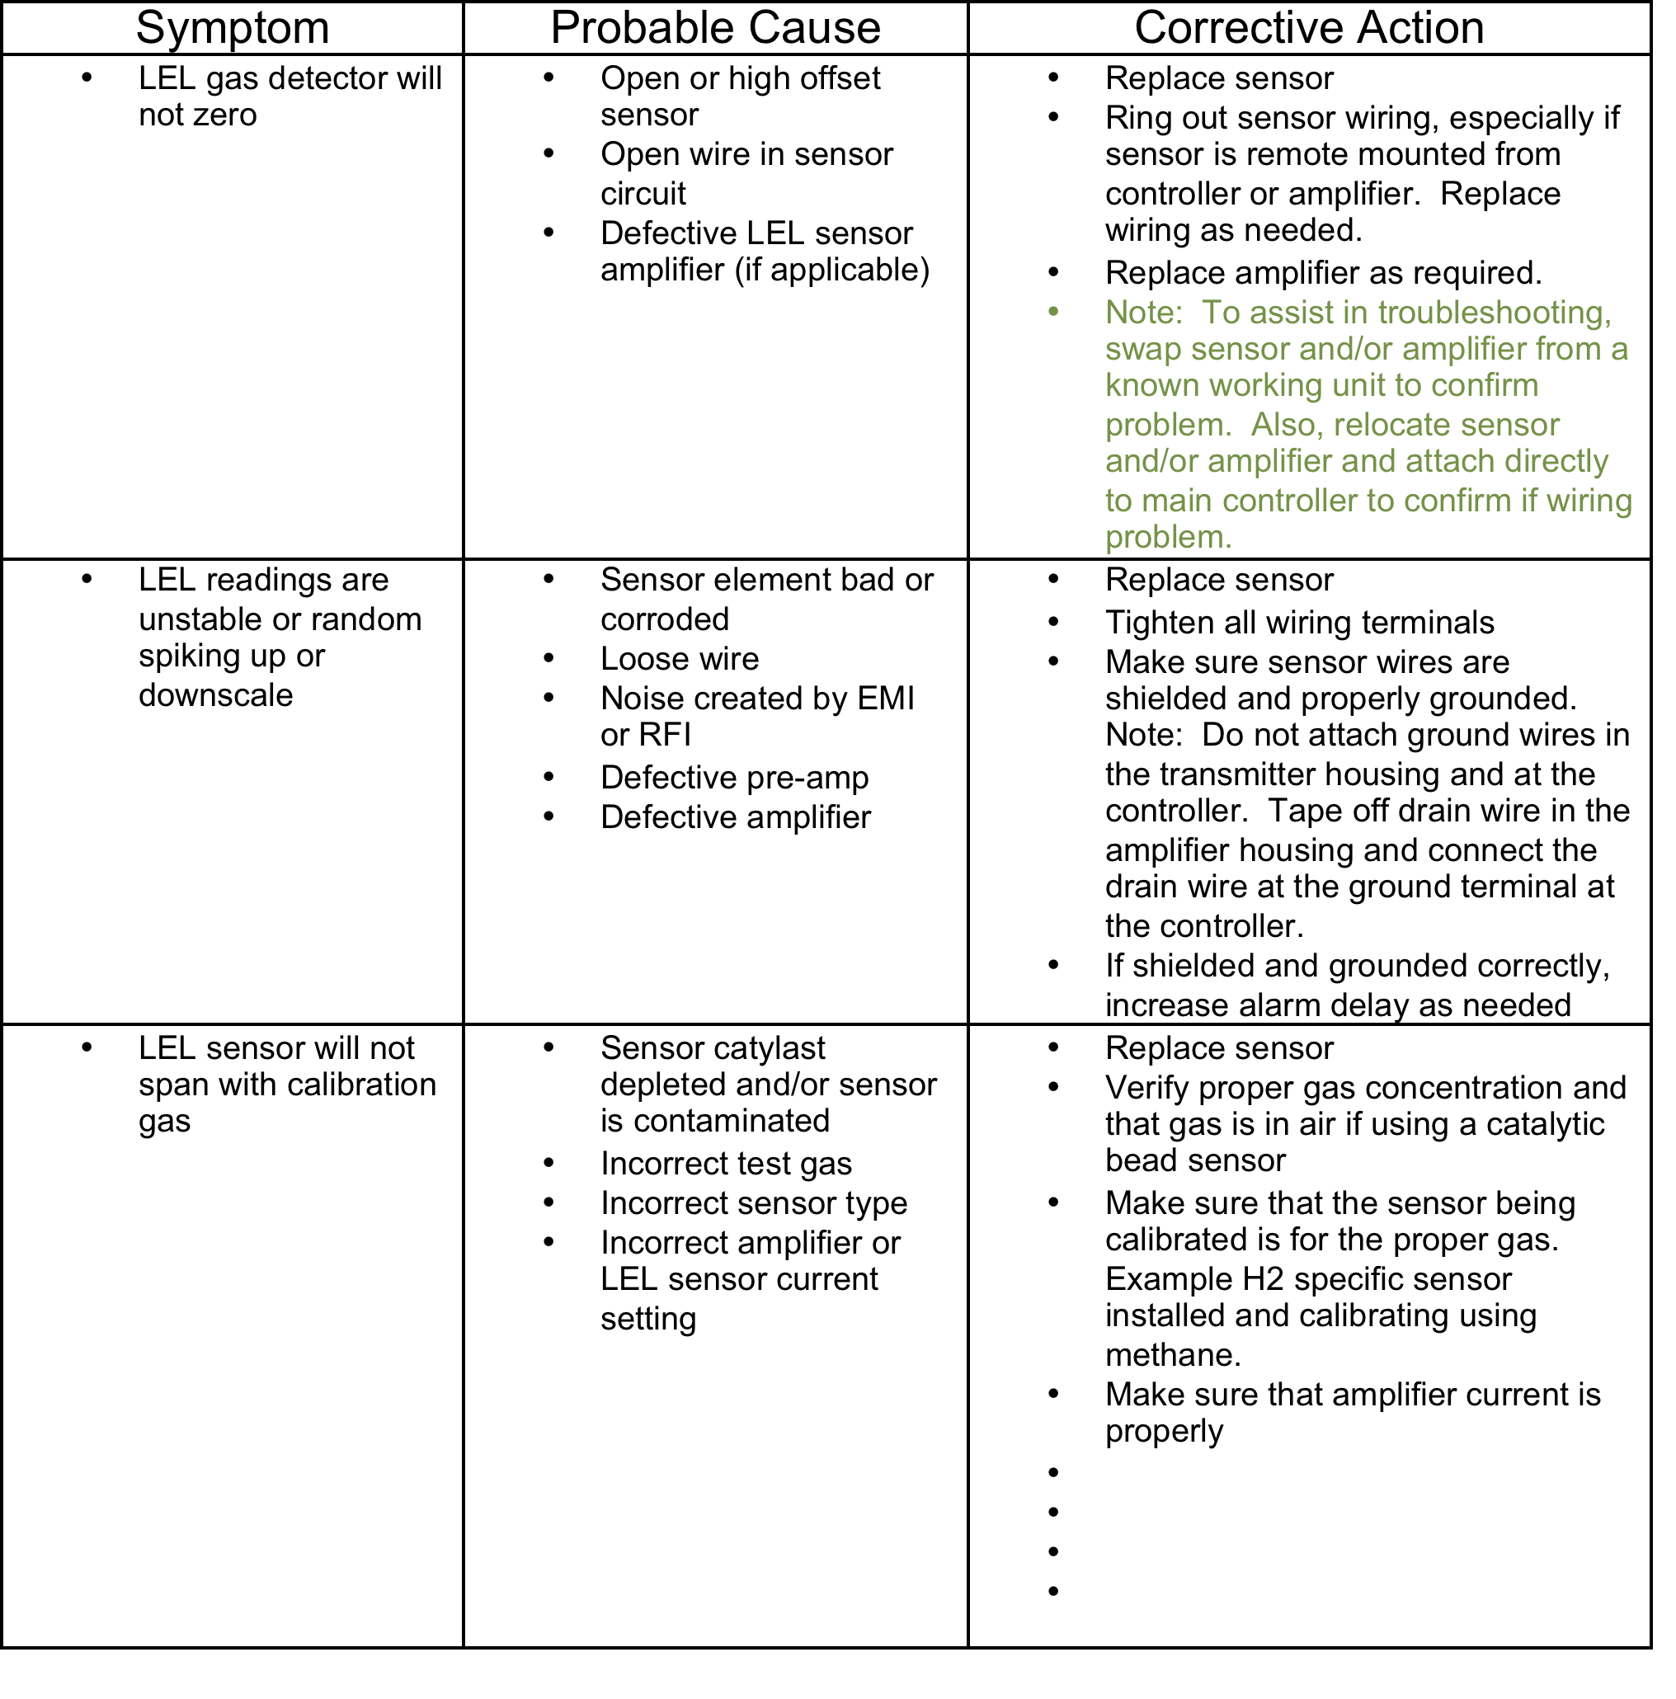
Troubleshooting Matrix

Slide 16
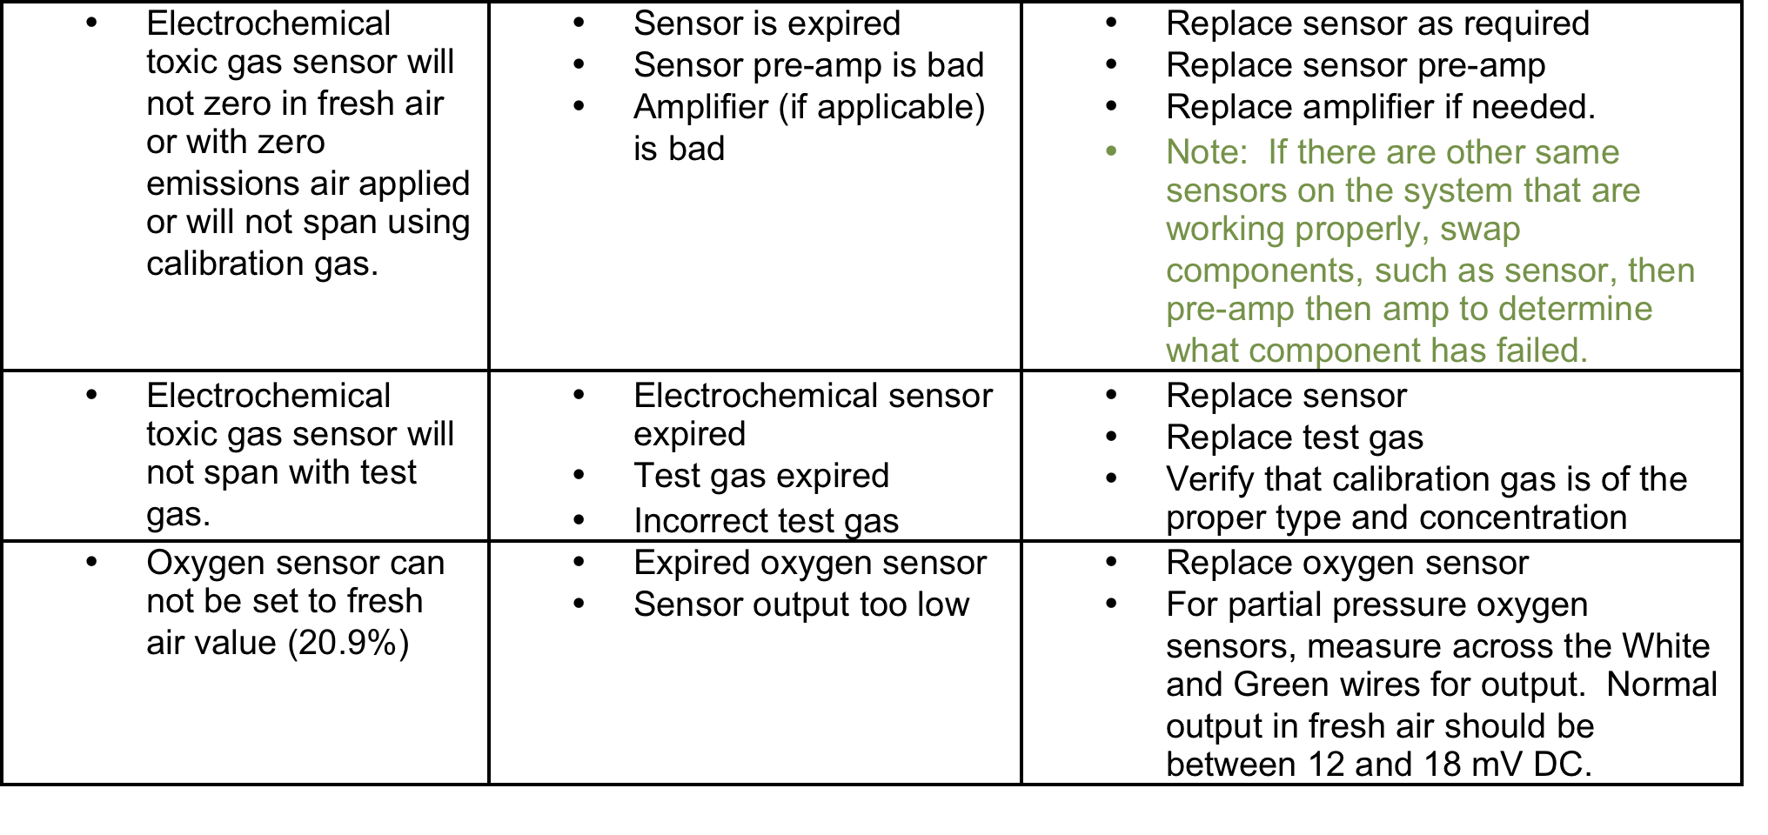
Troubleshooting Matrix

Slide 17
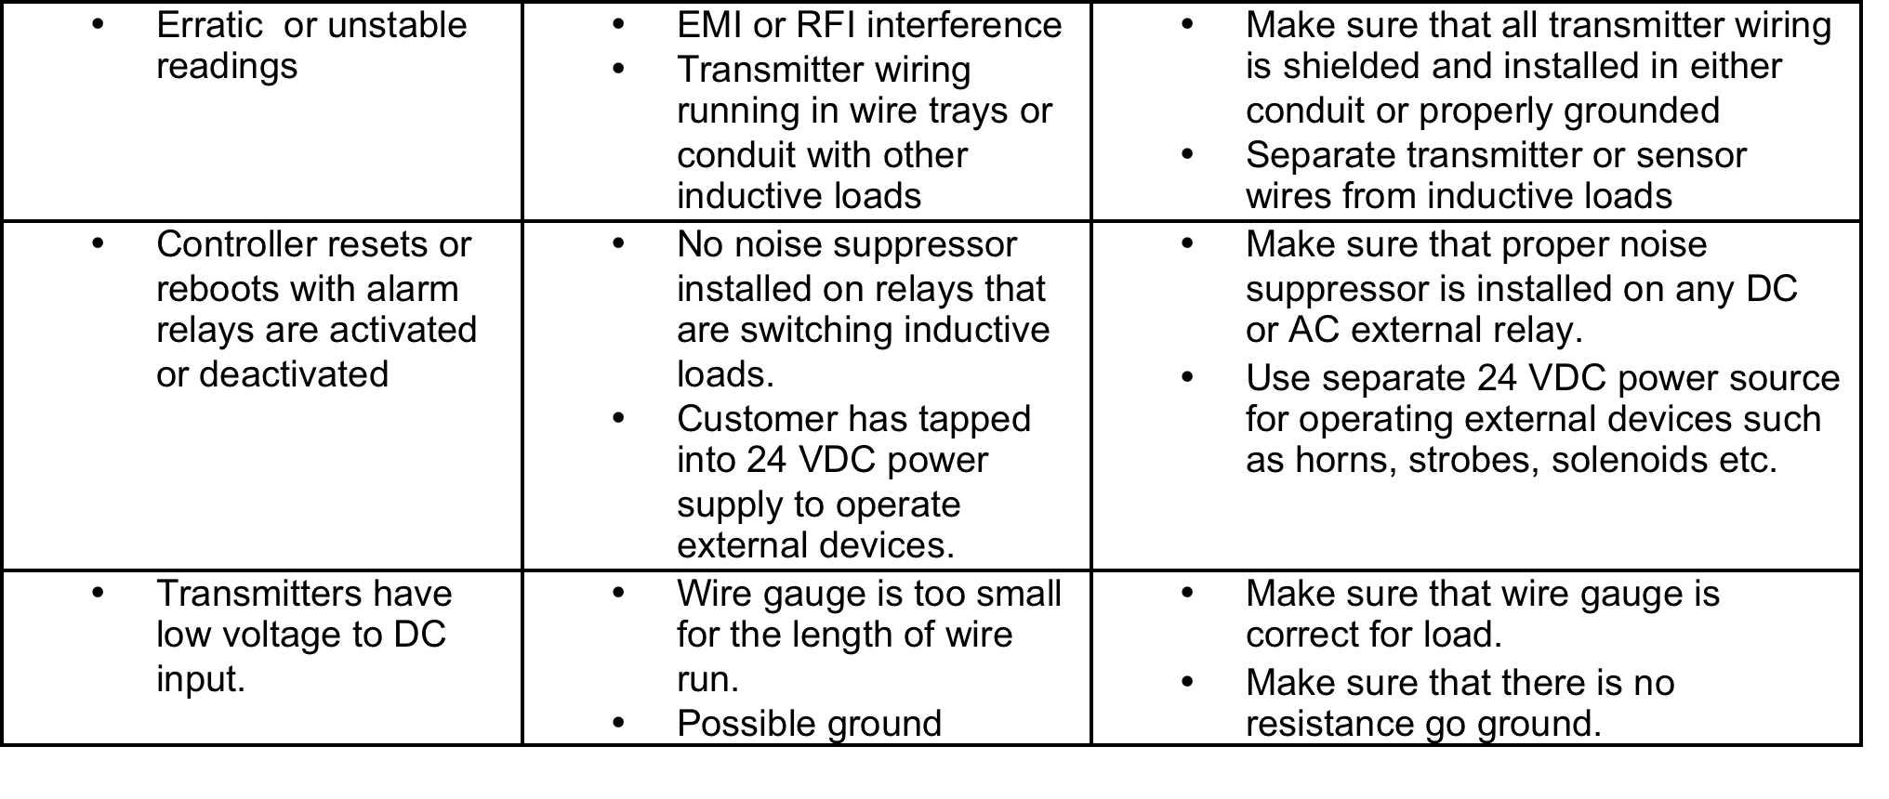
Troubleshooting Matrix

Slide 18

Questions?

