Slide 1


GX-3R & GX-3R Pro
Service Training Module

Slide 2

Agenda
Display Mode
User Mode
Maintenance Mode
Gas Select Mode
Factory Mode
Calibration
Filter maintenance
Sensor replacement
Disassembly

Slide 3

Display Mode
To enter Display Mode, press POWER/MODE when in normal operation/measurement mode.
You will know you are in display mode if you see a display mode menu title on the bottom of your screen
To return to normal operation, scroll all the way through the display menu using the POWER/MODE button, or wait 20 seconds and the unit will automatically return to normal mode

Slide 4
Display Mode
Display Mode menu options:
PEAK – Displays peak readings for each sensor
STEL – Displays STEL readings (CO, H2S, and CO2/Super-Toxic only)
TWA - Displays TWA readings (CO, H2S, and CO2/Super-Toxic only)
HC GAS LIST – Change the target gas for the LEL sensor
CAL DATA – Displays the last calibration date for each sensor
TEMPERATURE – Displays temperature, date and time
ALARM-PT – View alarm points
EXAMPLES: Re-setting PEAK readings, changing the LEL target gas

Slide 5
Display Mode
Re-setting the PEAK readings
Enter Display Mode by Pressing POWER/MODE
Press and hold AIR, The screen should read, “CLEAr”
Release AIR when prompted to release
Changing the LEL target gas
Enter Display Mode by pressing POWER/MODE
Scroll to HC GAS using POWER/MODE
Press AIR to select, CH4 should be blinking
Scroll to desired gas using AIR
Select the gas (listed by atomic number) by pressing and releasing POWER/MODE
You will be returned to the previous screen

Slide 6
Display Mode
Display Mode menu options (GX-3R Pro only):
USER ID – View/change the User ID
STN ID – View/change the Station ID
INVERT SELECT – Screen auto rotation, ON/OFF
LCD BACKGROUND –
  ON – black background white characters
  OFF – white background black characters
BLUETOOTH – Turn BlueTooth functionality ON/OFF
BUZZER VOLUME – Set buzzer volume, HIGH/LOW

Slide 7
User Mode
To enter User Mode:
  Make sure instrument is off
  Press and hold “AIR”
  Then press and hold “POWER/MODE”
  Release after 1 beep

Slide 8
User Mode
PASSWORD
  The default is set to OFF
  If PASSWORD is set to on, then, “PASSWORD 0000” will be displayed
  If you turn it on, the default password is 0405
  NOTE: 0405 will act as backdoor password if assigned one is forgotten or not given by end user
  NOTE: A small “M” will appear at the top of the screen, ”MAINTE” on the Pro. This indicator appears whether you are in User, Maintenance, Gas Select or Factory Mode

Slide 9
User Mode
User Mode menu options:
  BUMP – Perform a bump test
  GAS CAL – Perform a fresh air adjustment, perform a span adjustment, change calibration gas concentration, set the cylinder group
  CAL SET – Change parameters related to calibration
  BUMP SET – Change parameters related to bump testing
  ALARM-PT/ALARM SETTING – Set alarm points for all channels(WARNING, ALARM, ALARM H, STEL, TWA) or restore alarm defaults
  LUNCH – turn lunch break on/off
  BEEP/CONFIRMATION – Set confirmation beep parameters
  BL TIME – Set backlight timer
  KEY TONE – set key tone on/off
  DISP SET/ D MODE – Adds or removes certain menu items from Display Mode
  ZEROFLWR – Not intended for field adjustment*
  ZEROSUP – Not intended for field adjustment
  DATE – Set the date and time
  PASSWORD – Password needed to access user mode on/off, set password
  ROM/SUM – View firmware info
  START- start up and enter measurement mode
*Factory setting is on except O2 channel, O2 channel does not support zero follower functionality

Slide 10
User Mode
User Mode menu options (GX-3R Pro only):
MAN DOWN – Turn Man Down and Panic alarms on/off, set intervals for Man Down alarm
AUTO BACKLIGHT – The GX-3R Pro’s backlight automatically turns on in a low-light environment, on/off
LANGUAGE - Set the language of the instrument (10 options)
IR UNIT SELECT – Select the units for the IR CO2 sensor (%vol/ppm)*
CO2 AIR SETTING –
  On: channel is set to 400ppm (0.04%vol) when performing demand zero, auto zero or air calibration
  Off: channel is not adjusted in those processes
DATE FORMAT – Set the date format
RADIO STANDARD – Approval number for radio agencies

Slide 11
User Mode
Navigation
To enter any menu option, select it and press the “POWER/MODE” button
To scroll to the next option press the “AIR” button
  EXAMPLE: CAL SET

Slide 12
User Mode
CAL SET
  CAL RMDR – turn calibration reminders on or off (default is ON)
  CAL INT – Set the interval of your CAL RMDR (default – 90 days)
  (REMEMBER: if you need to reverse the direction of your numbers, press AIR and POWER/MODE together quickly, then use AIR to scroll back)
  CAL EXPD (default: CONFIRM)
    CONFIRM – allow the end user to acknowledge they are out of compliance and continue without calibration
    CANT USE – will not allow the instrument to be used if not calibrated
    NONE – The user can decide to calibrate, or if they do nothing the instrument will go into measurement (normal) mode

Slide 13
Maintenance Mode
To enter Maintenance Mode:
  Make sure instrument is off
  Press and hold “AIR”
  Then press and hold “POWER/MODE”
  Release after 2 beeps

Slide 14
Maintenance Mode
PASSWORD
  The default is set to ON
  If PASSWORD is required, then, “PASSWORD 0000” will be displayed
  The default password is 8102
  NOTE: 8102 will act as backdoor password if assigned one is forgotten or not given by end user

Slide 15
Maintenance Mode
Maintenance Mode menu options:
  GAS CAL - Perform a fresh air adjustment, perform a span adjustment, change calibration gas concentration, set the cylinder group
  GAS TEST – Apply gas to test sensor and observe alarm indications without alarm event being recorded
  SEN DATE – View replacement date of sensors and battery
  BUMP – Perform a bump test
  LATCHING - Turn alarm latching on/off
  DEM ZERO – Allow “Fresh Air” adjustment in measuring mode, on/off
  AUTOZERO – Offer “Fresh Air” adjustment at end of start-up, on/off
  ID DISP – User IDs and Station IDs appear in start-up, on/off
  ZERO SUP – Default is ON. Not intended for field adjustment. The suppression values are: LEL: 2%, O2: 0.5%vol, H2S: 0.3ppm, CO: 2ppm, CO2: 0ppm, SO2: 0.2ppm
  ZEROFLWR - Factory setting is on except O2 channel, O2 does not support zero follower functionality
  ZSUP.DISP – Zero Suppression menu appears in User Mode, on/off
  Z.FLW.DISP – Zero follower menu appears in User Mode, on/off

Slide 16
Maintenance Mode
Maintenance Mode menu options continued:
  DATE – Set the date and time
  PASSWORD - Password needed to access Maintenance Mode on/off, set password
  ROM/SUM – View firmware info
  M.DEFAULT – Set all parameters back to RKI factory settings
  START - start up and enter measurement mode
Maintenance Mode menu options (GX-3R Pro only):
DATE FORMAT – Set the date format
LANGUAGE – Set the language of the instrument (10 options)
LCD CONTRAST – Adjust contrast of the LCD display

Slide 17
Gas Select Mode
Gas Select Mode is essential for changing target gases for each channel on your instrument, or for turning those channels off if desired.
To enter Gas Select Mode:
  Make sure instrument is off
  Press and hold “AIR”
  Then press and hold “POWER/MODE”
  Release after 3 beeps

Slide 18
Gas Select Mode
PASSWORD
  The default is set to ON
  If PASSWORD is required, then, “PASSWORD 0000” will be displayed
  The default password is 2014

Slide 19
Gas Select Mode
Gas Select Mode menu options:
  GAS COMB – Change target gas for channels, turn channels ON/OFF
  SAVE AP – Set current alarm points as default alarm points
  MAX SPAN – Maximum span screen appears after calibration, ON/OFF
  STEALTH – Disable backlight, LED and buzzer, ON/OFF
  CHG LEL – Apply standard, IEC, or ISO settings for LEL ppm values

Slide 20
Gas Select Mode
CHANGE LEL: PPM Values for Different Standards
Gas | Standard (ppm) | IEC (ppm) | ISO (ppm)
Methane (CH4) | 50,000 | 44,000 | 44,000
Isobutane (i-C4H10) | 18,000 | 13,000 | 15,000
Hydrogen (H2) | 40,000 | 40,000 | 40,000
Methanol (CH3OH) | 55,000 | 60,000 | 60,000
Acetylene (C2H2) | 15,000 | 23,000 | 23,000
Ethylene (C2H4) | 27,000 | 23,000 | 24,000
Ethane (C2H6) | 30,000 | 24,000 | 24,000
Ethanol (C2H5OH) | 33,000 | 31,000 | 31,000
Propylene (C3H6) | 20,000 | 20,000 | 18,000
Acetone (C3H6O) | 21,500 | 25,000 | 25,000
Propane (C3H8) | 20,000 | 17,000 | 17,000
Butadiene (C4H6) | 11,000 | 14,000 | 14,000
Cyclopentane (C5H10) | 14,000 | 14,000 | 14,000

Slide 21
Gas Select Mode
CHANGE LEL: PPM Values for Different Standards
Gas | Standard (ppm) | IEC (ppm) | ISO (ppm)
Benzene (C6H6) | 12,000 | 12,000 | 12,000
N-hexane (n-C6H14) | 12,000 | 10,000 | 10,000
Toluene (C7H8) | 12,000 | 10,000 | 10,000
N-heptane (n-C7H16) | 11,000 | 8,500 | 8,000
Xylene (C8H10) | 10,000 | 10,000 | 10,000
N-nonane (n-C9H20) | 7,000 | 7,000 | 7,000
Ethyl acetate (EtAc) | 21,000 | 20,000 | 20,000
Isopropyl alcohol (IPA) | 20,000 | 20,000 | 20,000
Methyl ethyl ketone (MEK) | 18,000 | 15,000 | 15,000
Methyl methacrylate (MMA) | 17,000 | 17,000 | 17,000
Dimethyl ether (DME) | 30,000 | 27,000 | 27,000
Methyl isobutyl ketone (MIBK) | 12,000 | 12,000 | 12,000
Tetrahydrofuran (THK) | 20,000 | 15,000 | 15,000

Slide 22
Factory Mode
To enter Factory Mode:
  Make sure instrument is off
  Press and hold “AIR” and “POWER/MODE” at the same time
  Release after 3 beeps

Slide 23
Factory Mode
PASSWORD
  The default is set to ON
  “PASSWORD 0000” will be displayed
  The default password is 1994

Slide 24
Factory Mode
Factory Mode menu options:
  GAS COMB - Change target gas for channels, turn channels ON/OFF
  DATE - Set the date and time
  ROM/SUM - View firmware info
  A/D VAL – View A/D values
  SAVE DEF – Save a file to default to when performing M.DEFAULT in Maintenance Mode
  F.DEFAULT – Set to RKK (Japan) defaults
    -Press POWER/MODE to enter
    -Press AIR and POWER/MODE together to perform default
NOTE: It is advised to avoid using F.DEFAULT unless you are sure you can restore the instrument. Please contact RKI support if you have issues.

Slide 25
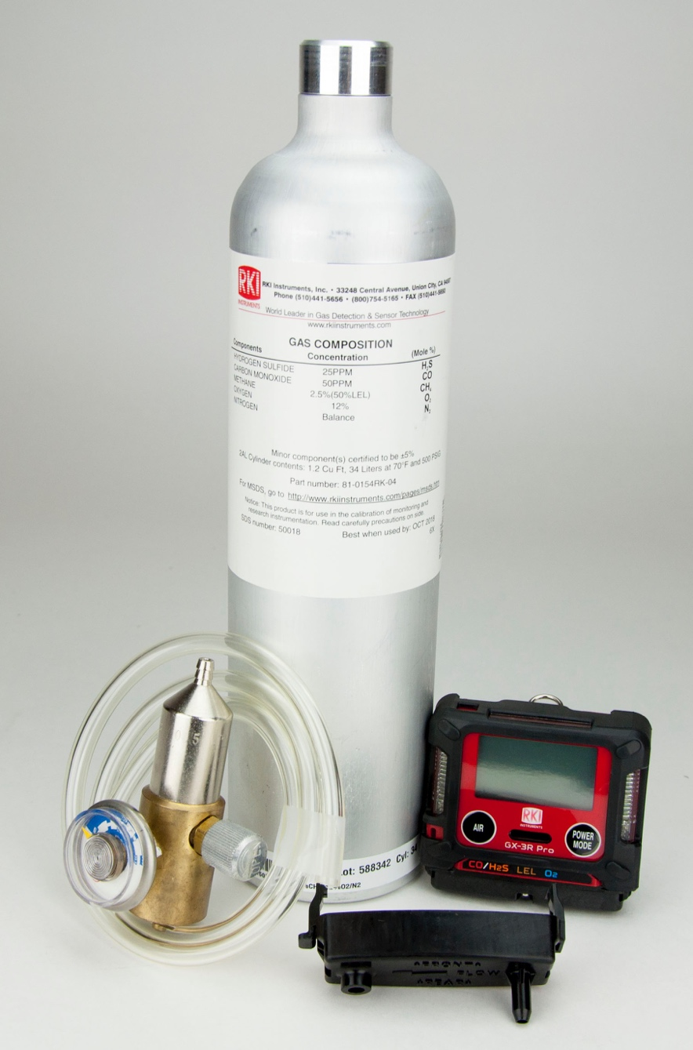

Calibration

Slide 26
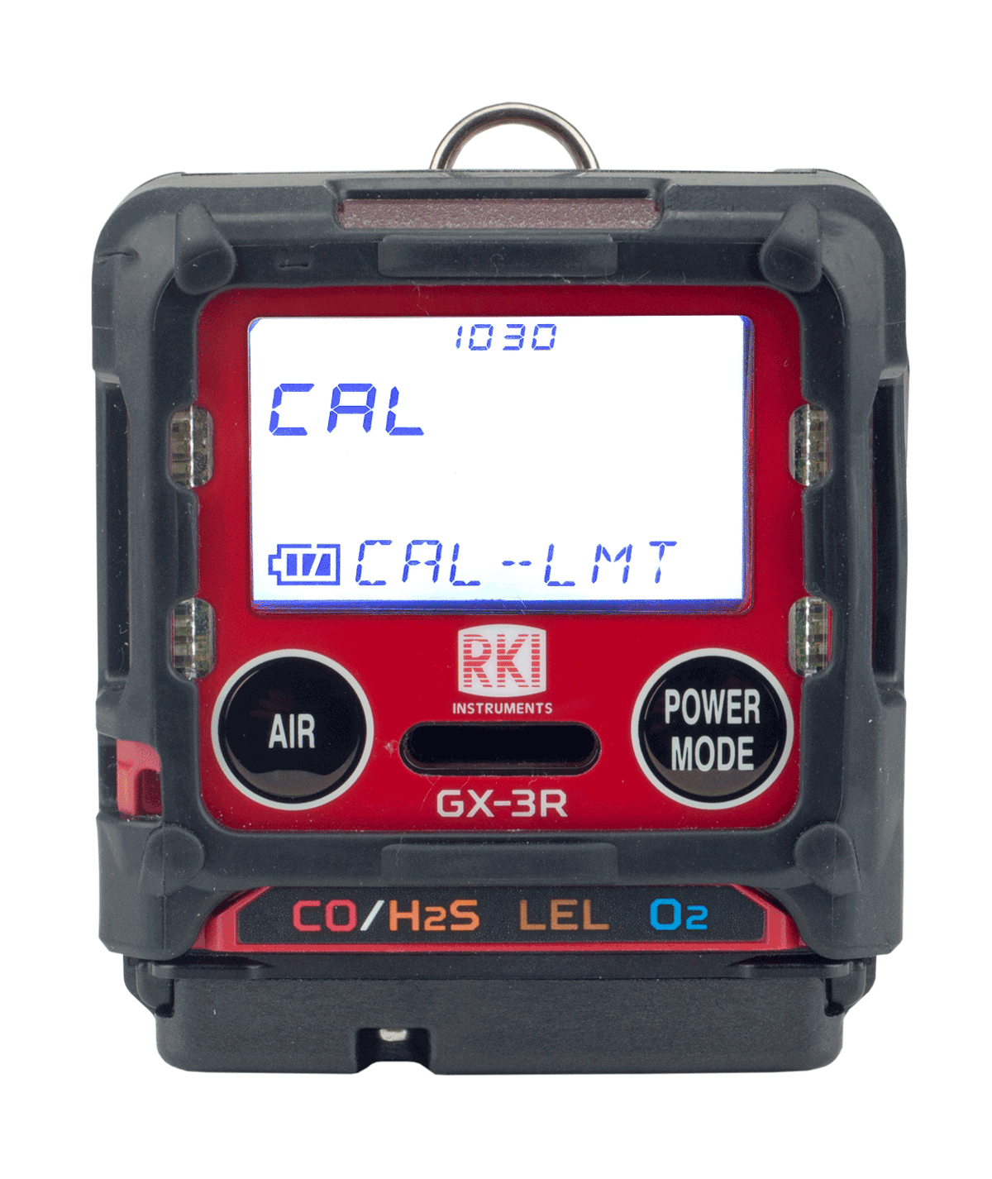
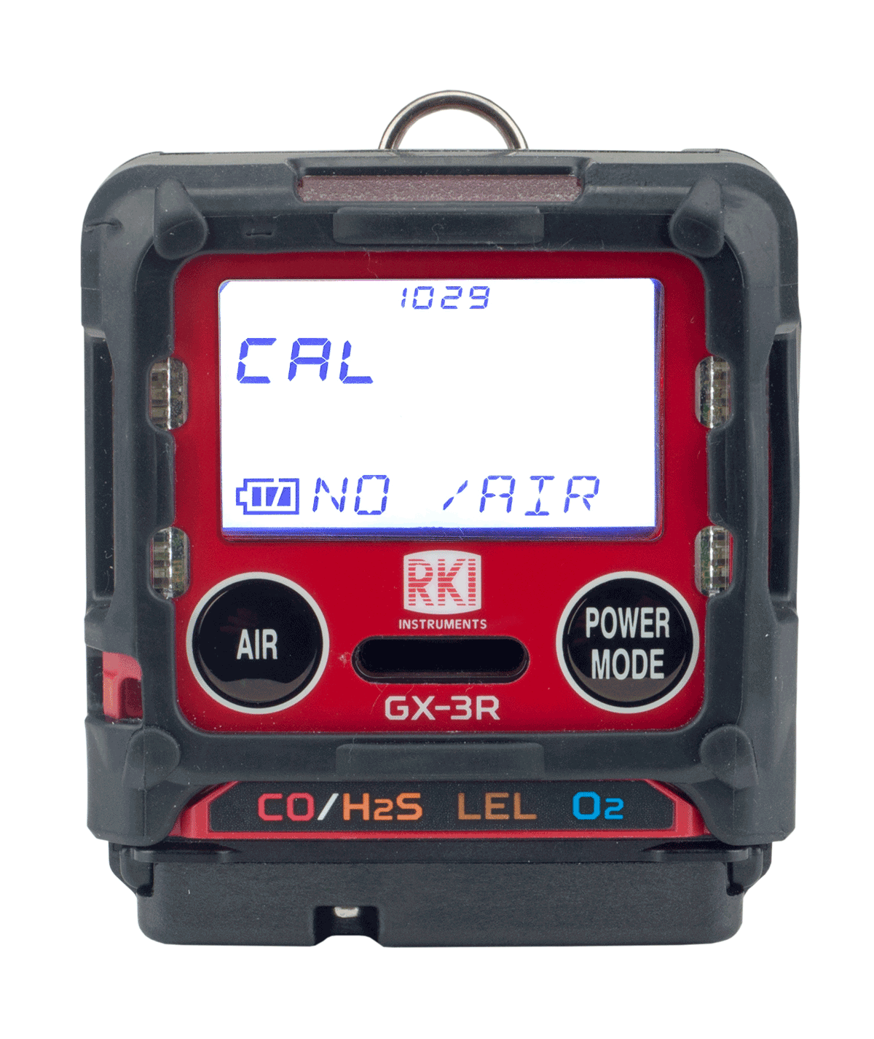
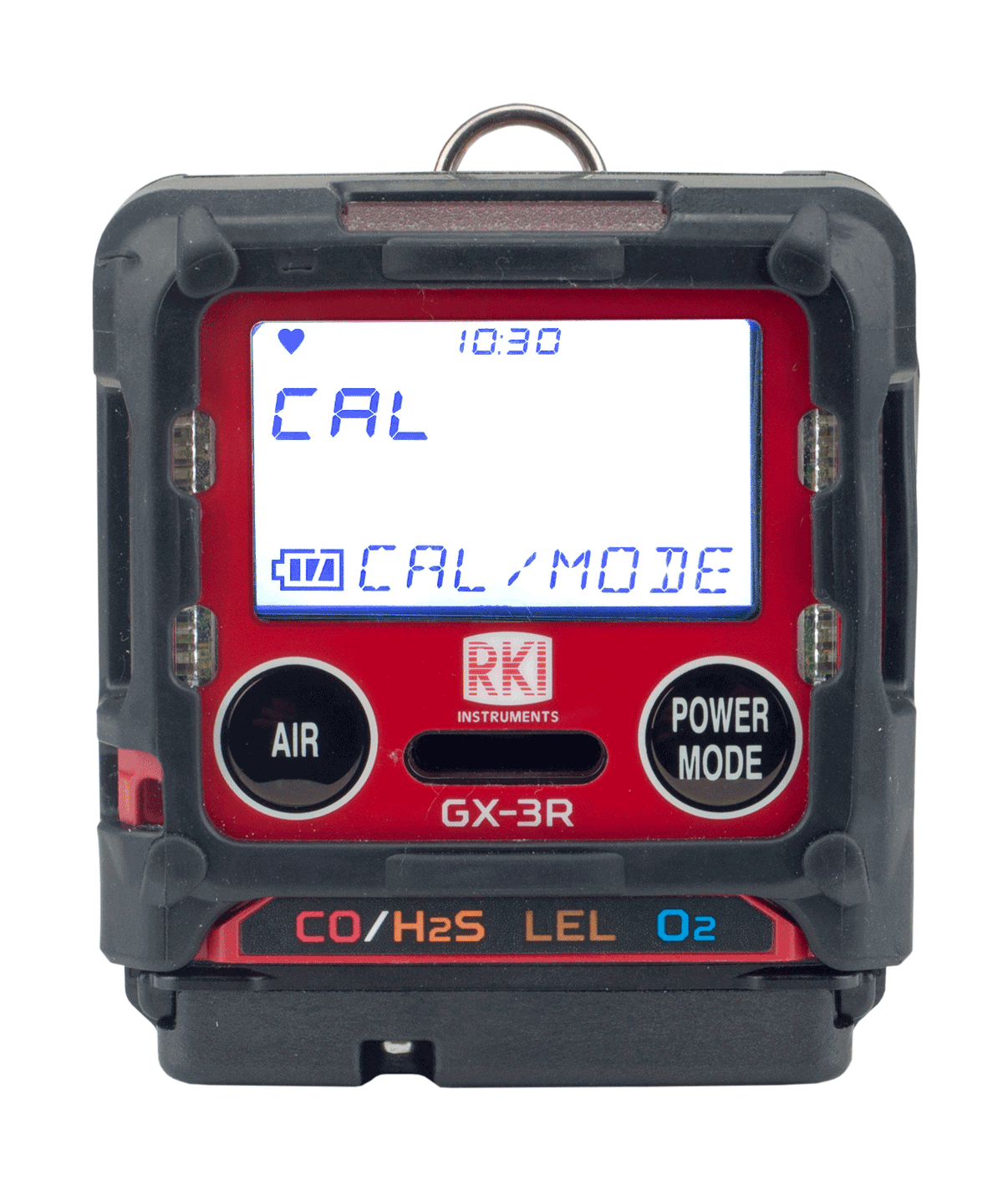
Calibration
Acknowledge and use
Perform a calibration
If your instrument is past its 90 day (factory set default) calibration limit, you will see a CAL-LMT reminder at start-up
Press the AIR button to continue without performing a calibration
Press the POWER/MODE button to perform calibration.

Slide 27
Calibration
To perform a fresh air calibration
⎯ Make sure you are in a gas free environment
⎯ Press and hold the “AIR” button
⎯ When prompted, release the button
Note: If you are unable to perform a Fresh Air adjustment, it may be that “DEM ZERO” in Maintenance Mode has been turned off.
In this case, you will have to enter User Mode and select
GAS CAL → AIR CAL to perform one.

Slide 28
Calibration
To perform a calibration without being prompted by the calibration reminder (CAL RMDR) turn the instrument off and restart it in User Mode
To enter User Mode:
Turn the GX-3R off
Press and hold the “AIR” button
Then press and hold the “POWER/MODE” button
Release after one beep

Slide 29
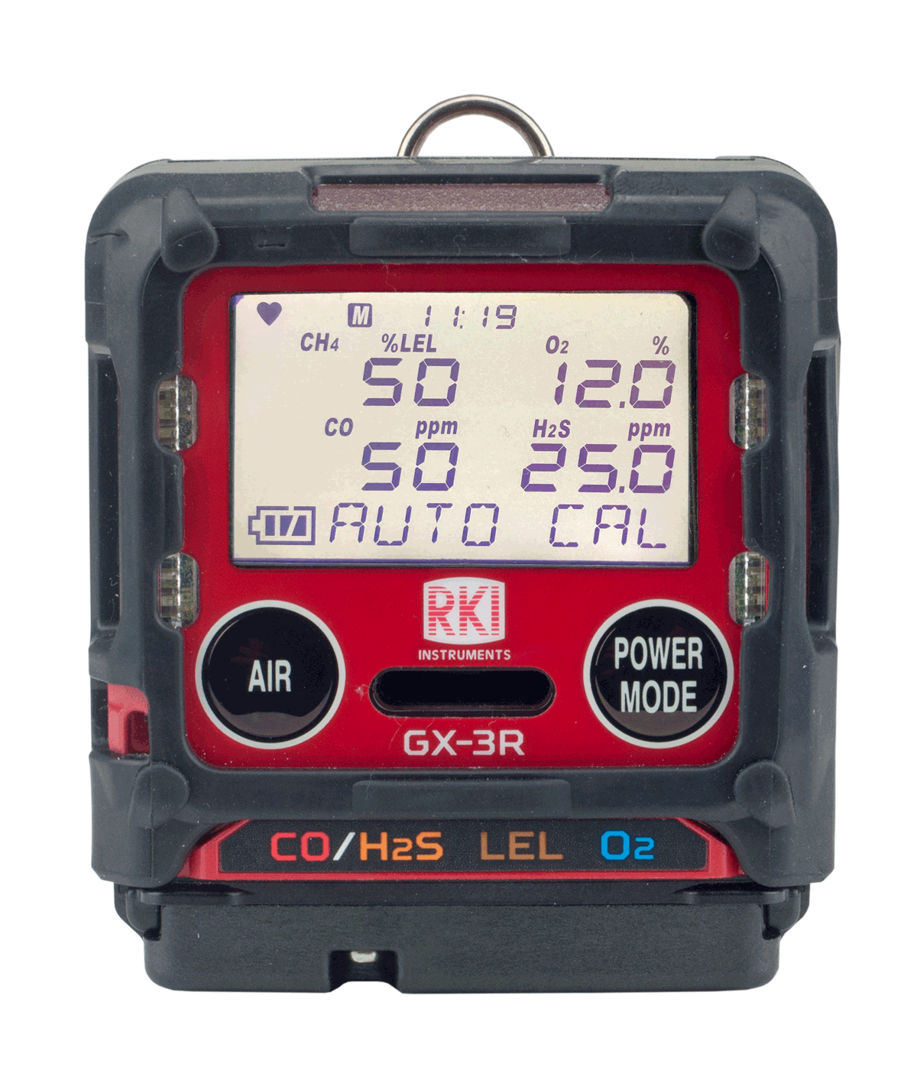
Calibration
In the User Mode menu
  Use the “AIR” button to scroll options
  Use the “POWER/MODE” button to select
Select “GAS CAL”
  Note your sub-menu options are “AIR CAL” and “AUTO CAL”
  (NOTE: This is where you can do a “fresh air” calibration if you did not on start-up)
  Select “AUTO CAL”
  Calibration values will be displayed
  (LEL – 50%, O2 – 12%, CO – 50ppm, H2S – 25ppm)
  (factory set default values)

Slide 30
Calibration
If the calibration values displayed do NOT match the gas cylinder values:
Enter the AUTO CAL menu (User Mode→ Gas Cal→ Auto Cal)
Scroll with “AIR” and select “CAL-P” with “POWER/MODE”
You should see the active channel marked with 3 dashes (- - -)
Use “AIR” to select which gas you want to change the value of
Press “POWER/MODE” to select
Use ”AIR” to adjust to the value matching your cylinder
(HINT: if you need to reverse the direction of your numbers, press AIR and POWER/MODE together quickly)
Press the “POWER/MODE” button to save
Press “AIR” to move to the next gas. Repeat as necessary
Select “ESCAPE” to return to the Auto Cal menu

Slide 31
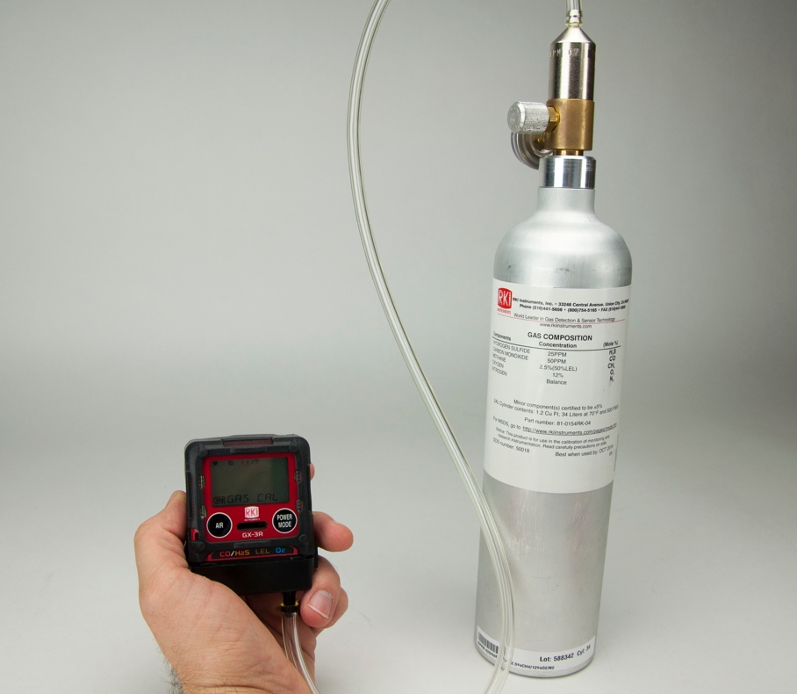
Calibration
Applying gas to the GX-3R
  Attach a fixed flow regulator to the calibration gas cylinder
  Attach the calibration adapter to the instrument and connect it to the 0.25 LPM regulator with tubing
  With “AUTO CAL” highlighted, press ”POWER/MODE”
  Turn on the regulator

Slide 32
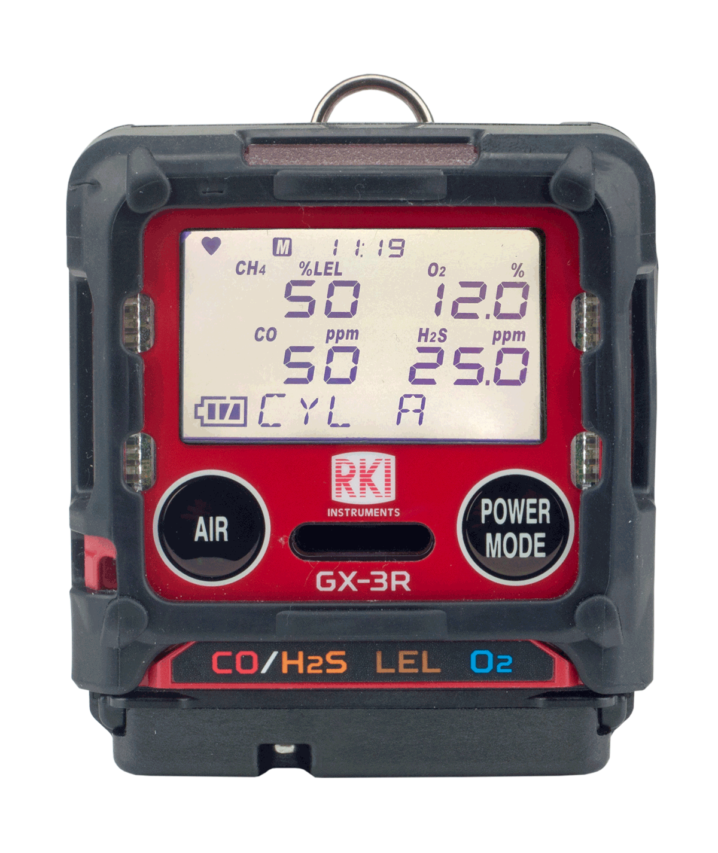
Calibration
  “AUTO CAL/CYL A” should be alternating on the display
  Press “POWER/MODE”
  Apply gas until readings stabilize or for 2 minutes maximum
  Press “POWER/MODE” Turn the gas regulator off

Slide 33


Calibration
  If the calibration is successful, the unit will read “PASS”
  If the calibration is unsuccessful, the unit will read “FAIL”
Note that the fail message gives status for each sensor

Slide 34
Calibration
AUTO CAL pass
  Remove the calibration adapter
  The unit will read “PASS,” then go through its start up sequence and enter measurement mode, ready for use
AUTO CAL fail
  The unit will read “FAIL” and return to the AUTO CAL menu in User Mode
  NOTE: In the “CAL EXPD” User Mode menu item, you can set the instrument to “CANT USE” to prevent the end user from continuing without calibration

Slide 35

Maintenance

Slide 36
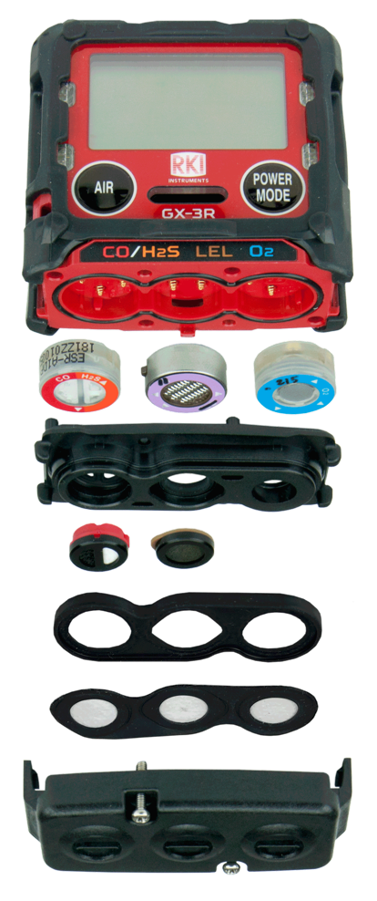
Sensor/Filter replacement
H2S/CO:
ESR-A1DP
O2 Sensor:
ESR-X13P
Scrubber Disk Filter for H2S/CO:
33-7130 (5 pk)
LEL Sensor:
NCR-6309
Scrubber Disk Filter for LEL:
33-7131 (5 pk)
Sensor Dust Filter:
33-0181-10 (10 pk) – GX-3R
33-0182-10 (10 pk) – GX-3R Pro

Slide 37
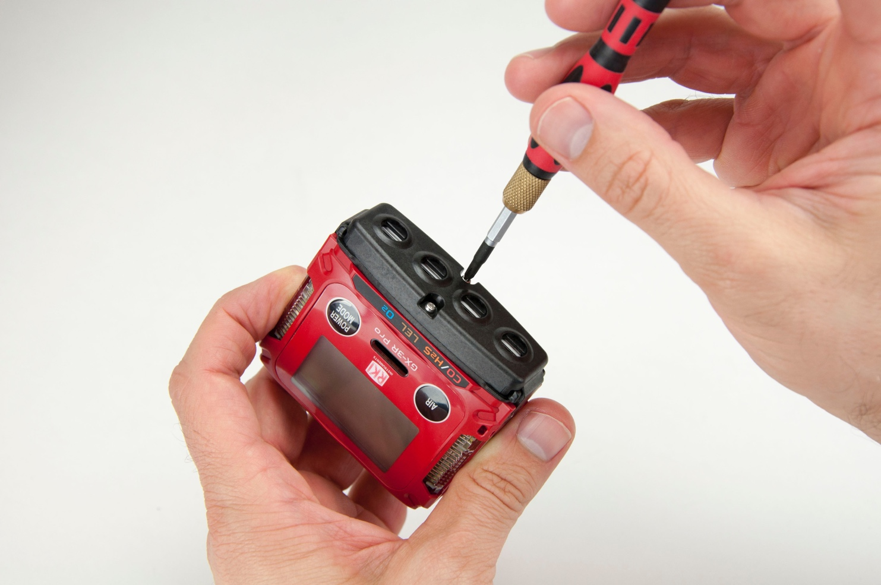
Sensor/Filter replacement
Unscrew the screws on the bottom of the unit

Slide 38
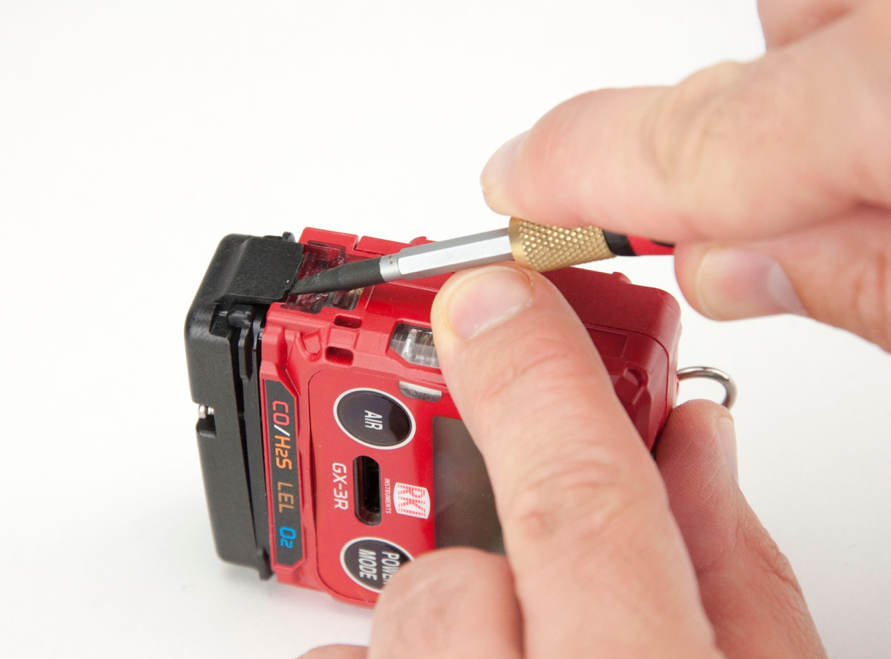
Sensor/Filter replacement
Use the flat side of your small screwdriver to gently pop up the edges of the sensor cap to remove it

Slide 39
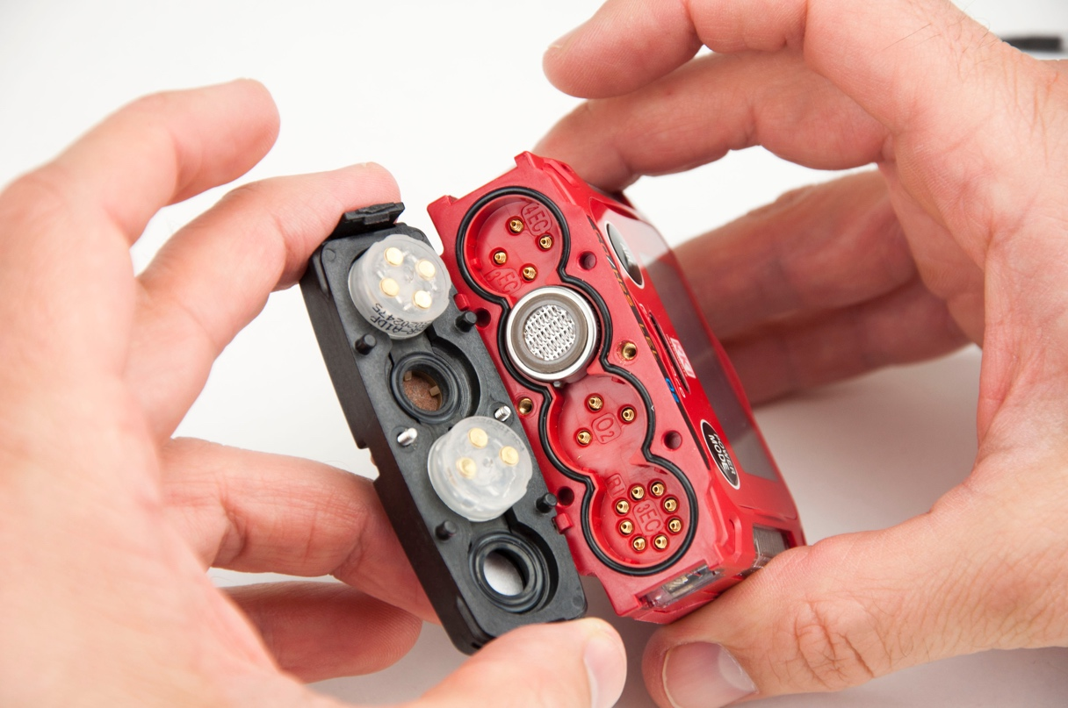
Sensor Replacement
Replace sensors when they cannot be calibrated or readings become unstable
Remember to always calibrate your instrument after replacing a sensor
Make sure the tabs of the sensors are aligned with the contacts and placed correctly

Slide 40
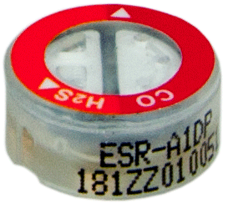
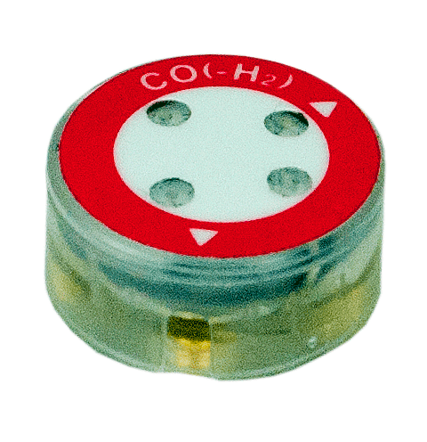
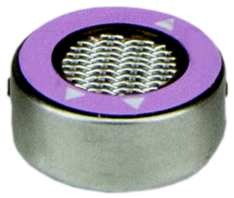
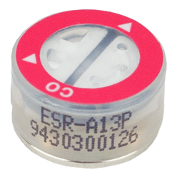
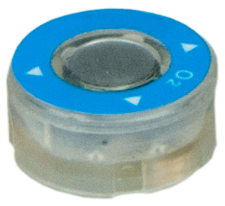
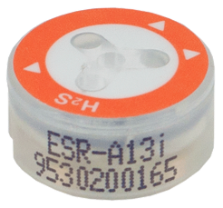
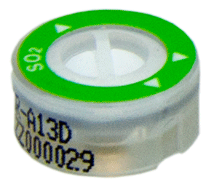
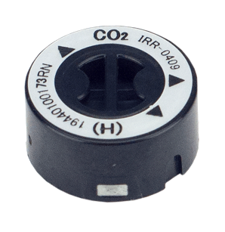
Sensor Replacement
ESR-A1DP – H2S/CO combo
ESR-A1CP - CO w/ H2 compensation
NCR-6309 – LEL
ESR-A13P - CO
ESR-X13P – O2
ESR-A13i - H2S
ESR-A13D – SO2
IRR-0433 - CO2, 0-10,000 ppm
coming fall 2019
HCN, NO2, NH3, CL2 all coming 2020
IRR-0409 - CO2, 0-10% volume

Slide 41
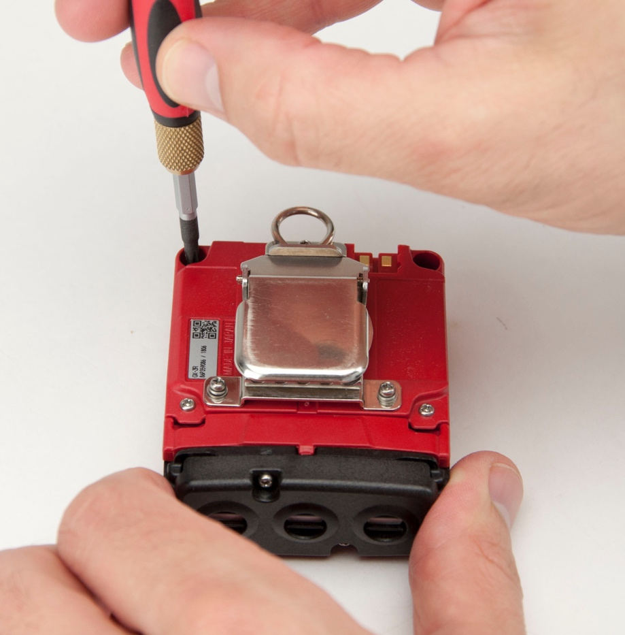
Disassembly
Turn the instrument off
Remove the rubber boot
Using a small Phillips head screwdriver, remove the 4 screws that are holding the 2 halves of the casing together

Slide 42
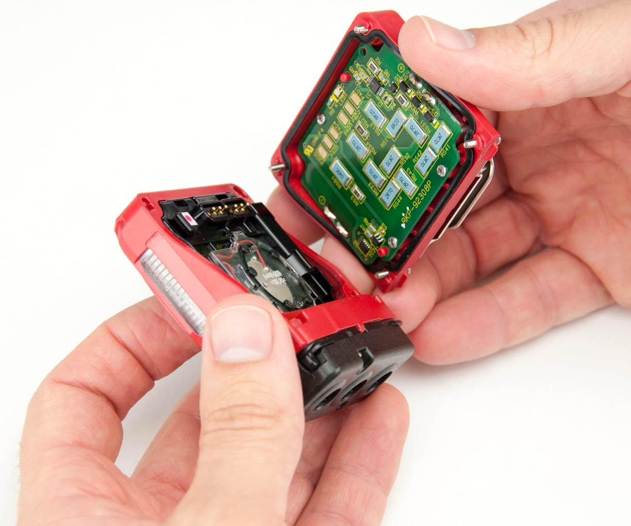
Disassembly
Grab the casing and separate it

Slide 43
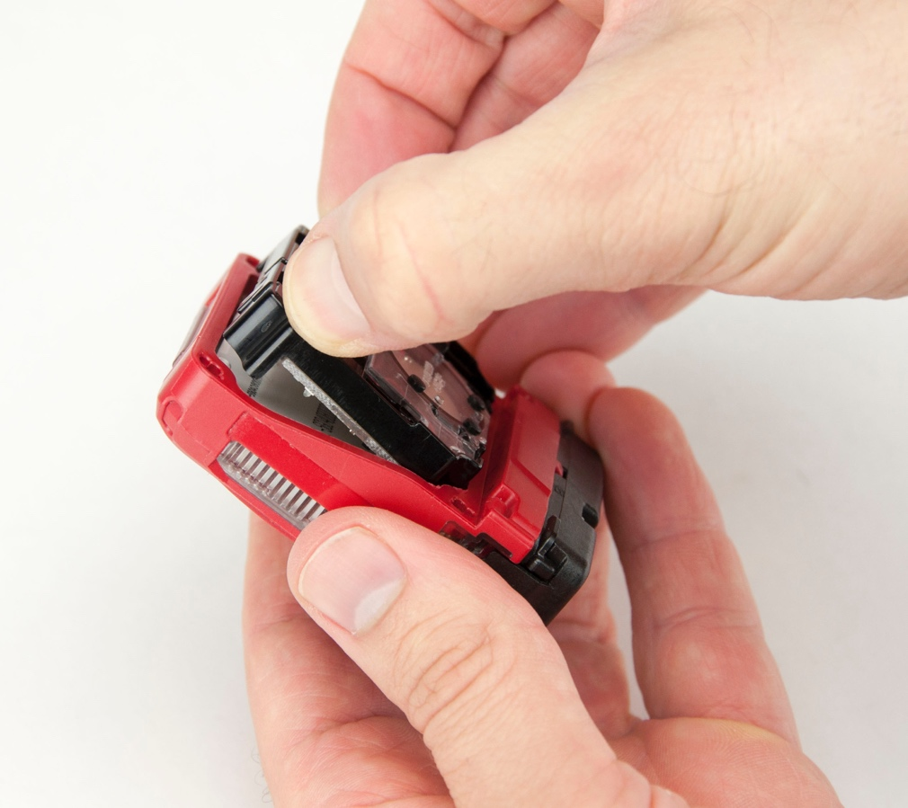
Disassembly
  Gently grab the plastic tabs, and pull the display and buzzer straight out

Slide 44
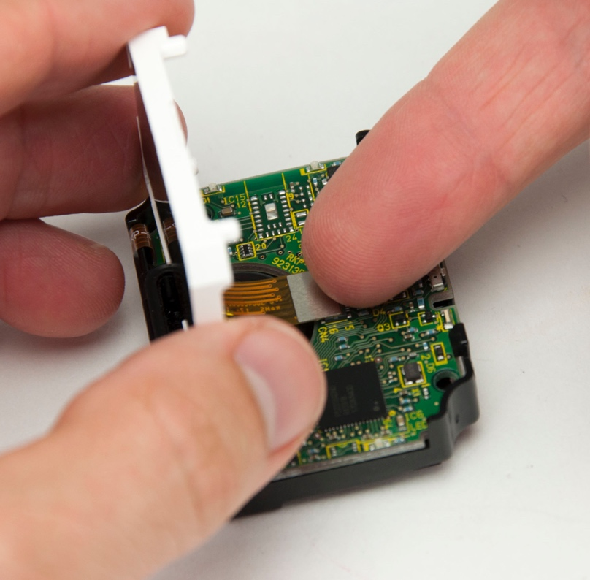
Disassembly
Carefully detach the ribbon connector for the display from the board by very gently pulling it straight out. If you have a small plastic tool, use it. If not, your fingernail will do. Do NOT use your flathead screwdriver.

Slide 45
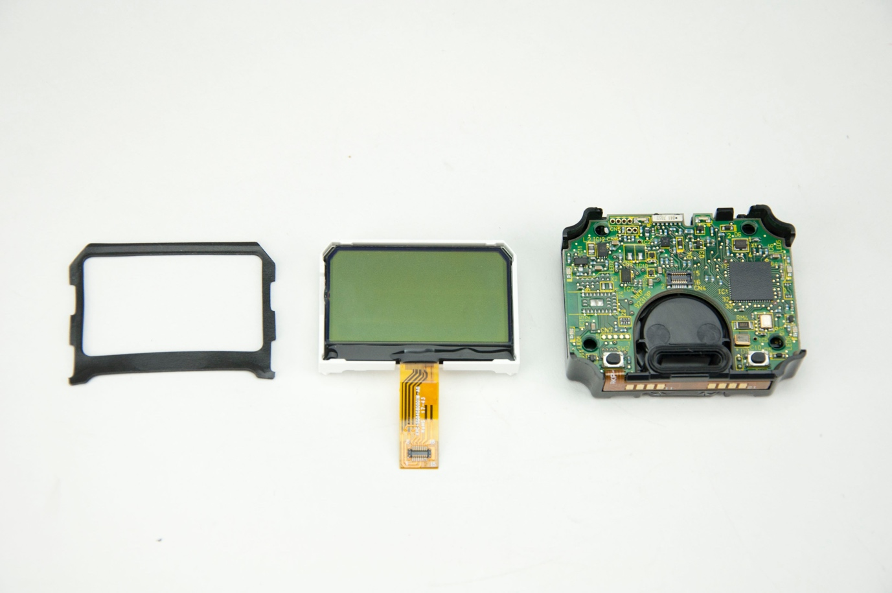
Disassembly
Display assembly pieces

Slide 46
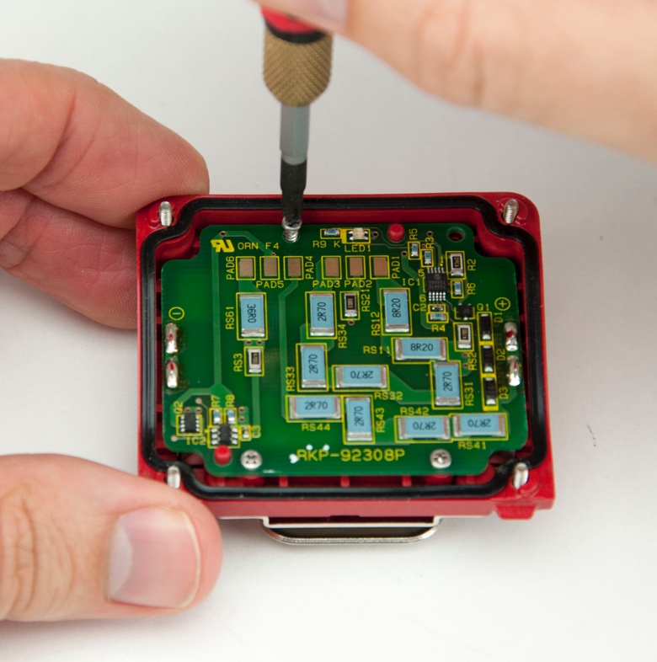
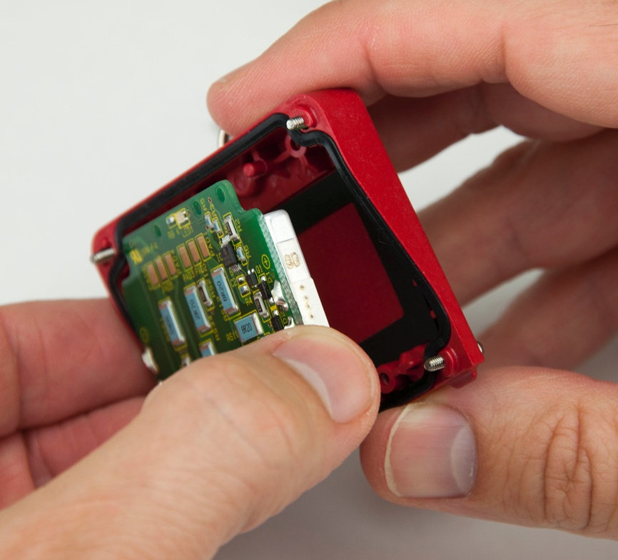
Disassembly
Now remove the battery and board from the other side by unscrewing the 3 small screws, then pull the battery and PCB straight out to remove.

Slide 47
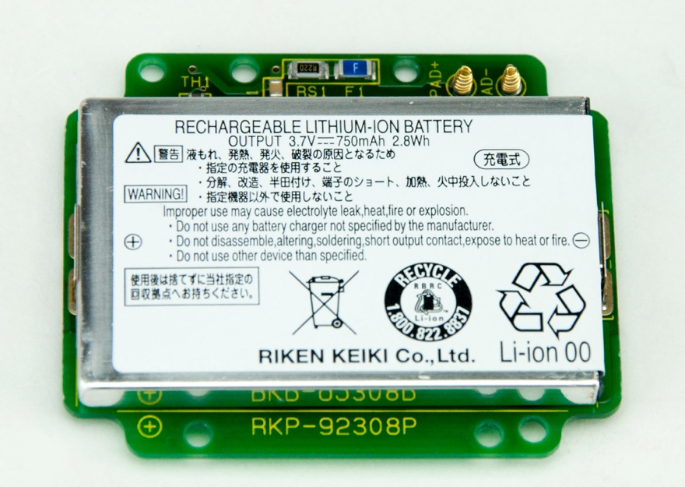
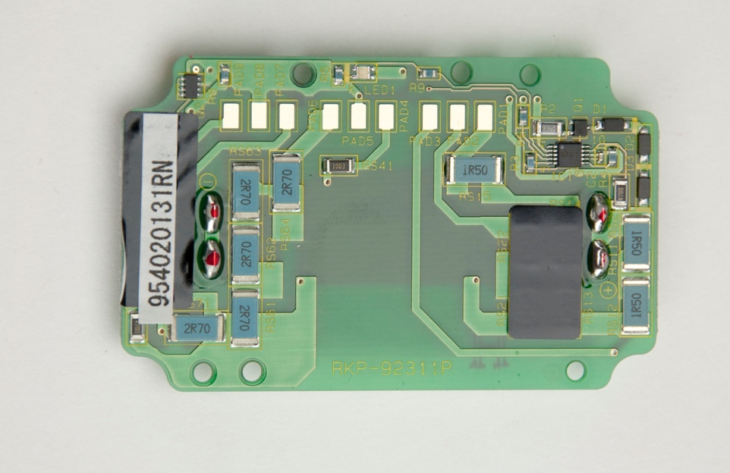
Disassembly
The Li-Ion battery is replaceable
Please note, the initial runs of the product have the battery soldered to the board. If this is the case, please send to RKI for service

Slide 48
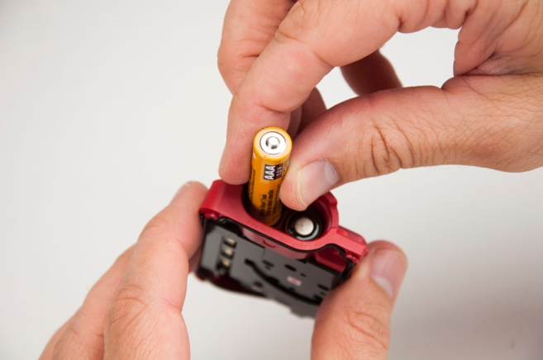
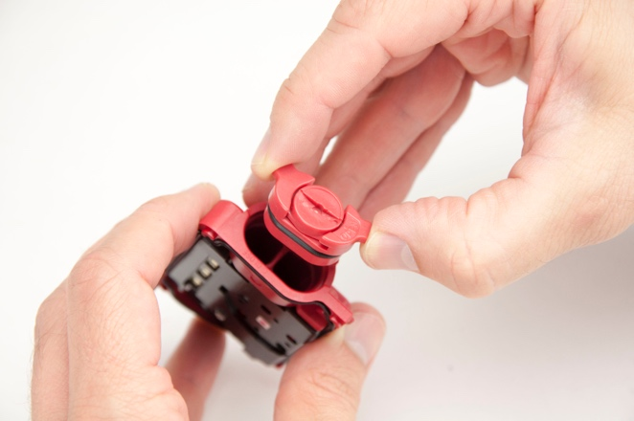
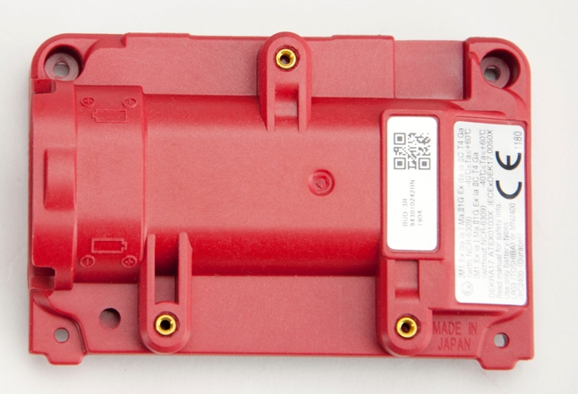
Disassembly
Alkaline battery pack (optional) for the GX-3R Pro
Turn the slot with your thumbnail until it aligns with “open,” then pull the cap straight out
Screw the alkaline battery pack back on the unit to replace the Li-Ion battery assembly
Insert 2 AAA batteries according to diagram

Slide 49

Questions?

