Slide 1
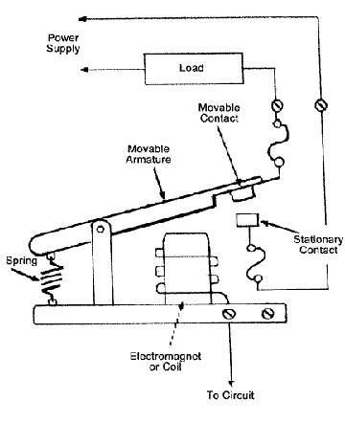
Relays
Form A
  Common & Normally Open Contact
Form B
  Common & Normally Closed Contact
Form C
  Common, Normally Open and Normally Closed Contacts

Slide 2
Relays
Dry contacts
  Not powered
Current ratings are critical
  Verify that relay meets current capacity.
  Use “Slave” or high power relay option on Beacon 800 to switch large loads.
Use diode or Transient Voltage Suppressor (Tranzorb) to negate stored energy in high power relays to prevent damage.

Slide 3
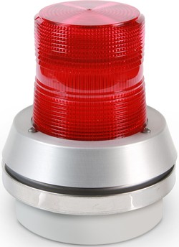
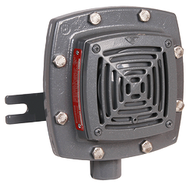
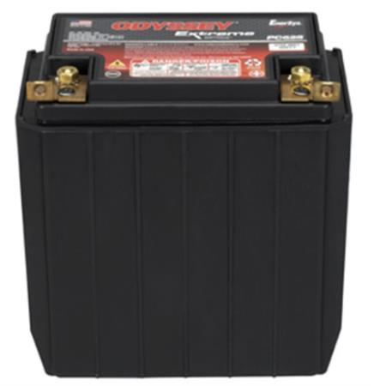
Relays
ALM 1
ALM 2
TRBL
C NO NC
C NO NC
C NO NC

