Slide 1
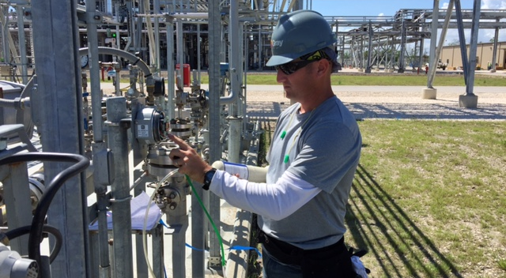
Fixed System Installation

Slide 2
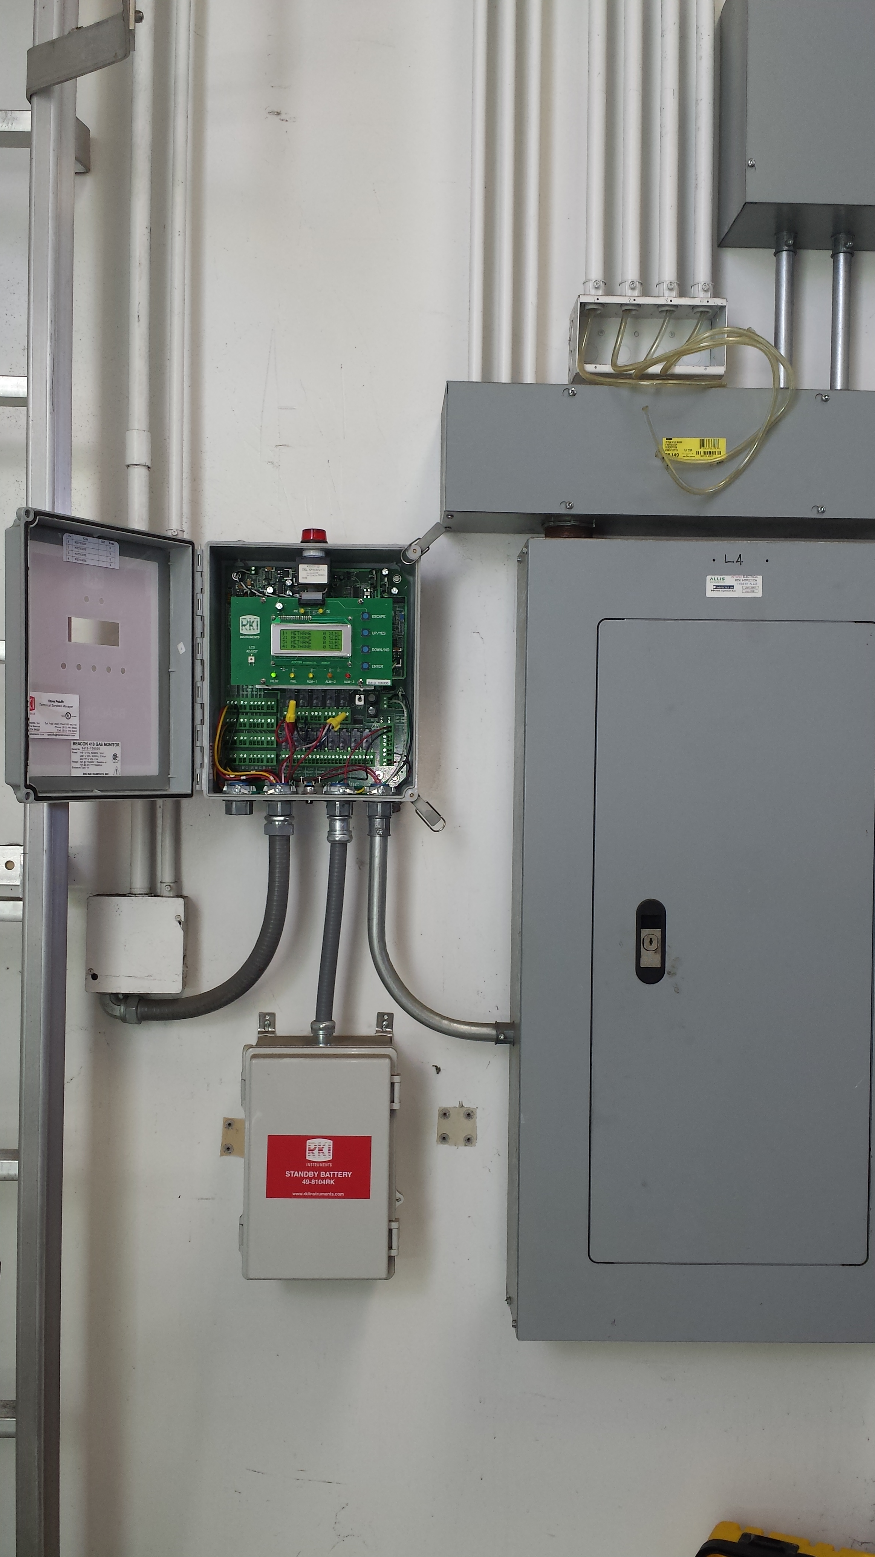
Mounting the Controller
Make sure there is sufficient space to mount controller.
Make sure that door can be opened.
Mount for easy access and visibility.
Always use conduit hubs to route wires.

Slide 3
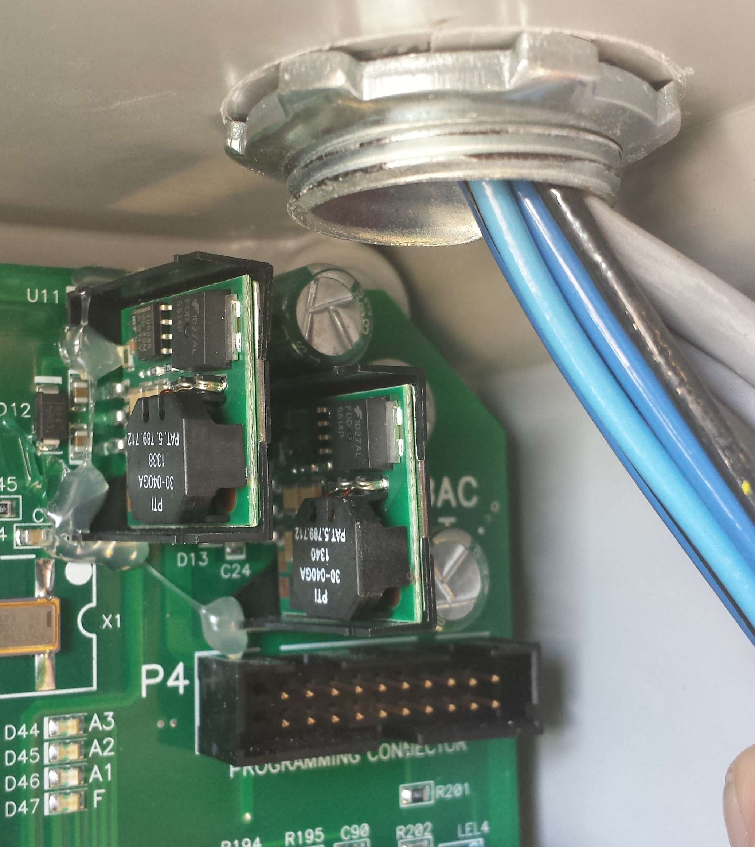
Controller Wiring
Do not drill the top case and run power wires into the unit.
Noise from wiring will cause controller to malfunction.
Condensation may drip down conduit and damage PCB.

Slide 4
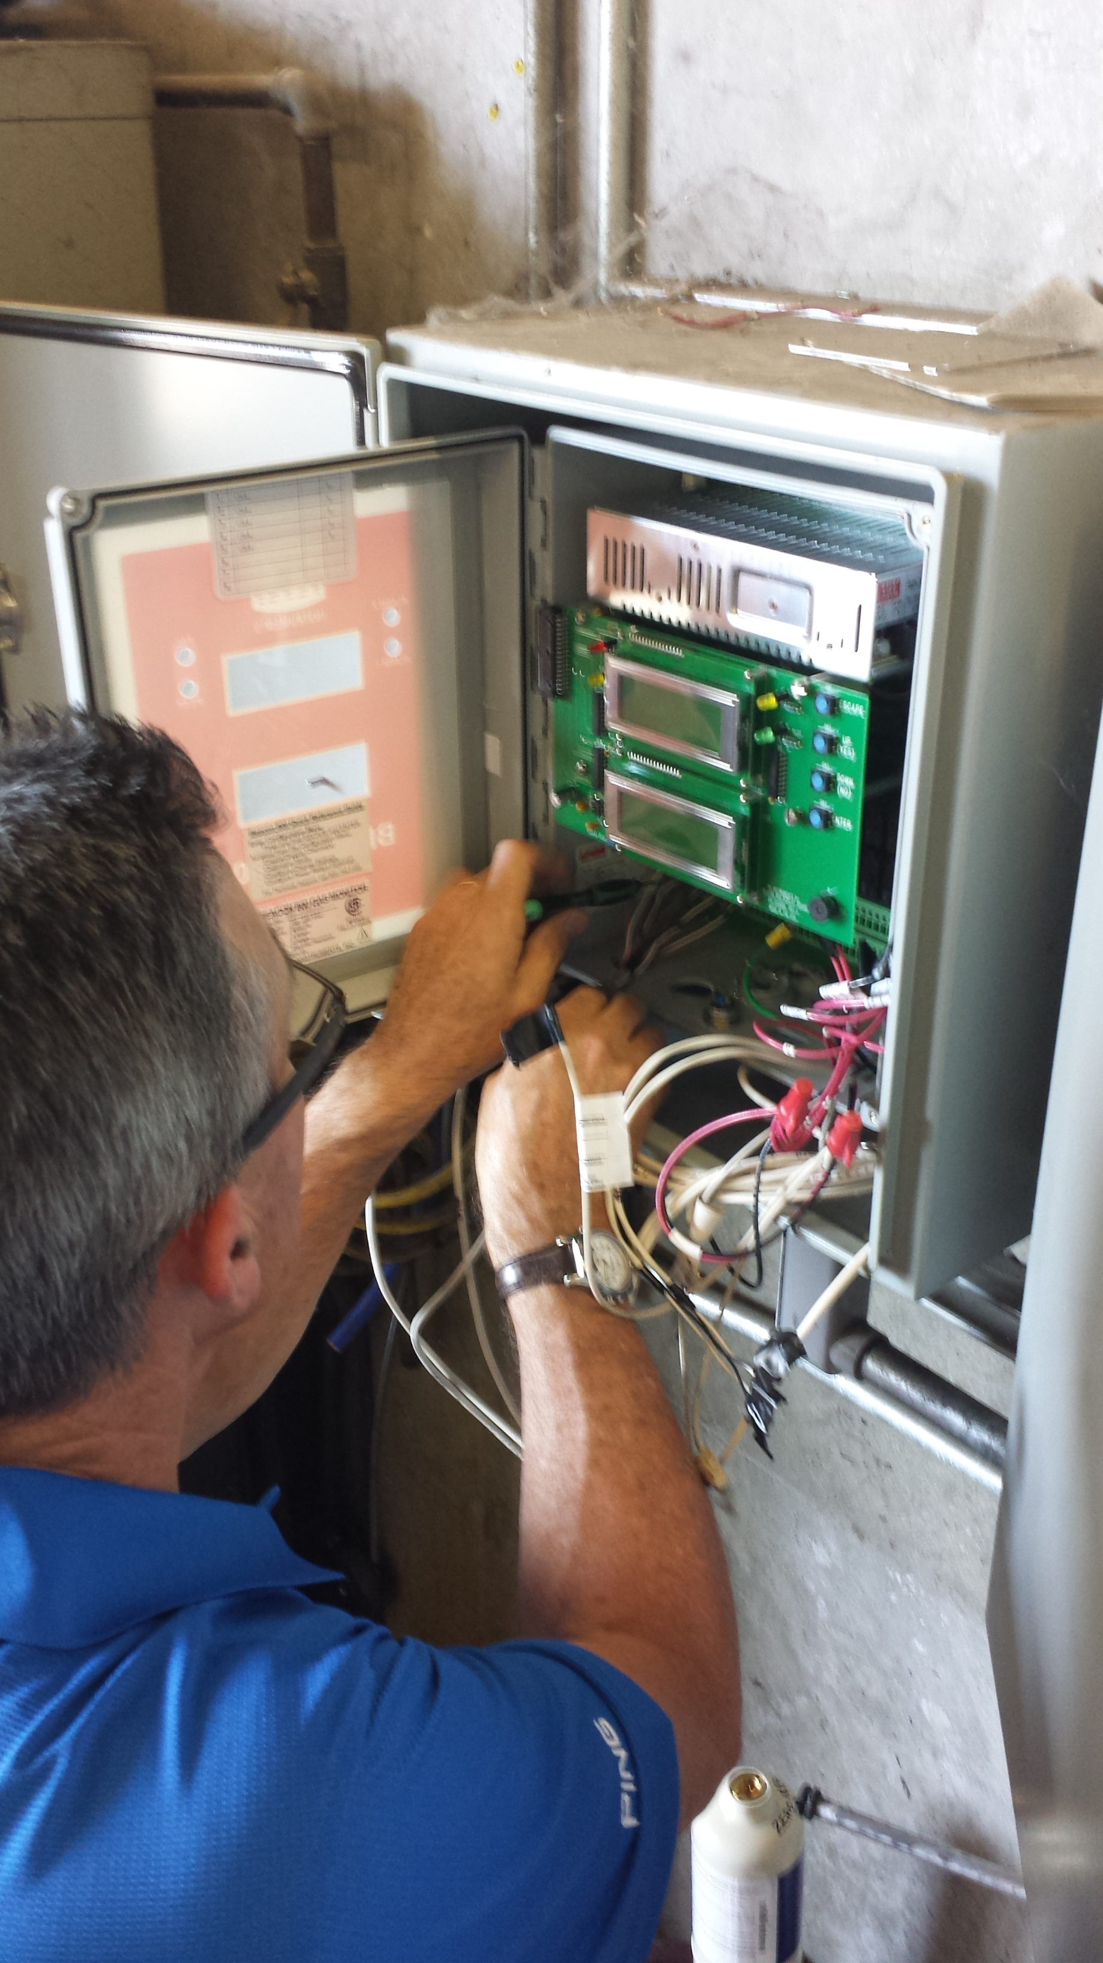
Grounding
Proper grounding is essential to proper system operation.
Connect transmitter wiring shields to the ground terminal on main PCB or conduit hubs.
Grounding at transmitter and controller may create a ground loop.

Slide 5
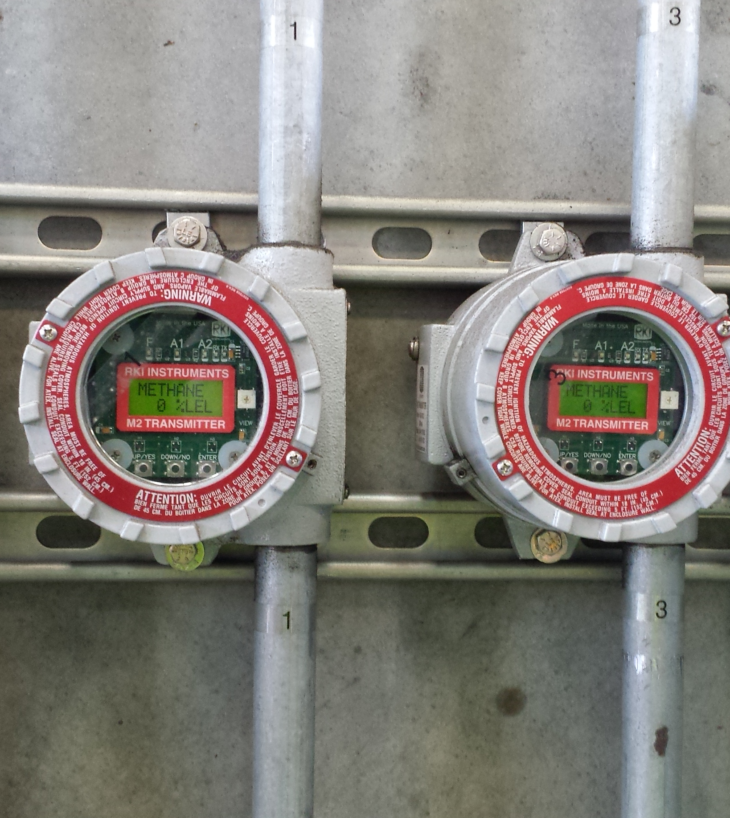
Transmitter Mounting
Mount transmitter at eye level.
Avoid mounting transmitters in areas of high vibration, extreme heat or cold.

Slide 6
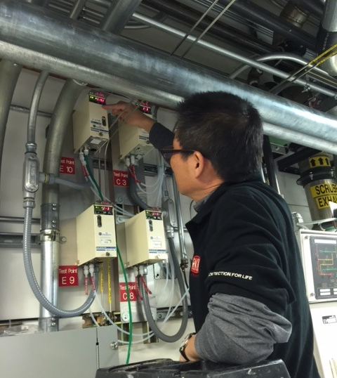
Transmitter Mounting
Mount transmitter in a location that can be easily accessed.

Slide 7
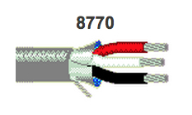
Transmitter Wiring
Use proper wire for each transmitter.
Use the proper gauge wire for the distance needed.
Insulated, shielded and jacketed cable.
Follow local installation codes.
Belden Cable

Slide 8
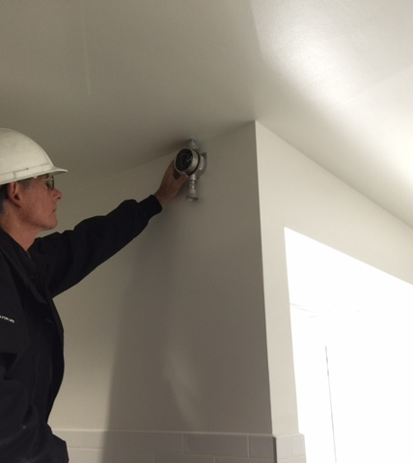
Transmitter Mounting
Mount transmitters properly.
  Lighter gases such as methane on ceiling.
  Heavier gases such as propane, mount near floor.
  Always place transmitter as close as possible to potential leak source.

Slide 9
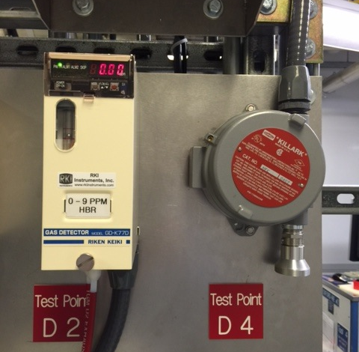
Transmitter Mounting
Clean Installation
Transmitters mounted in the breathing zone for general area monitoring.
Transmitter labeling makes identification easy.

Slide 10
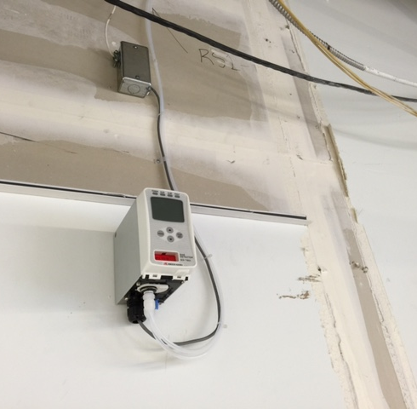
Transmitter Sample Lines
Use PTFE tubing (Teflon®) when detecting reactive gases.
Keep sample tubing length as short as possible.
Line filters protect pump and sensor from damage.

Slide 11
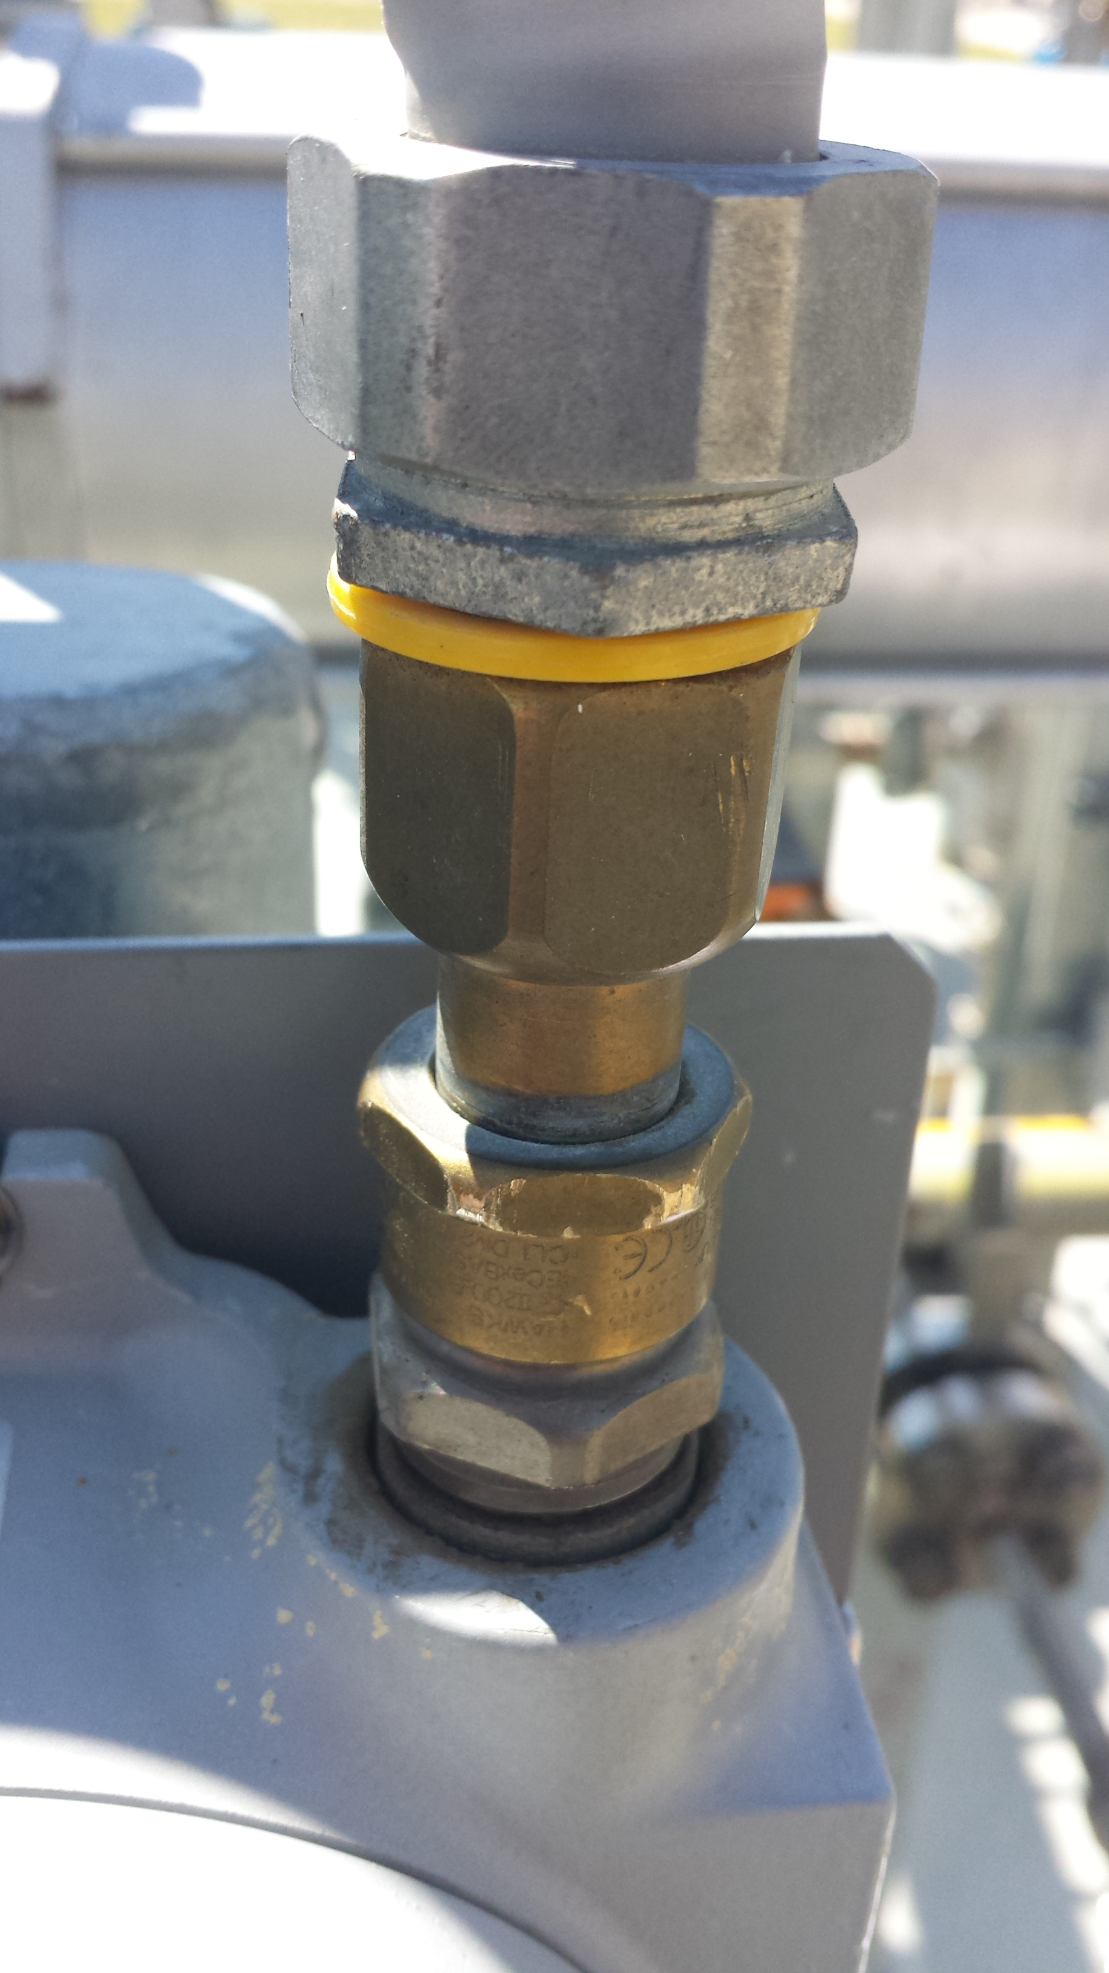
Sealing Conduit
For outdoor installations, seal threads to prevent water intrusion.
Install conduit seal to prevent water from entering into housing.

Slide 12
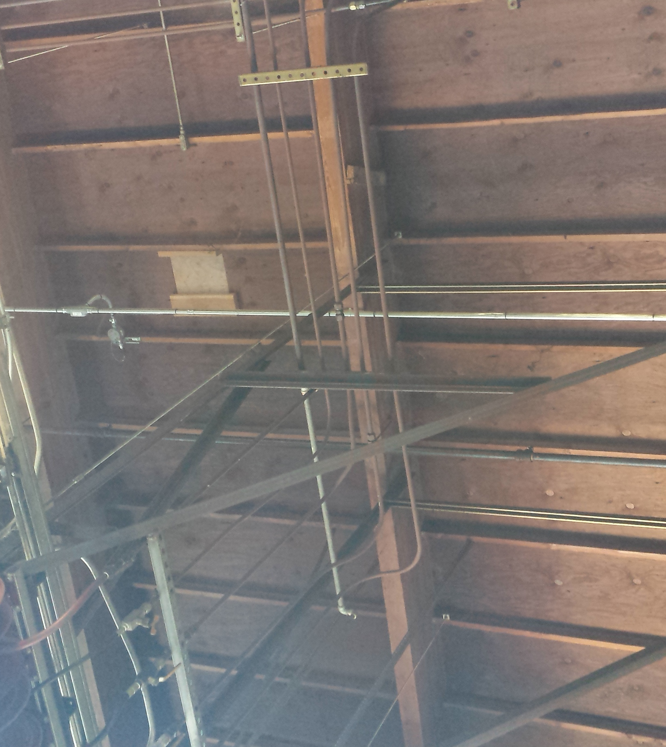
Remote Cal Adapter
Makes calibration simple for sensors that are mounted in locations that are difficult to access.

Slide 13
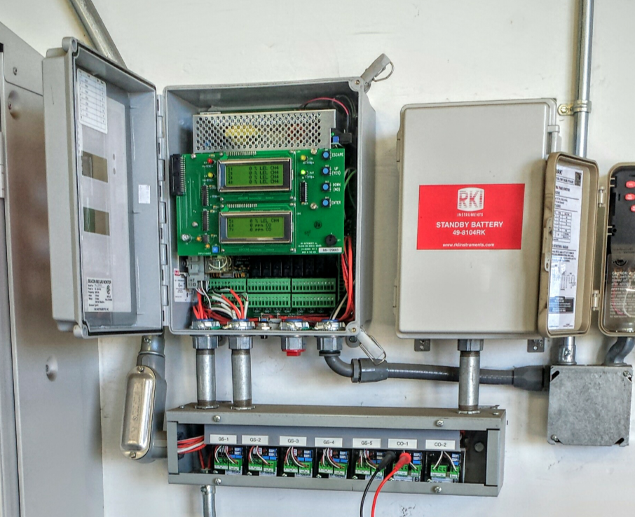
Battery Backup
Battery backup will power controller and sensors during a power outage.
Source proper battery back up to provide necessary current.

Slide 14
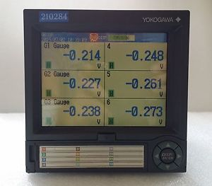
Recording Devices
Recording devices can provide data on exposure over time.
Make sure that recording devices are compatible with controller output.

Slide 15
Communication
RKI Instruments have several communication protocols:
  4 to 20 mA (most common)
  Direct connect (can be used on all controllers except Beacon 800)
  Modbus (found on M2A’s)
  PoE (Special order GD-70D’s only)

Slide 16
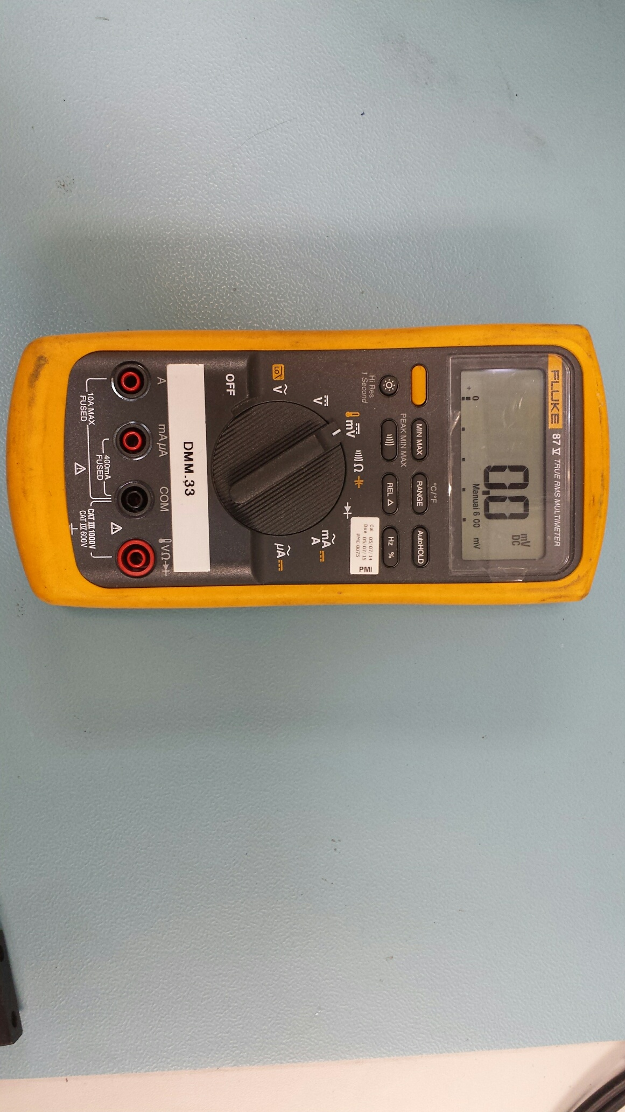

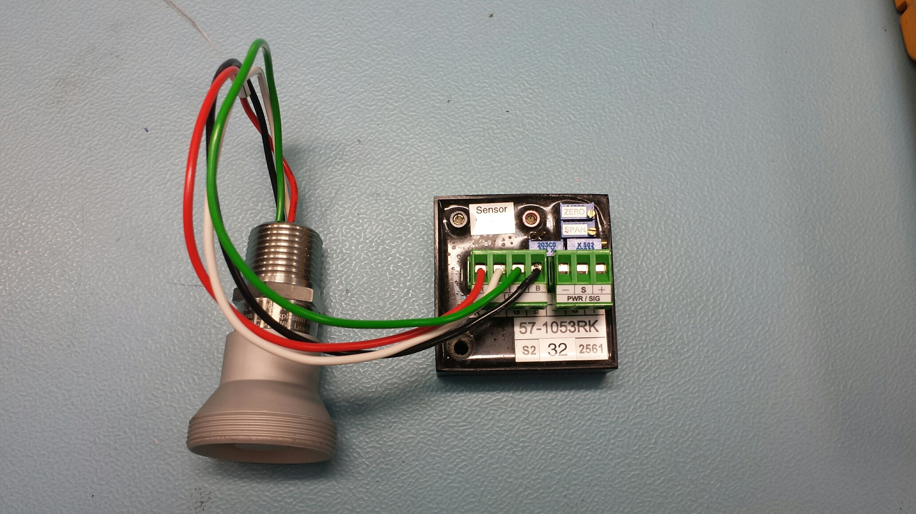
4 to 20 mA Communication
(Neg)
(Pos)
4 to 20 mA
Ammeter
(Signal)
ZERO POT
SPAN POT

Slide 17
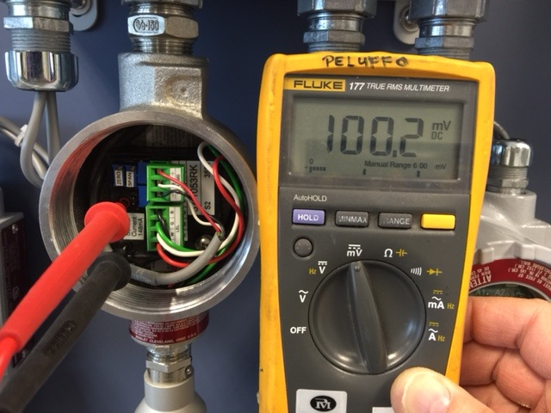
4 to 20mA Communication
For combustible or toxic gases, set zero to 100mV with fresh air applied.

Slide 18
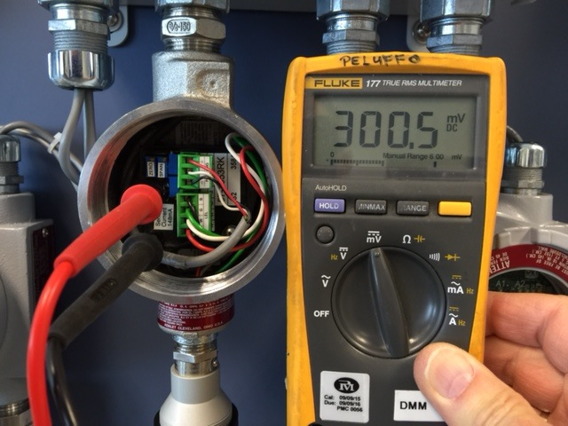
4 to 20 mA Communication
When setting the span to 50% LEL, adjust the SPAN pot so DVM reads 300mV.
Formula:
  (Cal gas/Full Scale) x 400 + 100 = mV setting

Slide 19
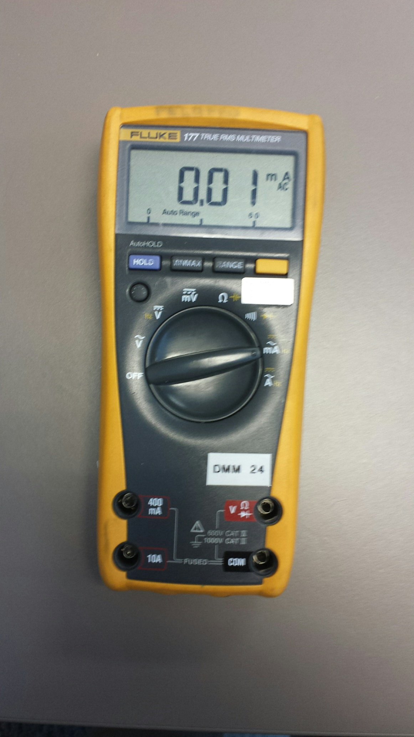
4 to 20 mA Communication
GD-K8A
Amp.
SPAN
ZERO
GAIN
+
CHECK
-
4 to 20 mA

Slide 20
Calculations
Standard S-Type Transmitter
  Oxygen: 20.9/full scale x 400 + 100
    Oxygen calibration setting in mV
  Combustible & Toxic: (Cal gas/full scale) x 400 + 100
    Combustible/toxic span setting in mV
Current Source Amplifier
  Toxics: (Cal gas/full scale) x 16 + 4
    Toxic span setting in mA

Slide 21
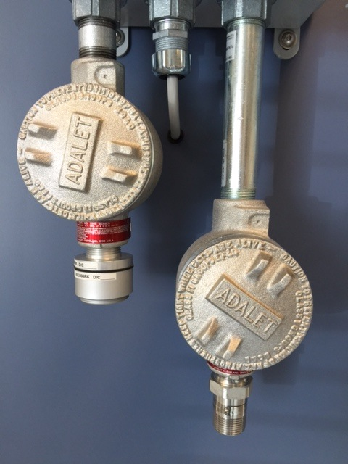
Direct Connect
Sensor directly wired to controller.
No amplifier housing.

Slide 22
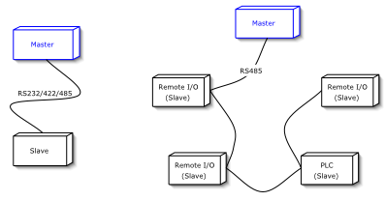
Modbus

Slide 23
PoE
Ethernet
PoE
Ethernet
Hub
PoE
RJ-45
PoE
Hub
LAN
Ethernet

Slide 24

Relays
Relay Terminal Strip
Alarm 1
NO
NC
C
Power Source

Slide 25
Area Classifications
NEC Division System Gas Groups
Area | Group | Representative Materials
Class I, Division 1 & 2 | A | Acetylene
 | B | Hydrogen
 | C | Ethylene
 | D | Propane
Class II, Division I & 2 | E (Division 1 only) | Metal dusts, such as magnesium
 | F | Carbonaceous dusts, such as carbon & Charcoal
 | G | Non-conductive dusts, such as flour, grain
 | None | Ignitable fibers/flyings, such as cotton lint, flax & rayon

Slide 26

Questions?

