Slide 1
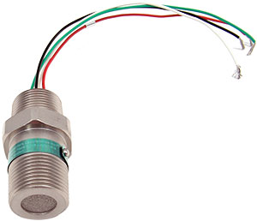
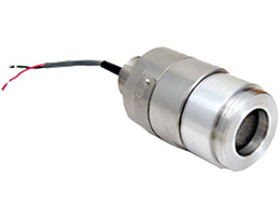
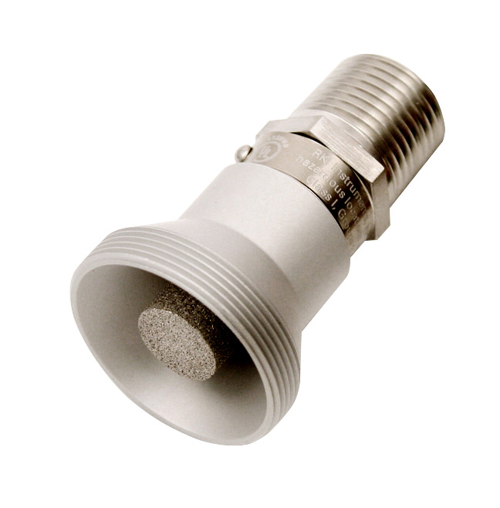
Gas Detection Basics
Rev. 7/28/16

Slide 2


Safety vs Process Control
RKI’s products mostly address safety applications
A few of RKI’s products may also address some process control applications
SAFETY
  Protecting life and property/assets
  Gases normally not present
  Detect occasional leaks if they occur
PROCESS CONTROL
  Adjusting processes based on the gas present
  Gases normally present

Slide 3

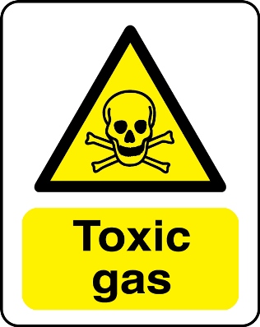
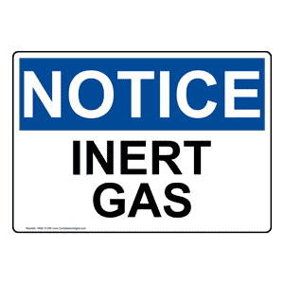
Types of Gases/Compounds
Combustibles
  Flammable gases and vapors
    Most are also toxic
    Organic compounds (HC’s)
“Toxics”
  Usually refers to non-hydrocarbons
    Inorganic compounds (Non-HC’s)
    Several inorganic compounds are also
    combustible
Inerts
  Non-reactive gases
    Usually are N2, He, Ar

Slide 4
Flammability Band
Percent LEL
Upper Explosive Limit (UEL)
0
10
100
100% Vol
(LEL)
(UEL)
Lean
Explosive
Rich
0
Infrared Sensor
Catalytic Bead Sensor
Thermal Conductivity Sensor
Ammonia 12.0 Vol. %
Methane 5.0 Vol. %
Hydrogen 4.0 Vol. %
Hexane 1.1 Vol. %
Lower Explosive Limit

Slide 5
Area Classifications
NEC Division System Gas Groups
Area | Group | Representative Materials
Class I, Division 1 & 2 | A | Acetylene
 | B | Hydrogen
 | C | Ethylene
 | D | Propane
Class II, Division I & 2 | E (Division 1 only) | Metal dusts, such as magnesium
 | F | Carbonaceous dusts, such as carbon & Charcoal
 | G | Non-conductive dusts, such as flour, grain
 | None | Ignitable fibers/flyings, such as cotton lint, flax & rayon

Slide 6
Toxicity
TLV’s & PEL’s: Threshold Limit Values & Permissible Exposure Levels
  TWA
    Time Weighted Average:
      -Average Exposure over 8 hours
  STEL
    Short Term Exposure Limit:
      -Average Exposure over 15 minutes
  C
    Ceiling:
  -Not to be exceeded for any length of time
  IDLH
    Immediately Dangerous to Life and Health:
      -30 minutes of exposure may result in permanent physiological damage
Agencies
ACGIH: American Conference of Governmental Industrial Hygienists
NIOSH: National Institute of Occupational Safety and Health
OSHA: Occupational Safety and Health Administration

Slide 7
Inerts
Oxygen deficiency
  Permissible Low Levels Exposure
    Oxygen sensor used to measure the displacement of oxygen by an inert compound
    Typical first alarm points at 19.5% Vol. or
    18.0% Vol. (Decreasing Alarm Logic)

Slide 8
Sensor Technologies
Catalytic
  Combustibles- %LEL
Metal Oxide Semiconductor (MOS)
  Combustibles- PPM, % LEL
Infrared –
  Combustibles- %LEL, % Vol.
  Carbon Dioxide- PPM, % Vol.

Slide 9
Sensor Technologies
Thermal Conductivity –
  Combustibles- % Vol.
Electrochemical –
  Inorganic gases/Compounds PPB, PPM
Galvanic (Partial Pressure) –
  Oxygen - %Vol.
Capillary
  Oxygen - %Vol

Slide 10
Sensor Technologies
Zirconia
  PPB, PPM, %Vol O2
Paper Tape –
  Formaldehyde, Inorganic gases – PPM

Slide 11
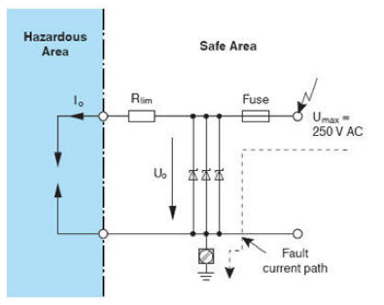
Intrinsic Safety

Slide 12
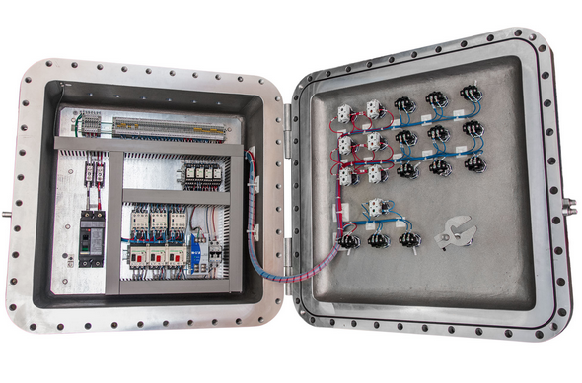
Explosion Proof

Slide 13
Catalytic Bead Combustible Gas Sensor

Slide 14
Principle of Operation
The catalytic bead sensor consists of two coils of fine platinum wire each embedded in a bead of alumina, connected electrically in a Wheatstone bridge circuit. One of the pellistors is impregnated with a special catalyst which promotes oxidation while the other is treated to inhibit oxidation. Current is passed through the coils so that they reach a temperature at which oxidation of a gas readily occurs at the bead treated with the platinum cataylist (500-550°C). Passing combustible gas raises the temperature further which increases the resistance of the platinum coil in the catalysed bead, leading to an imbalance of the bridge. This output change is linear, for most gases, up to and beyond 100% LEL, response time is a few seconds to detect alarm levels (around 20% LEL), at least 10% oxygen by volume is needed for the oxidation.

Slide 15
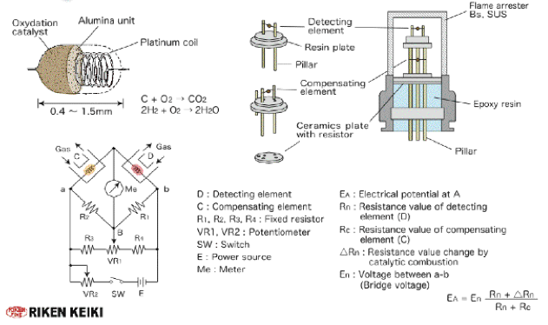
Catalytic Bead Sensor

Slide 16
Catalytic Bead Sensor
Platinum Catalyst
Deactivator
Platinum Alloy Wire
Ceramic Coating
Active
Reference
Four Wire Catalytic Bead Combustible Gas Sensor
Constant Current
Notes:
Different sensors have different sensor voltages, however the principles of operation are the same.

Slide 17
Catalytic Oxidation
Active
Reference

Slide 18

Catalytic Bead Sensor
500 Ω
5 Ω
500 Ω
10 Ω
5 Ω
Resistance values are approximate and will vary slightly
Between sensors. H2 specific sensors will be approximately 3 Ohms per leg.

Slide 19
Catalytic Bead Sensor
Sensor current for fixed systems can be adjusted to “tune” the gas sensor for specific gas to be detected
Methane, Propane, Iso Butane, Pentane & Hexane Detection (NC-6241)
  Set at 148 mA
Hydrogen (NC-6241)
  Set at 130 mA
Hydrogen Specific (NC-6205)
  Set at 115 mA

Slide 20
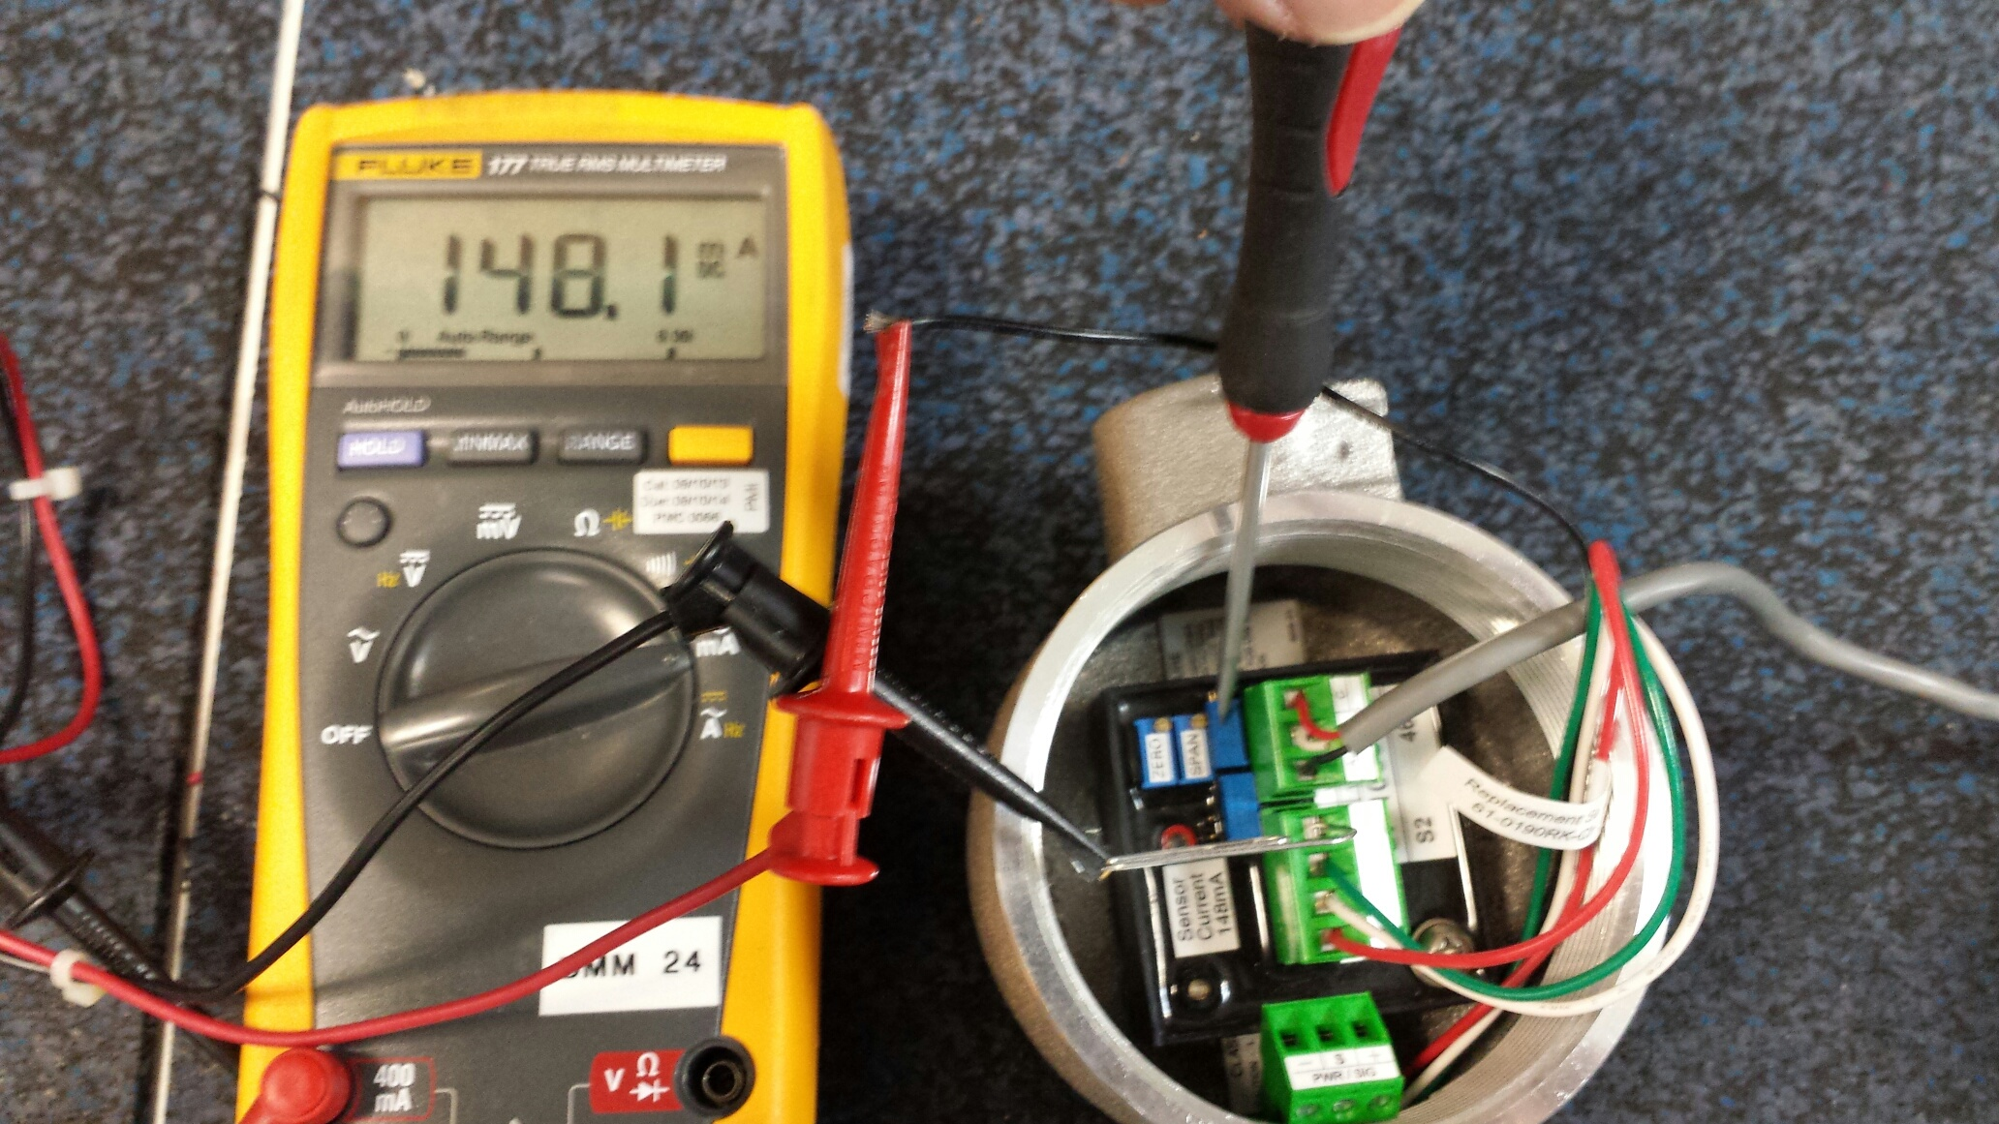
Adjusting Sensor Current
(S2-Series)

Slide 21
Catalytic Bead Sensor
Sensor Type | Pros | Cons
Catalytic Bead | Linear output, responds to most hydrocarbons, low cost, long life, can be used for ppm HC detection | Affected by catalyst poisons, not suitable for wet or high vibration areas, requires oxygen to operate, not suitable for measuring gas above 100% LEL
Infrared | Not affected by catalyst poisons, long life, requires less frequent calibration, | Non linear output, not suitable for high vibration or humid areas, will not respond to certain compounds such as hydrogen and acetylene. Not suitable for low ppm detection.

Slide 22
Catalytic Bead Sensor
Sensor Type | Pros | Cons
Thermal conductivity | Long life, does not require oxygen to operate, sensors available for methane and hydrogen, | Not suitable for ppm combustible detection,

Slide 23
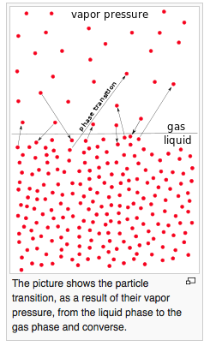
Vapor Pressure

Slide 24
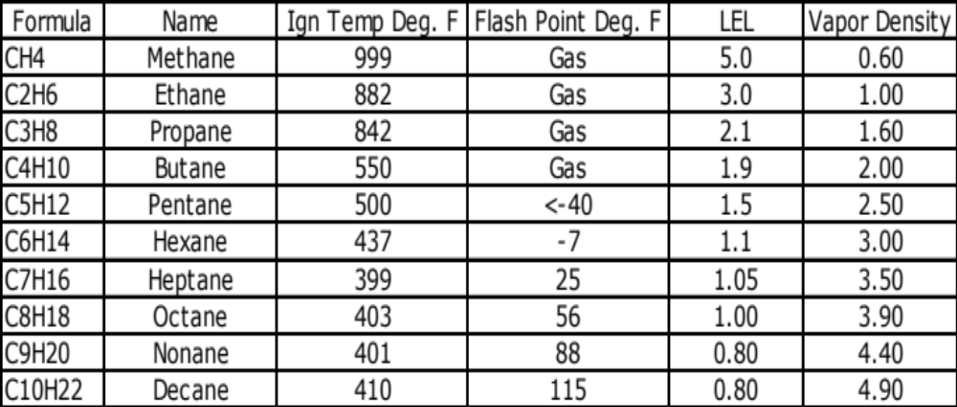
Hydrocarbon Comparison

Slide 25
Common Failures
Reading pegs either upscale or downscale
  Open Active or Reference detector element
  Excessive vibration can damage the filaments
  Liquids or corrosion can cause output failure
Unstable or Erratic Operation
  Reading can be slow to respond or slow to recover due to contamination of the sensor elements and or contamination of the flame arrestor

Slide 26
Common failures
Low span on test gas
  Deterioration of the catalyst caused by continuous exposure to flammable gas, repeated exposure to high concentrations of gas, contamination or age of the sensor.
Exposure to catalyst poisons such as:
  Silicone compounds
  Chlorinated hydrocarbons
  Corrosive gases or vapors
  Leaded gasoline

Slide 27
Thermal Conductivity
Gas Sensor

Slide 28

Thermal Conductivity
Reference element contained
out of gas stream
Temperature coefficient of air
is different than gas causing
temperature of coil to cool
increasing resistance. No
catalytic activity on sensor.
Active
Reference

Slide 29
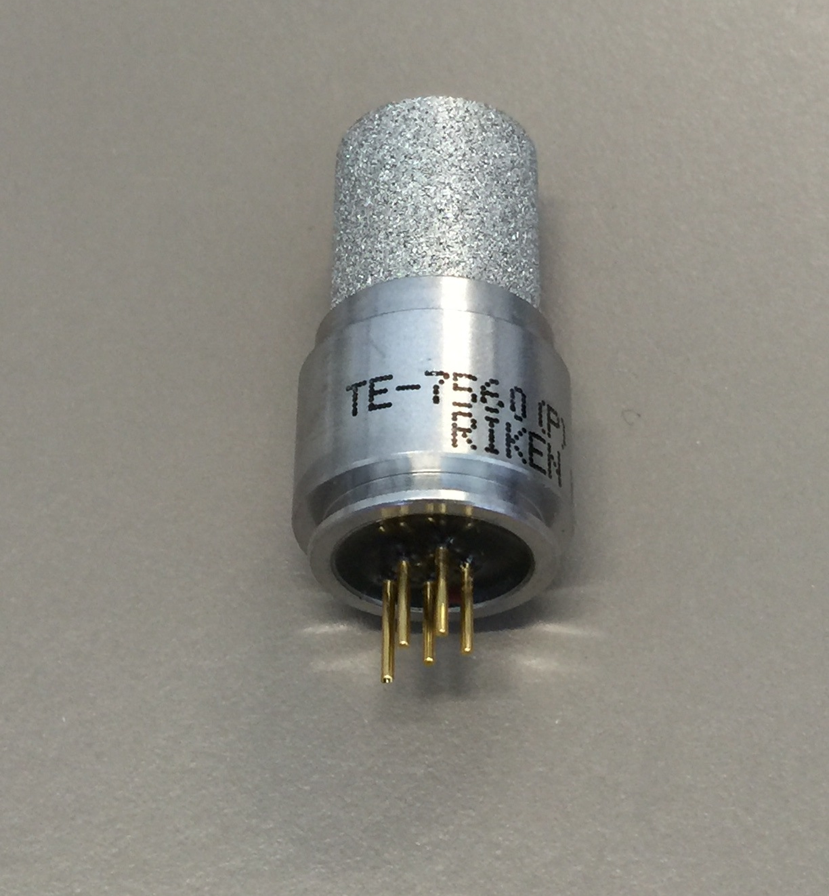
TC Troubleshooting
TC sensors may open causing instrument to fail.
Contamination can cause the sensor to respond improperly or become unstable.
13.7 Ω
13.7 Ω
TE-7560 H2 Detector
Guide Pin

Slide 30
Galvanic Oxygen
Gas Sensor

Slide 31
Galvanic Sensor
Principle of Operation
The oxygen sensor is a galvanic fuel cell with a gas-permeable Teflon membrane at one end. Any gas that is in contact with the sensor membrane will diffuse through the membrane and dissolve in a thin layer of weak acetic acid gel electrolyte. Oxygen reduces at the gold cathode and lead oxidizes at the anode.
At the cathode:
  O₂ + 2H₂O + 4e- => 4 OH⁻
At the anode:
  2Pb + 4OH⁻ => 2 PbO + 2H₂O + 4e⁻
The flow of electrons from the anode to the sensing cathode via an external electronic circuit is directly proportional to the amount of oxygen in the gas phase and varies linearly with the partial pressure of the oxygen in the gas stream. The electrolyte conducts the ionic current, generated by the migrating OH- groups.

Slide 32
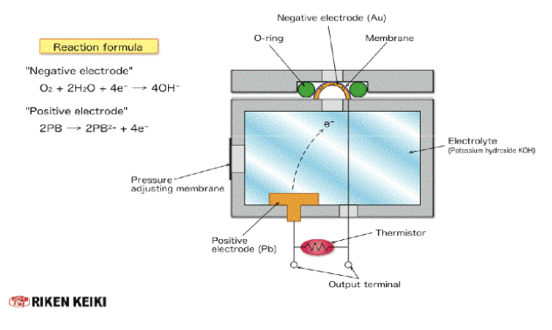
Galvanic Oxygen Sensor
Typical output: 11-18 mV in fresh air

Slide 33
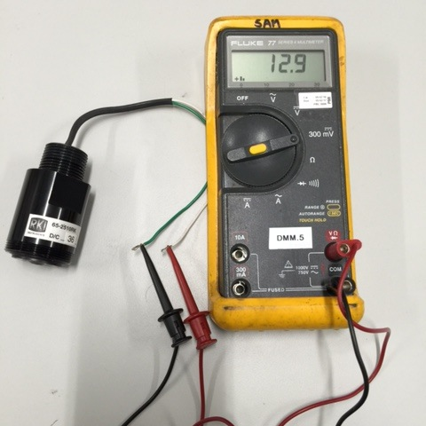
Oxygen Sensor Troubleshooting
Replace Sensor if:
Voltage is outside specifications
Unstable output
Will not zero with N2 applied
Leaking
Corroded or contaminated

Slide 34
Capillary Oxygen Sensor

Slide 35
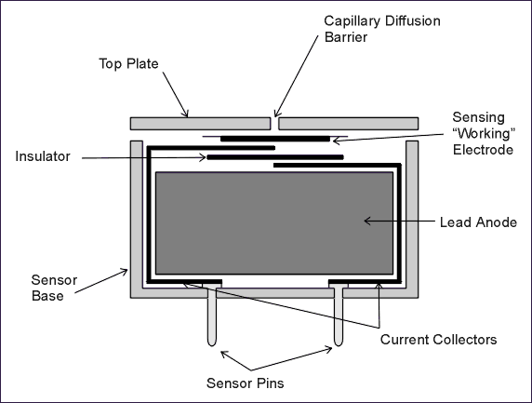
Capillary Oxygen Sensor

Slide 36
Metal Oxide Semiconductor Gas Sensor

Slide 37
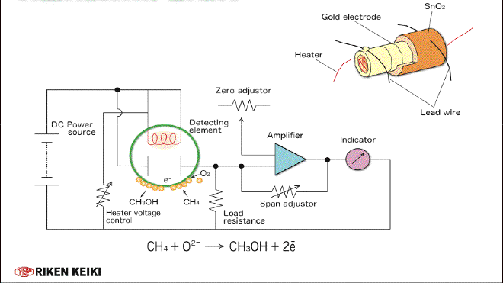
MOS Sensor

Slide 38
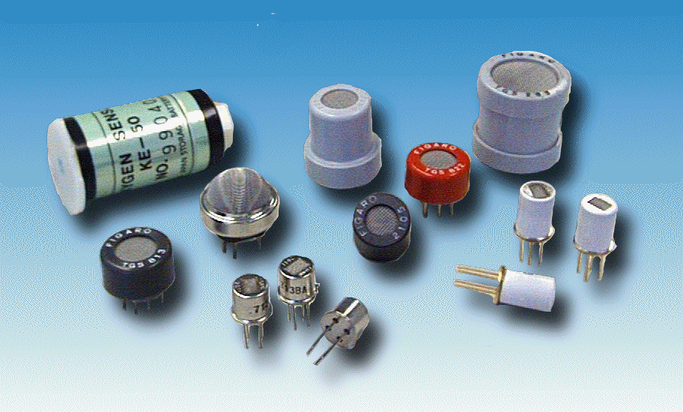
MOS Troubleshooting
Contamination of oxide layer will cause unstable or erratic output
Improper heater voltage will cause sensor to function improperly

Slide 39
MOS Sensor
Non linear output
Responds to many different gases, non-specific
May respond to moisture
Broadband gas sensor

Slide 40
Infrared
Gas Sensor

Slide 41
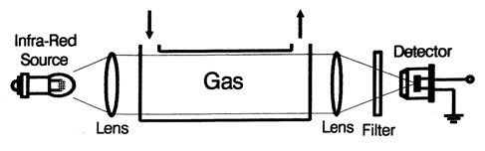
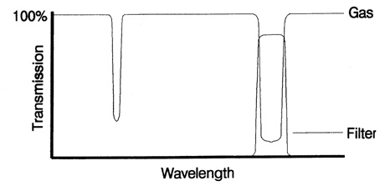
Sample Draw NDIR Sensor

Slide 42
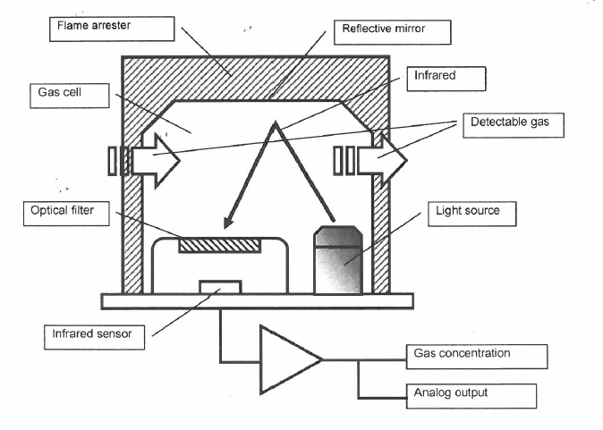
Diffusion IR Sensor

Slide 43
NDIR Troubleshooting
Contamination of the sensor will reduce energy reaching sensor causing high output. Contaminants consist of:
  Dust
  Moisture/Liquid
Open IR source will cause output to peg upscale

Slide 44
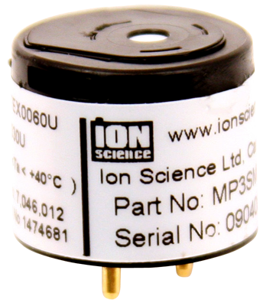
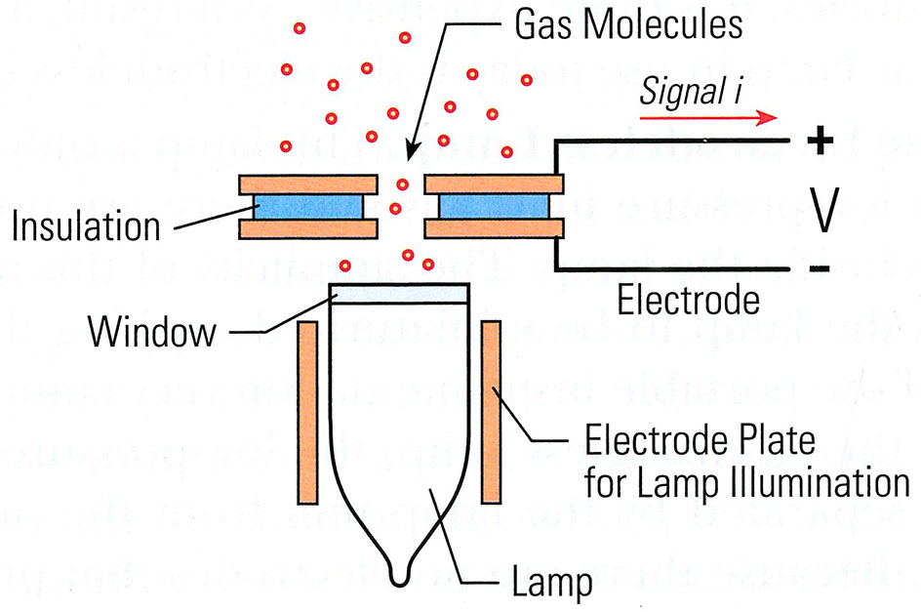
Photo Ionization Detector
A PID is a broadband VOC detection technique

Slide 45
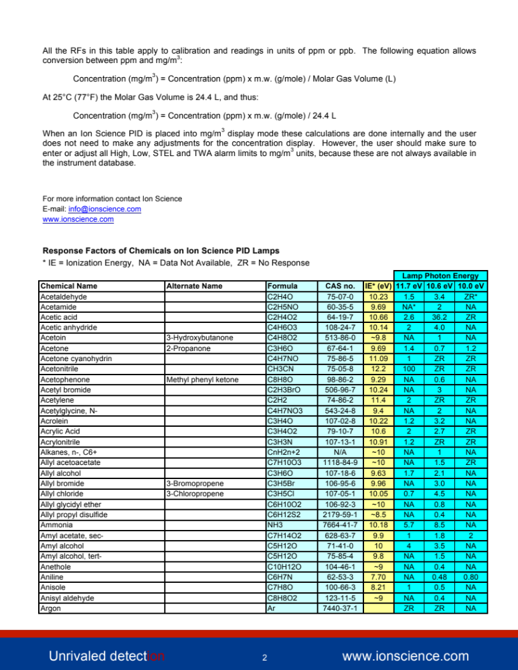
Partial List of PID Detectable Compounds

Slide 46
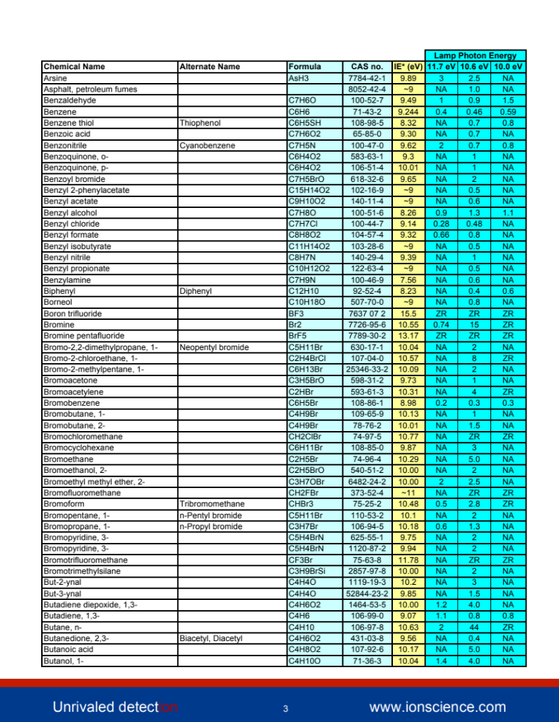

Slide 47
Electrochemical Toxic
Gas Sensor

Slide 48
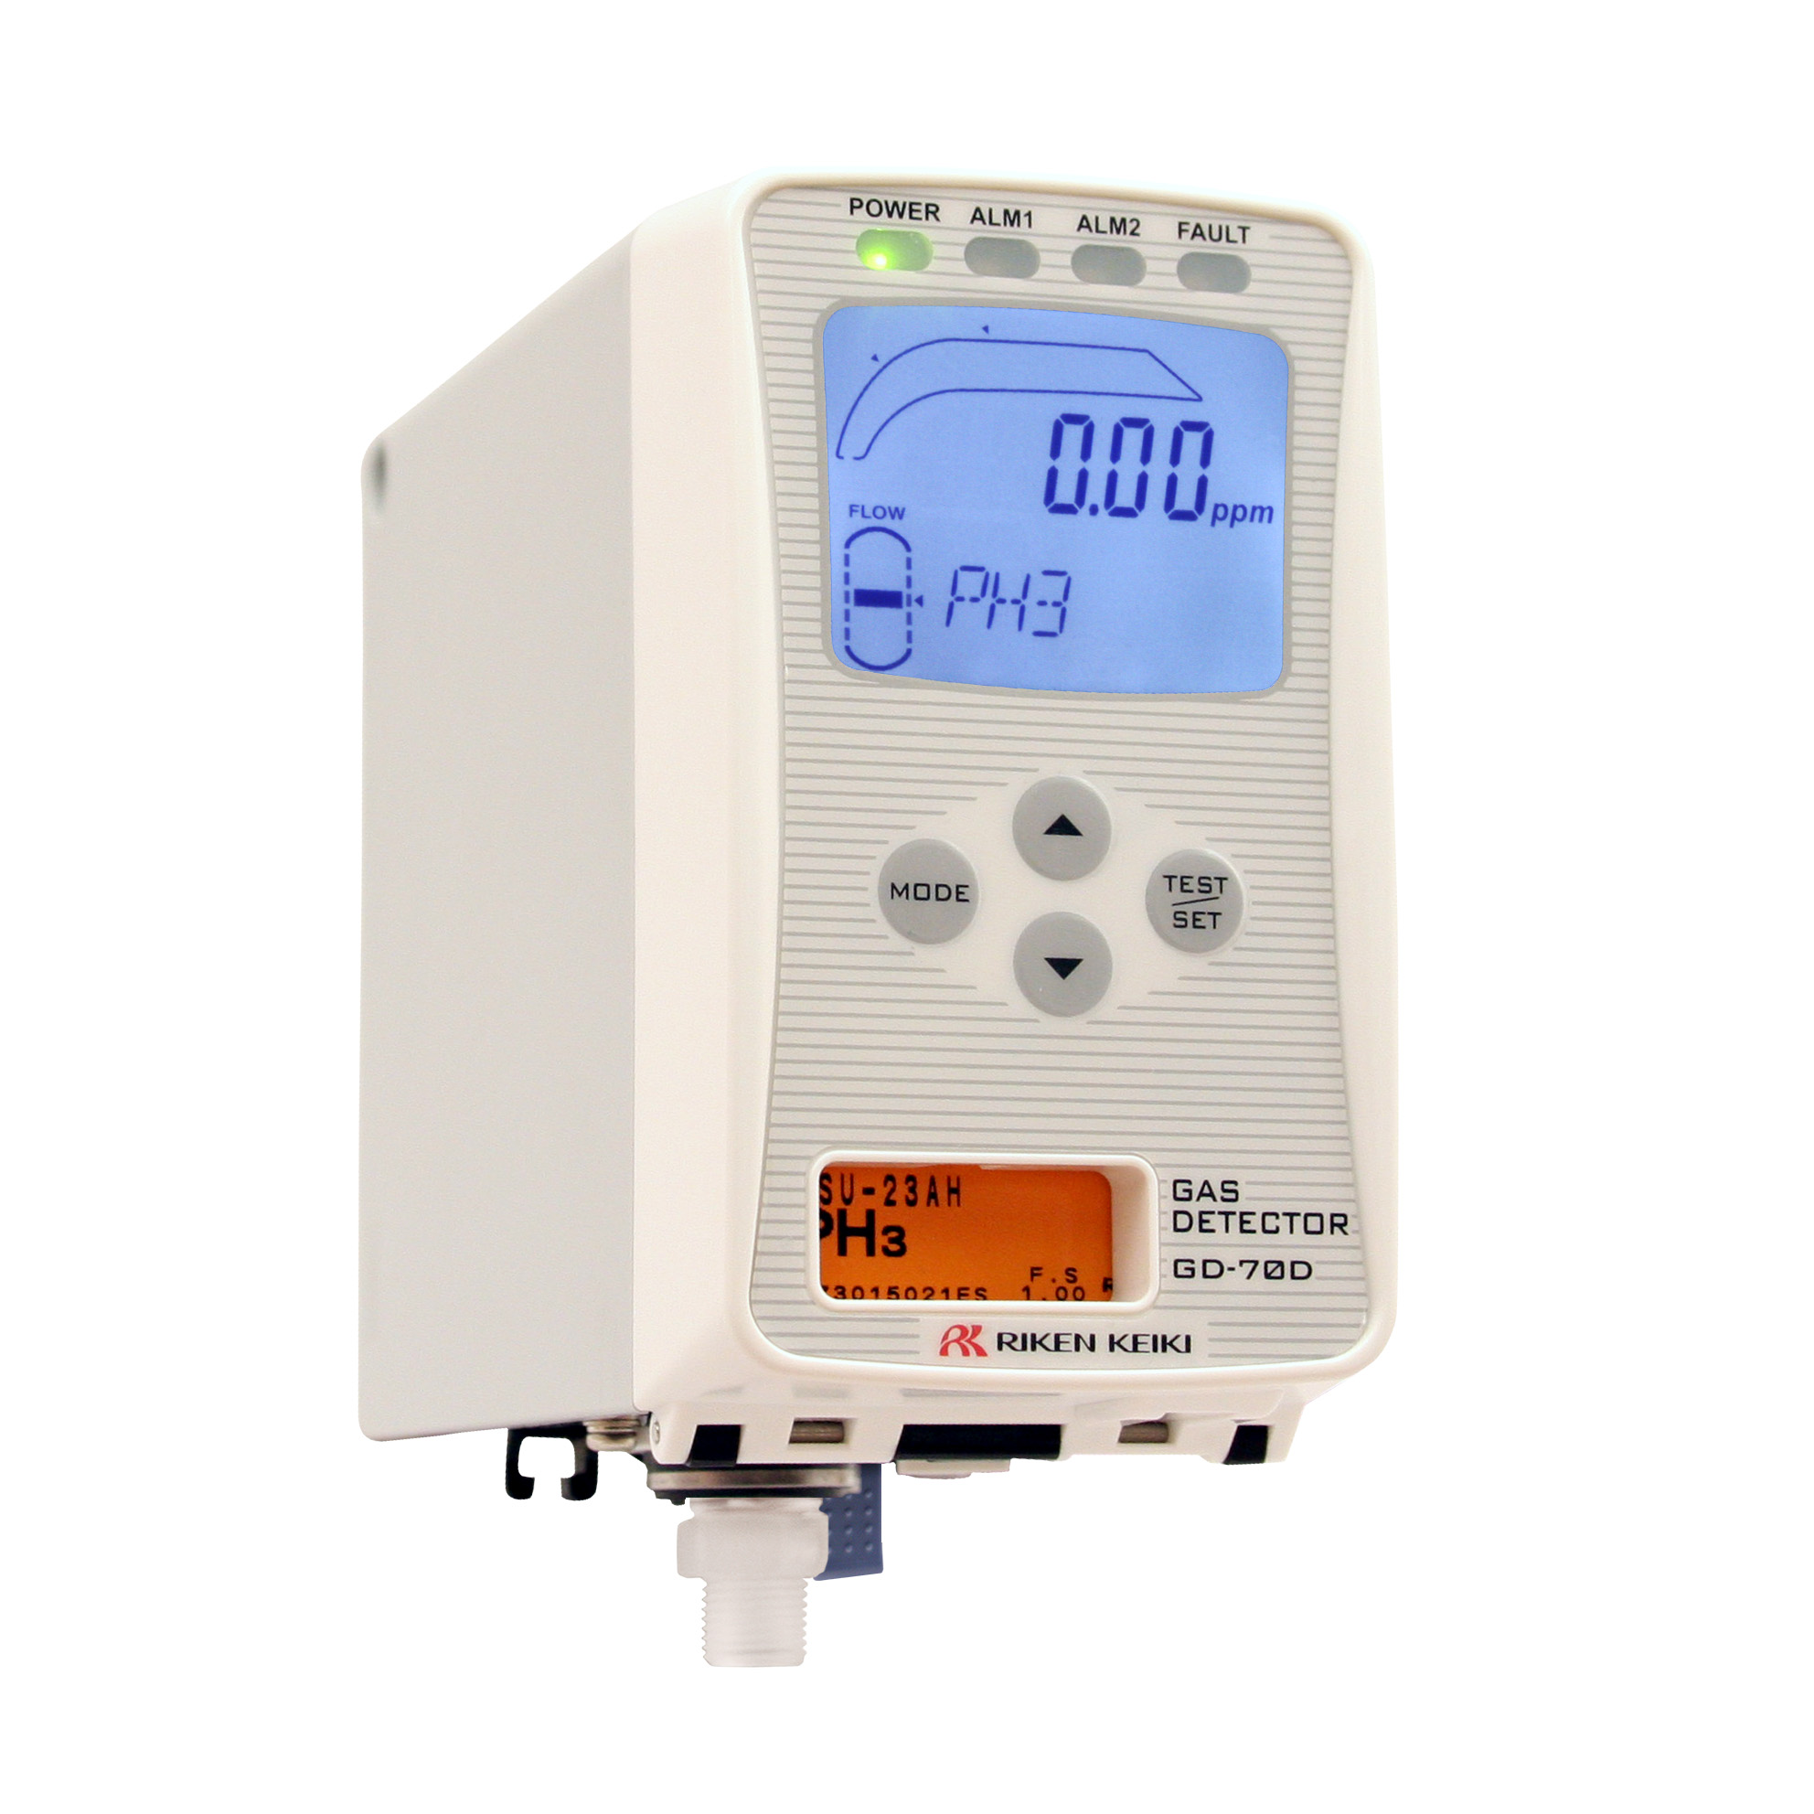
Electrochemical Sensors
5 Key Factors that separate Riken sensors from the competition
Electrode material
Bias voltage
Electrolyte
  Sulfuric acid
  Potassium Iodide
  Potassium Iodate
Reaction area of electrode
Electrolyte reaction

Slide 49
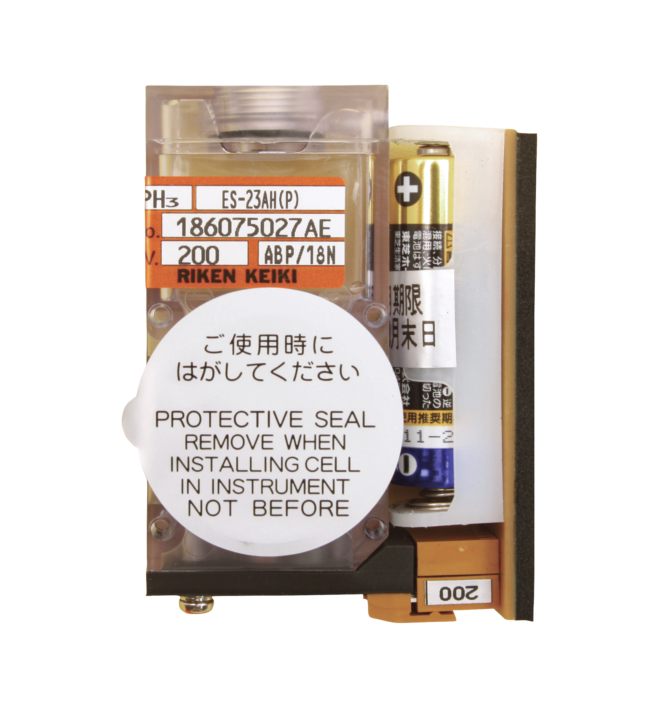
Electrochemical Sensors
Long life (2+ years)
Excellent stability
High degree of selectiveness
Easy to replace and calibrate

Slide 50
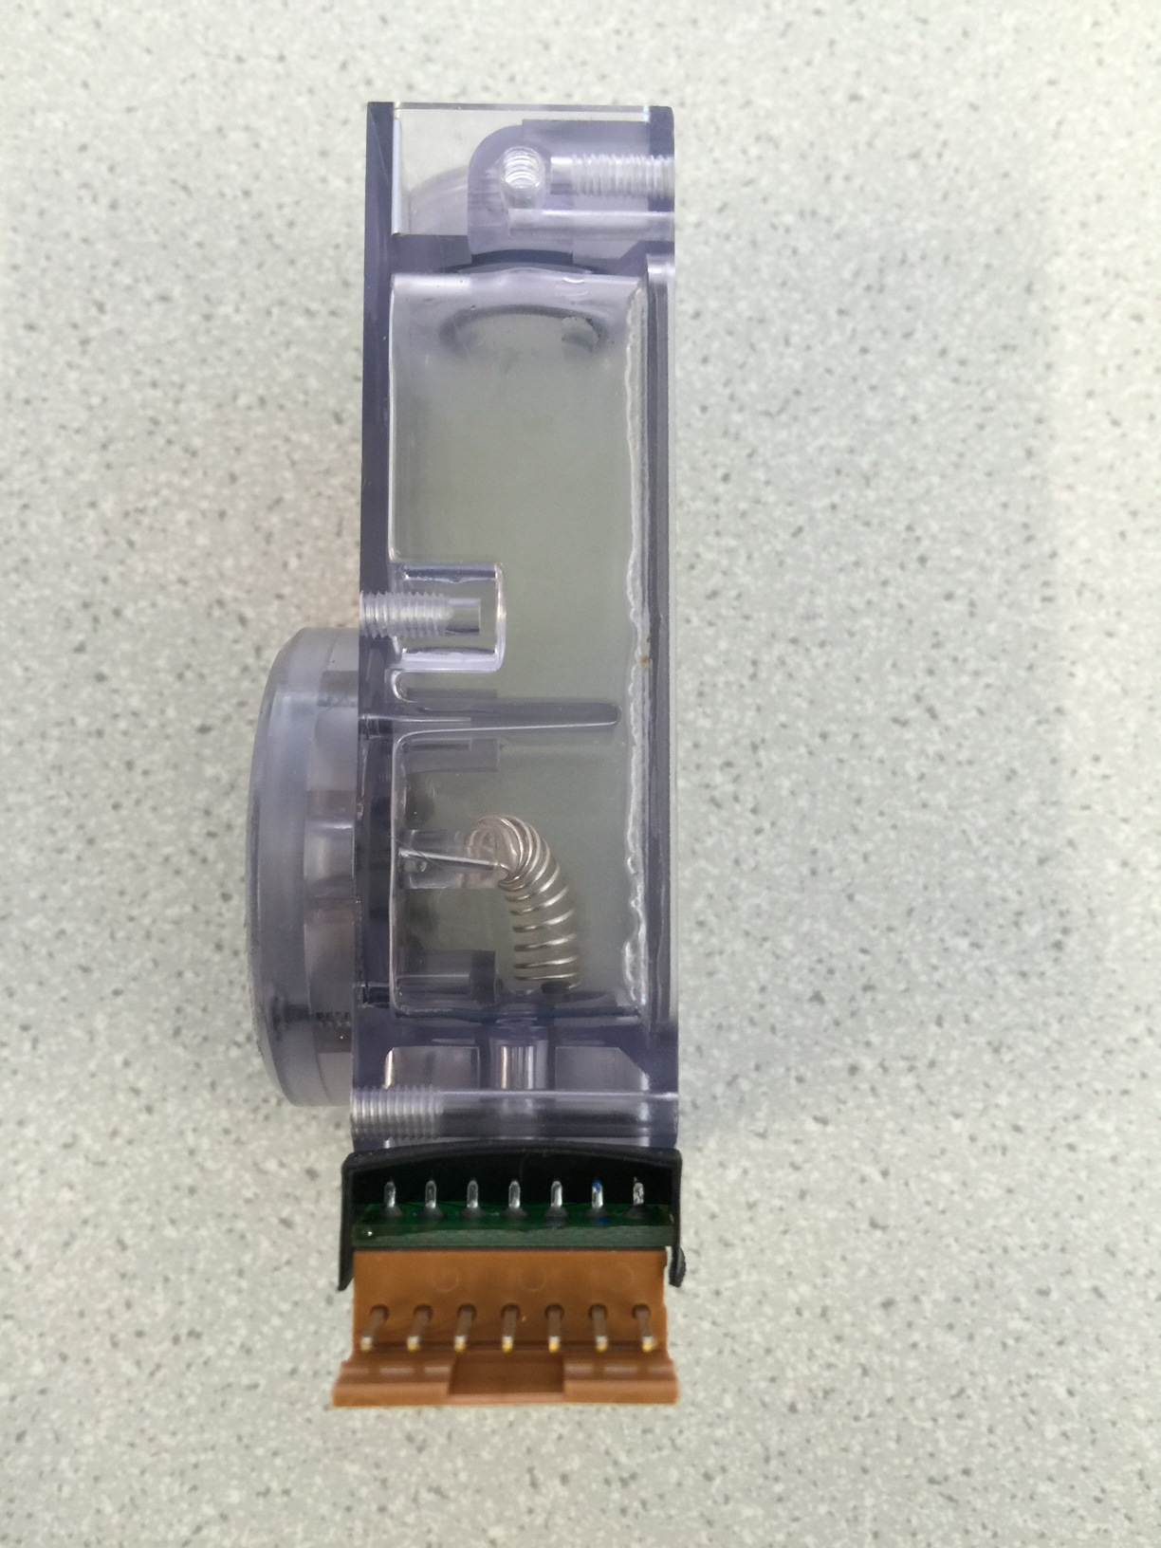
Electrochemical Sensors
May require bias stabilization period
Replace if:
  Sensor has low span
  Sensor is unstable
  Unable to set zero
  Electrolyte is contaminated
  Sensor is leaking

Slide 51
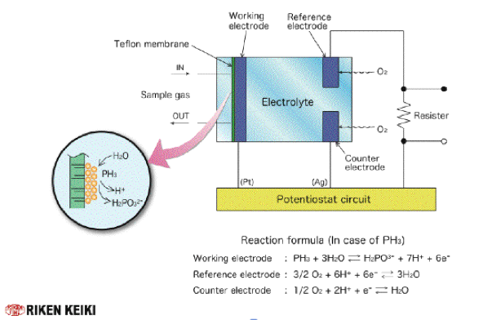
Electrochemical Sensors
Resistor

Slide 52
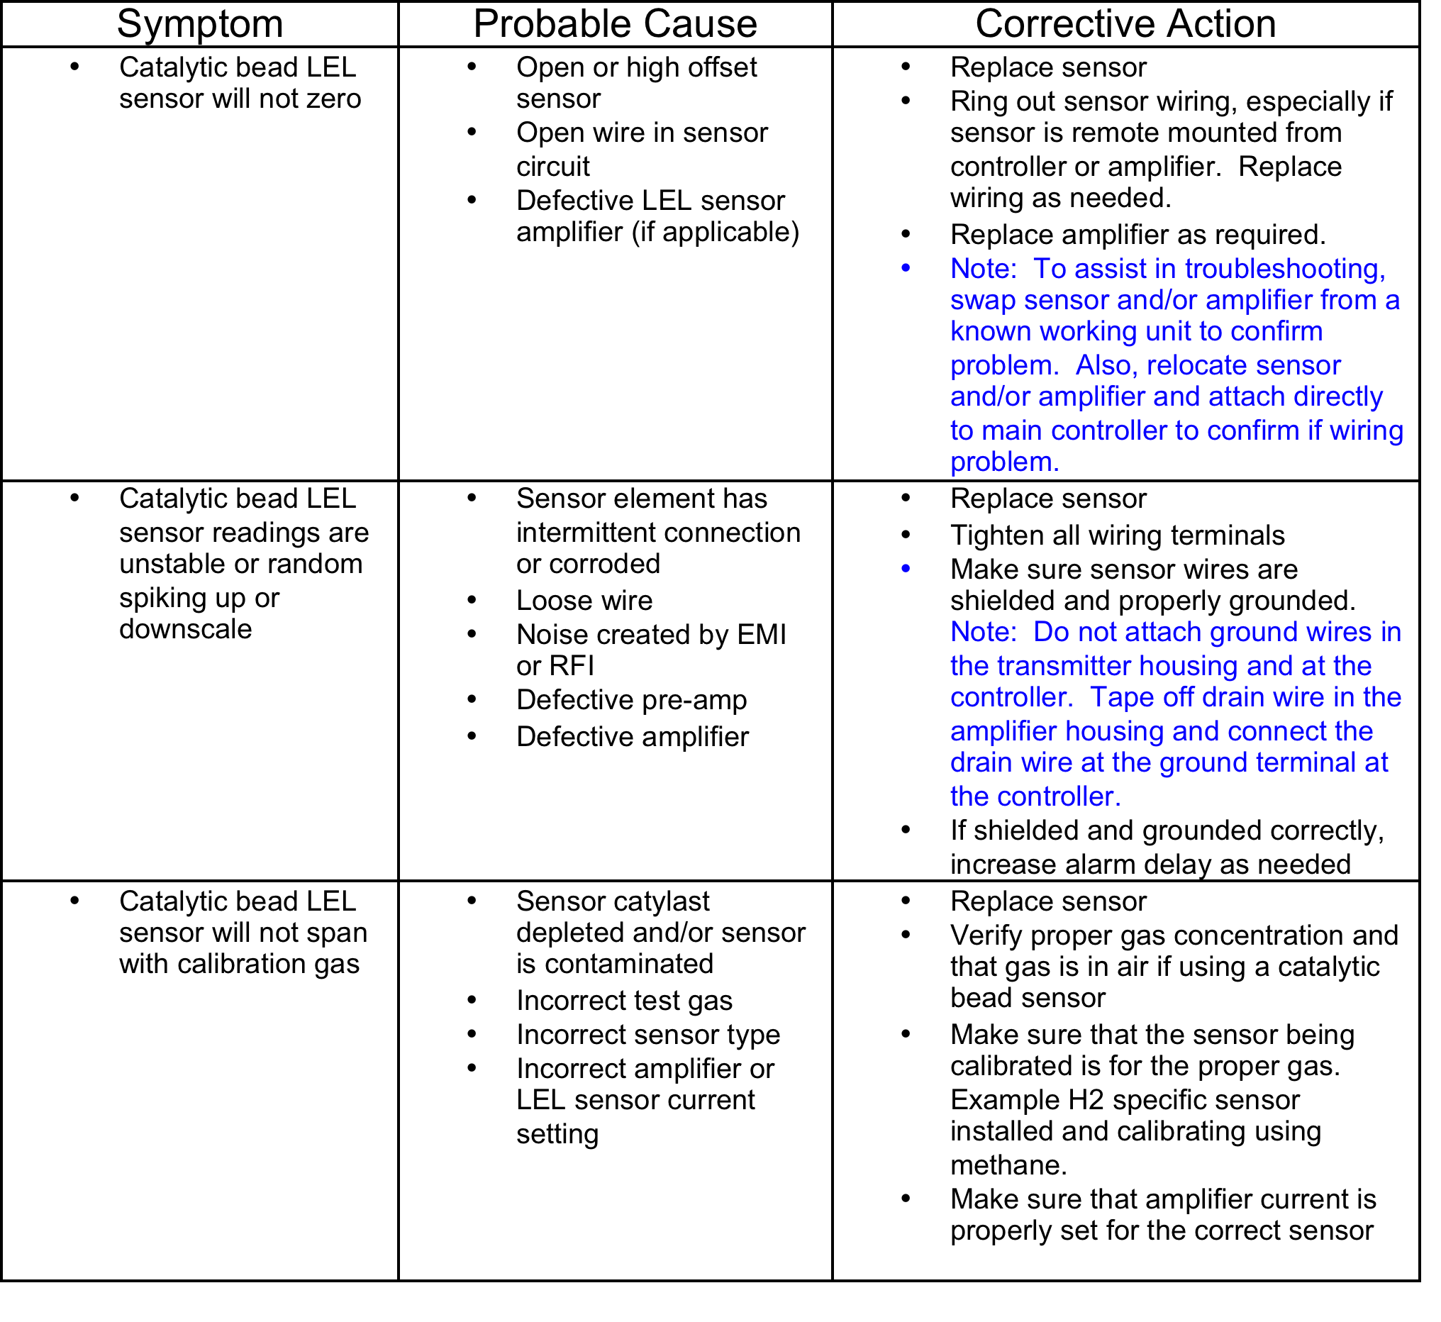
Sensor Troubleshooting

Slide 53
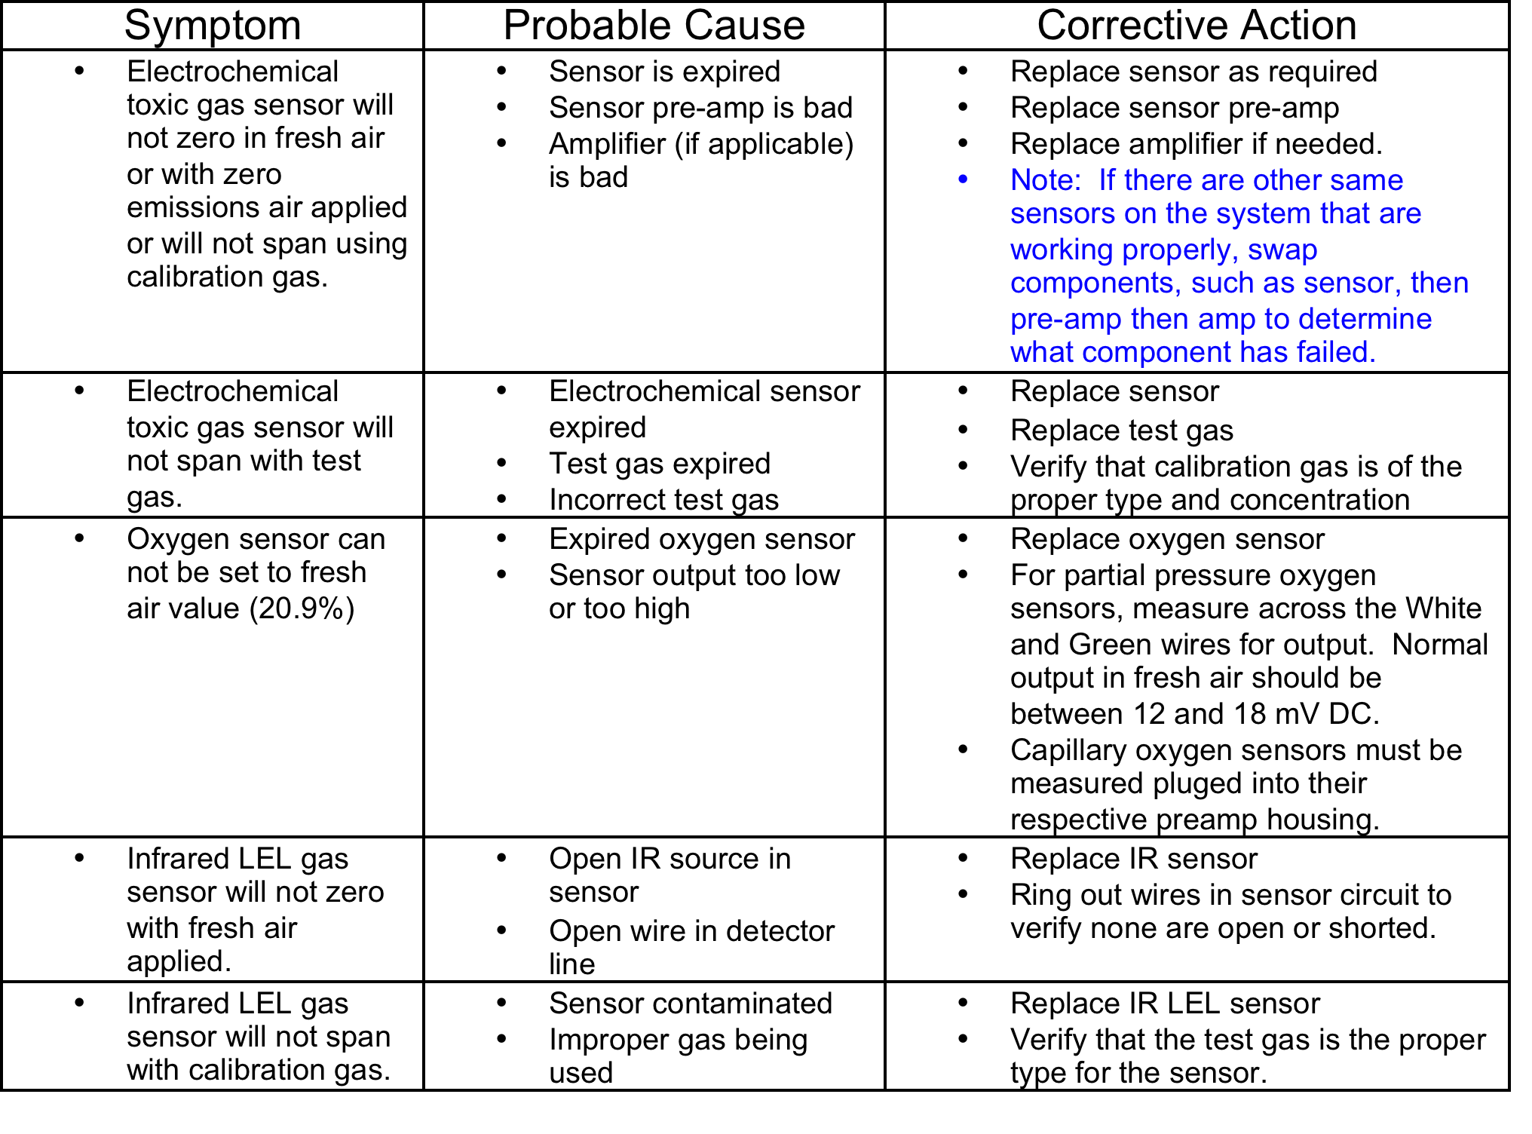
Sensor Troubleshooting

Slide 54
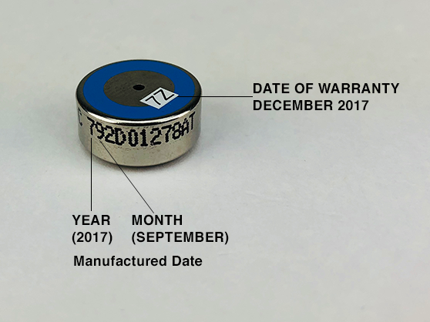
Understanding Date Codes
Each RKI Sensor has a date code to determine warranty begin date.
  The date code may be a small adhesive label on the sensor or may be read from
  the serial number on the sensor.
  Example: S/N 792D01278AT
    Date code is 79 (Mfg. date)
    First numeral is the year (2017)
    Second numeral is the month (August)
    Months are coded 1=Jan to 9= Sept. Oct.= X, Nov. = Y and Dec. = Z.
    Note: Warranty for this sensor starts on December 2017 based upon
    D/C sticker 7Z.

Slide 55

Questions?

