Slide 1
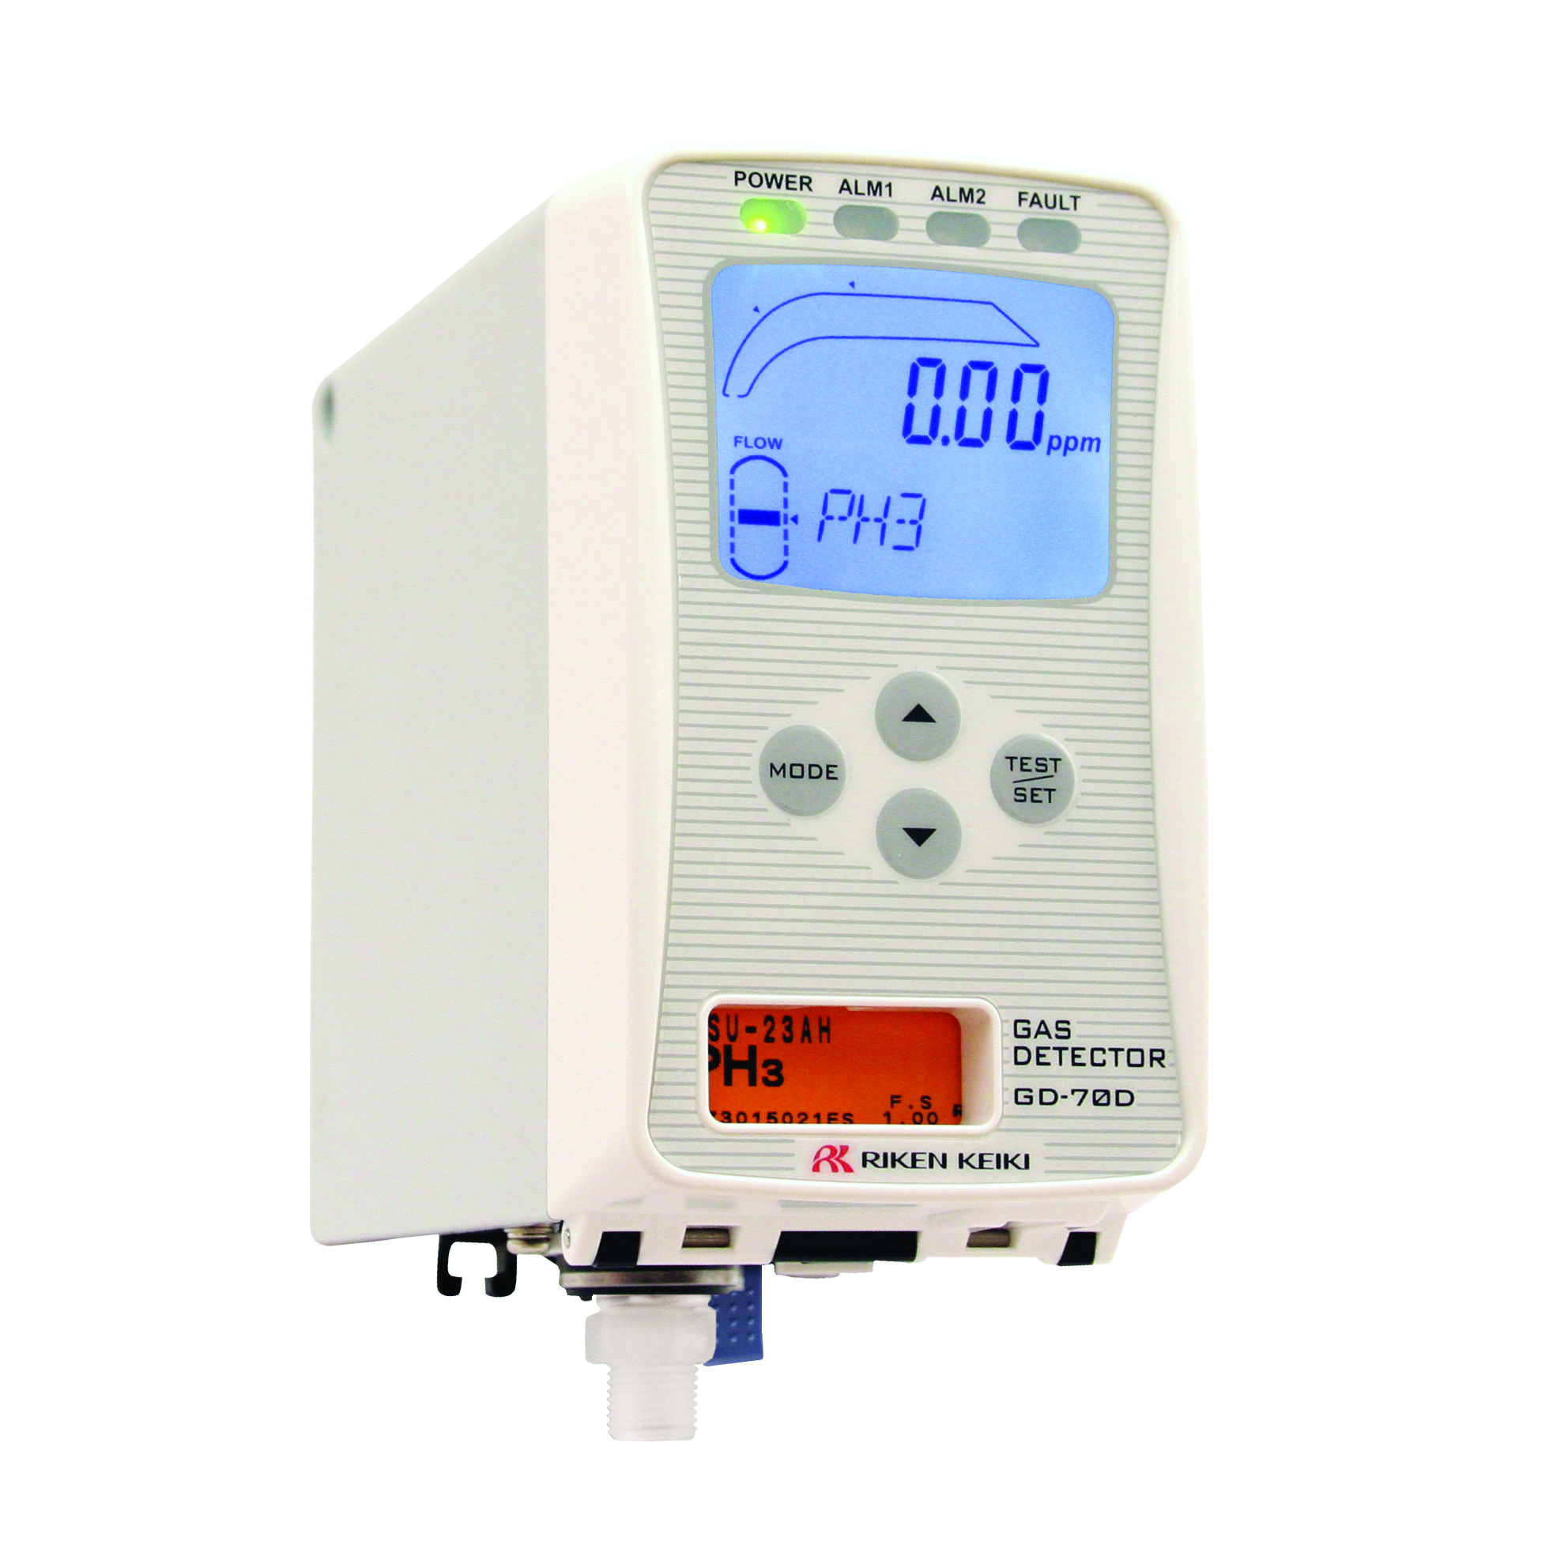
Replacing the GD-70D
Flow Sensor

Slide 2
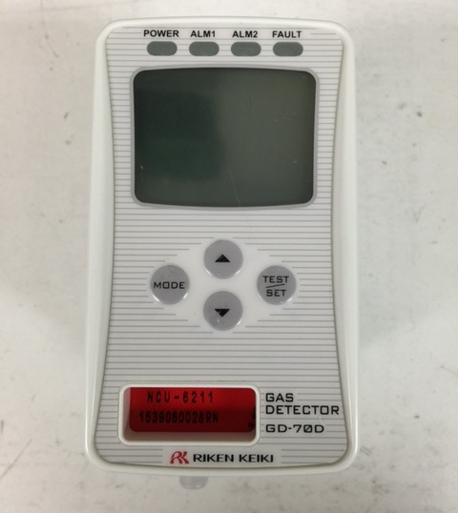
Replacing the Flow Sensor
Turn off power and remove the GD 70D from the mounting bracket.

Slide 3
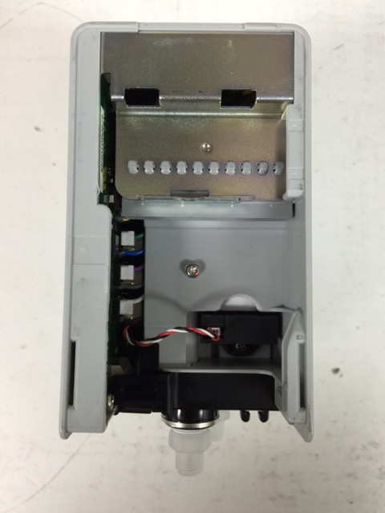
Replacing the Flow Sensor
Turn the GD-70D upside down to gain access of the flow sensor.
Replacement flow sensor is: P/N 31-1011-01.

Slide 4
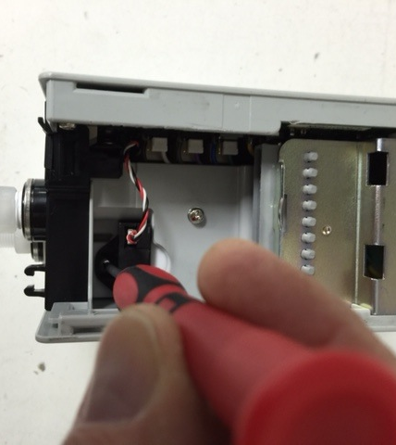
Replacing the Flow Sensor
Using a small Phillips screwdriver, remove the one screw that secures the flow sensor to the GD-70D.
Lift up on the connecting cable to remove sensor.

Slide 5
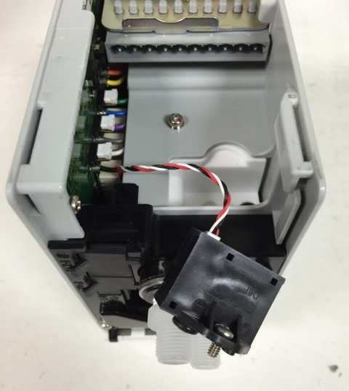
Replacing the Flow Sensor
Lift out flow sensor and remove electrical cable from flow sensor.
Make sure that the old O-rings are removed from the chamber.

Slide 6
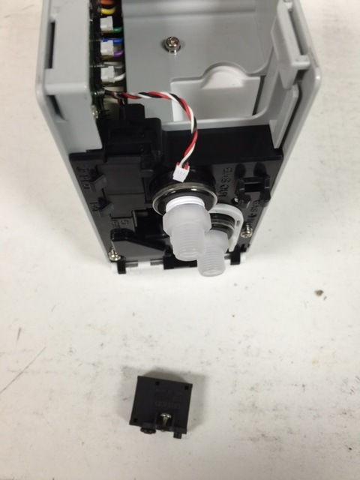
Replacing the Flow Sensor
Old flow sensor removed.

Slide 7
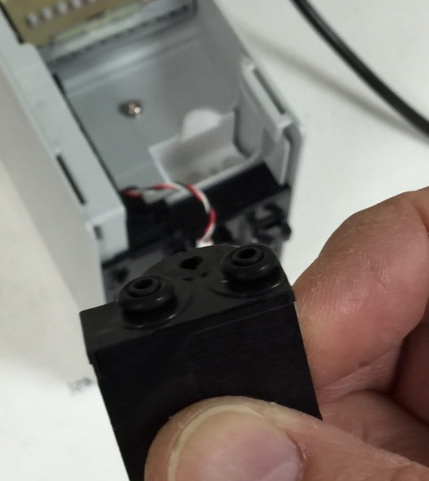
Replacing the Flow Sensor
Place new O-rings on the new flow sensor if not already installed.
Attach electrical cable to flow sensor and place flow sensor back into GD-70D.

Slide 8
Replacing the Flow Sensor
Screw new flow sensor back into GD-70D.

Slide 9
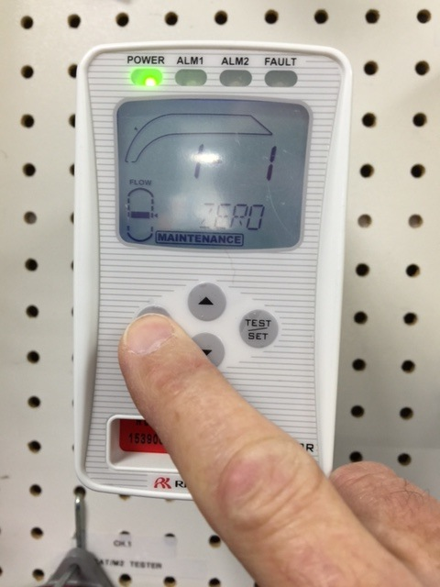
Replacing the Flow Sensor
Reattach the GD-70D to the mounting plate.
Turn on the GD-70D
Press and hold the MODE button.
First menu is 1-1, ZERO.
Press the UP button to Menu 1-3 Flow

Slide 10
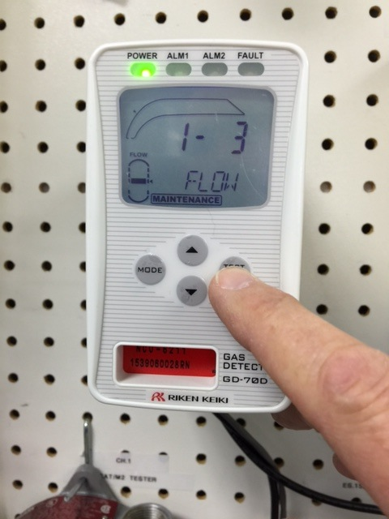
Replacing the Flow Sensor
With Menu 1-3 displayed, press the SET button to enter this mode.

Slide 11
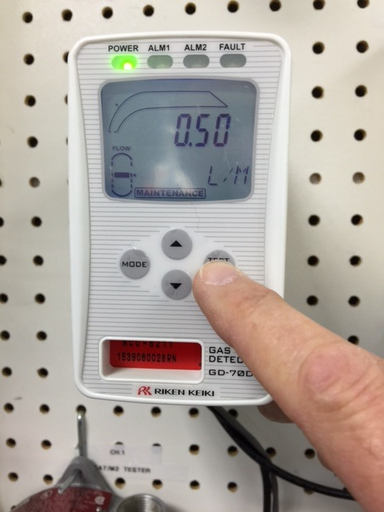
Replacing the Flow Sensor
In Menu 1-3 you will see the flow rate in Liters per Minute.
Press the Mode button to return to menu 1-3.

Slide 12
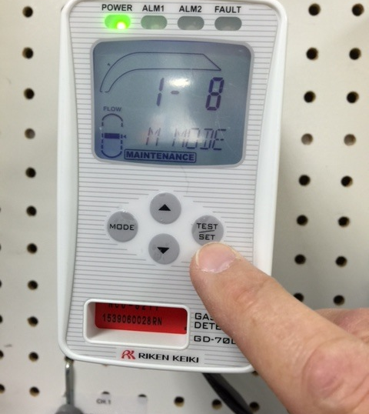
Replacing the Flow Sensor
If flow rate is not at .5 LPM, use UP button to scroll to menu 1-8.
Push and release the SET button.

Slide 13
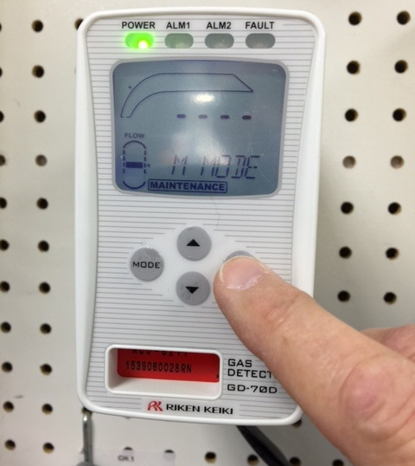
Replacing the Flow Sensor
You will see dashes.
Press and HOLD the SET button to enter into Level 2 menu.

Slide 14
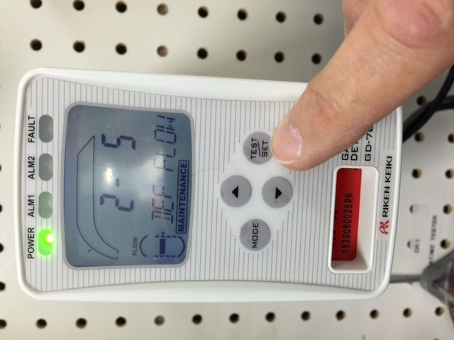
Replacing the Flow Sensor
Using the UP button, scroll to Menu 2-5 DEF FLOW and press the SET button.

Slide 15
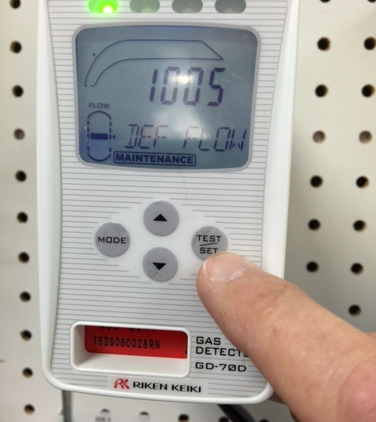
Replacing the Flow Sensor
Push the SET button again to default flow.
This will bring you back to Menu 2-5.
Push and HOLD the MODE button to return to normal mode.

Slide 16
Replacing the Flow Sensor
With instrument back in normal operation verify that flow indicator shows normal flow rate.
Calibrate the GD-70D when completed.

