Slide 1
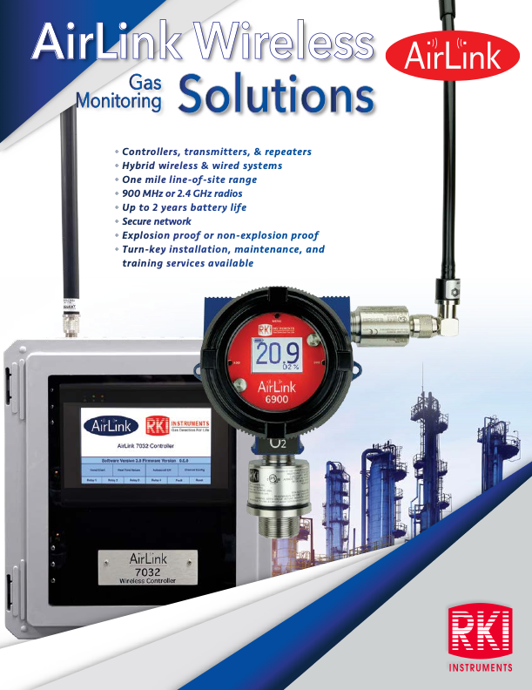

Slide 2


Overcoming common objections

Slide 3
Scenario 1
Objection: Fifteen years ago, we tried wireless and it caused interference with other items.
R: Technology has come a long ways.
  The radio modules operate in the “900 MHZ ISM band” which is in the frequency range of 902-928 MHZ
  It operates using a Frequency Hopping Spread Spectrum (FHSS) protocol which means they use a different frequency within the above range for each transmission.

Slide 4
Scenario 2
Objection: We don’t want to have to replace batteries.
Response:
We have wireless transmitters that are powered by 24 VDC and not batteries.
Check out our battery life.
  2 year max – electrochemical
  1 to 1.5 years max – IR
  2-weeks plus for PID

Slide 5
Scenario 3
Objection: We are concerned about stocking batteries and their shelf life.
Response: Our batteries have over a 10 year shelf life.

Slide 6
Scenario 4
Objection: We are concerned about connectivity issues.
Response: This is why we do a signal propagation test before offering a solution.

Slide 7
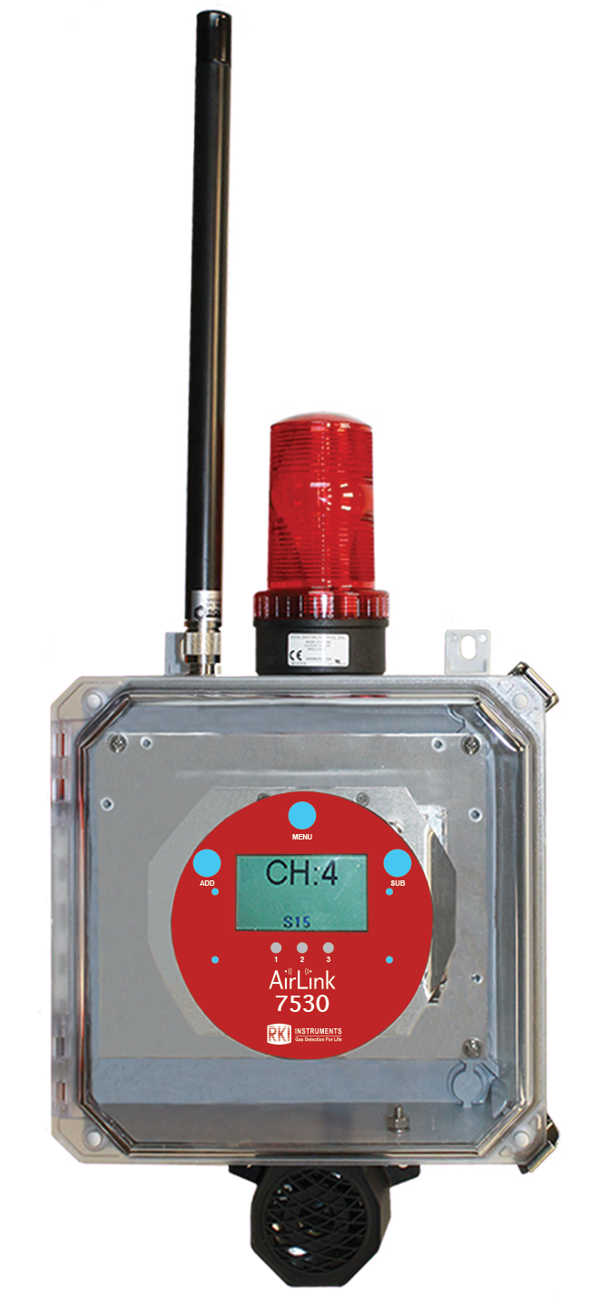
Scenario 5
Objection: We need to run ancillary devices but don’t want to have to wire them back to your controller.
Response: No problem, use our 7530.

Slide 8
Scenario 6
Objection: I am concerned about security.
Response: We use frequency hopping along with every item on our wireless platform requires a Network ID and a Channel ID.

Slide 9
Scenario 7
Objection: It costs too much.
Response: Please also remember the cost of installation when considering your gas detection equipment and cost. Your installation costs are always less expensive when utilizing wireless technology.

Slide 10
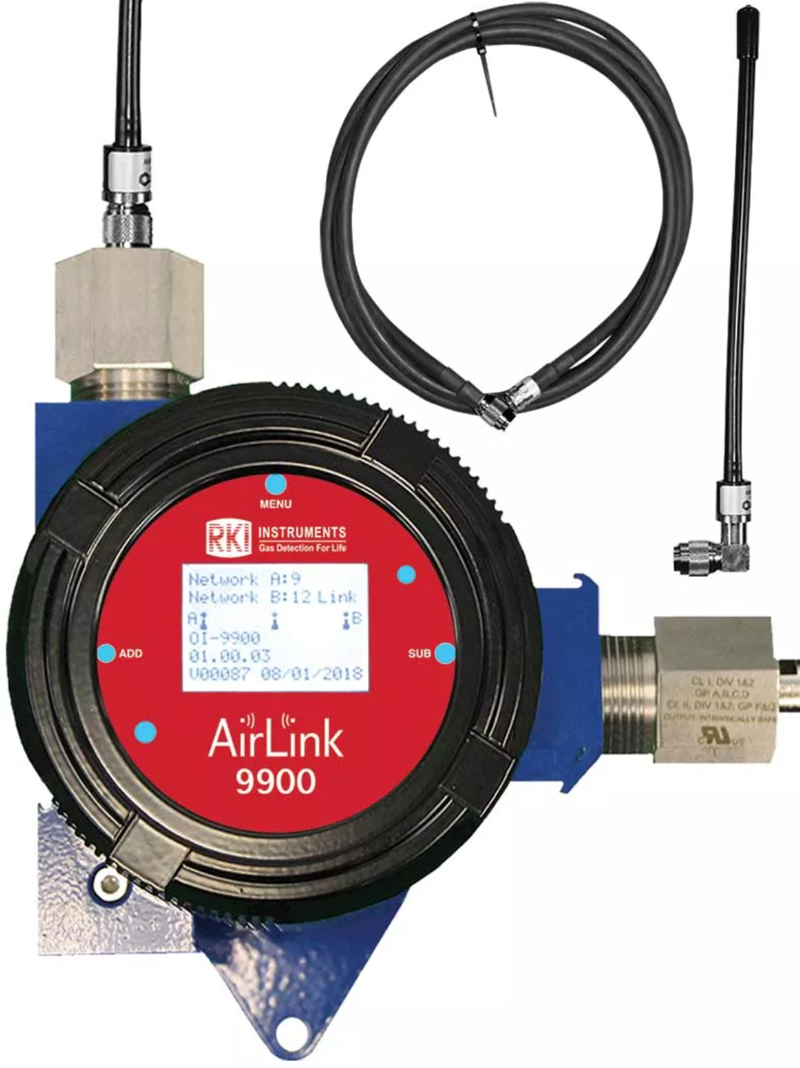
Scenario 8
Objection: Our range is too long, or we have to many obstacles.
Response: Just use our 9900 repeaters.

Slide 11

Questions?

