Slide 1
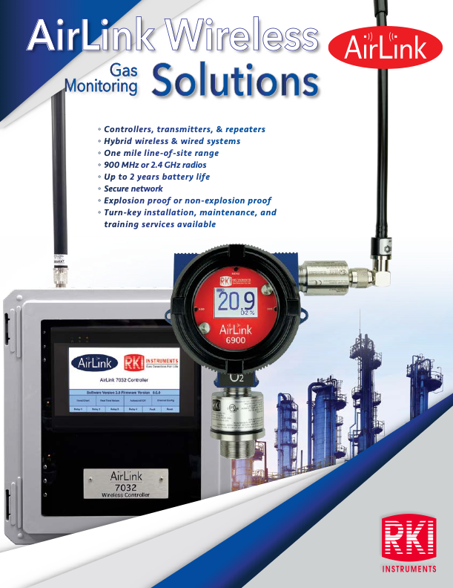

Slide 2
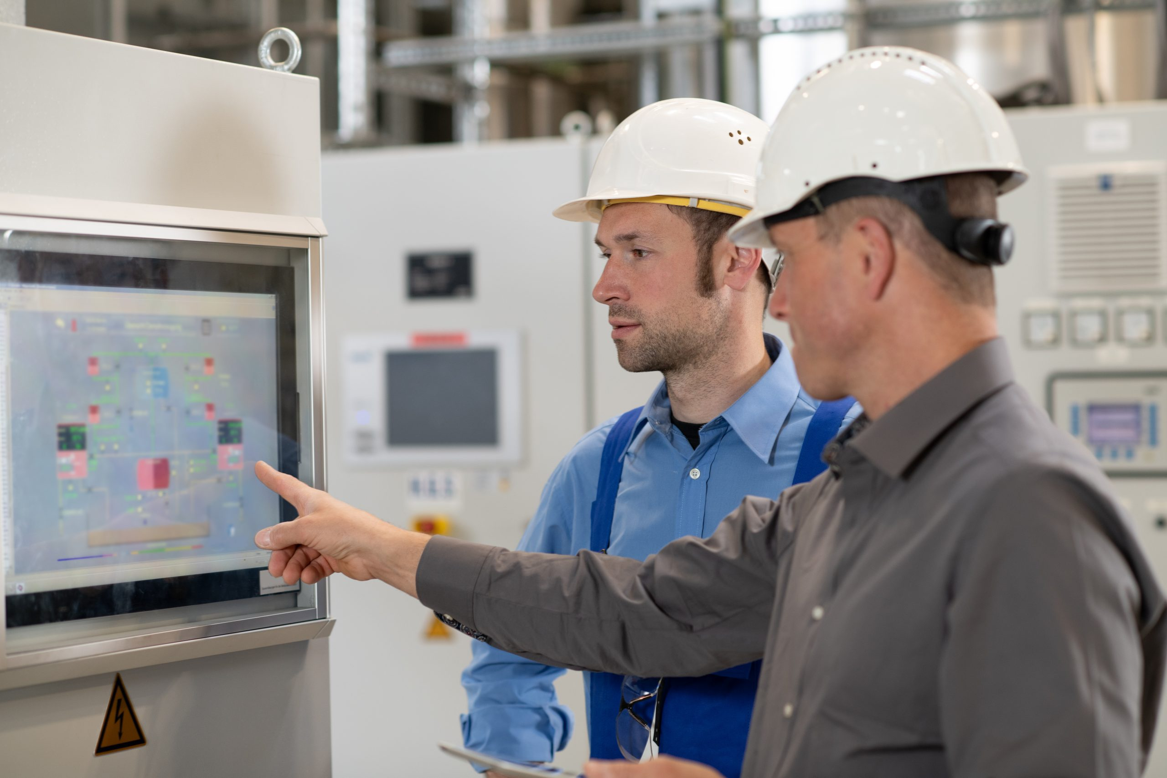
Asking The Right Questions
What gases need to be detected?
  What range of detection is needed?
How many points of detection are needed?
  Vapor density
  Air movement in space
  What are the sources of potential gas?
Does any of the equipment need to be explosion proof?
  If yes, explain what part of the solution, what class, and what division is required?
What is the temperature that the sensor will be exposed to?
What are the humidity levels that the sensor will be exposed to?
Is the preferred sampling method pump or diffusion?

Slide 3
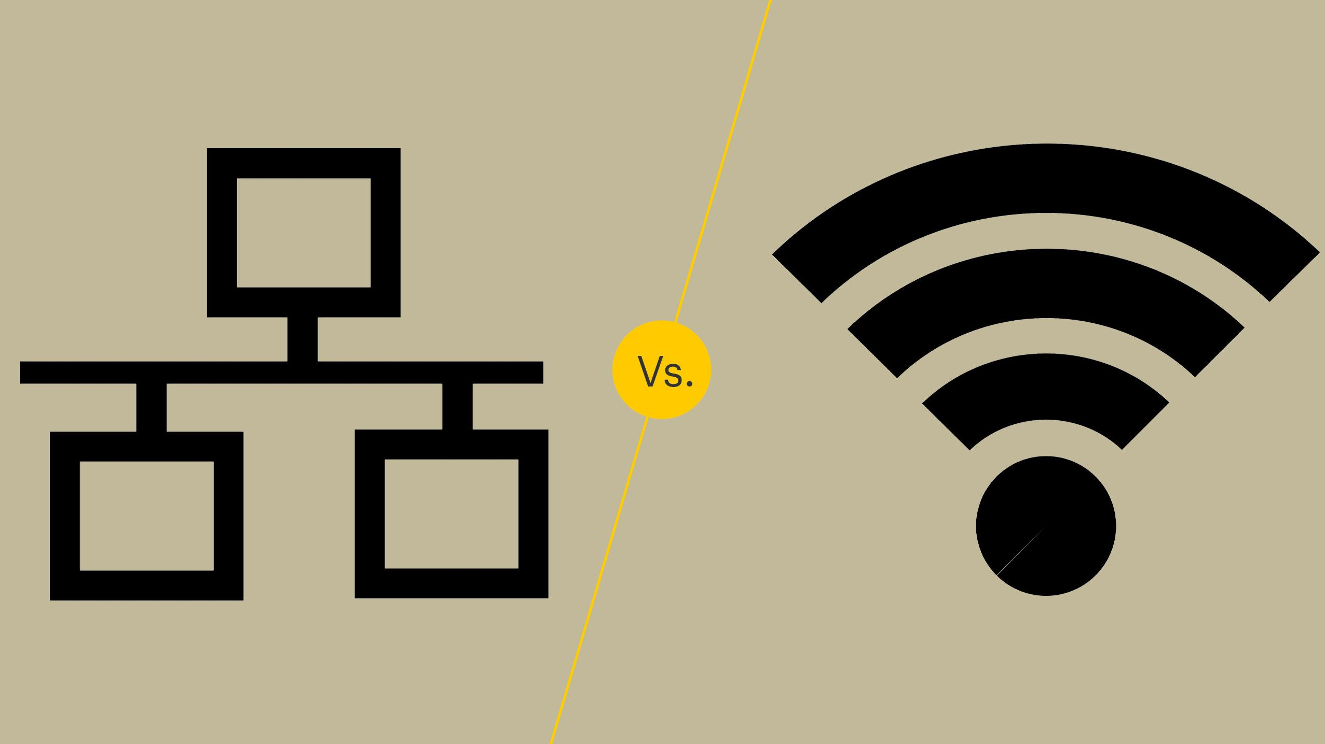
Asking The Right Questions
Is wired or wireless preferred?
Do the transmitters need a display?
Do the transmitters need relays?
Do the transmitters need to report to one of our central controllers?
  Yes
    What needs to happen when there is an alarm detected?
      What auxiliary equipment must be activated?
    Does our controller need to communicate with any other control device (fire panel, SCADA, PLC, etc.)
      Yes - What signal input does your control device require?
  No - Does the transmitter need to be stand alone or report back to your control device?
    Your control device
      What signal input does your control device require?
      What power can your control device supply to run the transmitter?
Wired or Wireless

Slide 4


Asking Ourselves The Right Questions
We Sell: Trust & Value
Trust: The belief that someone or something is reliable, good, honest, and effective.
Value: The amount of money that something is worth; or the worth of something that has importance to someone.
Value: Is defined by the customer.

Slide 5
Fundamental Principles
The secret to selling is to be in front of qualified prospects when they are ready to purchase. Not when you need to make a sale.
Qualified Prospect
Have a need and are aware of it.
Have the legitimate ability and authority to purchase.
Have a sense of urgency about the decision.
Trust you and your company.
Willingness to listen to you.

Slide 6
Value to the Customer
Money
Time
Energy
Risk
Position
Relationship ( Trust )

Slide 7
Steps of the Sale
Investigate
Meet
Probe
Apply - Customer Needs
Convince
Tie it up
Impact

Slide 8
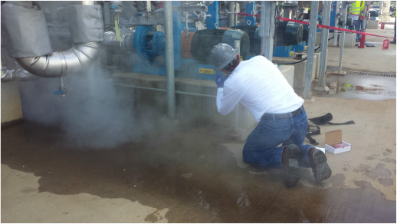
Fixed System Services
Ask the questions!
How do you plan on installing the equipment?
  Can we quote you the install.
How do you plan on doing the start-up for your new gas detection system

Slide 9

Sales Cycle
Distributor contacted RKI with a fixed system install opportunity.
RKI RSM arranged for a TEAMS or on-site meeting with end user, distributor, RKI National Fixed Systems Manager, and herself/himself.
  Fact finding conversation to determine product solution
RKI National Fixed Systems Manager determined Scope and price for full installation.
The distributor quotes the customer.
Customer issues PO# to distributor
Distributor issues PO# to RKI

Slide 10

Questions?

