Slide 1
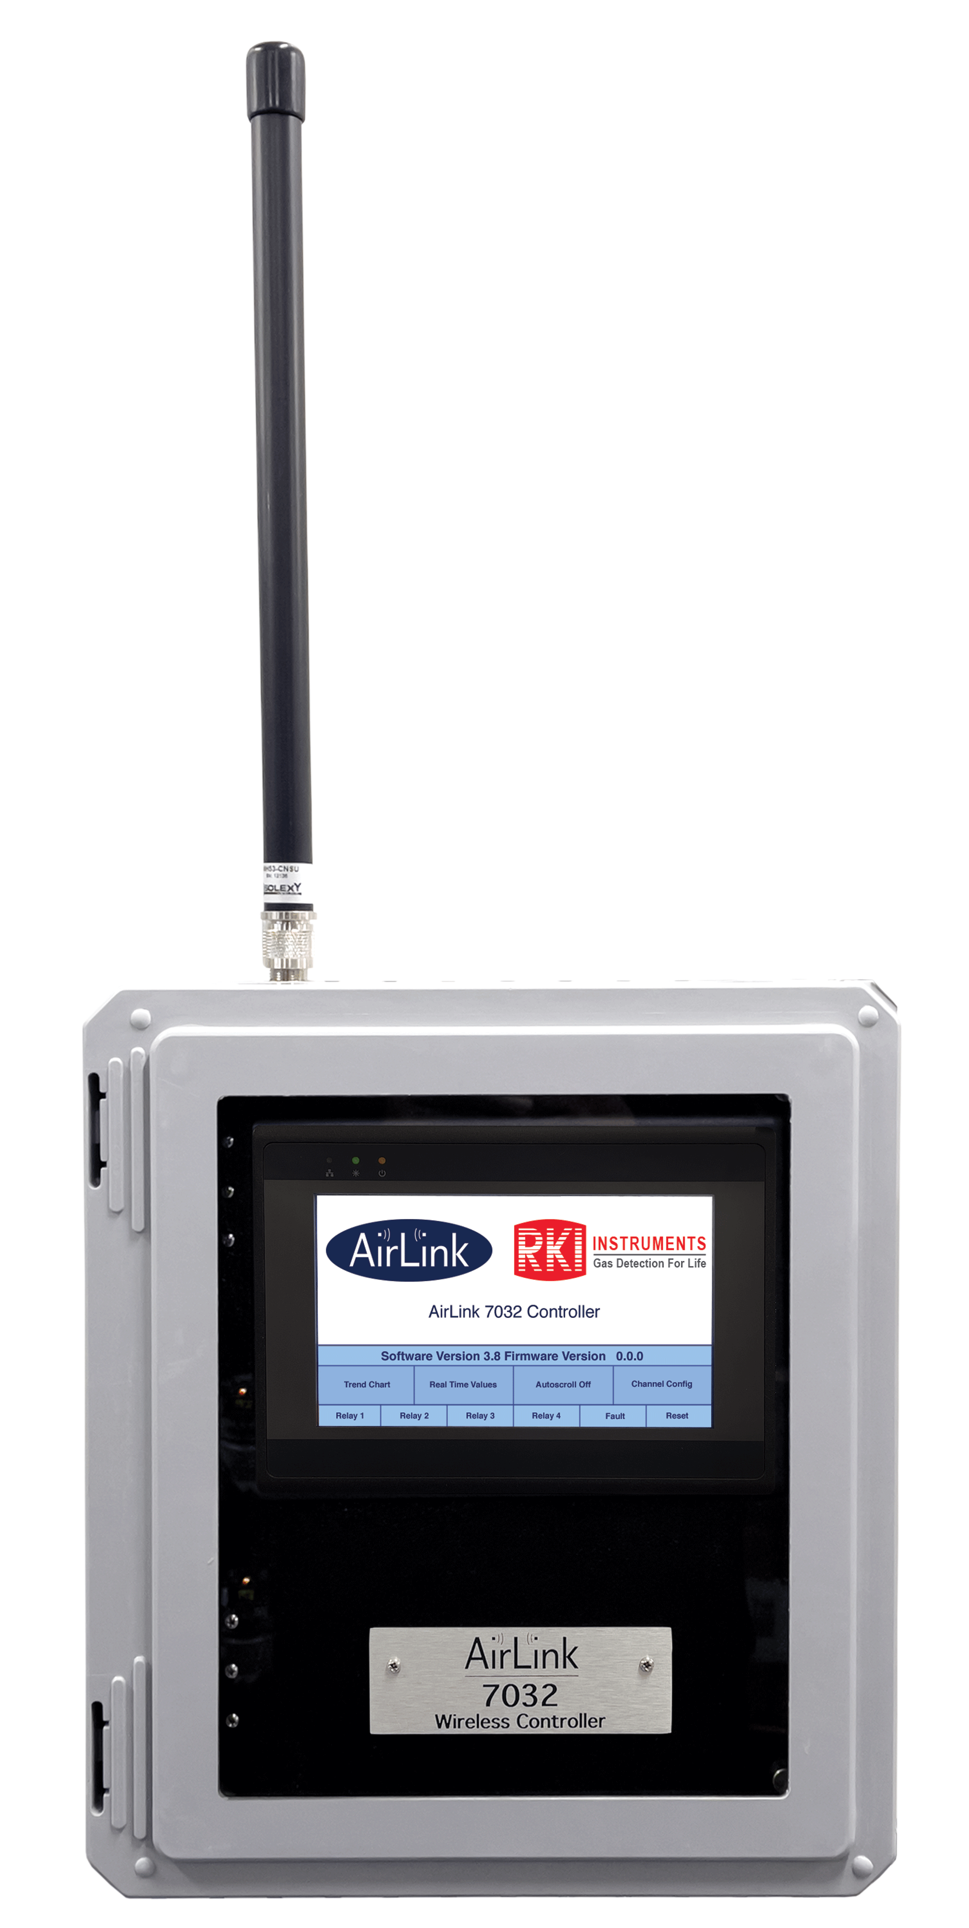
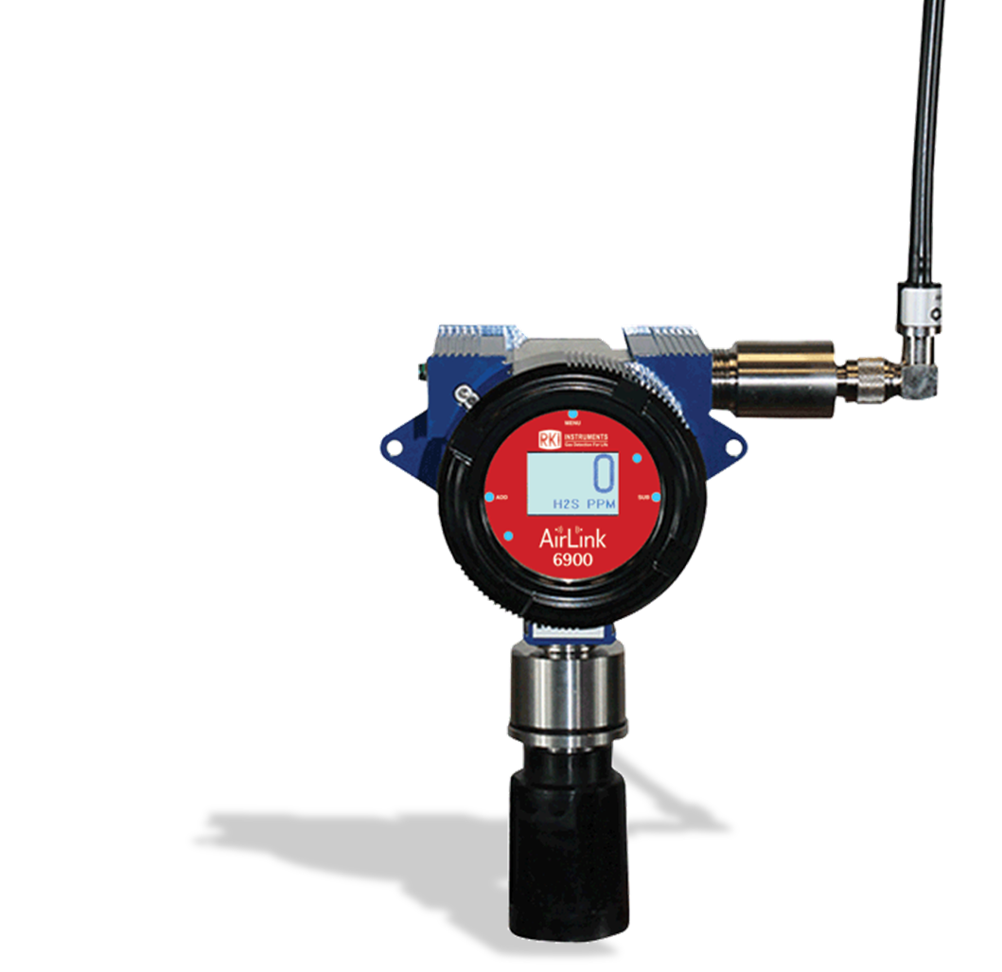
How does Wireless Work?

Slide 2
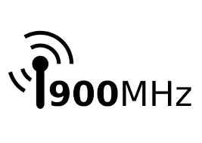
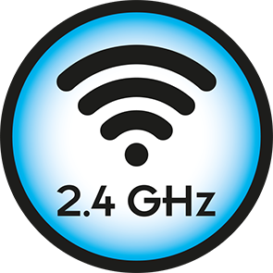
2.4 GHz vs 900 MHz Frequencies
Lower frequencies can use greater power and can penetrate walls and other obstacles.
  The 900MHz radio system is at a lower frequency and will penetrate surfaces more easily.
  900 MHz systems are most common in the US.
Higher frequencies can use less power, but will reflect off of dense surfaces.
  2.4 GHz systems are more reflective and tend to be affected more by bodies, foliage, or moisture that can attenuate the signal. In addition, some large venues are not suitable for the 2.4 RF signal due to potential destructive reflective signals.
  2.4 GHz systems are typically sold in internationally.

Slide 3

What is Wireless?
A wireless transmitter sends electronic information through the air in the form of radio waves. The signal is picked up by a receiver and translated back into the original electronic information, which is then displayed in the relevant medium.

Slide 4
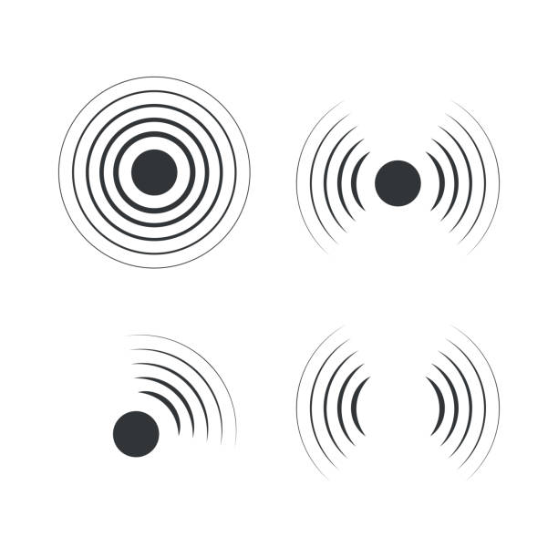
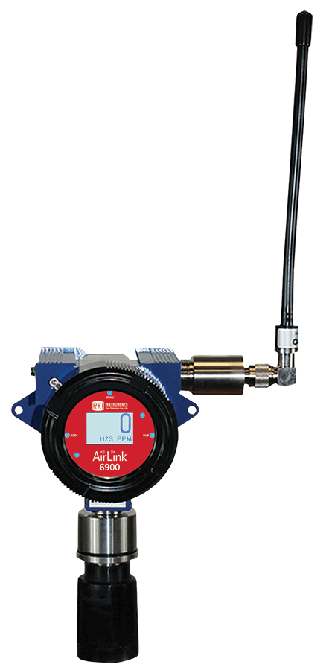
What is Wireless?
A wireless transmitter sends electronic information through the air in the form of radio waves. The signal is picked up by a receiver and translated back into the original electronic information, which is then displayed in the relevant medium.

Slide 5
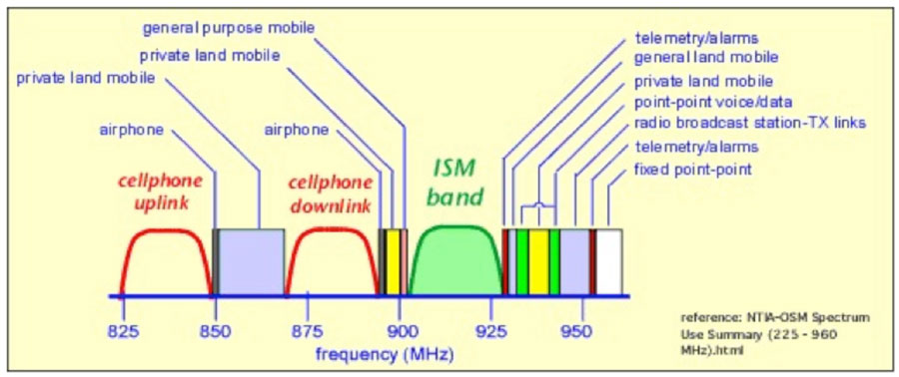
RKI Systems
The radio modules operate in the “900 MHZ ISM band” which is in the frequency range of 902-928 MHZ

Slide 6
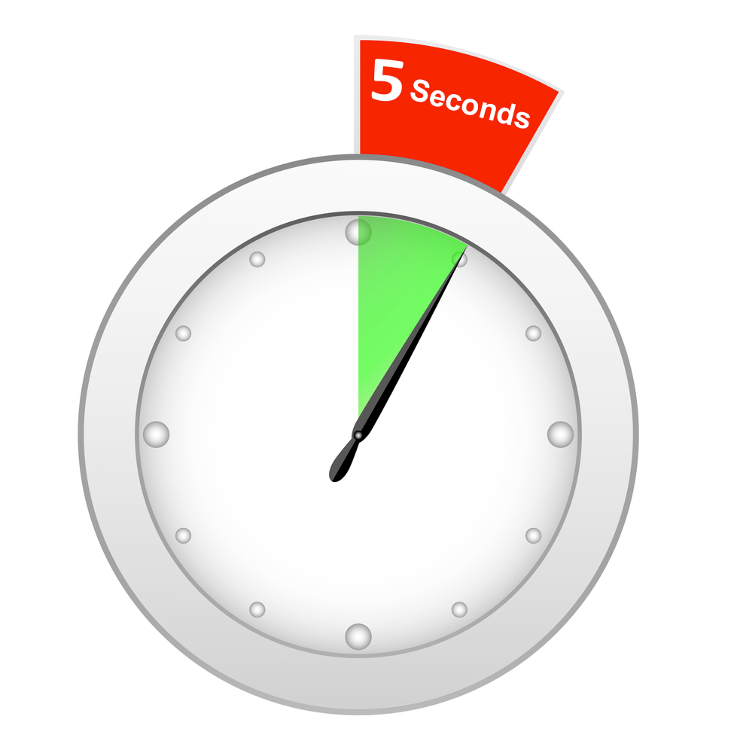
RKI Systems
In normal operation the sensors transmit once every minute, when the gas concentration rises above the background setting they will transmit every 5 seconds
They operate using a Frequency Hopping Spread Spectrum (FHSS) protocol which means they use a different frequency within the above range for each transmission
  This eliminates interference being caused to other devices and any outside signals interfering with the controller and transmitters..

Slide 7
RKI Systems
For the sensor assembly and monitor to communicate successfully three things must be configured correctly:
  The address of the transmitter must be configured on the controller
  The network ID of the transmitter and controller must match
    The Network ID setting allows you to ensure only devices properly configured are allowed on the network, there are 52 network IDs available.
  The vendor ID for the transmitter radio and the controller radio must match
    Devices with non-matching vendor IDs will not even see the network exists.
      The vendor ID is set by RKI at the factory and can not be read or changed once it is set in the radio.

Slide 8

What sets us apart from the competition?
Battery Life: Dual 3.6 Lithium Thionyl Chloride
  10 year shelf life
Point to Point radio vs. Mesh or Bluetooth
Quality of product
Certifications and ratings
  CSA, ATEX and QPS; Class 1 Division 1 as a complete unit and individual piece parts
Operating temperatures
  -40 to +50C
Diverse climates across the world
  From the North Rim of Alaska to Saudi Arabia
Ease of use
Ability to move from place to place

Slide 9
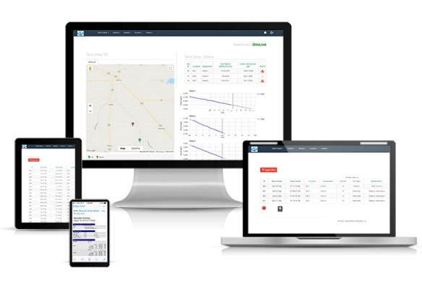
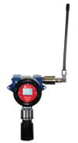

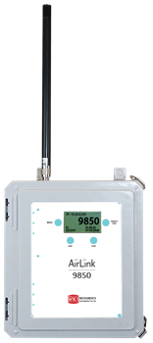
Telemetry & Remote Monitoring Options

Slide 10

Questions?

